Slide 1
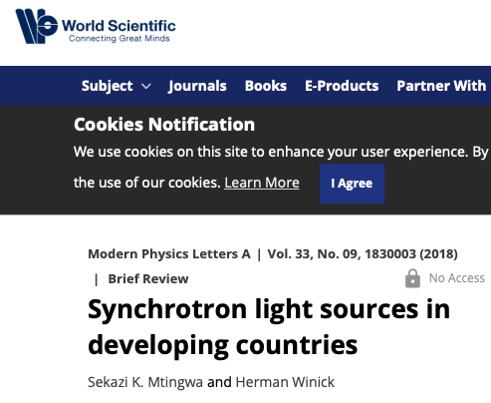

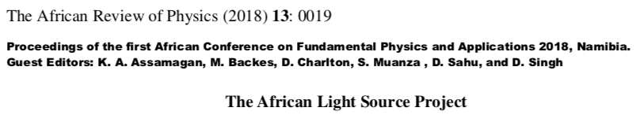

AfLS – A powerful Boost
AfLS History : 2 decades → AfLS → IAC, LoS / MoU, CDR
Reminder – Media
  AfLS Website http://africanlightsource.org
  AfLS2020 http://afls2020.africanlightsource.org
Science
Perspectives
Upcoming
Johannesburg – Soccer World Cup 2010
https://www.worldscientific.com/doi/abs/10.1142/S0217732318300033
http://lamp.ictp.it/index.php/aphysrev/article/view/1610/586

Slide 2
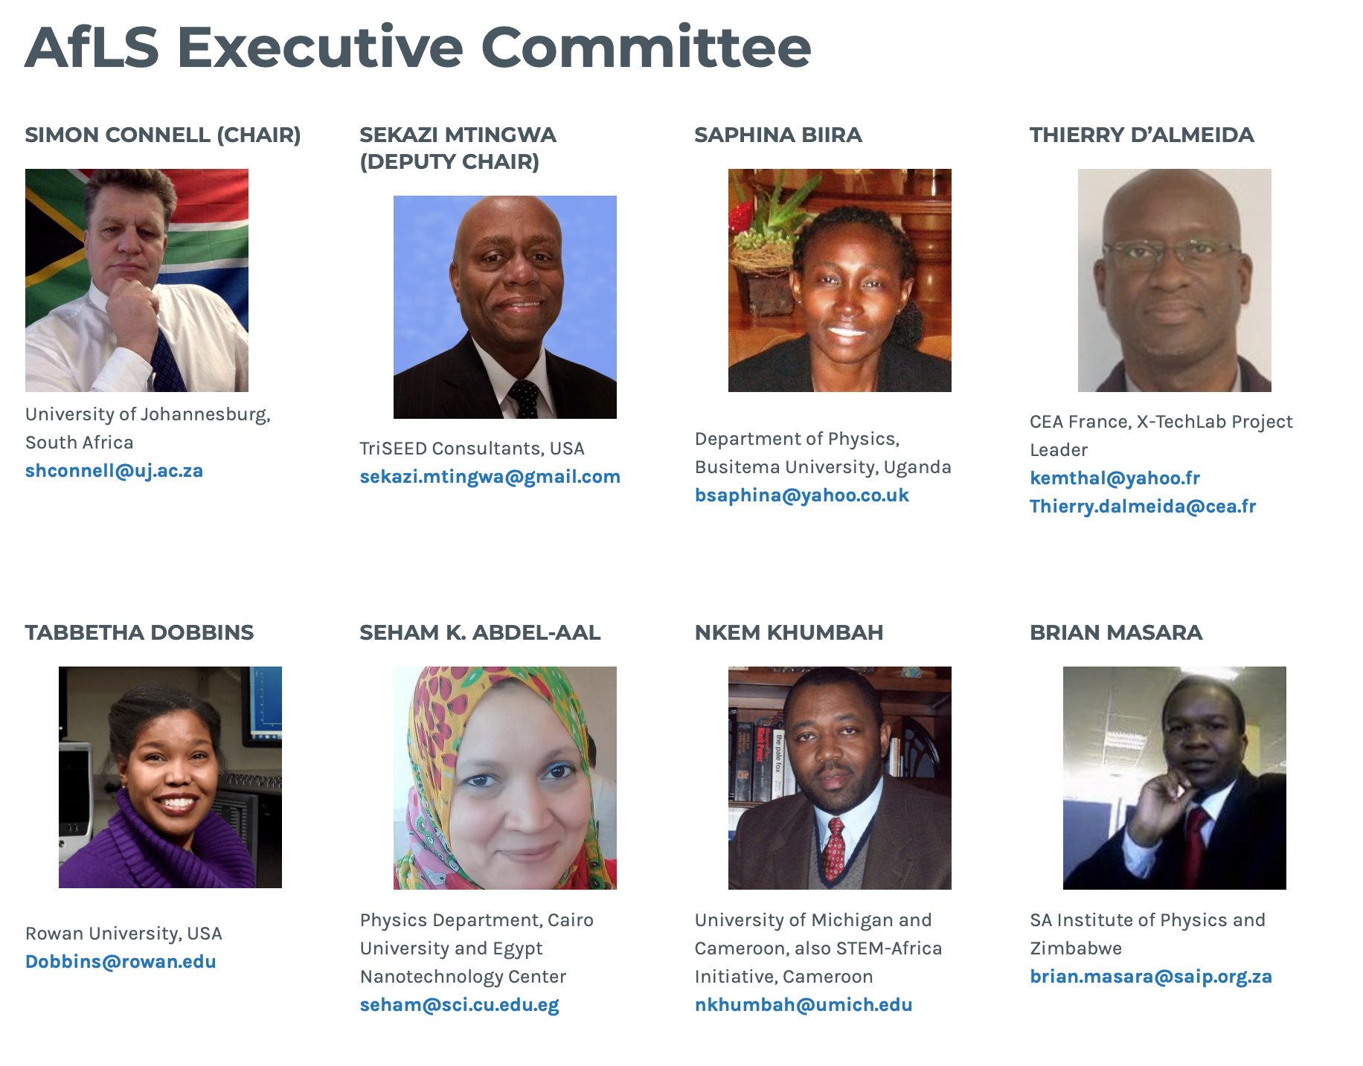
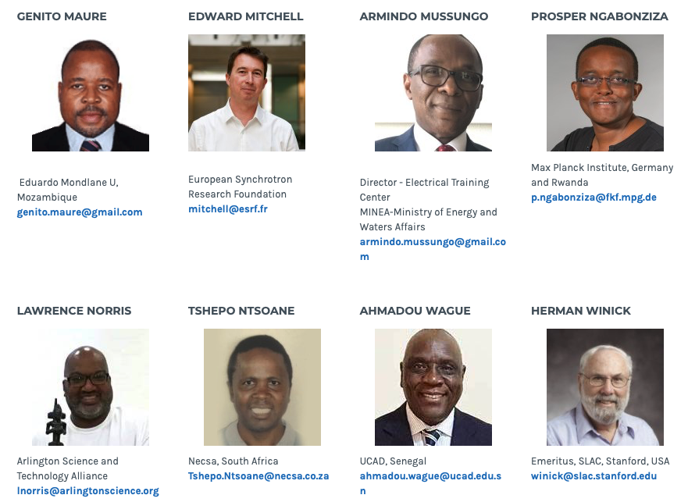
Visit us at : http://www.africanlightsource.org

Slide 3
Socio-economic benefits
Boost African Scientific Research, Research Capacity (Continent, regions, Institutes), Capacity Building - African Science Renaissance
Global Research Community
Tackling Diseases (Malaria, TB, Aids, Ebola ....)
Unique African Research Opportunities attracting international collaboration : Energy opportunities, African Environment, Cradle of Humankind, Cradle of Culture, Mineral beneficiation, Agriculture.
Mobility, Conferences, Schools, International Mentoring partnerships in student training, Regional Centres of Excellence, Local feeder instrumentation
Build Research capacity in Industry, competitive industry
Science for Peace (eg CERN, SESAME)
Return of the African Science Diaspora - new opportunities for young excellent scientists
For African countries to take control of their destinies and become major players in the international community

Slide 4
Part of our Aim
A wealthy advanced Africa
Africa has 1.2 billion people
169 scientists per million people (UNESCO Science Report 2015)
Italy : 2600/million
Germany : 7600/million
Africa needs at least ……
1 000 000 scientists to get 1/6 of <1st world>

Slide 5
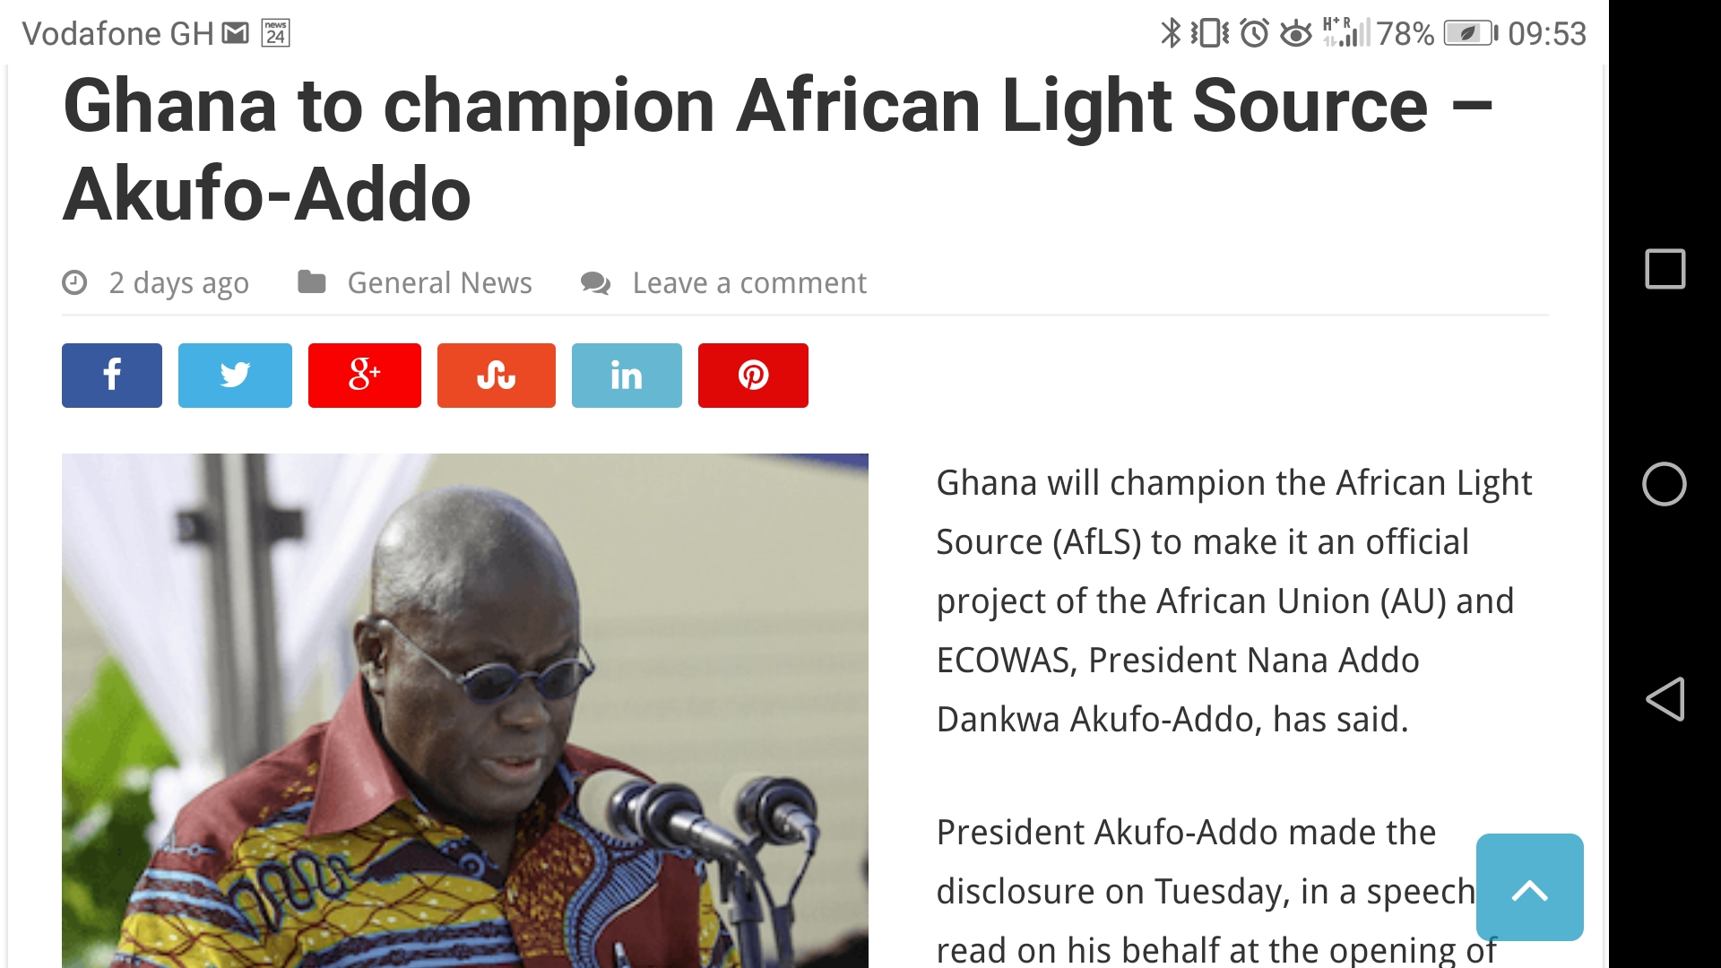
Top Down …. and Bottom up ….

Slide 6

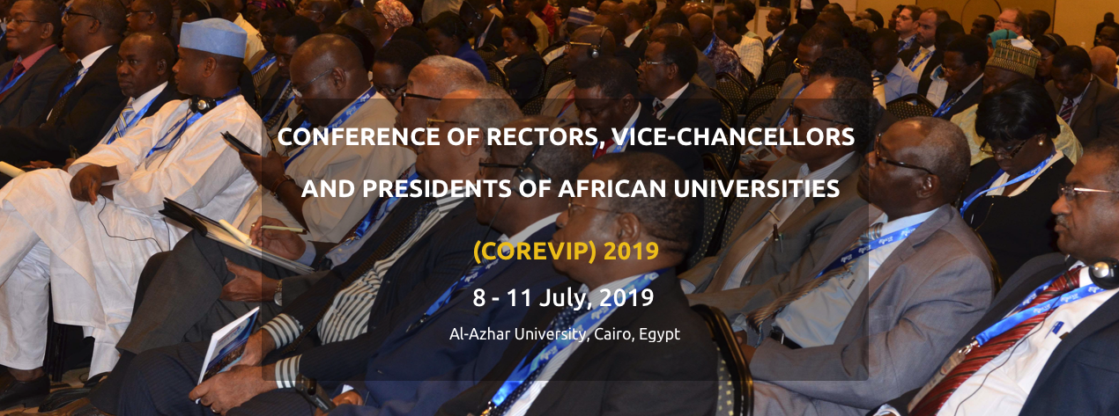
Top Down …. and Bottom up ….
AfLS : Plenary Session at COREVIP 2019
The AfLS was endorsed in a Conference Resolution
Proceeding to develop MoU for Formal Collaboration

Slide 7

Top Down …. and Bottom up ….
AfLS at the AU : Jan 2018
DECISION ON THE REPORTS OF THE
SPECIALISED TECHNICAL COMMITTEES (STCs)
The Executive Council,
C. STC ON EDUCATION, SCIENCE AND TECHNOLOGY
CALLS UPON Member States to support the Pan-African Synchrotron Initiative;

Slide 8

Letters of Support - MoUs - MoAs
See Friday Programme

Slide 9


International Advisory Commttee
See Friday Programme

Slide 10

Conceptual Design Report
See Wednesday Programme

Slide 11
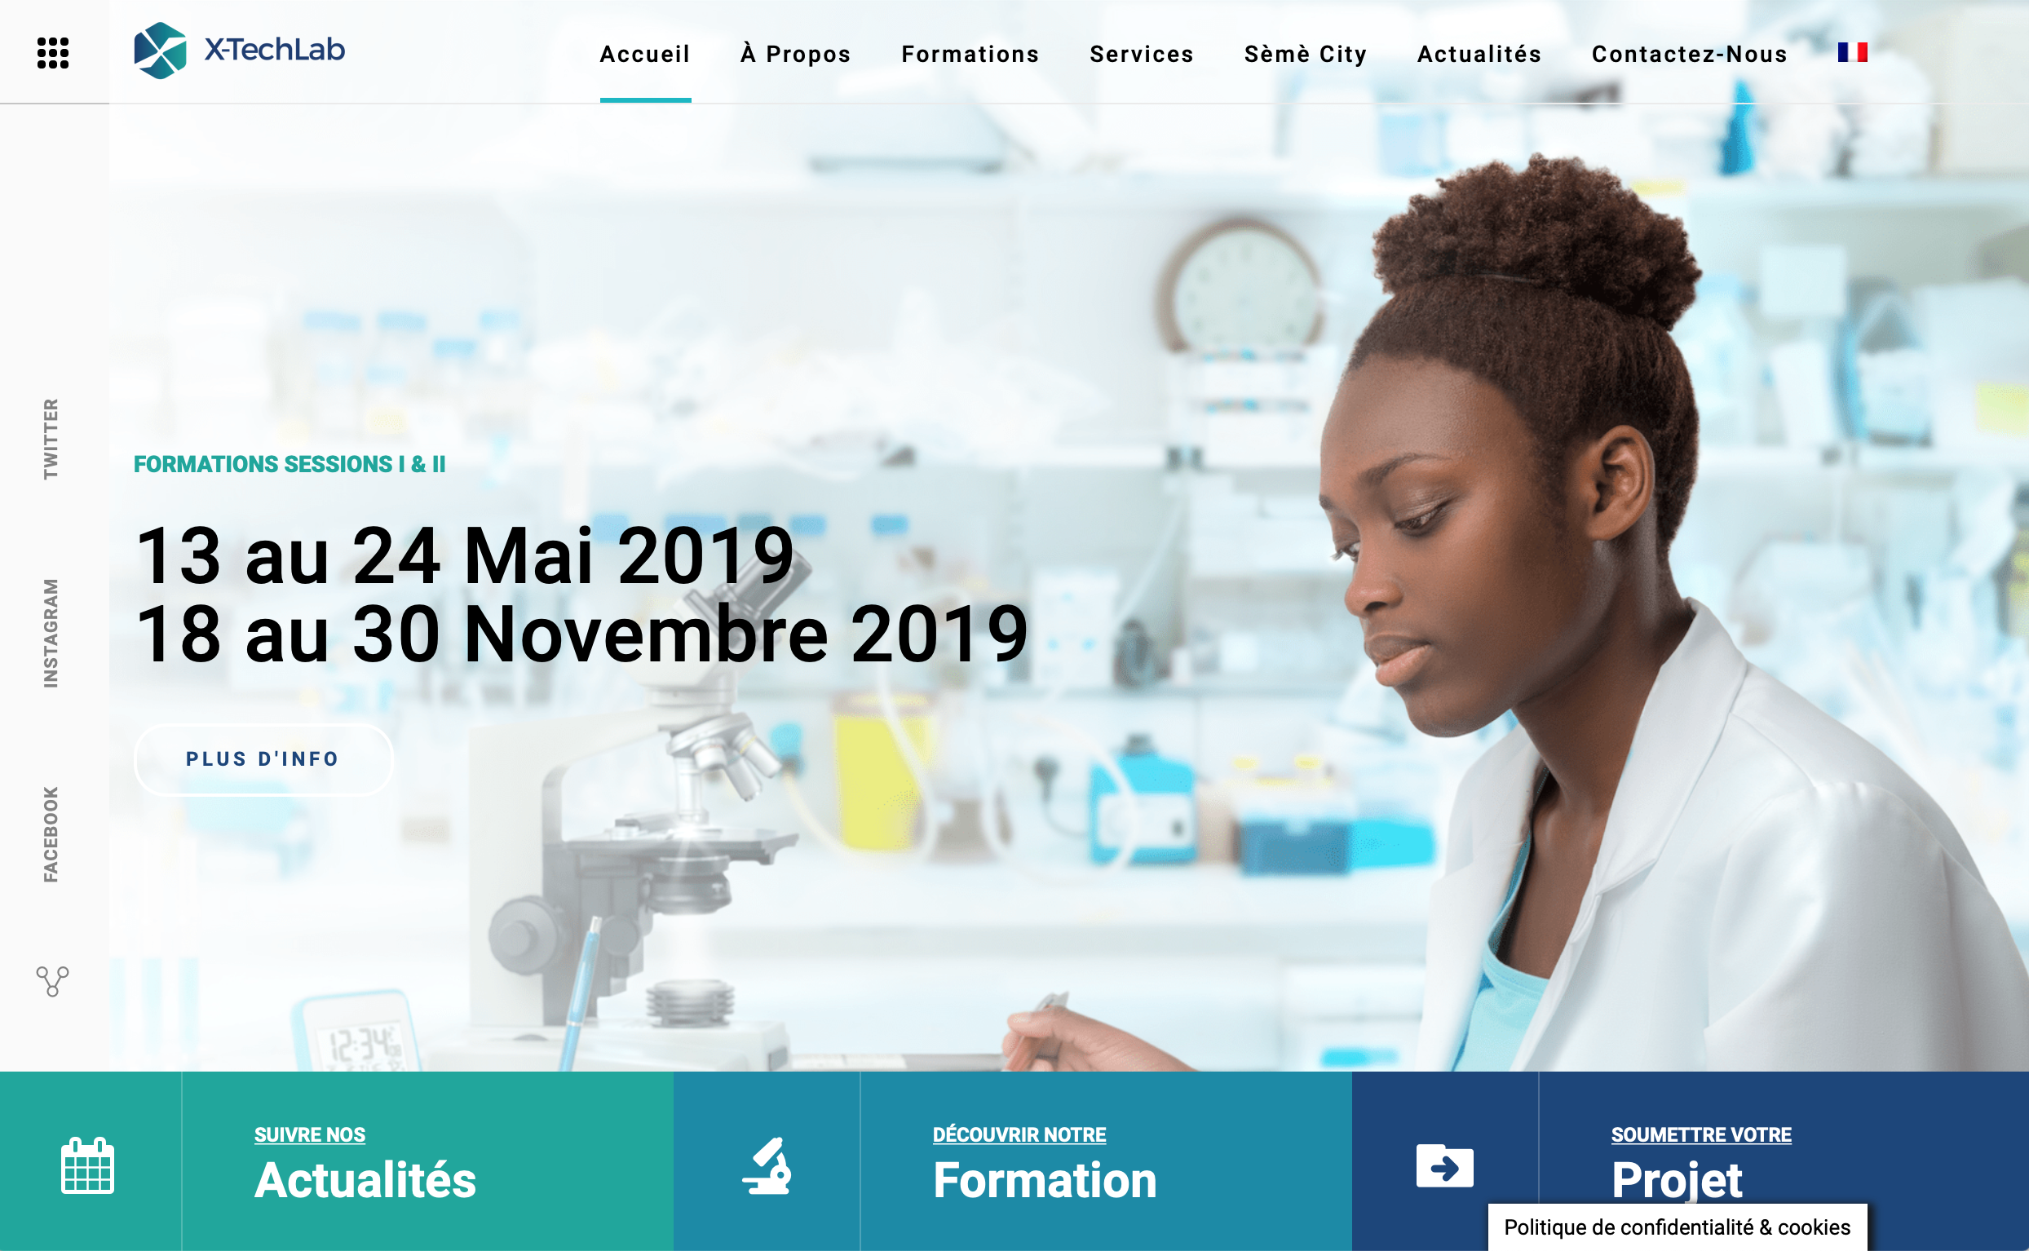
Partners on the AfLS Roadmap
See Thursday Programme

Slide 12
African Light Source Based Science
4 examples at this Conference
Energy Materials - Prof Diale (Today)
Environment - Prof Berhe (Today)
Paleo Science - Dr Kudakwashe (Today)
Bio Science - Dr Moyo (Friday)

Slide 13
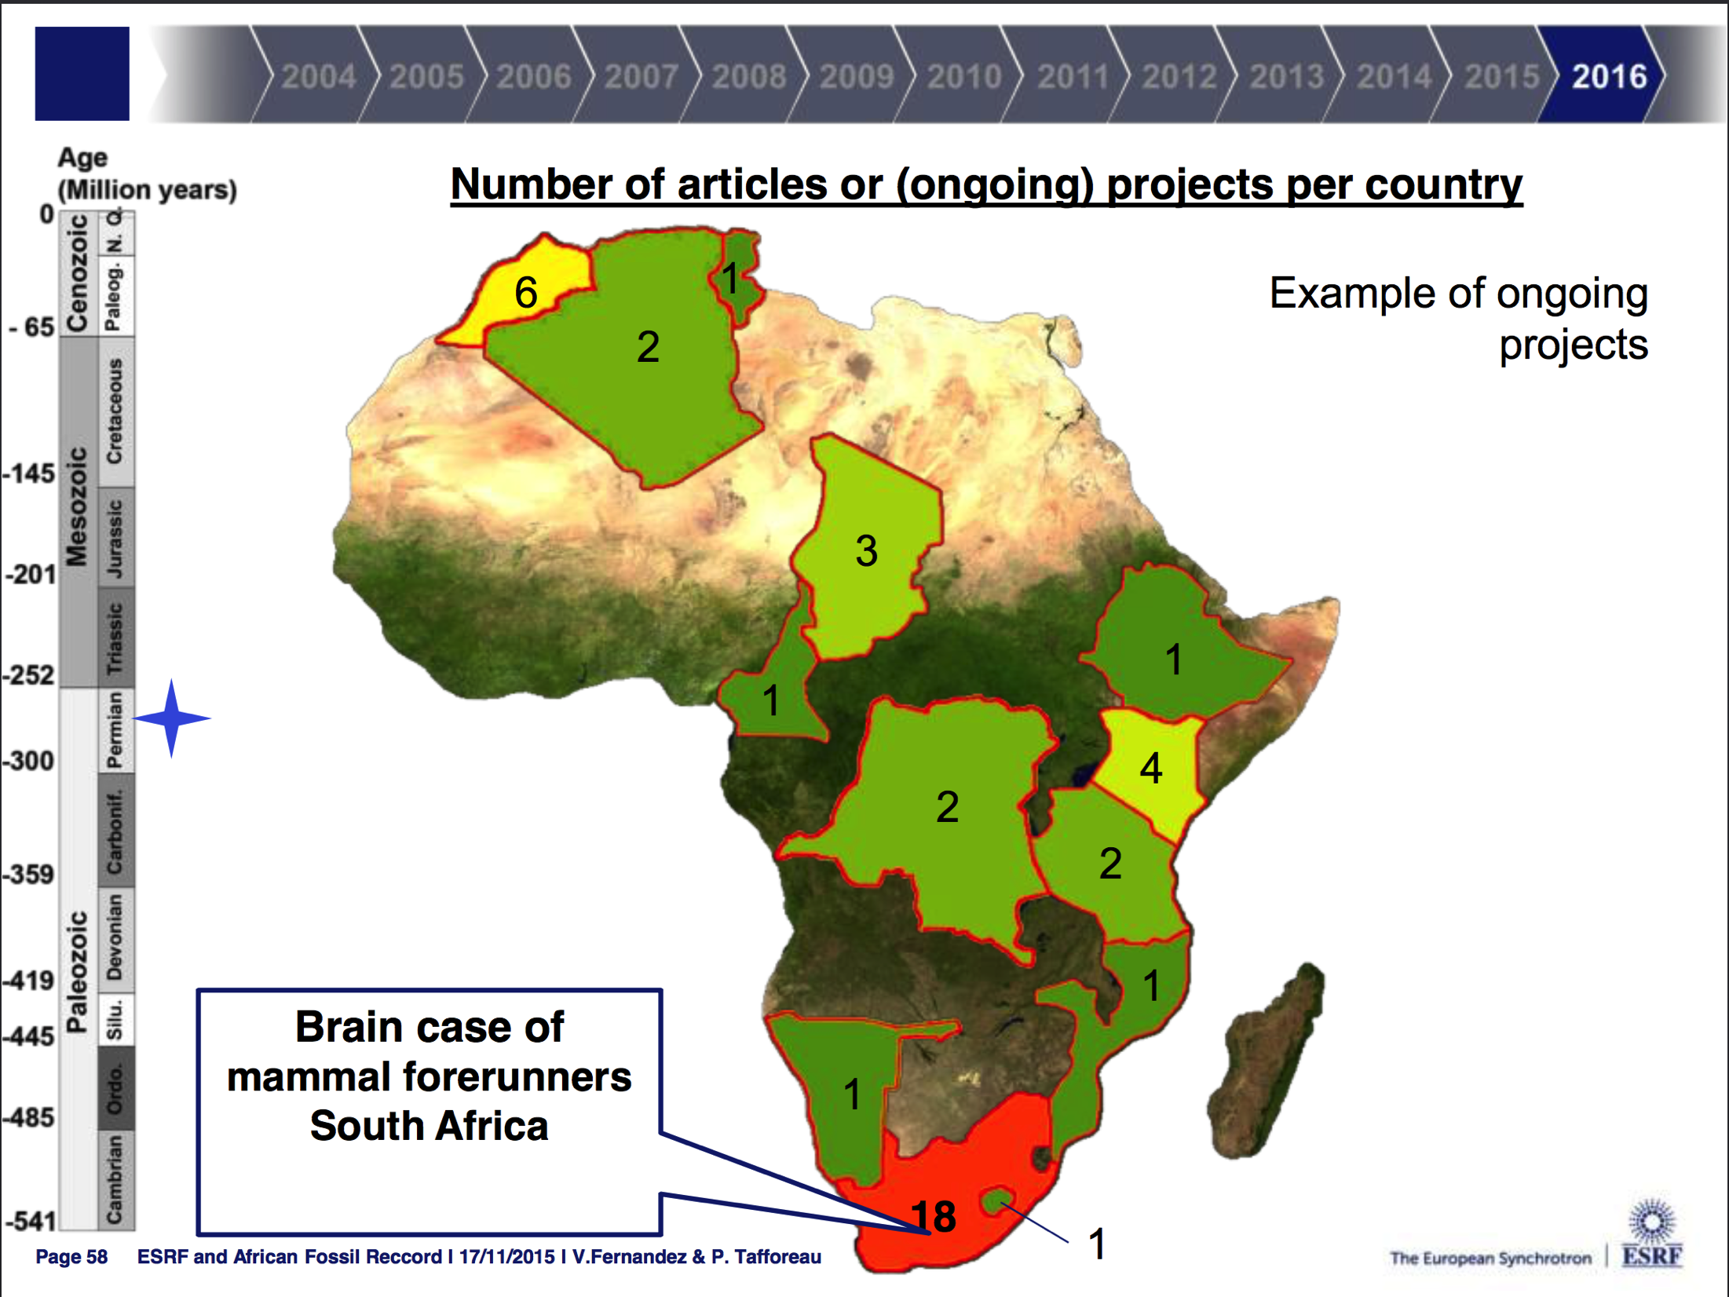

Slide 14
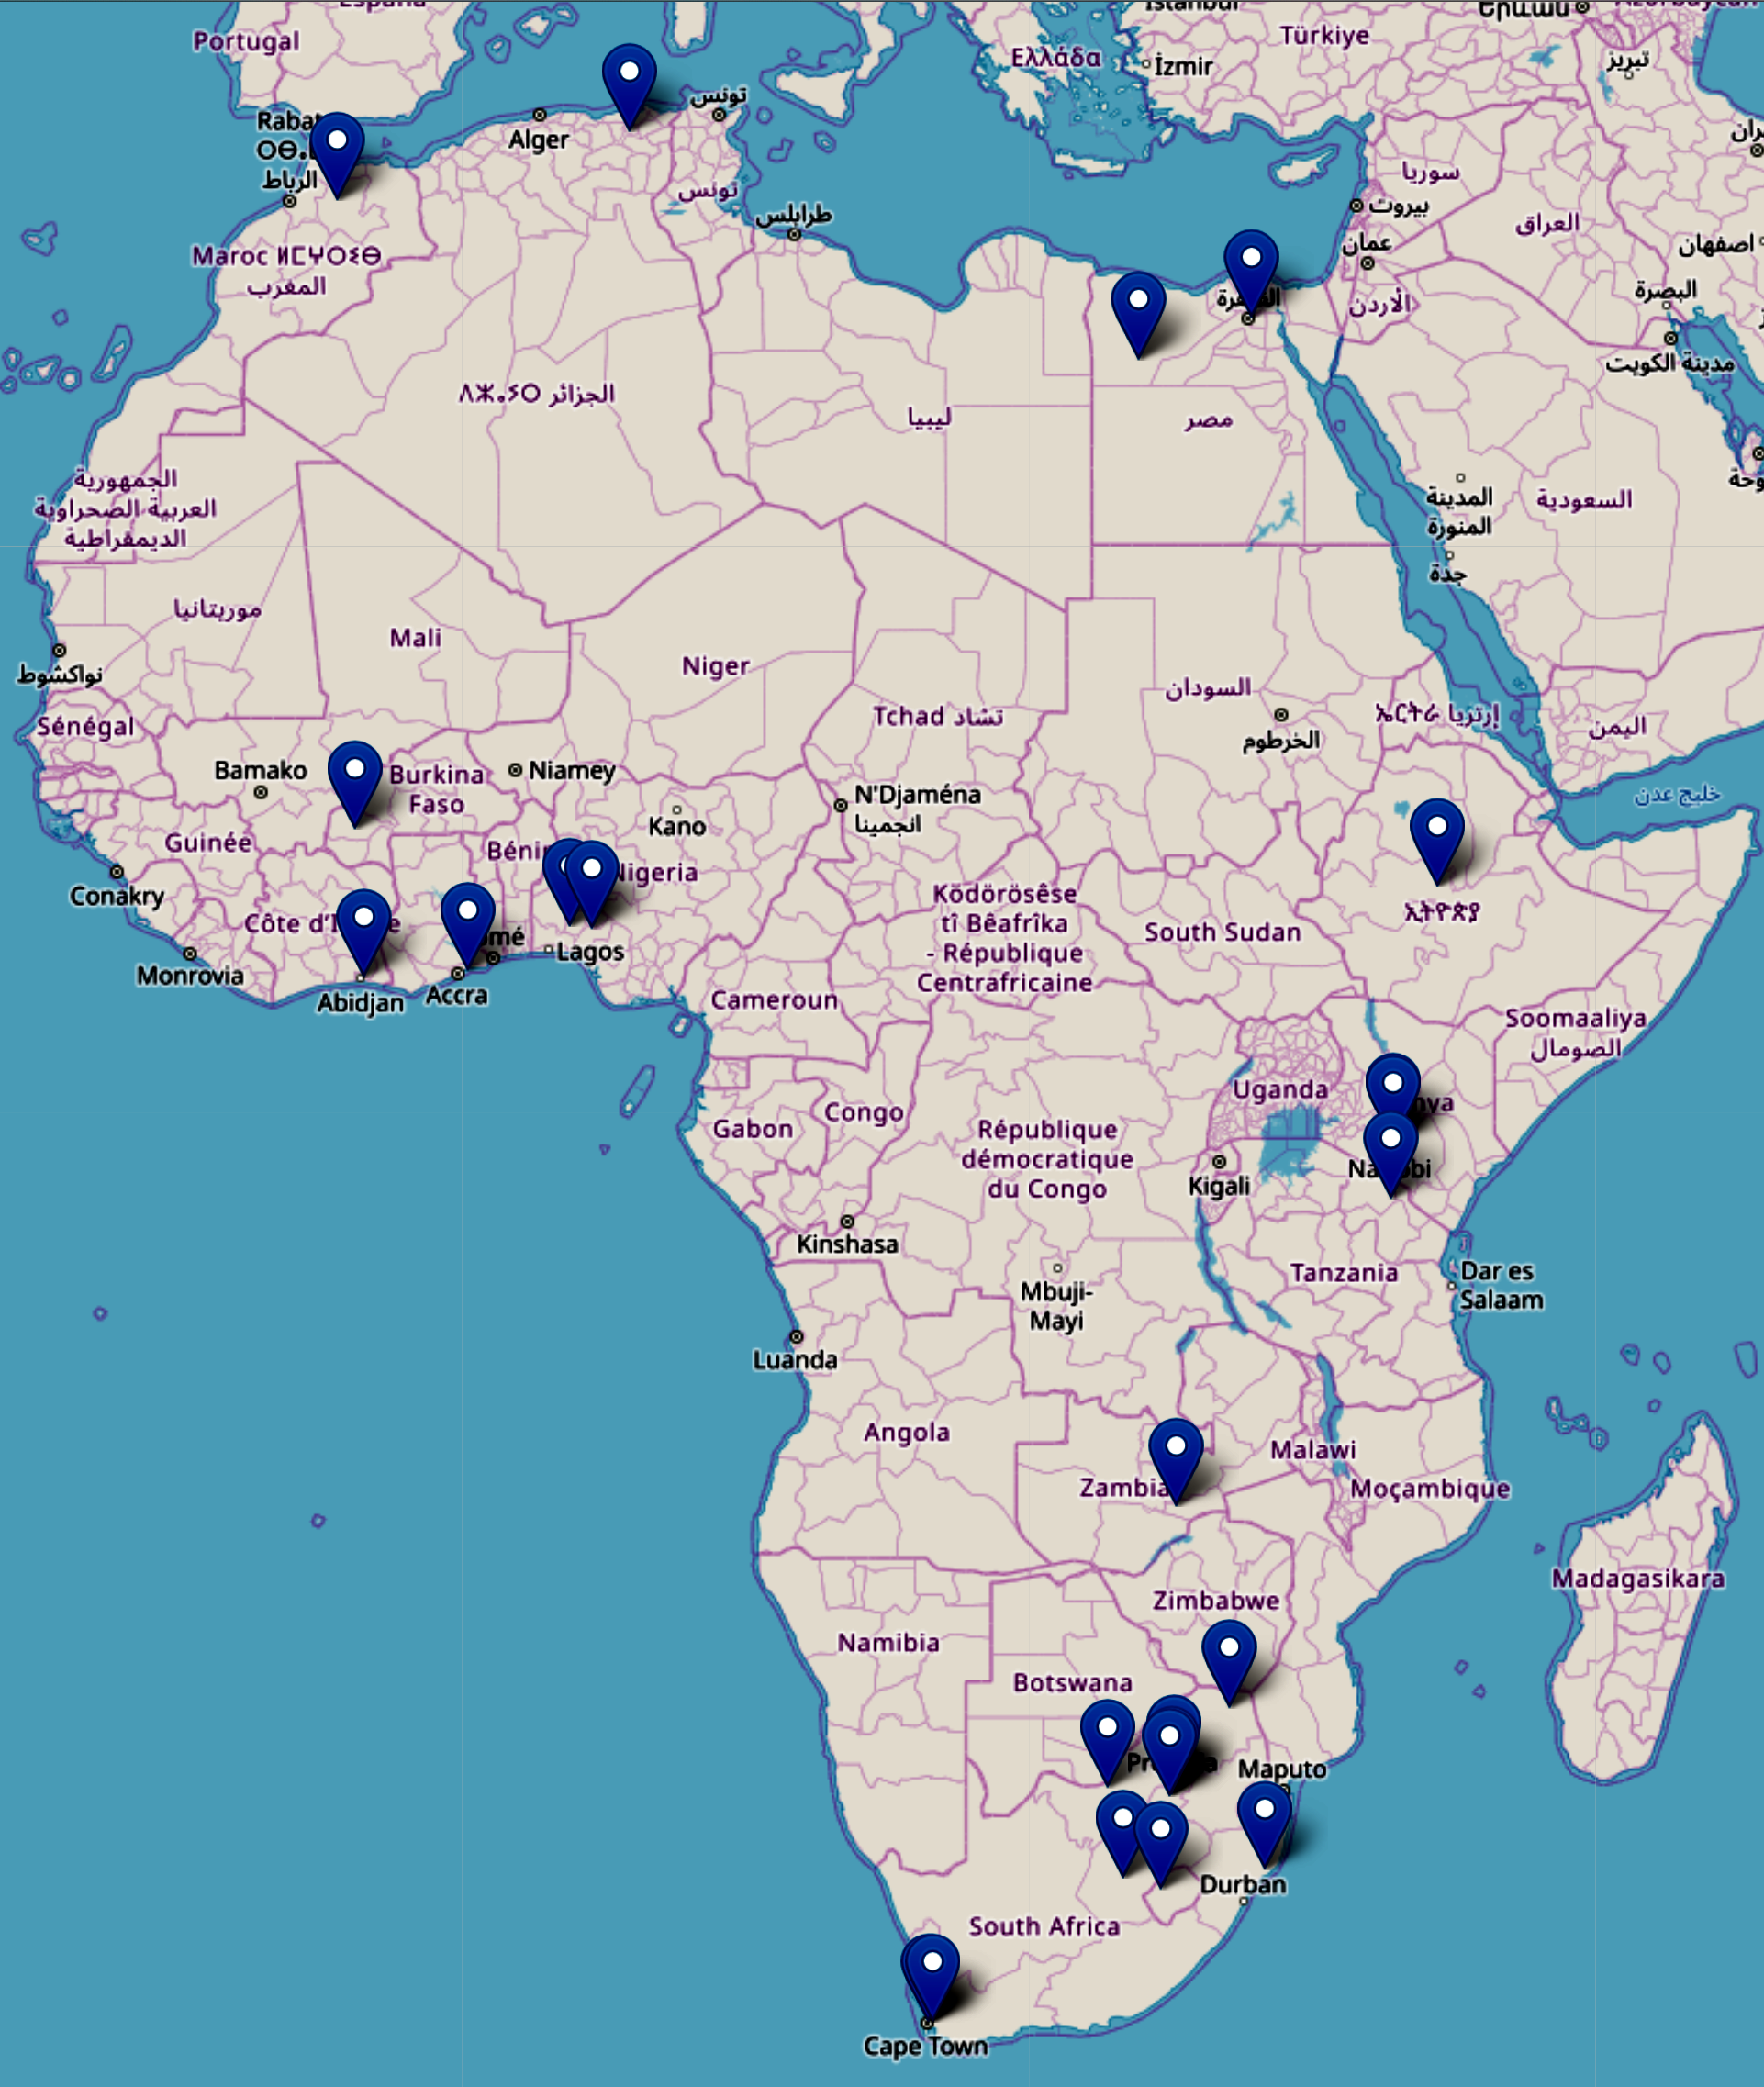
Bio Science : Feeder facilities
Ghana
University of Ghana
Zambia
The University of Zambia
Algeria
Ecole Nationale Polytechnique de Constantine
Nigeria
Federal University of Technology, Akure
University Ile-Ife
Burkina Faso
Institute of Research in Health Sciences, Burkina Faso
Morocco
University Sidi Mohamed Ben Abdellah
Ivory Coast
Universite Felix Houphouet Boigny
Egypt
Helwan University, Ain Shams University
Lesotho
National University of Lesotho
Ethiopia
Addis Ababa University

Slide 15
Example motivation based on Bio Science
Structural information helps to elucidate function, the mechanisms of enzymes → inspires the design of new drugs.
Africa should lead research of this nature → cures for diseases of particular relevance to Africa
Synchrotrons are extremely important facilities for the imaging of bio-molecules.
Development of 210 new drugs that depended on protein structural information [Westbrook et al. 2019].
Development of drugs for treating HIV-AIDS, [Wlodawer et al. 1998].
Listing of about drugs, their targets “Practical Fragments” Website [Prac. Frag 2018].
Development of new treatments for tuberculosis [Blundell 2017a ].
Interplay between academia and industry [Blundell 2017b].
See Light Sources for vaccine development for the current Pandemic [AfLS web page]

Slide 16
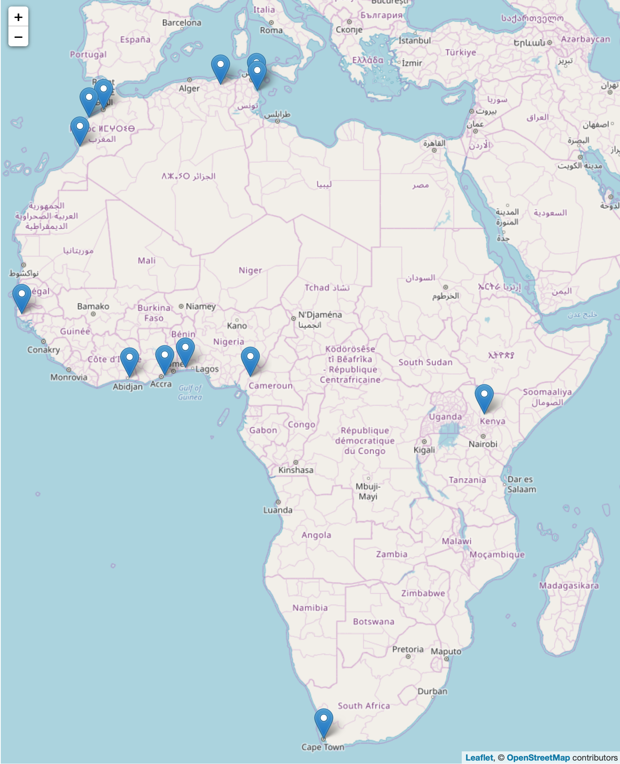
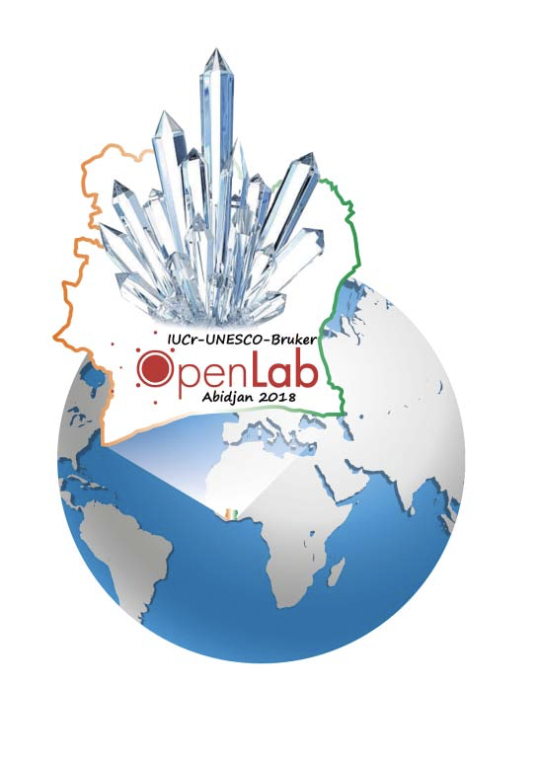
Materials : Feeder facilities
South Africa
  Aaron Klug Centre, UCT, link,
  U Witwatersrand, U Free State,
  U Stellenbosch, iThemba
Benin, X-TechLab, Benin, link
Ghana, U Ghana, link
Côte d'Ivoire, LaCPM, Universite Felix
Houphouet Boigny, Abidjan, link
Senegal, Ziguinchor, link
Cameroon, Dschang, link
Kenya, Kenyatta University, link
Tunisia
  Monastir, link, Nabuel, Tunisia, link
Algeria, Constantine 1, link
Morocco
  U Rabat,, link, El Jadida, Morocco, link ,
  Agidir, Morocco, link
Significant facilities
IUCr OpenLab venues with facilities

Slide 17
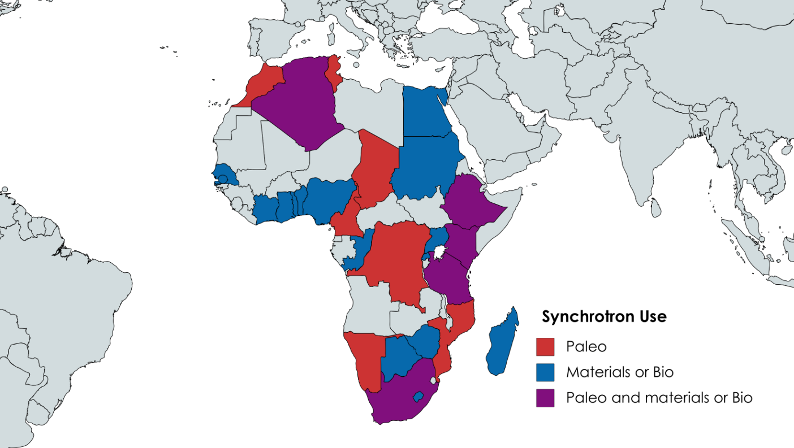
African Footprint
28/52 > 50%
PhD / Paper / Programme

Slide 18

Now 3rd week November 2021

