Slide 1
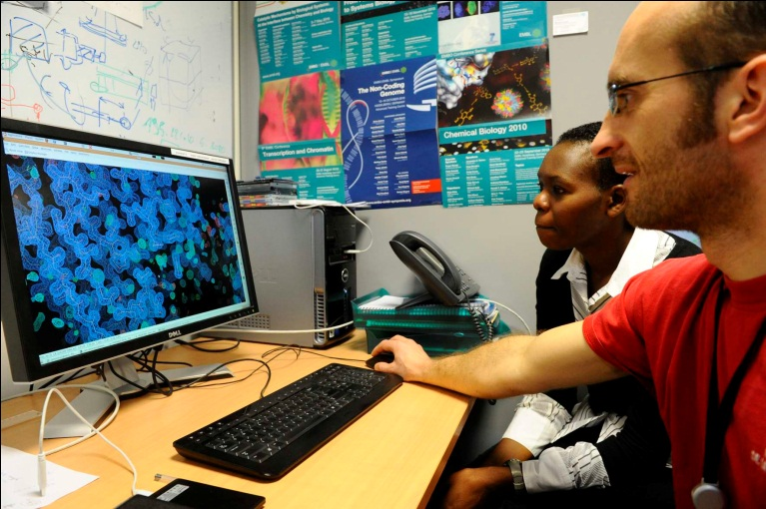
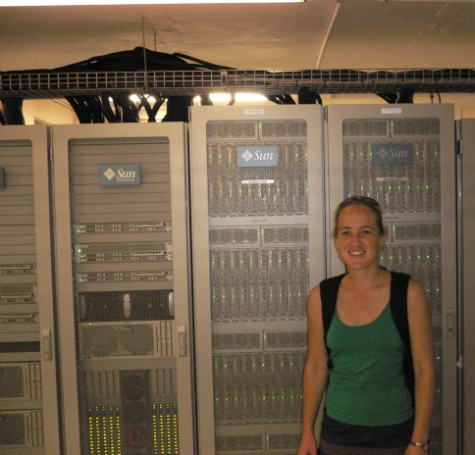
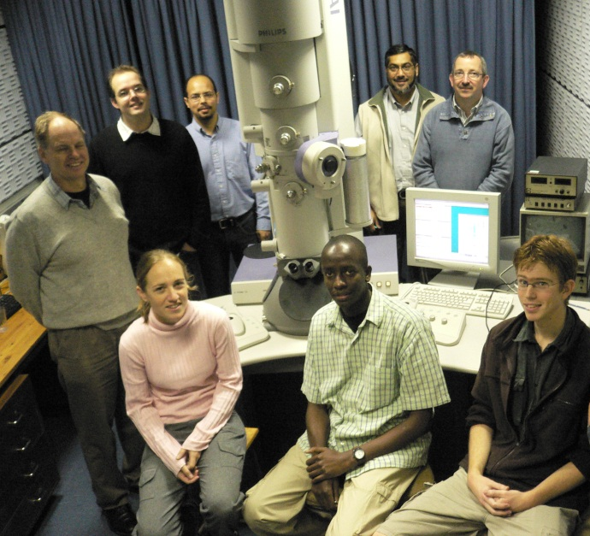
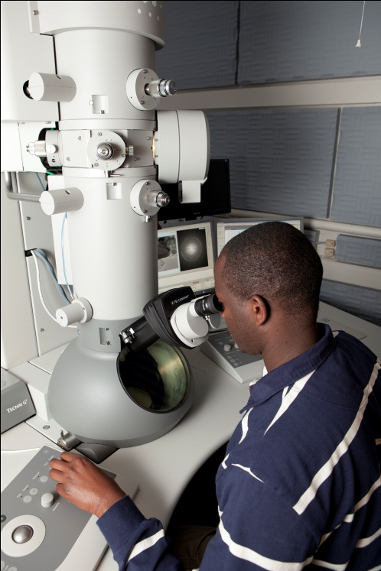
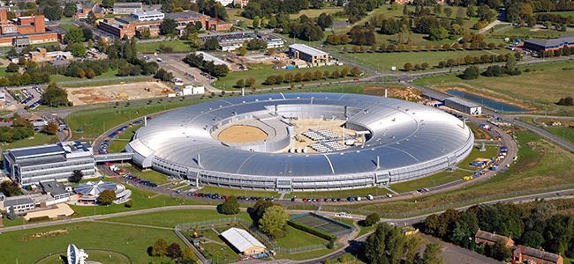
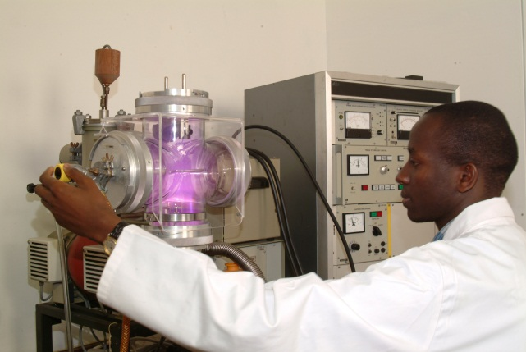
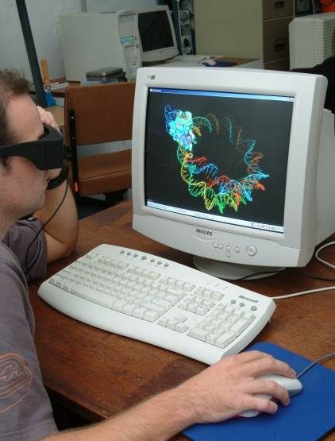
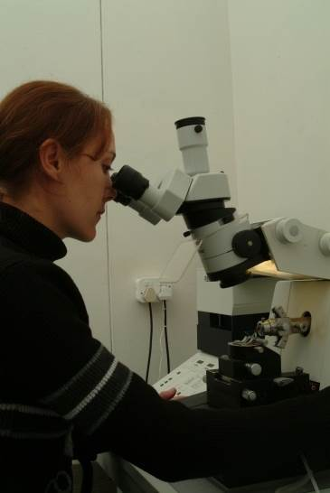
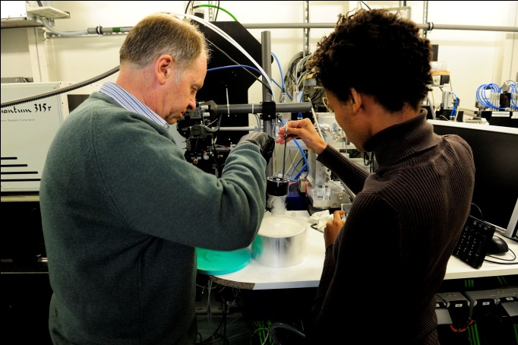
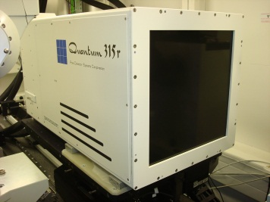
Crossing the Potential Barrier
How START stimulated Structural Biology in South Africa
Notes:
Story of the development of an SBIO programme at UCT.
Talking on behalf of Trevor who is unfortunately indisposed following elective surgery.
My authority to tell this story comes from honour of being one of the first graduates of the SBIO MSc programme.
I am going to reveal the developments that led to where we are today but also the projects that drove the need for develpoing these capabilities.
Deputy vice-chancellor, Deans, colleagues, students, friends and family. Thank you Professor le Roex for the introduction.
It goes without saying that we humans are concerned about (1) food (2) health (3) products for our comfort and convenience – in arbitrary order. We are driven by the need to have more and better. Our curiosity also drives us to look towards Nature and to observe how things happen in the world around us.
Biological systems hold a particular fascination – they replicate and propagate in a sustainable way – they live!
There are many ways to try and understand biological systems. The way I have chosen is to rationalize the way the systems function by visualizing biological macromolecules, especially proteins, at atomic resolution. This approach brings Biology into the domain of Chemistry and Physics and it is enabling for Biotechnology – especially such things as rational design of medicines and industrial enzymes. The discipline that is concerned with every stage of the visualization and interpretation of the structures is called Structural Biology. It is a very large field attracting significant investment internationally in both the academic and industrial spheres. No fewer than twenty-two Nobel prizes have been awarded to Structural Biologists since 1953. The impact of the field touches our daily lives in many ways – crops that are grown using herbicides and pesticides designed by structural biologists, , the drugs we take have almost certainly passed through the hands of structural biologists, if not in their discovery then in their synthesis or in the determination of their mechanism of action, even the water that we drink may have been purified with gels made by enzymes that have been designed by structural biologists and the fuel that you put in your car in the future will be made using tailor-made enzymes that have been designed by structural biologists.

Slide 2
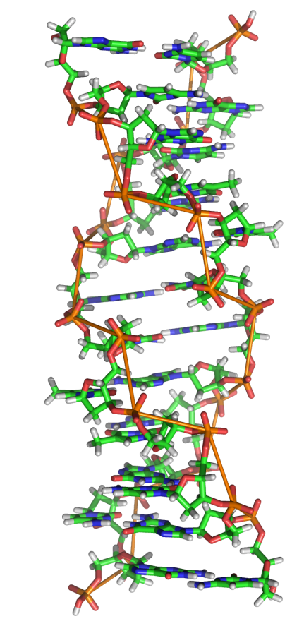
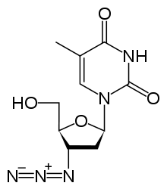
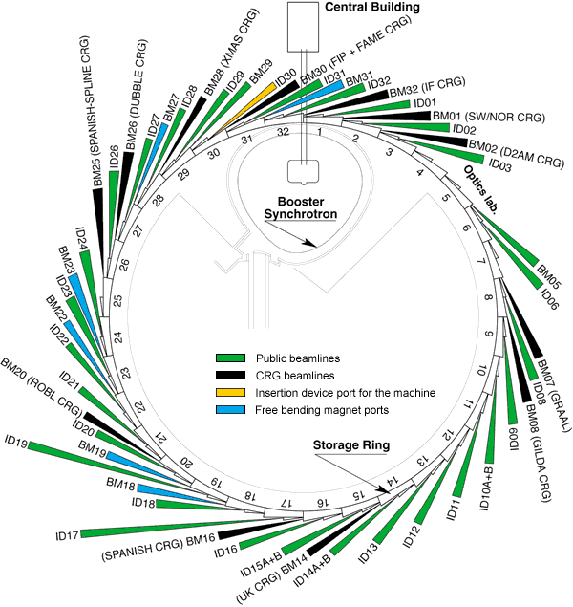

Importance
Global context
  Fundamental knowledge
  Applied discoveries
Local context
  Alleviate disease burden
  Contribute to food security
  Develop BioEconomy
Notes:
Before we move on to the hows I would like to address the why of SBIO. I think it is always important to justify why we study certain things and it is particulary relevant to reveal the motivation behind the establishment of an SBIO programme at UCT.
Importance of SBIO
both internationally
Show Nobel Prizes (fundamental knowledge in basic research) and applied discoveries mostly in disease mechanisms and resulting interventions from pesticides to retroviral inhibitors.
and locally.
Challenging and relevant discipline -> human capital development.
Academic pursuits and training,
Technologies

Slide 3
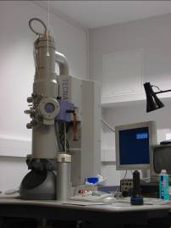
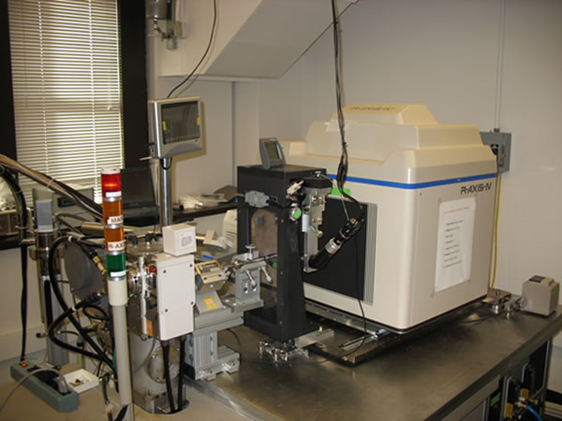
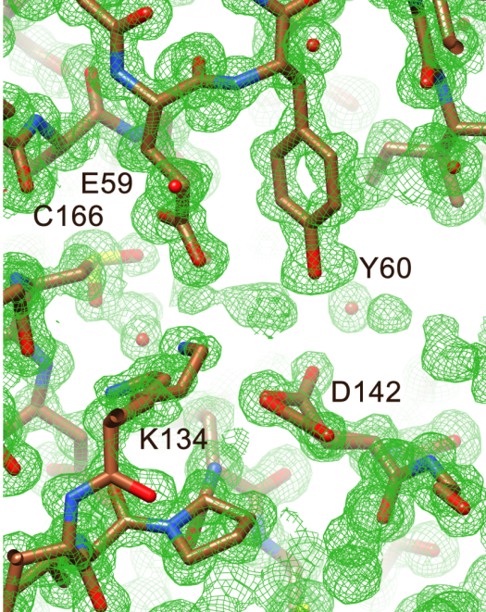
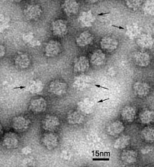
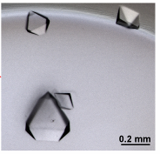
Convergent techniques
Cryo-EM
MM crystallography
Notes:
Discipline of electron density maps!
This dose sensitivity is eloquently addressed in two of the main structural biology techniques: crystallography and electron microscopy both of which aim to raise the signal from the noise using very different approaches and different wavelengths of radiation.
One through the arrangement of molecules into an ordered array to exploit diffraction phenomena and the other which relies on computational methods to average images obtained from direct imaging with electrons.
Although, quite different in their execution and application, there is much commonality between these technique and with the rapid improvements in EM technologies that are parallelling the early developments in X-ray, this is a trend that can only continue. Fastest developing method for determining protein structures.
One of the most obvious commonalities between the two disciplines is that neither techniques are trivial and require an enormous investment in trainign and infrastructure. Disciplines in their own right rather than pieces of equipment.
The tale of the oringins of structural biology at UCT is therefore a tale of the development of the infrastratucture (both the human and equipemnt) to tackle such fields of study.

Slide 4
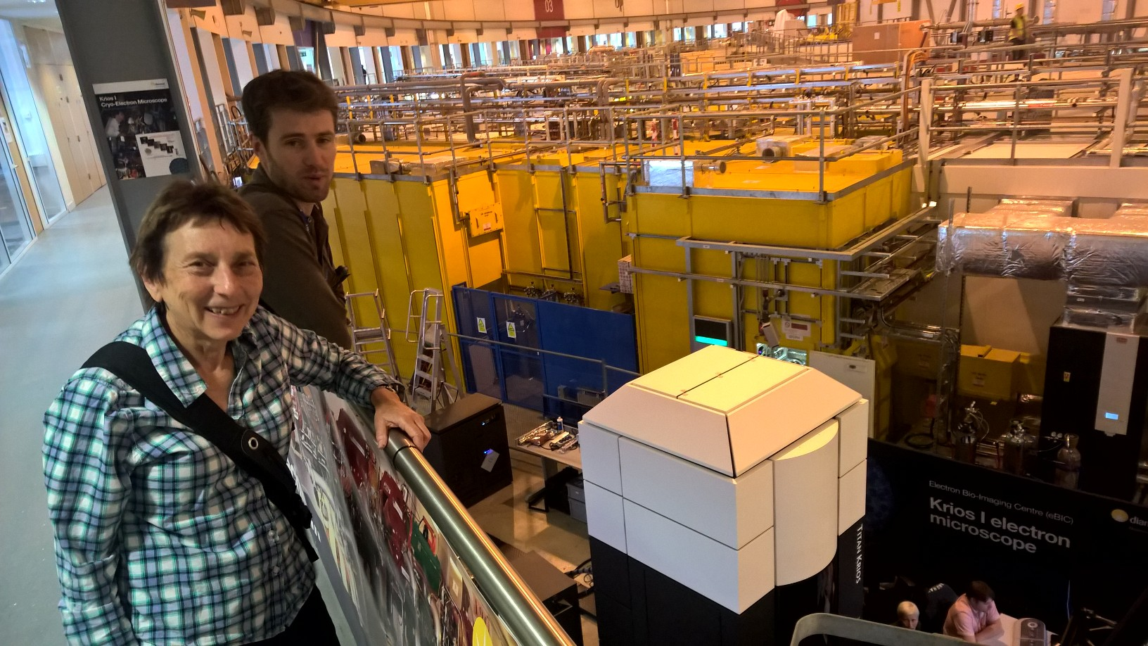
An electron microscope among the synchrotron beamlines at the Diamond Light Source
Dr Alistair Siebert
Prof Helen Saibil FRS, PI

Slide 5
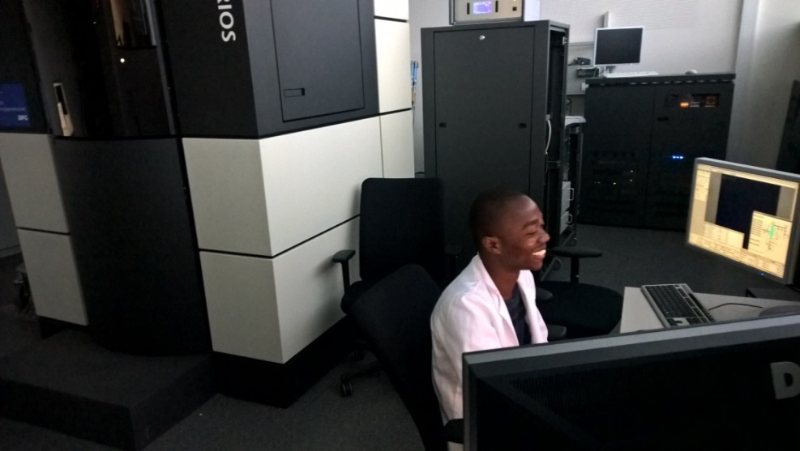
Andani Mulelu operating the world’s most powerful cryo-EM at Goethe University in Frankfurt

Slide 6
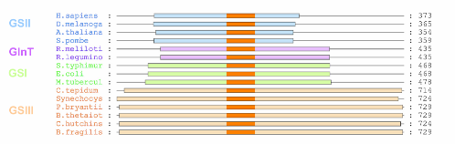
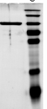
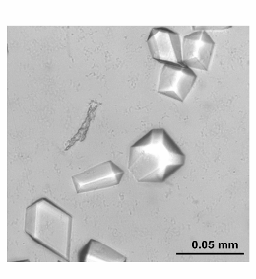
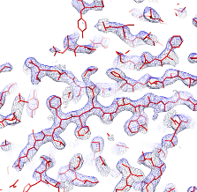
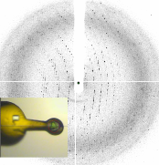
Structural biology … pipeline
1. Sample selection
2. Soluble expression
3. Purification
4. (Crystallization)
5. Data collection
6. Data processing
7. Interpretation
8. Publication
Notes:
It’s also very important to note that Biophysics is only one aspect, often the celebrated for the visual insights it brings, but no more important that the other stages of the experiment.
Often more than half the battle is in preparing sample and a considerable portion of our efforts in growing capacity have centred around equipping world class protein production facilities and growing the skills to execute this critical part of all aspects of the pipeline.
We have not been alone in this pursuit and the developments in our collaborators labs have been essential for them accessing our resources.
Entering at different points in the pipeline e.g. collaborations with partners providing excellent protein samples skip ahead in the experiment. Or collaborations with overseas partners have allowed us to access resources we don’t posses in the country.

Slide 7
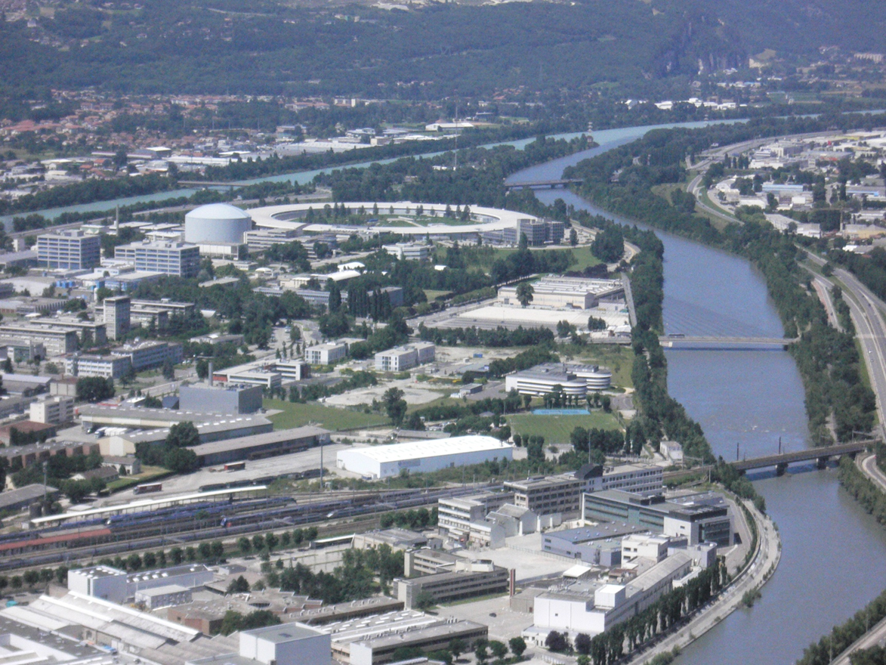
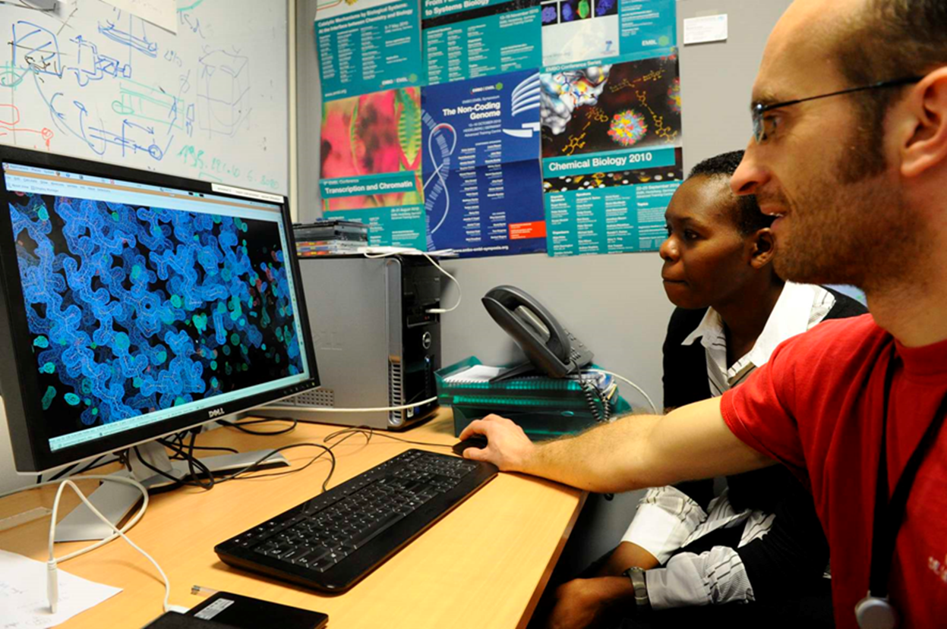
What problems faced scientists wanting to solve protein structures in South Africa?
No existing community
Lack of appreciation of the value of structures
No supportive funding environment
In 1990 South Africa was isolated from all this.

Slide 8
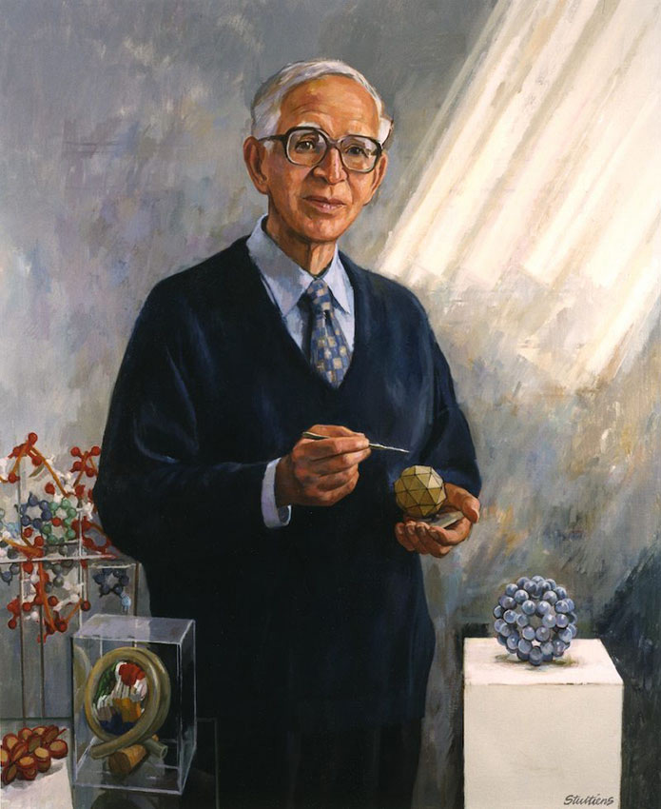
So how does anyone get started?
Go abroad!
Sir Aaron Klug
(Nobel Prize in Chemistry 1982)
Portrait by Jeff Stultiens RP
Principles of virus structure,
Structure of the nucleosome
Structure of tRNA
Structure of Zinc fingers among others.
This doesn’t change anything on the local scene and actually makes the problem worse
Notes:
Klug was a student of RW James in Cape Town – one of two Nobel laureates trained by James – the other was Allan Cormack who discovered how to make three dimensional images from two dimensional medical X-rays.
To an insider it is not really surprising that the science of structural biology did not emerge in South Africa during the beleaguered years of the twentieth century. The priorities were simply different. The barriers were too large and if you wanted to do advanced bioscience like Sydney Brenner and Aaron Klug, you went abroad. When the barriers to international contact and funding came tumbling down at the end of the century several people at UCT were able to exploit their international contacts. In particular the Wellcome trust funded collaborations between Heln Saibil in London and Trevor Sewell and between Ravi Acharya in Bath and Ed Sturrock, These resulted in the first EM structure (nitrilase) and the first crystal structure (a domain of angiotensin converting enzyme) published by South African authors. In the first instance the Wellcome Trust enabled the acquisition of a second-hand cryo EM by UCT and in the second case the data were collected at the Daresbury Synchrotron. It is interesting to reflect on the greatest barriers that needed to be overcome in the two cases – Publication in the case of the nitrilase – the spiral enzyme structure was just too different to be immediately accepted and the paper was rejected many times essentially until a prominent German group published a paper describing a different spiral enzyme structure. The barrier in the case of the ACE was crystallization – it is a glycoprotein. Ed sturrock solved the problem by mutating the glycosylation sites in every possible combination until he produced an active enzyme that crystallized. The huge medical significance of the structure assured immediate acceptance by Nature.

Slide 9
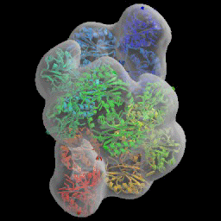
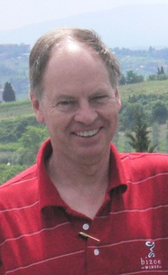
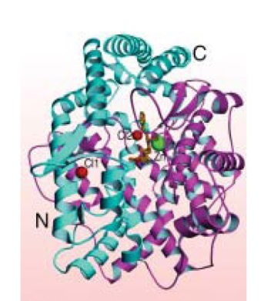
Collaborate with established groups abroad
Crystal structure of the human angiotensin-converting enzyme-lisinopril complex.
Natesh, R; Schwager, SLU; Sturrock, ED; et al. Nature, (2003), 421, 551-554.
Structure of the cyanide dihydratase from Pseudomonas stutzeri AK67.
Sewell, BT; Berman, MN; Meyers, PR; et al. Structure, (2003), 11, 1413-1422.
Slightly better. Projects differed in the extent to which technology and IP was returned to SA.

Slide 10

Try to establish everything in South Africa
The Joint UCT – UWC Masters programme in Structural Biology (2002-2009)
Lecturers: Dr Arvind Varsani and Dr Muhammed Sayed
Learning centres at both UCT and UWC
Protein X-ray diffractometer was purchased and located at UWC and the NMR spectrometer at University of Stellenbosch was modified for protein use in 2003.
Laboratories for research established at UCT and UWC.
13 international experts lectured on the programme
BSc (Hons) programme was accredited by the Higher Education Quality Committee in 2007.
Website and computer based courseware at Masters level was implemented
17 M.Sc students and three honours students graduated
32 papers co-authored by the students were published
Programme assessed by Professor Sir Tom Blundell and Professor Johann Mouton.
The First African Structural Biology Conference was held. It attracted 139 delegates and 17 plenary lecturers.
Computer network linking UCT and UWC was created
Notes:
What follows are some of the highlights of the science from the programme from students in our labs.
It’s important to note that other students from the programme went on to join other labs.
Covering our research interests from: medical application from drug discovery to industrial catalysis.

Slide 11
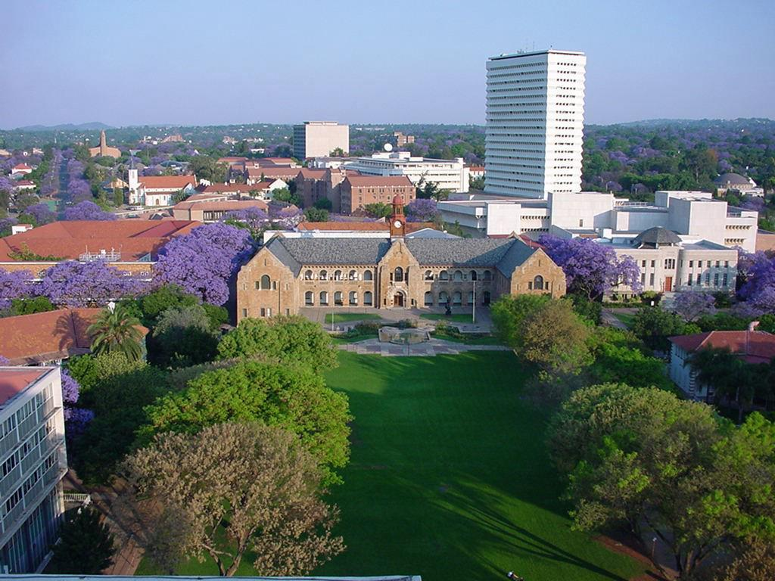
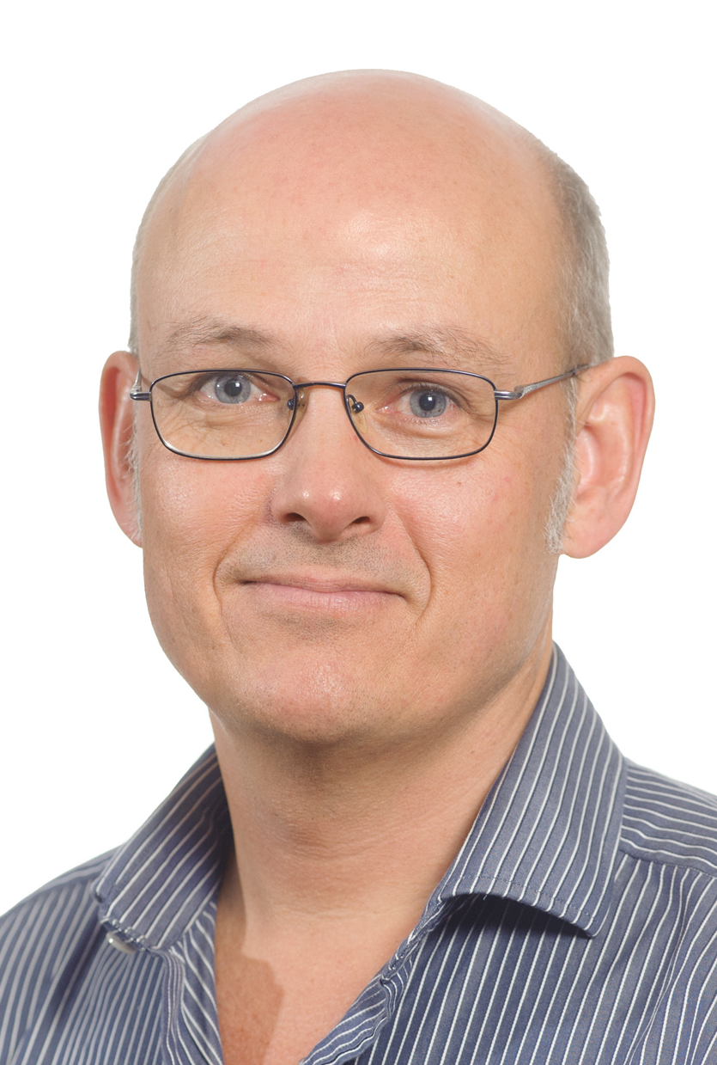
University of Pretoria
Department of Biochemistry, Genetics and Microbiology
Wolf-Dieter Schubert
Structural Biology of Infectious Diseases

Slide 12
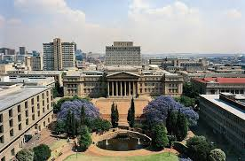
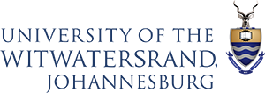
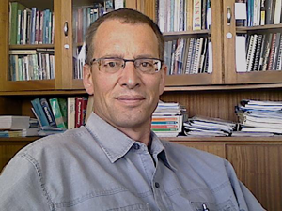
Prof Heinrich Dirr
NRF/DST SARChI Chair in Protein Biochemistry and Structural Biology
Director: URC Protein Structure-Function Research Unit

Slide 13
biocatalysis structural and evolutionary biology
Prof Dirk Opperman
Fundamental research / industrially feasible reactions

Slide 14
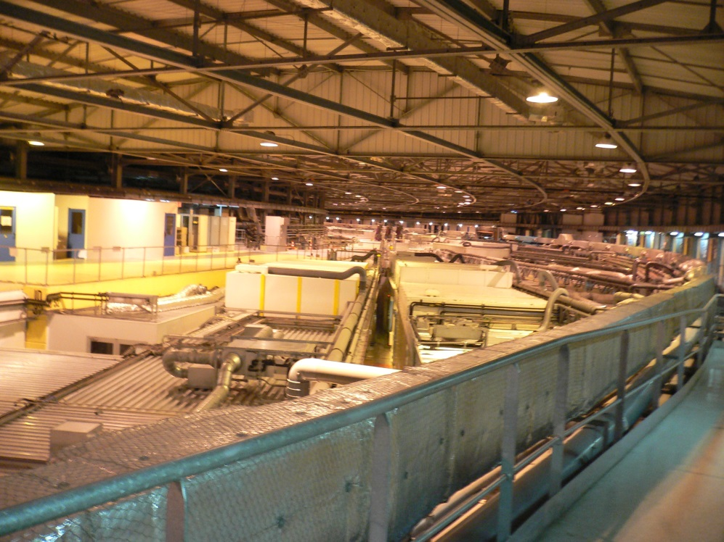
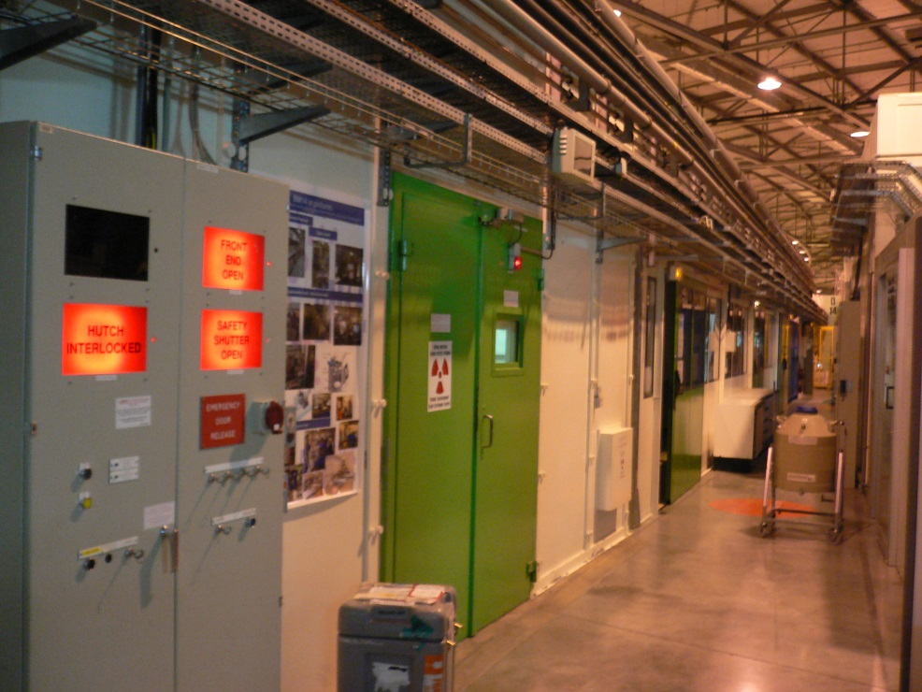
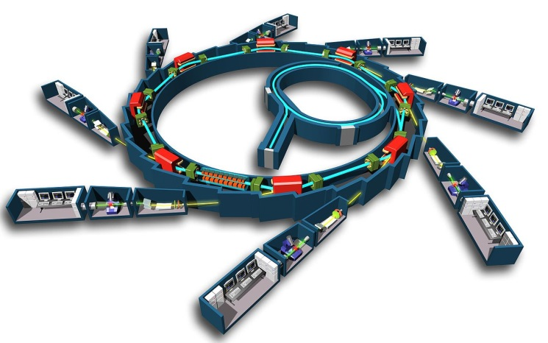
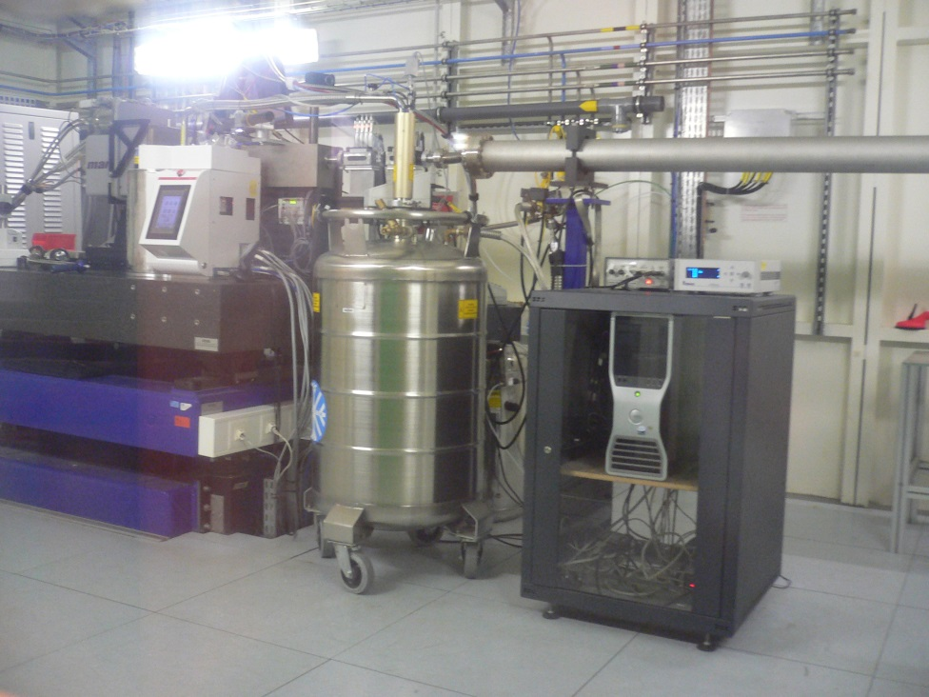
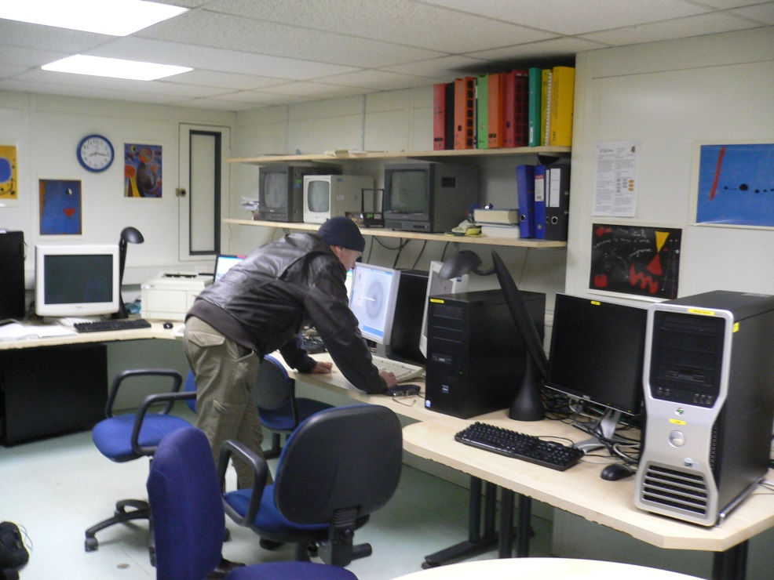
Synchrotron access was provided via an MoU with EMBL Grenoble
BM14

Slide 15
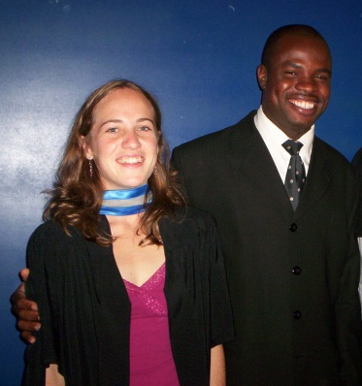
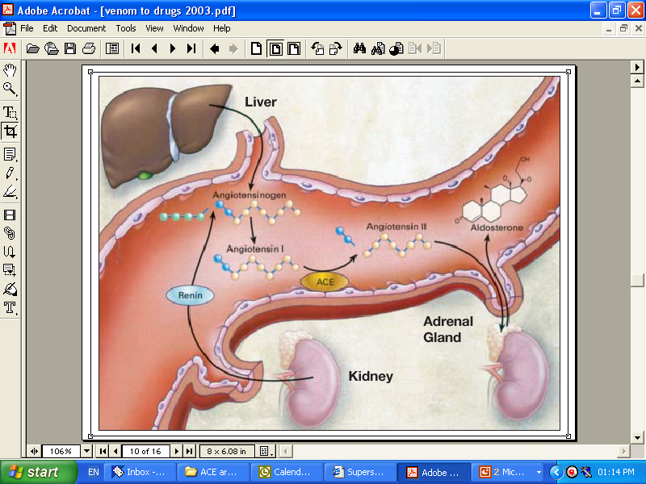
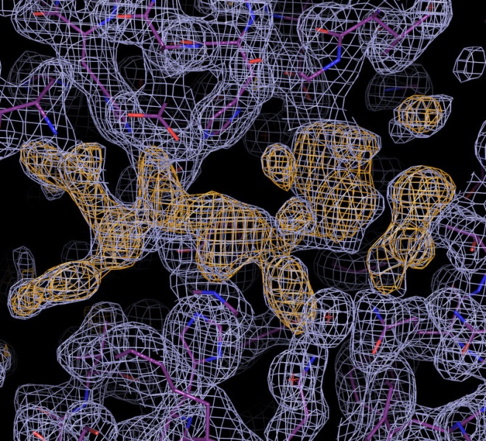
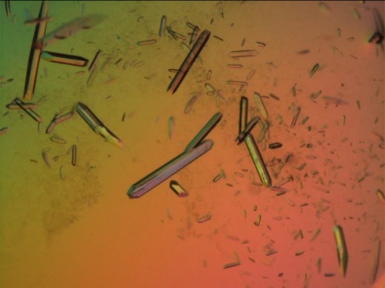
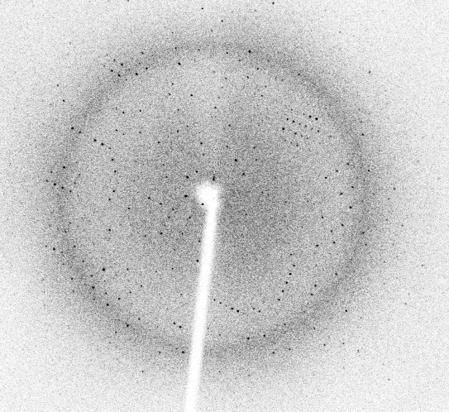
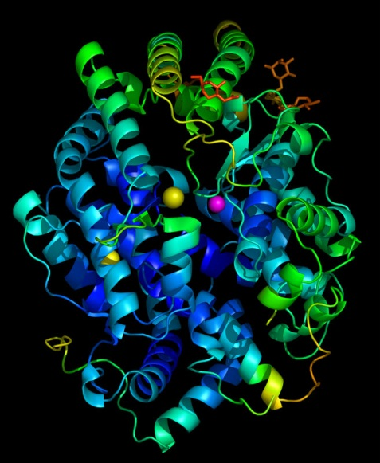
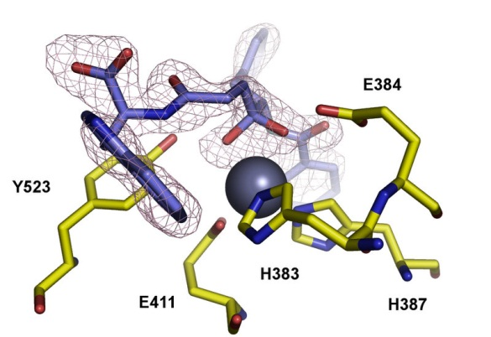
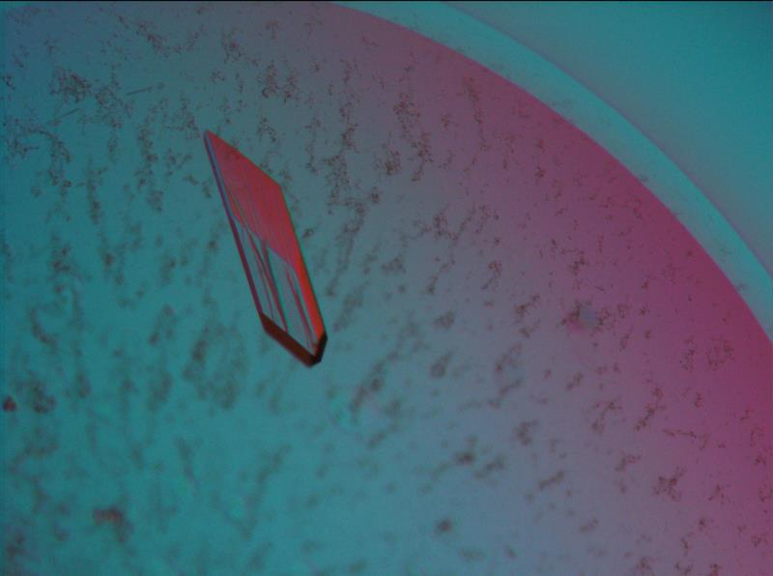
Drug design for hypertension
Nitrilases, Amidases and related enzymes: Ndoria Thuku, Serah Kimani, Andani Mulelu, Jeremy Woodward, Joni Frederick, Jean Watermeyer
Nitrile Hydratases: Jennifer van Wyk, Joni Frederick
Glutamine Synthetase: Jason van Rooyen, Satish Patel
Mycothiol processing enzymes: Simon Broadley
Angiotensin converting enzyme: Jean Watermeyer
Plant viruses: Kyle Dent Jennfier Miller
African Horsesickness Virus
Methods development: Jean Watermeyer, Jeremy Woodward, Kwok Yan Chan
High blood pressure is treated using inhibitors of angiotensin-converting enzyme.
X-ray crystallography allows visualisation of locally-designed, novel inhibitors binding to the enzyme.
Dr. Jean Watermeyer
Notes:
Thirdly, we want to help make sick people better. In this case I am highlighting the work of our colleague Professor Ed Sturrock who has used our ability to see the atoms in a particular protein molecule to make better drugs to control high blood pressure.

Slide 16
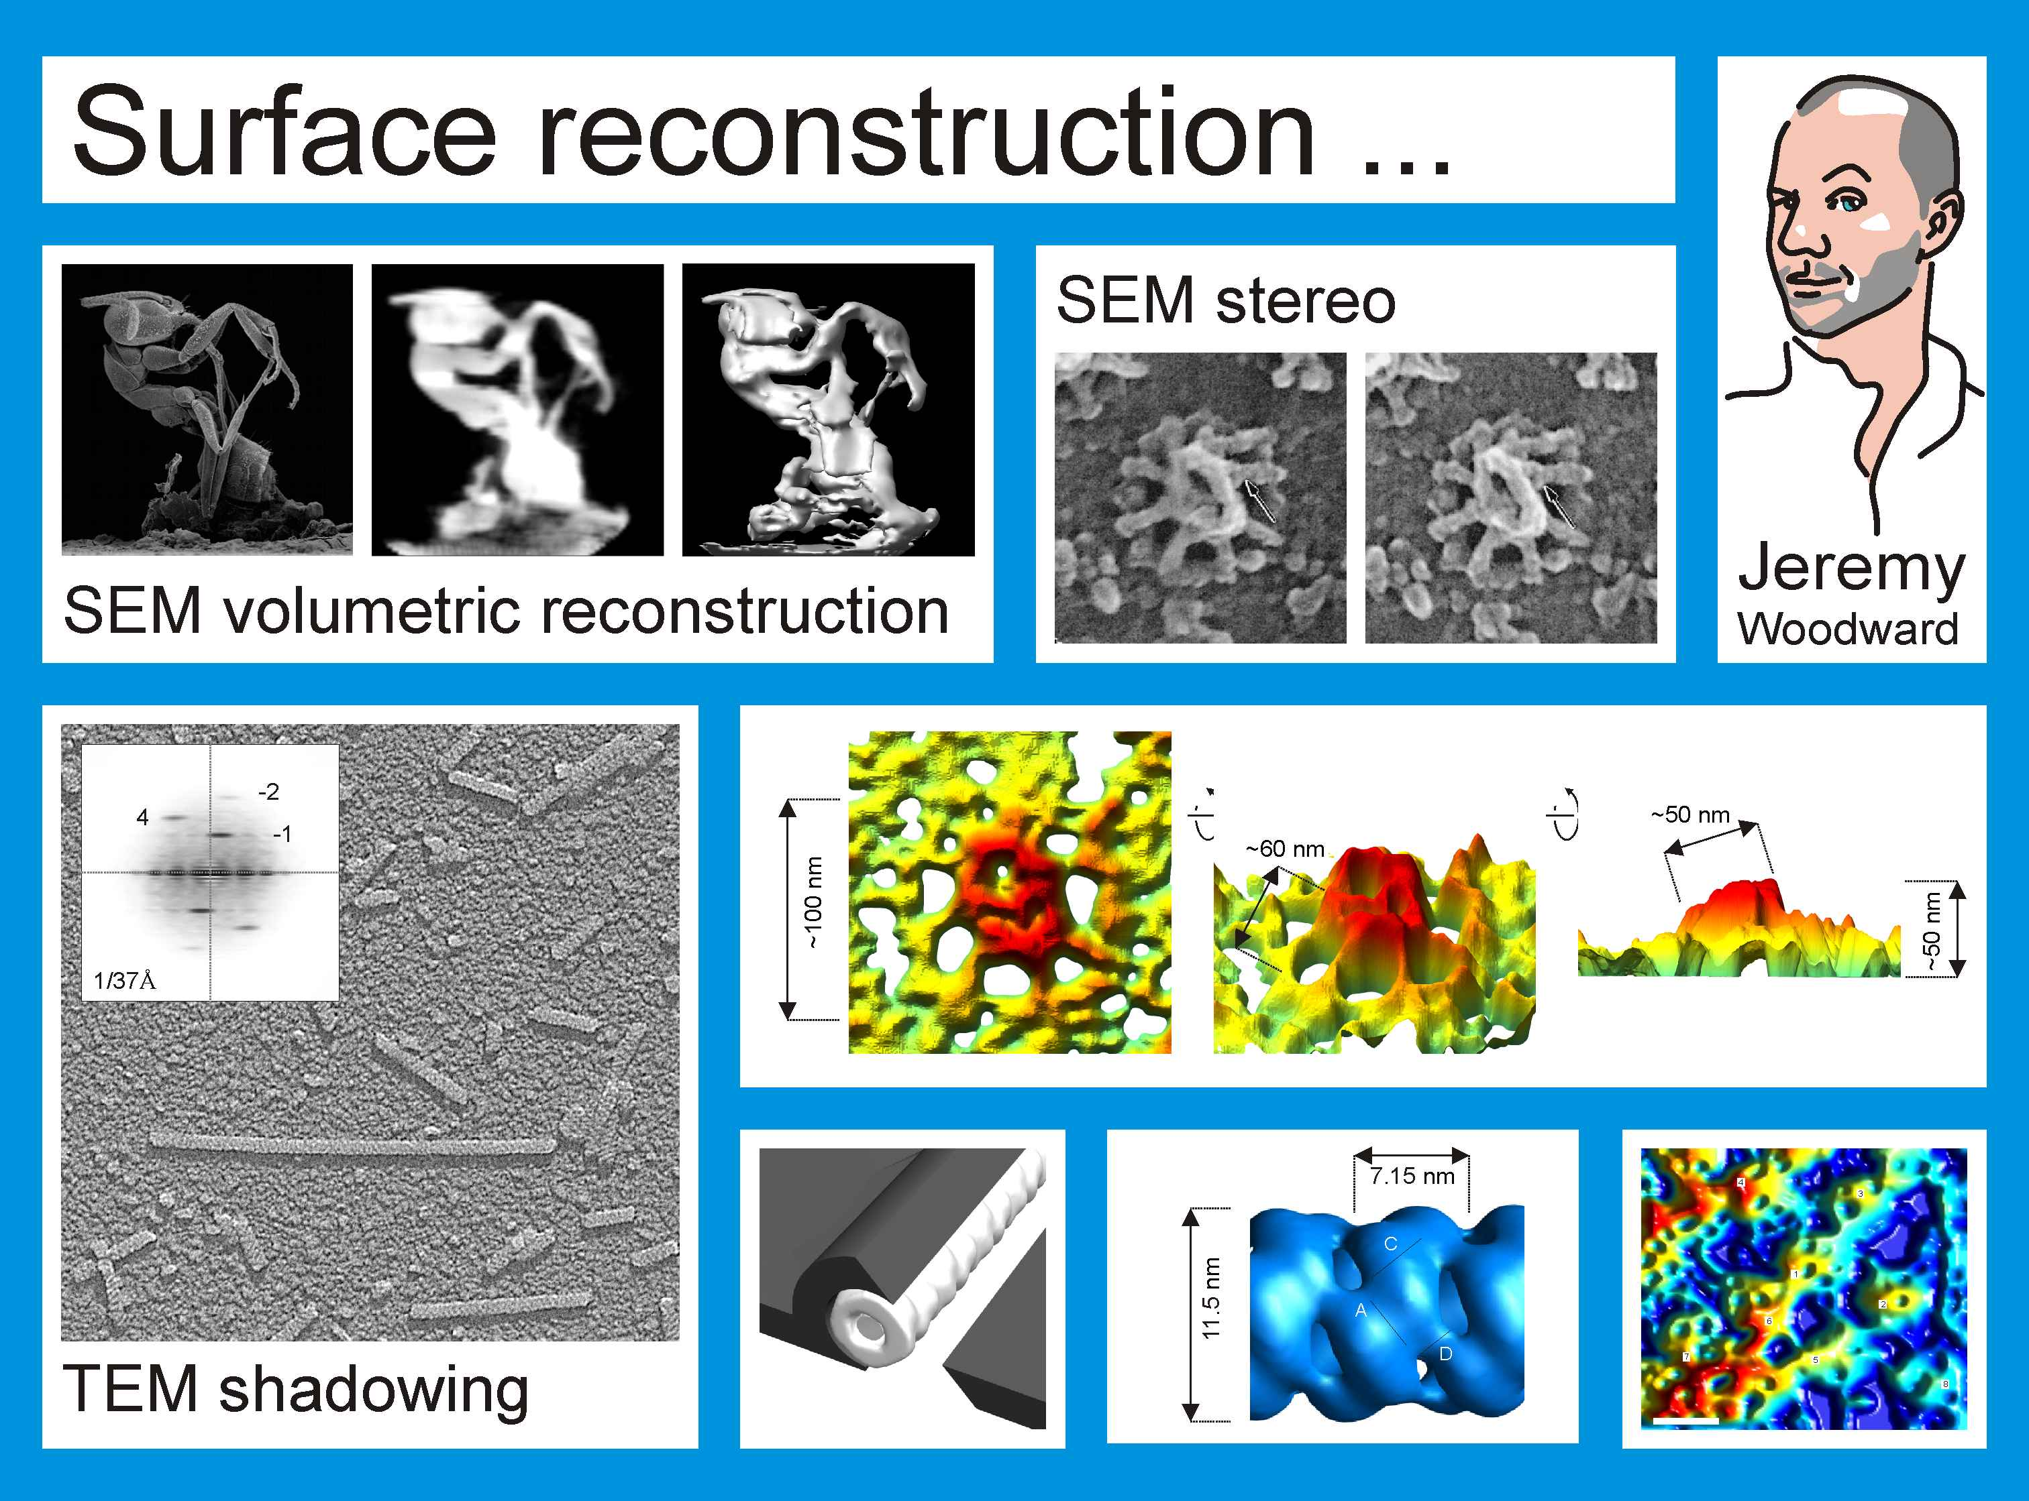


Slide 17






Bacillus pallidus RAPc8 Amidase
2-fold
3-fold
A surface
Serah Kimani
Kimani et al (2007) Biological Crystallography
Notes:
Try as we might – we were unable to crystallize a nitrilase - so we had to change our approach. We realised that the amidases that catalyse the conversion of an amide rather than a nitrile to a carboxylic acid were similar except for some bits to the nitrilases. By determining the structure of the amidase we were able to build a model of the nitrilase that is probably a good first approximation to the truth.

Slide 18

Frouws et al Biophy

Slide 19





Slide 20


Slide 21






Is it possible to explain the transition from spirals to helices which occurs in B. pumilus CynD at pH 5.4?
The pH 6 structure is possibly a hybrid between a
terminating 14mer and a terminating 18mer
Margot Scheffer
90º
E
pH 6.0
pH 5.4
Hypothesis: The charged histidines repel one another disrupting the E surface
interaction and create space for an additional dimer which is located by the
D surface interactions.

Slide 22





GlcNAcIns Deacetylase (MshB) from Mycobacterium tuberculosis
Simon Broadley
Significant structural changes triggered by substrate binding (green)
The reaction catalysed occurs in the synthesis of mycothiol – an essential antioxidant in Mtb
Binding of substrate fragments , glycerol and acetate, reveals key enzyme substrate interactions
Notes:
Students embedded in other groups like Simon working with Digby at IIDMM on MshB.

Slide 23







Water purification is achieved through polyacrylamide flocculation
Acrylamide is made in kiloton quantities using nitrile hydratase
Dr Jennifer van Wyk
Naturally occurring nitrile hydratase
Enzyme modified for greater thermostability
Better enzymes for acrylamide manufacture are designed using structural knowledge

Slide 24




African Horsesickness Virus
threatens the South African
thoroughbred industry
Red tide
Marine Algal viruses
can be used to protect the
shellfish industry which is
threatened by Red tide.
Notes:
Finally, we have visualized harmful viruses in collaboration with partners in vetenary and marine sciences.
like AHSV and the viruses that we seek to deploy as biological control agents to kill the algae that cause red tide.

Slide 25







The highlights
Papers written by our students have been given front cover prominence in major journals
Jason van Rooyen
Serah Kimani
Ndoria Thuku
Notes:
The Dean of Science once asked me to prepare some slides to show Minister of Science and Technology Naledi Pandor why it was important to do structural biology especially at UCT – I am going to take the liberty of showing you those slides.
Firstly, I believe that the role of the University is to follow scholarly pursuits, that is, to gain new knowledge and publish it in the open literature. There is no doubt that the determination of the structure of biological macromolecules is challenging, current and good science. The insights are sound – in the words of one of our post-docs – “what sets us apart is that we actually see the molecules we are studying”.

Slide 26
Collapse in 2009
In spite of the amazing success of the Carnegie sponsored MSc programme a series of decisions were made to halt it in both Faculty of Health Science and the Science faculty at UCT because fears concerning the long-term sustainability of the discipline of Structural Biology in South Africa.
The Electron Microscope Unit at UCT was obliged to put more resources into Materials Science following a review and could no longer act as the academic home for Structural Biology.
UWC was unable to sustain momentum after Wolf-Dieter Schubert moved to Pretoria.

Slide 27


Aaron Klug Centre for Imaging and Analysis
Purpose: To provide the instrumental resources and expertise for structural analysis in all disciplines including structural biology
Staff: Director, 4 scientific officers, 2 technical officers employed by UCT
.

Slide 28

Space: 660m^{2,}, vibration free, magnetic field compensated, temperature controlled, humidity controlled
Equipment: 3 TEMs, 4 SEMs, Protein Diffractometer, Preparative equipment, computer infrastructure
Grant Applications for a Direct Electron Detector to NRF in process, high-end TEM (e.g. TITAN Krios) - pending
Automated acquisition systems
Web-based image processing interfaces
Integration with UCT HPC

Slide 29




Chromatography
Crystal trials
Crystals
Data collection

Slide 30






The Structural Biology Research Unit
Purpose: To promote Structural Biology at UCT. To formulate and pose questions in structural terms. To plan and execute experiments that produce structural insights. To prepare material for structural analysis. To support the preparation of grants for work in structural biology. To raise grants to work with a substantial structural component.
Resources: 80m² lab space, molecular biology, cell culture, chromatography and biochemical assay facilities. Computers.
Status: Approved UCT research unit within the Department of Integrative Biomedical Sciences
Members:
PI Woodward
Weber
Meissner
Sturrock
Sewell

Slide 31
The First African Structural Biology Conference
Macromolecular Structure, Health and Biotechnology in Developing Countries
The Wilderness, Western Cape, South Africa
24-27 October 2006
The First African Structural Biology (FASB) conference will be held in
The Wilderness, South Africa. Structural Biology is fundamental to
rational drug design and central to the drug discovery process. The
conference will focus on the contributions and potential contributions
of Structural Biology to science in Africa with some emphasis on
biotechnology and health.

Slide 34


Slide 35
The Problems facing Structural Biology in South Africa
Lack of infrastructure for:
  Educating people in the discipline
  Preparing proteins
  Characterizing proteins
  Determining structures
  Big Data / Computing
Funding
  Early Career Positions
  Students
  Projects
  Equipment
National Science Infrastructure
  Lack of transparency
  Failure to engage with scientists
  Poor planning
Credibility

Slide 36
START created a UK-Africa partnership to develop a programme of world class research based around energy materials (strand 1) and protein structure determination (strand 2).
The grant funded:
Extended training in Synchrotron techniques - The nexus of START is Diamond Light Source, the UK synchrotron.
Researchers who studied emerging and neglected diseases of direct importance to the African continent through an extensive programme of structural biology.

Slide 37
9 South African co-investigators at 7 institutions
Trevor Sewell
University of Cape Town
Ed Sturrock
University of Cape Town
Jeremy Woodward
University of Cape Town
Wolf-Dieter Schubert
University of Pretoria
Yasien Sayed
University of the Witwatersrand
Dirk Opperman
University of the Free State
Erick Strauss
Stellenbosch University
Lynn Morris
National Inst for Communicable Diseases
Albie van Dijk
North West University

Slide 38
What was funded for three years:
Nine Research Assistants (post-docs), including a research budget and travel costs
A local resource centre in Cape Town
Two posts in the resource centre
Annual workshops in South Africa
Annual meetings in South Africa
Travel between Diamond and South Africa for both South African and British participants
Due to the Covid-19 pandemic the budget was considerably underspent

Slide 39
Post docs
Ana Ebrecht
University of North West
Ramesh Pandian
University of the Witwatersrand
Stanley Makumire
Lauren Arendse
Andani Mulelu
Lizelle Lubbe
University of Cape Town
Thandeka Moyo
NICD
Rodolpho do Aido Machado
Carmien Tolmie
University of the Free State
Blake Balcomb
Anton Hamann
University of Stellenbosch
Extension
Paul Kappo
University of Zululand
Kevin Naidoo
University of Cape Town
Anwar Jardine
University of Cape Town
Brandon Weber
University of Cape Town
Penny Moore
NICD
Nigel Makoah
UFS
Portia Maumela
Rhodes University

Slide 40


Slide 41


Slide 42


Slide 43


Cryo Electron Microscopy is the fastest developing method for determining macromolecular structure
The National Research Foundation funded a direct electron detector on the F20 in the Aaron Klug Centre. This was installed during lockdown

Slide 44
Amino acid side chains in a 1.25Å resolution electric potential map of apo-ferritin obtained with the current best cryo-electron microscope

Slide 45
The success of START
All the structural biology groups in South Africa are working together
In particular we have the crystallography BAG and a cryo EM BAG
We have established a mechanism to enable more people to become involved by giving people free access to the resources of the Aaron Klug Centre and by holding workshops conducted by leading experts.
The next event will be a virtual CCP4 workshop early next year.
Threats
South African Funding remains very limited, but it has helped in critical areas
The largest threat we face is the loss of members of our very small community. This means that it is imperative to find sustainable funding to retain the people that we train.

Slide 46
Thank you
To all the people involved with the programme, in particular:
At Diamond Light Source
Chris Nicklin
Gwyndaf Evans
Frank von Delft
In South Africa
All involved in the programme – but in particular:
Carmien Tolmie
Thandeka Moyo
Wolf-Dieter Schubert
Jeremy Woodward
Kelly Chibale

Slide 47
Final interpreted, published structure of the cyanide dihydratase from Pseudomonas stutzeri AK67. Map deposited in EMDB (EBI, Hinxton)

