Slide 1
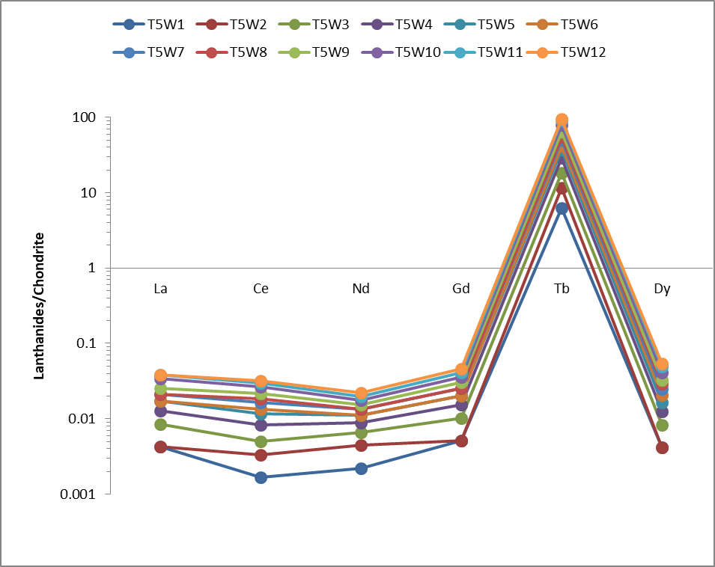
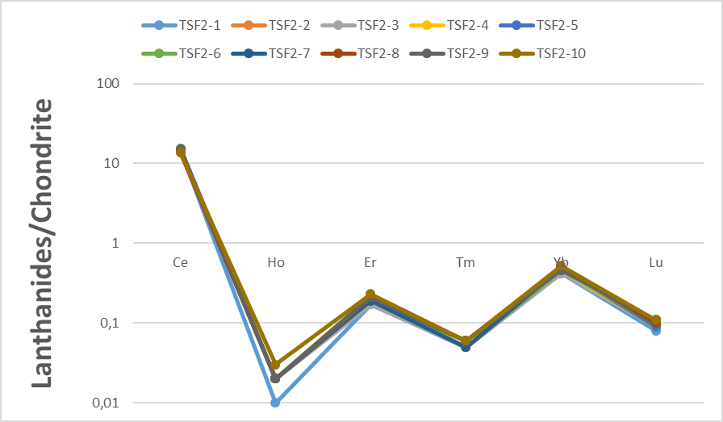
Investigation of the Rare Earth Elements Pattern for uranium attribution in nuclear forensics environment
Tebogo Gilbert Kupi¹², Manny Mathuthu¹, Danel van Tonder²
Center for Applied Radiation Science and Technology (CARST), North-West University, Mafikeng Campus, Mmabatho, 2735, South Africa
North-West University, Potchefstroom Campus, 11 Hofman Street, Potchefstroom 2531, South Africa
Abstract
Sample preparation
A total of 20 soil samples from two mine tailings representative of the gold mining area were collected with a hand corer at a depth of 5 cm and packaged in 4 kg polyethylene bags. Close attention were paid on sample preparation to avoid cross-contamination as is the major source of errors if not done properly. The collected samples were allowed to air dry for 2-3 days then heated in an electric oven at 110 degrees Celsius for up to 24 hours to remove moisture (Chen et al., 2002). The samples were then crushed and ground into small grain sizes using mortar and pestle. All the samples were then passed through a sieve of mesh size 2 mm to obtain a homogenous sample matrix (Sharma et al., 2007).
Later, approximately 0.5 g of sample were weight into a 75 mL microwave digestion vessel (PerkinElmer Titan MPS System) and 3 mL of concentrated HNO3, 9 mL of concentrated HCL were added. To achieve complete dissolution, samples were heated for 40 minutes at a maximum power of 100%.
Sample analysis
The Lanthanides pattern were measured on an Inductively Coupled Plasma Mass Spectrometer (ICP-MS) (PerkinElmer NexION 2000) which is equipped with a Quadrupole ion deflector that focuses the ion beam to the dual mode detector. In addition to being highly sensitive, the ICP-MS PerkinElmer NexION 2000 uses a helium gas collision system that greatly reduces the spectral interference caused by argon and chlorine. The Instrumental operating conditions and signal measurement settings are summarized in Table 1.
The major advantage to ICP-MS is sensitivity of the instrument. Before the start of the analysis the instrument were allowed to 30 minutes following plasma ignition to reach thermal stability. The instruments shown excellent precision as provided in Figure 1 and 2.
Figure 1: Lanthanides patterns of investigated soil samples obtained from South African uranium mine tilling.
Figure 2: Lanthanides patterns of investigated soil samples obtained from Namibia uranium mine tilling .
Discussion of results
Measurement of nuclear material is the backbone of the verification measurements in the nuclear forensics environment. Measurements can provide information on the uranium content, as well as uranium isotopic composition and the REE pattern in a given material. However, the measurements methods of nuclear material is an elaborate and time-consuming process. The measurements requires clean working environment to monitor the impurity levels that arise from any working procedure involved.
The aim of this study was to determine whether lanthanides patterns measured in a particular samples can be used to attribute the uranium sample to the production or reprocessing plant. For lanthanides pattern measurement, an 8 ppb solution of PerkinElmer Multi-Element Standard were measured for 3 number of replicates.
As a means of looking for variations or similarities in the measurements of South African and Namibia soil samples, Figure 1 and 2 shows very interesting results. The lanthanides pattern for the South African mine, the results shows the REEs exhibit heavy REE-enriched patterns with pronounced positive Tb anomaly when normalized to chondrite, while for Namibian mine the REEs results exhibit heavy REE-enriched patterns with pronounced positive and negative anomaly for Er and Yb as well as for Ho and Tm respectively when normalized to chondrite. These results confirm that, REE patterns used for origin location do reflect significant variation within mine and thus provide valuable information about the geochemical formation and origin. The difference of both results is distinct and shows is possible to distinguish South Africa and Namibia samples from different sources.
The South African results are similar to those obtained by Khumalo and Mathuthu (Khumalo and Mathuthu, 2018). These results support and strengthen national nuclear security in deterring theft of nuclear material by nuclear terrorist for non-peaceful purposes within the country, as South Africa seek to develop and establish a national nuclear forensic library.
It is recommended that comprehensive sampling to include the full cycle of any nuclear material (cradle to grave and mining to waste characterization) be undertaken to give the full view of the forensics signatures in different stage of the nuclear fuel cycle. However, this study has clearly demonstrated that the nuclear forensics signatures from the gold/uranium mine can be distinguished using isotopic profiles and lanthanides pattern.
Table 1: Nexion 2000 ICP-MS instrumental operating conditions (Kupi TG et al., 2020).
Conclusion
Illicit trafficking of radioactive material and especially nuclear material (thorium, uranium, and plutonium) has been an issue of concern since the beginning of the 1990s, when the ﬁrst seizures of nuclear material were reported to the International Atomic Energy Agency. In this work, twenty samples selected for investigation originate from South Africa and Namibia uranium mines. The aim of this study was to determine whether lanthanides patterns measured in a particular samples can be used to attribute the uranium sample to the production or reprocessing plant. Measurements were carried out using an inductively coupled plasma mass spectrometer (ICP-MS) PerkinElmer NexION 2000. The lanthanides pattern for the South African mine shows the REEs exhibit heavy REE-enriched patterns with pronounced positive Tb anomaly when normalized to chondrite, while for Namibian mine the REEs results exhibit heavy REE-enriched patterns with pronounced positive and negative anomaly for Er and Yb as well as for Ho and Tm respectively when normalized to chondrite. These results confirm that lanthanides patterns used for origin location do reflect significant variation within mine and thus provide valuable information about the geochemical formation and origin.
The summary of all the results described in this work is that, the use of ICP-MS technique alone for nuclear forensics analysis is not sufficient on its own. Results must be verified against other techniques. However, this study clearly demonstrates that the nuclear forensics signatures (eg. REE pattern) from the gold/uranium mine shafts in South Africa and Namibia can be distinguished using their elemental and isotopic profiles. This will support and strengthen national nuclear security in deterring theft of nuclear material by nuclear terrorist for non-peaceful purposes within South Africa.
Acknowledgements
Authors would like to acknowledge the International Atomic Energy Agency (IAEA) for sponsoring this Project under CRP J02013, (IAEA Research Contract No: 23100/R0).
Appreciation also goes to the North-West University’s Centre for Applied Radiation Science and Technology (CARST) for financial support to attend and present some part of this work at the SAIP2021 conference held at North-West University, Potchefstroom, South Africa, 26th–30th July 2021.
Finally, we acknowledge the National Research Fund (NRF) for funding the purchase of newly installed NexION 2000 ICP-MS (PerkinElmer Inc., Connecticut, USA) at North-West University’s Centre for Applied Radiation Science and Technology. Opinions expressed and conclusions arrived at, are those of the author and are not necessarily to be attributed to the NRF.
Worldwide, nuclear and radioactive materials are used daily for beneficial purposes, in industry, medicine, agriculture and research. However, the use of nuclear and radioactive material generates some risk due to radiation being emitted, which is harmful to human health especially if they enter the human body even at low levels (i.e. microgram amounts) (Aggarwal, 2016). The main security concerns relating to their use, are perceived ease of access to them, the culture of personnel responsible for managing the material, and the potential for theft and construction of radiological dispersive devices (RDDs) also referred to as “dirty” bombs (IAEA, 2007, Hutcheon et al., 2013). Applying Nuclear Forensics as a fingerprinting tool to compare with reference data allows the researcher to determine the origin, the intended use, the last legal owner and the smuggling route of the nuclear or radioactive material (Mathuthu and Khumalo, 2018). This makes Nuclear Forensics to be a key element of Nuclear Security.
In South Africa, the Nuclear Forensics efforts are still in a developing stage. In nuclear forensics, the lanthanide pattern aid as one of the parameters that contribute to “nuclear fingerprint” of the material and thereby provide a basis for drawing conclusions on the potential origin of the material. Nuclear fingerprinting refers to the determination of origin, mode of production from the composition of nuclear material (Jariwala, 2014). In the context of this work, fingerprinting would refer to the process of identifying signatures in the nuclear fuel cycle. Signatures are measurable attributes of nuclear fuel cycles (Borg and Hutcheon, 2013). Nuclear forensic analysis is a key technical capability that utilizes signatures inherent to nuclear or other radioactive material to provide information on its source, production and history (Stork et al., 2017), (Kristo et al., 2016). This study investigates the application of lanthanides pattern in nuclear forensics.
Background
References
Results
AGGARWAL, S. K. 2016. Nuclear forensics: what, why and how. Current Science.
APOSTOL, A., PANTELICA, A., SIMA, O. & FUGARU, V. 2016. Isotopic composition analysis and age dating of uranium samples by high resolution gamma ray spectrometry. Nuclear Instruments and Methods in Physics Research Section B: Beam Interactions with Materials and Atoms, 383, 103-108.
BORG, L. & HUTCHEON, I. 2013. Forensic Analysis of samples from the Nuclear Fuel Cycle. Lawrence Livermore National Laboratory (LLNL), Livermore, CA.
CHEN, D., YANG, C., HUANG, Z. & WANG, X. 2002. Using lead isotope ratios to distinguish between samples of the traditional Chinese medicine Dan-Shen. Note d’application Agilent.
DAHLKAMP, F. J. 2013. Uranium ore deposits, Springer Science & Business Media.
HUTCHEON, I. D., KRISTO, M. J. & KNIGHT, K. B. 2013. Nonproliferation nuclear forensics. Uranium: Cradle to Grave. Mineralogical Association of Canada, 377-394.
IAEA 2007. Combating Illicit Trafficking in Nuclear and other Radioactive Material, Vienna (Austria), International Atomic Energy Agency (IAEA).
JARIWALA, K. N. 2014. Nuclear Forensics-A Review.
KEEGAN, E., WALLENIUS, M., MAYER, K., VARGA, Z. & RASMUSSEN, G. 2012. Attribution of uranium ore concentrates using elemental and anionic data. Applied geochemistry, 27, 1600-1609.
KHUMALO, N. & MATHUTHU, M. 2018. Determination of trace elements and lanthanide (REE) signatures in uranium mine products in South Africa by means of inductively coupled plasma mass spectrometry. Journal of Geochemical Exploration, 186, 235-242.
KRISTO, M. J., GAFFNEY, A. M., MARKS, N., KNIGHT, K., CASSATA, W. S. & HUTCHEON, I. D. 2016. Nuclear Forensic Science: Analysis of Nuclear Material Out of Regulatory Control. Annual Review of Earth and Planetary Sciences, 44, 555-579.
KUPI TG, UUSHONA V, MATHUTHU M, COETZEE M, VAN TONDER D. 2020. Using lead isotope ratios to distinguish between samples of diffrent uranium mines, Journal of Radioanalytical and Nuclear Chemistry (IF1.371), DOI: 10.1007/s10967-020-07048-1
MARGUI, E., IGLESIAS, M., QUERALT, I. & HIDALGO, M. 2007. Precise and accurate determination of lead isotope ratios in mining wastes by ICP-QMS as a tool to identify their source. Talanta, 73, 700-709.
MATHUTHU, M. & KHUMALO, N. 2018. Determination of lead isotope ratios in uranium mine products in South Africa by means of inductively coupled plasma mass spectrometry. Journal of Radioanalytical and Nuclear Chemistry, 315, 1-12.
MOGAFE, P. R., KOKWANE, B., TSHIDADA, P., MATSHIGA, A. & HANCKE, J. J. 2015. South Africa’s Nuclear Forensics Response Plan Step 1 - in Support of Nuclear Security Investigations. Journal of Physical Science and Application, 5, 183-190.
NEA, I. 2006. Forty Years of Uranium Resources, Production and Demand in Perspective. The Red Book Retrospective, OECD Publishing.
SHARMA, R. K., AGRAWAL, M. & MARSHALL, F. 2007. Heavy metal contamination of soil and vegetables in suburban areas of Varanasi, India. Ecotoxicology and environmental safety, 66, 258-266.
STORK, C. L., UMMEL, C. C., STUART, D. S., BODILY, S. & GOLDBLUM, B. L. 2017. Dynamic analysis environment for nuclear forensic analyses. Computer Physics Communications, 210, 60-71.
ŠVEDKAUSKAITĖ-LE GORE, J. 2008. DEVELOPMENT AND VALIDATION OF A METHOD FOR ORIGIN DETERMINATION OF URANIUM-BEARING MATERIAL.
Samples
Samples selected for this study are soil samples collected from the uranium mines tailing. The soil from the mine tailing is part of the waste which form part of intermediate products in nuclear fuel cycle. The samples were collected from South African and Namibian uranium and gold mines.

