Slide 1
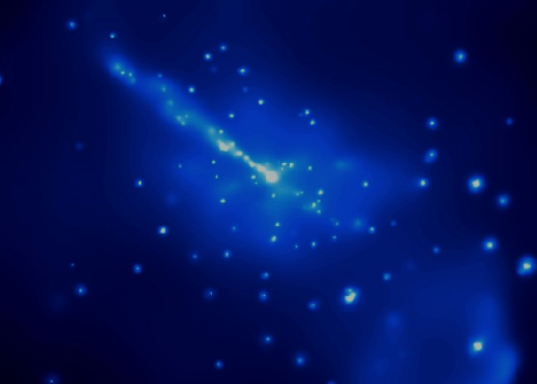



Modeling Blazar SEDs and Spectral Variability with Time-Dependent Diffusive Shock Acceleration:
Application to 1ES 1959+650 Observed with AstroSAT
0
Markus Böttcher
North-West University
Potchefstroom, South Africa
Matthew Baring (Rice University, Houston, TX, USA)
Sunil Chandra (NWU, Potchefstroom, South Africa + SAAO)
Based on Böttcher & Baring (2019): ApJ, 887, 133 (arXiv:1911.02834)
+ Chandra et al. (2021): ApJ, in press (arXiv:2105.08119)
Supported by the South African Research Chairs Initiative (SARChI) of the Department of Science and Technology and the National Research Foundation of South Africa.

Slide 2
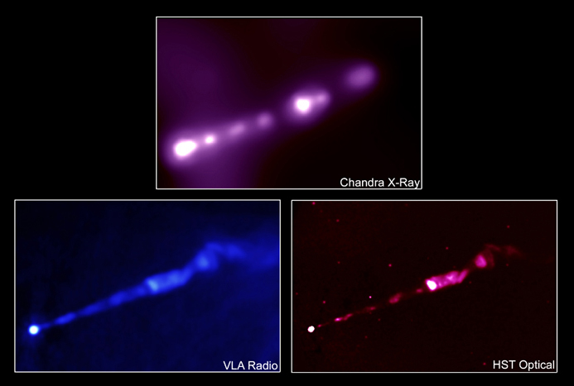
Relativistic Shocks in Jets
Γ_{b}
Γ_{a}
Internal Shocks: likely sites of relativistic particle acceleration.
Most likely mildly relativistic, βγ ~ 1
In most works: Simple power-law or log-parabola electron spectra (from Fermi I / II acceleration) assumed with spectral index (~ 2) put in “by hand”.
Jet of M87 at different wavelengths

Slide 3
Monte-Carlo Simulations of Diffusive Shock Acceleration (DSA)
Gyration in B-fields and diffusive transport (pitch-angle diffusion) modeled by a Monte Carlo technique.
Shock crossings produce net energy gains → first-order Fermi.
(Summerlin & Baring 2012)
Pitch-angle diffusion parameterized through a mean-free-path (λ_{pas}) parameter η (p):
λ_{pas} = η(p)*r_{g} ~ p^{α} (α ≥ 1)

Slide 4
Shock Acceleration Spectra
Particle spectra as hard as n(γ) ~ γ⁻¹ possible!
Baring et al. (2017)
Non-thermal particle spectral index and thermal-to-non-thermal normalization are strongly dependent on η₀, α, and B-field obliquity!

Slide 5
Constraints from Blazar SEDs
Synchrotron peak ↔ γ_{max}
Balance t_{acc} ~ η(γ) ω_{gyr}(γ)⁻¹
with radiative cooling time scale
If synchrotron cooling dominates:
γ_{max} ~ B^{-1/2} [η(γ_{max})]^{-1/2}
hν_{sy} ~ 100 δ [η(γ_{max})]⁻¹ MeV (independent of B-field!)

Slide 6
Constraints from Blazar SEDs
hν_{sy} ~ 100 δ [η(γ_{max})]⁻¹ MeV (independent of B-field!)
Need large η(γ_{max}) to obtain synchrotron peak in optical/UV/X-rays
But: Need moderate η(γ ~ 1) for efficient injection of particles into the non-thermal accelerations scheme
Need strongly energy dependent pitch-angle scattering m.f.p., with α > 1 (Baring et al. 2017)
Probably indicative of high-energy particles probing larger volumes, away from the shock.

Slide 7
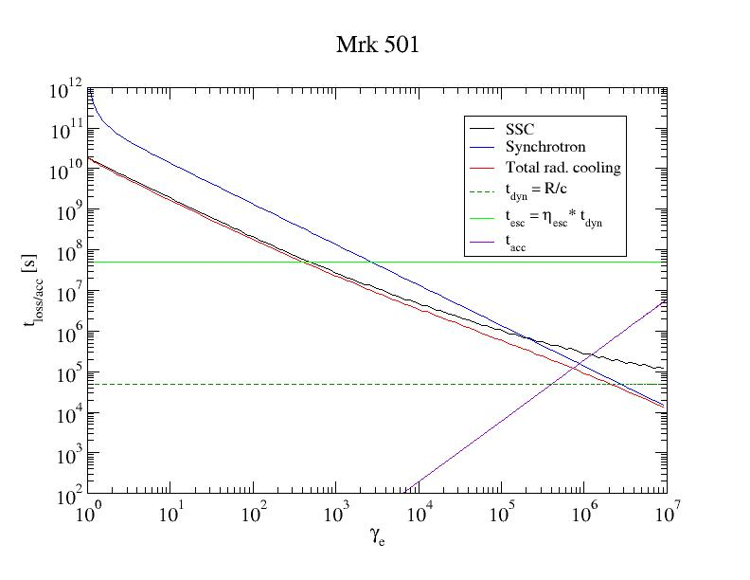
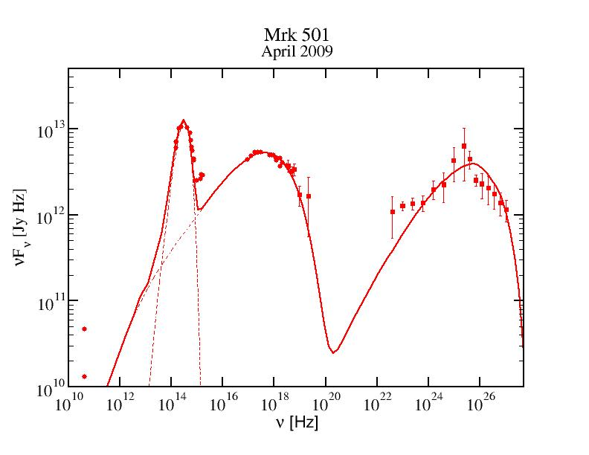
Electron Evolution Time Scales

Slide 8
Time-Dependent Electron Evolution with Radiative Energy Losses
Acceleration time scale:
For almost all electrons
Use shock-accelerated electron spectrum as instantaneous injection Q_{e}(γ);
Solve Fokker-Planck Equation for electrons:
∂n_{e} (γ,t)
.
______
∂
__
n_{e} (γ,t)
______
= - (γ n_{e}) + Q_{e} (γ,t) -
∂t
∂γ
t_{esc,e}

Slide 9
Numerical Scheme
Injection spectra from turbulence characteristics + MC simulations of DSA
Injection from small acceleration zone (shock) into larger radiation zone
Time-dependent leptonic code based on Böttcher & Chiang (2002)
Radiative processes:
  Synchrotron
  Synchrotron self-Compton (SSC)
  External Compton (EC: dust torus + BLR + direct accretion disk)
L’
Shock injection “on” for
0 < Δt’ < L’/v’_{s}
Γ
β_{s}
Q_{e,s}(γ,t’) = Q_{e,s}(γ) H(t’; 0, Δt’)

Slide 10
Example: HBL 1ES 1959+650
Prototypical HSP BL Lac object at z = 0.048
Observed with AstroSAT during flaring states in 2 long (144 ksec) observations in 2016 and 2017
2016
2017
(Chandra et al. 2021)

Slide 11
Example: HBL 1ES 1959+650
Pronounced spectral variability (harder when brighter)
Log-parabolic spectral fits: F_{E} ~ E^{-(α + βlog[E/E0])}
(Chandra et al. 2021)

Slide 12
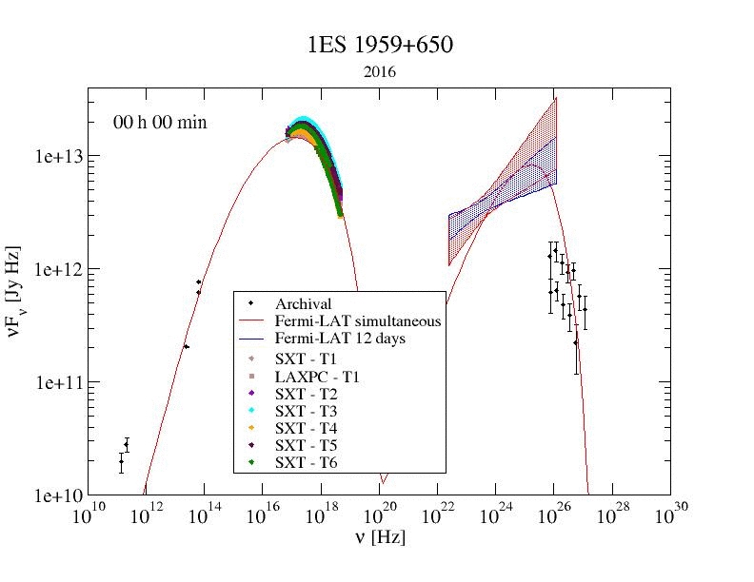
1ES 1959+650 in 2016
Complex variability patterns require passage of multiple shocks.
λ_{pas} = 60 r_{g} γ^{0.9}
η₁ = 60
α = 1.9
B = 0.15 G
δ = 20
R = 6*10¹⁵ cm
-> Δt’ ~ 2*10⁵ s
-> Δt_{obs} ~ 2.8 h
Flaring caused by
increasing L_{inj}
decreasing η₀
(Chandra et al. 2021)

Slide 13
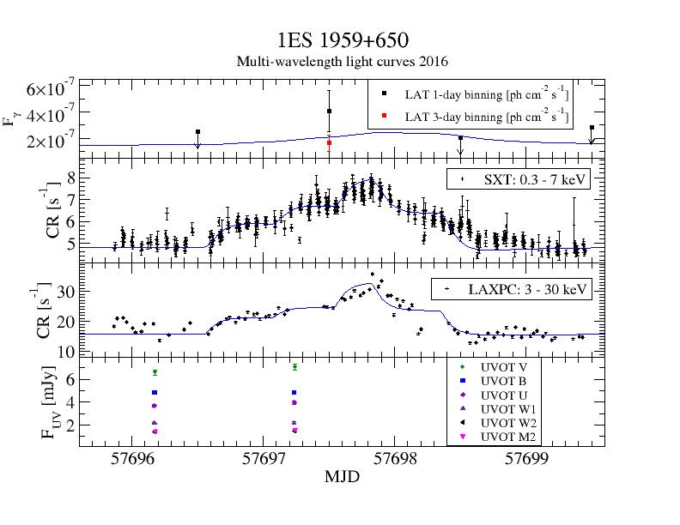
2016: MWL Light Curves
1
2
3
4
(Chandra et al. 2021)

Slide 14
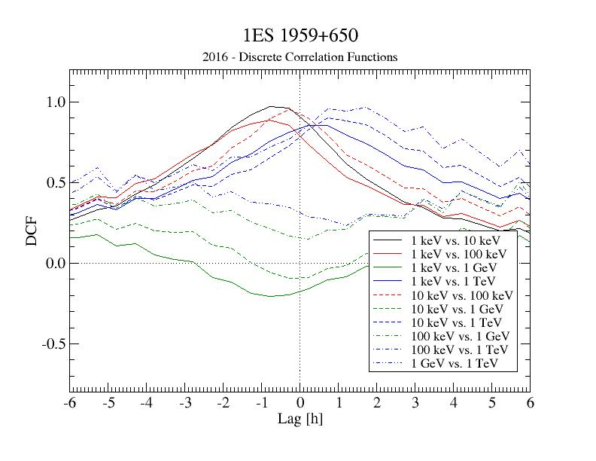
2016: Discrete Correlation Functions
Strong correlations between X-rays and VHE γ-rays
Soft X-ray lags of ~ 1 hour behind hard X-rays and VHE γ-rays.
(Chandra et al. 2021)

Slide 15
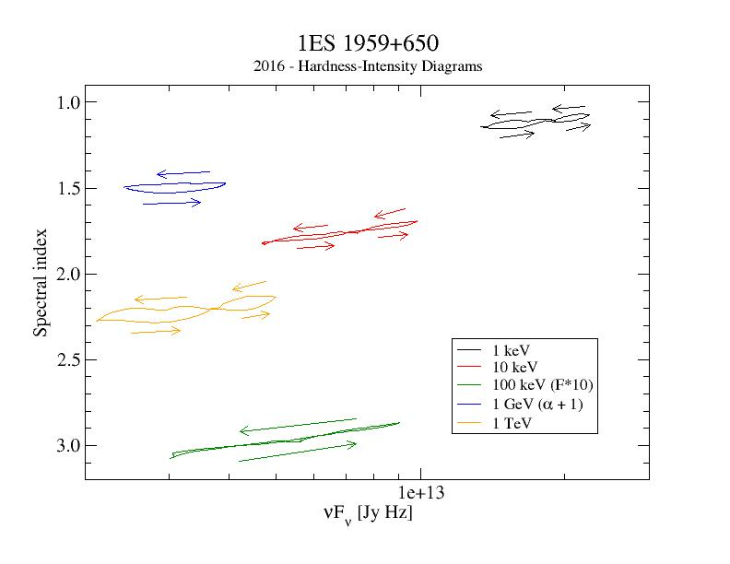
2016: Hardness-Intensity Diagrams
Harder-when-brighter trend without significant spectral hysteresis is well reproduced.
(Chandra et al. 2021)

Slide 16
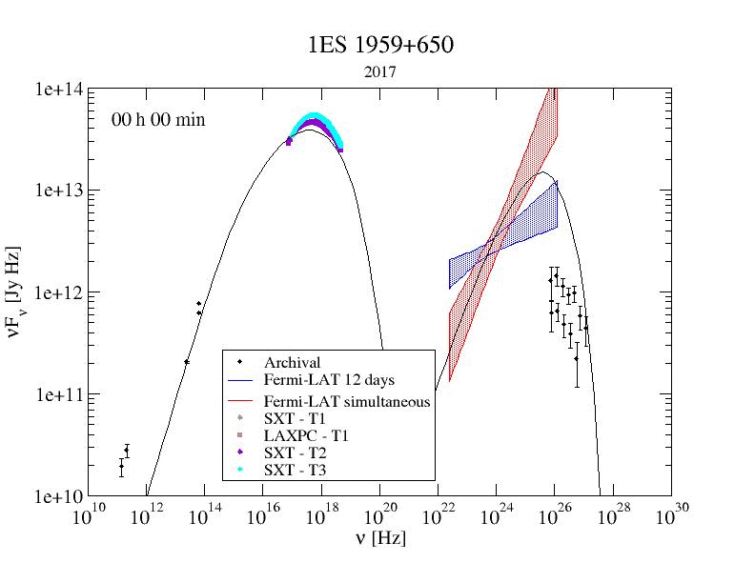
1ES 1959+650 in 2017
Higher flux state well reproduced by changing Doppler factor (smaller viewing angle θ_{obs}: 2.87º → 2.34º)
λ_{pas} = 40 r_{g} γ^{0.8}
η₁ = 40
α = 1.8
B = 0.08 G
δ = 24
R = 10¹⁶ cm
-> Δt’ ~ 3*10⁵ s
-> Δt_{obs} ~ 3.9 h
Flaring caused by
increasing L_{inj}
decreasing η₀
decreasing α
(Chandra et al. 2021)

Slide 17
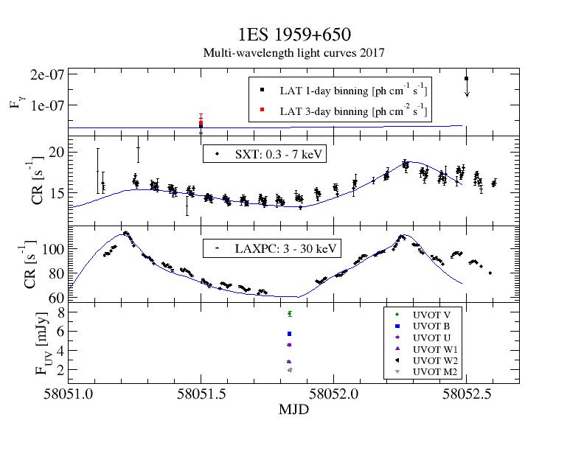
2017: MWL Light Curves
5
1
2
3
4
(Chandra et al. 2021)

Slide 18
Summary
0
Coupled MC Simulations of Diffusive Shock Acceleration and radiation transport reveal strongly energy-dependent mean-free-path to pitch-angle scattering.
Time-dependent simulations of shock-in-jet model with realistic particle injection from diffusive shock acceleration, applied to long AstroSAT + MWL observations of 1ES 1959+650 in 2016 and 2017:
Flares with harder-when-brighter trend (no significant spectral hysteresis) well reproduced by decreasing pitch-angle-scattering mean-free path → increased turbulence levels induced by shock passage.
Supported by the South African Research Chairs Initiative (SARChI) of the Department of Science and Technology and the National Research Foundation of South Africa.

Slide 19
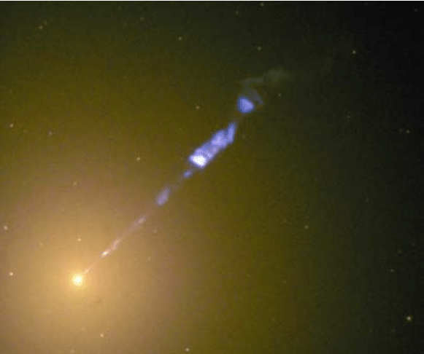
Thank you!
Based on Böttcher & Baring (2019): ApJ, 887, 133 (arXiv:1911.02834)
+ Chandra et al. (2021): ApJ, in press (arXiv:2105.08119)
Any opinion, finding and conclusion or recommendation expressed in this material is that of the authors and the NRF does not accept any liability in this regard.

Slide 20
Backup

Slide 21
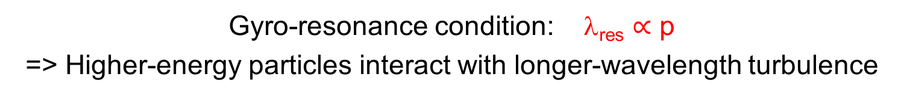
Implications for Shock-Induced Turbulence
Gyro-resonance condition: λ_{res} $∝$ p
=> Higher-energy particles interact with longer-wavelength turbulence
Stirring Scale ~ R
Inertial Range
Energy density W(k)
Dissipation Scale
k_{stir} ~ 2π/R
k = 2π/λ
Turbulence level decreasing with increasing distance from the shock
High-energy (large r_{g}) particles “see” reduced turbulence
Large λ_{pas}

