Slide 1
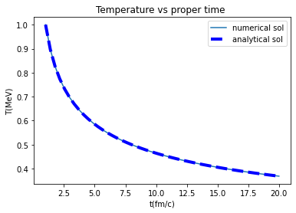
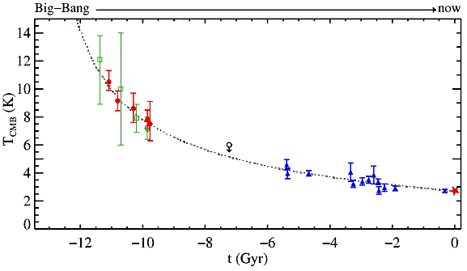
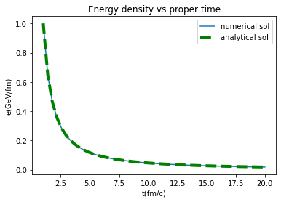
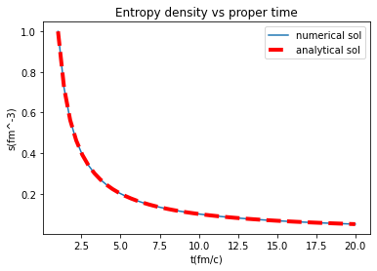



Bjorken Hydrodynamics for high energy nuclear collisions
MM Seabi (UWC), M Phakoe (UWC), R Nemalili (WITS), B Ramogayana(UL)
Tutors: Dr R Netshikweta (UNIVEN) and Dr M. Younus (UFSM)
Supervisor: Prof. Azwinndini Muronga (NMU)
Introduction
Methodology
Results
.
.
Here, we study the time evolution of thermodynamic variables during the heavy ion collision.
Our system resembles that of early universe just after the big bang.
At relatively high temperature the collisions of highly relativistic nuclei gives the possibility of generating quark-gluon matter.
We simulate a system of mass-less quarks and gluons.
Since the main objective of the study was to understand some of the properties of nuclear matter under extreme conditions through heavy ion collisions using Bjorken hydrodynamics model [2], this was achieved:
firstly, by deriving and understanding both non- relativistic and relativistic equation, followed by some derivations of energy density, entropy density, and temperature against proper time [3].
numerical simulations of energy density, entropy density, and temperature against proper time were also conducted with the aim of investigating their respectively status just after high relativistic energy collision.
the derived analytical and numerical solutions of energy density, entropy density and temperature were then plotted against proper time using python language.
$$\frac{T}{T_{0}}={{(τ}_{0}/τ)}^{\frac{1}{3}}$$
$T_{0}=1$, and $τ_{0}=1$
Hubble expansion[4]
$$\frac{ε}{ε_{0}}={\left(\frac{τ_{0}}{τ}\right)}^{\frac{4}{3}}$$
$$\frac{s}{s_{0}}=\frac{τ_{0}}{τ}$$
$ε_{0}=1$, and $τ_{0}=1$
$s_{0}=1$, and $τ_{0}=1$
Space-time diagram of longitudinal evolution of quark-gluon plasma [1]
Python script
Conclusion
Credit: Dirk Rische
J.D Bjorken, Phys. Rev. D 27, 140 (1983).
Fluid Mechanics book by Landau and LIfshitz, Vol.6, 2nd Edition.
The hubble expansion, viewed 26 July 2021, https://physics.stackexchange.com/questions/76241/cmbr-temperature-over-time
This research was made possible through NITheP/NITheCS Program, and we would like to thank Mrs René Kotze for all the logistical support.
Many thanks from the above-mentioned authors to Prof Azwinndini Muronga and our tutors.
References
At the collision region the energy is at its maximum, and the energy density as a function of proper time decreases when the system expand into freeze-out zone.
The entropy density of the system decreases as a function of proper time.
The temperature decreases as the system cools down.
The time evolution of the temperature of heavy ion collision resembles that of the early universe.
Acknowledgements

