Slide 1
Reactor simulation and design
The Necsa OSCAR-5 system and its application to reactor analysis
Necsa, South Africa
Date: Nov 2019
Rian Prinsloo
HEAD: OSCAR development team

Slide 2
Outline
Necsa R&TD/RRT section background
OSCAR-5 system and features
OSCAR-5 application and reactor database
Latest developments

Slide 3
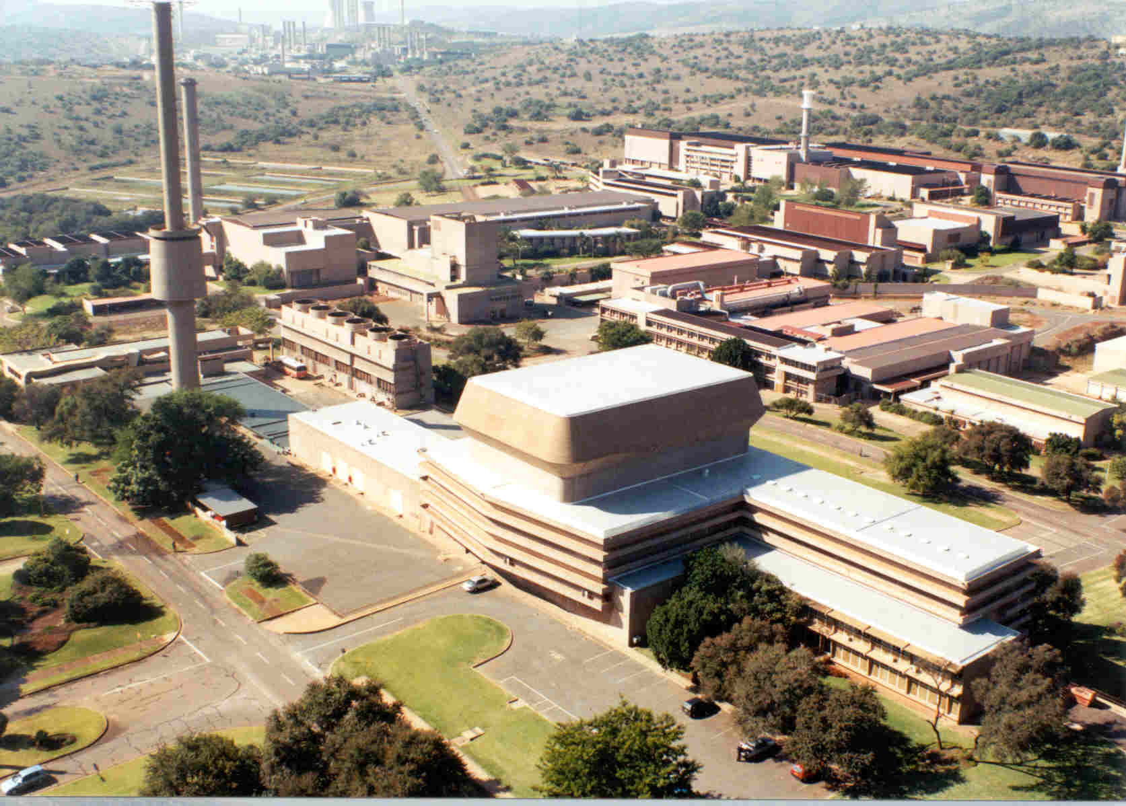
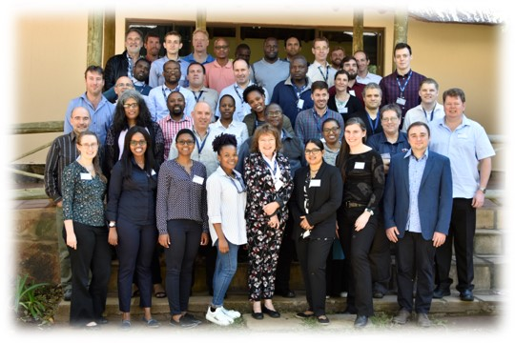
Background
Major analyses activities
In-house calculational system development
OSCAR - High fidelity, multi-physics reactor modelling
SAFARI-1 and NTP calculational support
Structure of the RRT section
RRT (Radiation and Reactor Theory section)
Establishment and growth of RR, LWR and SMR modelling capabilities
Radiation and Reactor Analysis (RRA) – analysis services
Reactor analysis, radiation shielding, material activation, criticality, isotope production and thermal-hydraulics calculations
Reactor modelling activities
Multiple international projects on reactor calculational validation (IAEA CRPs, OECD/NEA, etc.)
Active client base of international research reactors
Method and Code Development (MACD) – OSCAR product
Active research into new codes, modelling and numerical methods
20+ years experience in calculational support to research reactor operation
External analysis support to various local and international clients
Ongoing expansion of OSCAR capabilities toward LWR and SMR modelling

Slide 4
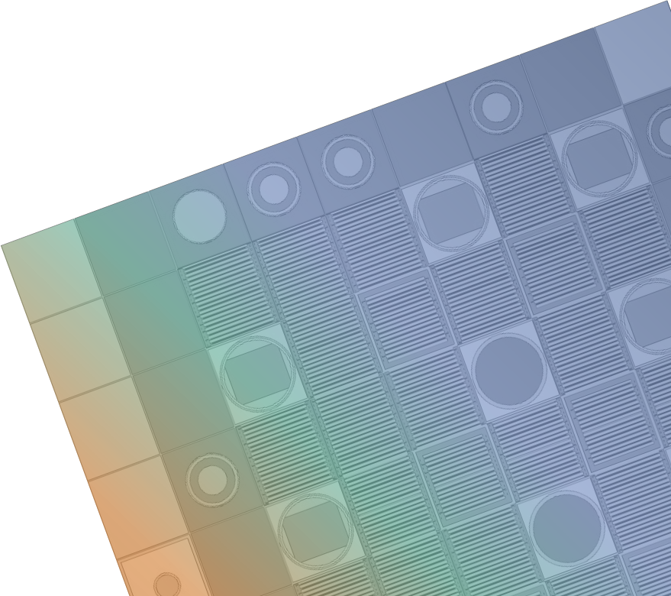
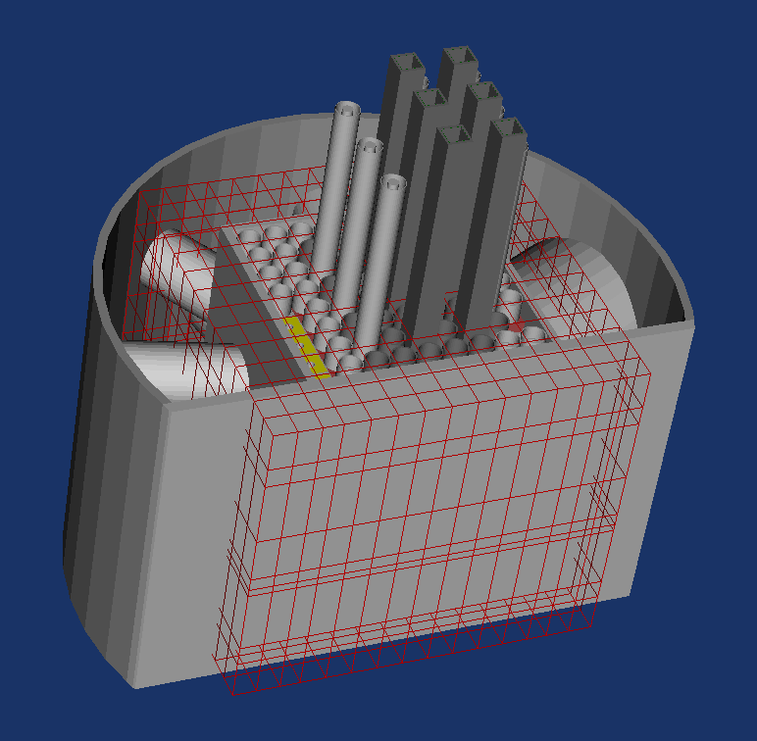
OSCAR-5
OSCAR-5 Characteristics
Client usage and expansion
NRG (Dutch HFR reactor),
Multi-code, full reactor operational support calculational system
What is OSCAR
OSCAR represents both a commerical industry support product and critical piece of research infrastructure (50+ MSc’s, 10+ PhD’s, hundreds of publications over 25 years)
Development / collaboration partners
ISS (RELAP) developers
OSCAR-5 is an advanced multi-physics, high fidelity research reactor modelling system (April 2019 release)
Unified model philosophy with multi-code support
Core design, core-follow, core-optimization, safety analysis, isotope production support
Encompass in-house and external codes as solver options
Studsvik (Swedish R2 reactor),
TU-Delft (Dutch HOR reactor)
McMaster University (Canadian MNR reactor)
PALLAS company (New Dutch reactor design company)
Collaboration agreements in draft with NCSU (Pulstar), ANSTO (OPAL)
INVAP (CONDOR) developers
MTECH (FLOWNEX) developers
NCSU (COBRA-TF) developers
COMPUSIM (Nodal solver) developers
Various SA universities (NWU, UP, UJ)
Spans neutronics, thermal-hydraulics, core depletion (steady state and time-dependent)
CEA/TA – benchmarking RR codes
Support for research reactor, light water reactor and high-temperature reactor analysis
Necsa (SAFARI-1 reactor)

Slide 5
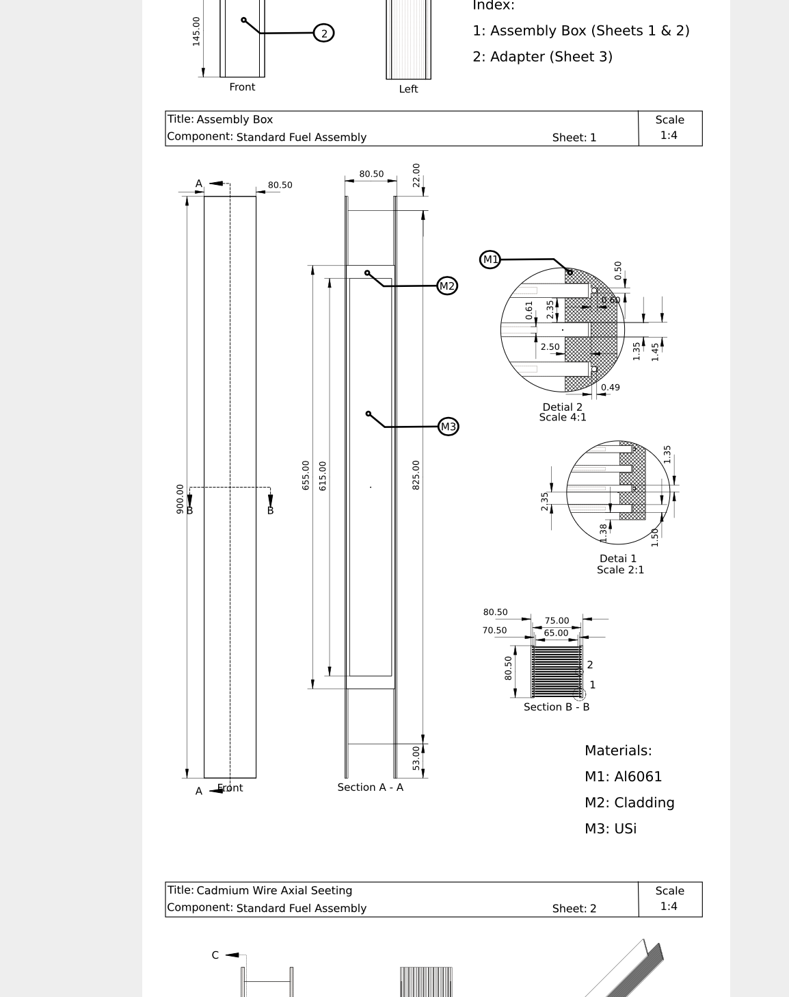
Features
OSCAR-5 Components
OSCAR-5 reactor model database
Set of extensive reactor models for various international benchmarks part of package
Ships with in-house state-of-the art OSCAR nodal solver – MGRAC (analysis is seconds)
OSCAR-5 motivation
Improve and accelerate model building (customizable macros for components)
Integrated V&V with in-built error bound estimation
Support for modern reactor designs via customizable model macros (RR, LWR and SMR).
Support for modern computing architectures
Integrated support for MCNP and Serpent (analysis in hours to days)
Includes a database of reactor models for V&V, training and capability demonstration
Auto-generation of documentation of model and analysis documentation
Novel “Compose” system for auto-mated nodal model development
Fit-for-purpose code selection (fidelity, accuracy and performance as user choice)
SAFARI-1, OPAL, MNR, INR, ETRR-2, IRR, IPEN, BEAVRS, WATTSBAR, MHTGR-350, HTR-10
Represents wide array of research reactor designs, components and philosophies
Benchmarks include experimental data and calculated comparisons for supporting V&V
Extensive html/pdf user guide, theory manuals, tutorials and GUI based help system.
Does not include client reactors, but experience vested from HFR, HOR, R2, PALLAS support
Database a valuable asset in conceptual design and requirement spec development
Various triso-particle and pebble dispersion models for SMR/HTR core designs

Slide 6
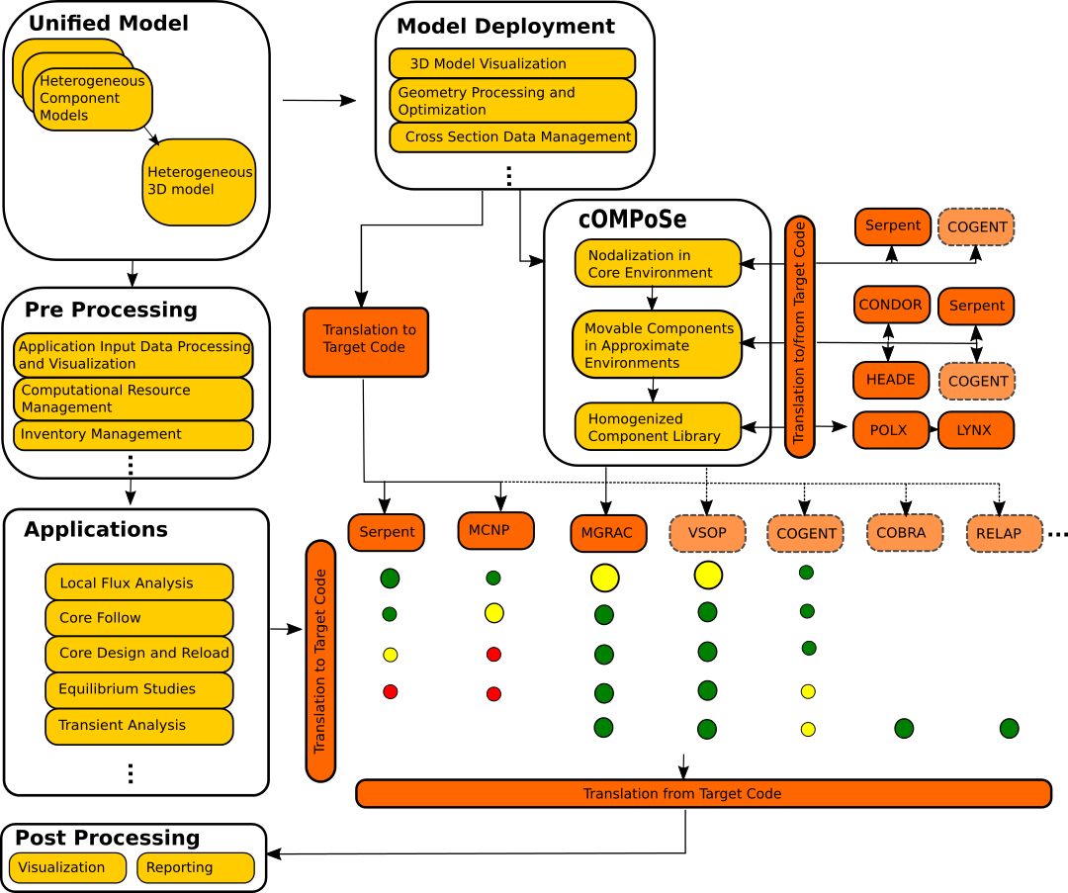
System design

Slide 7
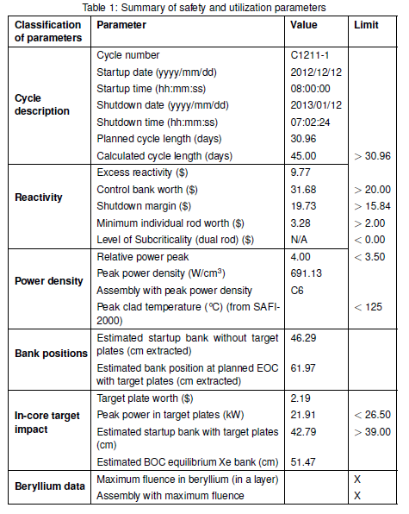
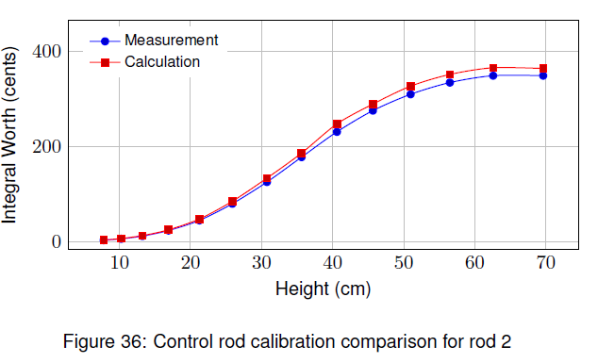
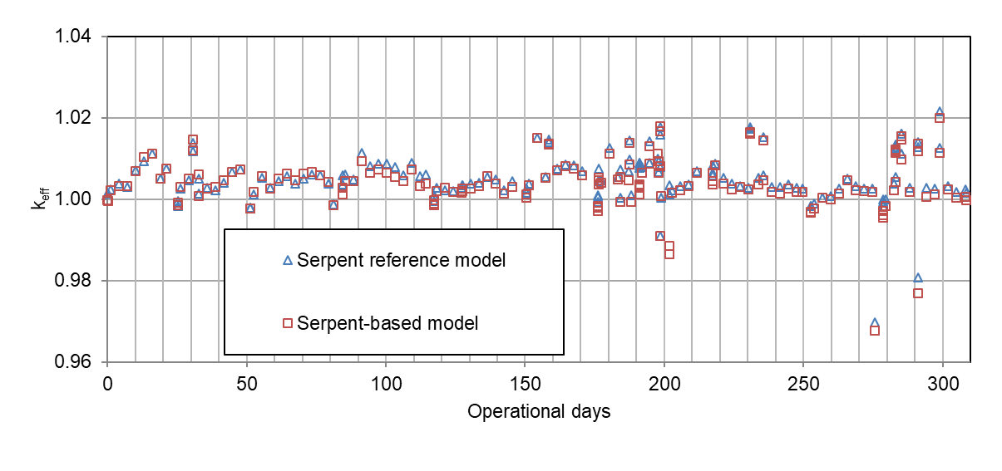
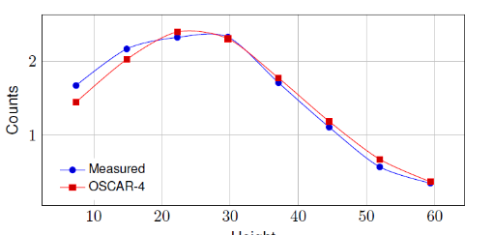
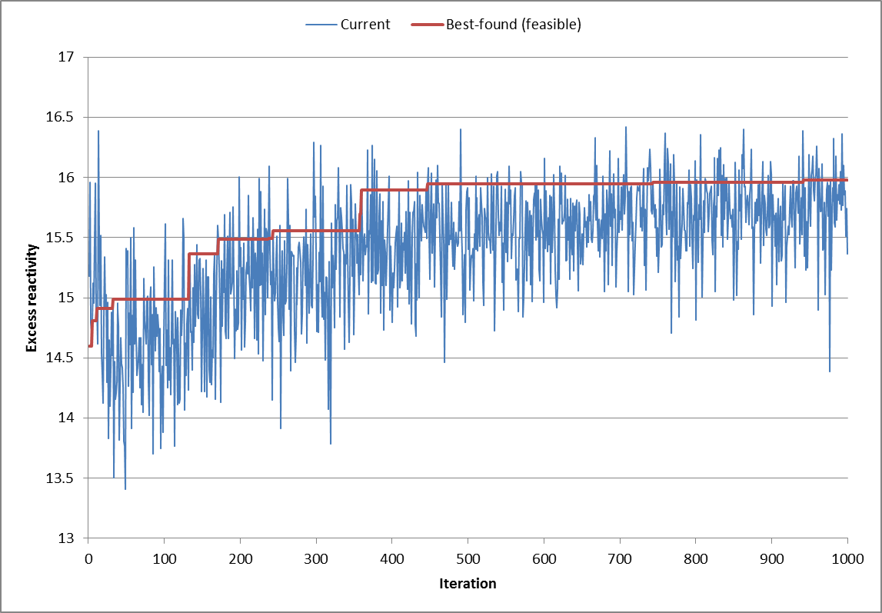
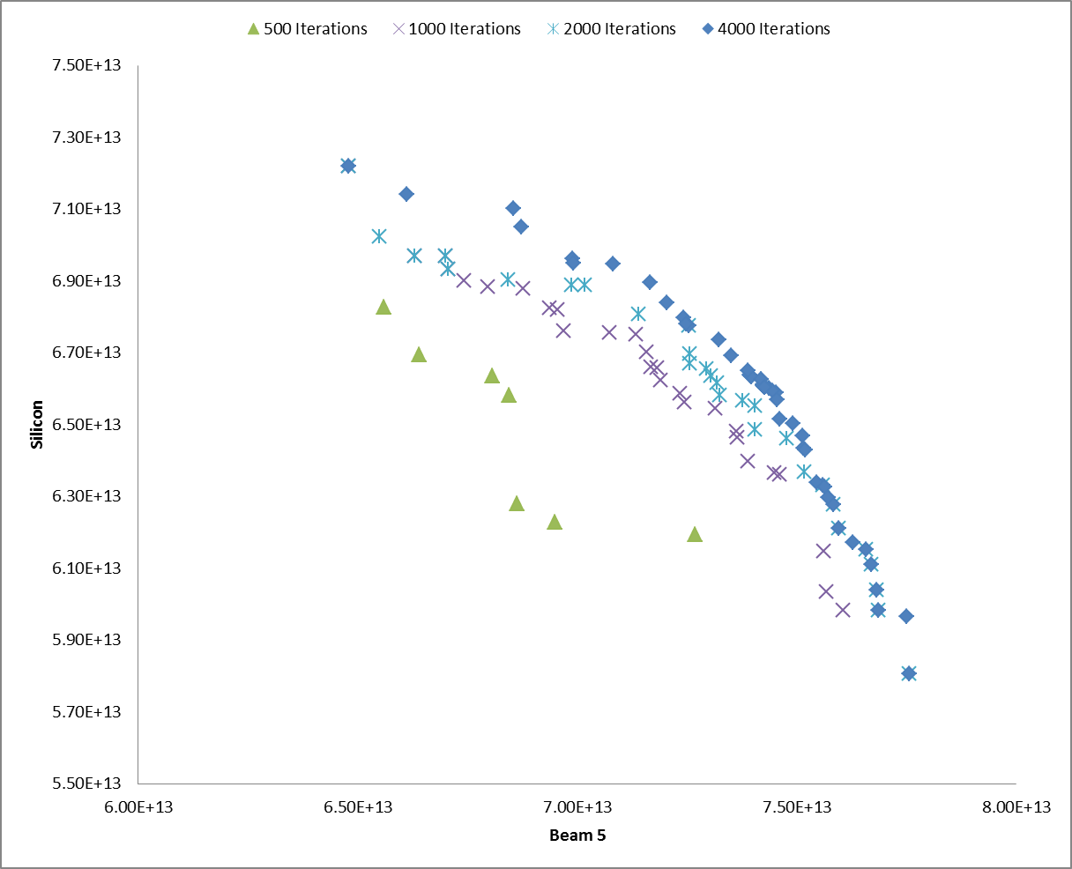
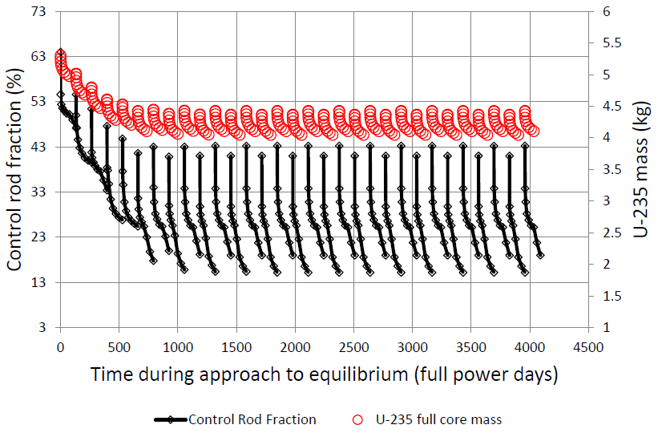
Applications
CORE-FOLLOW
DESIGN
EQUILIBRIUM
OPTIMIZATION

Slide 8
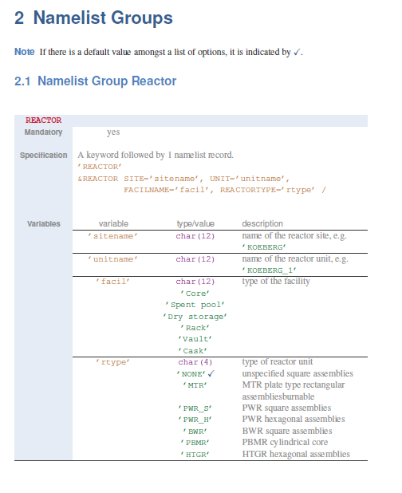
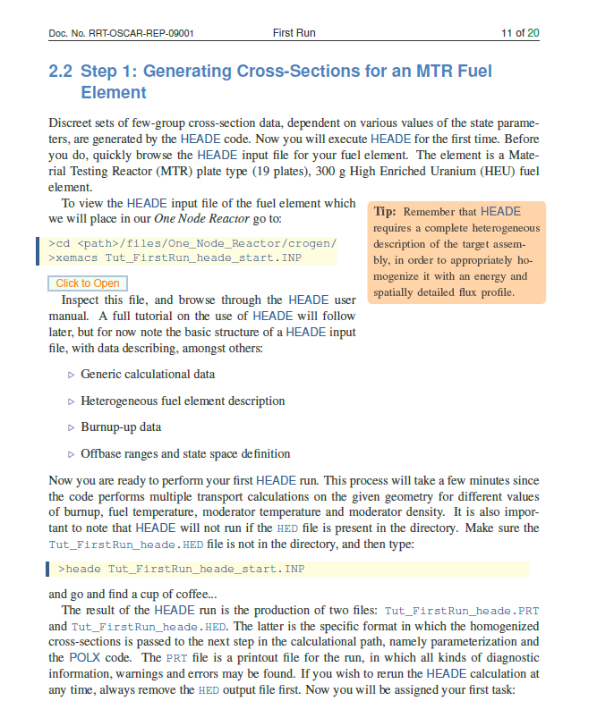
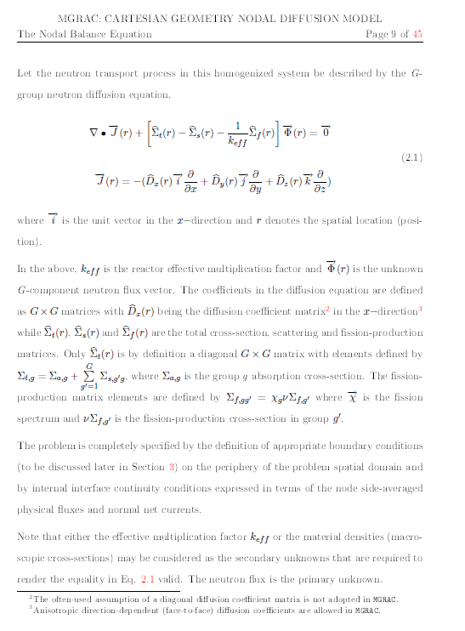
Documentation
User documentation, hands-on tutorials, code manuals, theory manuals and auto-generated model and result documentation

Slide 9
Reactor database
Reactor model database provides spread in:
Core design
Fuel design
Particle dispersion
Control design
Reflector choice
Burnable poison usage
Moderator choice
Power level
Burnup levels
Enrichment
Reactor applications
Client models cannot be shared, but adds to modelling experience
SAFARI-1
ETRR2
OPAL
INR
MNR
IRR
BEAVRS
MHTGR-350
IPEN
WATTSBAR
HTR-10
AMR

Slide 10
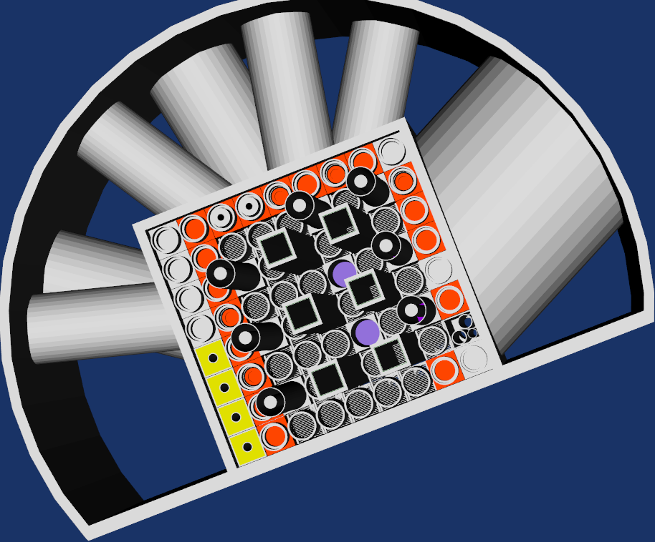
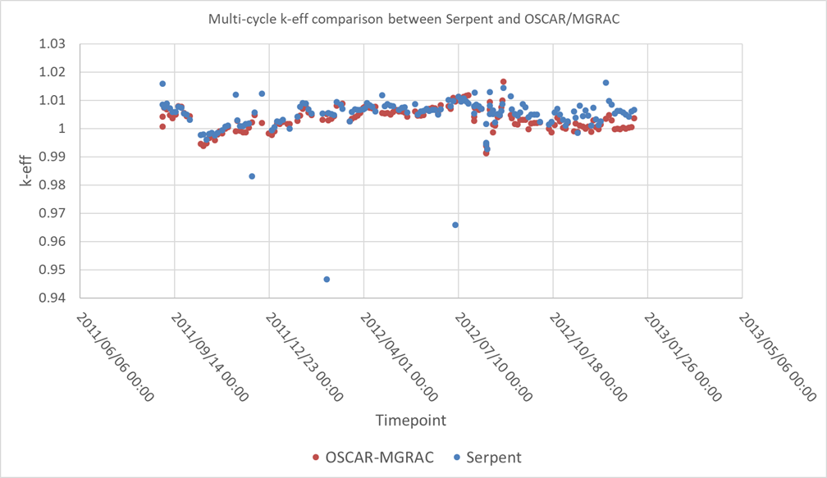
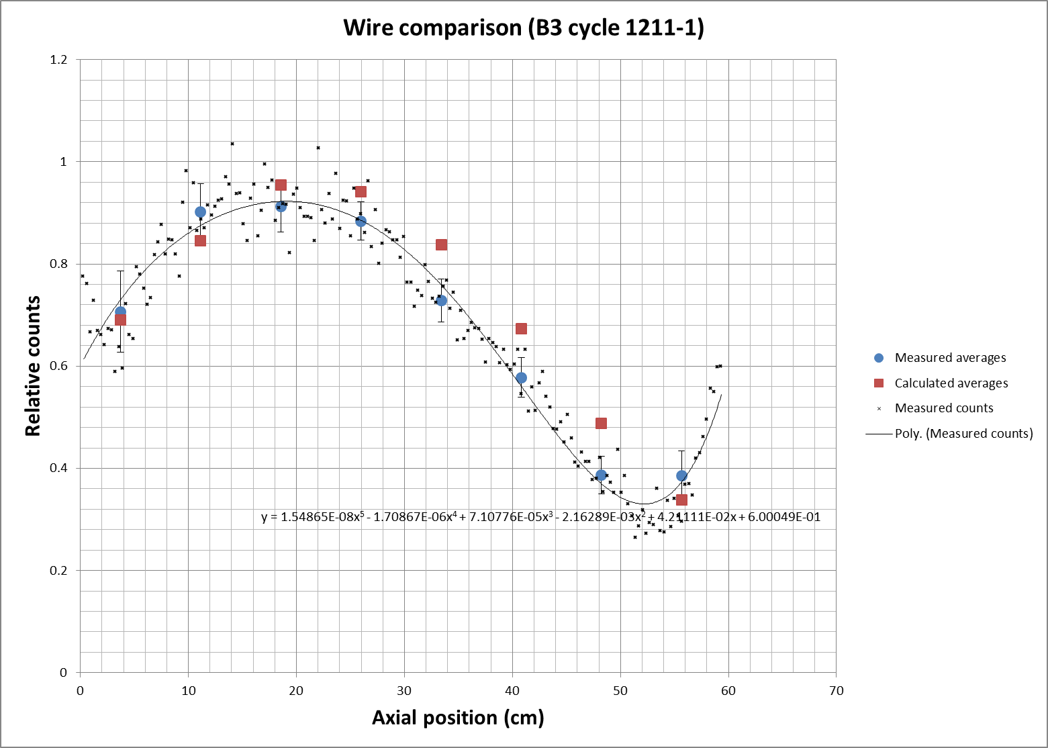
SAFARI-1
20 MW tank in pool, cooled and moderated by light water
Fuel follower type control elements
Reflected by beryllium elements
Benchmark includes multi-cycle irradiation history, various experiments (copper wires, control rod calibrations), estimate of the beryllium poison effect.

Slide 11
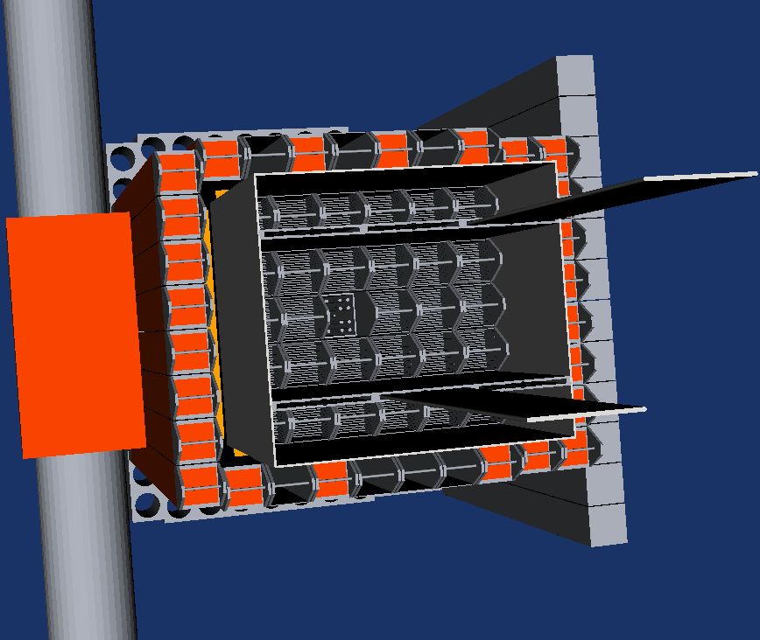
ETRR2
22 MW open pool, cooled and moderated by light water
Blade type control elements
Reflected by beryllium elements
Benchmark includes startup experiments, and fuel element burnup measurements.

Slide 12
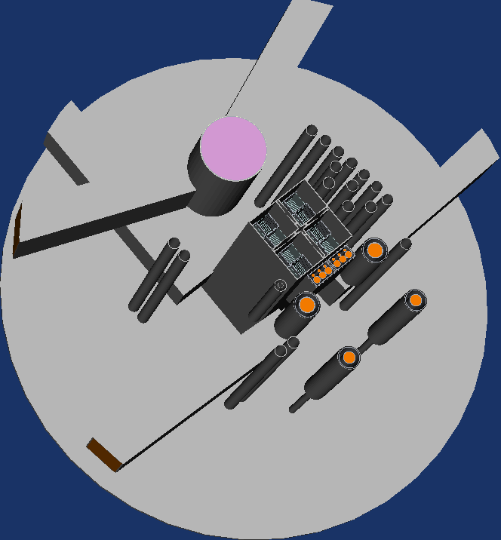
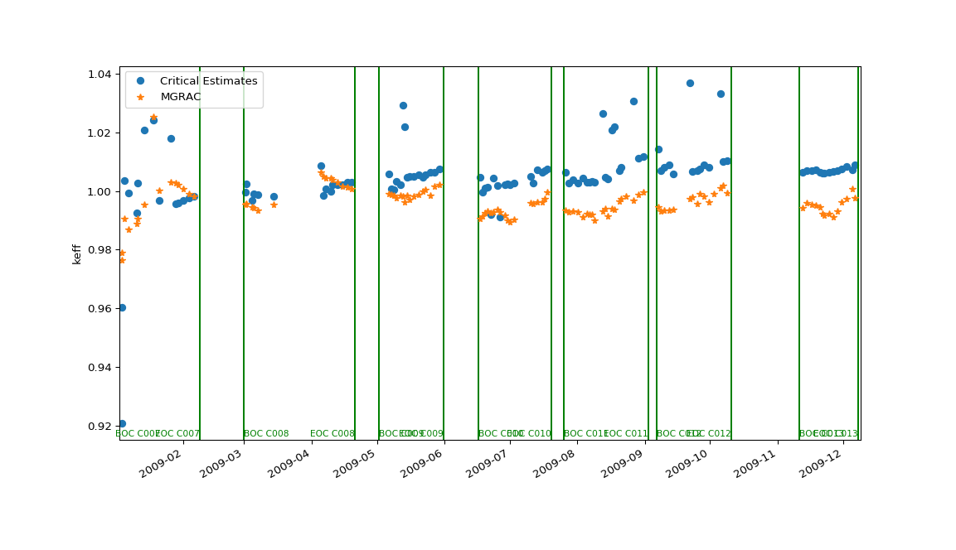
OPAL
20 MW open pool, cooled and moderated by light water
Blade type control elements
Reflected by heavy water
Benchmark includes startup experiments, multi-cycle operational data, and material activation measurements.

Slide 13
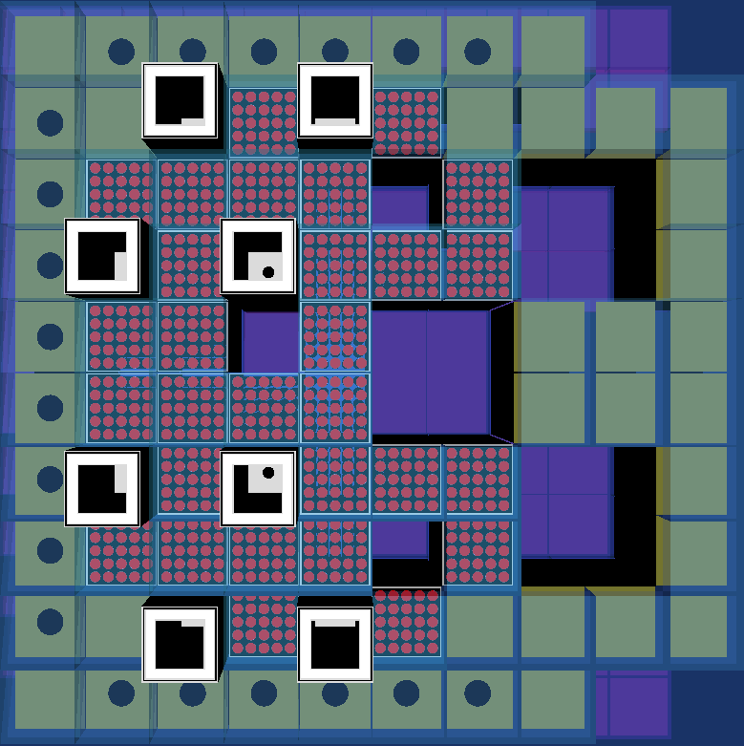
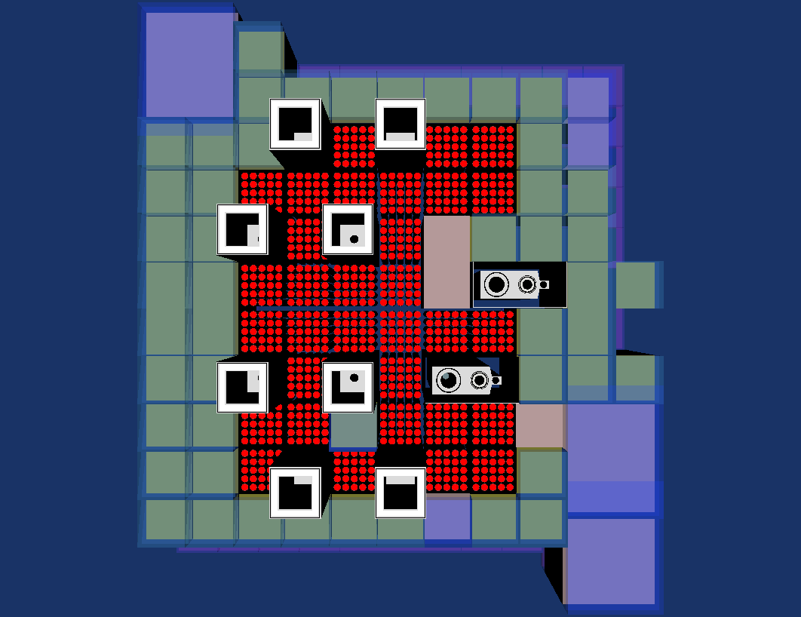
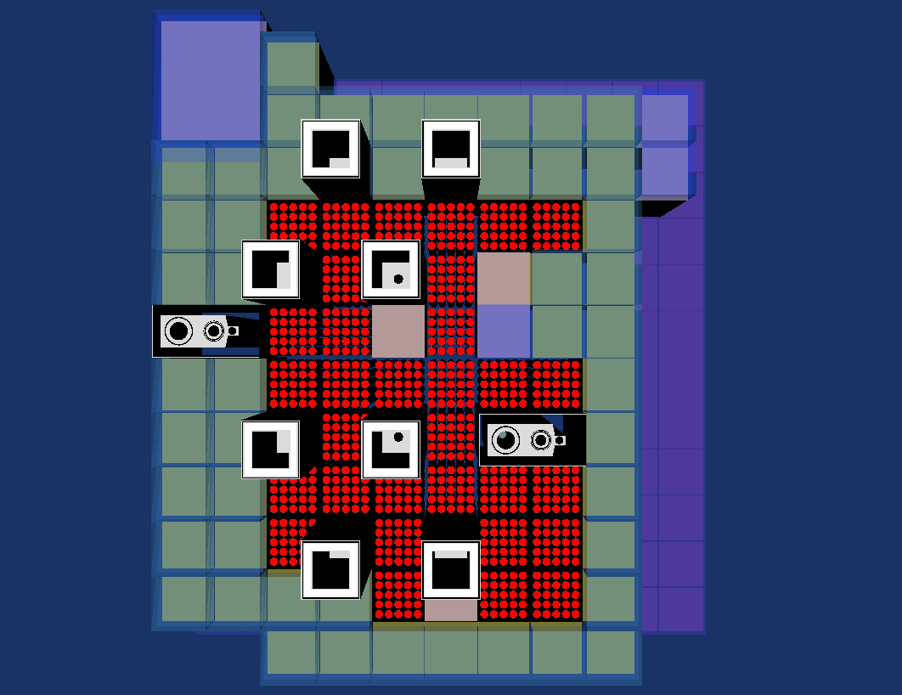
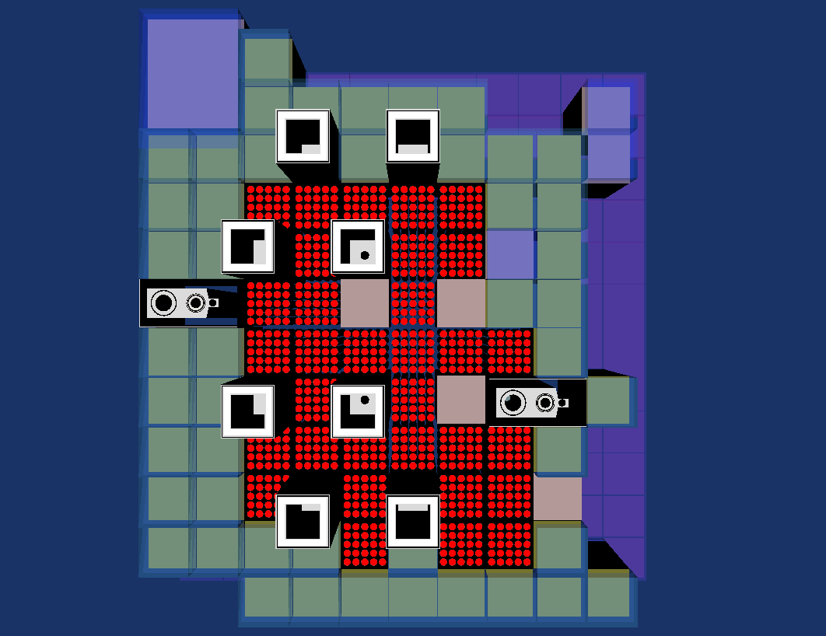
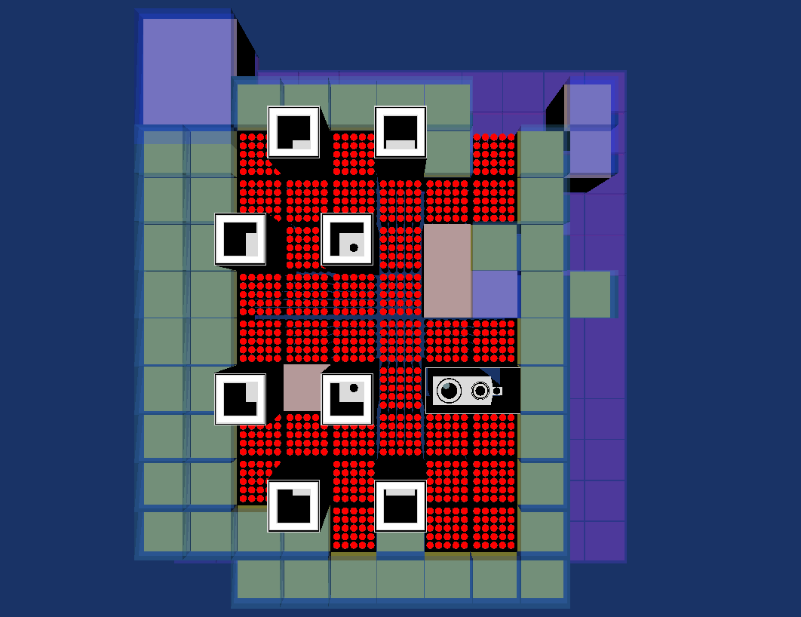
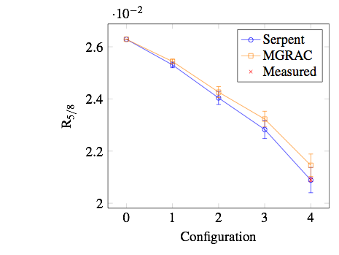
INR
TRIGA pin type 14MW open pool, cooled and moderated by light water
B4C control elements
Reflected by beryllium
Benchmark involves the activation of a tests fuel element
Experiments

Slide 14
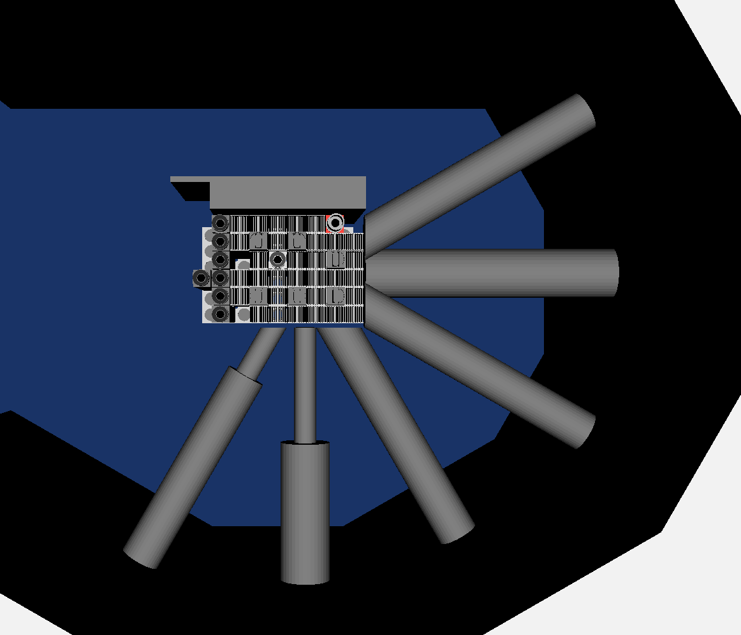
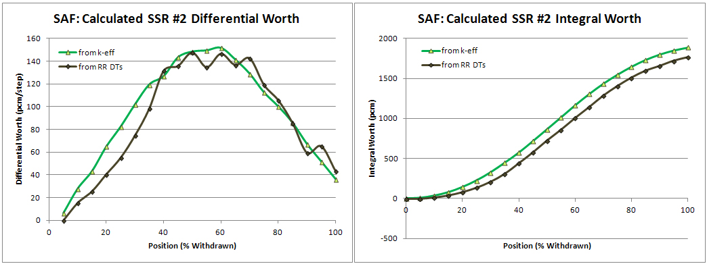
MNR
3MW open pool, cooled and moderated with light water
Intra assembly control elements
Reflected with graphite elements
Benchmark includes a number of experimental measurements at various core states.

Slide 15
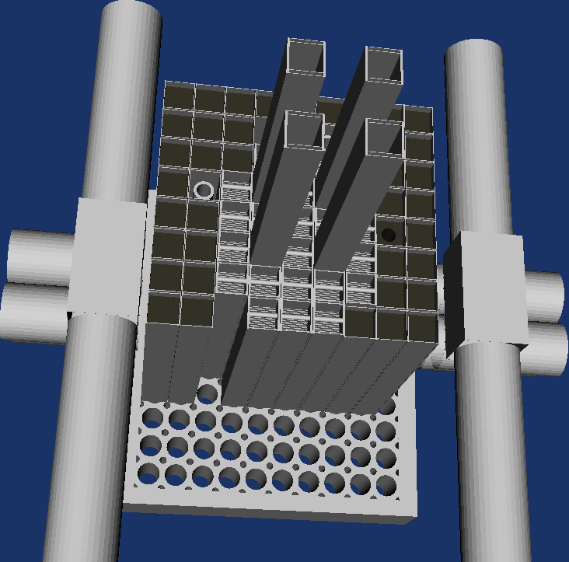
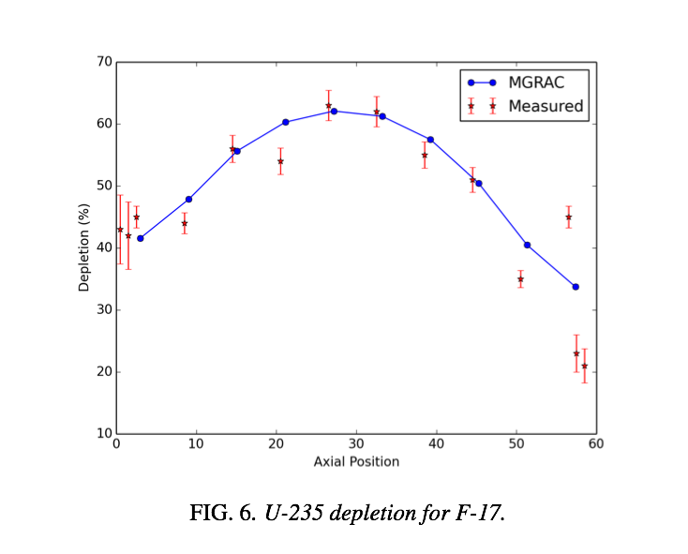
IRR-1
5MW open pool, cooled and moderated with light water
Intra assembly control elements
Reflected with graphite elements
Benchmark includes fuel depletion measurements at relatively high burnup

Slide 16
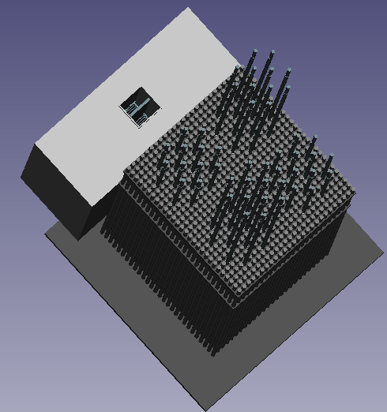
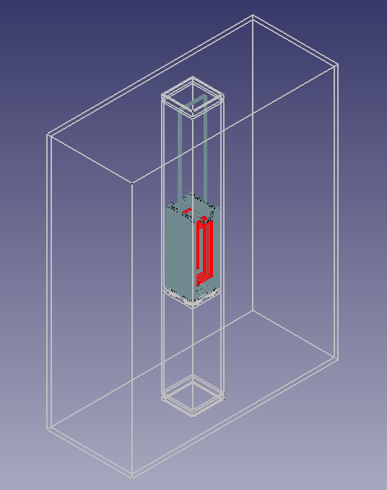
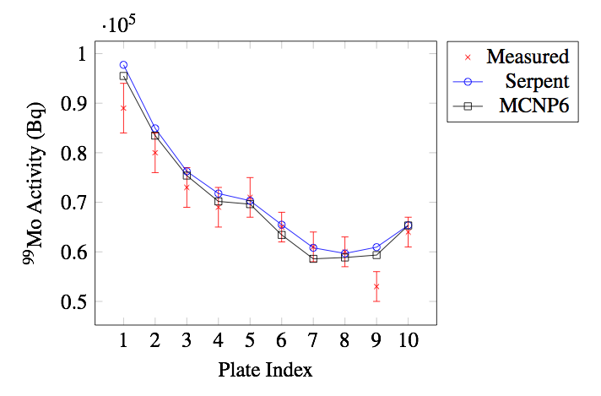
IPEN
The IPEN/MB-01 reactor consists of a 28x26 square array of fuel pins immersed in an open top, cylindrical moderator tank.
Fuel pin contains 4.3% enriched UO2 pellets.
Experiments were performed at ~108W
Targets were placed in a heavy water reflector box facing the core

Slide 17
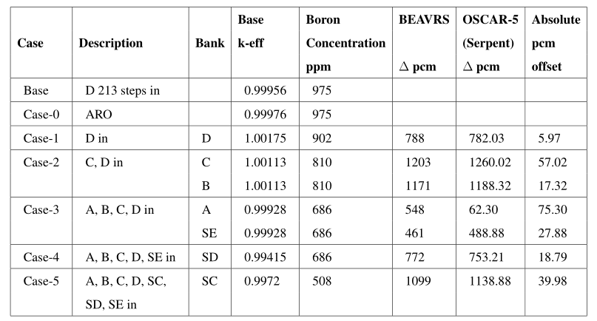
BEAVRS & WATTSBAR
Benchmarks for validation of power reactor simulations – still in progress
Detailed PWR specification (designed for high fidelity physics modelling)
Numerous startup (Hot Zero Power, with no burnup) experiments and measurements
Two cycle’s operational data, with additional measurements at the end of the first cycle

Slide 18
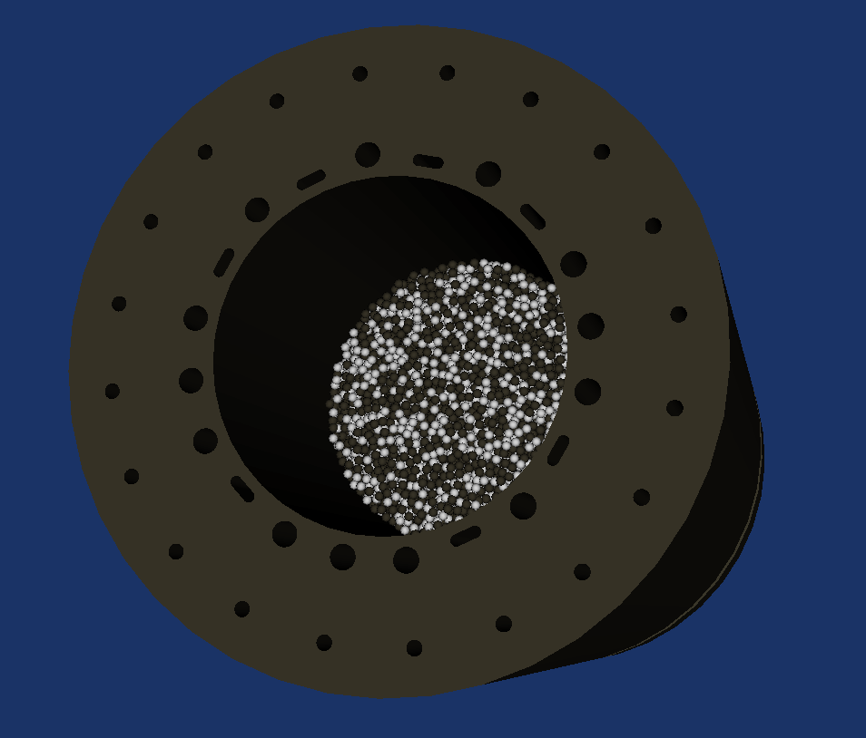
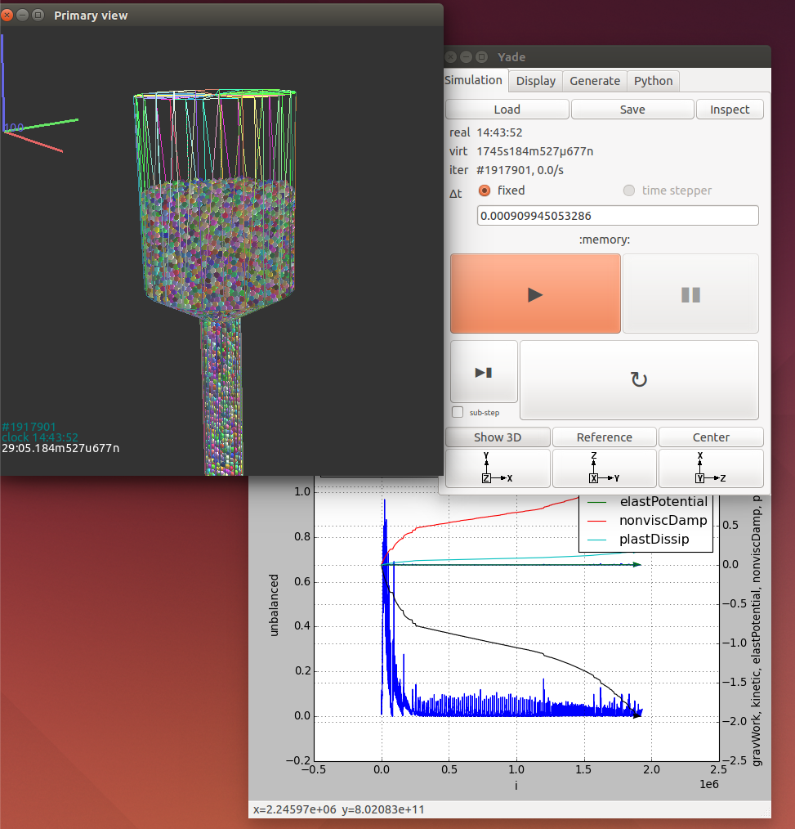
HTR-10
Benchmarks for validation of high temperature reactors
Model for HTR-10 benchmark almost complete.
Plan to simulate all startup (cold) cases.
Other cases will follow as our tools mature
Gravity packing of pebbles using YADE (with detailed interaction physics)
Packing 450k pebbles takes about 24 hours on a desktop PC
Slow, but more feasible than a decade ago.
Can also be used to track pebble movement and generate flow paths (will off course require some validation)

Slide 19
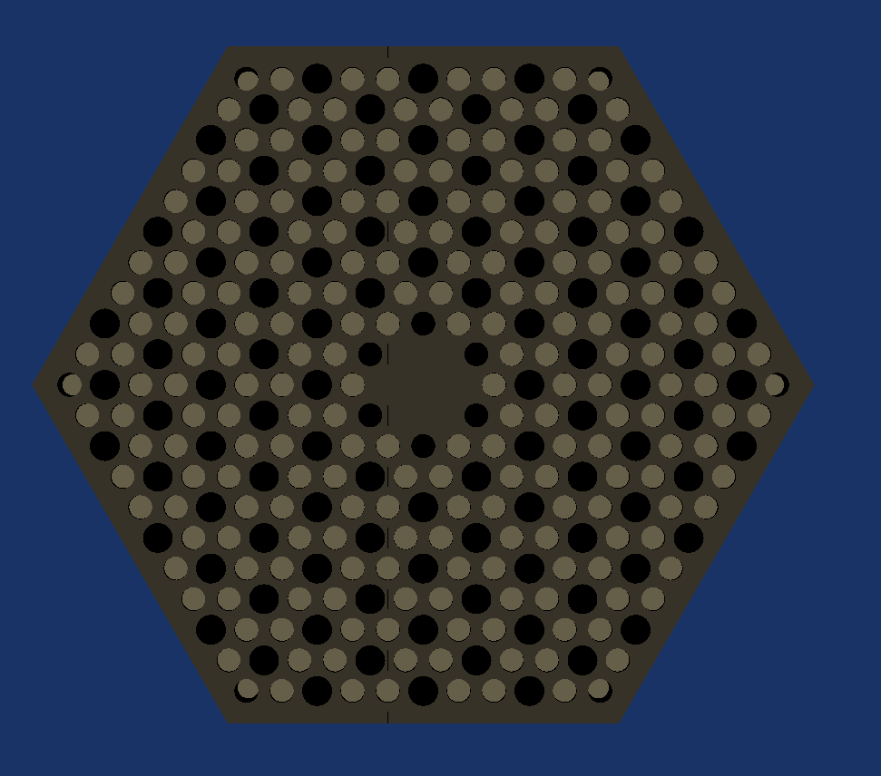
MHTGR-350
Benchmarks for validation of high temperature reactors
In progress – currently primarily used to test OSCAR-5 options for
Compact based fuel model building
Monte Carlo evaluation of fully heterogeneous models
Evaluation of homogenization schemes for graphite moderated systems in hexagonal and cylindrical geometry

Slide 20
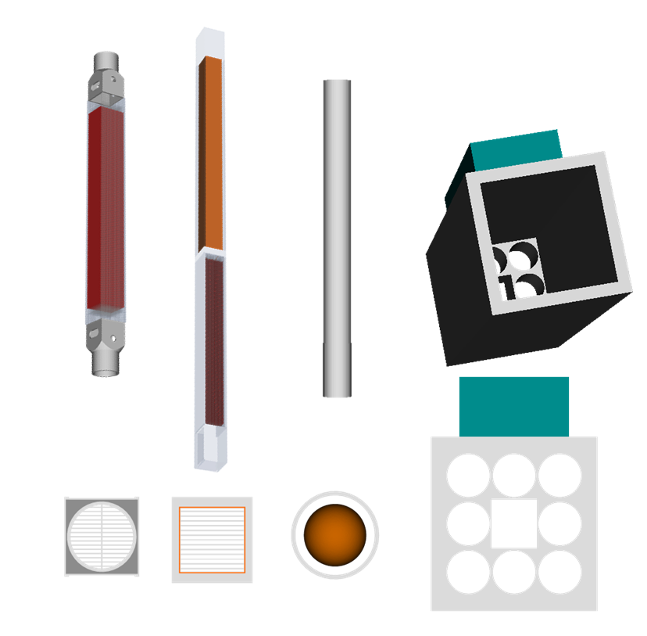
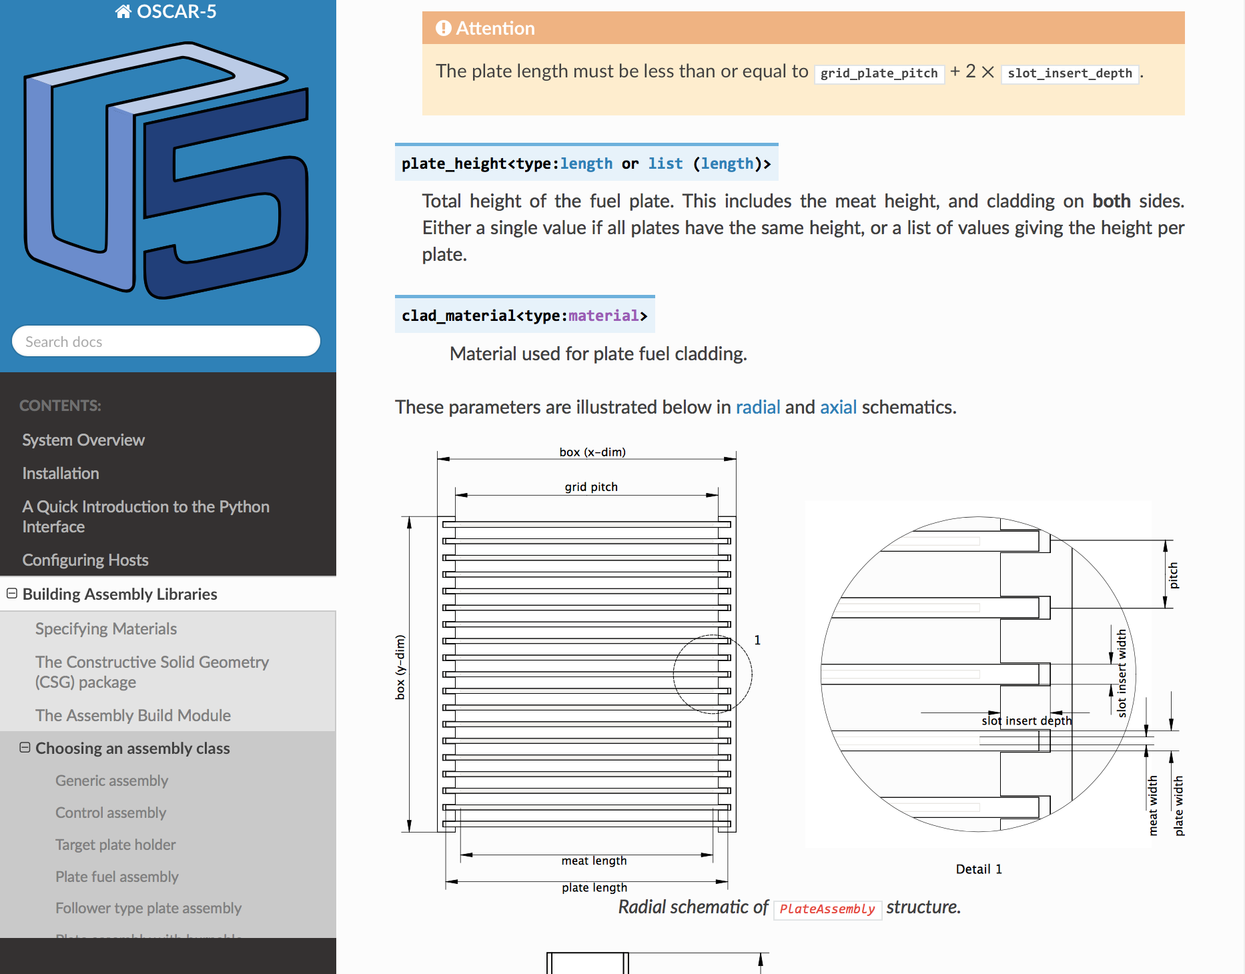
Recent developments
External code coupling initiatives
Numerical schemes
Fully coupled neutronic/thermal-hydraulic safety analysis – under verification
Multi-code geometric support for SMR novel concepts
RELAP (ISS) and COBRA-TF (NCSU) coupling for LWR safety analysis
Uncertainty propagation and sensitivity analysis
Flownex (MTECH) coupling for HTR thermal-hydraulic modelling
CONDOR (INVAP) coupling for improved LWR neutronics
Embedded calculational schemes for on-the-fly homogenization
Integration of SCALE / FISPACT to expand
>>> from core import *
>>> m = material.Material()
>>> m.name = 'MyMaterial'
>>> m.add('B-10', 1.0E-3 * units.number_density)
>>> m['B-11'] = 1.0E-2 * units.number_density
>>> print m
Material : MyMaterial
Type : generic
Mass density : 0.1994 g/cc
Isotope Wt Nd (1/b/cm)
B-10 8.34 % 1.00000e-03
B-11 91.66 % 1.00000e-02
Total 100.00 1.10000e-02

Slide 21
Questions?

