Slide 1


Superionic Conductors For Solid Oxide Fuel Cells: Probing the Local And Average Structure of the Enigmatic Bismuth Oxide and Its Chemical Derivatives
Name: Sikhumbuzo Masina
Supervisors: Prof. D. G Billing
Dr C. Billing

Slide 2
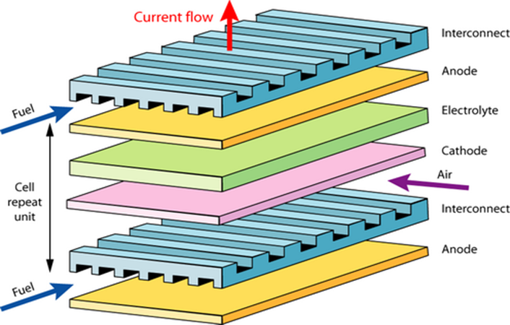
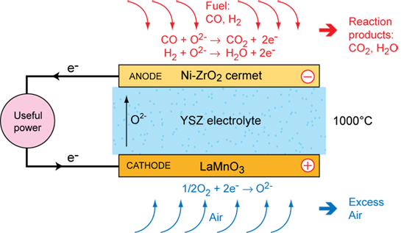
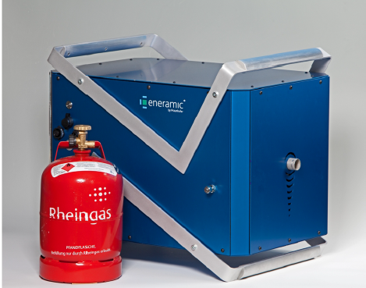

SOLID OXIDE FUEL CELL COMPONENTS
Over 60% efficient in stand alone configuration
Over 80% efficient in combined heat and power configuration.
https://www.doitpoms.ac.uk/tlplib/fuel-cells/high_temp_sofc.php, Dziurdzia, B., Magonski, Z. and Jankowski, H., 2016. Commercialisation of Solid Oxide Fuel Cells-opportunities and forecasts. In IOP Conference Series: Materials Science and Engineering (Vol. 104, No. 1, p. 012020). IOP Publishing.

Slide 3

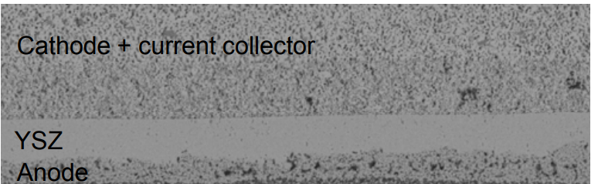
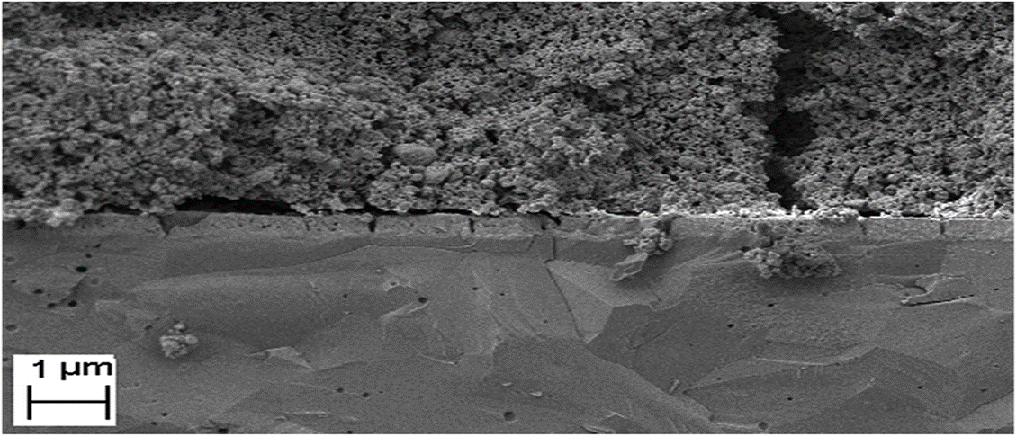
DEGRADATION OF CELL COMPONENTS
Synthesis of mesoporous nanocomposites for their application in solid oxide electrolysers cells: microstructural and electrochemical characterization M. Torrell, L. Almar, A. Morata and A. Taranc´on* DOI: 10.1039/c5fd00035a

Slide 4
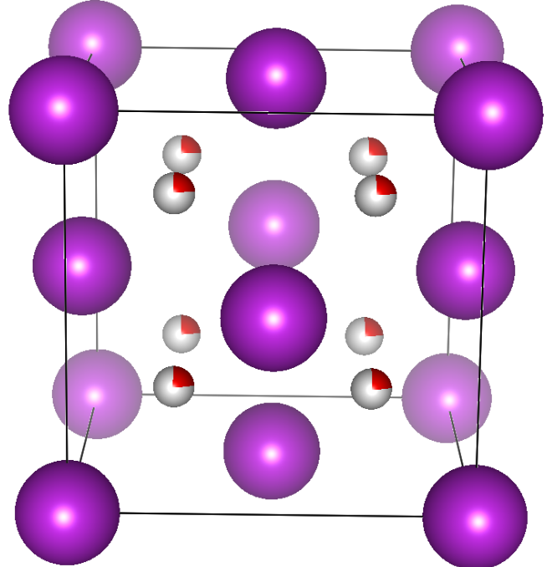
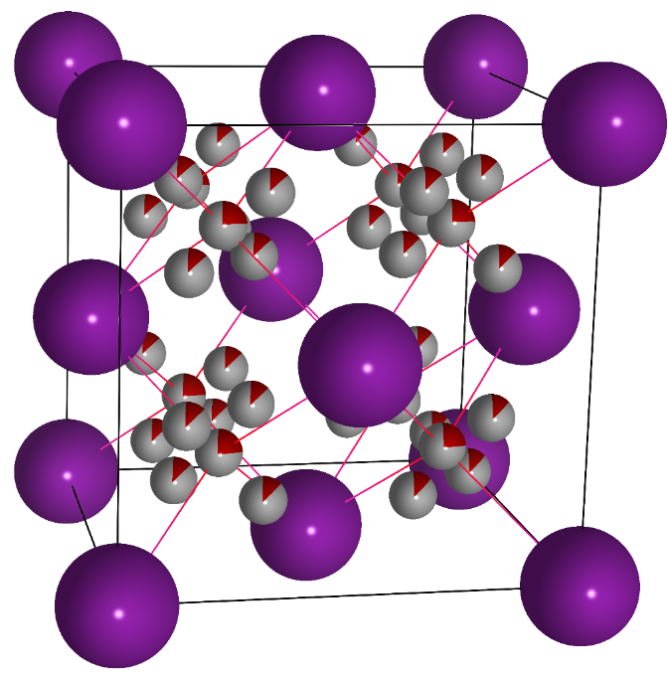
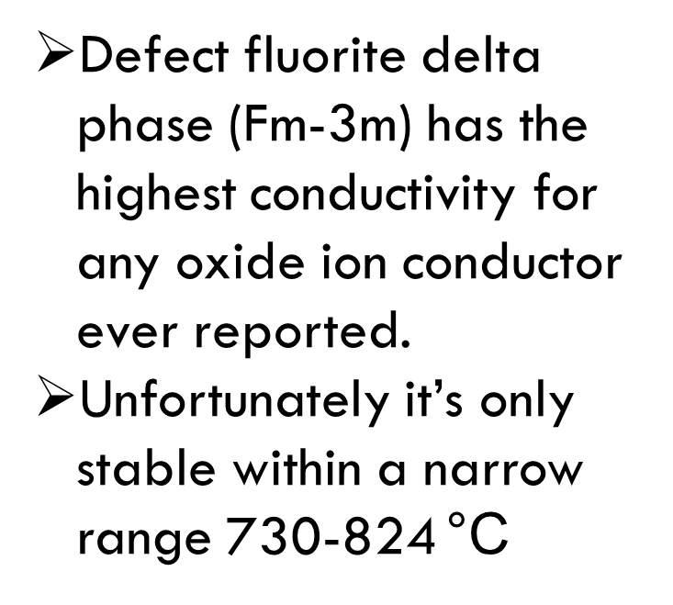
THE DELTA PHASE
Defect fluorite delta phase (Fm-3m) has the highest conductivity for any oxide ion conductor ever reported.
Unfortunately it’s only stable within a narrow range 730-824 °C
Bi³⁺
O²⁻
Vacancy

Slide 5
Ambient Temperature XRD
(Bi₂O₃)_{0.88} (Dy₂O₃)_{0.08} (WO₃)_{0.04} (8D4WSB)
(Bi₂O₃)_{0.88} (Dy₂O₃)_{0.08} (Er₂O₃)_{0.03} (WO₃)_{0.01} (8D3E1WSB)
(Bi₂O₃)_{0.88} (Dy₂O₃)_{0.08} (Er₂O₃)_{0.04} (8D4ESB)

Slide 6
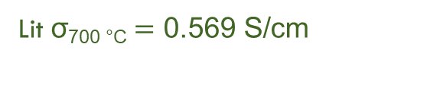

VT-ELECTROCHEMICAL IMPENDANCE SPECTROSCOPY
σ_{700 °C} = 0.227 S/cm
Lit σ_{700 °C}$=\text{0.569} \text{S}\text{/}\text{cm}$
σ_{500 °C} = 0.00033 S/cm
Lit σ_{500 °C}$=\text{0.098} \text{S}\text{/}\text{cm}$
Literature values sourced from: Effect of total dopant concentration and dopant ratio on conductivity of (DyO1.5)x–(WO3)y–(BiO1.5)1-x-y by Doh Won Jung, Keith L. Duncan, Eric D. Wachsman

Slide 7
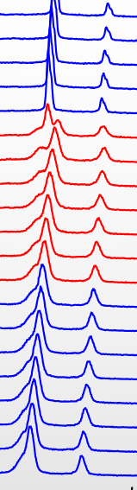
Vt-XRD
8D3E1WSB

Slide 8
8D4ESB-NO W⁶⁺

Slide 9
vt-Raman Spectroscopy

Slide 10
Lab XRD Data vs Synchrotron XRD data
8D3E1WSB
8D3E1WSB

Slide 11

Phase Stability Test
500 °C
100h
100h

Slide 12
Conclusion and Future work
There’s overwhelming evidence for a link between average structure and conductivity.
What role is the local structure playing on the conductivity?
The rapid acquisition pair distribution function (RAPDF) technique will be used to probe the local structure.
EXAFS will also be used to compliment the PDF and probe the oxidation states of the impurity cations.

Slide 13




Acknowlegements
13

Slide 14

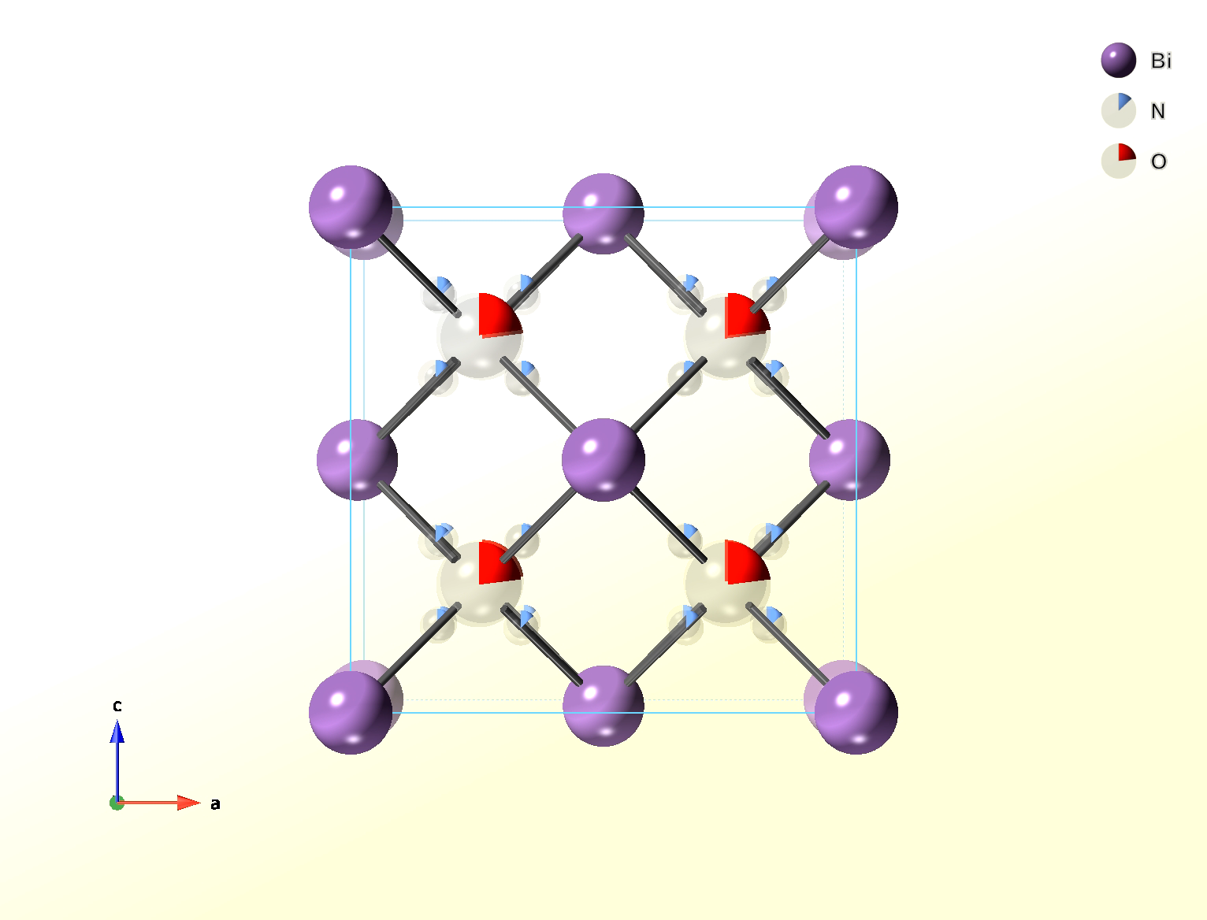
Thank you very much,
Questions are most welcome

