Slide 1



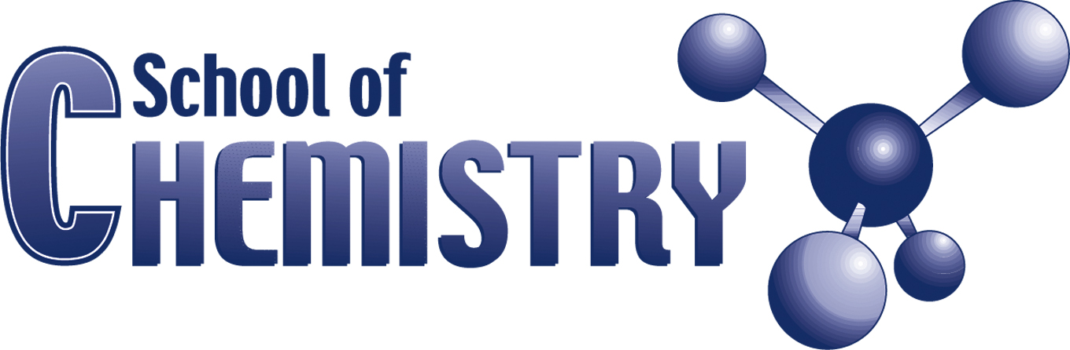
The Search for an Improved SOFC Electrolyte Material: Stabilizing the Fm3̅m Phase of Bismuth Oxide to Lower Temperatures
A presentation by Mathias A. Kiefer

Slide 2

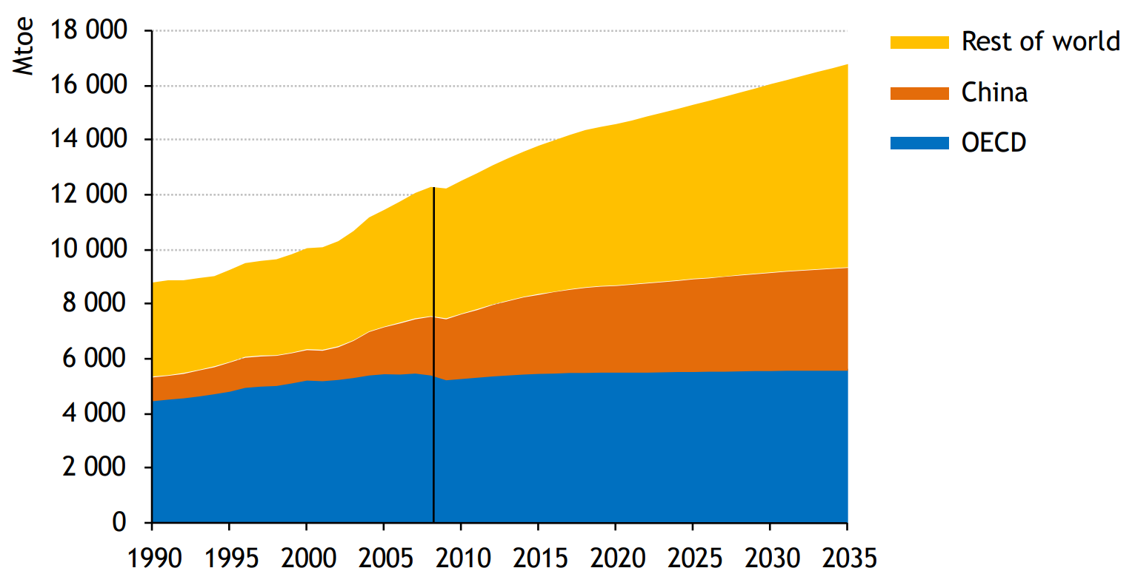
The (not-so-great) State of the World
Global Population Growth
Global Demand for Energy

Slide 3
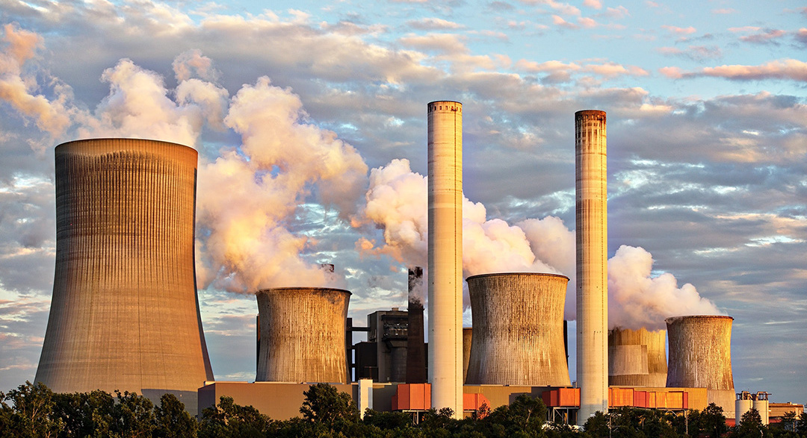
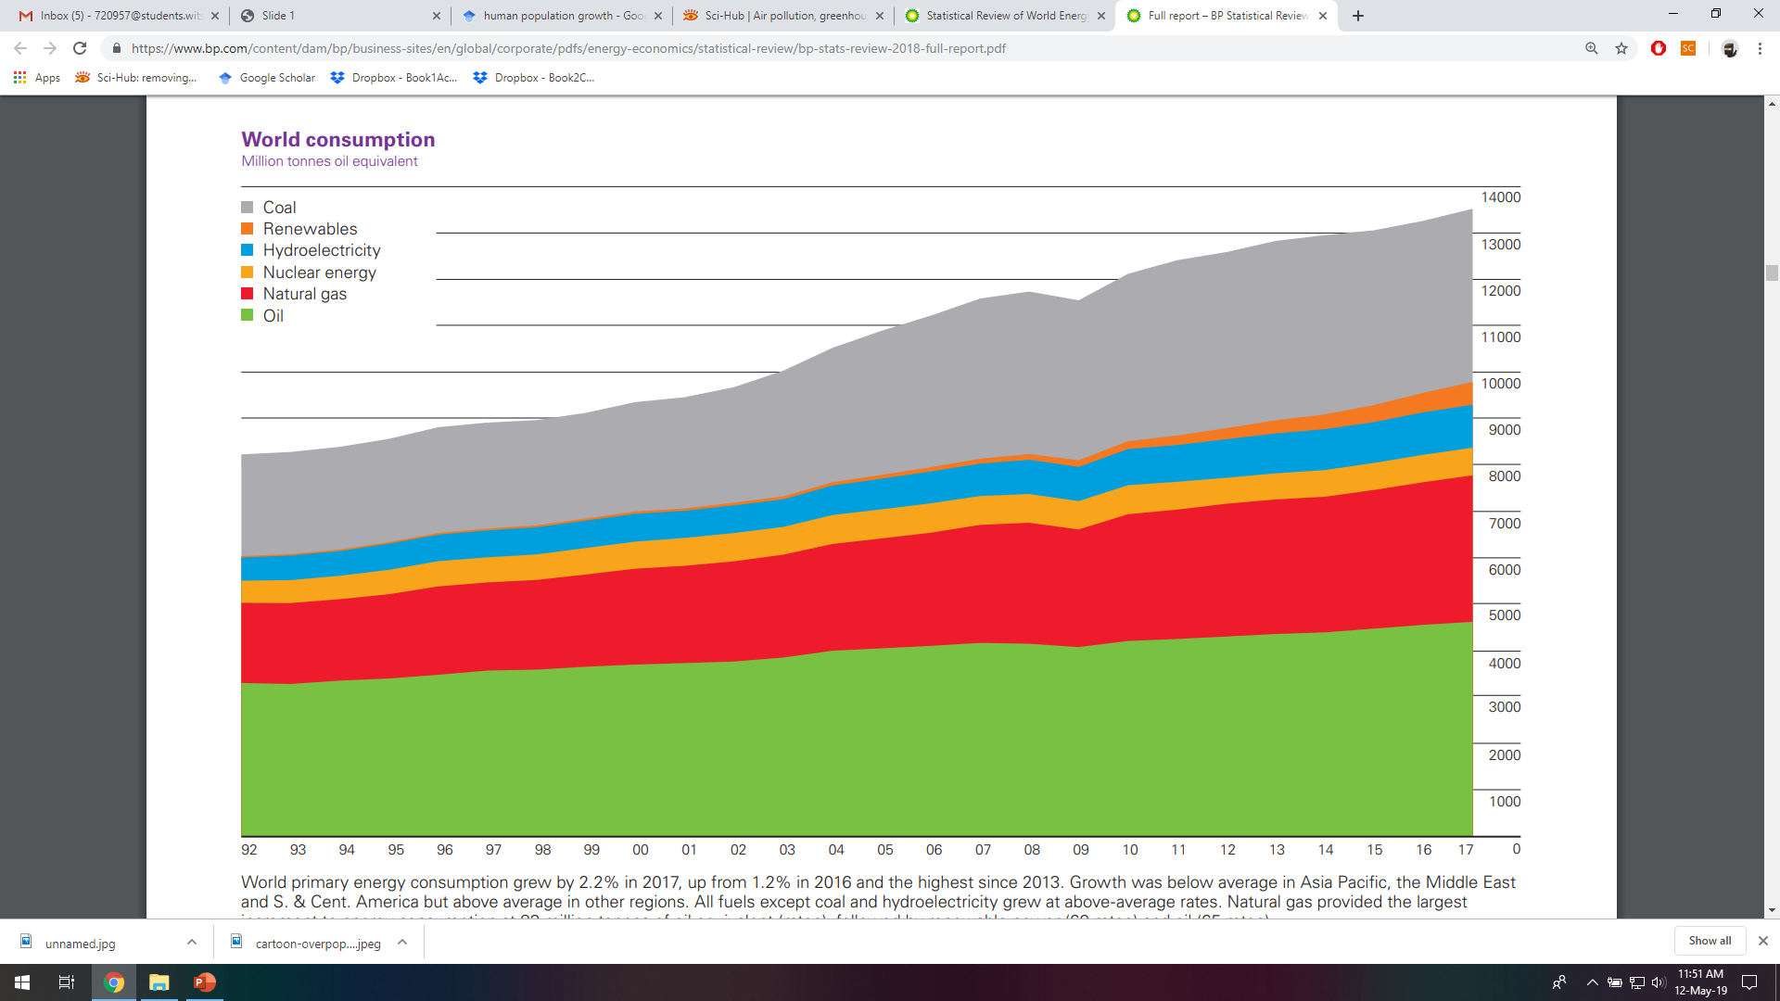

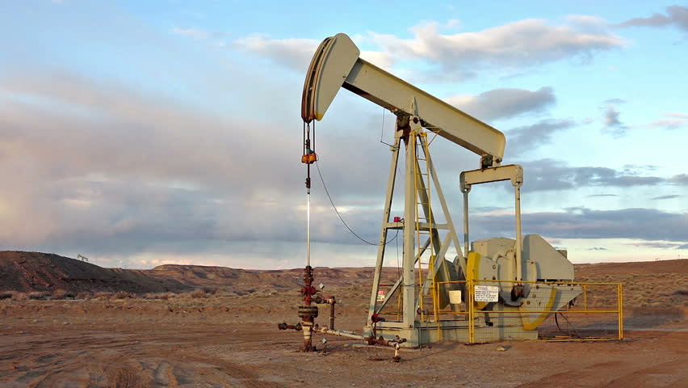

Satisfying the Energy Demand

Slide 4
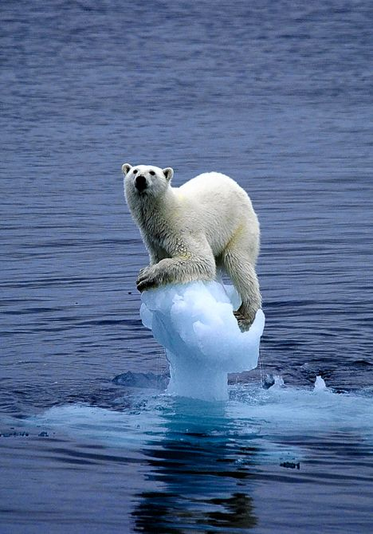
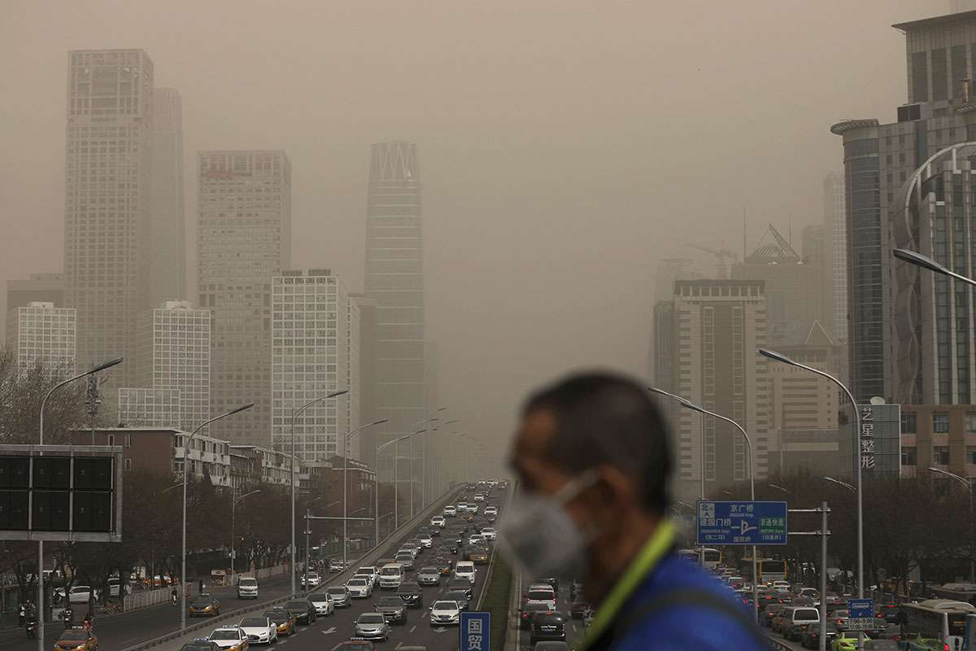
…but at what cost?

Slide 5


Plenty Alternatives Are Available
Polymer Electrolyte Membrane (PEM) Fuel Cell
Alkaline Fuel Cell (AFC)
Molten Carbonate Fuel Cell (MCFC)
Solid Oxide Fuel Cell (SOFC)

Slide 6




SOFC Working Principle
H₂O
H₂O
O²⁻
O₂
H₂
O²⁻
Air
H₂
O²⁻
O²⁻
O²⁻
O₂
H₂
H₂
O²⁻
O₂
H₂
Anode
Electrolyte
Cathode

Slide 7
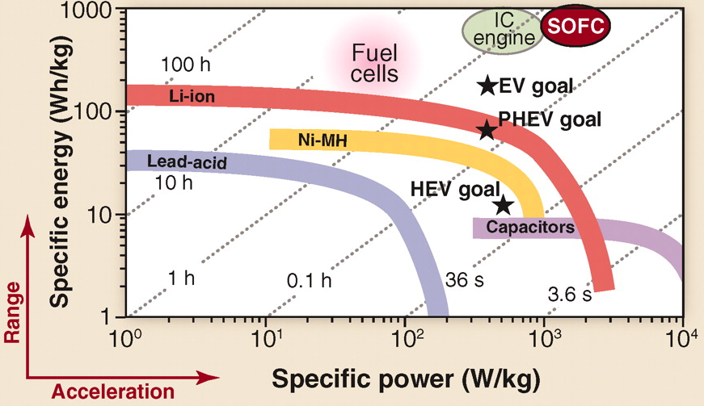
Advantages of SOFCs
+ Fuel Flexibility
H₂, bio-ethanol, CH₄, etc
+ Excellent Efficiencies
Up to 85%
+ Reduced emissions
Dependent on fuel
+ All solid state device
No scary liquids!
Ragone Plot

Slide 8


SOFCs sound great but…
High operating temperature 500 – 1000 ºC
Dictated by the electrolyte material
Knock-on effects:
Chemical (Phase) Degradation
Thermal expansion incongruities
Overall: Very Limited lifespans (<10000 hours)
Why haven’t we seen any SOFCs yet? – Material Limitations!

Slide 9
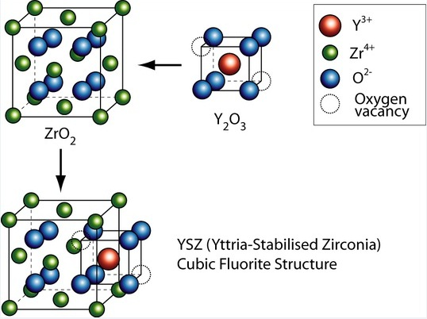
Currently used electrolyte: 8YSZ
High ionic conductivity
Low(er) thermal expansion
High phase stability
BUT: High temperatures needed – material limitation
Overall: Device lifespan limitations

Slide 10
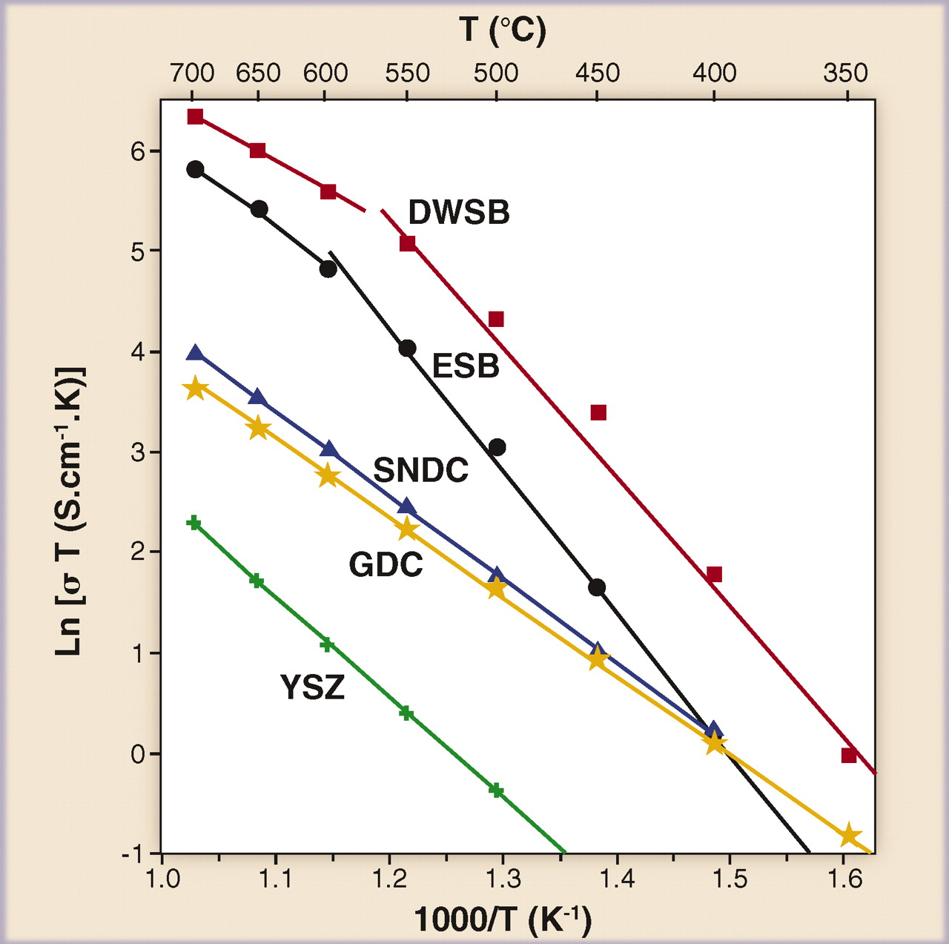
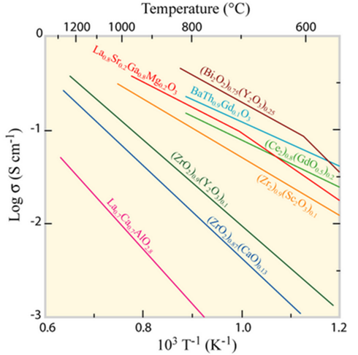
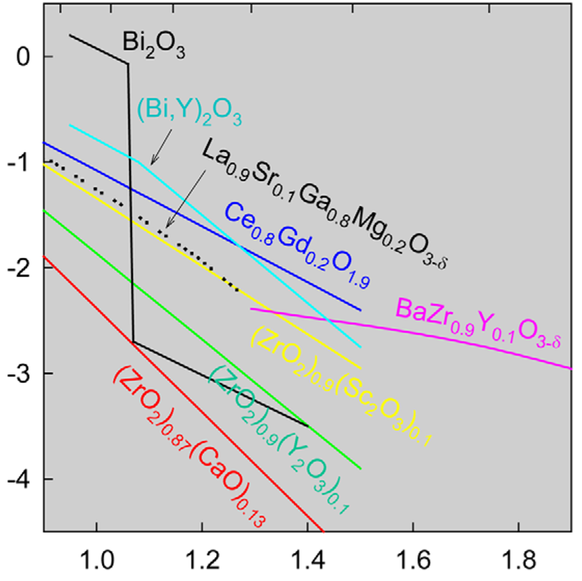
What options are available?
‘Why aren’t doped bismuth oxides used commercially?’
10

Slide 11
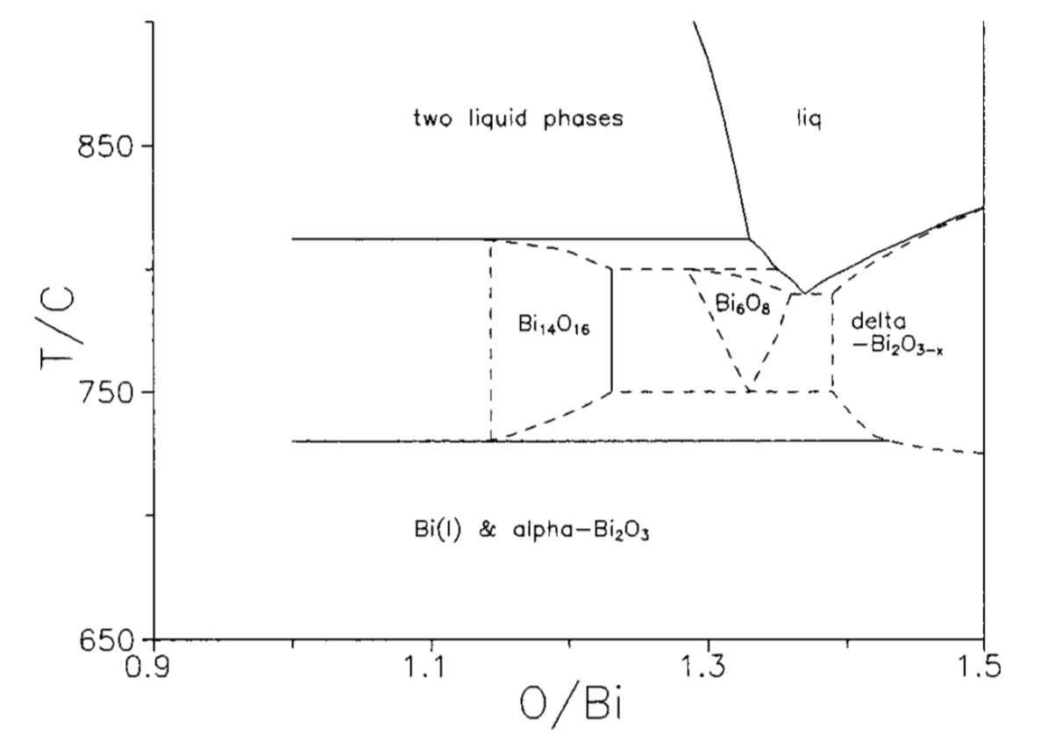
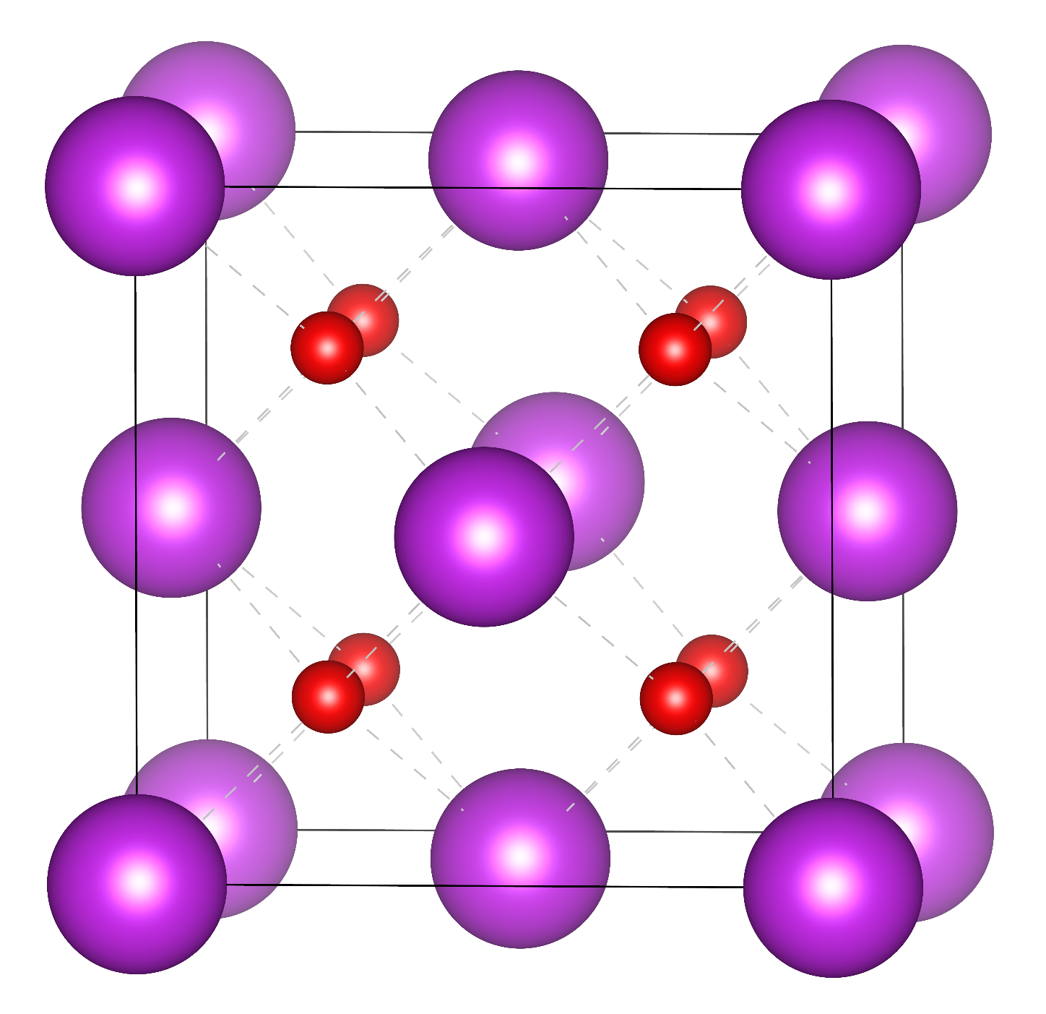
Bi₂O₃ as an alternative
Bi³⁺
O²⁻
SG: Fm3̅m (#225)

Slide 12



We need an improved electrolyte
High Phase Stability and Purity
Low thermal expansion
High Oxide ion conduction at lower temperatures
12

Slide 13
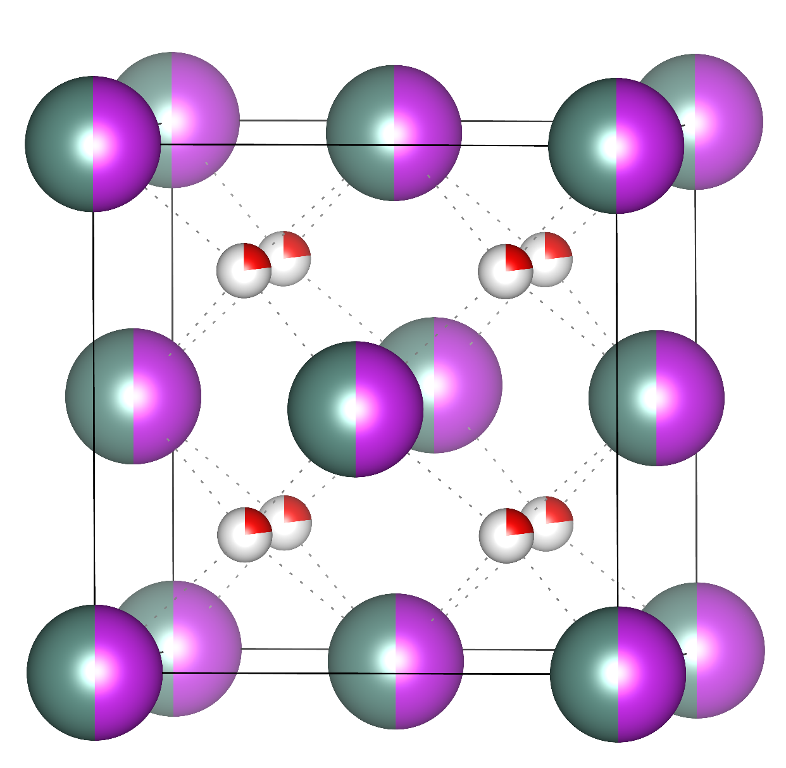
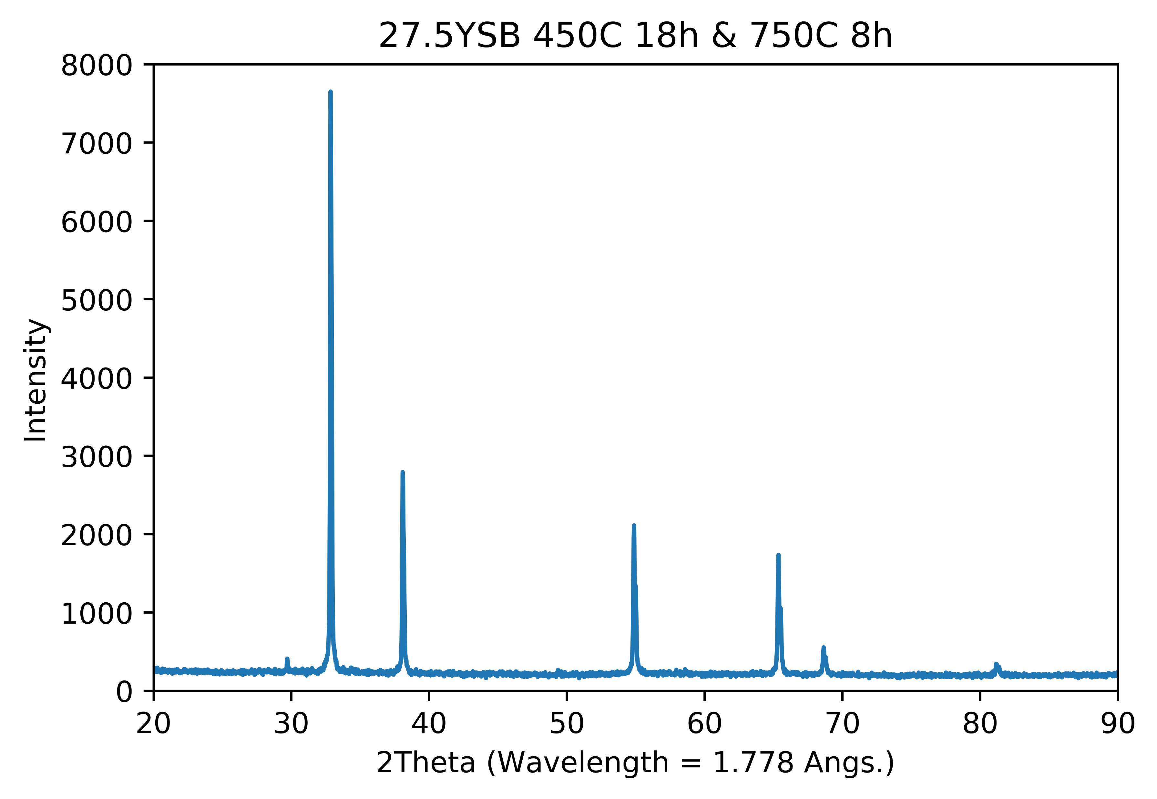
Stabilizing the delta phase to lower temperatures – ‘doping’ approaches
Y³⁺/Bi³⁺
O²⁻

Slide 14
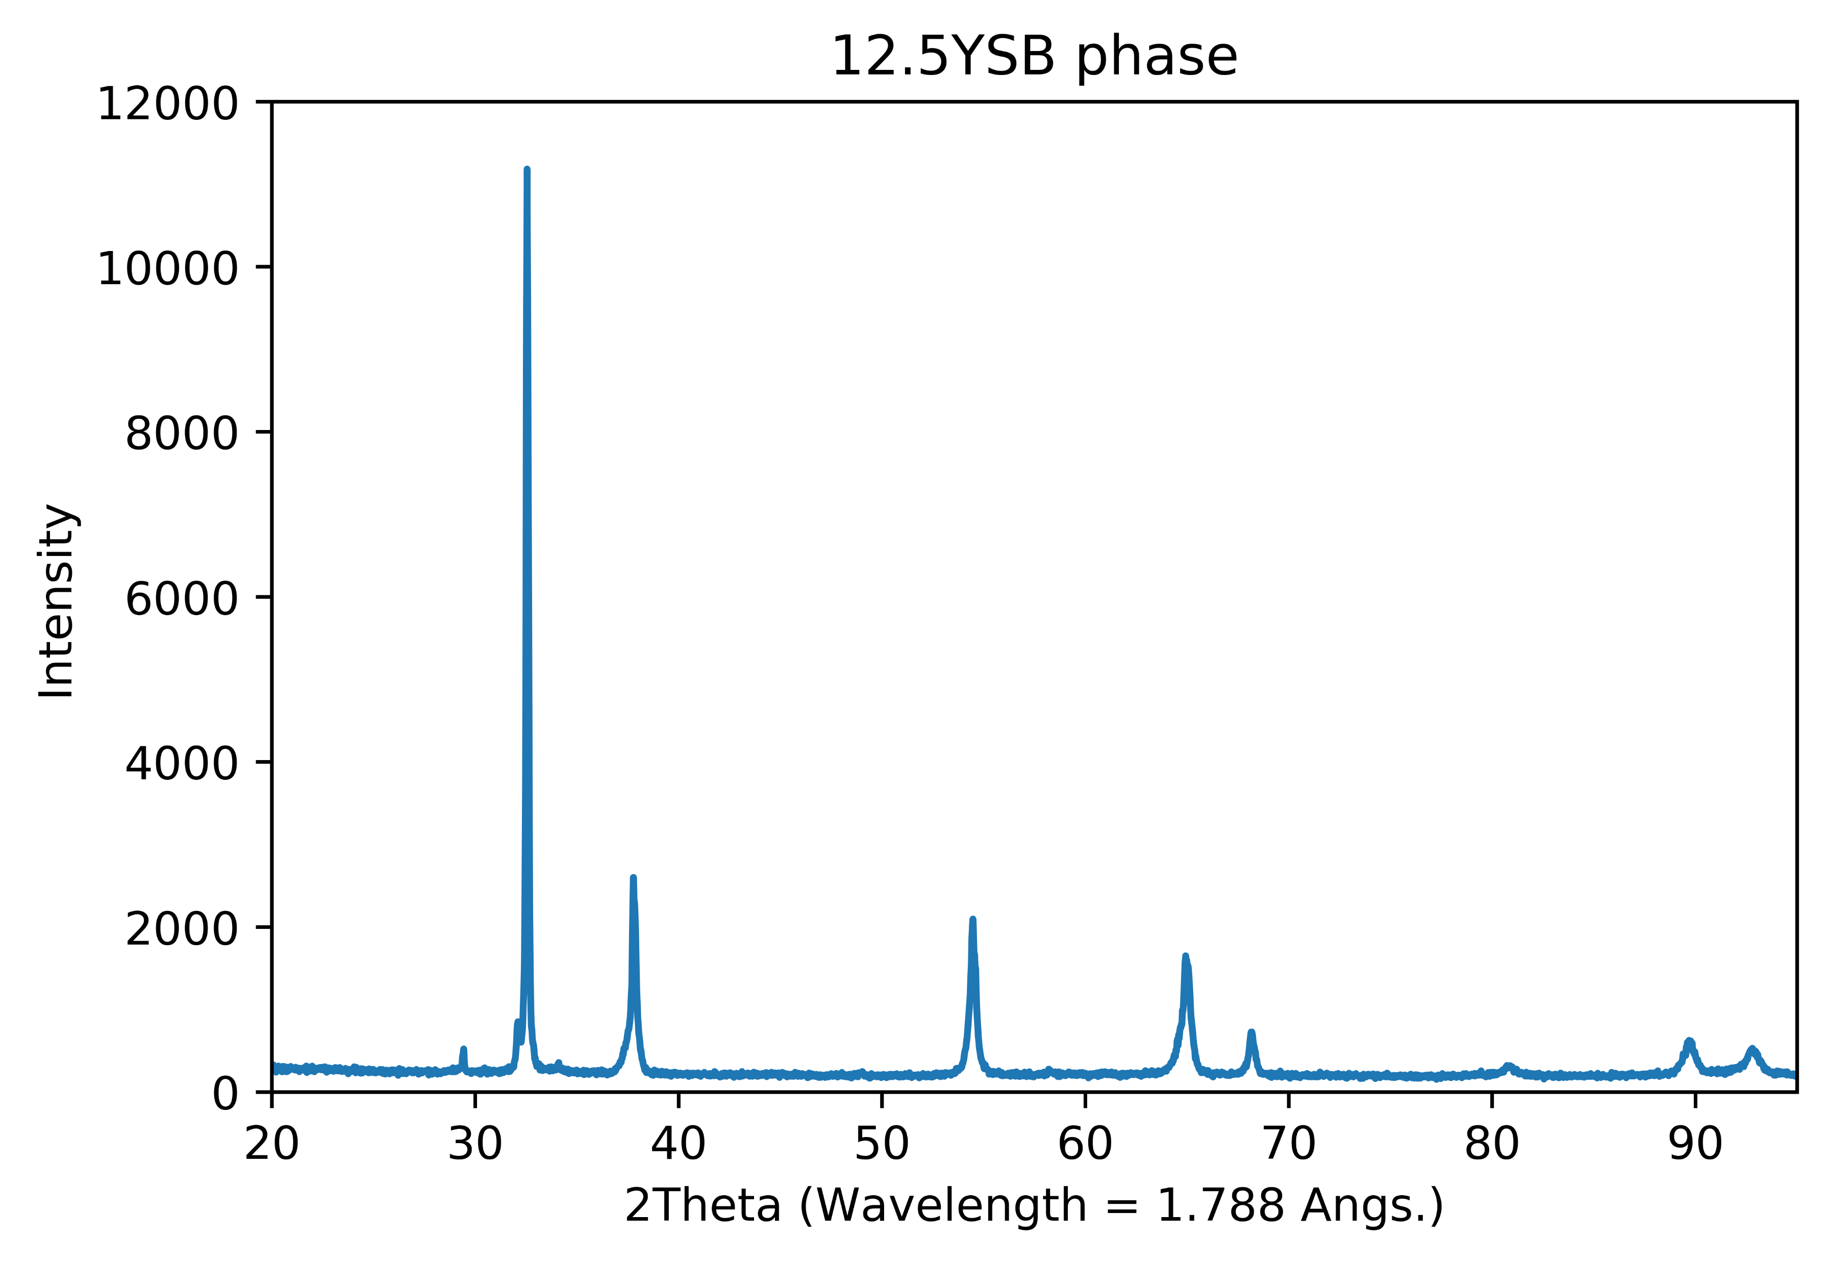
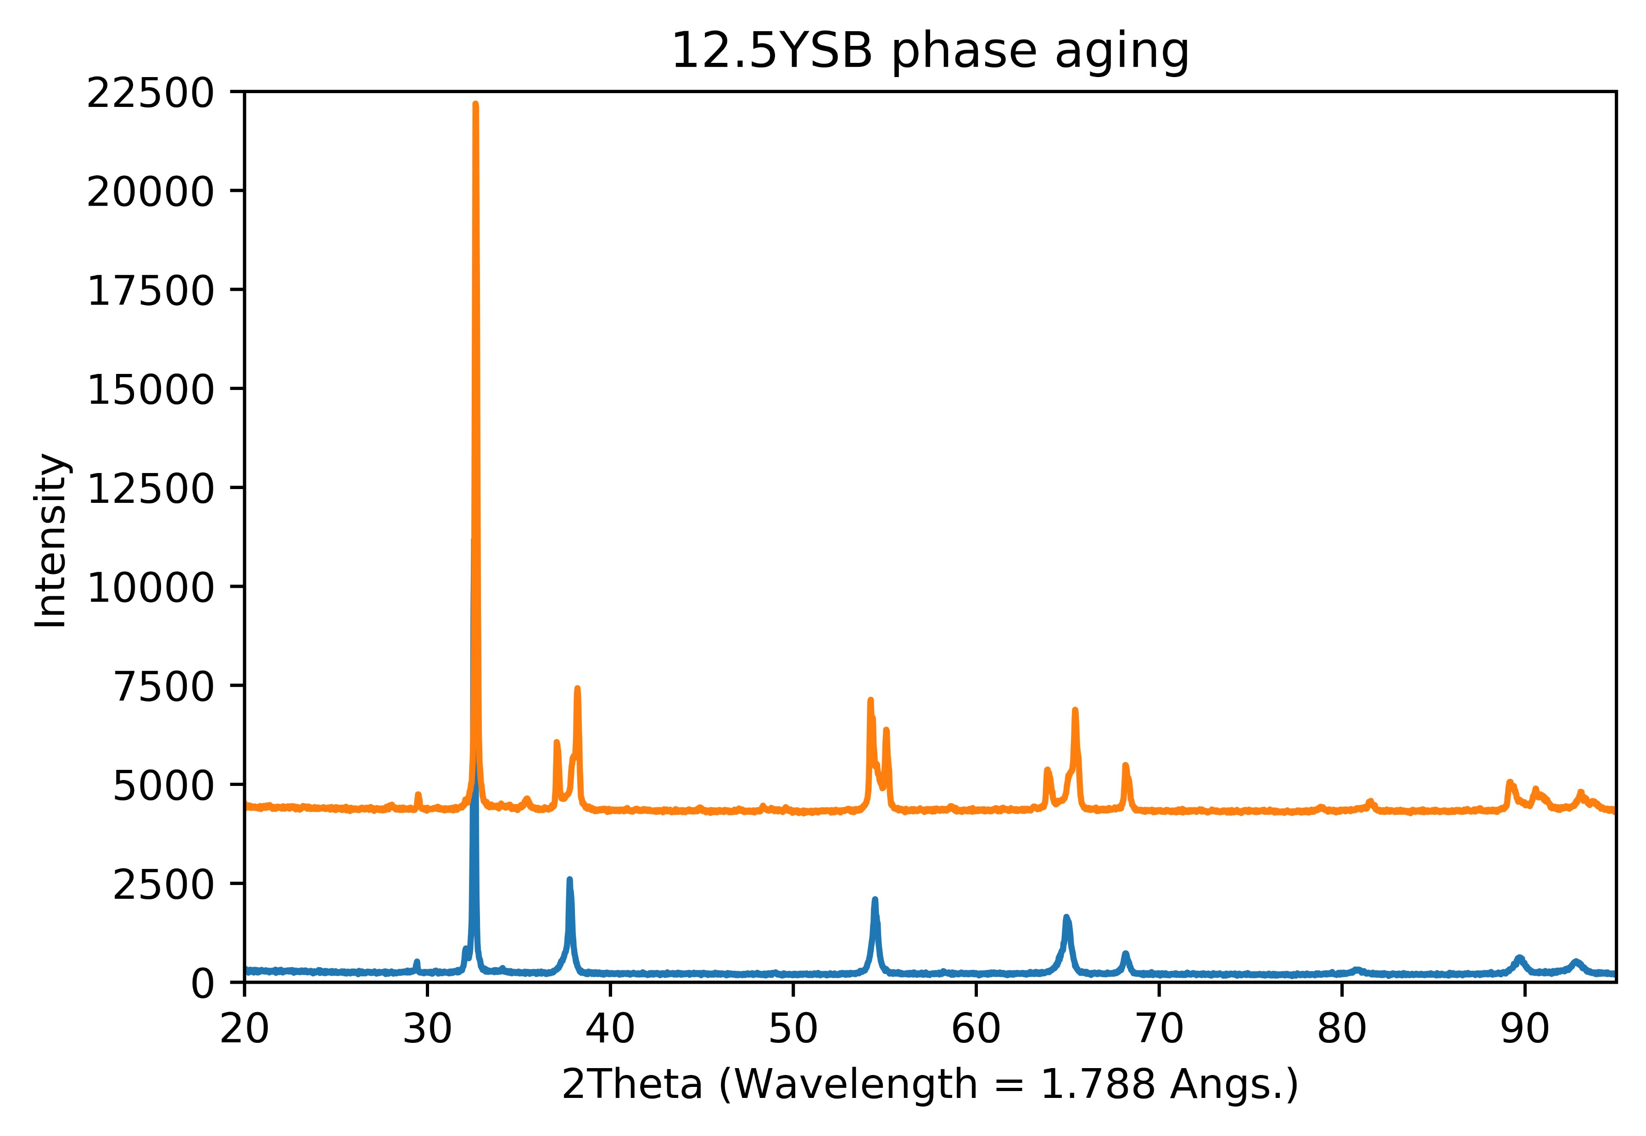
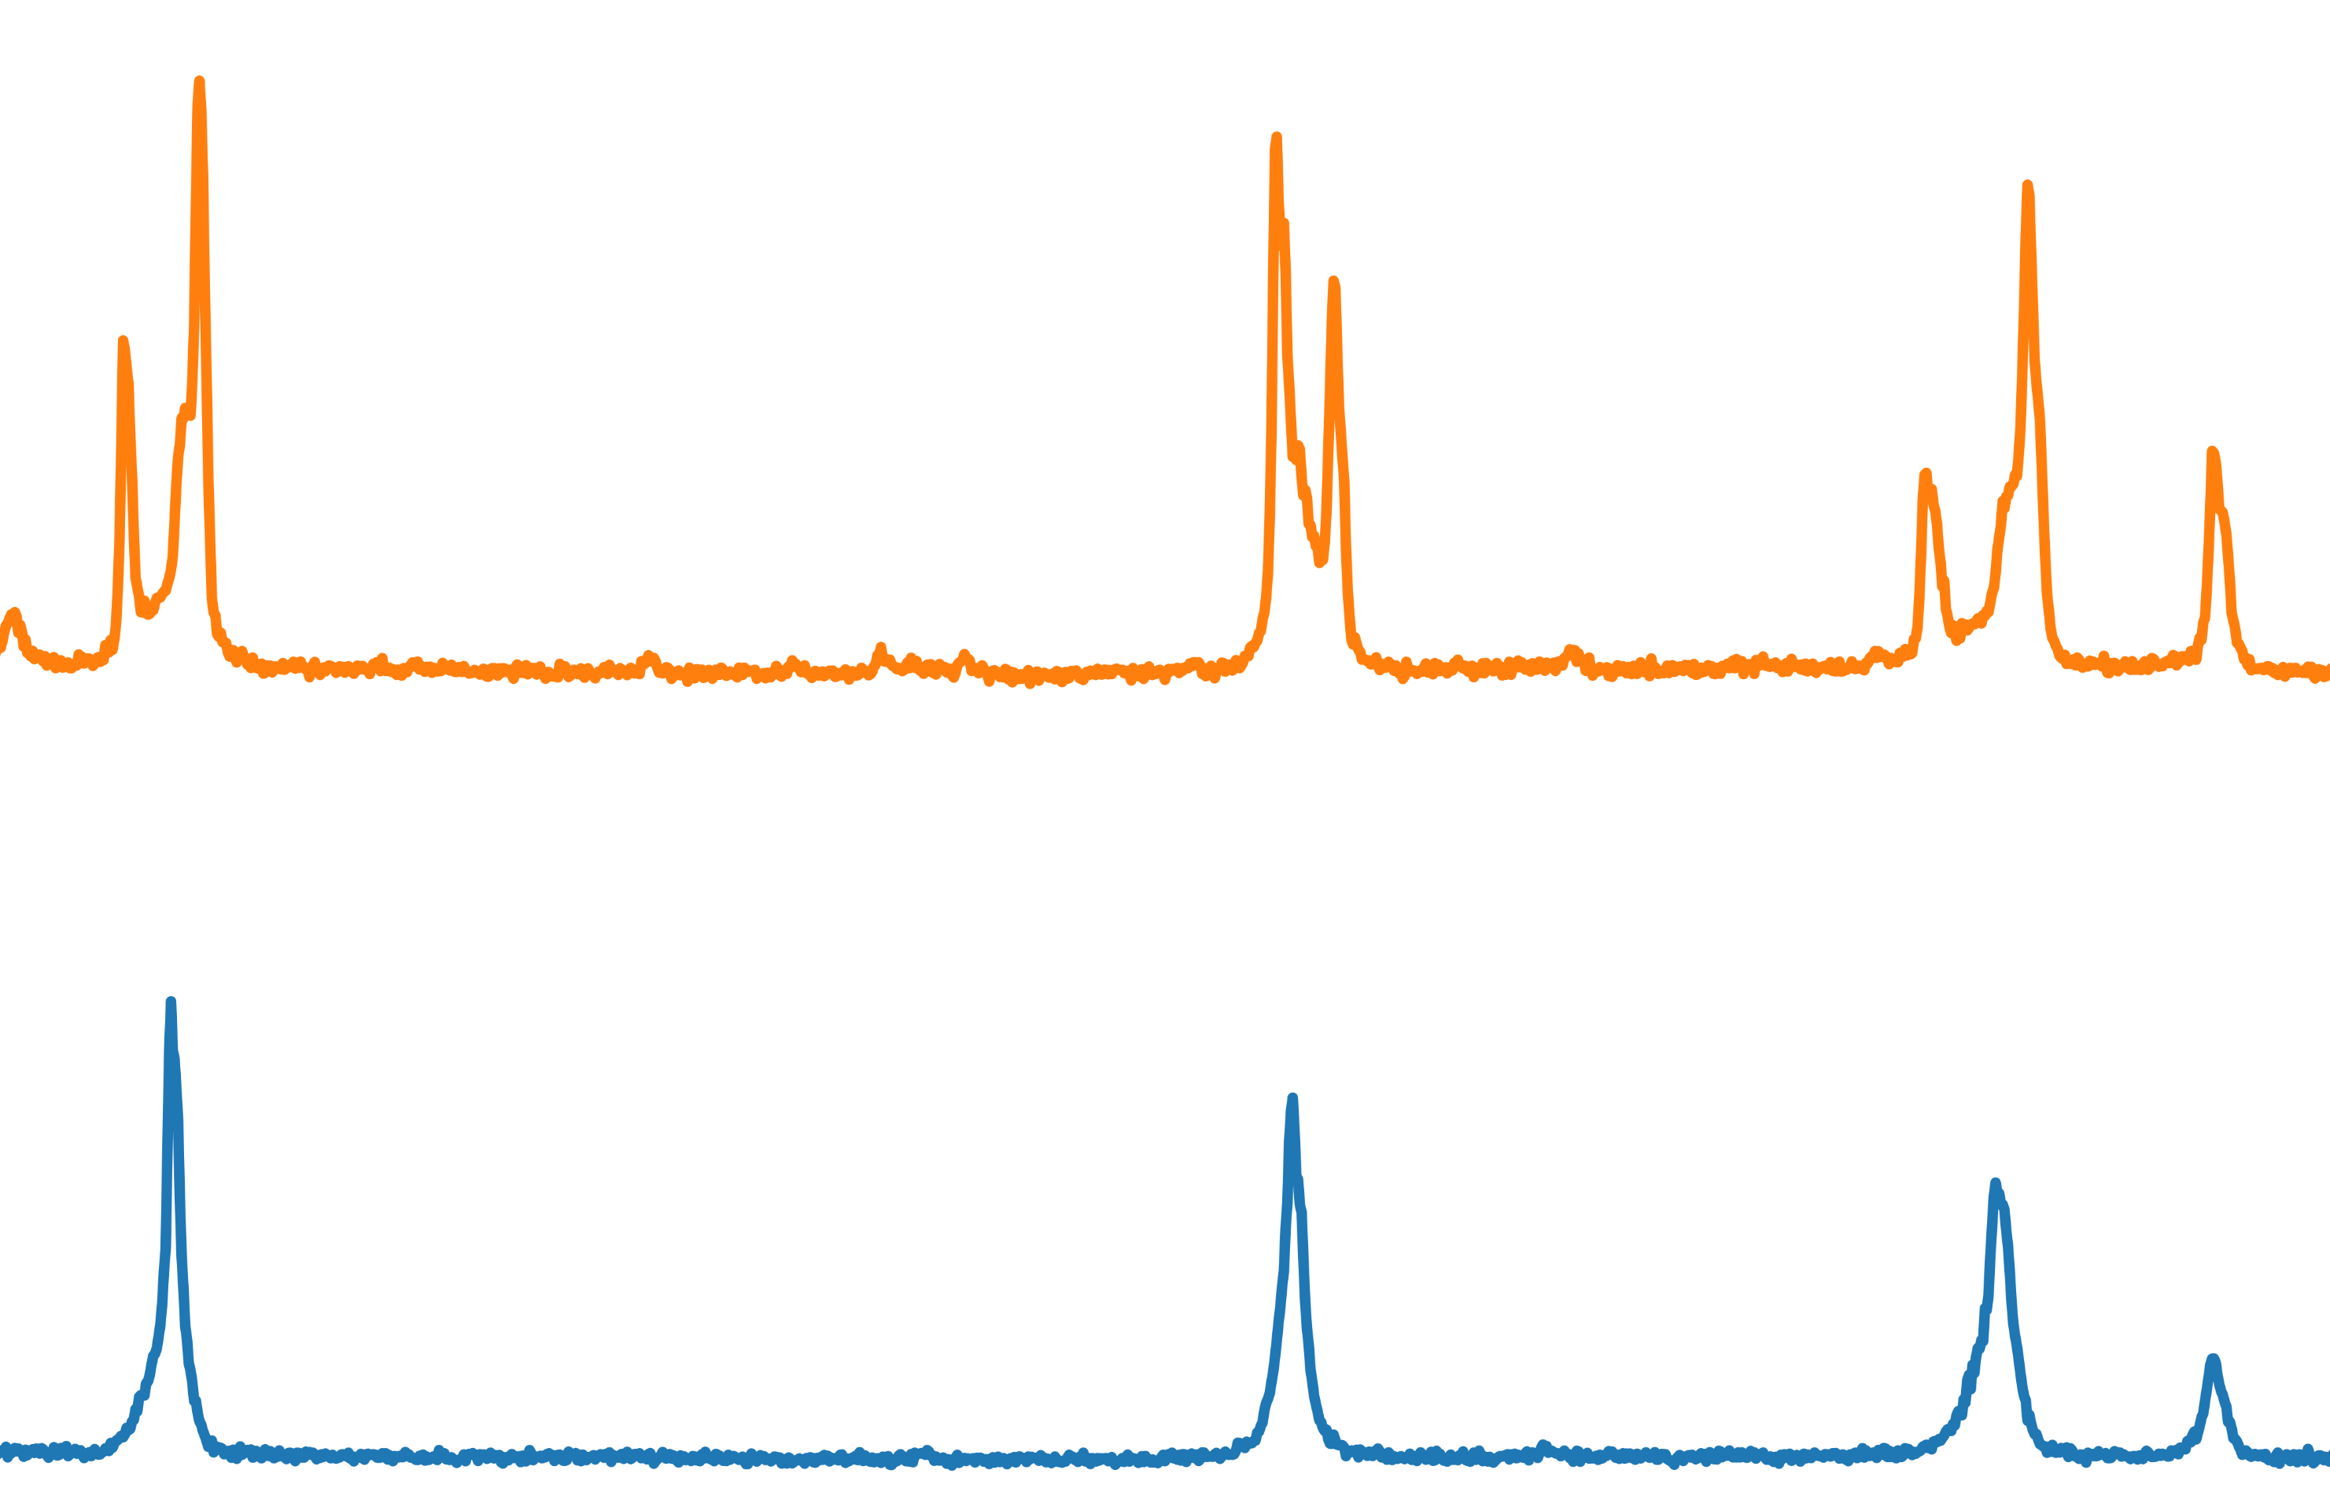
Successful … BUT there are problems
Problem #1: Aging phenomenon
12 months

Slide 15

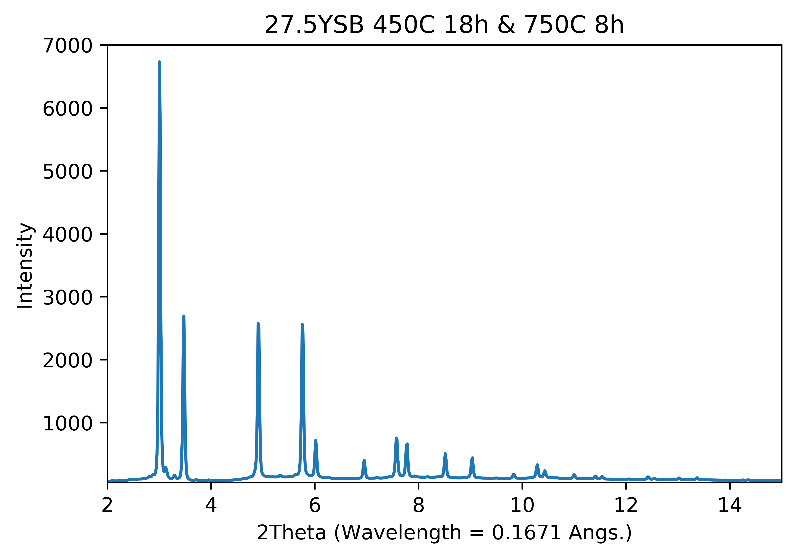
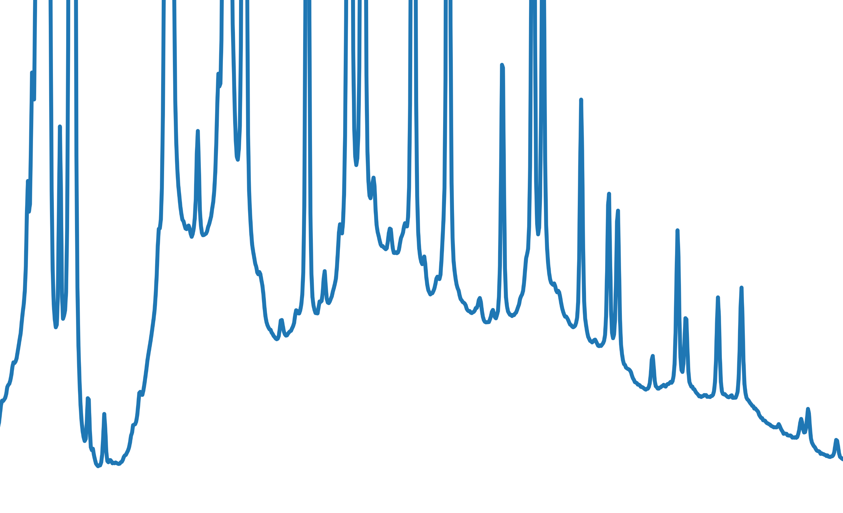
Problem #2: Phase purity
Lab data
NSLS-II data

Slide 16
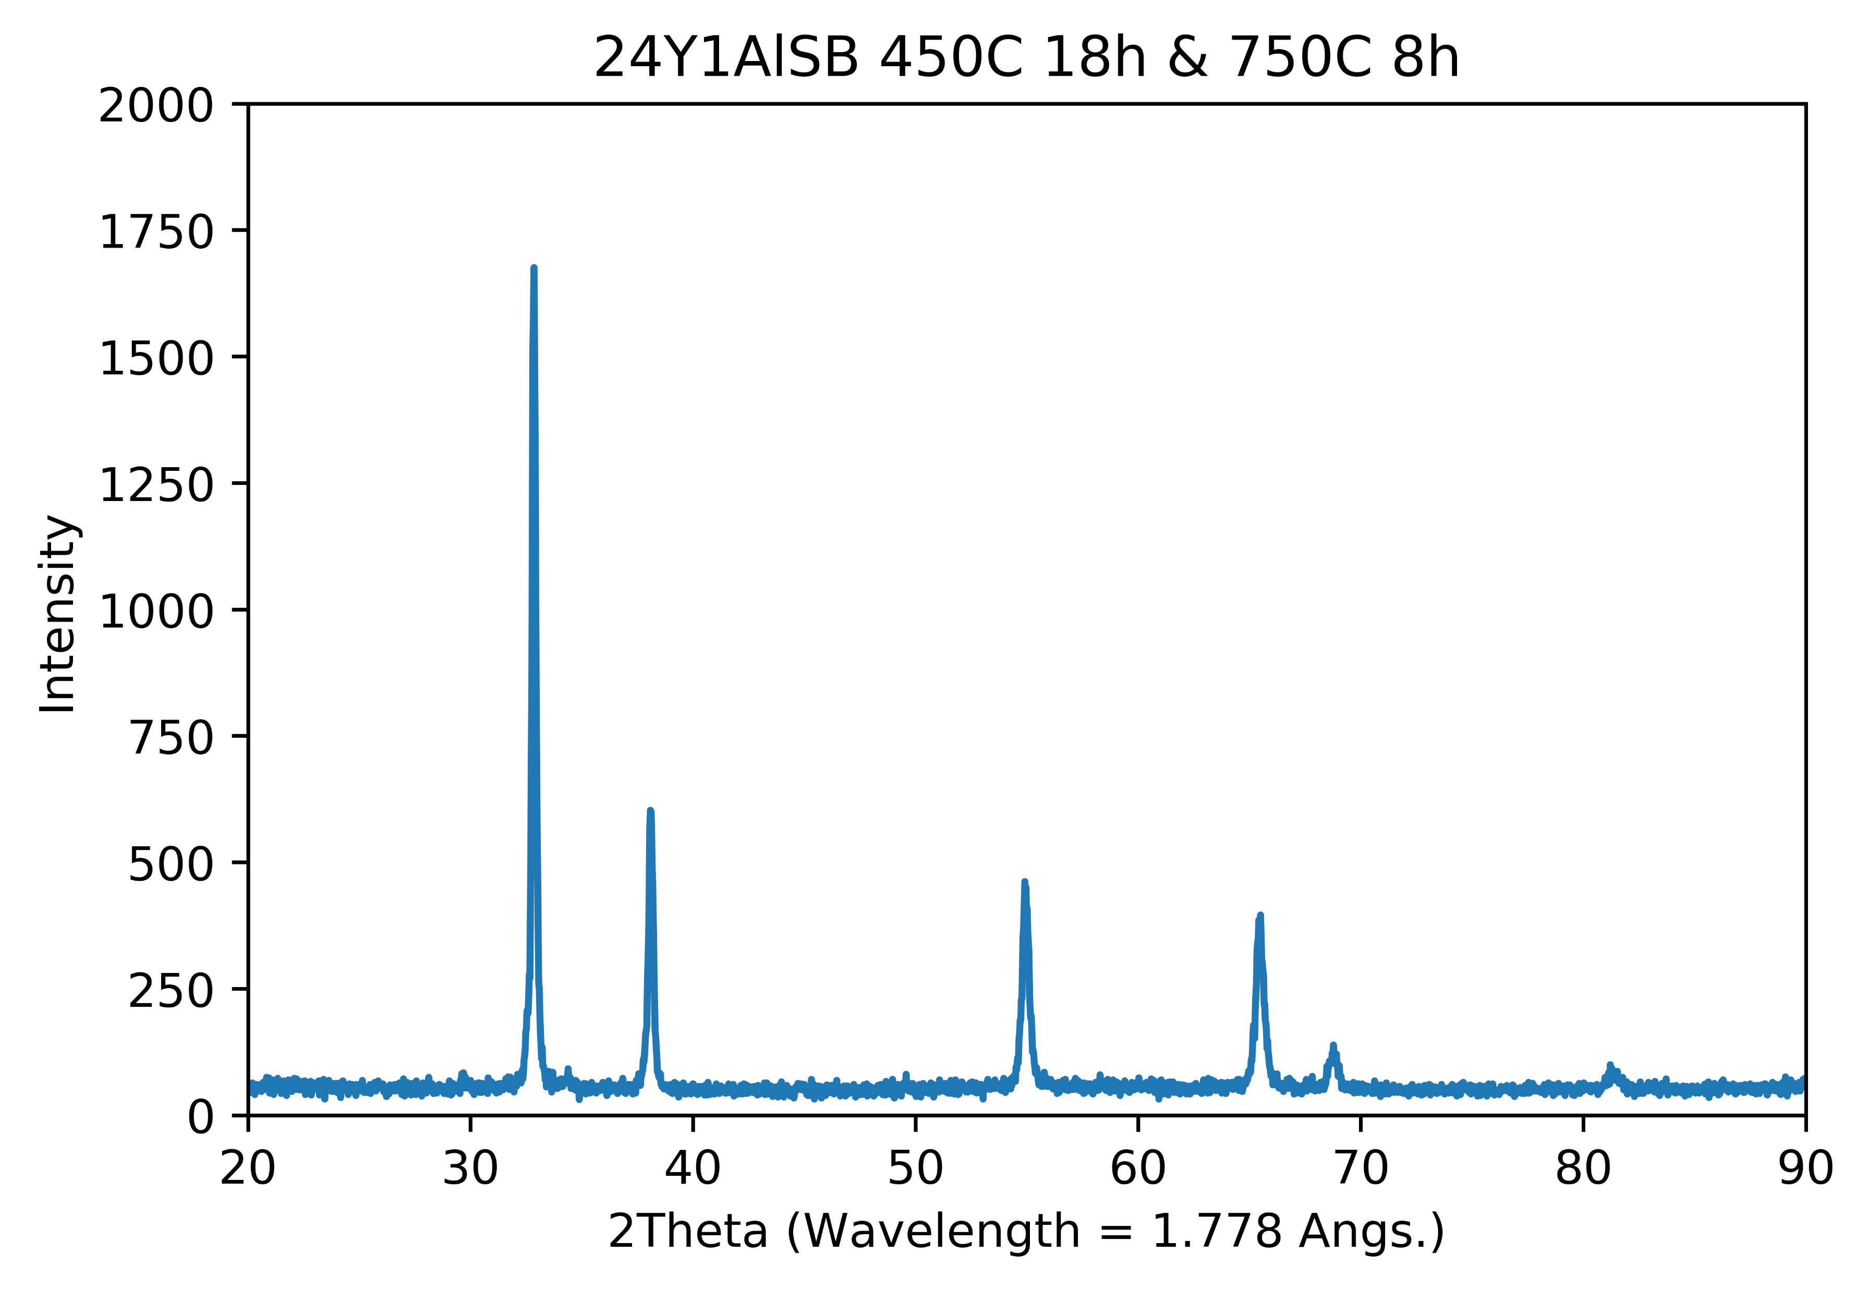
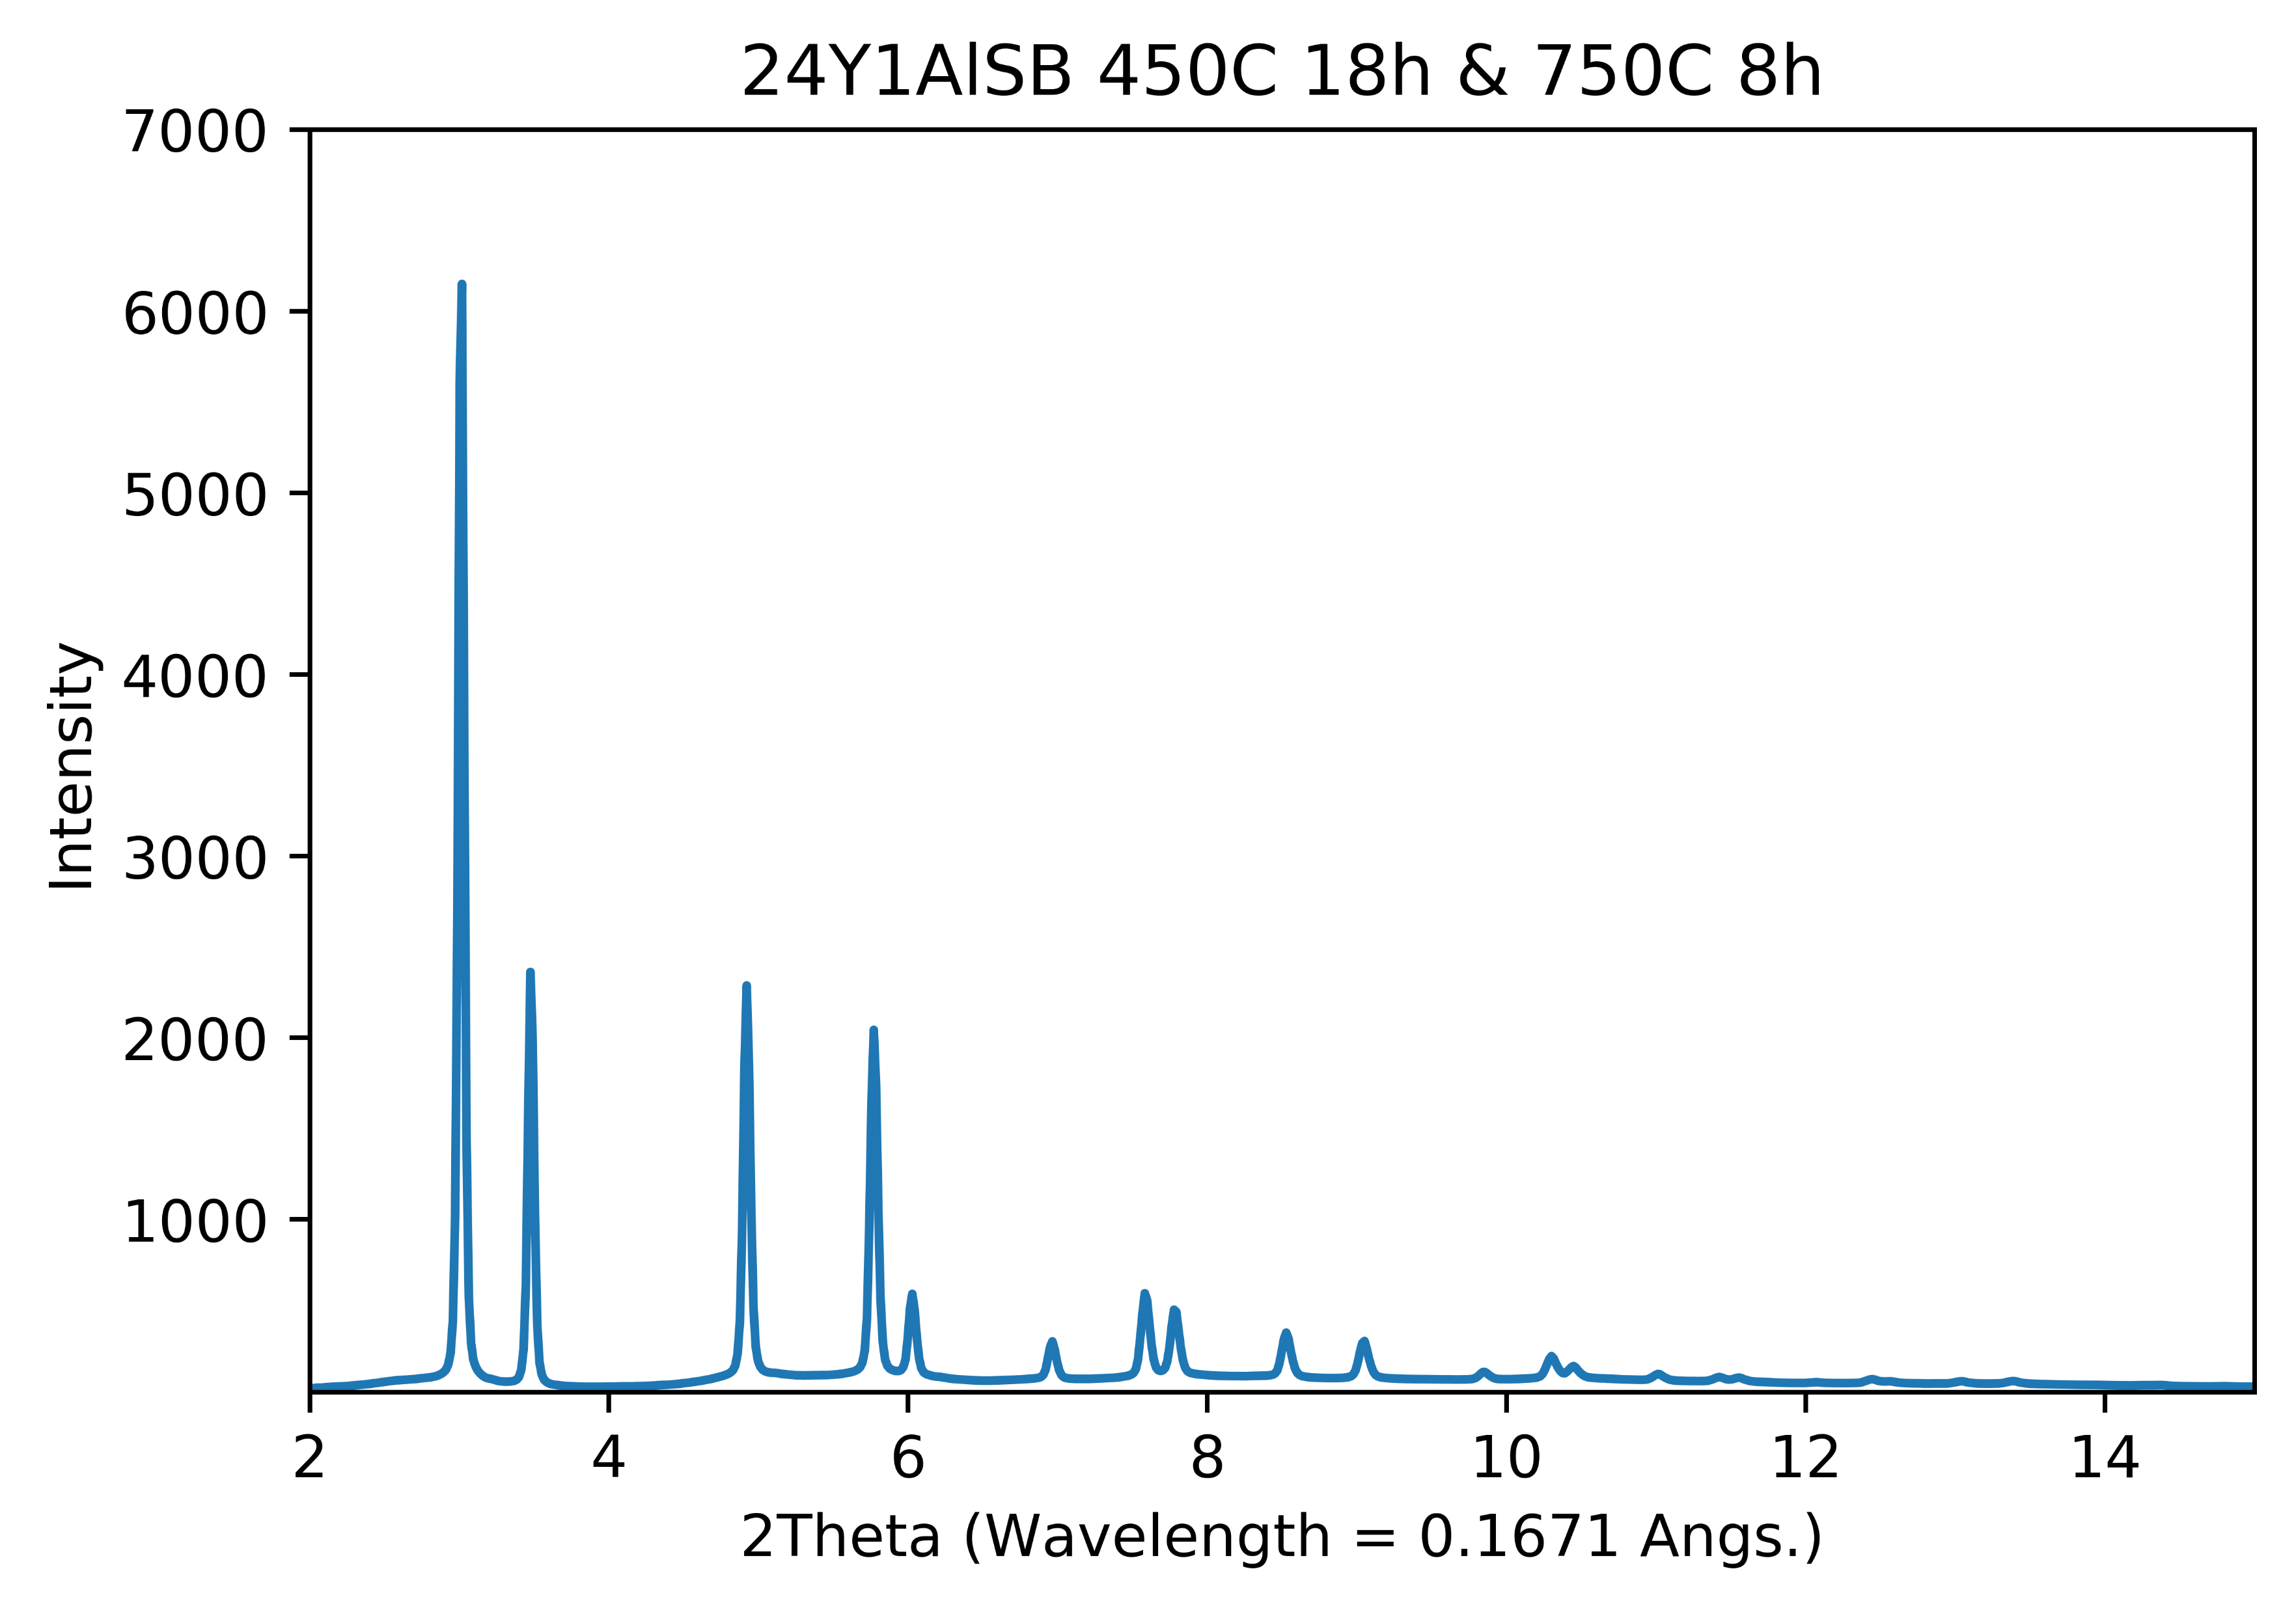
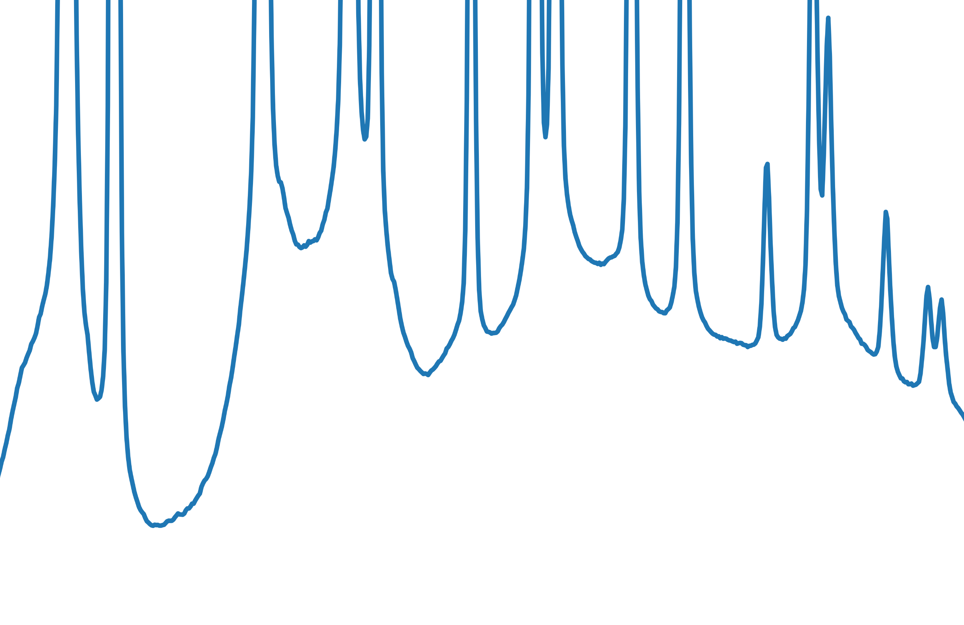
Phase purity continued
Lab data
NSLS-II data

Slide 17
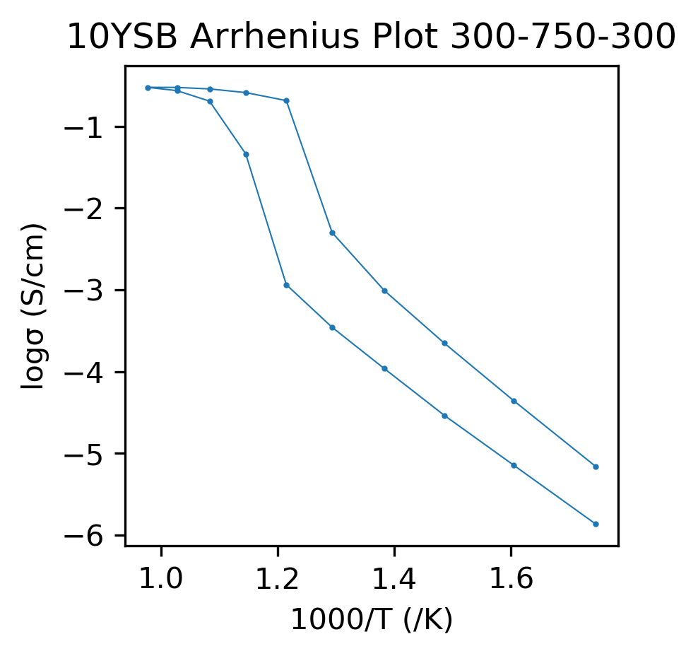
Problem #3: Anomalous conductivity data
Synchrotron data used to unravel anomaly

Slide 18
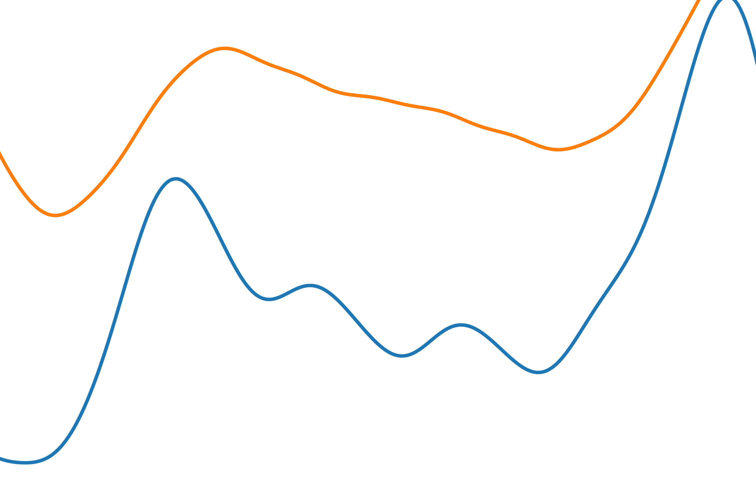
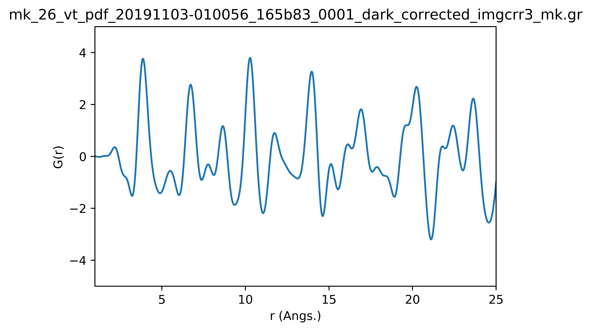
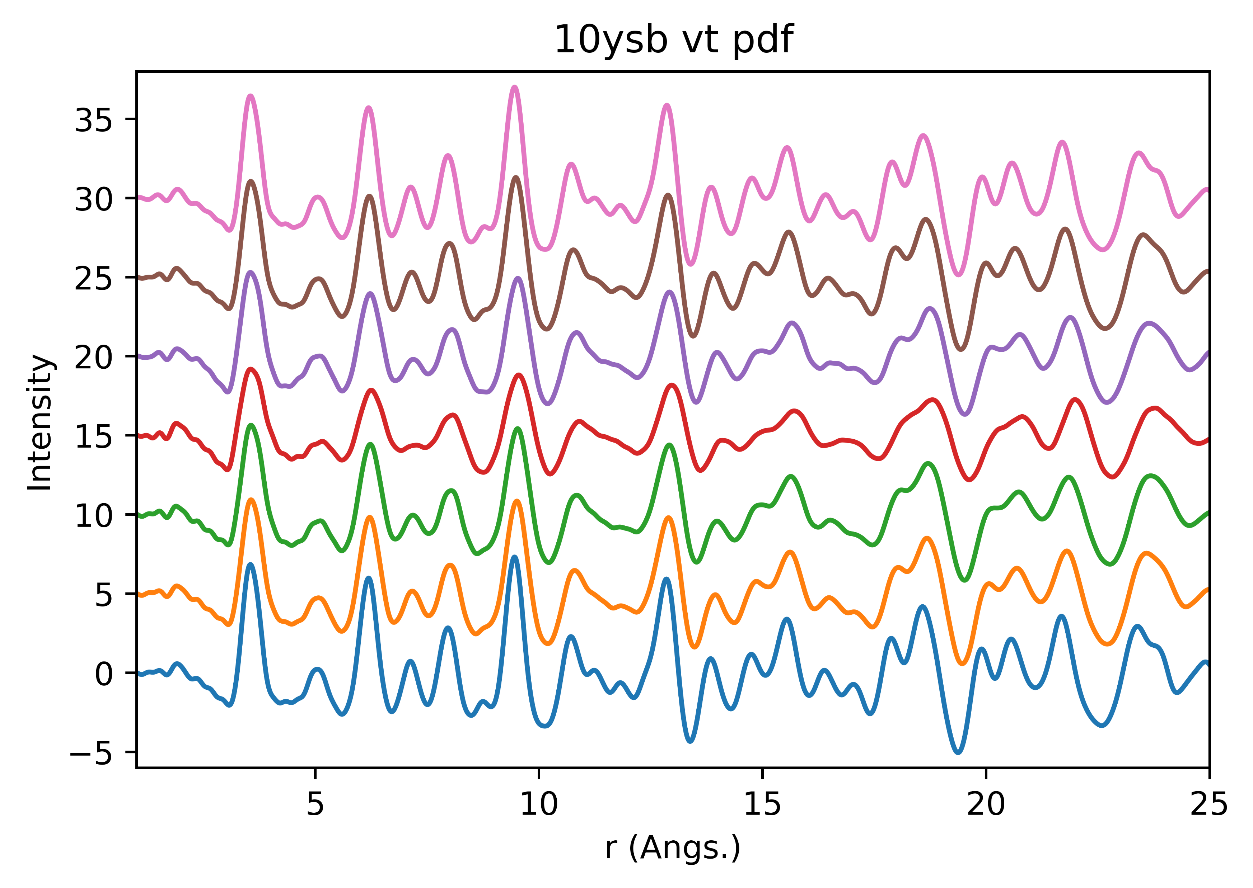
A new hope: PDF measurements
Local structure changes = anomalous cond.

Slide 19
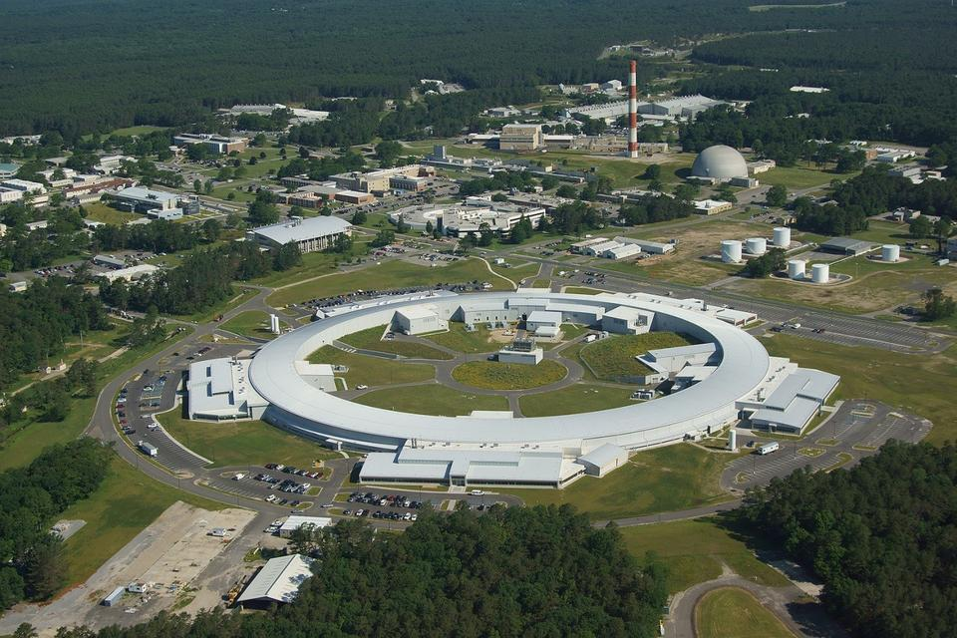
The Need for synchrotron data
Material challenges: High resolution Bragg and PDF data is needed
ID-28-1 at NSLS-II ☺
I11 at DLS (fingers crossed!)

Slide 20
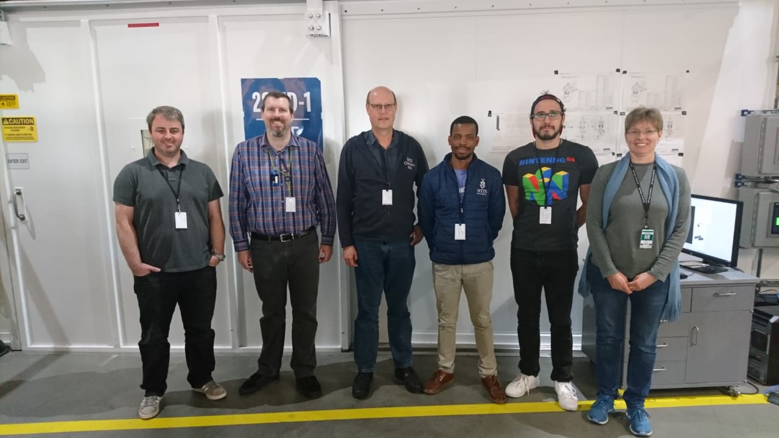
A word of thanks

Slide 21

Thank You/Merci!
Any questions, comments or suggestions?

