Slide 1
Overview of computed tomography in South Africa
K. Jakata
Evolutionary Studies Institute, University of the Witwatersrand, South Africa

Slide 2
Four facilities:
Stellenbosch (Western Cape)
Somerset (Western Cape)
NECSA (Gauteng)
ESI (Gauteng)

Slide 3
NECSA

Slide 4
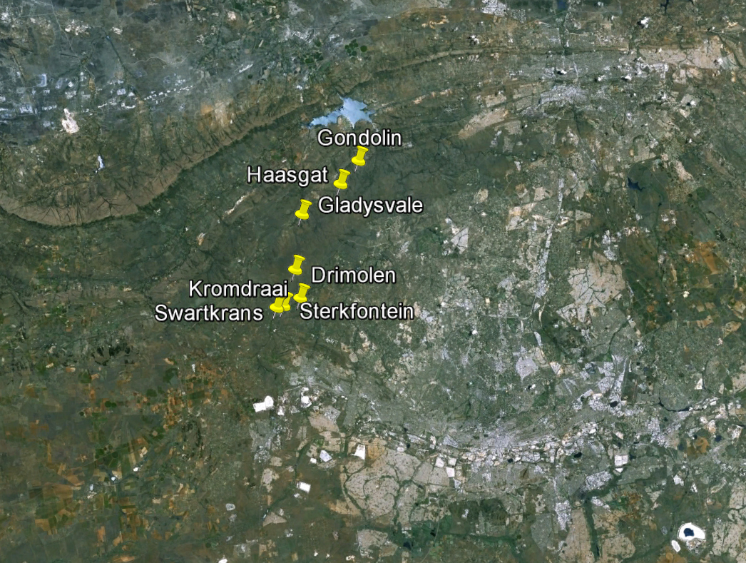
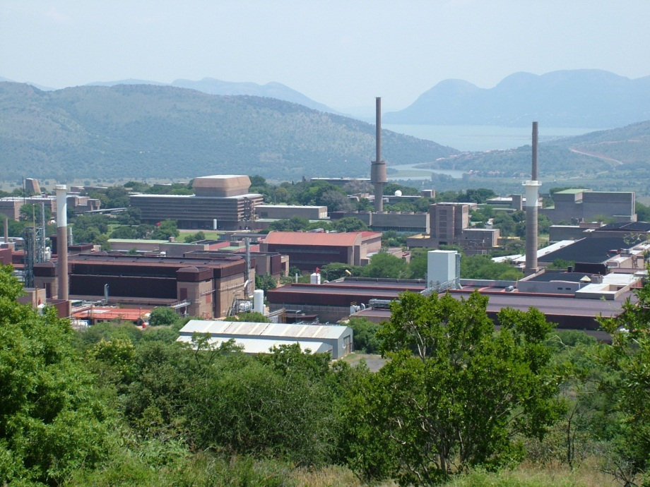
Pretoria 35 km
Johannesburg 55 km
Necsa

Slide 5
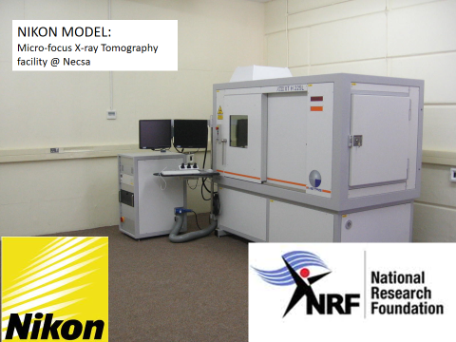
Necsa’s MICRO-FOCUS X-RAY TOMOGRAPHY FACILITY
Commissioned: 1 July 2011
µXCT FACILITY @ Necsa

Slide 6
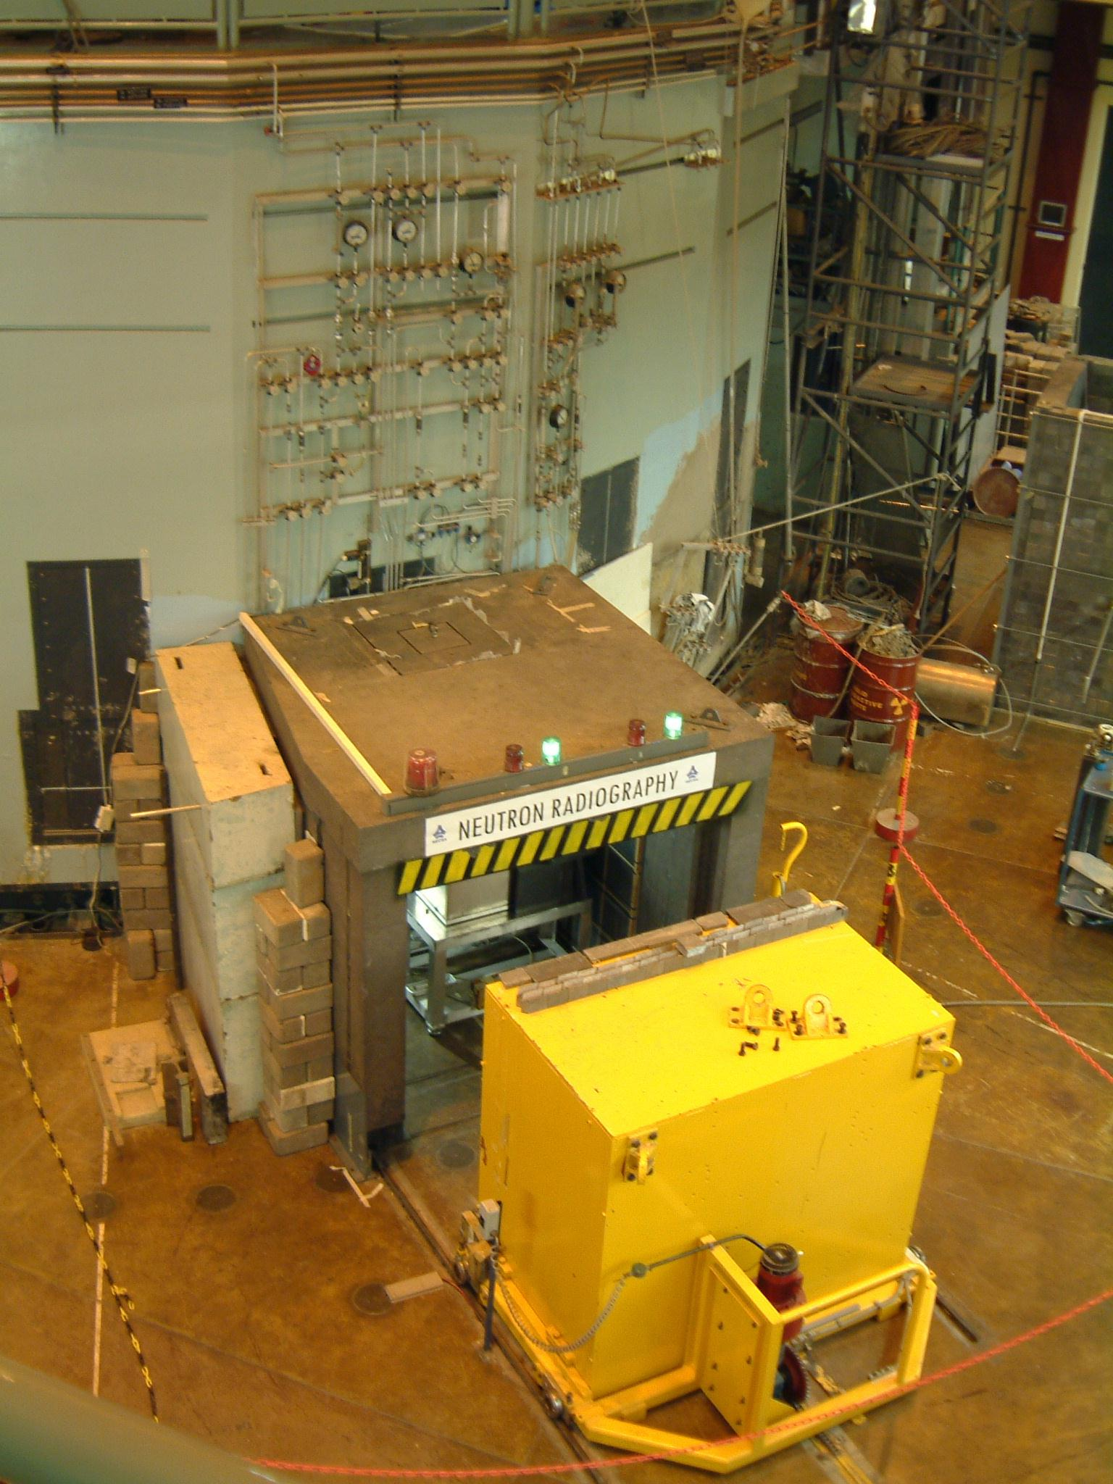
Necsa’s THERMAL NEUTRON TOMOGRAPHY FACILITY @ SAFARI-1
Commissioned: 1 Jan 2003
NEUTRON CT
FACILITY @ Necsa
OPERATIONAL FROM 1975 – 2013 (Thermal N)
1975: Film
1996: Digital
2003: Tomography
SAFARI-1 reactor wall
Shielding
Beam stop / door

Slide 7
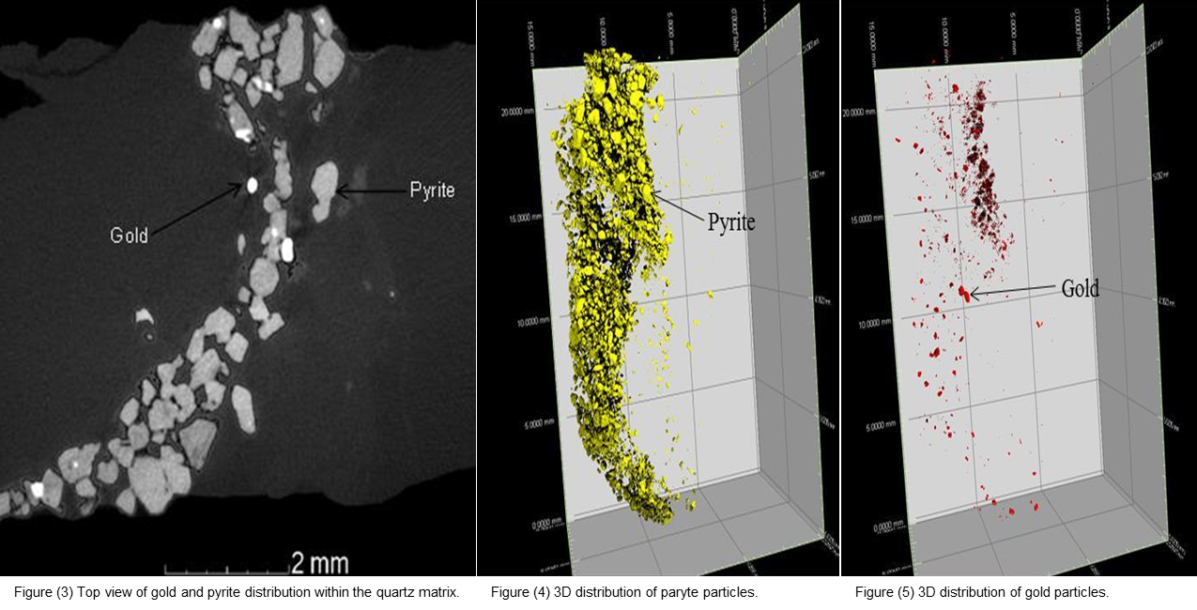
XCT:
Gold
XCT : Gold within pyrite
A B C

Slide 8
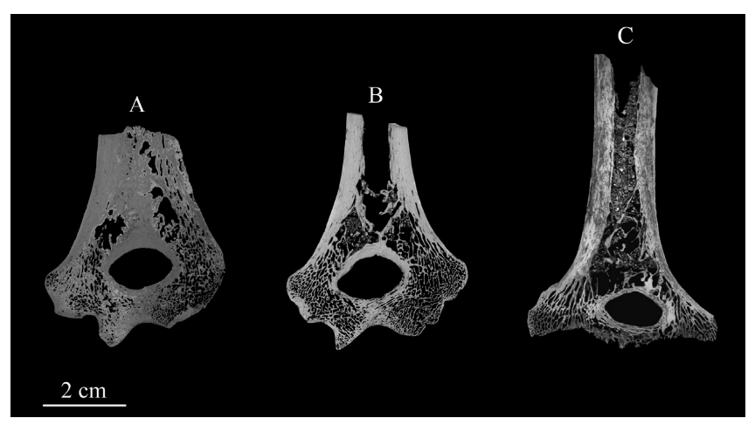
Used non-invasive imaging techniques to tentatively characterize the endostructural organization of five early Pleistocene distal humeri from South Africa
µCT-based coronal slice of SK24600(A), SKX10924(B) and SKX34805(C),all from Swartkrans, SouthAfrica.

Slide 9
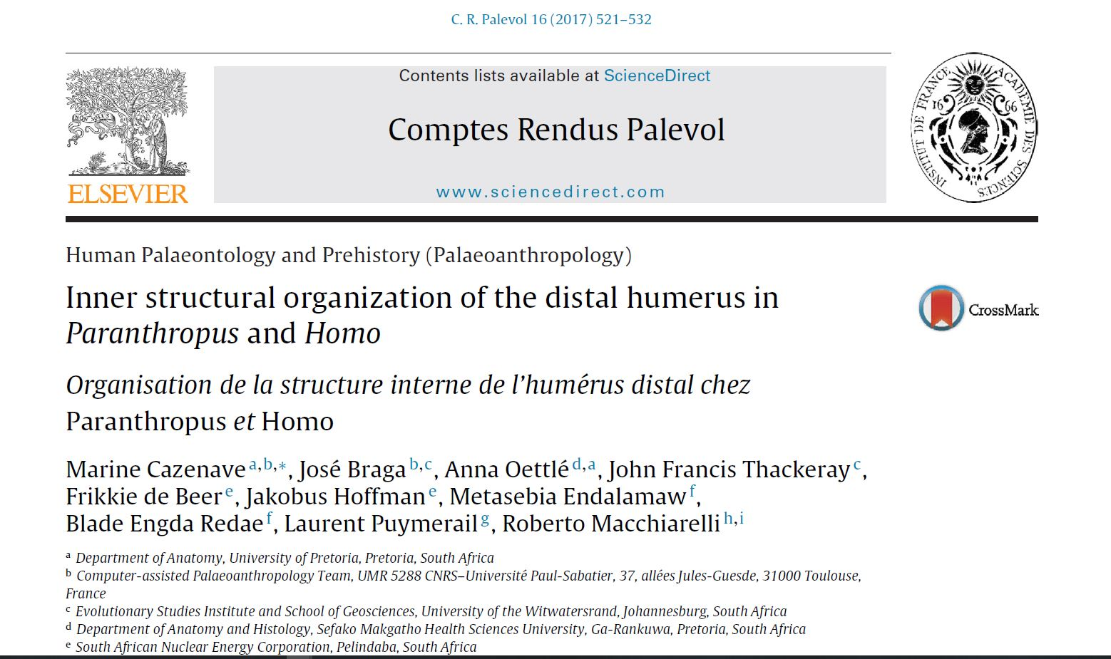

Slide 10
Stellenbosch

Slide 11
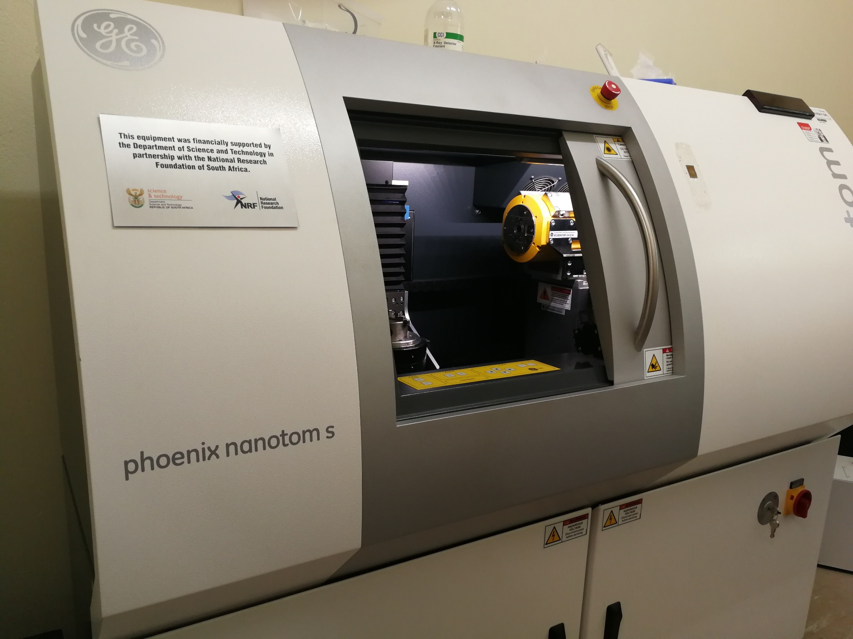

Slide 12
Reflection target (240 kV, 5 μm)
Transmission target (180 kV, 2 μm)
Nano-CT (180 kV, 0.5 μm)

Slide 13
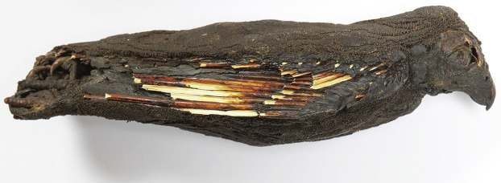
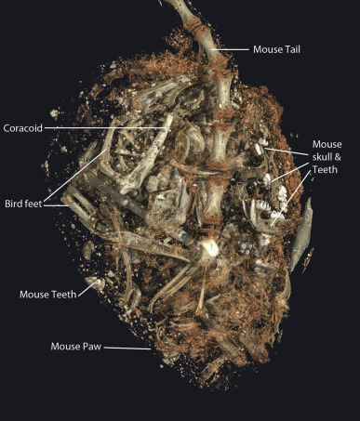
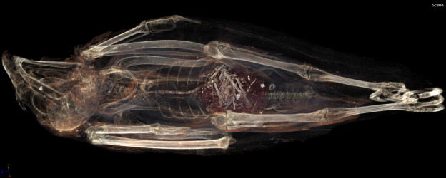

Slide 14
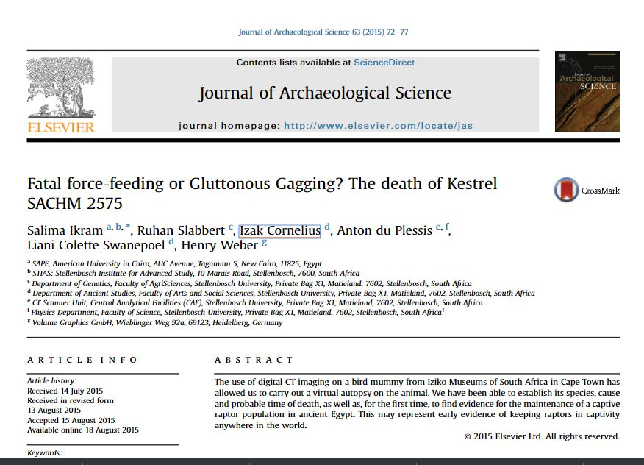

Slide 15
ESI

Slide 16
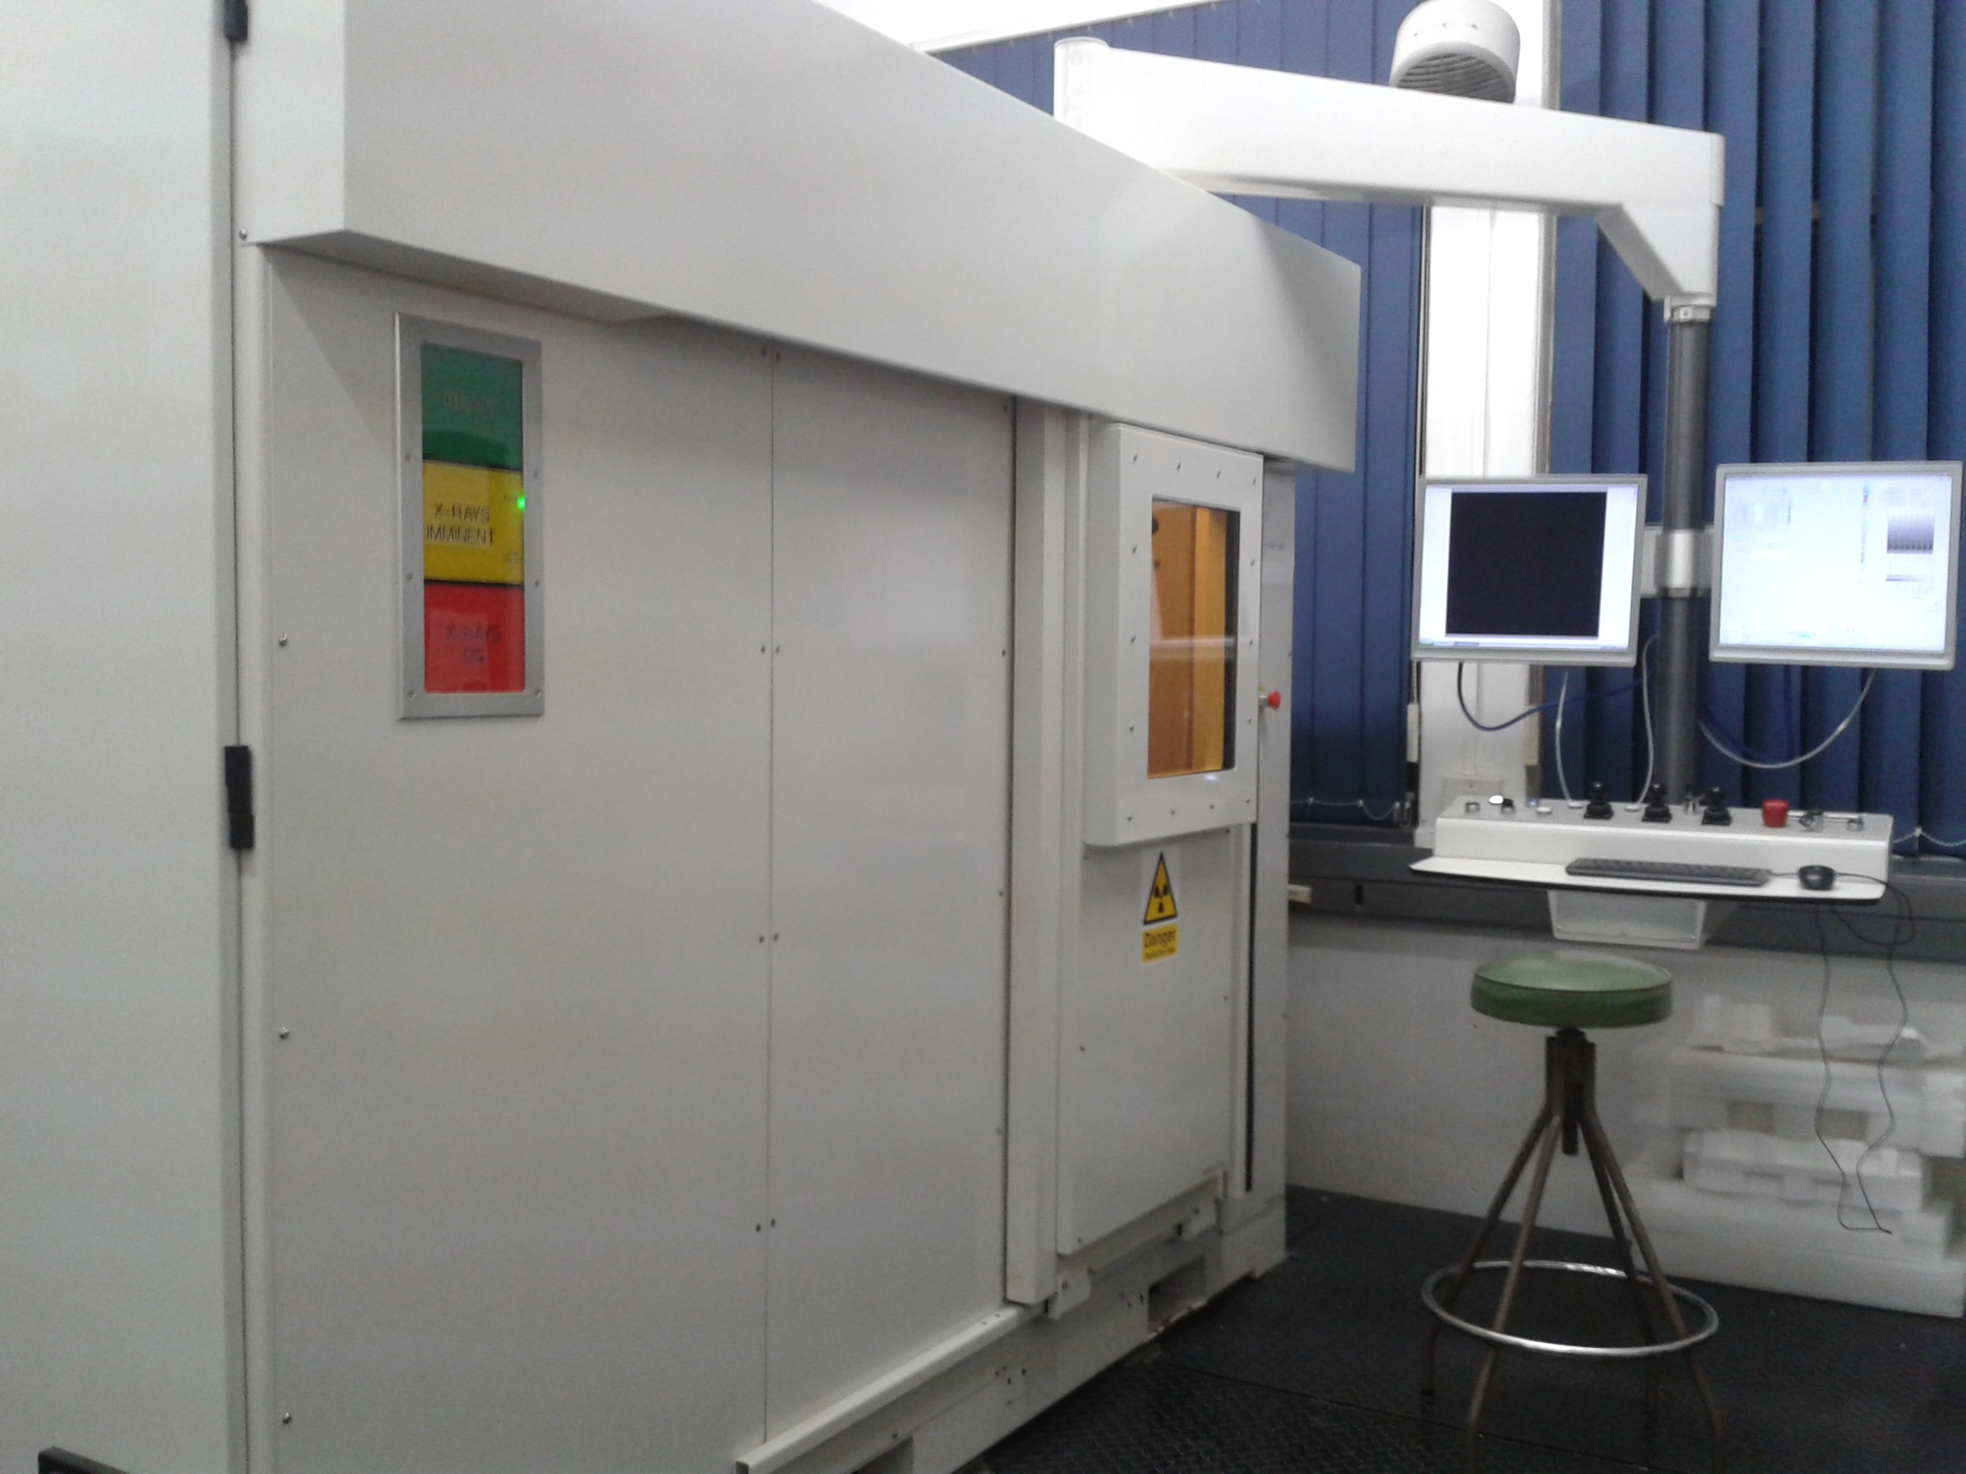
Nikon

Slide 17
Static target (225 kV, 5 μm)
Rotating target (225 kV, 20 μm)
320 kV target

Slide 18
Inspection
R. Machaka, et al

Slide 19
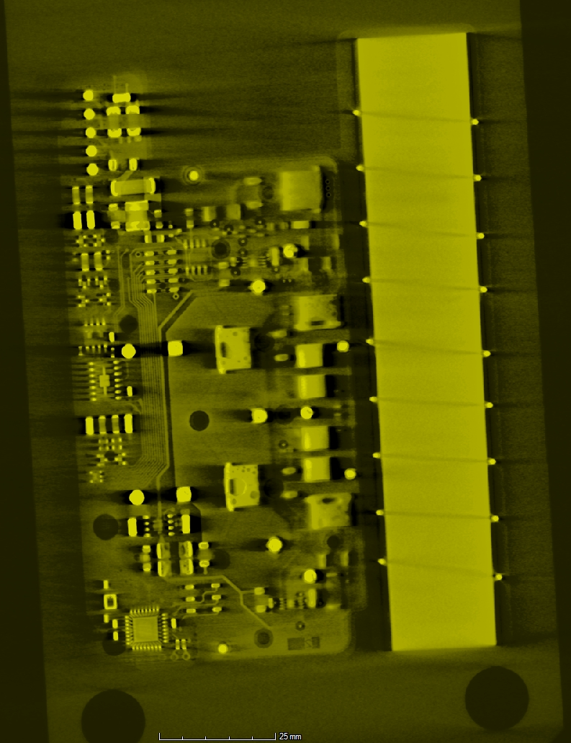
Electronic components

Slide 20
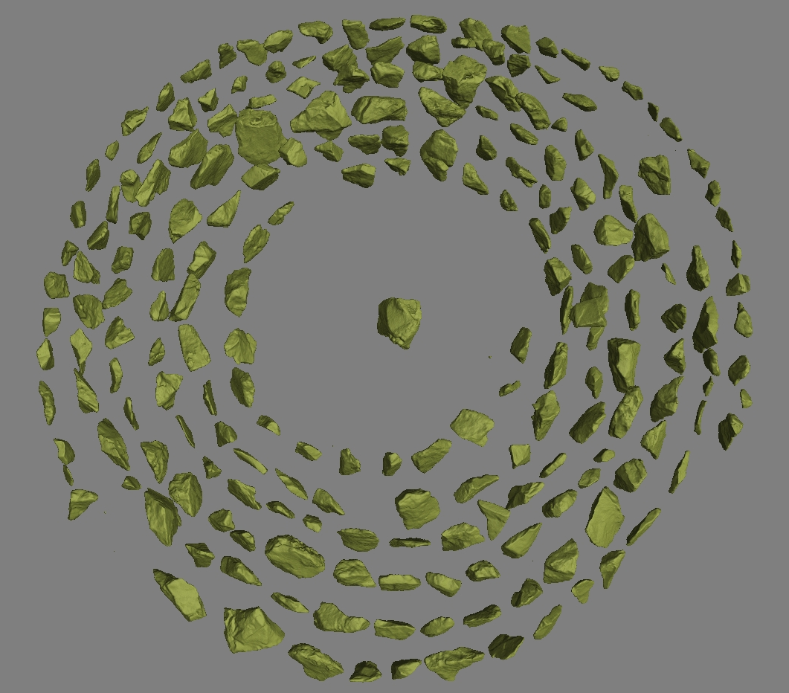
Stone tools
R. Couzins, et al

Slide 21
Cross-hatched pattern drawn with an ochre crayon on a ground silicate flake
~ 73 000 year old Middle Stone Age levels at Blombos Cave, South Africa

Slide 22
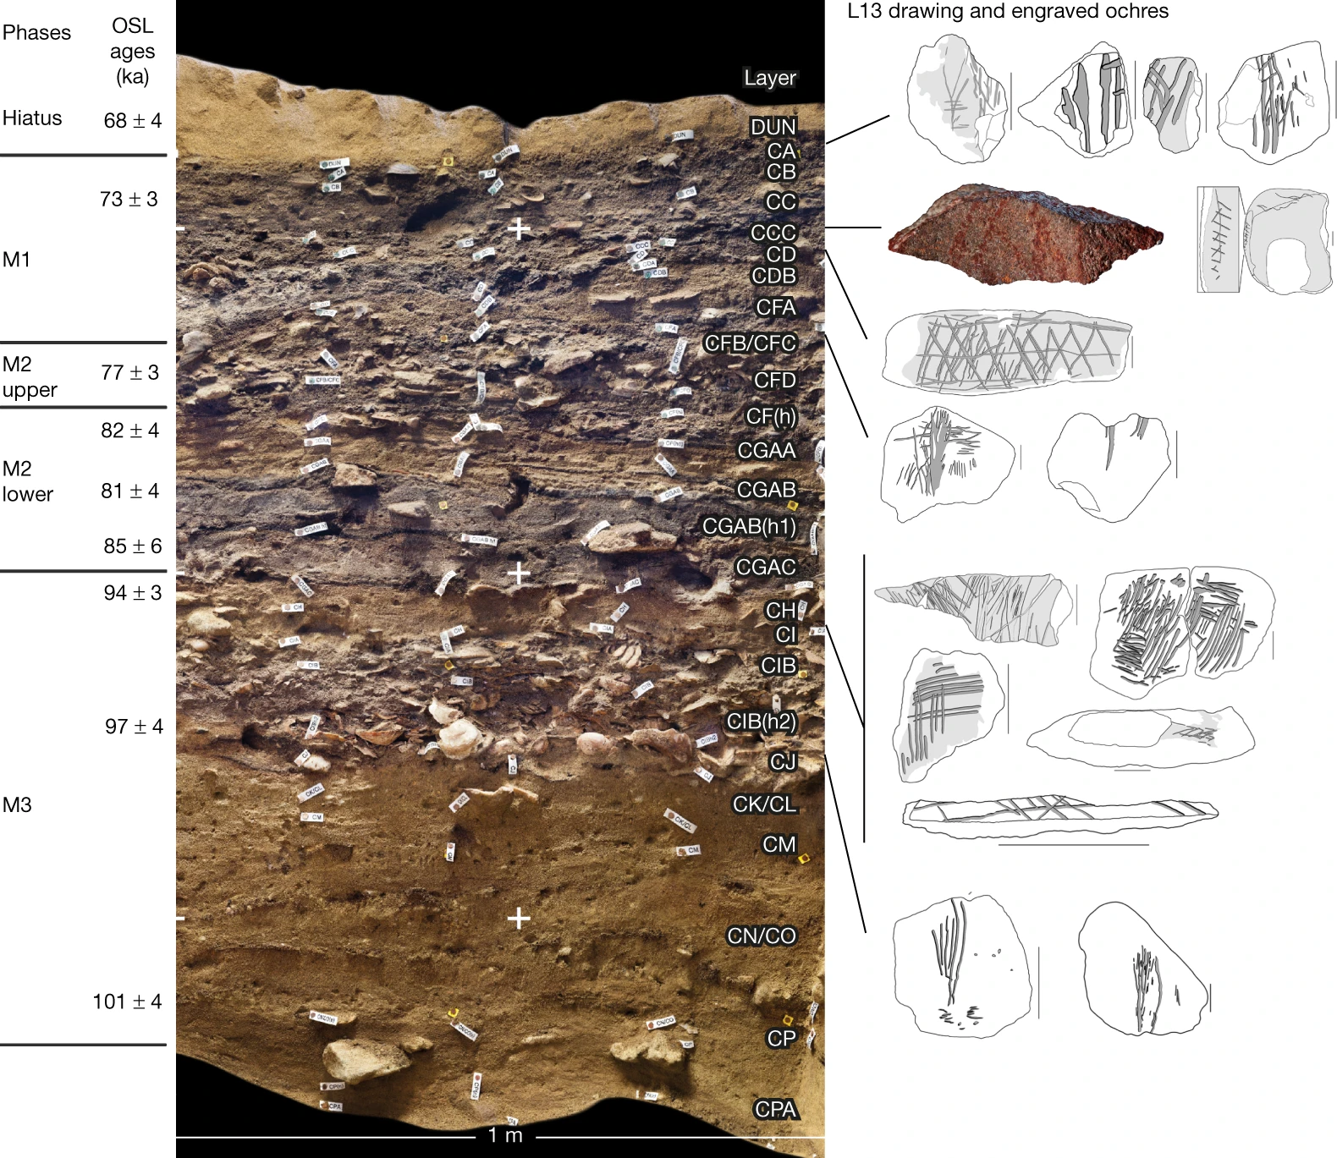
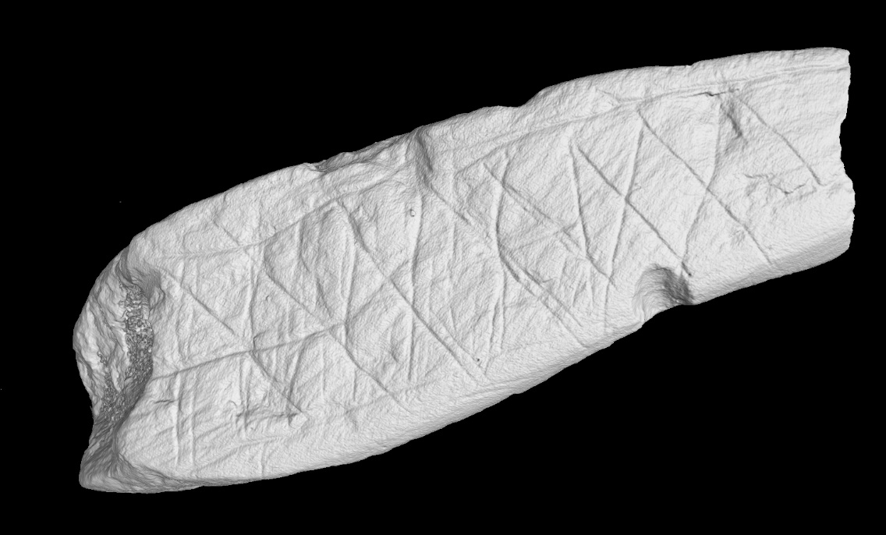

Slide 23
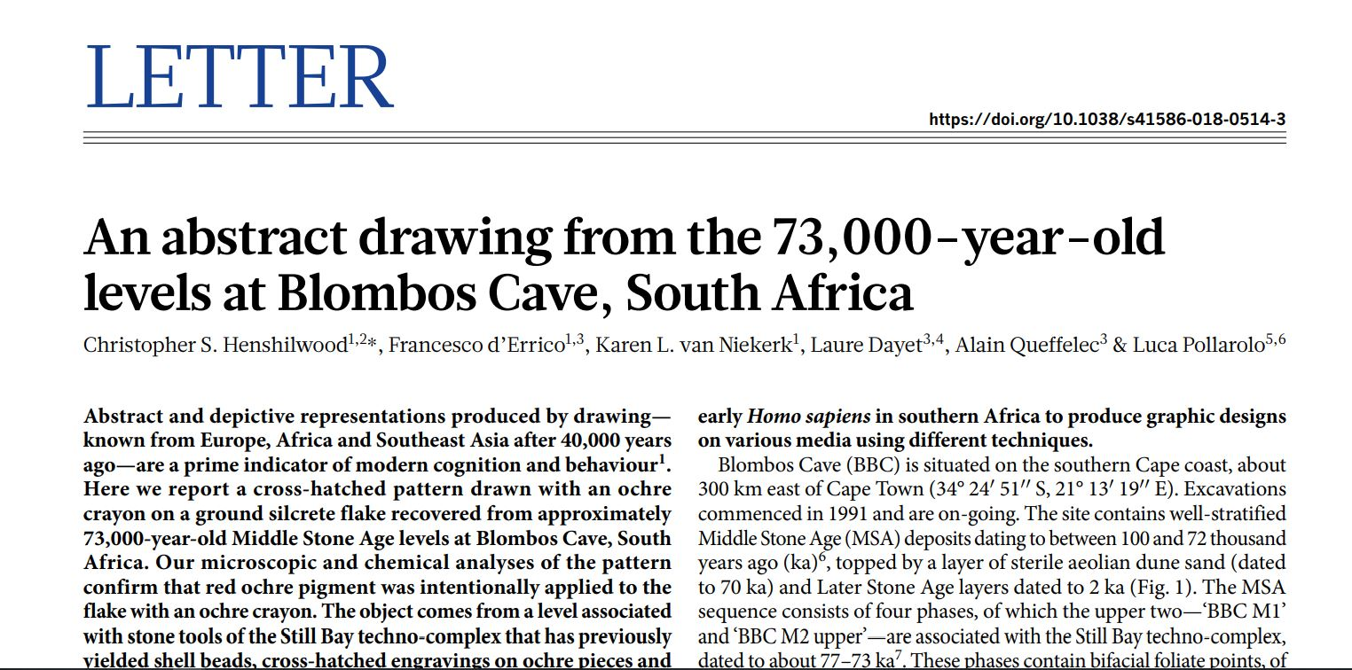
Demonstrates the ability of early Homo Sapiens to produce graphic designs

Slide 24
Geological
core
R. Latypov, et al

Slide 26
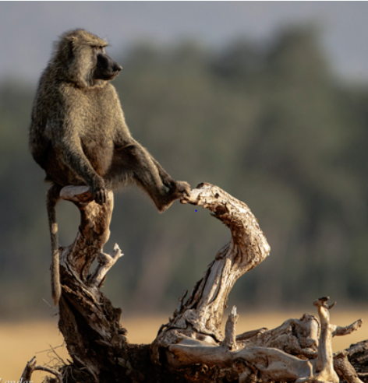
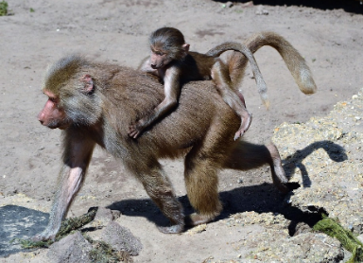
Locomotor and habitat reconstruction of Plio-Pleistocene cercopithecoids: evidence from trabecular bone organization.
M. Babutsi, et al.
Lender (2018)

Slide 27
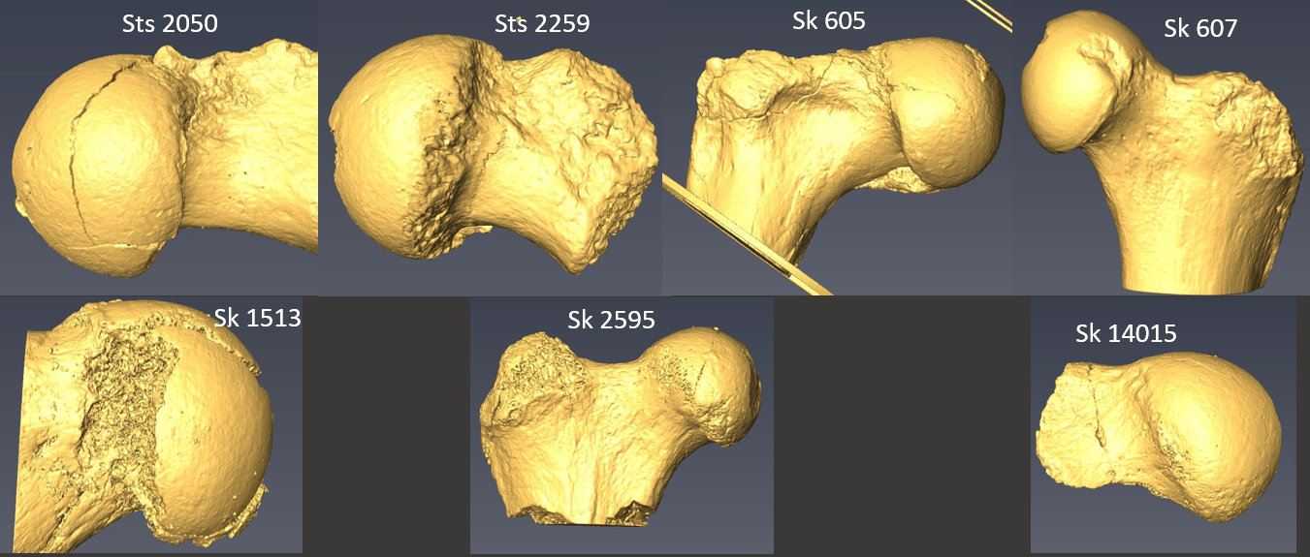
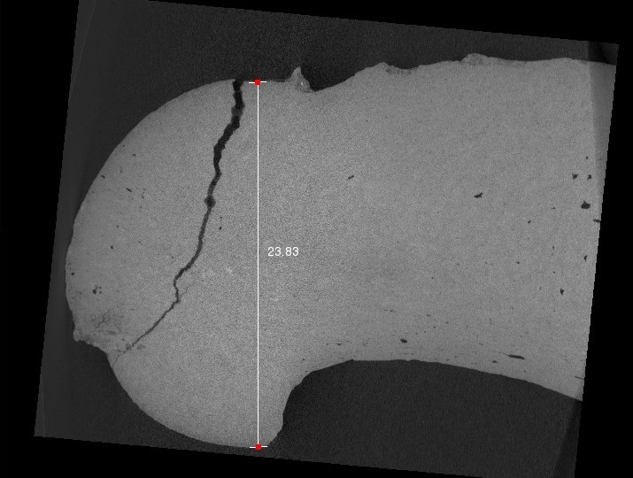
Fossils

Slide 28
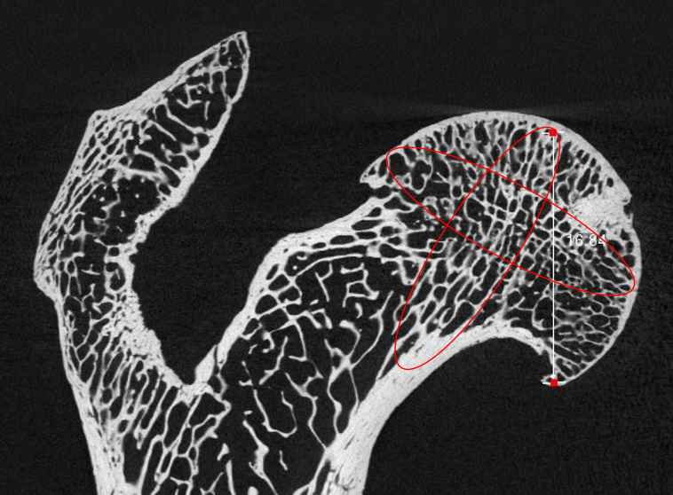
Extant material

Slide 29
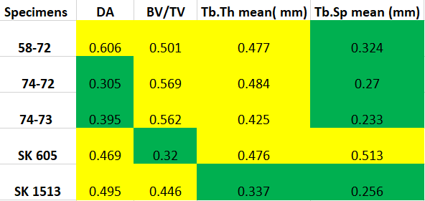
High fabric anisotropy of fossil specimens.
Volume fraction is high in extant specimens than fossil specimens.

Slide 30
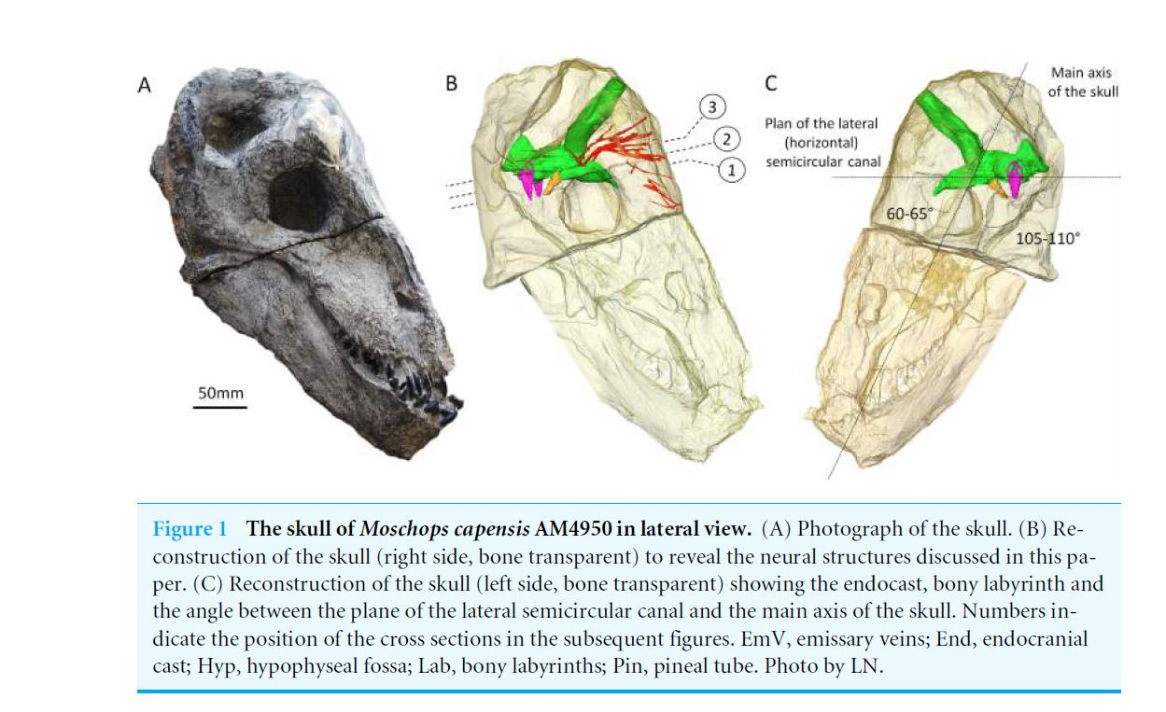

Slide 31
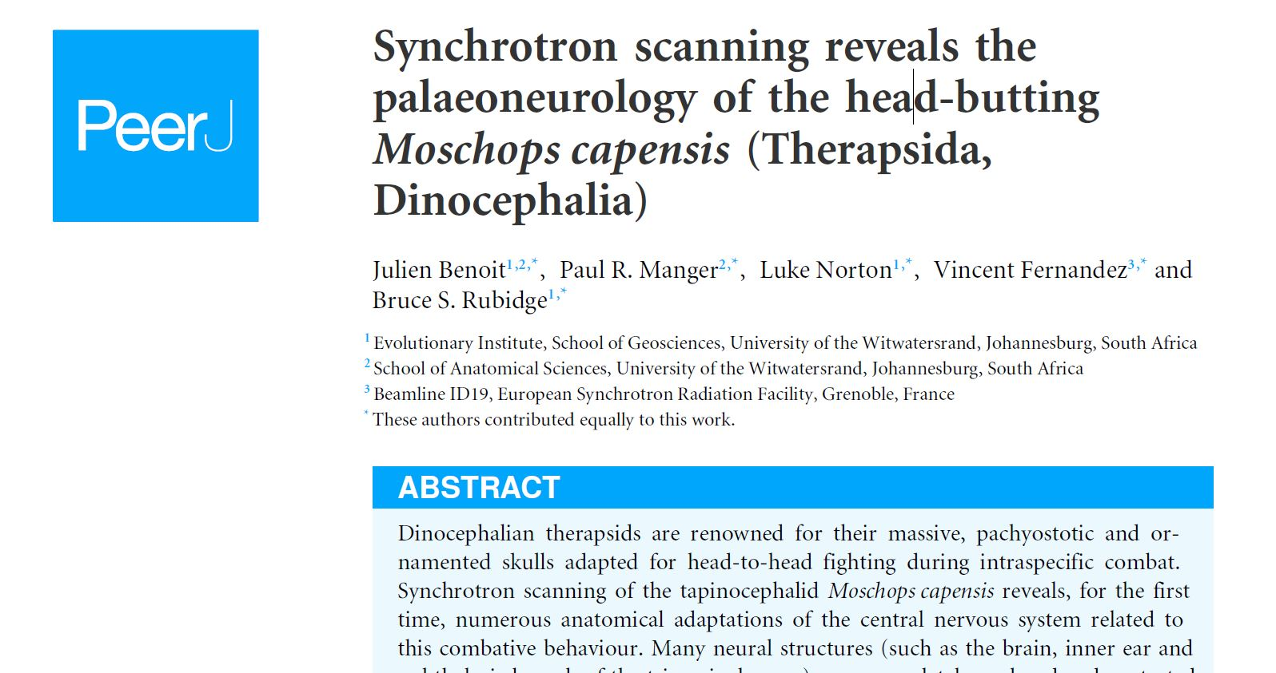

Slide 32
Fossil embryos CT scanned at the European Synchrotron Radiation Facility in Grenoble.

Slide 33
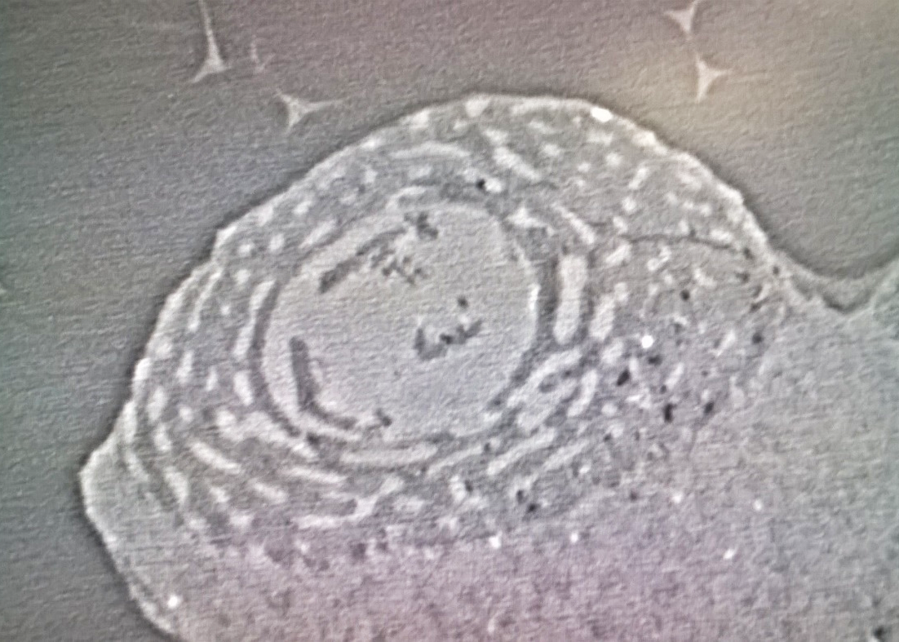
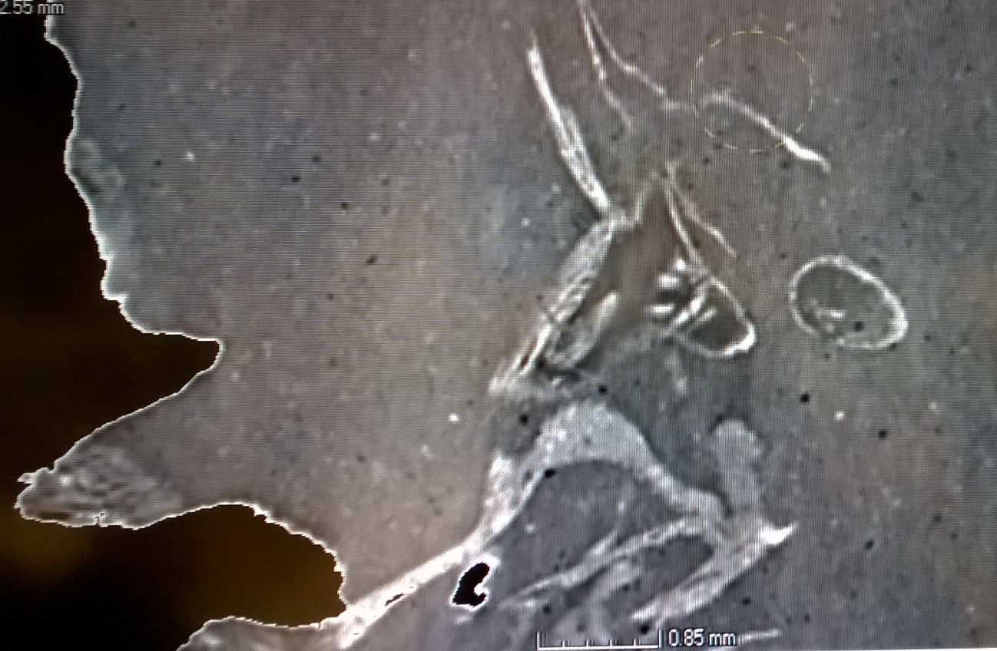
AFTER
BEFORE

Slide 34
Fossil hominin inner ear from Kromdraai B
Images at the same anatomical level (a) X-ray micro-CT (left image) and, (b) X-ray synchrotron (right image)
J. Braga, et al

Slide 35
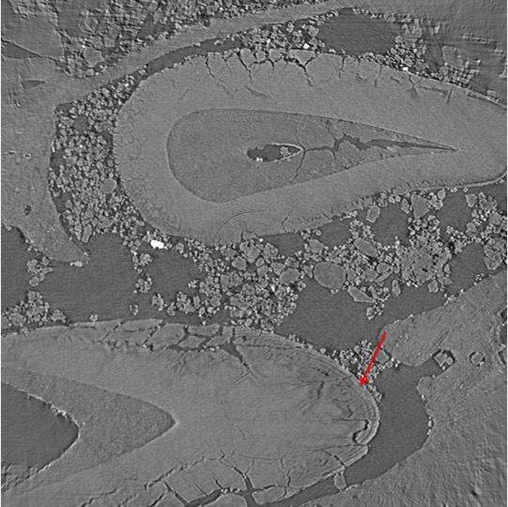
Fossil hominin lower jaw from Kromdraai that we recently discovered (KW 7000).
Incremental lines (ie Striae of Retzius) on this image (black lines shown with the red arrow)
J. Braga, et al

Slide 36
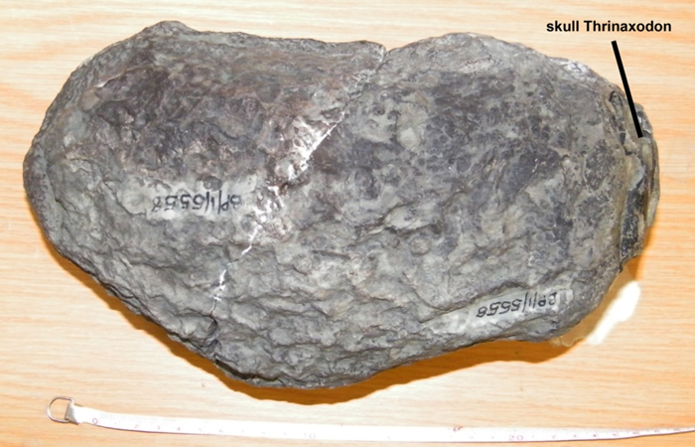
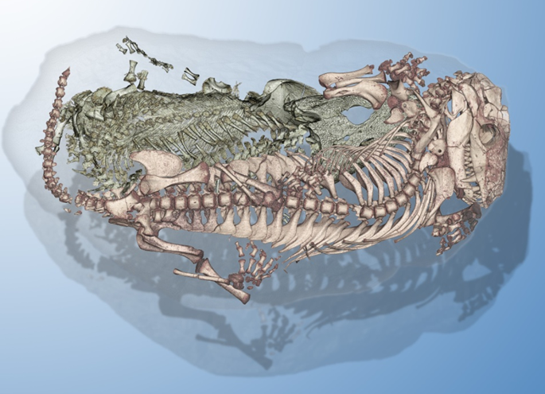
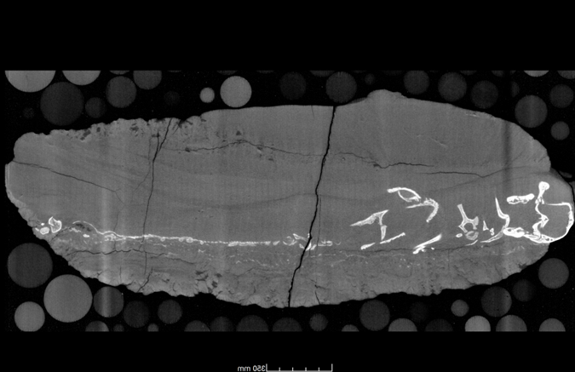
V. Fernandez, et al
The fossil burrow

Slide 37
Spinning
Skull

Slide 38
Thank you

