Slide 2
Structural Biology at the ESRF: present and future
Gordon Leonard
(on behalf of)
ESRF Structural Biology Group

Slide 3
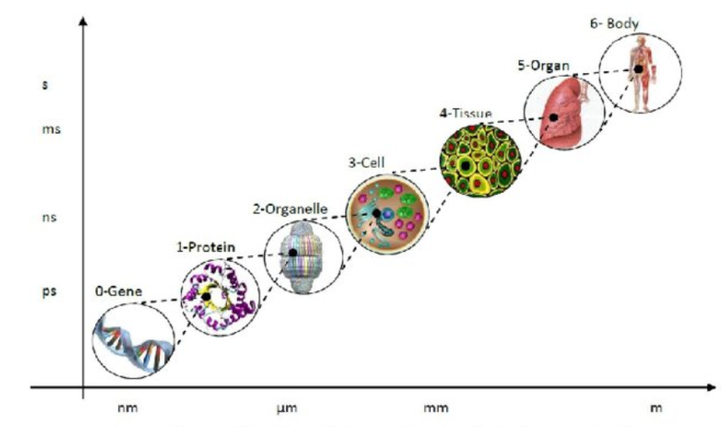
Hierarchical length scales in biology
Structural/Molecular Biology
Figure adapted from Bărbulescu, R. & Ioan, D. (2015). Multi-scale and reduced modelling of biological systems. 9th International Symposium on Advanced Topics in Electrical Engineering (ATEE); DOI: 10.1109/ATEE.2015.7133876

Slide 4
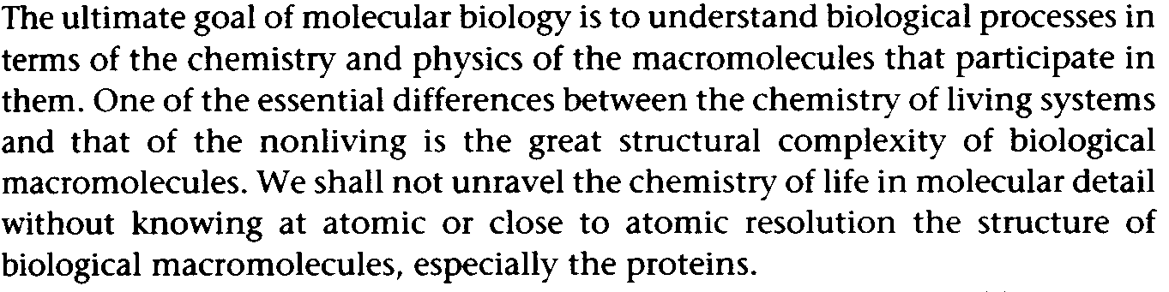
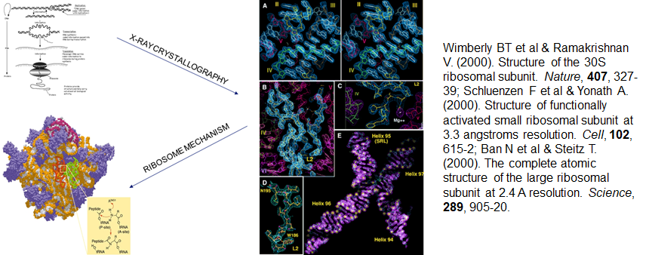
Structural/Molecular Biology
Introduction to Protein Structure, C-I. Branden & John Tooze, Garland Publishing Inc., 1991

Slide 5
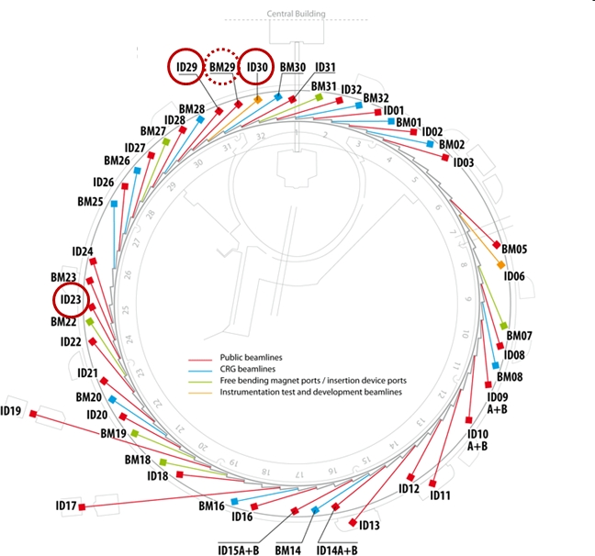
ESRF Facilities for (Integrated) structural Biology
BM29 (BioSAXS)
MASSIF-1, MASSIF-3, ID30B
ID29
High Pressure Cryo-cooling
Sample storage
iCoS
CM01 cryo-EM
8 end-stations:
6 MX
1 Cryo-EM
1 BioSAXS
iCoS
HP Cryo-Cooling
CIBB
ID23-1, ID23-2

Slide 6
SB@ESRF PRE-EBS: versatile, complementary end-stations
 | 1st Operation | Energy [keV] | Beam size [μm²] | Flux [ph/s] | Diffractometer | Detector | Sample Changer | Experiments
ID29 | 2000 | 6-20 | 10-50 | 5x10¹² | MD2 | Pilatus 6M | FlexHCD | MAD/SAD; MDX; on-line Raman, UV
ID23-1 | 2004 | 6-20 | 10-40 | 3x10¹² | MD2M | Pilatus 6M | FlexHCD | MAD/SAD; MDX; dehydration
ID30B | 2015 | 6-20 | 20-200 | 10¹³ | MD2-S | Pilatus3 6M | FlexHCD | MAD/SAD; MDX; dehydration; in situ
MASSIF-3 | 2015 | 12.8 | 15 | >2 x 10¹³ | MD2-S | Eiger 4M | FlexHCD | Mini-focus; MDX; SSX; on-line UV
ID23-2 | 2006 (2017) | 14.2 | 5 x 7 (2 x 2) | 1x10¹² | MD3Up | Pilatus3 2M | FlexHCD | Microfocus; SSX
MASSIF-1 | 2014 | 12.8 | 50 (20-150) | 2x10¹² | RoboDiff | Pilatus3 2M | RoboDiff | Automatic data collection; Mail-in; fragment screening, etc.
BM29 | 2011 | 7–15 | 500 × 500 | 1.3x10¹³ | N/A | Pilatus 1M | ARINAX liquid handler | BioSAXS; SEC-SAXS
CM01 | 2017 | Electron Microscopy |  |  |  |  |  | Single particle reconstruction

Slide 7
MX Beamlines: Diffraction data for more than 15,000 PDB Depositions: How?
User-friendly
  Web-based MXCuBE3 User Interface
    MXCuBE Collaboration
Very high level of automation
  MD2 diffractometeters
  Flex-HCD sample changers
  Constant monitoring of flux on sample allows proper experiment design (radiation damage)
  Beamline expert system
    Workflows (beamline ‘Wizards’)
      MXPress workflows
      X-ray centering of samples
      Diffraction cartography
      Set up and execution of helical data collections
      Multi-crystal data collection (i.e. MeshandCollect)
      Dehydration protocols
      Radiation damage
    …..
Display and download of results at all stages of experiment
  ISPyB/Exi
    Automatic data processing
    Automatic structure solution (SAD, Molecular Replacement)
      ISPyB Collaboration

Slide 8
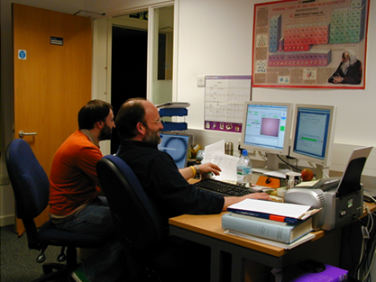
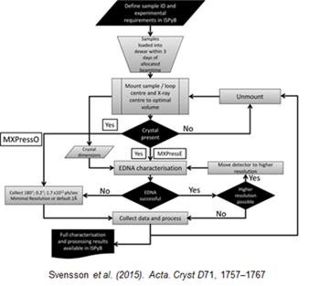
Automation + MxCuBE + ISPyB = Remote Access/Mail-in
For mail-in/remote access ESRF pays for sample transport to/from Grenoble
Notes:
Graphical overview of the automated characterization and data-collection process running on MASSIF-1. All steps in the process are shown. The beamline-control GUI MXCuBE takes care of sample mounting/unmounting and optical centring of the sample mount. Information about the samples, dewar tracking and the presentation of results are via the beamline LIMS system ISPyB. The software described here starts once a sample has been mounted and optically centred to the X-ray beam. [Svensson, O., Malbet-Monaco, S., Popov, A., Nurizzo, D. and Bowler, M. W. (2015). Acta Cryst. D71, 1757-1767. doi:10.1107/S1399004715011918]

Slide 9
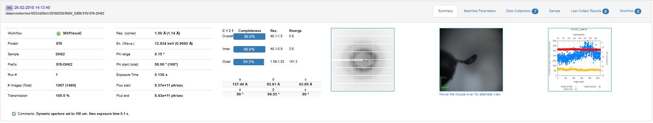
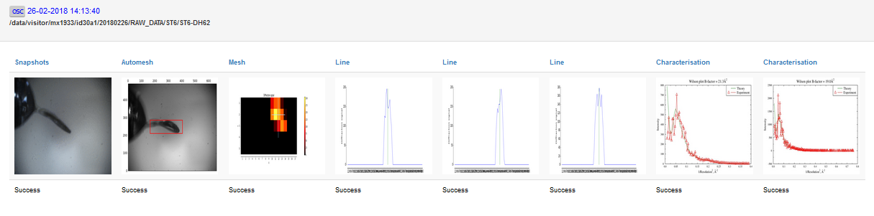
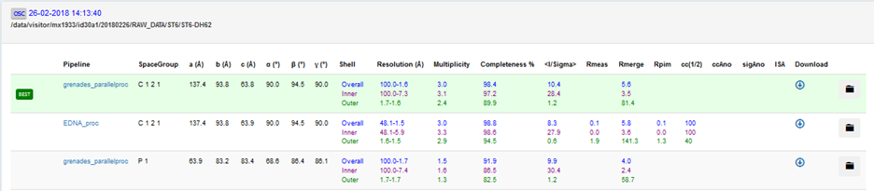
ISPyB/Exi Display and download of results (MXPRESSE Workflow)
Off-line reprocessing coming soon….

Slide 10
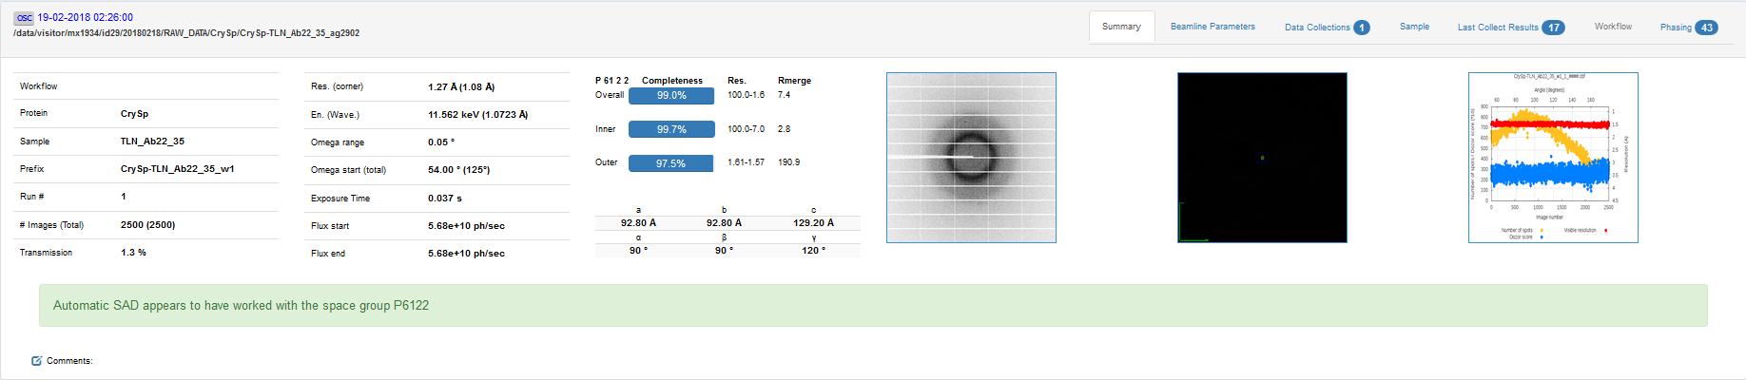
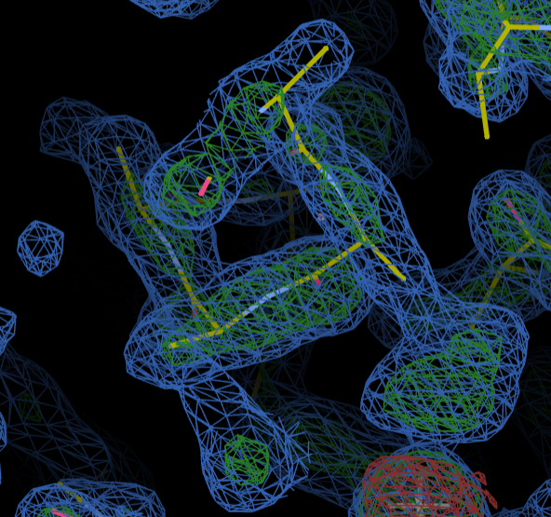
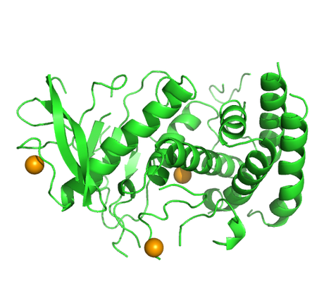
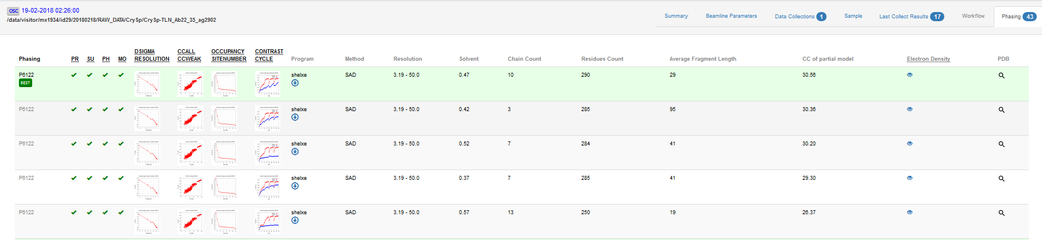
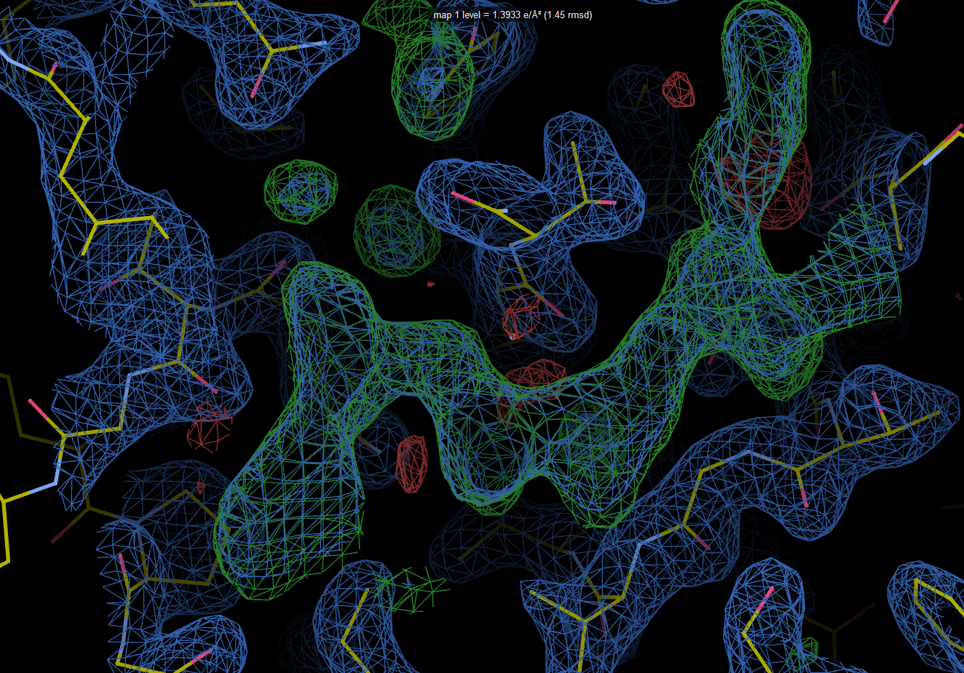
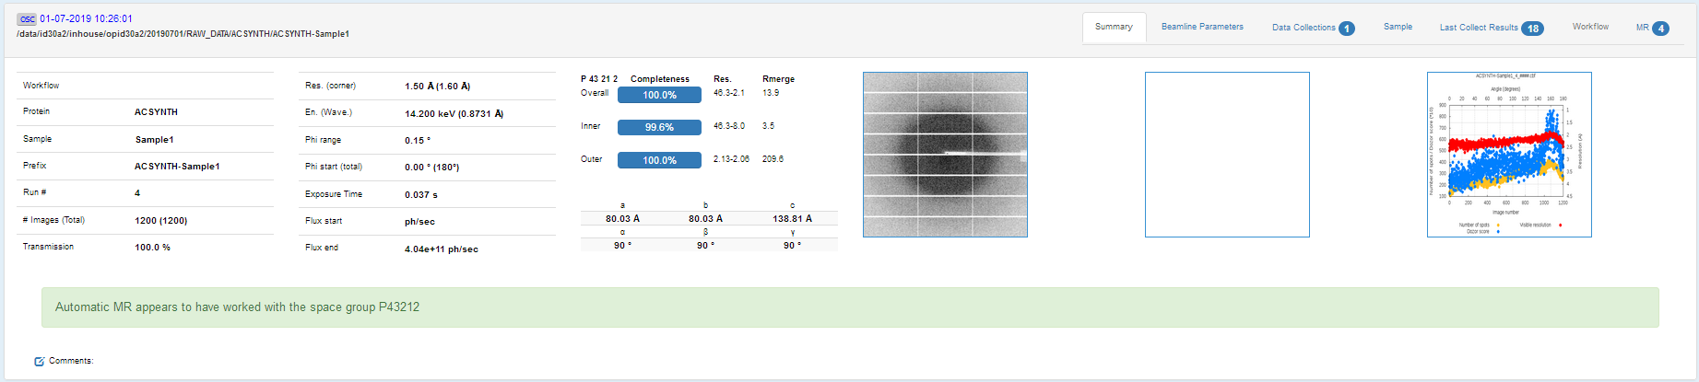
Automatic Structure determination
Automatic ligand fitting coming soon.

Slide 11
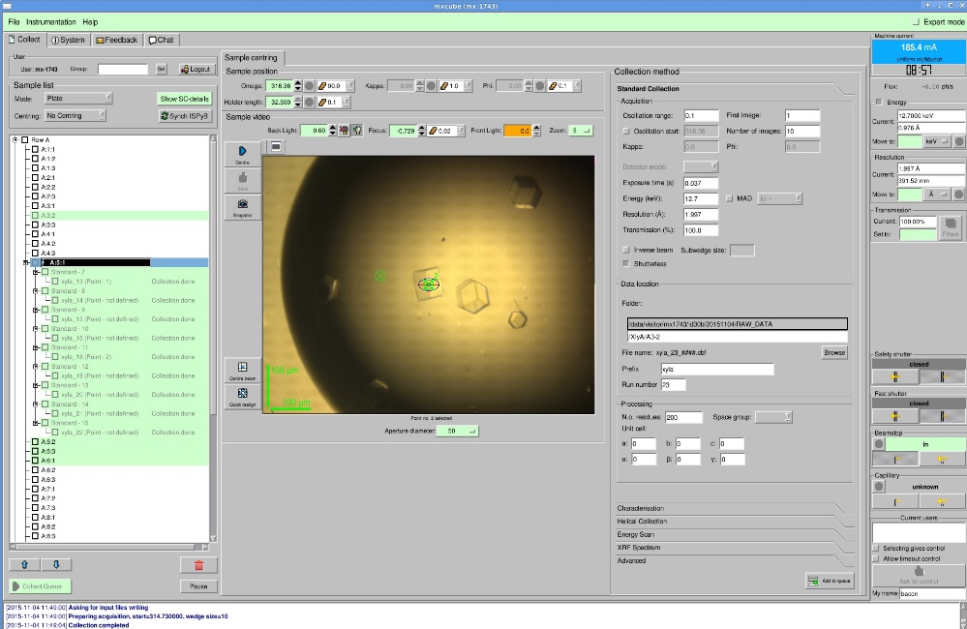
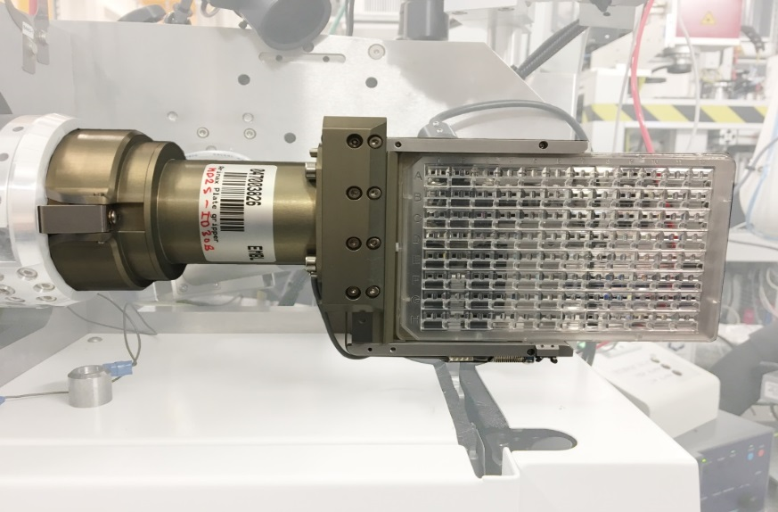
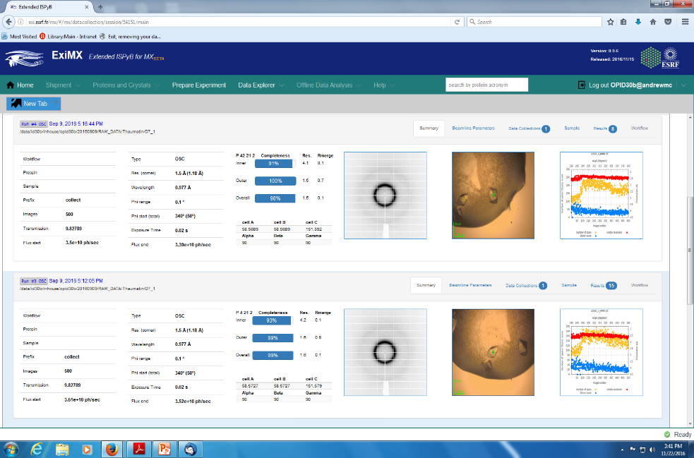
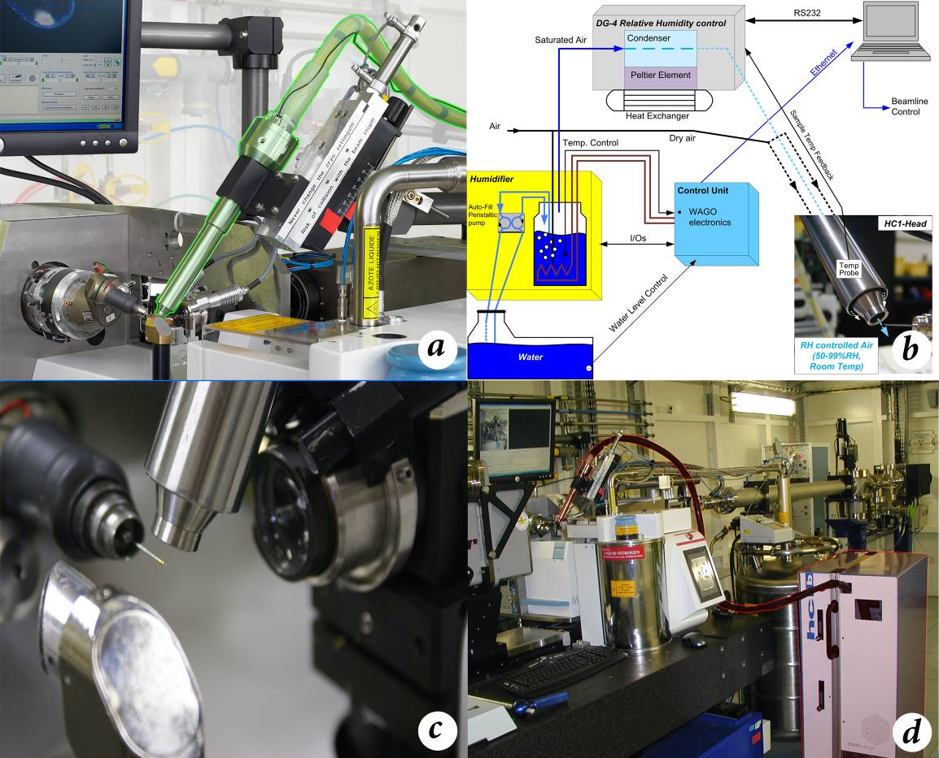
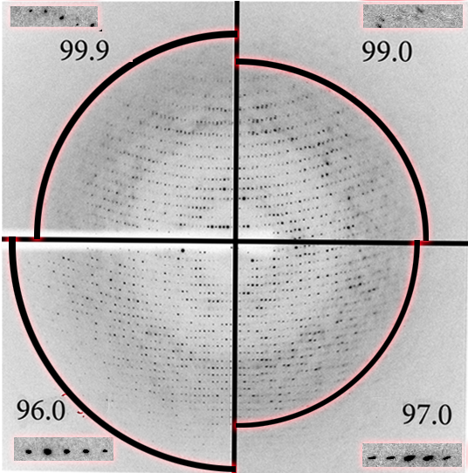
A versatile sample environment Allows less standard experiments
In situ Plate screening
In Situ-1TM ; Crystal DirectTM ; CrystalQuickTM X
Crystal dehydration

Slide 12
small crystals require Multi-crystal data collection: MDX & SSX:
Number of cryocooled crystals of a given size required to achieve dataset resolutions of d_{min} = 1.5 Å (blue) and d_{min}= 2.0 Å (orange).
Complete data set resolution vs. crystal size
Radiation damage means that the resolution of a complete data set that can be collected from a single crystal is (size) limited.
Can overcome this limitation by collecting (and merging) partial data sets from many crystals
For a Thermolysin crystal (Space Group P6₁22; B-factor=11.5 Å²) 1x1x1 μm³ in dimensions partial data sets from about 15000 crystals would be needed to achieve a final data set resolution of d_{min} = 1.5 Å (A. Popov, ESRF).
Multi-crystal data collection/‘Serial’ crystallography the only way to do this efficiently.
Notes:
12

Slide 13
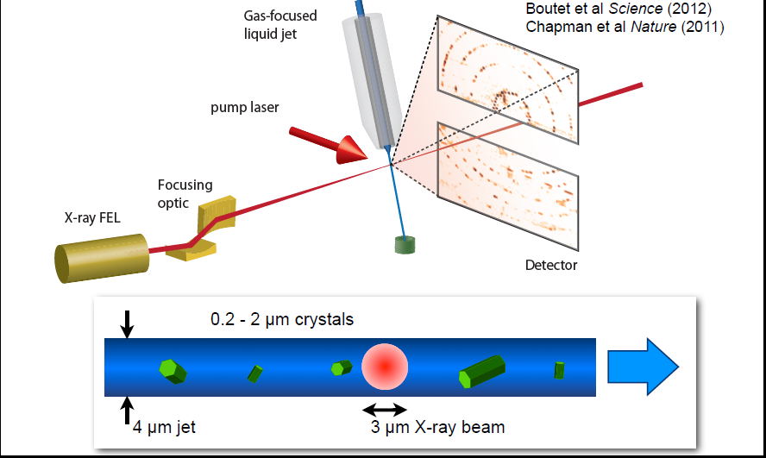
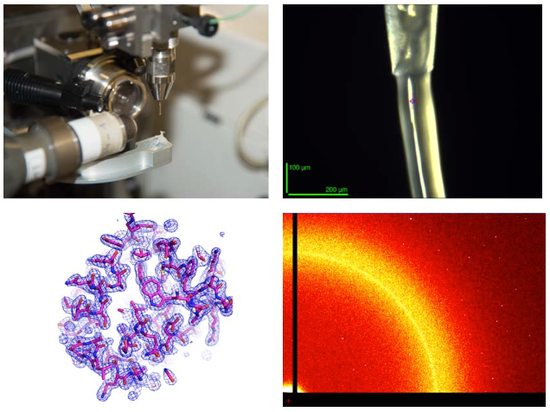
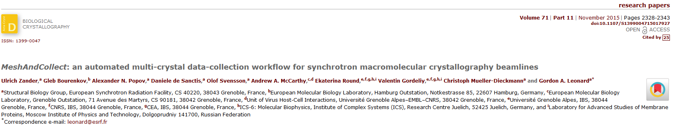
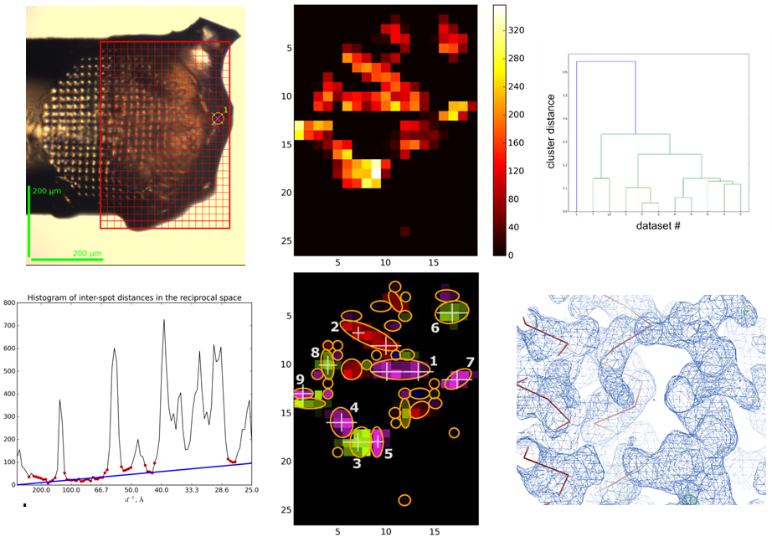
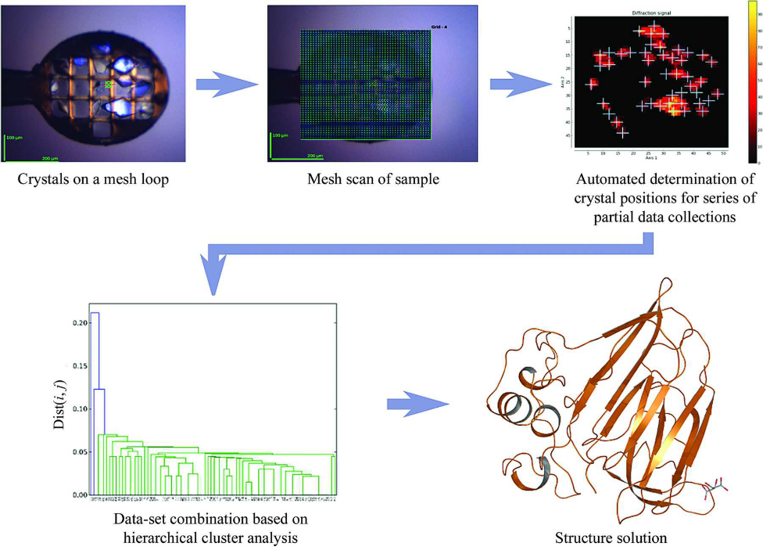
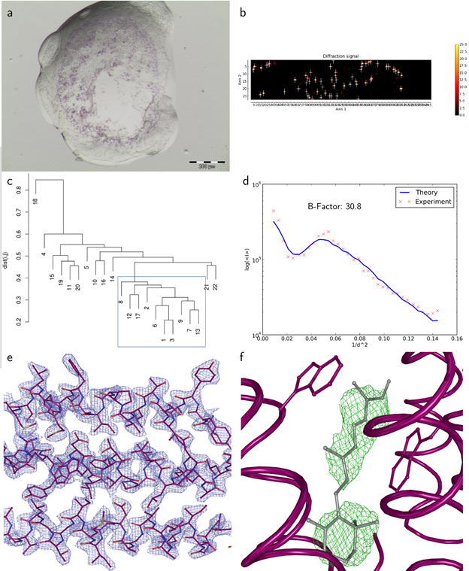
SSX & MDX at the ESRF: Room and Cryo-temperatures

Slide 14
Techniques complementary to MX

Slide 15
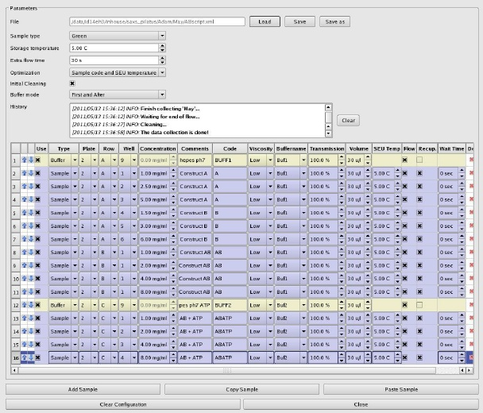
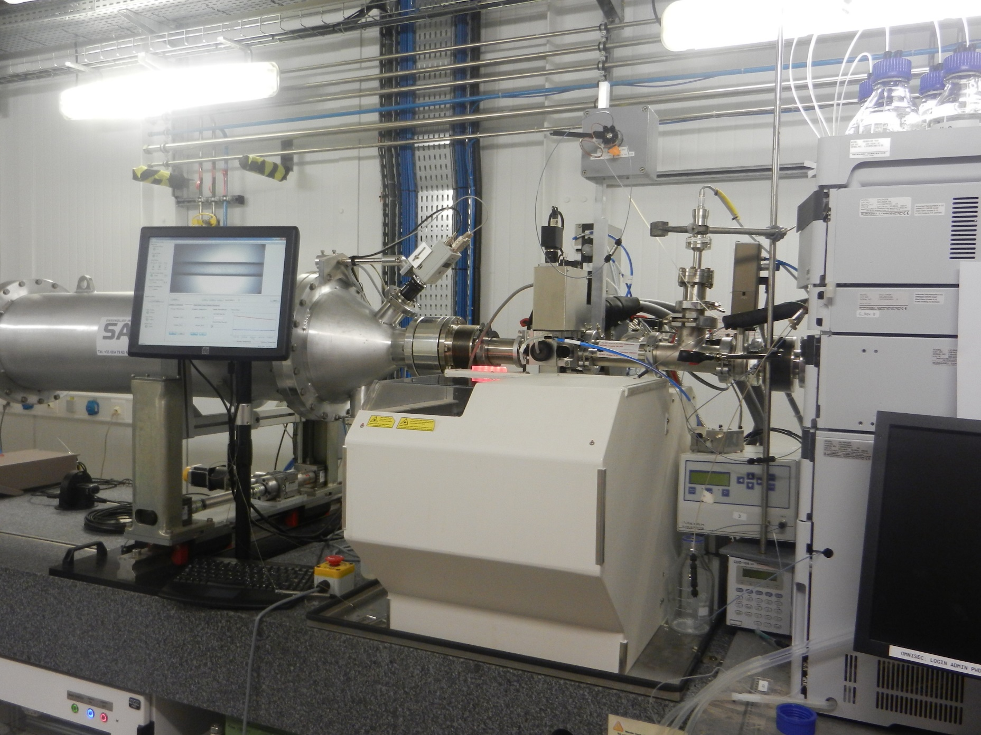
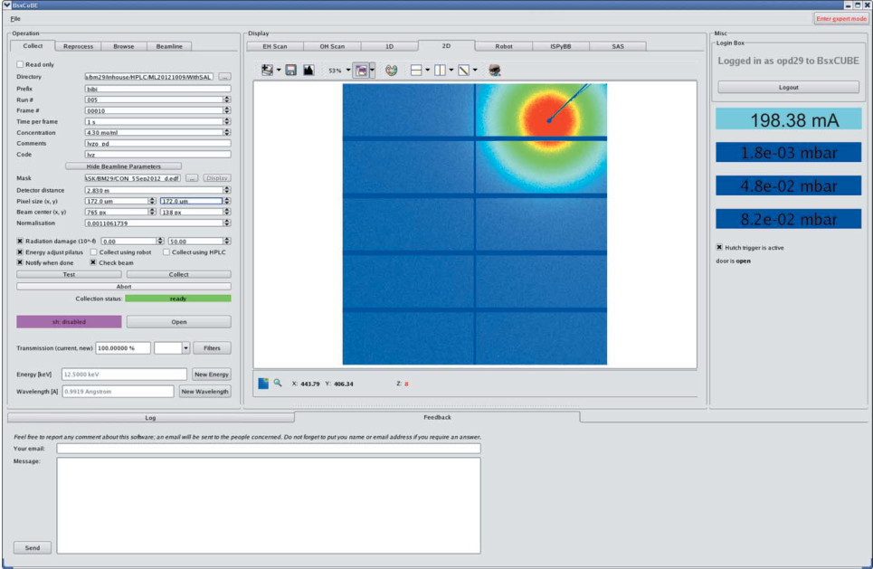
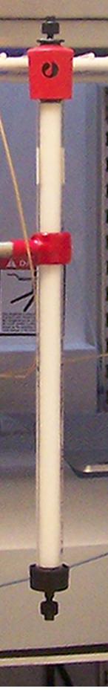
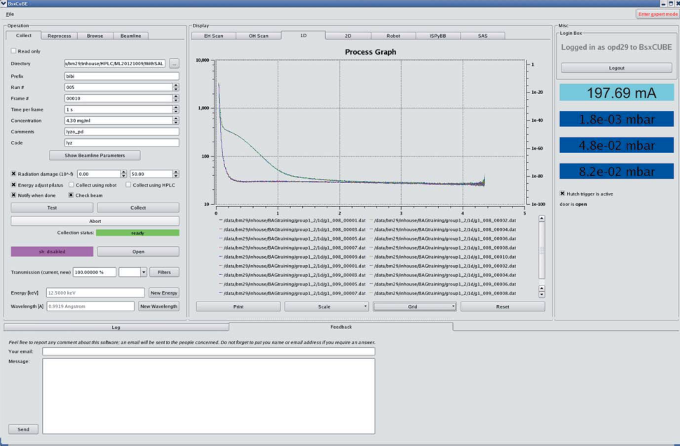
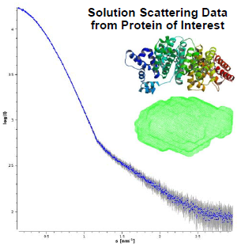
BM29 Biosaxs: Sample changer + HPLC system
Samples stored in 96 well plates, PCR tubes
Thermo-regulation storage: 4-40ºC, exposure cell: 4-60ºC
Sample loading and cleaning: 30’
Switch between
SC and SEC modes
quick and robust
ROBOT
HPLC system mostly used in isocratic elution mode
(mobile phase composition is kept constant and uniform

Slide 16
THE RISE OF BIOSAXS
HPLC online
ADDAPTED OPTICS
Complete refurbishment during ESRF-EBS
PILATUS
ROBOT
_{ID14-3} = 117
_{BM29} = 324
_{both} = 13
First BioSAXS users at ID14-3
in November 2008
ID14-3 closed in December 2011
First BioSAXS users at BM29
in June 2012

Slide 17
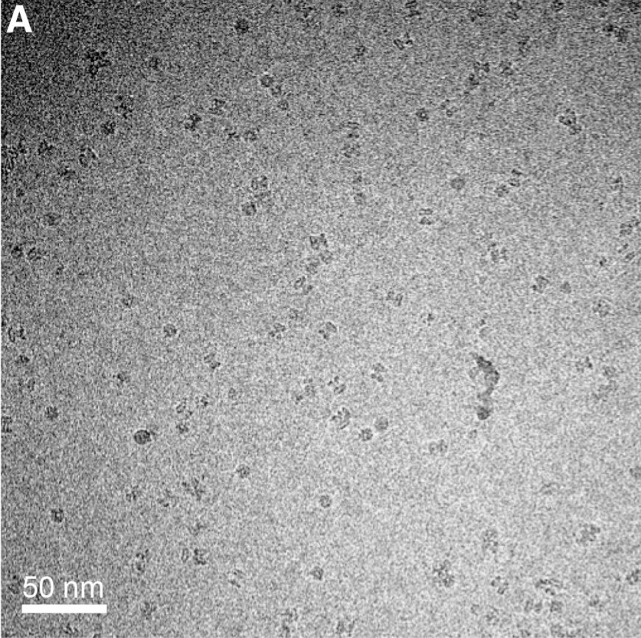
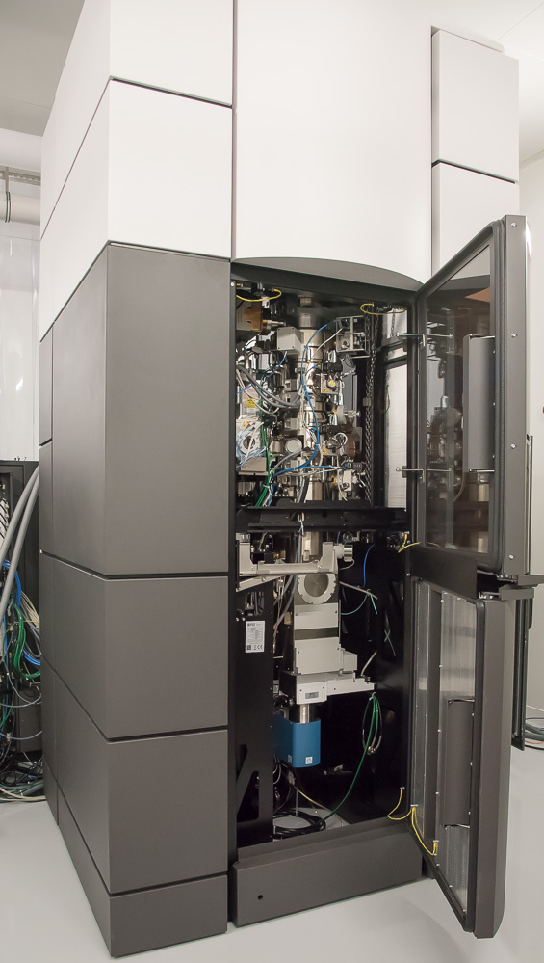
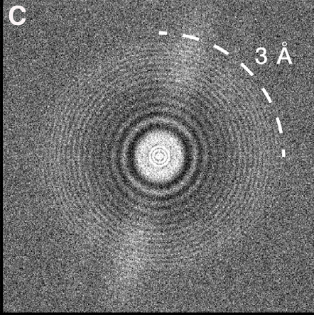
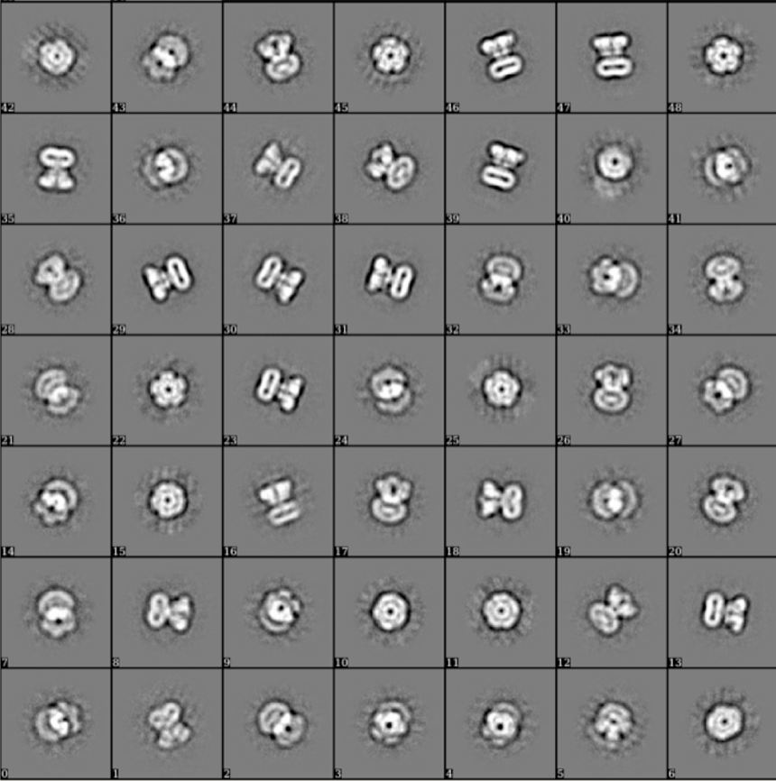
CM01: BRINGING THE CRYO-EM ‘RESOLUTION REVOLUTION’ TO THE ESRF USER COMMUNITY
Titan Krios G3
300 kV
Quantum LS energy filter
K2 summit direct detector
Volta phase plate
On-line: November 2017
Rolling proposal
BTAP evaluation
Approved proposal
Pre-evaluated project
(sample preparation
established)
Grids
available
Grids NOT
available
GRID preparation
@ ESRF cryoEM lab
KRIOS
KRIOS

Slide 18
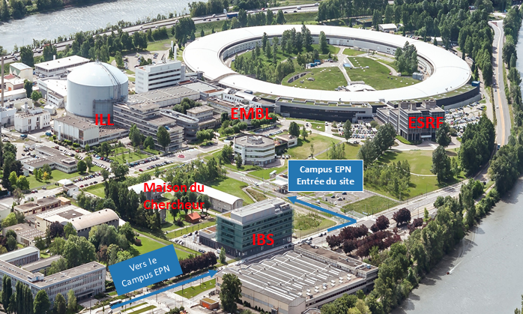
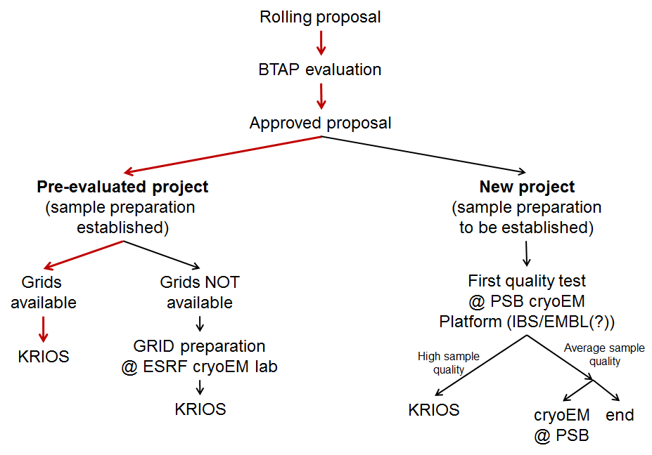

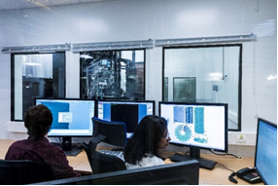
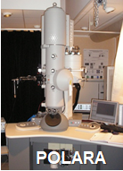
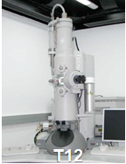
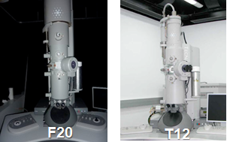
HOW ACCESS TO CM01 WILL EVOLVE: THE PSB CRYO-EM PLATFORM

Slide 19
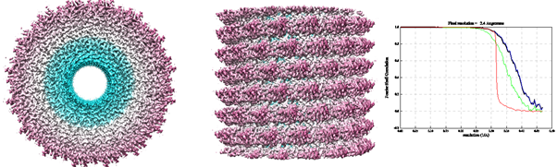
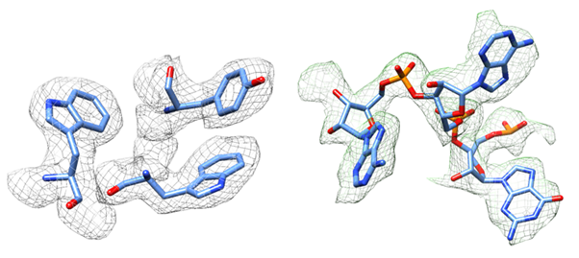
CM01: INITIAL RESULTS FROM TOBACCO MOASIC VIRUS
CM01 is operating during ESRF-EBS shutdown

Slide 20
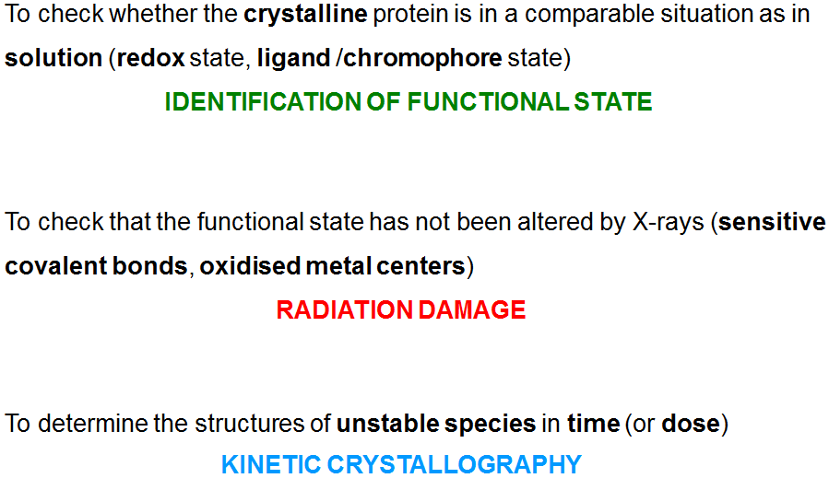
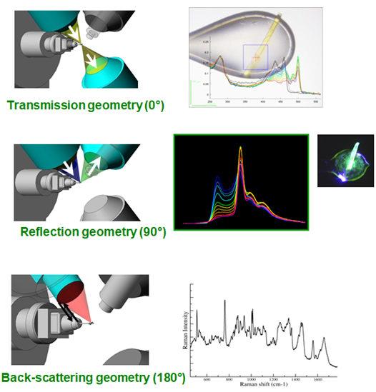
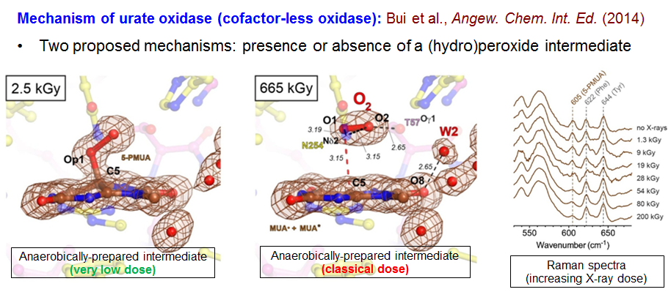
In crystallo optical spectroscopy (Icos)

Slide 21
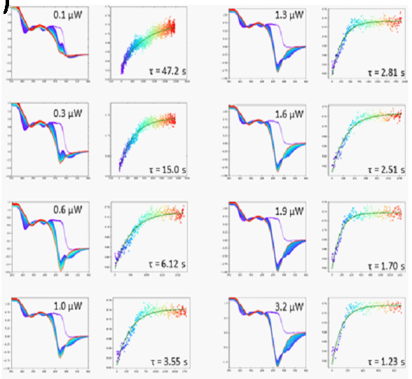
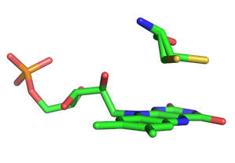
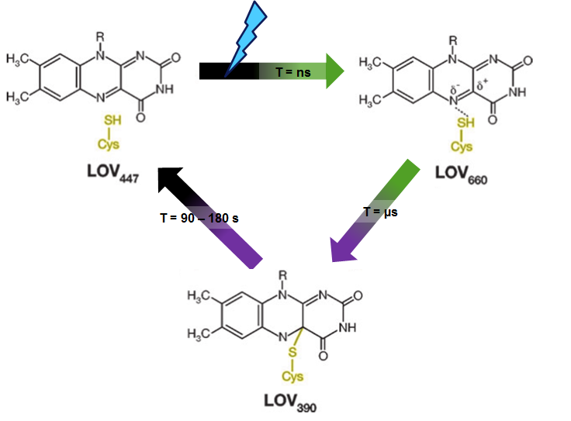


In crystallo optical spectroscopy (Icos)

Slide 22




HIGH-PRESSURE CRYO-COOLING
- Cool crystals without cryoprotectant
- Improve diffraction quality (lower mosaicity)
- where do ligands bind?
- where is O₂/NO/… entering/leaving
P. van der Linden et al. (2014) J. Appl. Cryst. 47, 584-592.
~2 kbar
Non-cryprotected Trypsin
-No ice rings
-High resolution 1.07Å
Low mosaicity 0.078
R_{sym} 5.3%
-R_{work /free} 10.9/13.4

Slide 23








Esrf-ebs: faster & better WITH SMALLER, MORE INTENSE x-RAY BEAMS
‘Standard’ MX / Fragment Screening
MDX
Microcrystals
SSX
100μm
Where? – What? – Optimise? – Trash?
Smaller beam = finer sampling
Large crystals
Where is ‘sweet spot’?
Smaller beam = finer sampling
Bowler et al. & Leonard , Acta Cryst. (2010). D66, 855–864
Notes:
23

Slide 24


Room Temperature Data Collection (SSX/MDX) and Pump-probe investigations
Room-temperature Data Collection
Pump-probe in crystallo
Crystal structures obtained at cryogenic temperatures can obscure functionally important conformations: i.e. for small GTPase H-ras only the RT structure showed the catalytically essential glutamine residue in the conformation that is required for GTP hydrolysis.
Fraser et al., PNAS 108, 16247-16252, 2011
Because of radiation damage, serial crystallography is (probably) the only route to obtaining RT structures.
A. Pearson, ESRF UM2016
Notes:
Mutations in H-Ras paralogs in H3 are involved in cancers supporting idea that this network is critical for function.
The allosteric network involved had been suggested by NMR.

Slide 25

EBSL8 - A beamline for (time-resolved)serial crystallography
High flux (10¹⁶ ph/s), large bandwidth (~1%)
Beamsize: 0.5 μm – 10 μm
Tuneable: 10-30 keV
iCOS

Slide 26


time-resolved crystallography experiment performed at an XFEL
Study of the photocycle of the membrane protein bacteriorhodopsin (Nango, Royant et al., Science, 354, 1552-1557, DOI: 10.1126/science.aah3497)

Slide 27



Time-RESOLVED MX AT esrf: A PHOTORECPTOR PHOTOCYCLE (Signalling in Phototropism)
100 complete data sets (1000 images) from 100 different crystals
Each complete data set divided into 66 sub-wedges of 15 images (60msec)
HCA clustering of 100 sub-data sets for each time point
66 complete data sets (time points) with time resolution of 60 msec
Improved experimental set-up (ω axis rotation of 720º/second)
Different clustering technique (i.e. Genetic Algorithm, (Acta Cryst. D72, 1026)).
~1msec time resolution?
CCcluster: Santoni, G., et al., (2018). J. Appl. Cryst. 50, 1844-1851.
time constant ~90 ms
S. Aumonier, A. Royant. G. Santoni, G. Leonard et al. unpublished.

Slide 28


Movie of adduct formation

Slide 29
SB@ESRF POST-EBS: versatile, complementary end-stations
 | 1st Operation | Energy [keV] | Beam size [μm²] | Flux [ph/s] | Diffractometer | Detector | Sample Changer | Experiments
ID29 | 2021 | 10-15 [35] | 0.5 x 0.5 [10 x 0.5] | 1x10¹⁶ | MD3Up-SSX | JungFrau 4M | N/A | (TR-)SSX
ID23-1 | 2004 (2021) | 6-20 | 10-40 | 3x10¹² | MD2-S | Eiger 2 16M CdTe | FlexHCD | MAD/SAD; MDX; dehydration
ID30B | 2015 | 6-20 | 20-200 | 10¹³ | MD2-S | Pilatus3 6M | FlexHCD | MAD/SAD; MDX; dehydration; plates
MASSIF-3 | 2015 | 12.8 | 15 | >2 x 10¹³ | MD2-S | Eiger 4M | FlexHCD | Mini-focus; MDX; SSX; on-line UV
ID23-2 | 2006 (2017) | 14.2 | (1 x 1) | 1x10¹³ | MD3Up | Pilatus3 2M | FlexHCD | Microfocus; SSX
MASSIF-1 | 2014 (2021) | 12.8 | 50 (10-100) | 1x10¹³ | MD2-S | Pilatus3 2M | FlexHCD | Automatic data collection; Mail-in; fragment screening, etc.
BM29 | 2012 (2020) | 7–15 | 500 × 500 | 5x10¹³ | N/A | Pilatus 2M in vacuuo | ARINAX liquid handler | (TR-)BioSAXS; SEC-SAXS
CM01 | 2017 | Electron Microscopy |  |  |  |  |  | Single particle reconstruction (tomography, ED)

Slide 30






Some recent highlights from SB FACILITIES at The ESRF
Structural Basis of Transcription: RNA Polymerase Backtracking and Its Reactivation, Molecular Cell, 75, 298-309.e4 (2019).
Molecular basis for high-affinity agonist binding in GPCRs. Science 364, 775-778 (2019).
A class of highly selective inhibitors bind to an active state of PI3Kγ. Nat. Chem. Biol. 15, 348-357 (2019).
Thank you for your attention!
Structural Principles in Robo Activation and Auto-inhibition. Cell, 177, 272-285.e16 (2019).
A kiwellin disarms the metabolic activity of a secreted fungal virulence factor. Nature 565, 650-653 (2019).
Polyclonal and convergent antibody response to Ebola virus vaccine rVSV-ZEBOV. Nature MedIcIne 25, 1589–1600 (2019).

Slide 31
Acknowledgements
ESRF
Jean Susini
Harald Reichert
Gordon Leonard
Christoph Mueller-Dieckmann
Sasha Popov
Max Nanao
Daniele de Sanctis
Petra Pernot
Mark Tully
Didier Nurizzo
(David von Stetten)
Isai Kandiah
David Flot
(Stephanie Monaco)
Montserrat Soler Lopez
(Guillaume Gotthard)
Gianluca Santoni
(Nicolas Foos)
(Gabriele Giachin)
Igor Melnikov
(Slyvain Aumonier)
Maksim Rulev
Romain Bouverot
Hadrien Depernet
ESRF
Hugo Caserotto
Fabien Dobias
Thierry Giraud
Mario Lentini
John Surr
Jonathan Gigmes
Samira Accajoui
Ulrike Kapp
Deborah Davison
Pascal Theveneau
Carole Clavel
Peter van der Linden
Antonia Beteva
Matias Guijarro
Olof Svensson
Alejandro de Maria
Solange Delageniere
Marcus Oskarsson
EMBL Grenoble
Stephen Cusack
Andrew McCarthy
Matthew Bowler
(Martha Brennich)
(Uli Zander)
Shibom Basu
Florent Cipriani
Franck Felisaz
Robert Janocha
Marcos Lopez-Marrero
Gergely Papp
Christopher Rossi
Jeremy Sinoir
Clement Sorez
EMBL Hamburg
Gleb Bourenkov
IBS
Winfried Weissenhorn
Guy Schoen
Gregory Effantin
Philippe Carpentier
Antoine Royant
ILL
Trevor Forsyth
Traore

