Slide 1
Sustainable Development
Research Professors Naidoo & Connell DMES, FEBE 2019

Slide 2
Reference

Slide 3
“THINK GLOBAL, ACT LOCAL”

Slide 4
Think Global : Think 4 IR Contributions
Water
Food
Waste
Transport
Energy

Slide 5
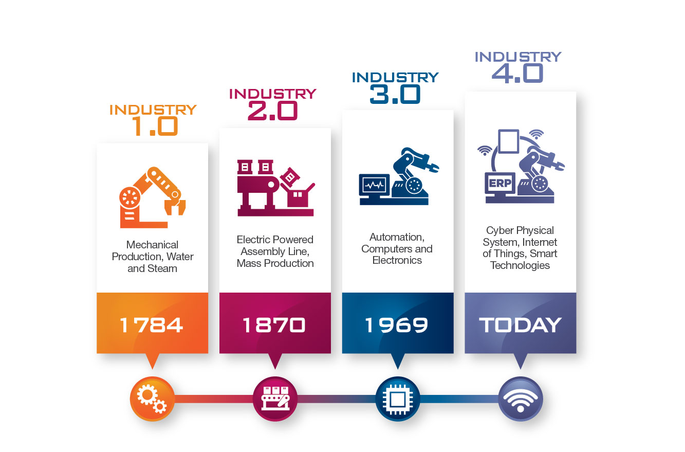
INDUSTRY 4.0
“We stand on the brink of a technological revolution that will fundamentally alter the way we live, work, and relate to one another. In its scale, scope, and complexity, the transformation will be unlike anything humankind has experienced before.”
Klaus Schwab, President -World Economic Forum, The Fourth Industrial Revolution

Slide 6
Act Local : South Africa Today Sharpen the Focus UNEMPLOYMENT POVERTY INEQUALITY

Slide 7
UNEMPLOYMENT Unlimited Human Energy Unlimited Youth Energy – Africa Endowed with Youth + Population Growth + Urbanization + Mechanization & Automation

Slide 8
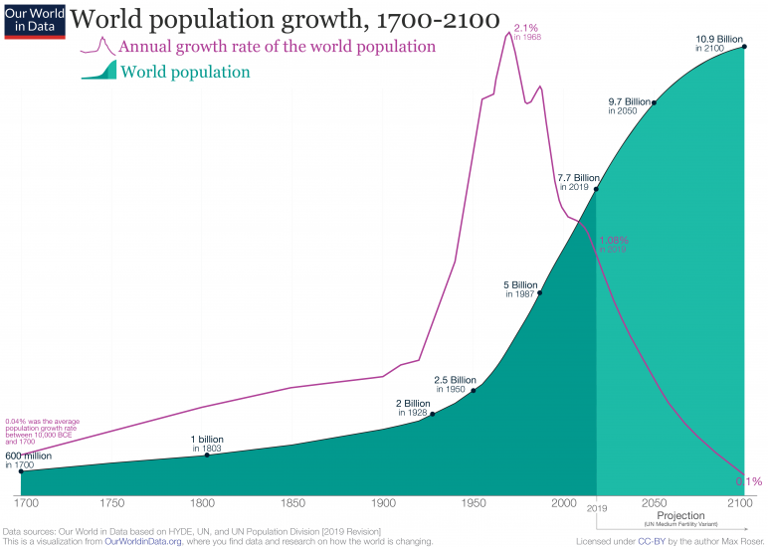
South Africa
2019 : 58.8 Million
2050 : 75 Million
2100 : 80 Million

Slide 9
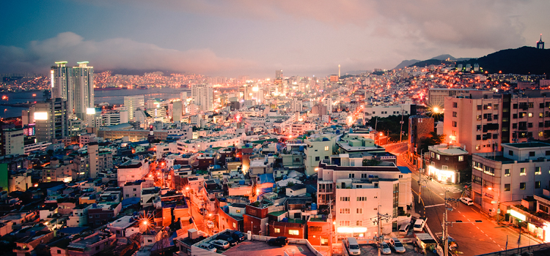

Slide 10
UNEMPLOYMENT

Slide 11
Green Economy & Innovation Research in Progress “ confluence of physical, environmental, biological, behavioural….factors; decision making is by machines; ….

Slide 12
WATER SECURITY AND IR 4.0 UJ FEBE and WRC and Rand Water and National Water Planning Commission and Southern African Power Pool and Joburg Market and ……

Slide 13
WATER SECURITY AND IR 4.0 From Data to Information to Intelligence Internet of Things, Big Data, Data Analytics, Blockchain Marketplace of Buyers and Sellers Price Making and Price Discovery Financial Closure and Contracting Infrastructure Engineer, Procure, Construct, Maintain, Performance Monitoring Data to Data

Slide 14
Natural Water : Rainfall, Dams, Rivers Used Water : Mining, Industry Sewer Water : Municipalities Virtual Water : Agriculture Environmental : Weather Forecasts
Big DATA
Internet of Things
Customer Needs
New Hydrogen Economy

Slide 15
+ New Value Stream Hydrogen Economy Hydrogen from Water : H₂O : 2 H Hydrogen from Sewer: CH₄ : 4 H

Slide 16
New Jobs
Water Security
Waste Management
Hydrogen Economy
Infrastructure Development and Maintenance

Slide 17
Transportation & IR4.0 data and machine decision making Hybrid Hydraulic & Liquid Fuels, Hydrogen & Fuel Cells, Electric & Hybrid Hydraulic Vehicles Solar Assisted Electric & Hybrid Hydraulic Vehicles Conversion of Old Petrol Driven Cars to Electric Duty

Slide 18
New Jobs
Liquid Fuel Savings
Carbon Emission Savings
Electric Transportation
Hydrogen Economy

Slide 19
Aquaculture & IR 4.0 internet of things - machine management and decision making Urban Farming, Production of Fish and Vegetables Food Processing and Canning Extremely High Volumes : Daily Production : 1 Million Cans of Fish – Impact on Input Energy (Water, Electricity, Fish Food), Fish Waste Generation and Removal; IR4.0 Management, Automation and Control of Production and Manufacturing.

Slide 20
New Jobs
Food Security
Renewable Energy Development
Mass Production, Packaging and Distribution
Urban Farming

Slide 21
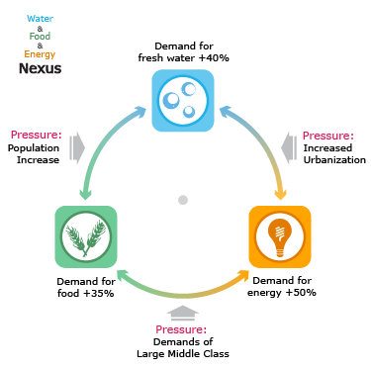
IR 4.0 = IR 1.0 + IR 2.0 + IR 3.0 + Humanities

Slide 22
IR 1.0 + IR 2.0 + IR 3.0 = Electrical Energy Lots of Electricity Quality Electricity : No disturbance, No downtime, No load shedding Affordable Electricity : World’s Lowest Cost; Accessible to all

Slide 23
Deepen the Penetration of Renewable Energy into Daily Living

Slide 24
Sole Source of All Energy

Slide 25
SUN : Always Present How much renewable energy do you use in daily living ? Answer : ZERO Why ?

Slide 26
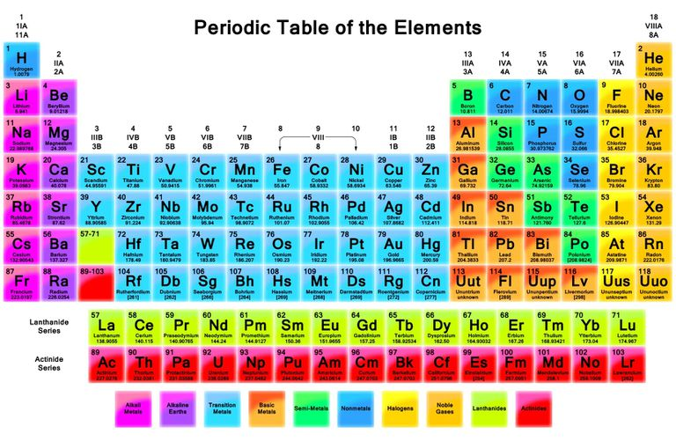
Energy is Neither Created Nor Destroyed

Slide 27
MECHANIZATION : MASS PRODUCTION IR 1.0 : Water – Steam Energy : H₂O IR 2.0 : Electricity : H₂O + C + U IR 3.0 : Electricity + Control DOMINANT SUN STORED ENERGY ELEMENT = CARBON

Slide 28
Environmental Boundary Condition UPPER LIMIT ON SUNS CARBON ENERGY Global Warming Climate Change ICE IS MELTING

Slide 29
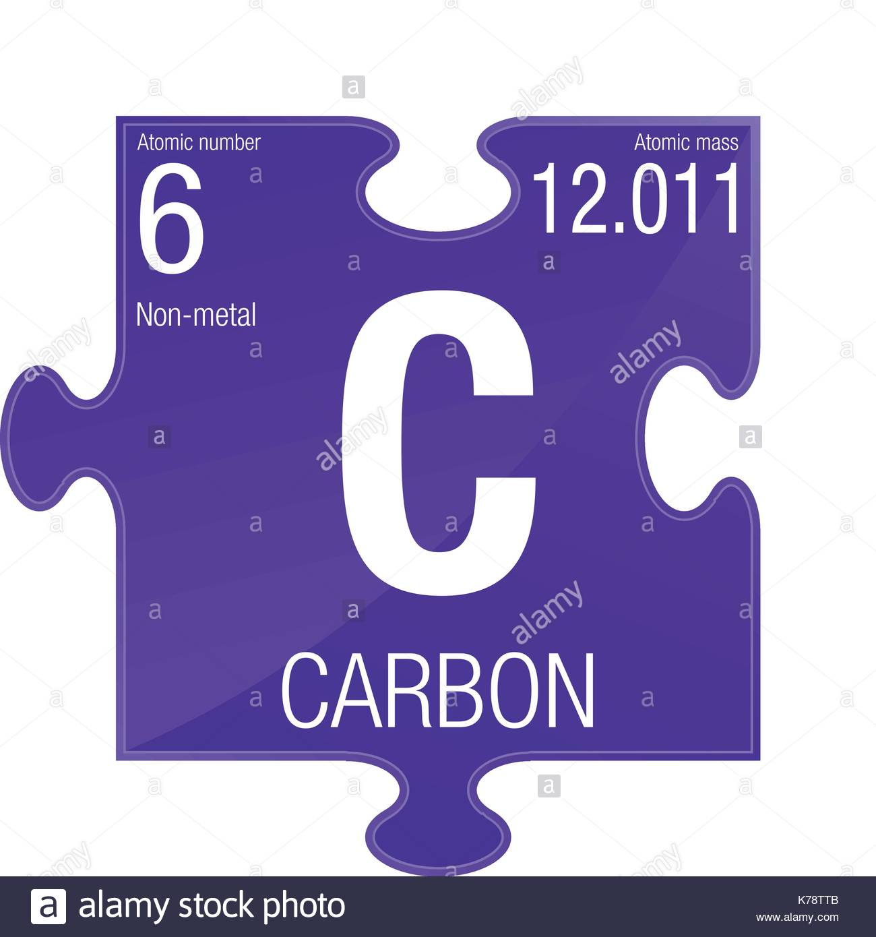
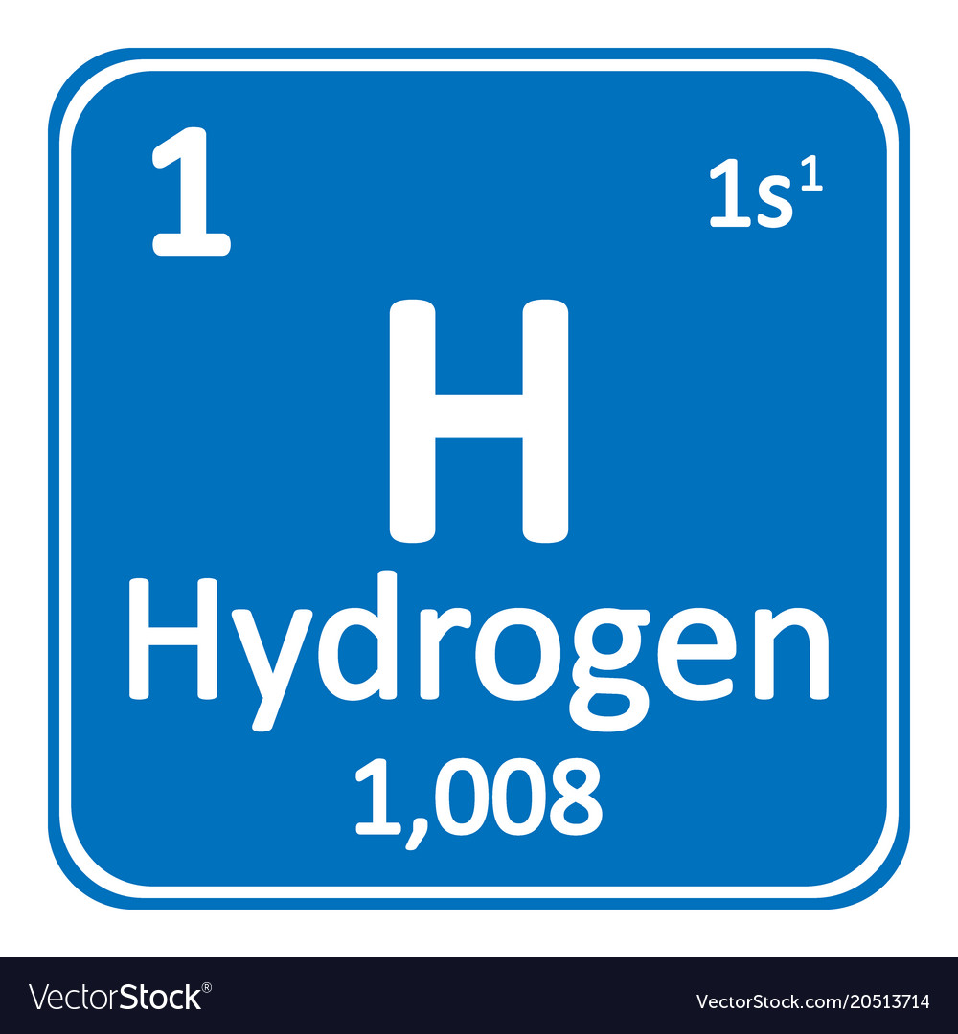
GLOBAL ENERGY SHIFT Away from C

Slide 30
HYDROGEN ECONOMY NEW JOBS Electric Cars Powered By Fuel Cells

Slide 31
URANIUM ECONOMY NEW JOBS Nuclear Reactors Large Reactors : Sunset Industry in USA, Germany, Japan; Sunrise Industry in China, Middle East, Russia Small Modular Reactors : New Global Industry

Slide 32
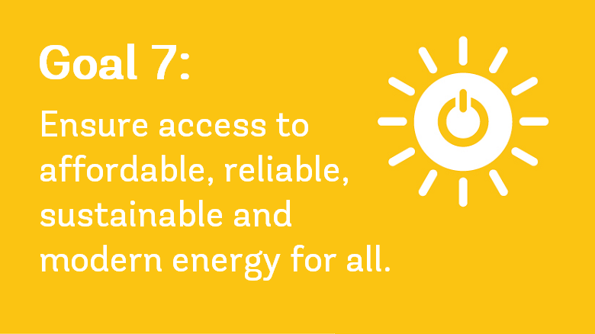
SMR’s 1 kW – 10 kW – 100 kW – 1 MW – 10 MW – 100 MW…. Modular Clean Affordable Reliable Sustainable Modern Energy Source

Slide 33
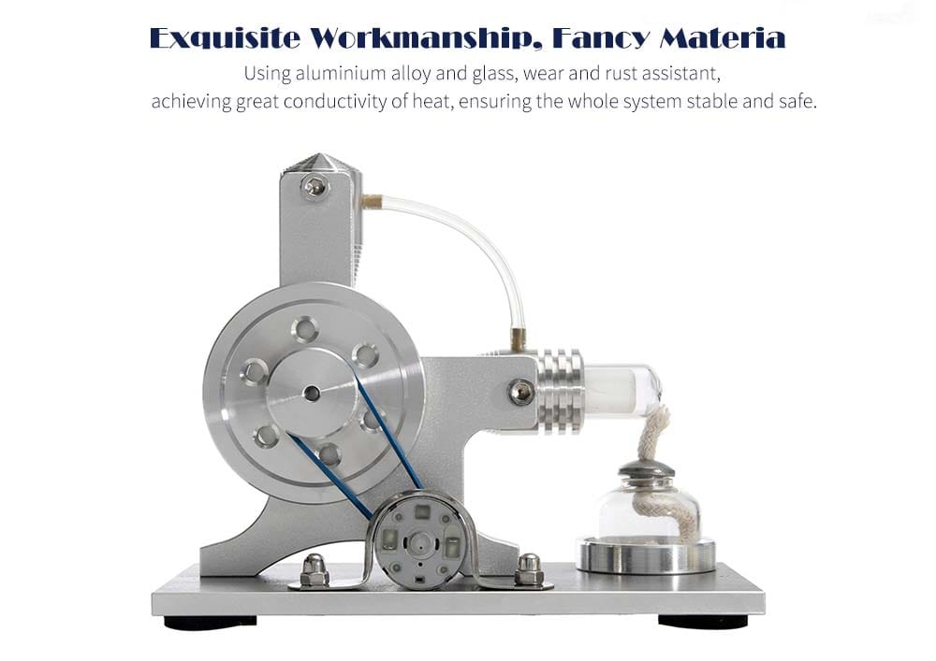

Slide 34
QUESTIONS SUN : Always Present Renewable and Stored Energy IR4.0 : Totally Dependent on Energy DECISION MAKING = MACHINES ASSURANCE : INTEGRITY & ETHICS Sustainable Development Nexus of Solutions from all Sectors Energy, Water, Waste, Food, Transport….

Slide 35
Answer HUMANITIES SOCIAL SCIENCES PEOPLE DEVELOPMENT LEADERSHIP We need 1000’s of PhD’s in all Disciplines Thank You

