Slide 1
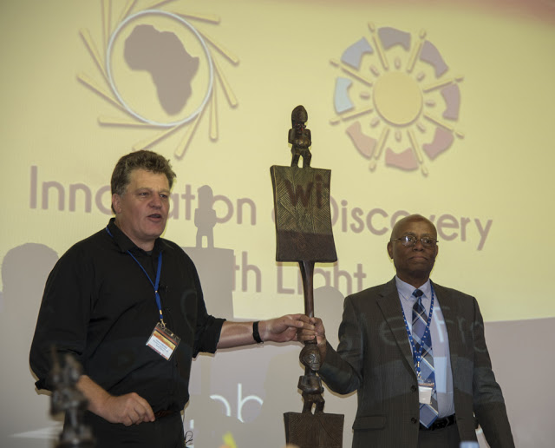
The Africa Light Source AfLS2020
Virtual Event : 15-19 Nov 2021
The AfLS Ceremonial calling stick
The AfLS African ceremonial calling stick summons us from around the world to participate in this historic Event.
From within Africa, it first called us, in 2015, to AfLS1 in Grenoble in November 2015. It was there throughout the proceedings. Then it next called us back to its home country, to Ghana, in January 2019, for AfLS2. From there it called us to Rwanda, for AfLS3, which was to be held at this very time. However, due to the pandemic, it has now called us instead to this Virtual Workshop, AfLS2020.
The AfLS ceremonial calling stick from ancient Ashanti culture. Normally, it would be planted at a nexus of roads, where all would pass and note its message boards. For the AfLS, the message is the vision of an Advanced Light Source in Africa, pumping out new scientific discoveries, of great relevance to Africa, and also the world. Realizing this vision, means Africa is well on the road to being a knowledge-based economy and a font of innovation.
The stick has the gravitas of a scepter. It depicts both genders equally Symbolically we have, inclusivity, and ubuntu. All are invited, and all will build the AfLS together.
At the end of these proceedings, it will call us again to Rwanda, in November 2021, for the rescheduled AfLS3
The calling stick final resting place is the future AfLS facility, where it will still call all people to its campus.

Slide 2
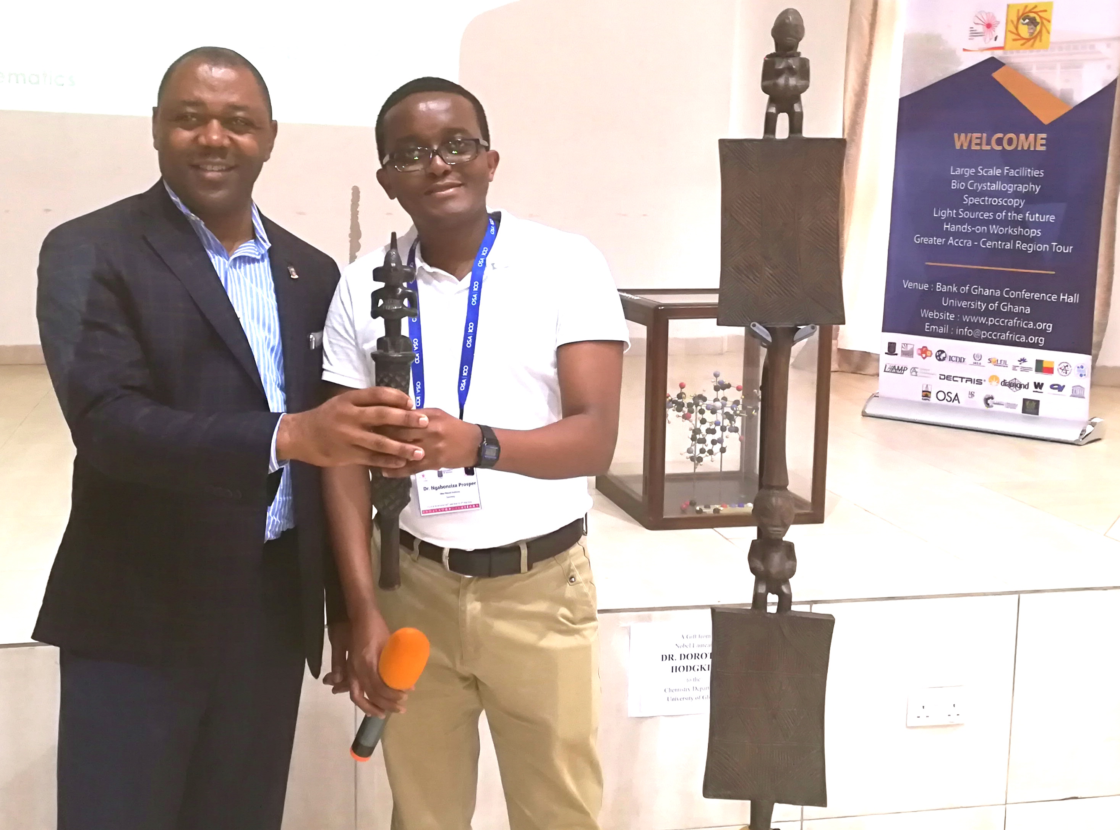
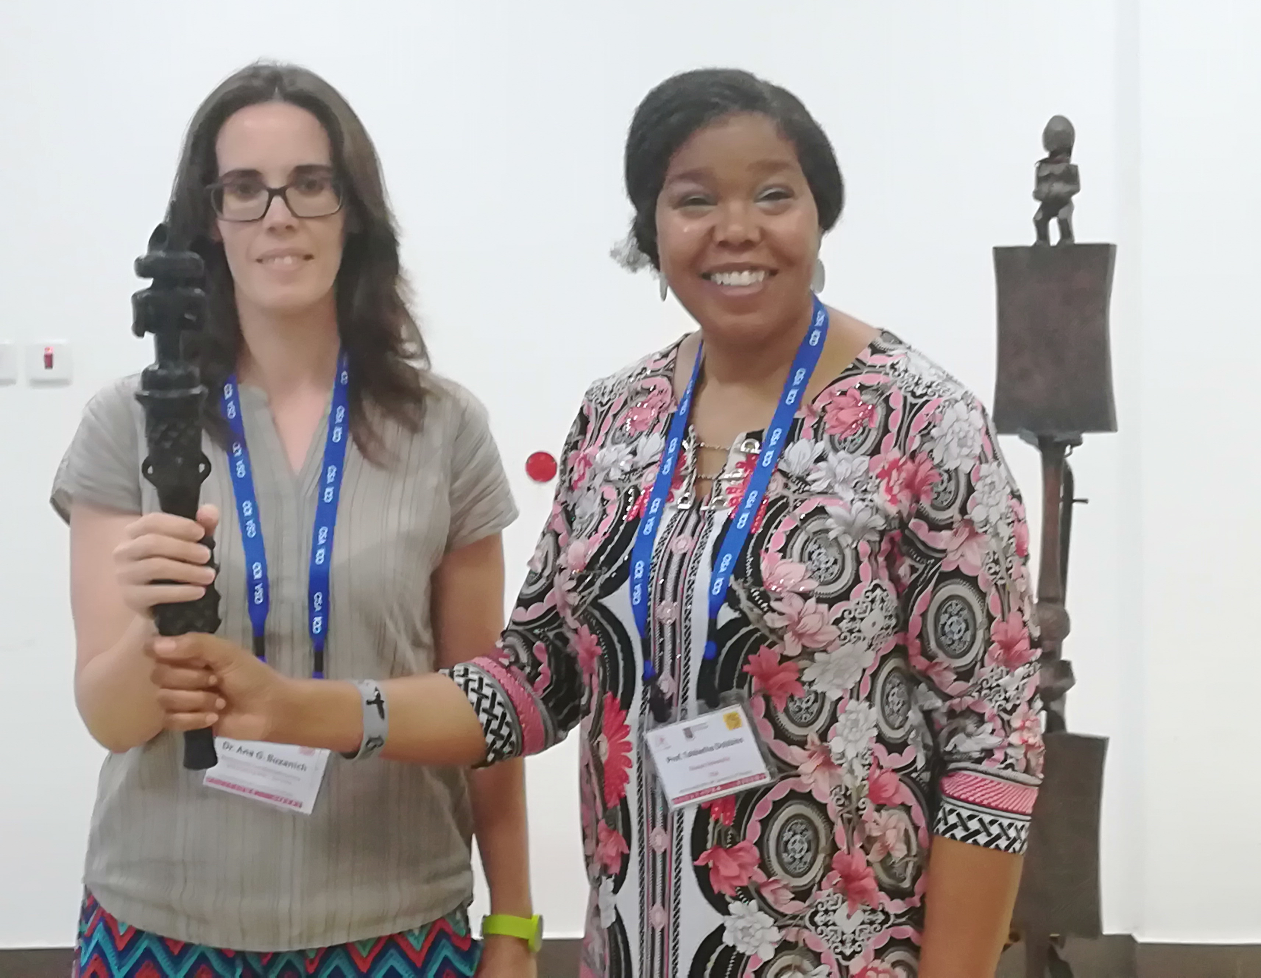
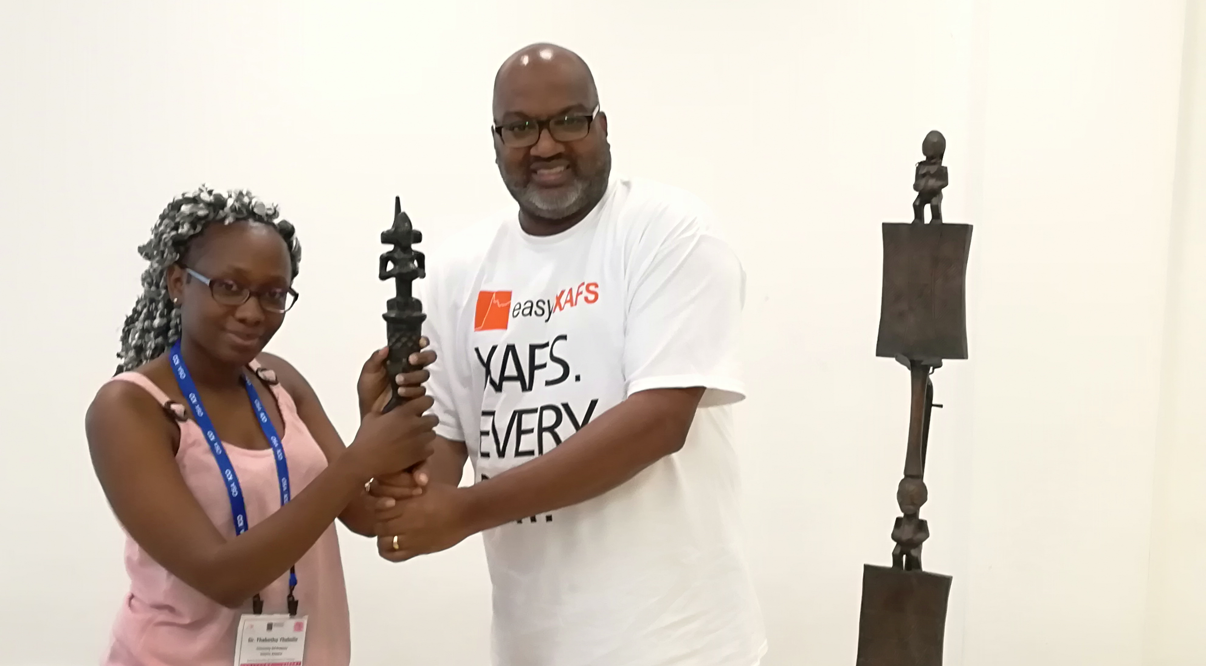
The Africa Light Source AfLS2020
Virtual Event : 15-19 Nov 2021
The AfLS Ceremonial speaking stick
The AfLS African ceremonial speaking stick, is used throughout the conference to endow, in the African tradition, each speaker in turn, with authority and wisdom to speak. The Speaking stick is handed over by the Session Chair to each next speaker, before they commence, and they return it to the chair as they leave. We use the moment of transfer for each official photograph of the speaker.
The AfLS speaking stick will be displayed at the future AfLS facility.

Slide 3
The Africa Light Source AfLS3-2021
Virtual Event : 15-19 Nov 2021
We will now crossover live virtually
from
Dr Marielle Agbahoungbata (X-TechLab)
to
Dr Prosper Ngabonziza
who will perform a virtual ceremony involving the handover
of the
AfLS ceremonial calling stick and the speaking stick

