Slide 1
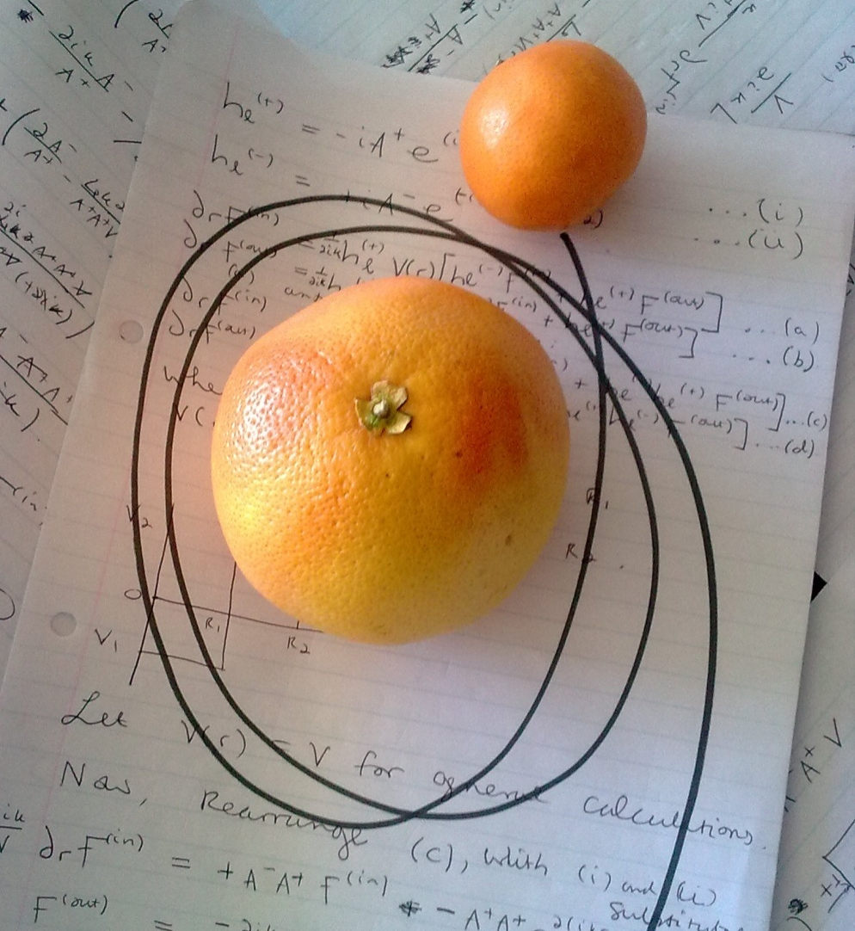
Paul Vaandrager
Supervisor:
Prof S. Rakitianski
10 July 2012
A Study of Resonant- and Bound-State Dependence on the Variables of a Step-Potential for a Quantum Mechanical System by making use of Jost Functions

Slide 2
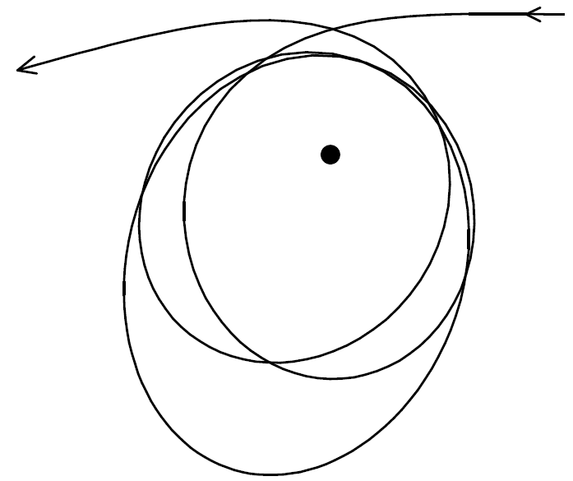
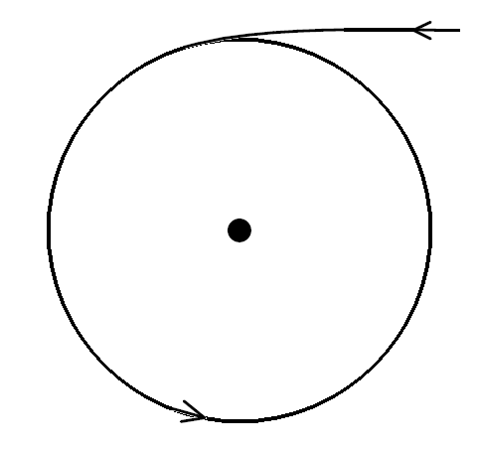
An easy classical analogy to understand bound- and resonant states:
Bound State:
Resonance State:

Slide 3
Introduction
System stability is a fundamental concept in understanding nature.
Can a system of particles in a specific scenario exist indefinitely, or will some sort of decay take place?
This can provide information on, among other things, nuclear and chemical reactions, nuclear decay, and specifically particle scattering.
For this project, resonant and bound state energies for a system of particles with a given step-potential are calculated by making use of Jost functions.

Slide 4
.
Basic Quantum Mechanics
Set of conserving quantum numbers:
Wave function:
Schrödinger's Equation:
Apply Separation of variables:
Wave function becomes:
Time independent Schrödinger's Equation:
Hamiltonian:
or

Slide 5
.
Laplacian:
Schrödinger's Equation becomes:
Substitutions:
Property of Spherical Harmonics:
Radial equation:

Slide 6
.
Boundary conditions on interval :
Solutions are Riccati-Hankel functions:
is a linear combination of these two functions:
Jost Functions

Slide 7
Bound States
The particle cannot leave the source of the attractive field in the bound state.
The probability of finding the particle when r → ∞ thus tends to zero.
Thus:
The total probability of finding the particle somewhere around the source of
the potential is 1.
This implies that 𝝍_{a}(r) is square integrable, which is the case if f_{l}^{(in)}(E) is zero.

Slide 8
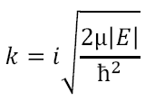
Since the potential vanishes at large r values, E must be negative.
or
The second term will tend to zero, and the first will blow up to infinity unless f_{l}^{(in)}(E) is zero, as before.
Bound states thus correspond with zeros of real, negative E such that f_{l}^{(in)}(E) is zero.

Slide 9
Resonant States
Resonances do not “remember” how they are formed, implying that there is no preferred direction for decay.
We can consider as a resonant state of oxygen, due to its temporary existence. It could have been formed in a number of different ways.
Consider an ensemble of such states: decay occurs isotropically.
Conclusion: only outgoing spherical waves form part of u_{l}(E), thus, similar to bound states, f_{l}^{(in)}(E) is zero.

Slide 10
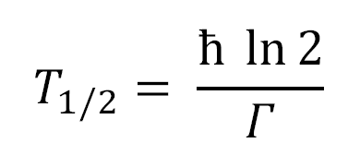
Decay law:
For some K, we can write:
Result:
Resonant states thus correspond with complex E with negative imaginary part such that f_{l}^{(in)}(E) is zero.

Slide 11
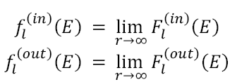
Radial Equation:
.
Calculating Jost Functions
Solution of form:
Lagrange condition

Slide 12
.
Calculating F_{l}^{(in)}(E)
Assume l = 0. This is because, for most systems, the S-wave contribution is by far greater than the higher partial waves. Then:
Also, assume V(r) = V. Solving analytically, we obtain:
P1 and P2 are constants, and K is defined as:

Slide 13
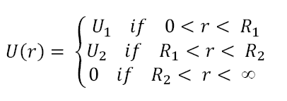
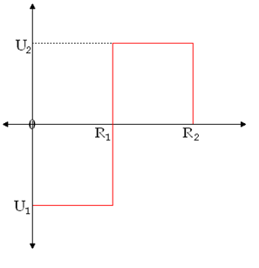
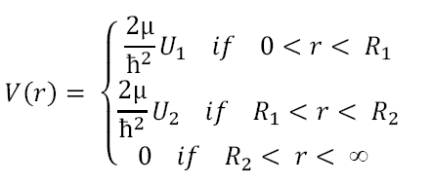
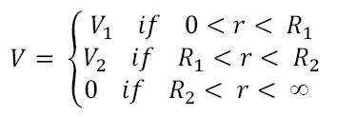
.
The Potential
Assumed that V(r) = V in the calculations. We will simply let:

Slide 14
.
First Region: 0 < r < R₁
It is known from the boundary conditions that:
Applying the above condition yields:
With:

Slide 15
.
Second Region: R₁< r < R₂
At boundary where r = R₁
It can be rigorously shown that:
Applying the above condition yields:
With:

Slide 16
.
Third Region: R₂< r < ∞
At boundary where r = R_{2,} a result is obtained similar to border where r = R₁

Slide 17
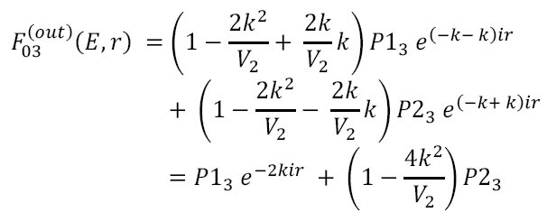
.

Slide 18
With:

Slide 19
.
Calculating f_{l}^{(in)}(E)

Slide 20
Spectral Points (Zero Points)
f_{l}^{(in)} is dependant on E, but E is related to k.
Spectral points that are purely imaginary in the k plane become real in the E plane.
Negative, imaginary k values resulting in real E values are dubbed virtual states, since such energies cannot exist in a physical sense.
Resonances may be calculated in the E plane that cannot be considered true resonances, for the same reasons.

Slide 21
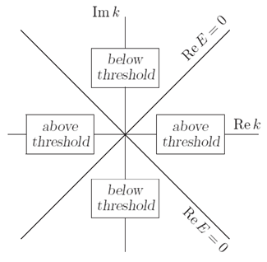
Sub-Threshold resonances behave in the same way as resonances, thus we will not concern ourselves overly with them.
Resonances and sub-threshold resonances have a mirror-image partner point relative to the real axis in the E plane, and relative to the imaginary axis in the k plane.
There can be infinitely many resonant states, but there is a finite number of bound states - there can even be no bound states.

Slide 22
The spectral points of the system will be found in the k-plane.
This is to avoid confusion with the virtual and sub-threshold states that cannot be distinguished from true bound and resonant states in the E plane.
Also, since we are only interested in bound and resonant state dependence on the variables of the system, and not necessarily on the actual values of the energies, k-plane spectral points are more than suitable.

Slide 23
In the k-plane, purely imaginary positive spectral points → negative real points in the E- plane → bound states.
Purely imaginary negative spectral points → virtual states.
Complex spectral points → resonant states and sub threshold resonances.
Since all spectral points have mirror images in the other quadrants, all complex spectral points are shown in the data, and are all pretty much thought of as resonant states or sub threshold resonances.

Slide 24
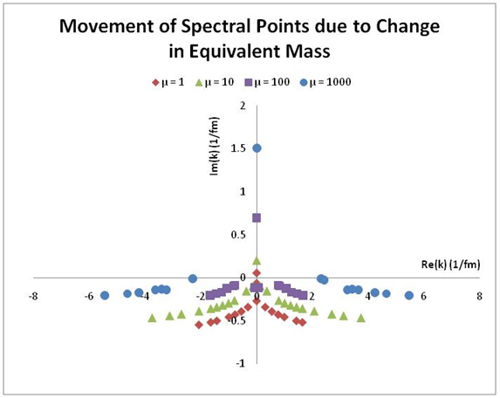
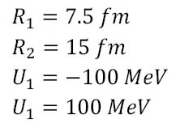
.
Results: Change in µ

Slide 25
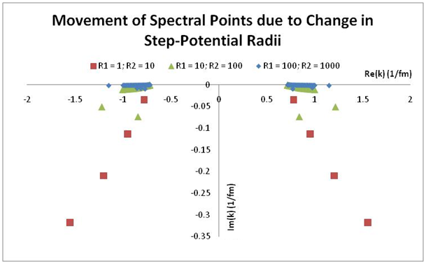
.
Results: Change in R

Slide 26
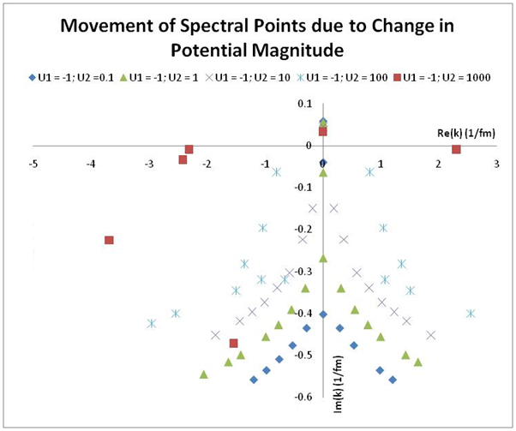
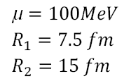
.
Results: Change in U

Slide 28
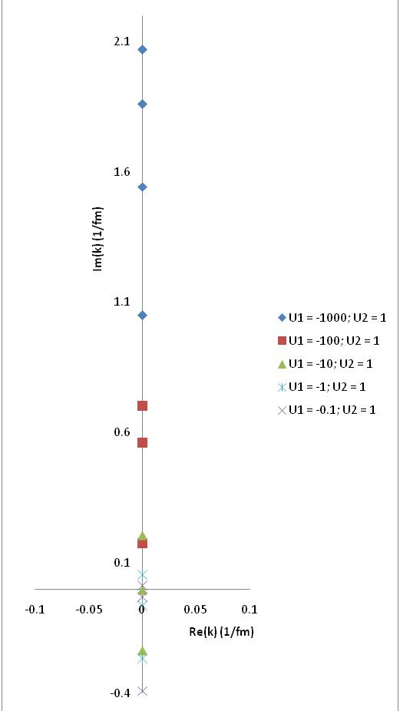
Movement of Bound and Virtual State due to Change in Potential Magnitude

Slide 29
References
[1] S. A. Rakityansky, Jost functions in Quantum Mechanics: Theory and Guide to Applications (University of South Africa, Pretoria)
[2] S. A. Rakityansky, S. A. Sofianos, K. Amos, A Method of Calculating the Jost Function for Analytic Potentials (University of South Africa, 1995)
[3] Lecture Notes: Jost functions in Quantum Mechanics, Compiled by S. A. Rakityansky (University of South Africa, Pretoria, 2007)
[4] Lecture Notes: PHY703 Quantum Mechanics Lectures 1-15, Compiled by S. A. Rakityanski (University of Pretoria, 2010)
[5] N. Zettili, Quantum Mechanics (John Wiley & Sons, Ltd., 3rd edition, New York, 2001)
[6] J. R. Taylor, C. D. Zafiratos, M. A. Dubson, Modern Physics for Scientists and Engineers, (Prentice Hall, Inc.,2nd edition, New Jersey, 2004)
[7] K. F. Riley, M. P. Hobson, S. J. Bence, Mathematical Methods for Physics and Engineering, (Cambridge University Press, 1998)
[8] J. S. De Villiers, Interaction of the Eta-Meson with Light Nuclei, (University of South Africa, 2005)

Slide 30
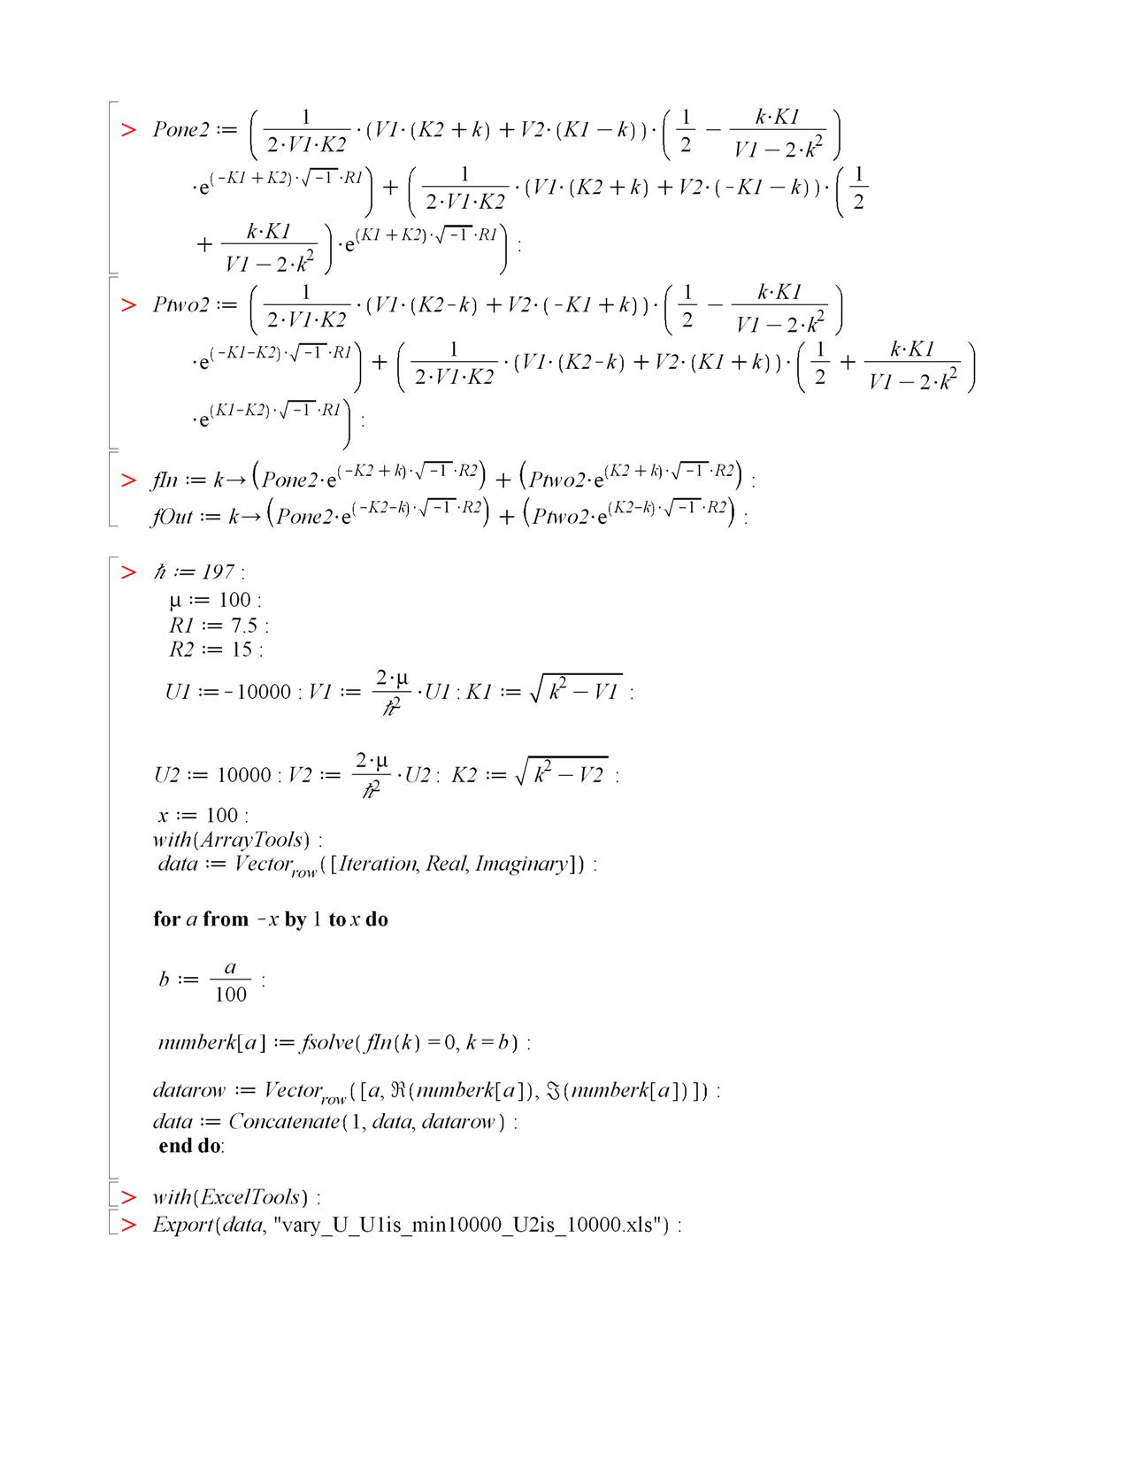
Appendix: Maple Code

Slide 31
The End

