Slide 1
Relevance of synchrotron radiation to inorganic medicinal chemistry
Ayodele Temidayo Odularu
(ayodeleodularu@gmail.com)
Department of Chemistry,
University of Fort Hare, Alice 5700.
November 13, 2019.

Slide 2
Outline
Introduction
Problem statement
Aim
Methodology
Conclusion
Future therapeutic agents
References

Slide 3
Introduction
The essential purpose of pharmaceutical drugs is to serve human beings by preventing diseases and enabling them to enjoy optimal health [1].
In preventing these diseases, are challenges of multi-drug and antineoplastic resistances [2].

Slide 4
Analytical instrumentation and analytical methods
In line with these diseases and their challenges, the role of analytical methods and analytical instrumentation in assessing drugs’ qualities in medicinal inorganic chemistry is important in order to make drugs serve their purpose [1].

Slide 5
Administration of therapeutic agents
Cellular uptake, distribution and biotransformation connected with administration of a therapeutic agent are very important to the medicinal chemist because they help in the design and administration of a pharmaceutical [3].

Slide 6
Medicinal inorganic chemistry
Medicinal inorganic chemistry is an aspect of inorganic chemistry which deals with metal ions in the human body [3].
It entails ever-increasing pharmacopeia of metal-based therapeutic and diagnostic agents, as well as, metal metabolism and mode of action [3].

Slide 7
Problem statement
Challenges in medicinal inorganic chemistry entail cellular uptake, circulation (distribution), and biotransformation of conventional therapeutic agents.

Slide 8
Aim
To evaluate how three synchrotron radiation techniques (infrared microspectroscopy, microphobe X-ray fluorescence imaging, and X-ray absorption spectroscopy could control the challenges encountered in inorganic medicinal chemistry.

Slide 9
Methodology
Methodological approach used for this study entails systematic literature review.
Non synchrotron radiation laboratory instruments
Synchrotron radiation (SR)

Slide 10
Non synchrotron radiation laboratory instruments
Challenges most encountered in the use of non synchrotron radiation laboratory instruments are:
Destruction of sample during preparation [4]
Weakest signal and low resolution from laboratory instruments, such as X-ray diffraction and spectroscopy [5]
These challenges are being solved with the use of synchrotron radiation [5].

Slide 11
Synchrotron radiation and spectral range
Synchrotron radiation (SR) is an electromagnetic radiation emitted when charged particles (electrons and ions) are radially accelerated, that is, they moved in a circular orbit [6].
Spectral range covered by SR are infrared (IR), ultraviolet (UV), visible, soft X-rays, hard X-rays, gamma rays and microwaves [7].

Slide 12
Inorganic medicinal chemistry and synchrotron radiation
The inorganic medicinal chemist can utilize the detection sensitivity and facility which synchrotron radiation (SR) techniques, such as X-ray fluorescence (XRF), and X-ray absorption possess for the detection and characterization of metal based therapeutics in biological systems.

Slide 13
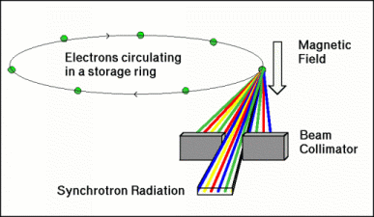
Emitted synchrotron radiation
Notes:
8. ISA: Centre for Storage Ring Facility, Aarus. http://www.isa.au.dk/facilities/astrid/electrons/sr.asp. (Accessed Nov. 8. 2019).

Slide 14
Beamline
In line with these spectral ranges are specific beamlines [9].
Beamlines use generated SR to study matter [10].

Slide 15
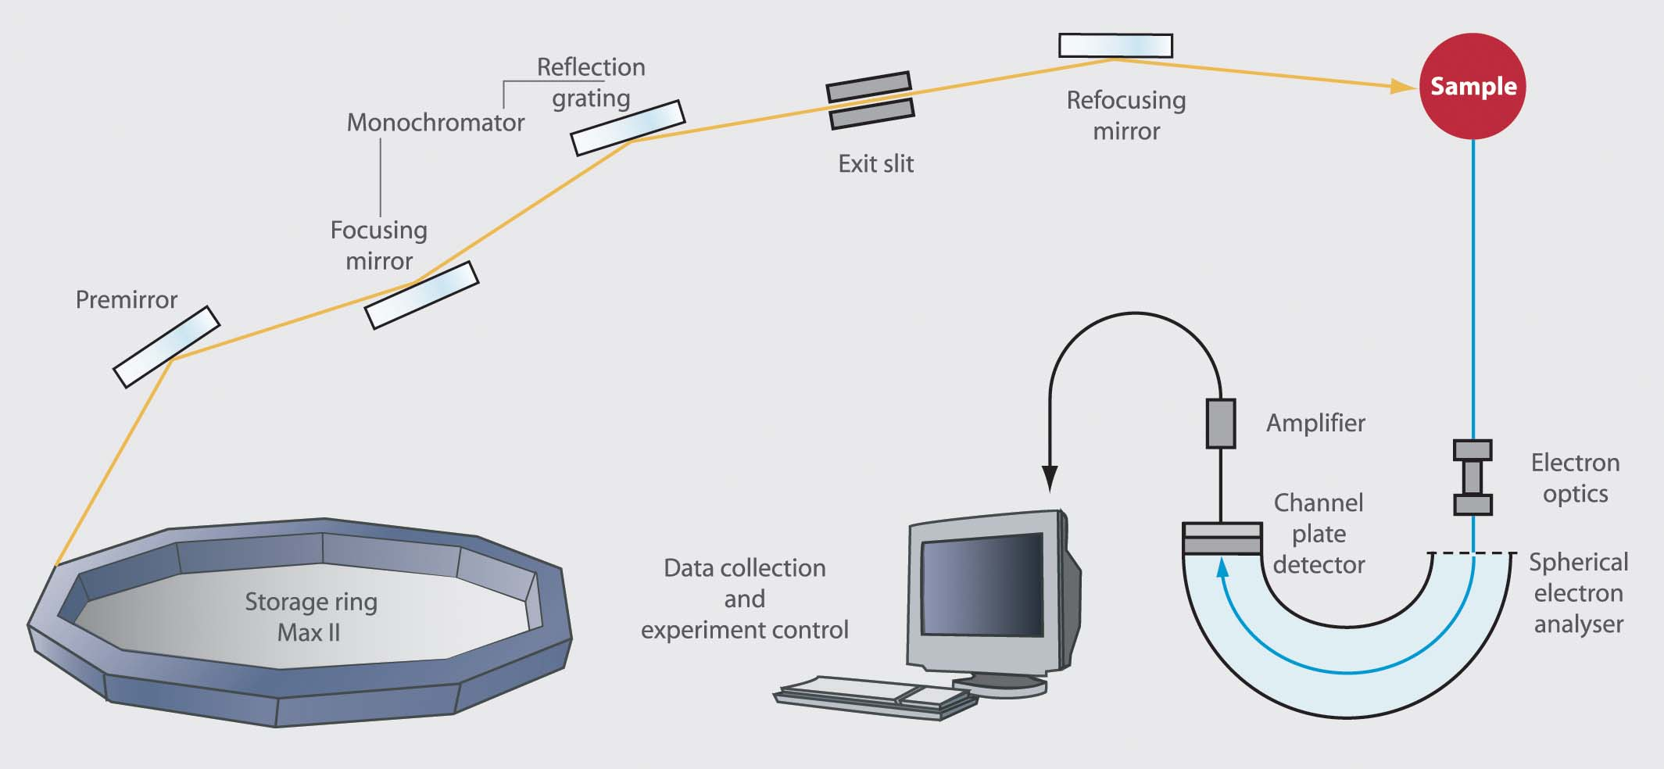
Beamline lay-out

Slide 16
Specific beamlines
Specific beamlines as regards X-ray diffraction and spectroscopy from European Synchrotron Radiation Facility are ID01 for microdiffraction imaging,ID09 for time resolved, ID 17 for bio-medical, ID 26 for X-ray absorption XAS and emission spectroscopy [12].
Notes:
13. Find a Beamline. https://www.esrf.eu/ome/UsersAndScience/find-a-beamline.html. (Accessed Nov. 12, 2019)

Slide 17
Synchrotron radiation and light’s wavelength
Synchrotron radiation is on the electromagnetic spectrum, that is, light.
Light’s wavelength is a function of electron energy, which is found in the hard X-ray region.
The small character of wavelength of X-ray is used to study the atomic structuring and imaging of matter.

Slide 18
Synchrotron radiation techniques
Synchrotron radiation techniques are applicable to virtually all fields of science [10].
As regards atomic structuring and imaging of matter, focus of this study entails infrared microspectroscopy, microphobe X-ray fluorescence imaging, and X-ray absorption spectroscopy.

Slide 19
Infrared microspectroscopy
Synchrotron radiation-Fourier Transform infrared (SR-FTIR) Microspectroscopy is useful because the IR source is 10-1000 times more brilliant than the conventional globar source [6]. This leads to superior signal to noise ratios in the resulting spectra, improving acquisition times and spatial resolution, both of which are vital for analyzing biological samples.

Slide 20
FTIR microspectroscopy

Slide 21
Application of infrared microspectroscopy
An urgent demand to develop accurate and cost-saving analytical techniques which can be used to screen new drug candidates resulted to the choice of SR-FTIR microspectroscopy.
Recently, attention has been directed to the use of SR-FTIR microspectroscopy to study and detect biomolecular changes which occur subsequent to drug administration or potential therapeutic agents in diseased cells.

Slide 22
Microprobe X-ray fluorescence imaging
Microprobe X-ray fluorescence imaging as upper edge over early microprobe because of two factors (i). the absence of continuum (bremstrahlug) background radiation, which is a feature of a spectral obtained from particle beams.
(ii). the increased X-ray flux on the sample connected with the use of third generation synchrotron facilities.

Slide 23
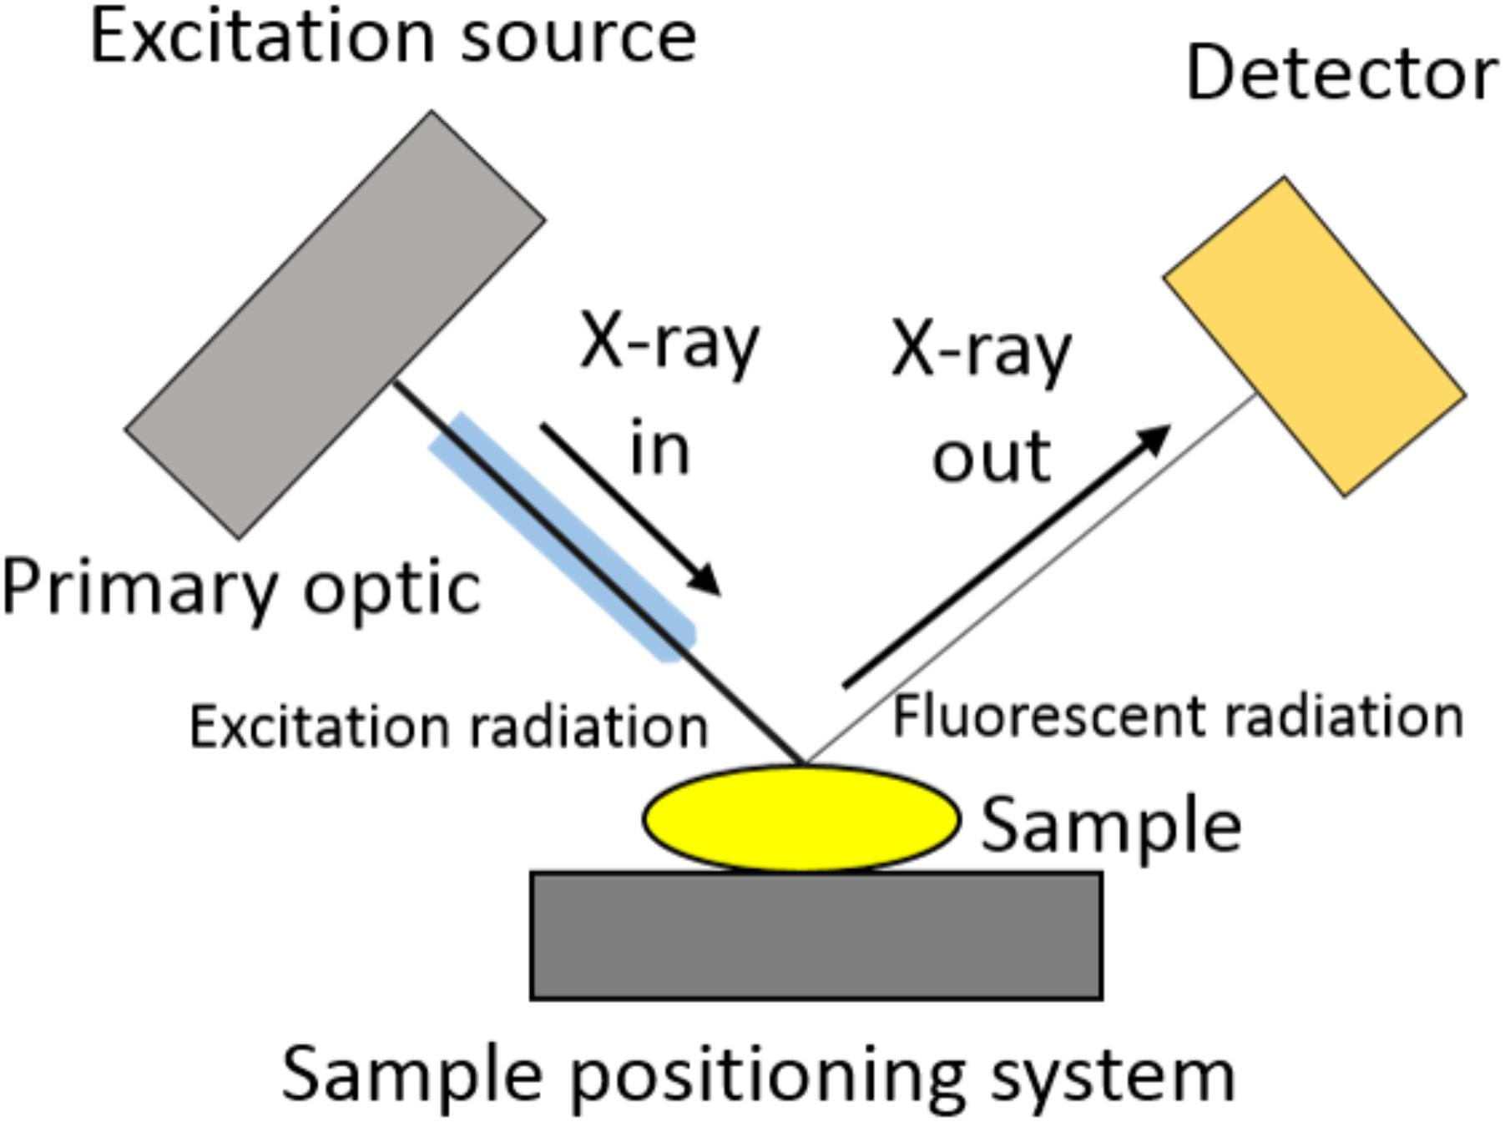
X-ray fluorescence imaging

Slide 24
X-ray absorption spectroscopy
X-ray absorption spectroscopy (XAS) is a high sensitive technique and of extreme versatility.
It is beneficial for studying metal based drugs in order to obtain information in their physical states and chemical environment.
It plays a useful role in structural analysis and metabolism of therapeutic agents. In addition, it confirms the chemical structures of newly synthesized coordination compounds [6].

Slide 25
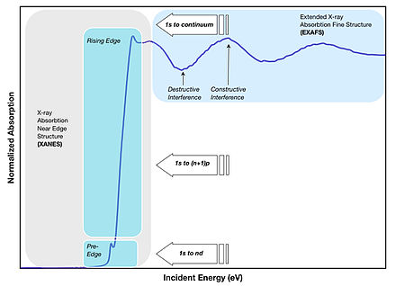
XAS: XANES and EXAFS

Slide 26
Conclusion
In medicinal inorganic chemistry, the three aforementioned synchrotron radiation (SR) techniques are found significant to enable synthesized drugs achieve its purpose in terms of minimal sample preparation, faster approach, turnability, localization, high spatial resolution, and high detection of bimolecular changes of therapeutic agents.

Slide 27
Ongoing and future therapeutic agents
A fast promising area in medicinal inorganic chemistry is the use of nanoparticles as direct therapeutic agents and drug delivery agents.
Additionally, future research agent will entail medicinal inorganic crystallography and microanalysis.

Slide 28
References
1. Siddiqul, M. R.; AlOthman, Z. A.; Rahman, N. Analytical Techniques in Pharmaceutical Analysis: A Review. Arab. J. Chem. 2017, 10, S1409-S1421.
2. Odularu, A.T. ; Ajibade, A. P.; Mbese, J. Z.; Oyedeji, O. O. Developments in Platinum-Group Metals as Dual Antibacterial and Anticancer Agents. J. Chem. 2019, 2019, 1-18.
3. Mjos, K. D.; Orvig, C. Metallodrugs in Medicinal Inorganic Chemistry. Chem. Rev. 2014, 114, 4540-4563.

Slide 29
References
4. Hall, C.; Lewis, R. Synchrotron Radiation Biomedical Imaging and Radiotherapy: From the UK to the Antipodes. Philos. Trans. Roy. Soc. A: Math. Engineer. Sci. 2019, 377, https://doi.or/10.1098/rsta.2018.0240.
5. Borgwardt, T. C.; Wells, D. P. What Does Non-Destructive Analysis Mean? Cog. Chem. 2017, 3, 1-6.
6. Dillion, C. T. Synchrotron Radiation Spectroscopic Techniques as Tools for the Medicinal Chemist: Microprobe X-ray Fluorescence Imaging, X-ray Absorption Spectroscopy, and Infrared Microspectroscopy. Austral. J. Chem.2011, 65, 204-217.

Slide 30
References
7. Paroli, B.; Potenza, M. A. C. Radiation Emission and Properties: Synchrotron, Undulator and Betatron Radiation, Adv. Phys.: X. 2017, 2, 978-1004.
8. ISA: Centre for Storage Ring Facility, Aarus. http://www.isa.au.dk/facilities/astrid/electrons/sr.asp. (Accessed Nov. 8. 2019).

Slide 31
References
8. Urpelainen, S.; Såthe, C.; Grizolli, W.; Agåker, M.; Head, A. R.; Anderson, M.; Huang S. W.; Jensen, B. N.; Wallén, E.; Tarawneh, .; Sankari, R.; Nyholm, R.; Lindberg, M.; Sjöblom, P.; Johansson, N.; Reinecke, B. N.; Arman, M. A.; Merte, L. R.; Knudsen, J.; Schnadt, J.; Andersen, J. N.; Hennies, F. The SPECIES Beamline at the MAX IV Laboratory: A Facility for Soft X-ray RIXS and APXPS. J. Synchrotron Rad. 2017, 24, 344-353.

Slide 32
References
9. Materlik, G.; Payment, T.; Stuart, D. I. Diamond Light Source: Status and Perspectives. Philos. Trans. Roy. Soc. A: Math. Engineer. Sci. 2015, 373, 1-16.
10. Hettiarachchi, G. M.; Donner, E.; Doelsch, E. Application of Synchrotron Radiation-Based Methods for Environmental Geochemistry: Introduction to the Special Section. J. Environ. Qual.2017, 46, 1139-1145.

Slide 33
References
11. https://indico.desy.de>indico >event>contribution>material>slides. (Accessed Nov. 13, 2019).
12. Find a Beamline. https://www.esrf.eu/home/UsersAndScience/find-a-beamline.html. (Accessed Nov. 13, 2019).
13. Halada, GG. P.; Clayton, C. R. Application of Synchrotron Infrared Microspectroscopy (SIRMS) to Corrosion Contamination and Coatings. 100th Meeting. (Accessed Nov. 13, 2019).

Slide 34
References
14. Rodrigues, E. S.; Gomes, Marcos, H. F.; Duran, N. M.; Cassanji, J. G. B.; Da Cruz, T, N. M.; Neto, A, S.; Savassa, S. M.; De Almeida, E.; Carvalho, H. W. P. Laboratory Microprobe X-Ray Fluorescence in Plant Science: Emerging Applications and Case Studies. 2Front. Plant Sci. 2018, 9, 1-15.
15. Porcaro, F.; Roudeau, S.; Carmona, A.; Ortega, R. Advances in Element Speciation Analysis of Biomedical Samples Using Synchrotron-Based Techniques. Trends Analy. Chem. Elsev. 2018, 104, 22-41.

Slide 35
Acknowledgements
My special appreciation to God Almighty for the grace to present this research.
My utmost appreciations to the organizers (SA-ESRF), and funders (NRF).
I also appreciate all listeners. You are the best.

