Slide 1
IVS contribution to the ITRF2014
S. Bachmann, D. Thaller, O. Roggenbuck, M.Lösler, L. Messerschmitt

Slide 2
Outline
Input contribution / submission
Analysis method
Results
  Station Coordinates
  Earth Orientation Parameters (EOP)
How to access to data and results
Conclusions – What did we learn?
Summary

Slide 3
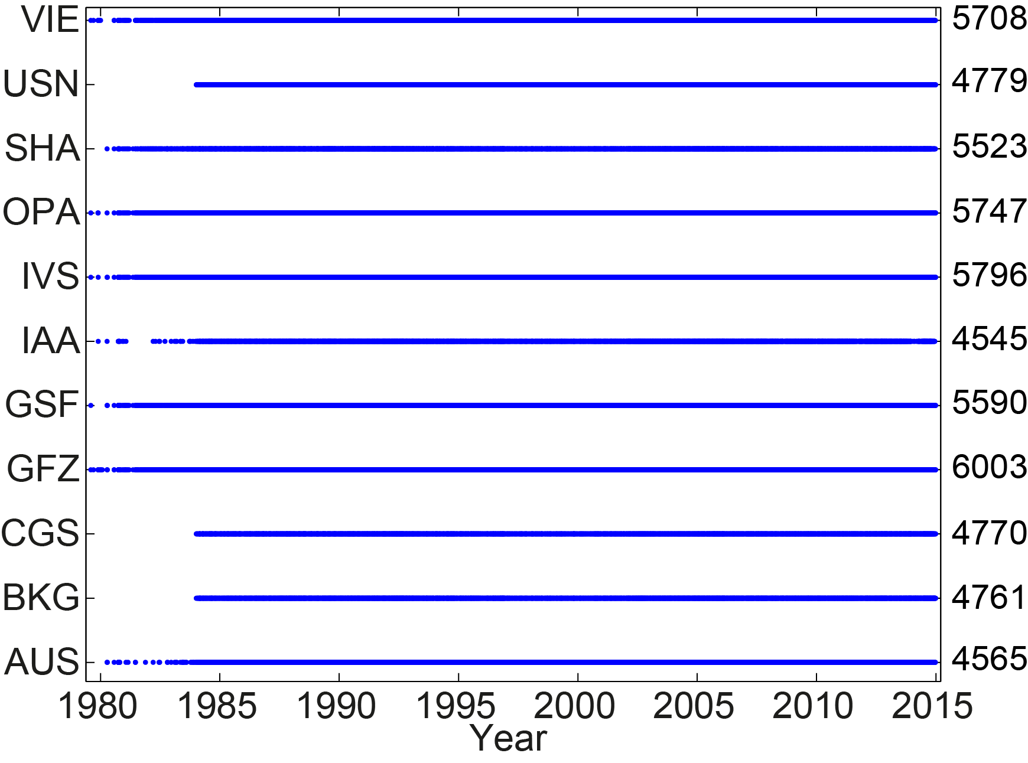
Data I
24h VLBI sessions
Datum free normal equations in SINEX format
Station coordinates and EOP
10 ACs (5 s/w packages) submitted SINEX files including sessions from 1979 until Dec. 31, 2014:
Contributing Analysis Centers (AC):

Slide 4
Data II
AC | Name | Software | Operational AC | ITRF2014 submitted included
AUS | Geoscience Australia, Australia | OCCAM | under review | yes | no
BKG | Federal Agency for Cartography and Geodesy, Germany | Calc/(nu)Solve | yes | yes | yes
CGS | Centro di Geodesia Spaziale, Italy | Calc/(nu)Solve | under review | yes | yes
DGFI | German Geodetic Research Institution | OCCAM | yes | no | no
GFZ | German Research Center for Geosciences | VieVS | under review | yes | yes
GSFC | Goddard Space Flight Center, USA | Calc/(nu)Solve | yes | yes | yes
IAA | Institute of Applied Astrometry, Russia | Quasar | yes | yes | yes
NMA | Norwegian Mapping Authority, Norway | Geosat | no | yes | no
OPAR | Observatory of Paris, France | Calc/(nu)Solve | yes | yes | yes
SHAO | Shanghai Observatory, China | Calc/(nu)Solve | no | yes | yes
USNO | US Naval Observatory, USA | Calc/(nu)Solve | yes | yes | yes
VIE | Vienna University of Technology, Austria | VieVS | under review | yes | yes

Slide 5
Data III
Various problems appeared within the data analysis at the ACs, e.g.
different axes offset or eccentricity files used,
problem with writing routines,
parameter naming,
which have all been solved.
Original IERS CfP contained data until 2014.0. Analysis of additional year 2014:
Analysis consistent to previous years not possible for all ACs
→ complete reprocessing necessary for 3 ACs.
Inconsistencies in the variance factors (next slide).
AC AUS data excluded from combined solution (station accuracy, bug fixed).

Slide 6
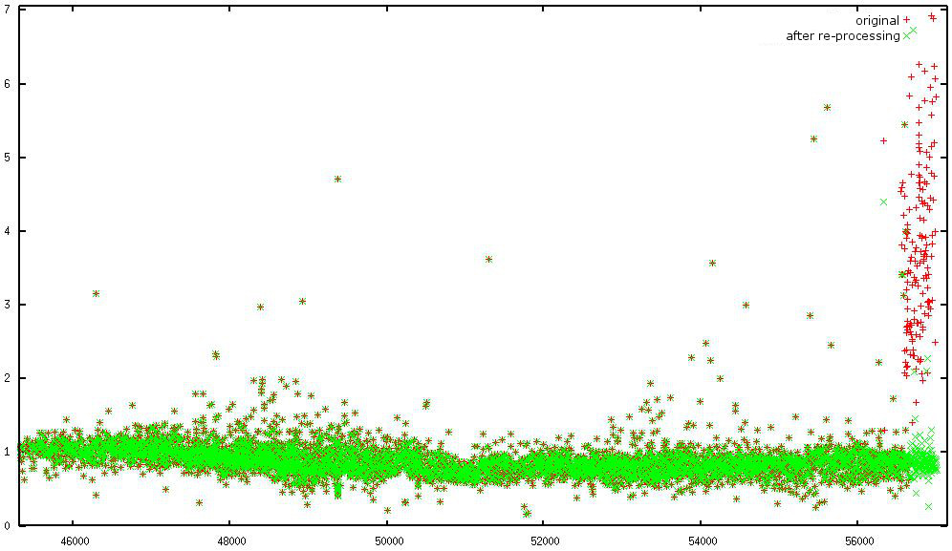
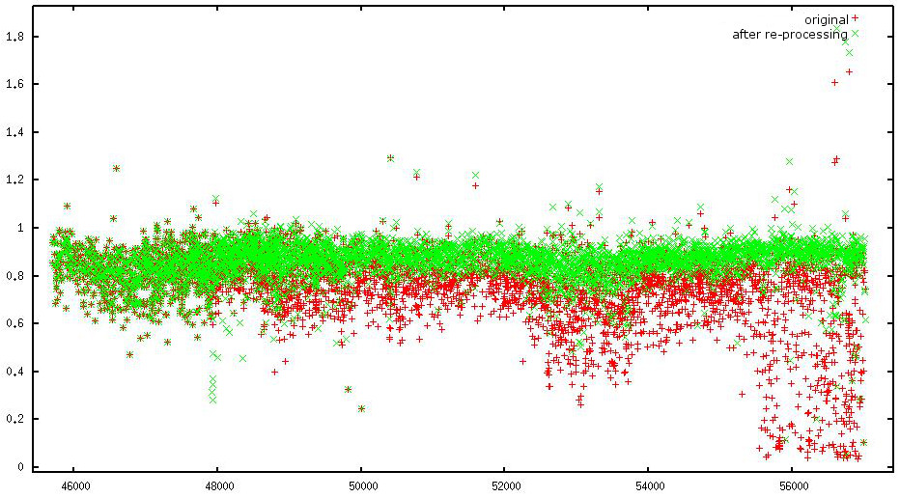
Data IV
Data quality inconsistencies found and corrected (variance factor)
Red: original session-wise variance factors.
Green: session-wise variance factors after
re-processing.
SHAO
USNO

Slide 7
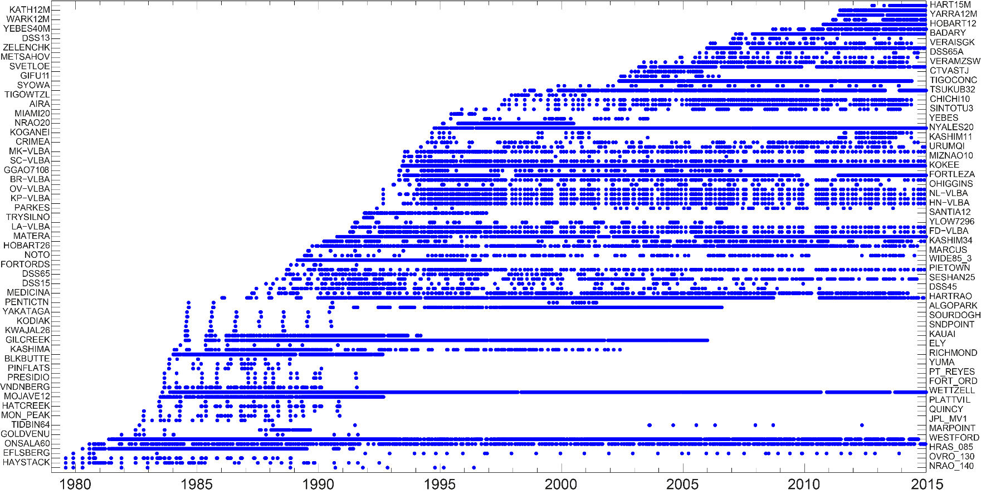
Data V
Station participation (> 10 observed sessions)
Overall 158 different stations.

Slide 8
Data VI
IVS Station distribution.

Slide 9
Analysis I
Parameter:
Station Coordinates
Earth Orientation Parameters
(X-, Y-Pole + rates, dUT + LOD, dX, dY)

Slide 10
Analysis II
Hypothesis:
Improved statistics for a combined solution compared to the individual solutions.
Combination on the level of normal equations with predefined analysis conventions (models, absolute terms, etc.).
Major differences to IVS ITRF2008 contribution:
Transformation on 12h UT for all parameters
(ITRF2008: mid-session)
Improved outlier test
(static / fixed threshold → dynamic / LMS)

Slide 11
Analysis III
Major differences to IVS ITRF2008 contribution (cont.)
Solid Earth Tide, Pole Tides:
IERS Conventions 2003 → IERS Conventions 2010
Nutation:
IAU2000A (without Free core nutation) → IAU2006 (without Free Core Nutation)
Gradients:
MacMillan(1995) with wet VMF1 → Chen-Herring Gradients

Slide 12
Analysis IV
Major differences to IVS ITRF2008 contribution (cont.)
Source positions:
Constrained on ICRF1+Ext.1 or individual CRF → constrained on ICRF2 a priori position (defining sources)
Major differences to IVS routine (rapid / quarterly) combination:
Non-tidal atmospheric loading not applied (annual / semi-annual model applied a posteriori)
Dedicated IVS ITRF2014 axis offset information file

Slide 13
Results I
Station Coordinates
Improvements around 1990s:
More VLBI stations.
Larger network size.
Better global distribution.
More sources observed.

Slide 14
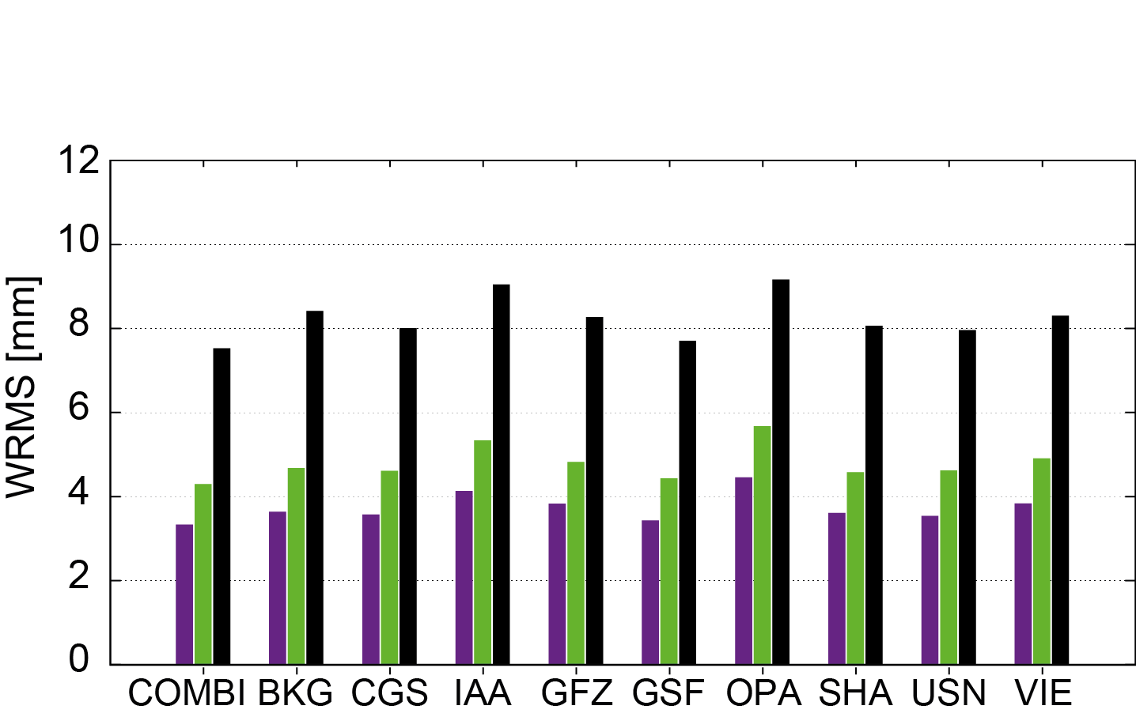
Results II
Station Coordinates
Station coordinates WRMS of all stations
North, East, Up

Slide 15
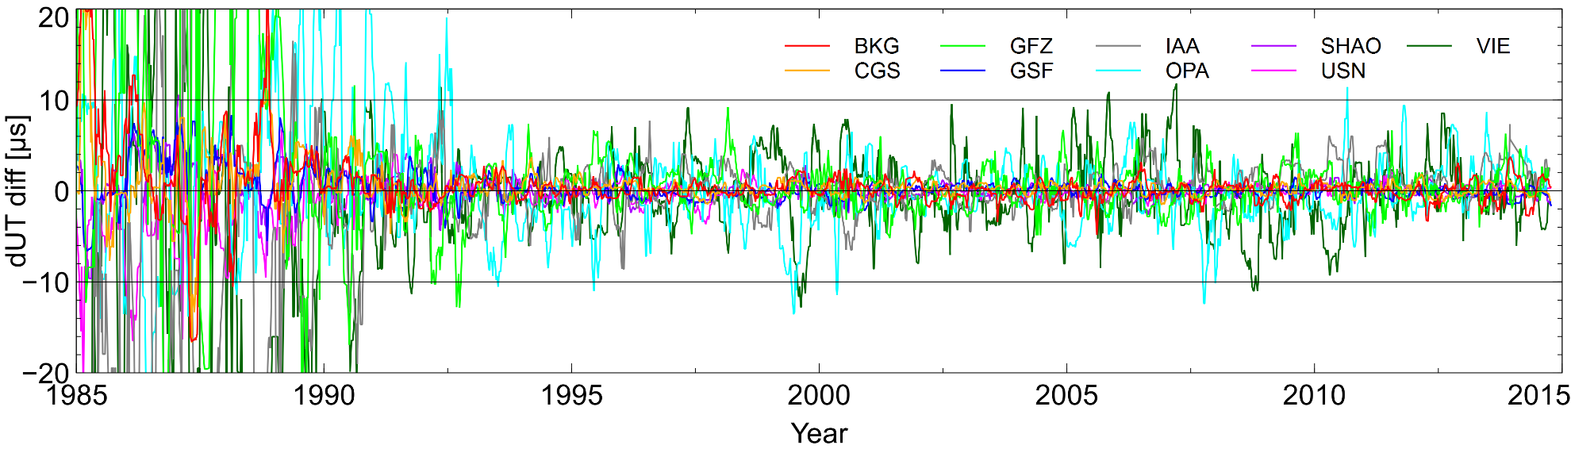
Results III
EOP
Internal comparison w.r.t. combined solution

Slide 16
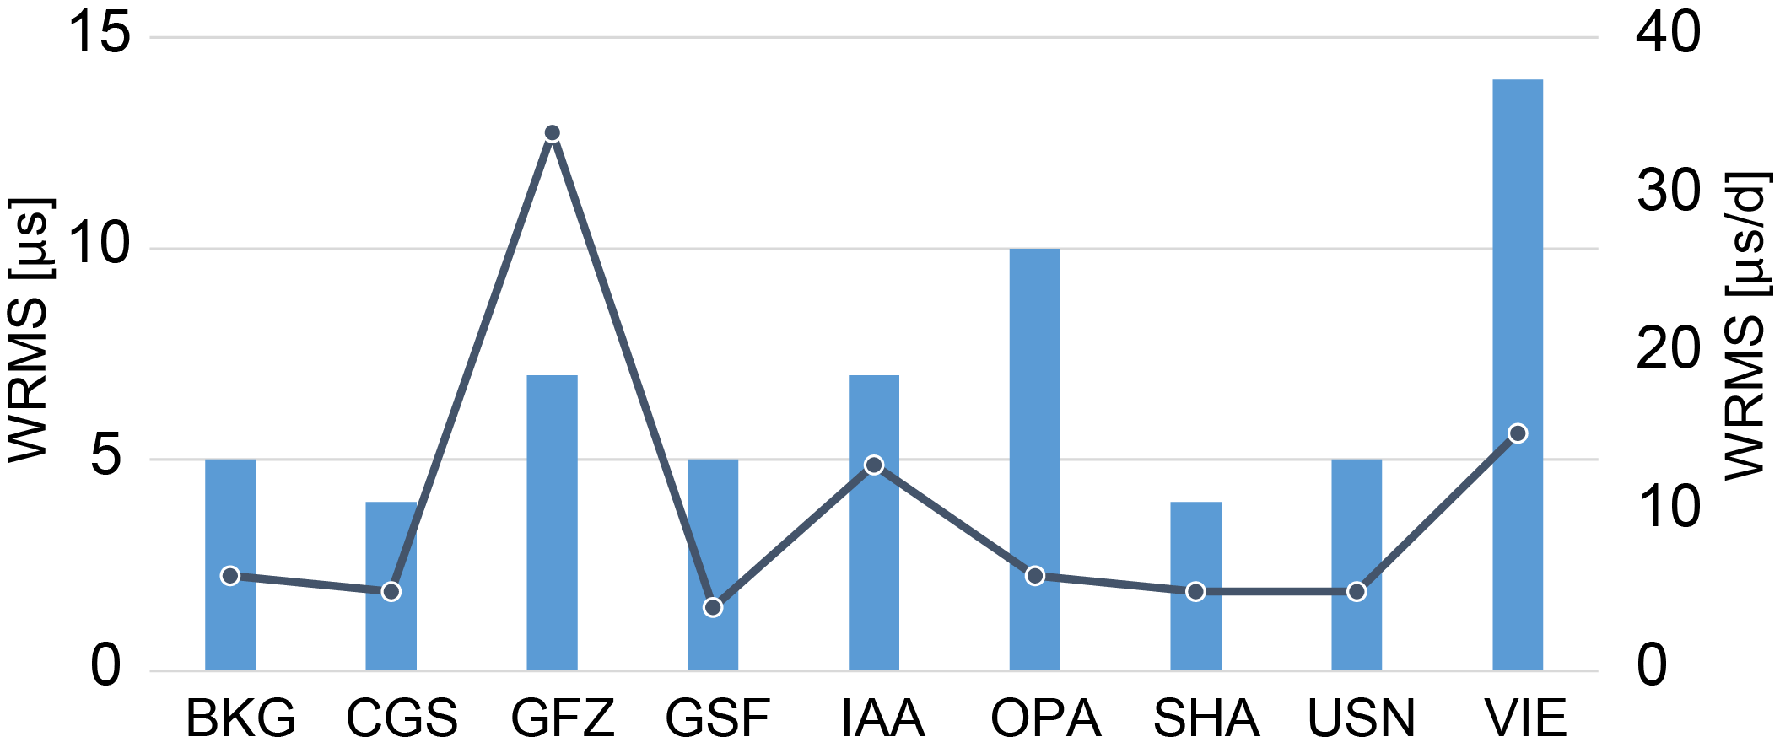
Results IV
EOP
WRMS of the differences w.r.t. combined solution
VIE dUT:
Offset (PWL) → offset + drift
Possible cause of elevated WRMS:
Change of parameterization within the combination process (not on the analysis basis – under investigation for operational combination).
dUT, LOD

Slide 17
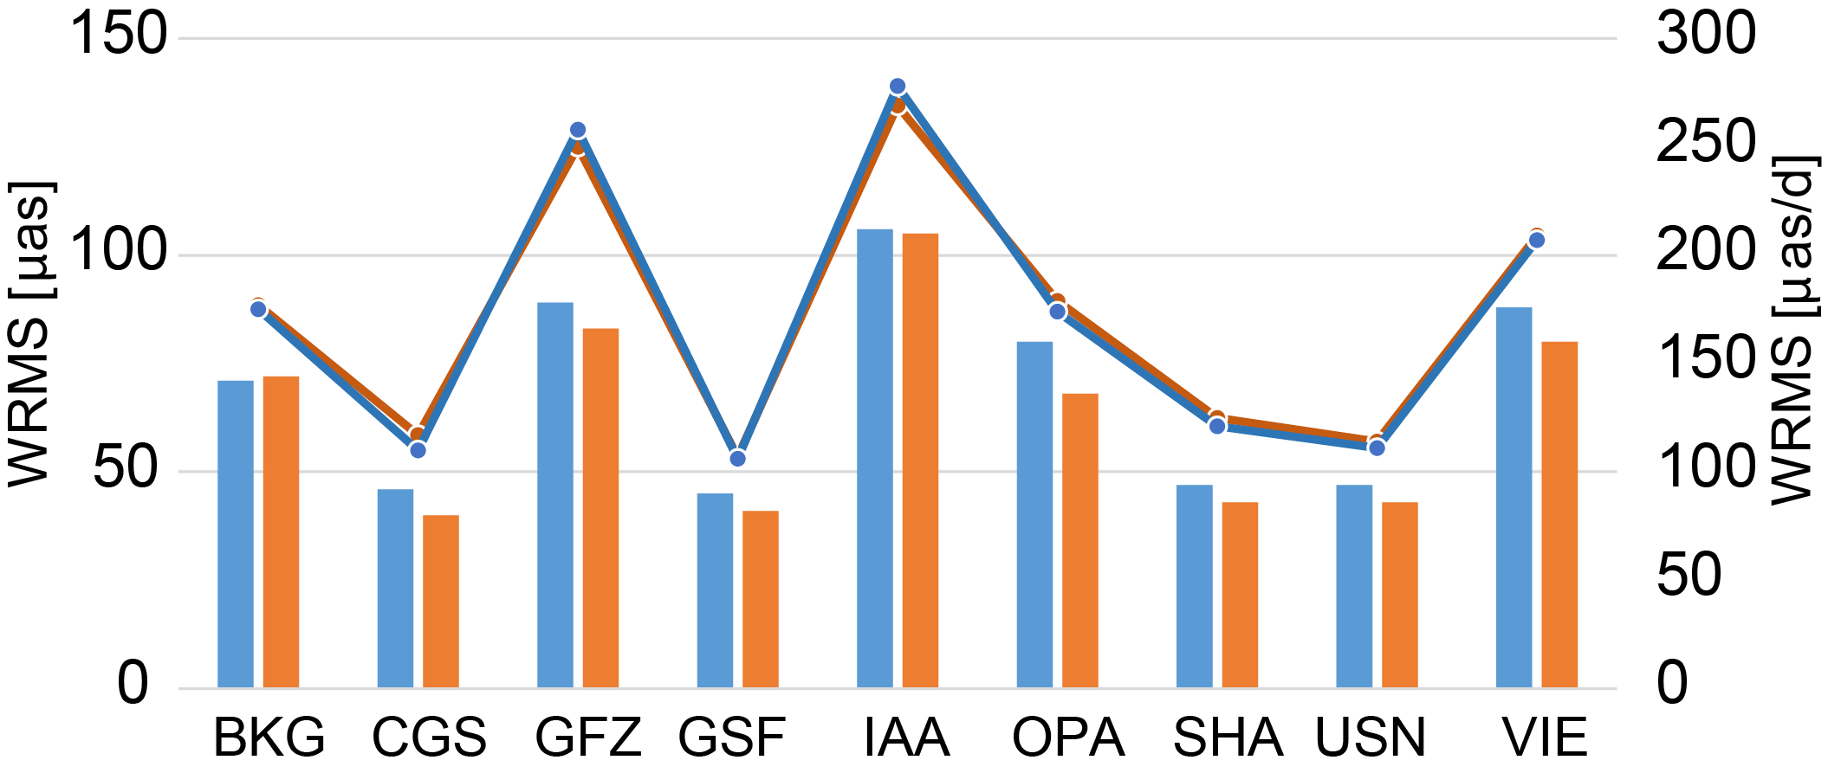
Results V
EOP
WRMS of the differences w.r.t. combined solution
X-Pole (+rate), Y-Pole (+rate)

Slide 18
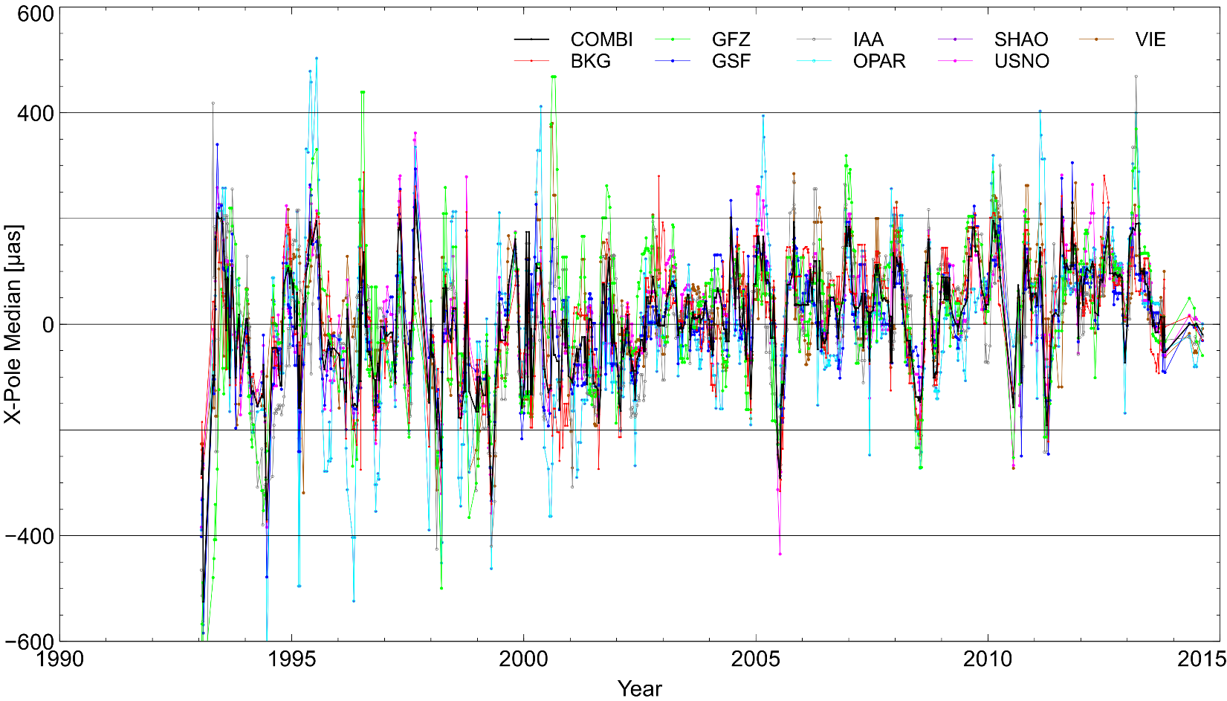
Results VI
EOP
External comparison w.r.t. IERS-08-C04

Slide 19
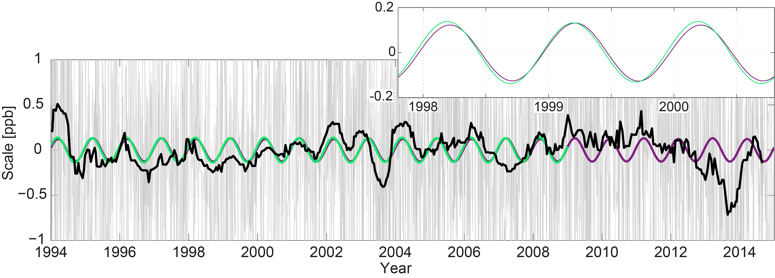
Results VII
Scale - Internal comparisons
Single combined session w.r.t. VTRF2014 (black)
Annual signal 1979-2015.0 (purple)
Annual signal 1979-2009.0 (green)

Slide 20
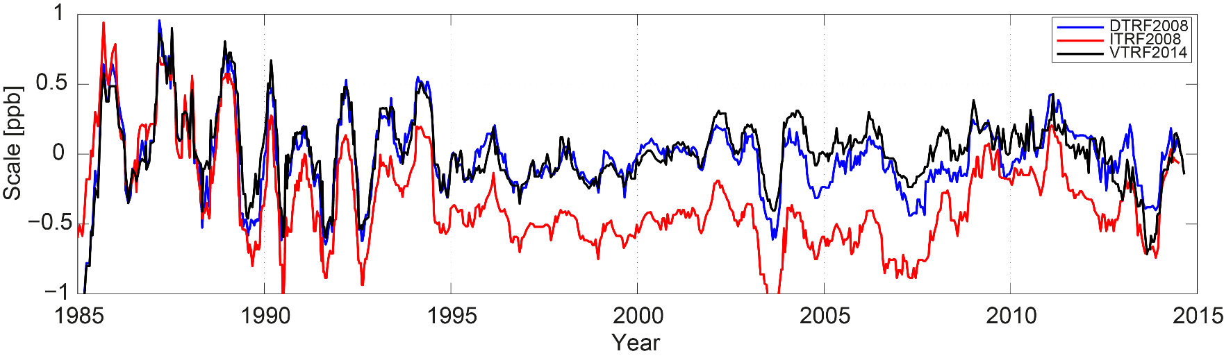
Results VIII
Scale - External comparison
Single combined session w.r.t.:
DTRF2008 (blue)
ITRF2008 (red)
VTRF2014 (black)

Slide 21
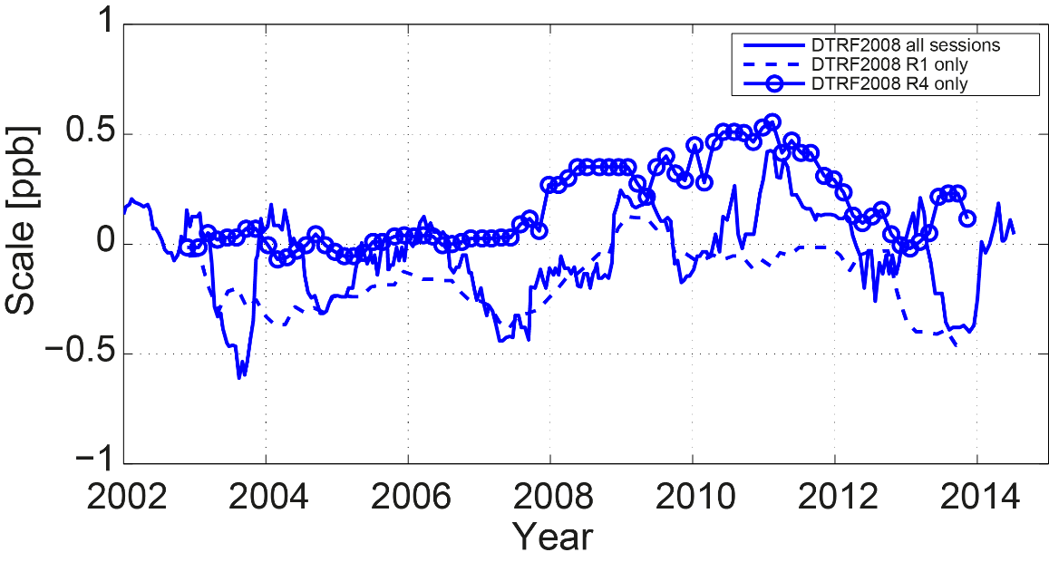
Results IX
Scale - External comparison cont.
Network size / geometry dependency
Session weighting in global solution?

Slide 22
Results X
Scale
14 parameter Helmert Transformation between VTRF2014 and DTRF2008 / ITRF2008:
HT Parameter | DTRF2008 Positions Velocities (per yr) |  |  |  | ITRF2008 Positions Velocities (per yr)
T_{x} [mm] | -2.1 | (± 0.8) | -0.5 | (±0.8) | -0.8 | (± 0.6) | -0.4 | (± 0.6)
T_{y} [mm] | -0.1 | (± 0.8) | -0.6 | (± 0.8) | 0.6 | (± 0.6) | -0.4 | (± 0.6)
T_{z} [mm] | 1.1 | (± 0.7) | 0.2 | (± 0.7) | -1.1 | (± 0.6) | 0.1 | (± 0.6)
R_{x} [mas] | -0.03 | (± 0.03) | -0.006 | (± 0.03) | -0.02 | (± 0.02) | -0.008 | (± 0.02)
R_{y} [mas] | 0.06 | (± 0.03) | 0.002 | (± 0.03) | -0.01 | (± 0.02) | 0.006 | (± 0.02)
R_{z} [mas] | -0.12 | (± 0.03) | 0.006 | (± 0.0.3) | 0.01 | (± 0.02) | 0.012 | (± 0.02)
Scale [ppb] | 0.11 | (± 0.11) | 0.02 | (± 0.11) | 0.44 | (± 0.09) | -0.02 | (± 0.09)

Slide 23
How to access to data and results? I
Retreat: “Low visibility of IVS results”
All AC + combined contributions are available in the IVS data centers (BKG, CDDIS, OPAR)
A paper on this subject will be published in the Journal of Geodesy:
Bachmann, S et al. „IVS contribution to ITRF2014“
(submitted, review process finished)
Preliminary results: IAG Symposia REFAG2014 (DOI 10.1007/1345_2015_136)
IVS GM 2016 Proceedings
(accepted)

Slide 24
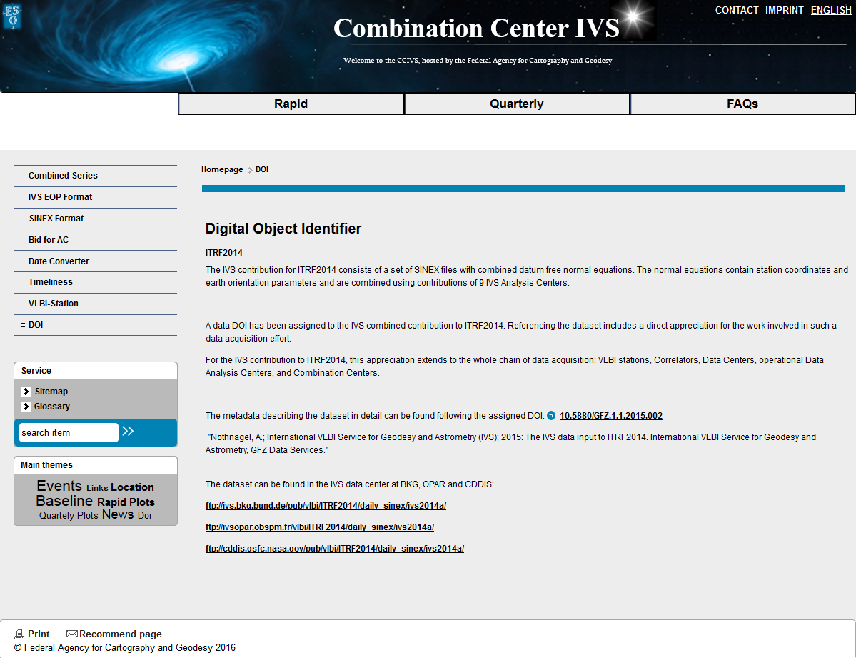
How to access to data and results? II
Presentation of results on the (newly designed) IVS Combination Centers website:
Time series of station coordinates, baselines, EOP, scale
Individual and combined results
Link to data DOI
ccivs.bkg.bund.de
→ IVS GM 2016 Poster

Slide 25
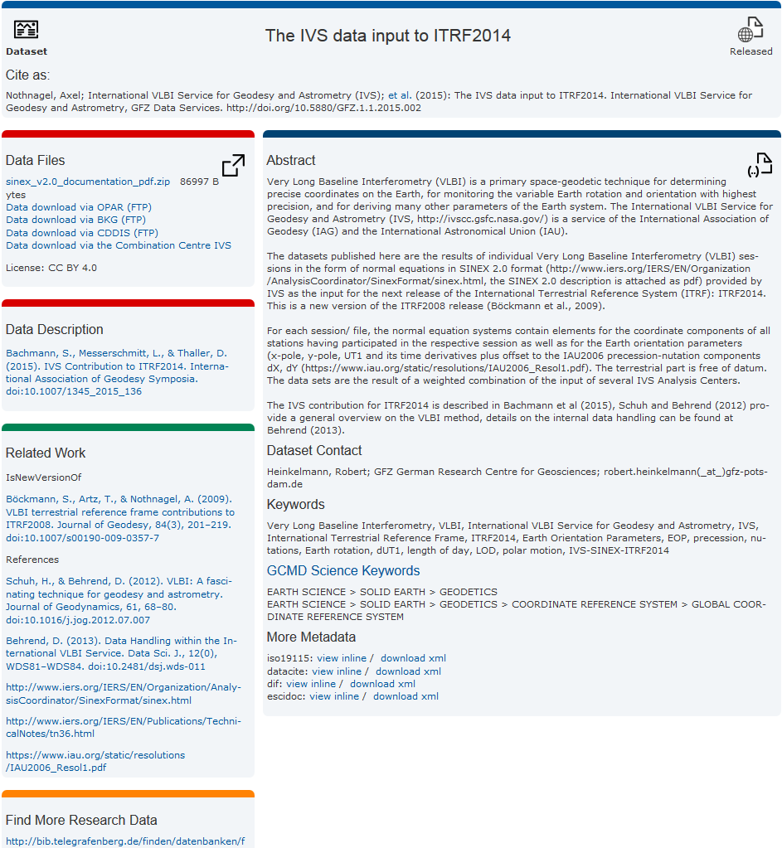
How to access to data and results? III
Data DOI - Citable data
10.5880/GFZ.1.1.2015.002
Established at GFZ, Germany
Abstract, Keywords, contact
Links to data files in IVS data center (freely available)
Meta data / data description
Etc.
Reference:
"Nothnagel, A.; International VLBI Service for Geodesy and Astrometry (IVS);
2015: The IVS data input to ITRF2014. International VLBI Service for Geodesy and
Astrometry, GFZ Data Services."

Slide 26
Conclusion
What we have learned
A lot…
Collecting data always takes longer than expected [..]
Improvement of weighting strategies of the ACs.
Scale irregularities: further investigations of the sessions and the network configuration, and other influences (e.g. drought).
EOP parameterization: offsets vs. offset + drift → ongoing subject of investigation and discussion.
[…]

Slide 27
Summary
5796 combined sessions submitted to IERS ITRS Center (ITRF2008: 4539)
9 ACs (ITRF2008: 7)
Time span: 1979.0 - 2015.0 (ITRF2008: 1979.0 – 2009.0)
Improved models and analysis methods
More VLBI stations, especially in the southern hemisphere
ITRF2014 released

Slide 28
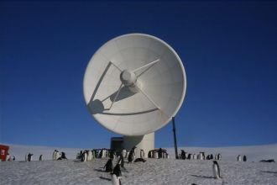
Thank you for your kind attention!
Contact:
Federal Agency for Cartography and Geodesy
Section G1
Richard-Strauss-Allee 11
60598 Frankfurt, Germany
contact person
Sabine Bachmann
sabine.bachmann@bkg.bund.de
www.bkg.bund.de
ccivs.bkg.bund.de
Tel. +49 (0) 69 6333-314

