Slide 1
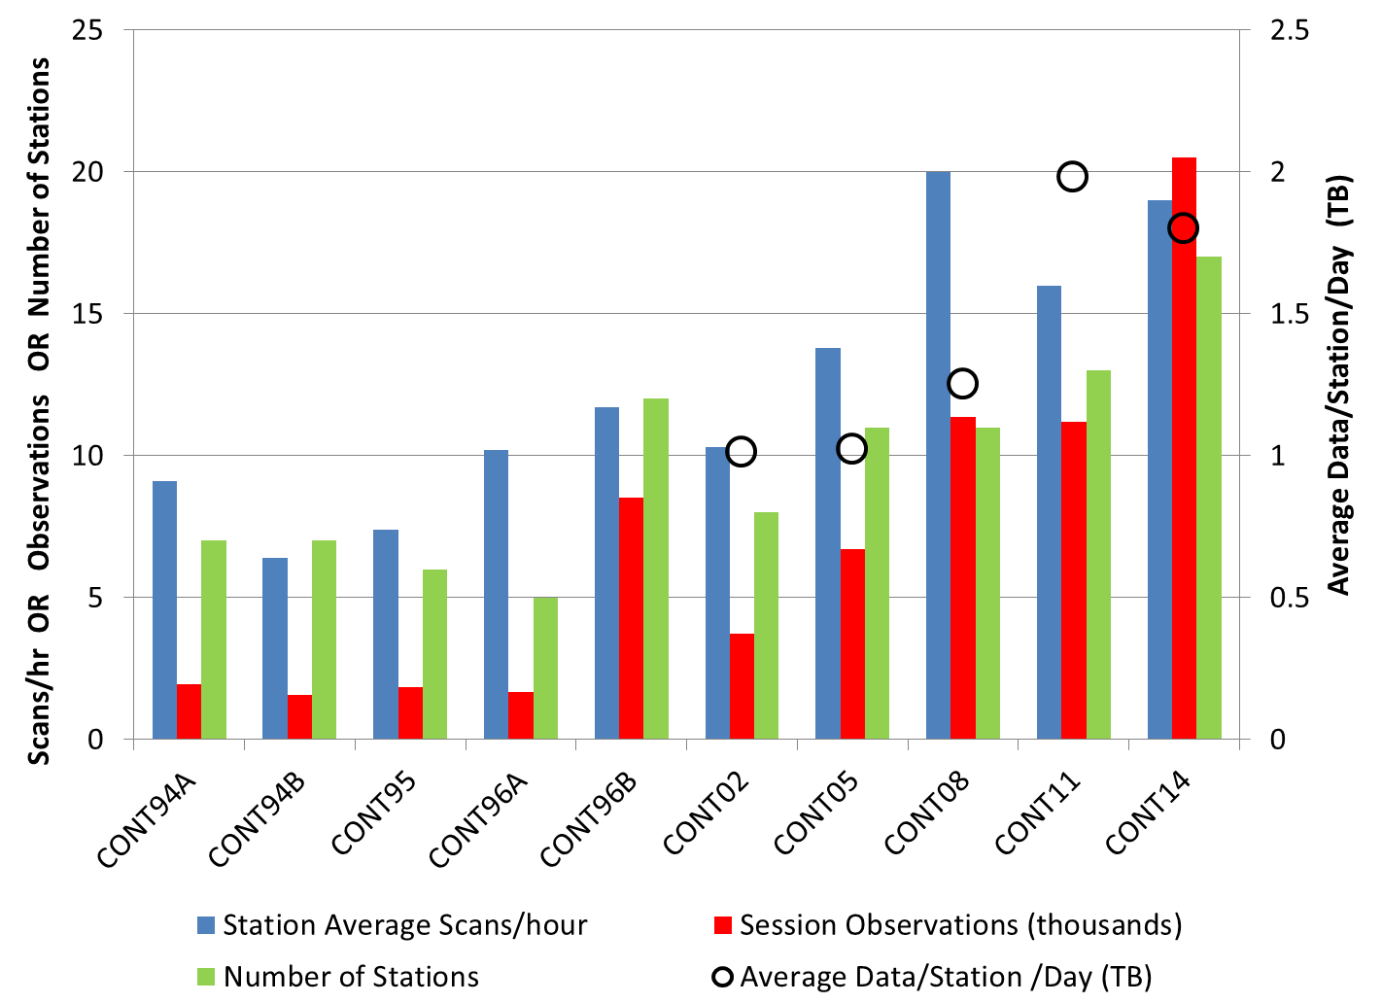
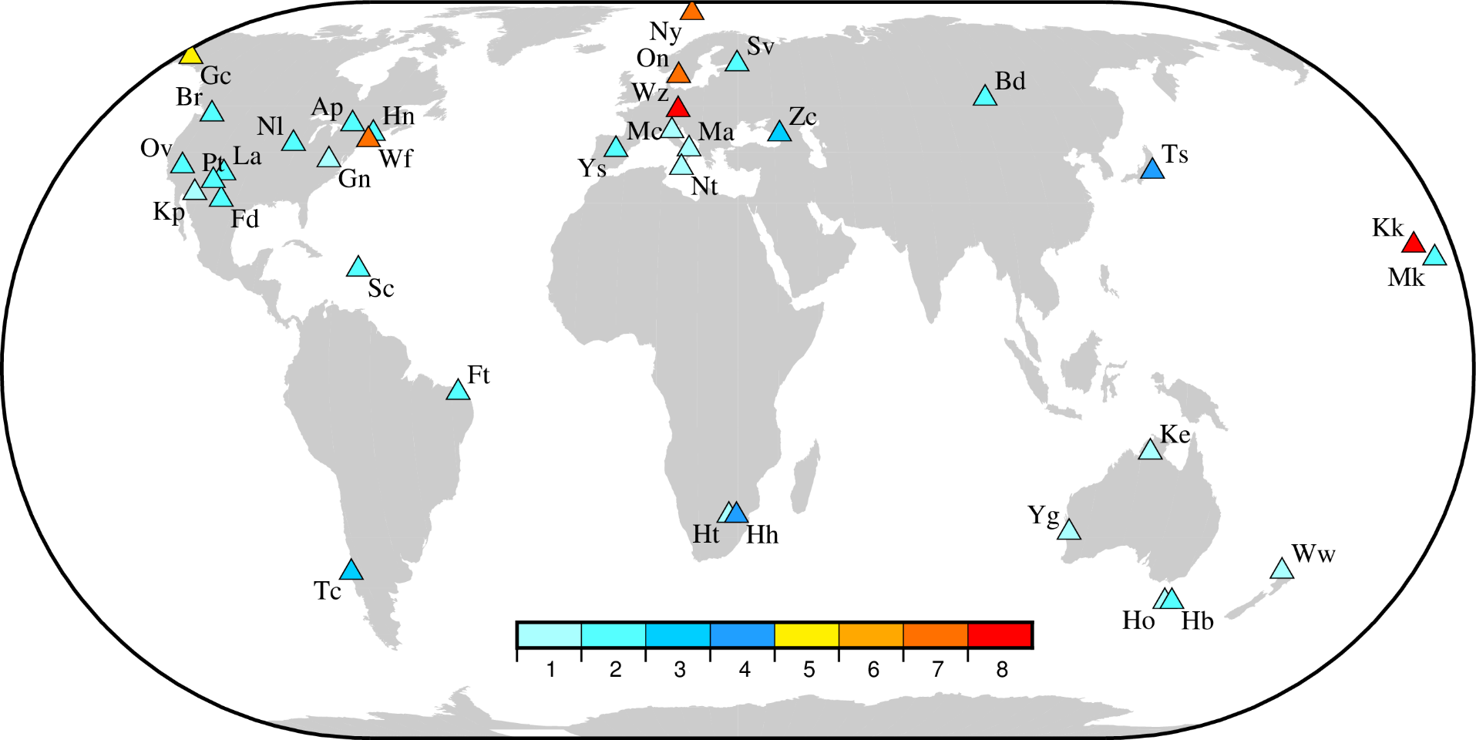
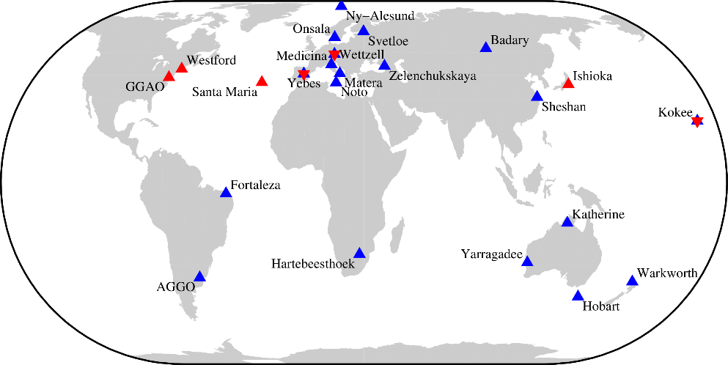
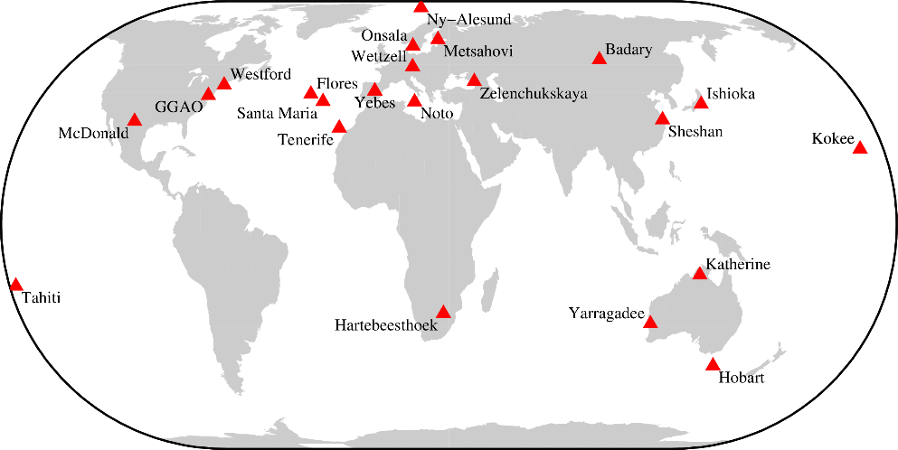
From CONT to VGOS: The Evolution of the CONT Campaigns
C. C. Thomas, D. Behrend, and D. S. MacMillan
NVI, Inc., Code 698, NASA Goddard Space Flight Center, Greenbelt MD, 20771
INTRODUCTION
SIZE OF THE CONT CAMPAIGNS
Continuous VLBI Campaigns (CONT) started in 1994 with the goal of demonstrating state of the art VLBI over a continuous period of time. The first CONT was followed by campaigns in 1995 and 1996. After a six year hiatus, CONT campaigns were organized approximately every three years from 2002 through 2014.
The chart shows the general increase in several measures of the size of the CONT Campaigns. The station average scans per hour were better in CONT08 than in CONT14, but CONT14 had five more stations than CONT08. That is why the number of session observations in CONT14 was much higher than previous CONTs. The average data per station per day was largest in CONT11.
1994‒2014 CONT NETWORKS
The networks of the CONT Campaigns have continued to improve over time. There were two campaigns with dual networks (CONT94 and CONT96). We are in the planning stage for CONT17 and are considering having two networks run simultaneously: one network with legacy stations and one with VGOS stations. Then the CONT20 Campaign may have VGOS stations only.
Campaign | #stations | Period | Comments
CONT94A, CONT94B | 7(A), 7(B) | Jan 12‒24 | Two independent networks running simultaneously: non-VLBA stations in A and VLBA in B
CONT95 | 6 | Aug 23‒28 | Six-day campaign
CONT96A, CONT96B | 5(A), 12(B) | Sep 2 ‒ Nov 15 | 11-week campaign. First eight weeks, observe bi-weekly, one week no observing. Two simultaneous networks during the last two weeks, one five-station and one 12-station (10 VLBA + 2 non-VLBA)
CONT02 | 8 | Oct 16‒30 | 15-day campaign
CONT05 | 11 | Sep 12‒26 | 15-day campaign
CONT08 | 11 | Aug 12‒26 | 15-day campaign
CONT11 | 13 | Sep 15‒29 | 15-day campaign
CONT14 | 17 | May 6‒20 | 15-day campaign (2 stations at Hobart)
CONT17 | 26 | Planning phase | Two networks running simultaneously, one with ~19 legacy stations only and one with ~7 VGOS stations only.
CONT20 | up to 26 | Planning phase | One network with VGOS stations only as a test bed for VGOS continuous observing.
EOP FORMAL UNCERTAINTIES
The EOP formal uncertainties steadily improved after CONT02. This was due to larger networks and increased recording rates.
FREQUENCY OF USE
Thirty-five stations have contributed to CONT Campaigns in the last 20 years. The map shows how many times a station participated in a CONT Campaign. There have been eight CONT Campaigns so far. Two stations, Wettzell and Kokee, have participated in all eight campaigns. The global coverage of the CONT Campaigns improved with more coverage in the south.
CONT17
The plan is to have the next CONT Campaign in late 2017 (or early 2018). We want to have as many VGOS stations (red triangles) as possible observing simultaneously with the legacy stations (blue triangles). As mentioned earlier, a vast amount of resources will be needed to support this campaign. Currently only the Haystack correlator can process the VGOS data. So, we may need two correlators to process the data. Mark 6 modules need to be purchased to support the VGOS observing. Depending on the recording rate, additional Mark 5 modules may need to be purchased as well.
MEDIA AND CORRELATOR RESOURCES
The CONT Campaigns used, and will continue to use, a large amount of resources: station time, tapes or modules, and correlator time. From the display below, one can see how much correlator time was used to support the CONT Campaigns. This required that all other sessions except the IVS-R1s and IVS-R4s were not processed until the CONT Campaigns were completed. The text in black is for pre-IVS CONTs. The CONT14 Campaign was processed with the DiFX Correlator in 38 days. This was a significant improvement from previous CONT Campaigns.
CONT20
CONT94
CONT95
CONT96
CONT02
CONT05
CONT08
CONT11
CONT14
41 Sources
Thin Tape
Haystack
34 Sources
Thin Tape
Washington
40 Sources (non-VLBA)
Thin Tape
Haystack
VLBA
Washington
44 Sources (VLBA)
Thin Tape
Westford (Module)
Bonn - 58 Days
Hays - 89 Days
Wash -45 days
50 Sources
74 sources
Modules
Bonn-50 days
Hays-81 days
Wash-68 days
80 sources
Modules
Washington
163 days
117 sources
Modules
146 days
Washington
73 sources
Modules
Bonn
38 days
We are also considering having a pre-VGOS Observing Campaign for CONT20. This would be 15 days of VGOS only observing to determine if the stations and the correlators can handle continuous VGOS observing. This will test the bandwidth for e-transfers along with module shipments. This also means that each station will have to be able to record continuously while sending their large volumes of data to the designated correlator(s).
2016 IVS General Meeting in Johannesburg, South Africa
E−mail: cynthia.c.thomas@nasa.gov

