Slide 1
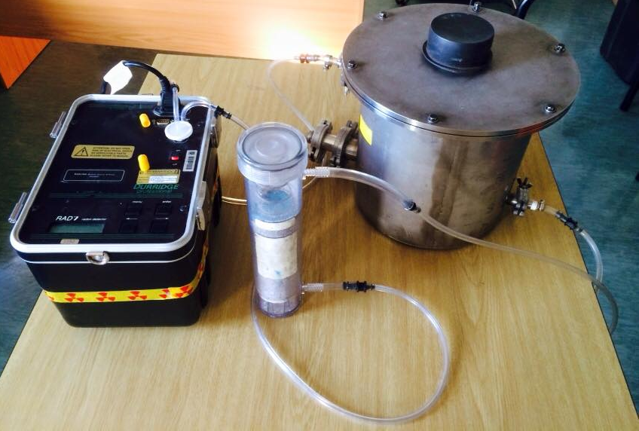
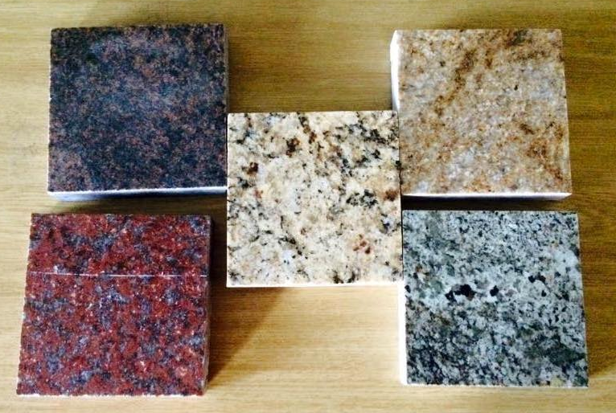
Radon exhalation of building materials
F.S. Wentzel¹, R. Lindsay¹
¹ Department of Physics, University of the Western Cape , Robert Sobukwe Road (Modderdam Road), Private Bag X17, Bellville, 7530, South Africa.
Introduction
Radon and radium are daughter products of the radioactive decay chain of ²³⁸U.[1] The most important materials needed for building material are soil and rocks, [2] we can say that building materials are a radon source.[3] There are many ways how radon enters a house, but it is mainly due to the soil and rock upon which it is built by means of diffusion. Exhalation from various building materials can be another potential source of radon in the indoor environment. [4][5] This makes radon a source of radiological health risks to humankind received by both ingestion and inhalation. The death of underground miners from lung cancer led to the identification of radon as a health hazard.[6][7]
Building Materials Used
Building materials used in construction of dwellings were
aggregate (basalt rock) , Malmesbury and Phillipi sand.
Building materials used in decorating of dwellings were
floor tiles, roof tiles and 5 types of granites. (Figure 6)
Background radiation was determined by leaving the vacuum
tube empty. This is the benchmark to determine how much
radiation each material emits. (Figure 3)
All the construction building materials had no significant
radon emissions.
Of the decorative building materials only two (Granite D and
Granite E) was found to emit significant amounts of radon
while the other three had no significant radon emissions.
It was very difficult to trace and verify the location of
the quarries of Granite D and Granite E. It was verified that
all the granites were mined in South Africa. [8]
There are many possible reasons why the radon levels were
elevated in these granite slabs;there are two main
possibilities why these levels are high.
The first reason is that the quarry might be close to a
Uranium mine or located inside a Uranium reserve.[9]
The second reason is that granite plutons are also a source
of Uranium ore deposits which increases the radiation level
due to the low permeability; this also serves as a Radon
trap. This causes radon levels to increase.[9]
Experimental Procedure
All experiments where done by using the RAD 7 which was connected to
the Vacuum chamber and Drying unit. (Figure 1)
Before all experiments commenced, purging was done to ensure that the
Relative humidity (RH) was below 10%.
All experiments were done in the Nuclear Physics lab of UWC.
After every experiment it is advisable to purge the RAD 7 and switch it
off for at least a day to ensure that the readings of the next experiment are
accurate.
Optimal conditions for usage of the RAD 7 is at 22ºC for the air
temperature and RH of less than 10%.
After a long period of disuse, please use a Radon emitting source like
Radium to see if the RAD 7 operates properly. (Figure 2)
Drying unit
Granite A
Granite B
Vacuum Tube
Granite C
Granite D
Granite E
Air tubes to
RAD 7
RAD 7
Figure 6: The five granites used in the experiment.
References :
[1] Bossew, P. (2003) The radon emanation power of building
materials, soils and rocks. Applied Radiation and Isotopes, Vol.59, pp389 – 392.
[2] Åkerblom, G., Mellander, H. (1997) Geology and radon. In
Radon measurements by etched track detectors, Editors S.A. Durrani and R. Ilić, World Scientific Publishing Co. Pty. Ltd.
[3] Elzain, A. (2014). Radon exhalation rates from some building materials used in Sudan. Indoor and Built Environment.IOSR Journal of Environmental Science, Toxicology and Food Technology (IOSR-JESTFT) e-ISSN: 2319-2402,p- ISSN: 2319-2399.Volume 9, Issue 3 Ver. III (Mar. 2015), PP 62-67
[4] Cothern, C. and Smith, J. (1987). Environmental radon. New York: Plenum Press.
[5] UNSCEAR, 1982. Ionising Radiation Sources and Biological Effects. United Nations Scientific Committee
on the Effects of Atomic Radiation. A/37/45, New York.
[6] Těšínská, E. "Epidemiological studies of lung carcinoma incidence in uranium miners (accumulation and retrospective use of diagnostic data)." Prague medical report 110.2 (2009): 165-172.
[7] Wilson, Janice, et al. "Synergistic cytotoxicity and DNA strand breaks in cells and plasmid DNA exposed to uranyl acetate and ultraviolet radiation." Journal of Applied Toxicology (2014).
[8] http://www.marbleclassic.co.za/exclusive -warehouse/index [Accessed 23 Jun. 2015].
[9] Cole DI, Ngofe, Hlenyane K. Mineral commodities in the Western Cape province, South Africa. Report number 2013-0165. Pretoria : Council for geosciences. ;2013
Figure 1: The experimental setup of the Vacuum Chamber method
Figure 2: Radiation emitted by the Radium source
Figure 3: Radiation emitted due to the background
Figure 4: Radiation emitted by Granite D
Figure 5: Radiation emitted by Granite E

