Slide 1





FAILURE MECHANISMS, SOURCE PARAMETERS and QUANTIFYING THE SIZE OF MINING INDUCED SEISMIC EVENTS
R. Ebrahim-Trollope*, G. Smith* and R. J. Durrheim^.
*University of Cape Town
^University of the Witwatersrand and CSIR
Witwatersrand Basin
South Africa

Slide 2

Introduction
Elastic waves have the shortest wavelength of any Geophysical wave.
  Sensitivity is localised spatially and temporally and allows for the highest resolution (Femto scale).
Geophysics (seismology) is a remote and observational discipline.
  Based on inverse theory and simple mathematical models.
  Most advances still based on empirical analysis.
Many unresolved hypotheses
  Complexities and heterogeneities of failures require resolution and quantification.

Slide 3
Measuring the Size of an Earthquake
Inversion
  Instruments record some distance from the source
  Time domain Amplitude, duration, etc.
  Frequency domain Source parameters (Ω₀, f_{c}, f_{c}^{-γ})
    Simple Models
      Double Couple Shear rupture type failures.
      Brune, Madariaga, Haskell, Savage, etc. (Moment, Energy ; Stress drops, Radius, etc.)
  Common assumptions
    Homogeneous (material properties and mechanisms)
    Shear rupture and scale invariant or Self-similar
    Azimuthal Bias (ignored)
    Q, kappa, etc.

Slide 4
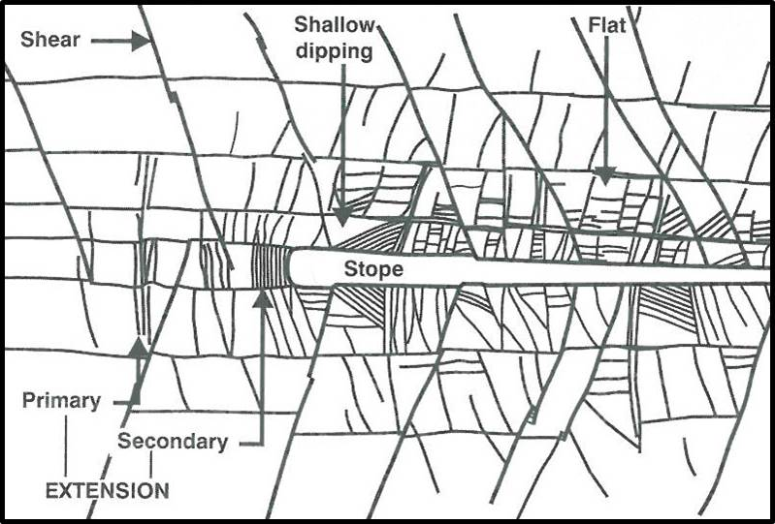
Measuring the Size of an Earthquake

Slide 5
Measuring the Size of an Earthquake
Tectonic earthquakes
  General M_{L} = Log (A_{max}) +B log (R) – C
  SANSN M_{L}= log (A_{max}) + 1.075 log (R) + 0.00061R – 1.89 + S
  M_{w} = 2⁄3 log M_{o} – 6
  M_{e (β)} = 2⁄3log E_{β} – 2.9 M_{o} = µAD
  Others (M_{c}, M_{S}, M_{D}, m_{B}, etc.) E_{β} = 4пρV_{c}R²E_{Flux}
Induced seismic events
  M_{KRSN} = 1.45 log T + 0.12
  M_{L} = A Log (E) + B Log (M_{o}) – C
  Carletonville: A - 0.272, B - 0.393, C - 4.630
  Klerksdorp: A - 0.263, B - 0.333, C - 3.612 and
  Welkom: A - 0.275, B - 0.433 and C -5.124.
  Current: M_{L} = 0.344 log (E) + 0.516 log (Mo) -6.57

Slide 6

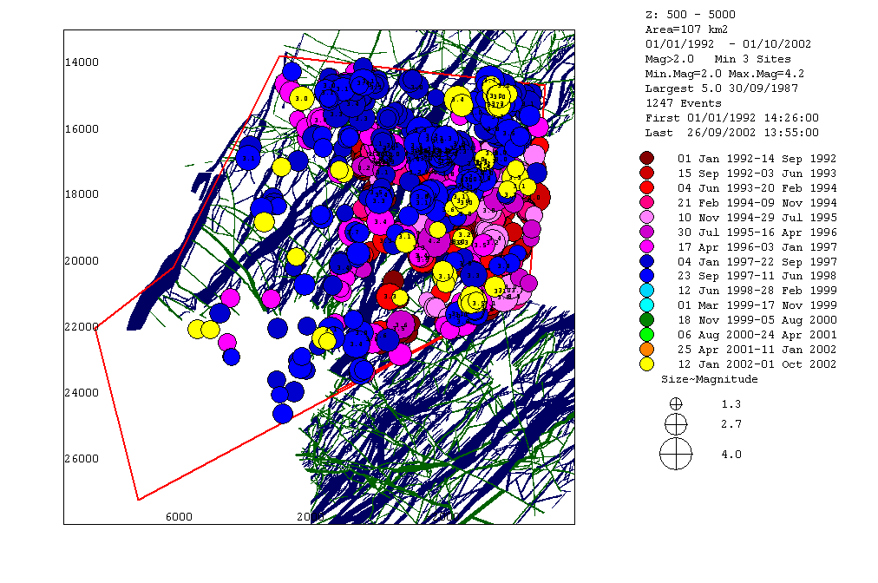
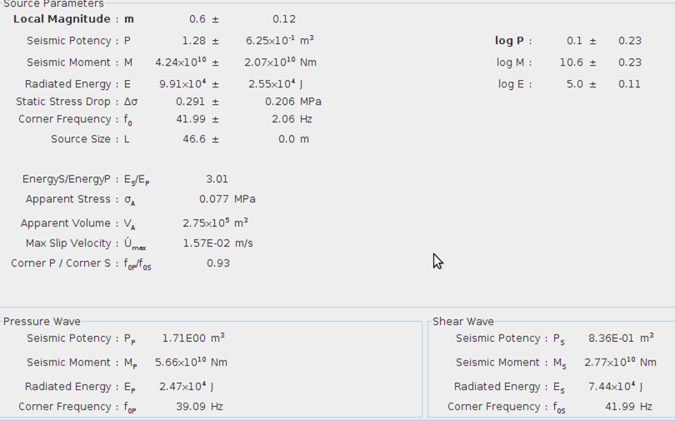
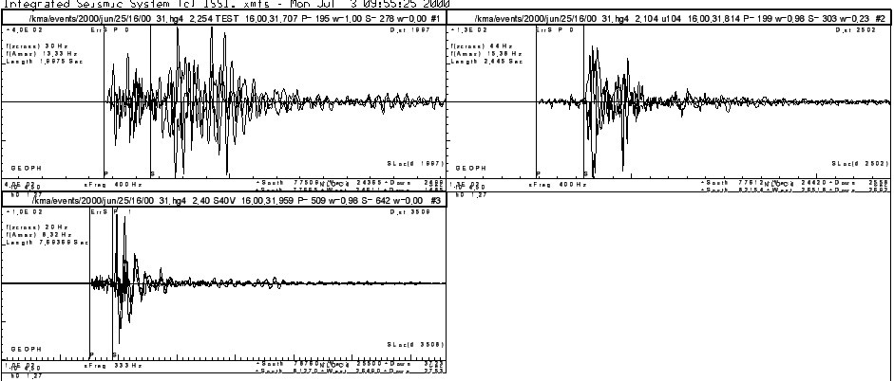
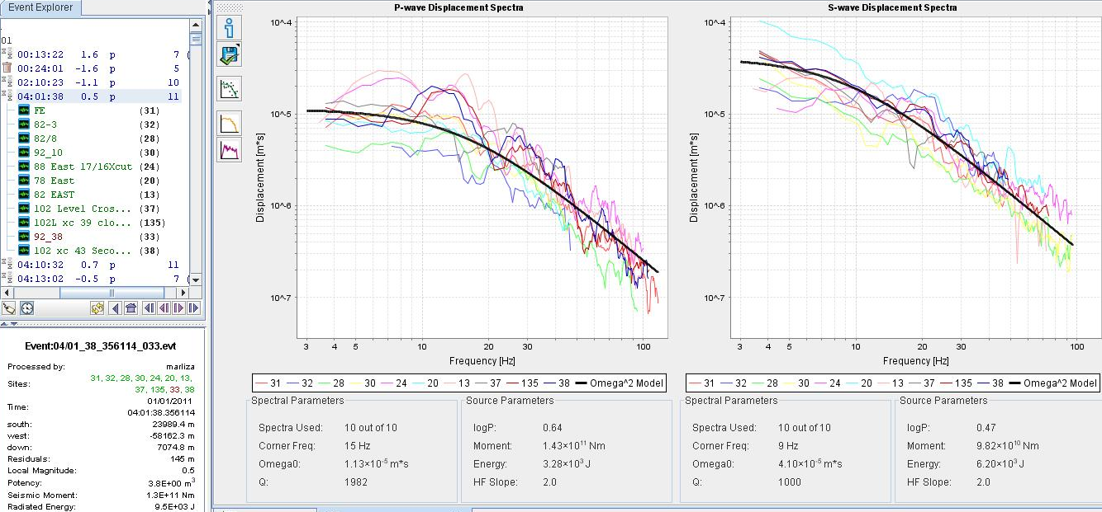
Available Data

Slide 7
Unresolved Inverse techniques and Hypotheses ?
The “Magnitude Scale”
  This is not a measure of a seismic event but rather a rating.
Self Similarity (Scale invariance)
  Is the physics of failure the same across the size spectrum?. Two camps.
Failure models
  Point source, circular spreading shear rupture.
Self organised criticality or characteristic.
  Size distribution (Gutenburg-Richter “Law”)
Fractal sets and fractal dimensions.
  Quantifying Hazards and Risks.

Slide 8
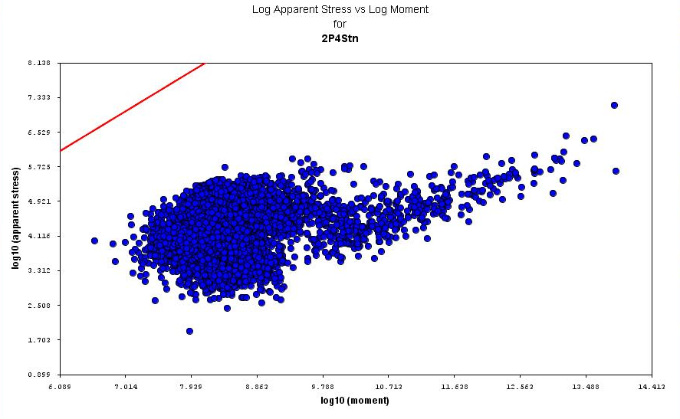
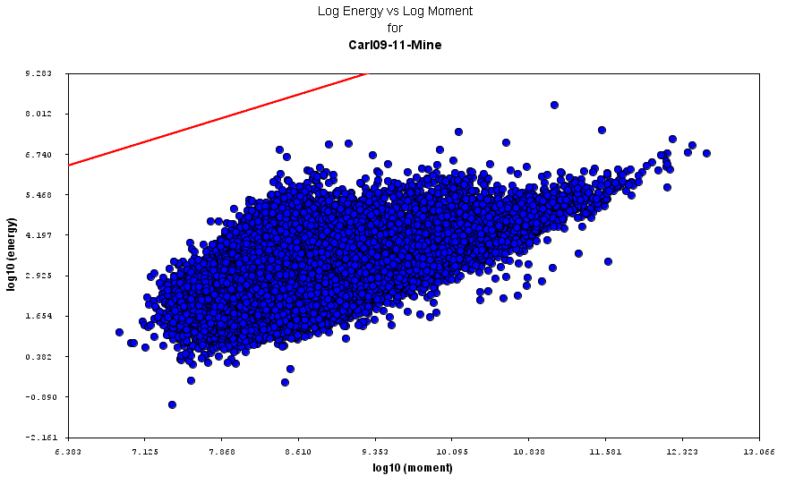
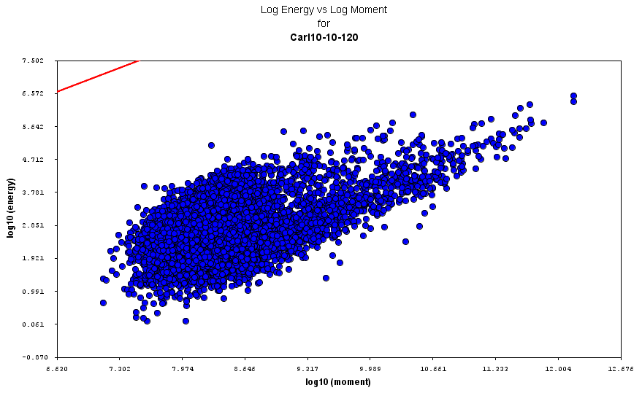
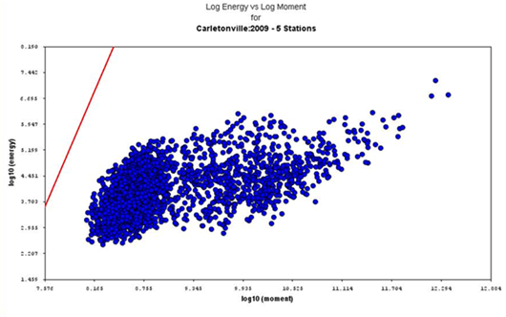
Results

Slide 9
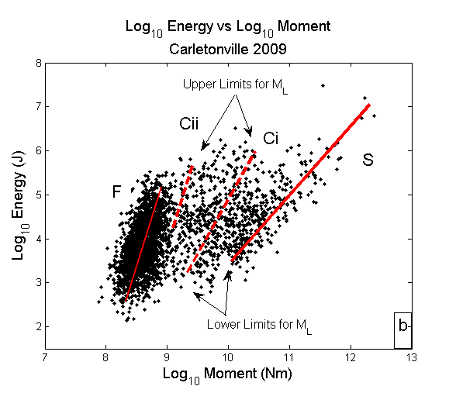

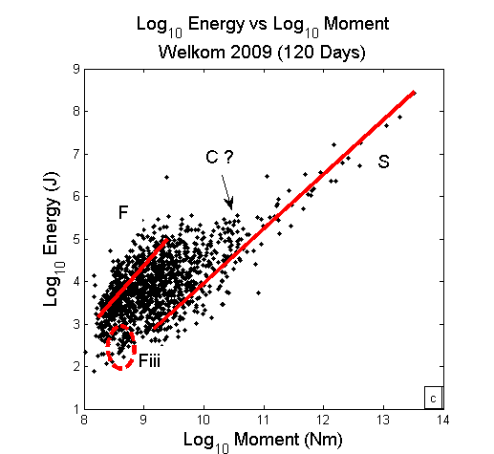
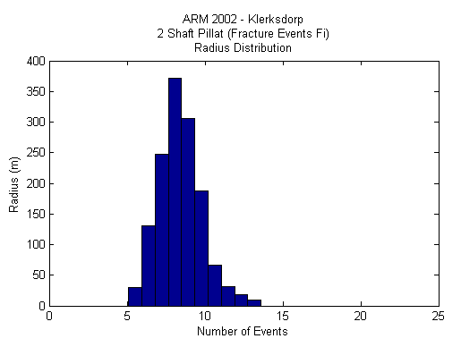
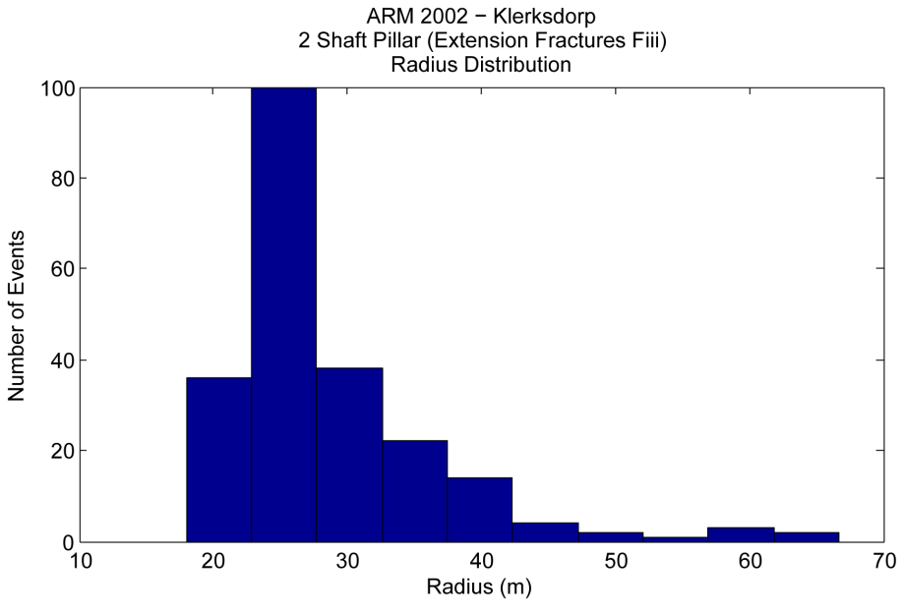
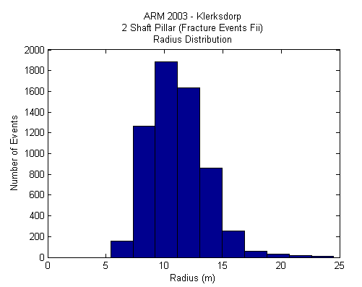
Results
Fi
Fii
Fiii

Slide 10
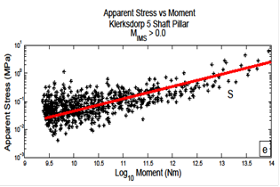
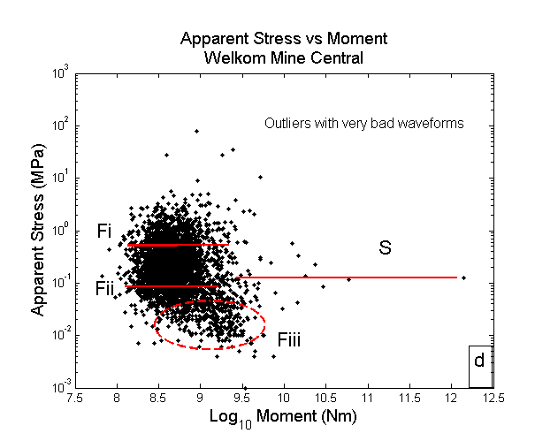
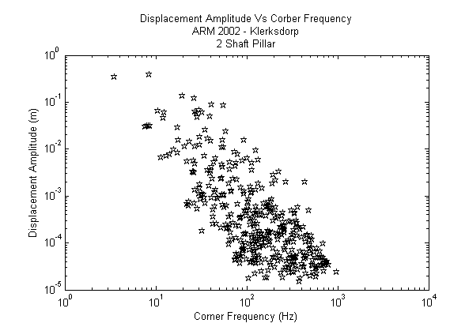
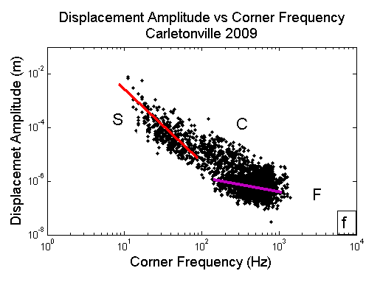
Results

Slide 11
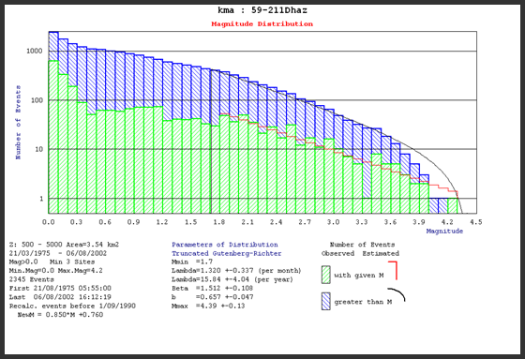
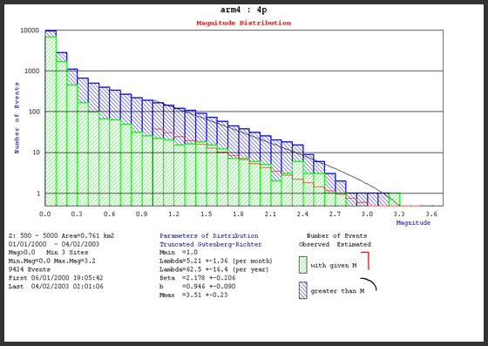
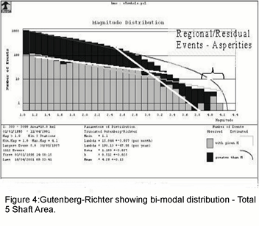
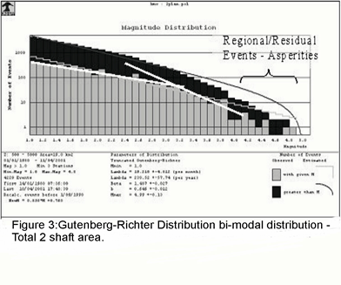
Results

Slide 12
Conclusions
Source parameters are noticeably different for different lithologies and failure mechanisms.
Self-similar scaling appears invariant for fracture events but not for structural events.
These differences significantly affect the “representability” of magnitude as an estimate of size.
A single number rating for a multi-dimensional failure is hopelessly inadequate.
  Multi-model distributions are a mix of mechanism datasets
  Probabilistic methods based on the G-R become invalid and non representative of hazards and risks i.e. ineffective.
  New techniques for hazard quantifications need to be developed

Slide 13
Proposal
The various sources / failure mechanisms exhibit different source parameter relationships
Significantly different energy radiated per M_{IMS} for the different ensembles and regions
I have grouped these into 3 classifications
  S – Structural Events (faults, fault filled dykes)
  C – Combination events (dykes, foundations, abutments, facebursts etc)
  F – Fracture events
S - Events |  |  |  |  |  | C - Events |  |  |  | F- Events
M_{L} | 0.0 | 1.0 | 2.0 | 3.0 | 4.0 | 0.0 | 0.5 | 1.0 | 1.5 | -0.5 | 0.0 | 0.5 | 0.9
Energy Log₁₀ (J) | 4.3 | 6.0 | 7.3 | 8.3 | 10.3 | 4.7 | 5.3 | 6.1 | 7.0 | 4.5 | 5.2 | 6.0 | 6.4
Length m | 30 | 58 | 10 | 140 | 240 | 26 | 30 | 34 | 39 | 6.4 | 7.5 | 10.2 | 15.8
E/L J/m | 0.7 KJ/m | 16 KJ/m | 180 KJ/m | 1.6 MJ/m | 80 MJ/m | 1.7 KJ/m | 6.7 KJ/m | 35 KJ/m | 223 KJ/m | 5.2 KJ/m | 23 KJ/m | 100 KJ/m | 171 KJ/m
E/Area J/m² | 30 J/m² | 352 J/m² | 2.3 KJ/m² | 18.2 KJ/m² | 410 KJ/m² | 85 J/m² | 280 J/m² | 1.5 KJ/m² | 7.2 KJ/m² | 1.0 KJ/m² | 4.0 KJ/m² | 12 KJ/m² | 14 KJ/m²
After: Ebrahim-Trollope et al, 2014

Slide 14
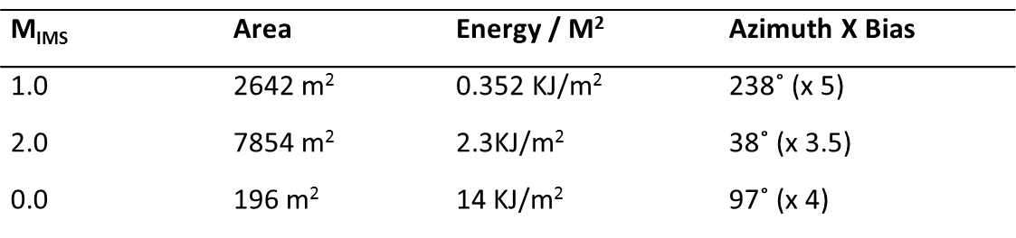
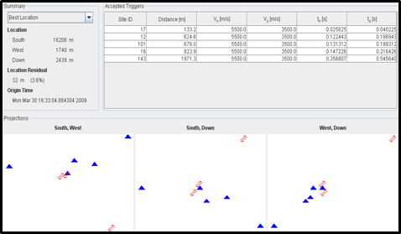
Proposal
Size and strength of mining induced seismic failures
Represented in physical SI units
Area in meters
Energy release per square meter (J/m²)
Azimuthal bias in degrees and maximum as per maximum spectra

Slide 15
The Magnitude Scale
A magnitude rating for quantifying the size of seismic events is inadequate
  General comments by seismologists (and consensus)
    Crude form of quantification (McGarr, 1982)
    Not directly related to any physical parameter of the source, should not be used beyond recognisance purposes (Kanamori, 1983, 2007)
    Hopelessly inadequate measure of the size of an earthquake (Dziewonski & Woodhouse, 1983)
    It is pervasive and remains widely used (Gibowicz, 1994)
  After 80 odd years “remains a dilemma” for tectonic earthquakes
    Greater depths and distances to induced failures
    Shear rupture models form the basis of source parameter estimates
    The biggest limitations are recording frequency bandwidth & azimuthal bias
    Multiple wave types
  More of a dilemma for induced seismicity
    Very close to or in the source
    Known differences in mechanisms (shear rupture is only one failure mechanism)
    Design does change seismicity
    Inhomogeneity amplified due to proximity (Including material properties)

Slide 16
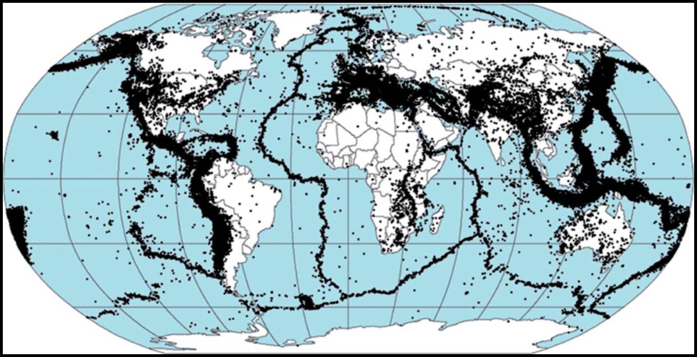
Introduction
After: Internet download

Slide 17
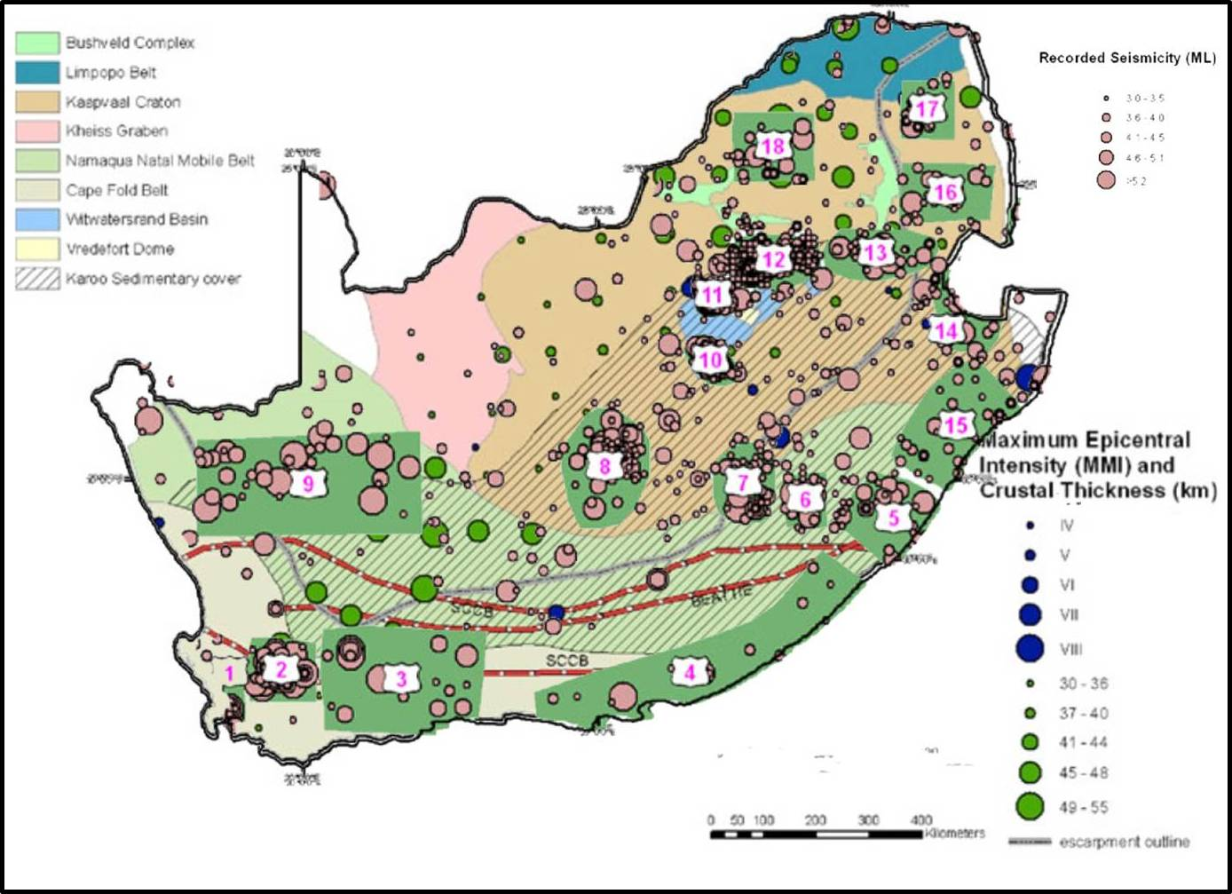
Introduction
After: Nguuri et al, 2001 and Singh et al, 2011

Slide 18
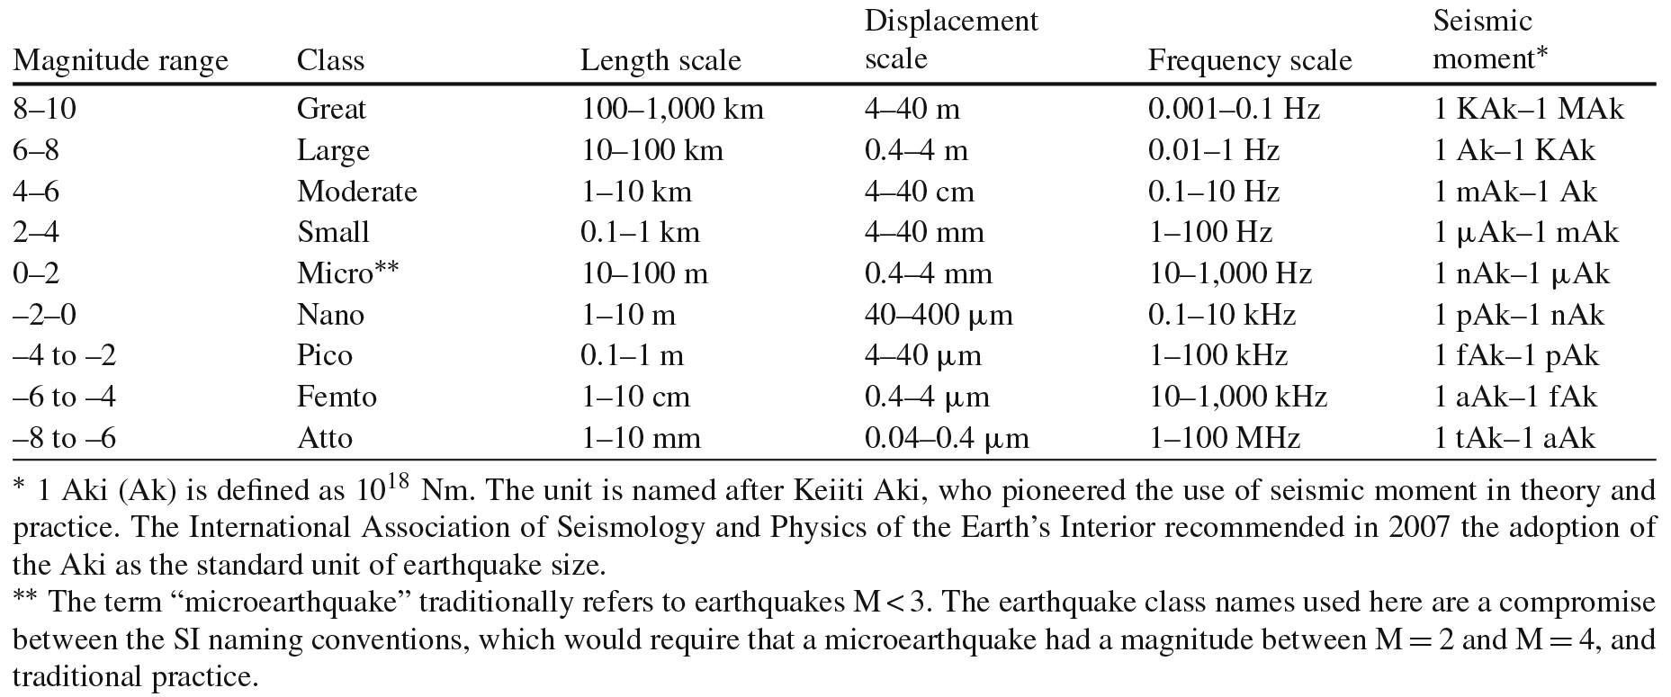
Introduction
After Bohnhoff et al, 2010

Slide 19

Sensors & Event Frequency Range

Slide 20
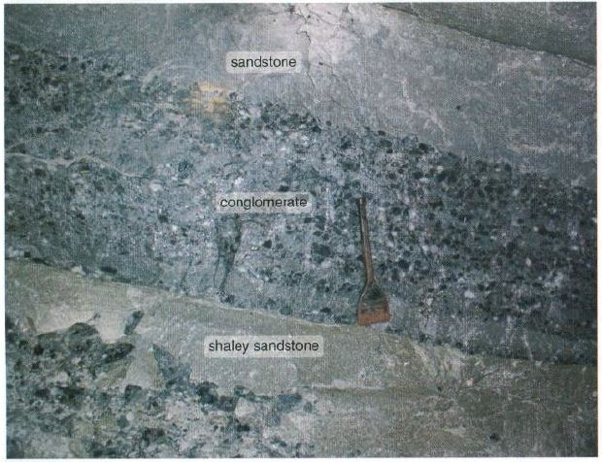
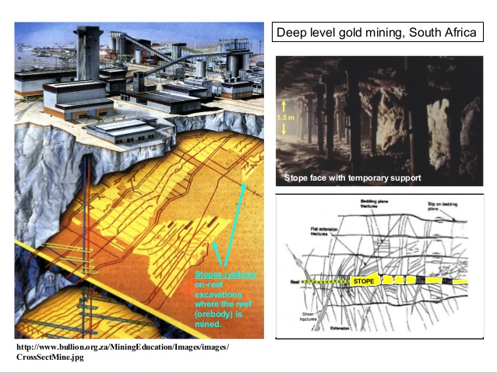
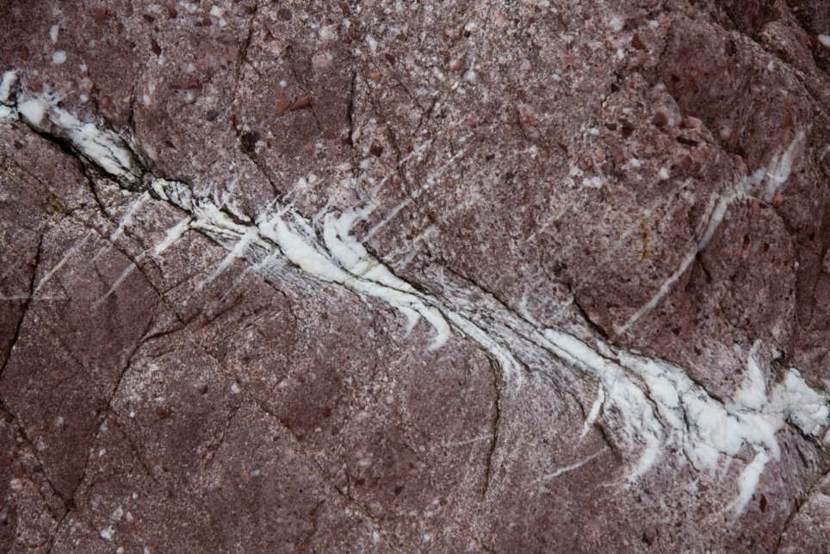
Going Underground

Slide 21
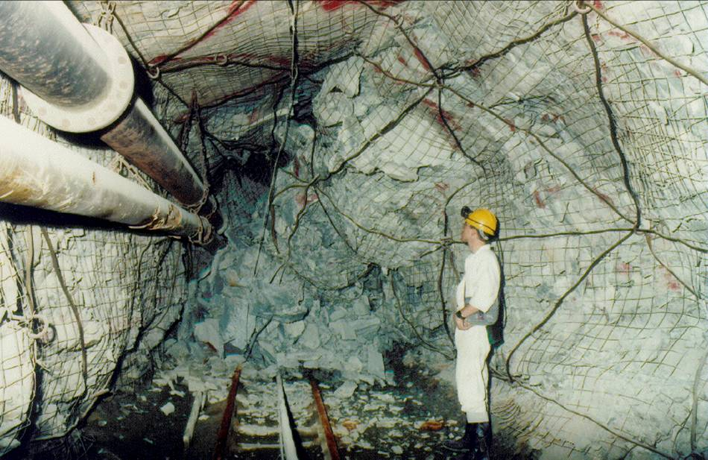
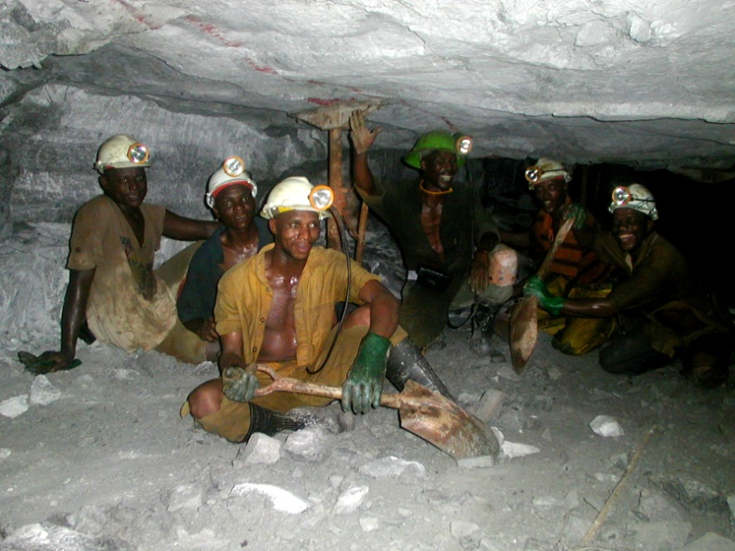
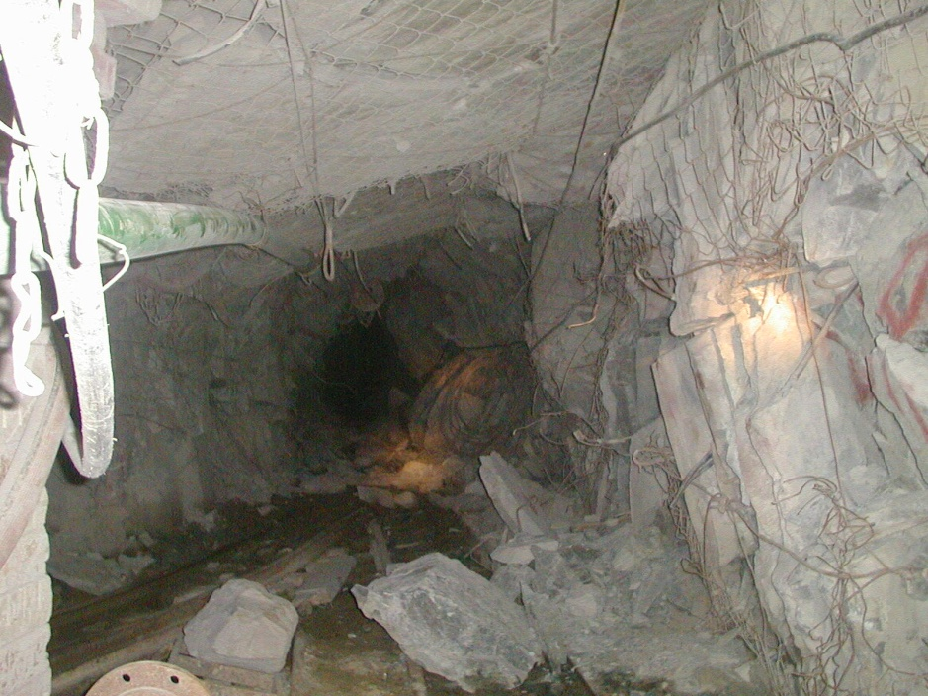
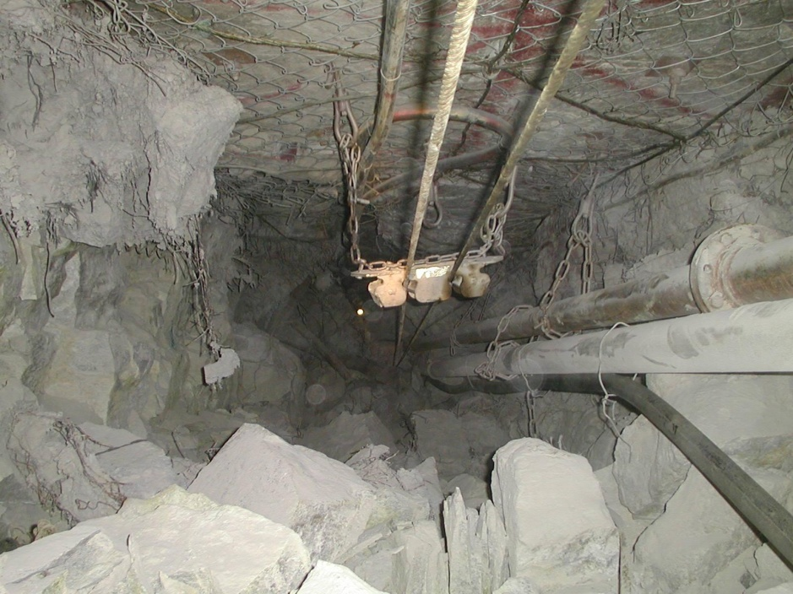
Damage Underground

Slide 22
SOME EFFECTS OF SEISMICITY
1967 60 Fatalities due to seismicity and FOG
1975-1982 100 Fatalities due to 9 major events
1981-1998 138 Fatalities due to seismicity (ARMgold / ANGLO) 14% of all fatalities –7.7/year (969 – 53.8/year - Injuries)
1998 – 1999 0 Fatalities due to seismicity (ARMgold)
2000 7 Fatalities
2001 5 Fatalities
2002 1 Fatal
Average 2.6/year (Since becoming ARMgold)
Revenue 5% of revenue (calculated in 80’s)
Example M_{L} = 3.3,3.0 events cost R 450 000-00 lost revenue

Slide 23


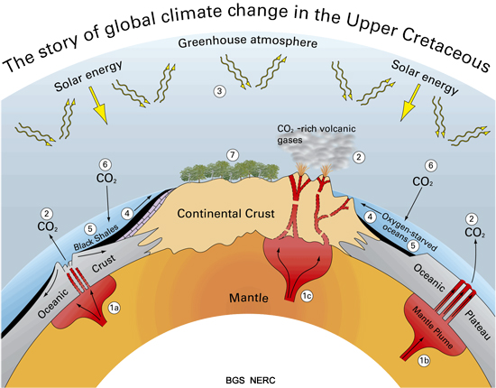
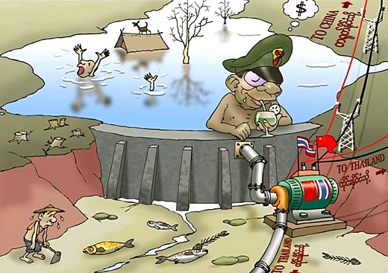

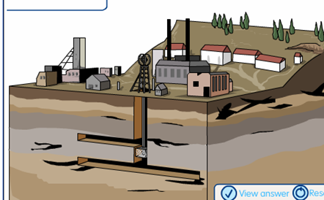


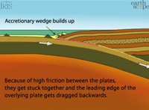

Induced seismic environment southern africa

