Slide 1

THE EFFECT OF FAULTING AND DOLERITE INTRUSIONS ON GAS-BEARING POTENTIAL OF LOWER KAROO STRATA
Peter Booth¹, and Marc Goedhart^{1, 2}
Department of Geosciences, Nelson Mandela Metropolitan University, Port Elizabeth
2. Kainos South Africa, Port Elizabeth
logo here…

Slide 2
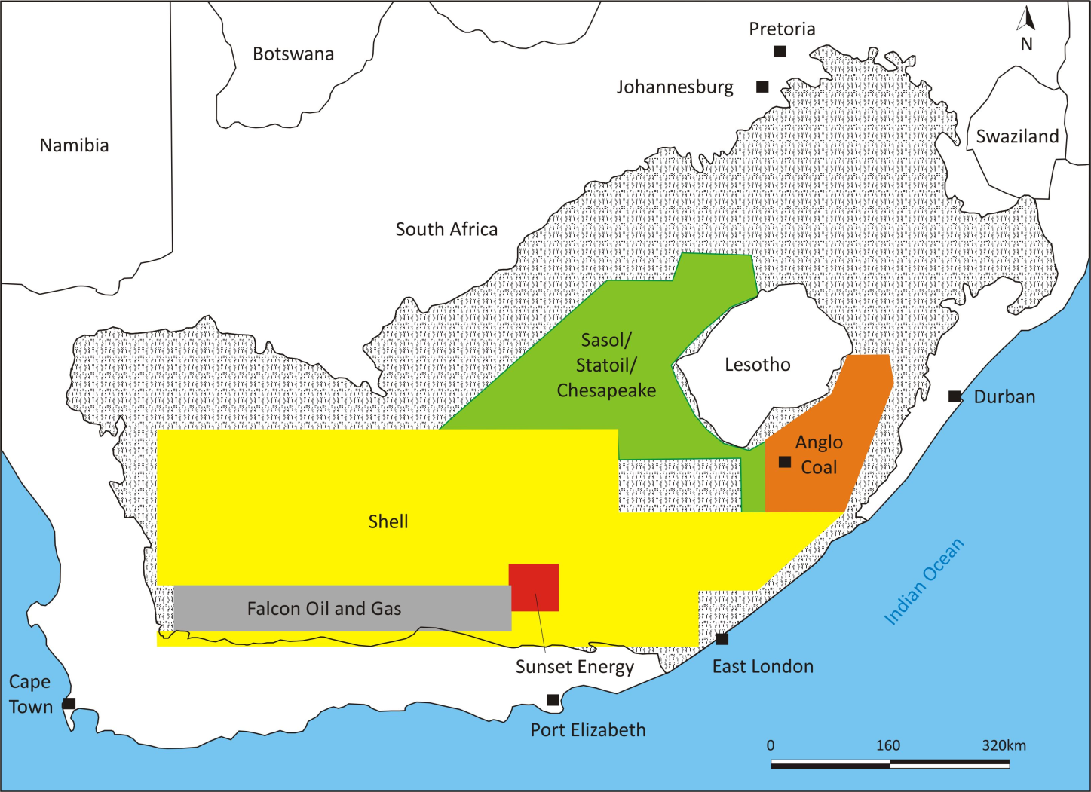
KAROO BASIN

Slide 5
CFB imprint = tectonism and metamorphism

Slide 6
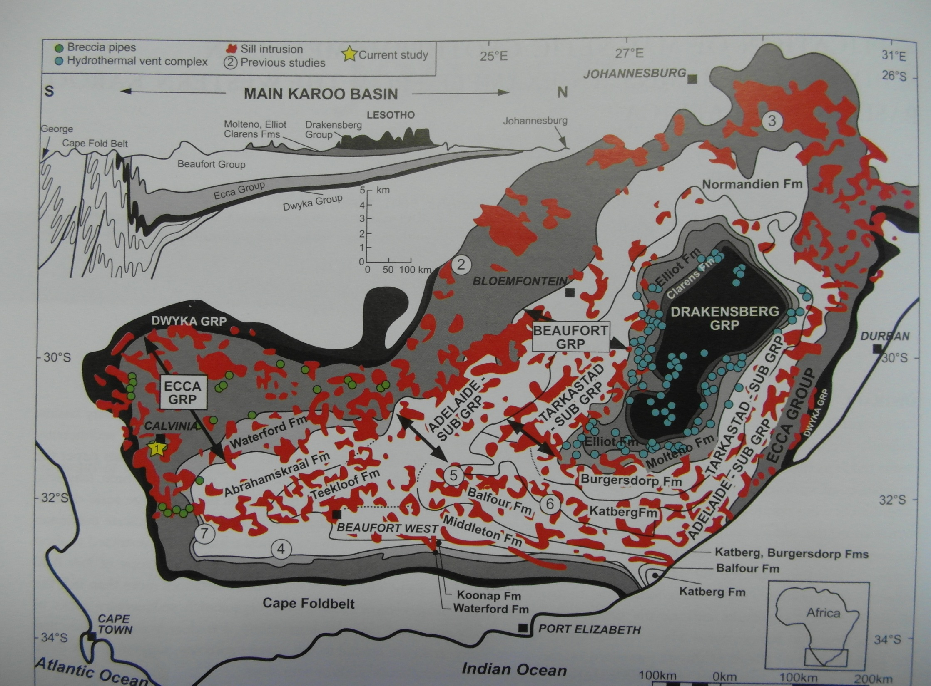

Slide 7
C
26° 00´
SOSSSSSSSU
C
Republic of
South Africa
32° 00´
East London
Cape Town
Port Elizabeth
Beaufort West
Graaff-
Reinet
Limit of Cape Fold Belt deformation
A
Fort Beaufort
Grahamstown
East London
B
200 km
Port
Elizabeth
Uitenhage Group
N
Karoo Supergroup
Cape Supergroup
Gamtoos Group

Slide 8
SOUTH
NORTH
Grahamstown
Fort Beaufort
Ecca Pass
Locality 1
Locality 2
1000 m
0
30 km
Dolerite (Jurassic)
Beaufort Group
Ecca Group
Karoo Supergroup
Dwyka Group
Witteberg Group
Cape Supergroup

Slide 9
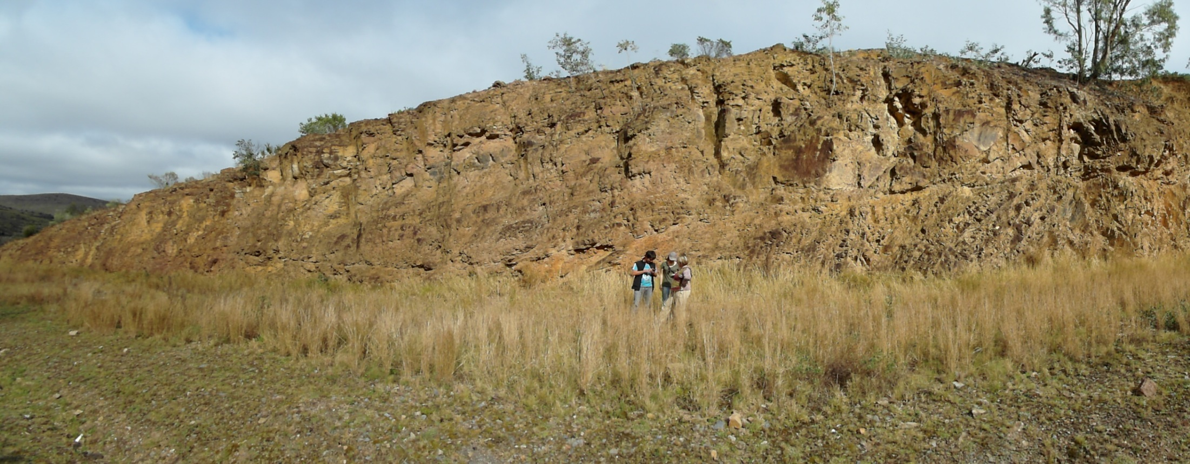
South
North

Slide 10
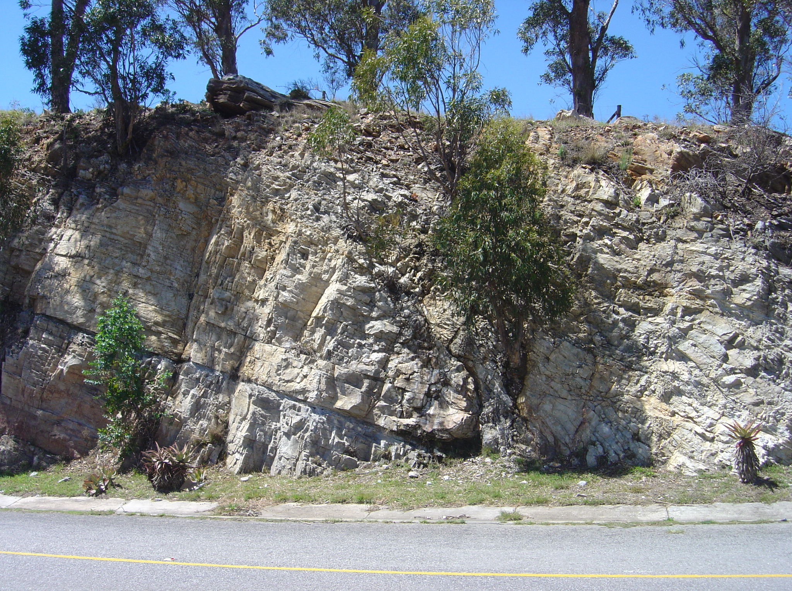
North
South

Slide 11
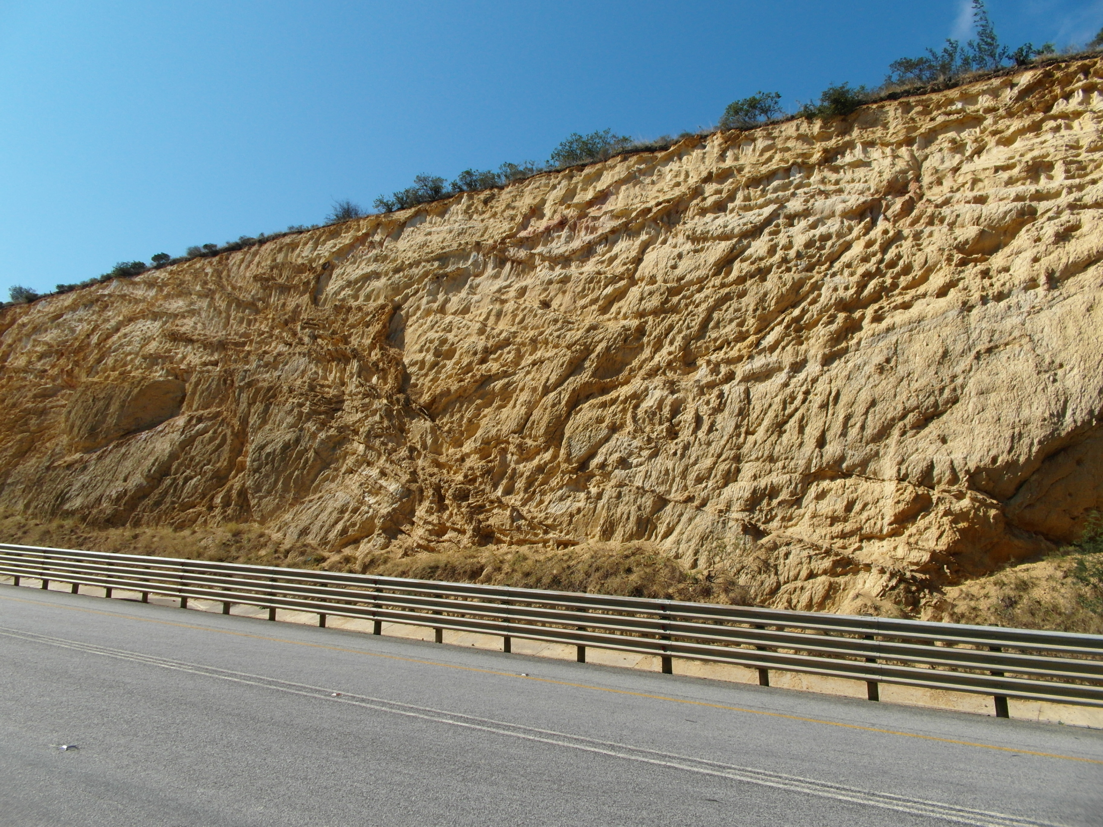
North
South

Slide 12
South
North
f
Cross Section A-B
5 km

Slide 13
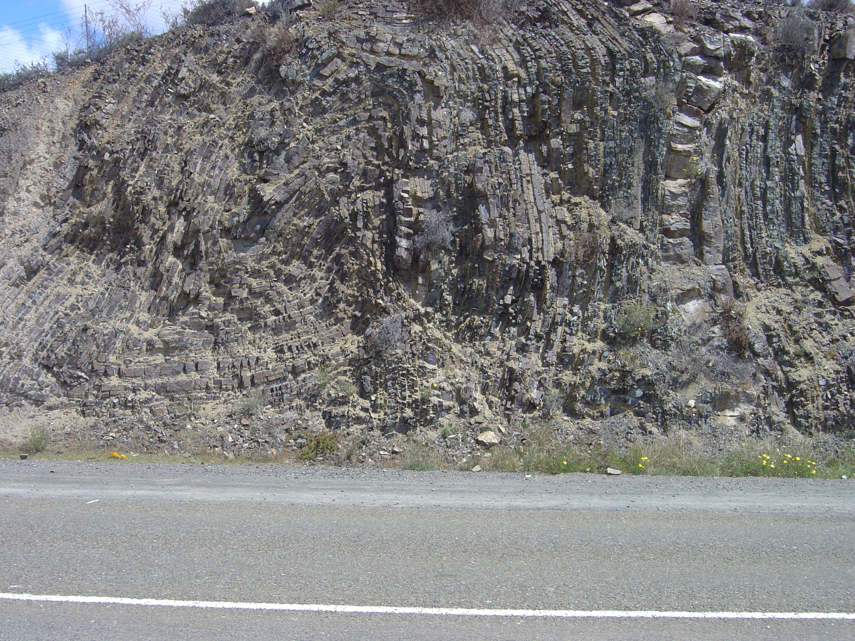
South
North
WH
Collingham Fm

Slide 14
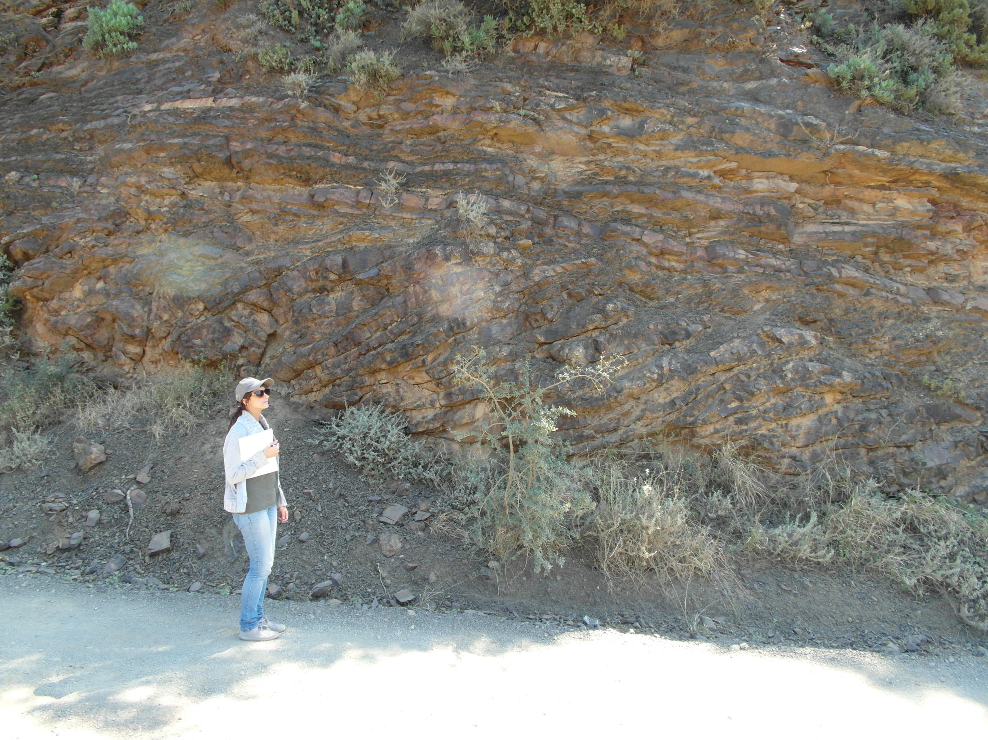
South
North

Slide 15
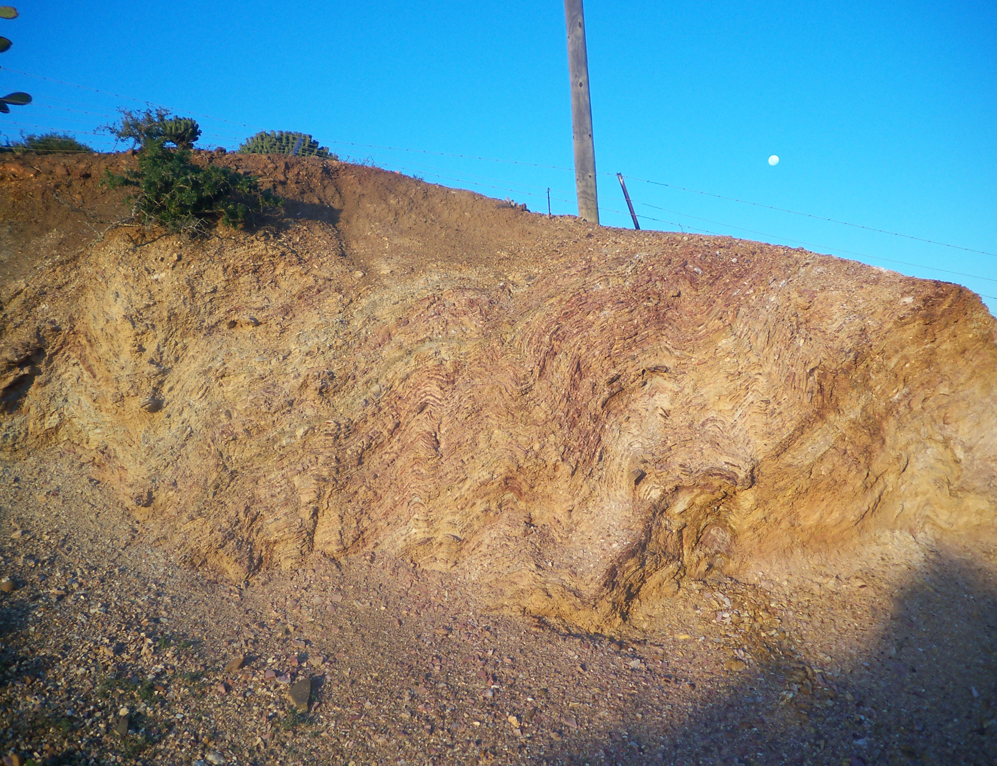
North
South

Slide 16
Jd
Adelaide
6
LEGEND
Strike and dip of beds
Fort Beaufort
Axial trace of syncline
Axial trace of anticline
Pb
9
Thrust fault (indicating
dip of fault)
Pm
Jd
4
Jd
Dolerite
Jd
Pb
Balfour Formation
LOCALITY 2
Pm
Middleton Formation
10 km
N
4
11
R 67
7
FISH RIVER
10
KAT RIVER
10
LOCALITY 1
Pm
33°00’
Jd
Pm
26°30’
Grahamstown

Slide 17
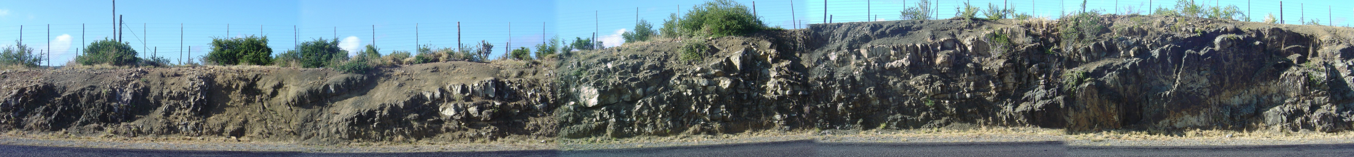
South
North
10 m
LOCALITY 1

Slide 18
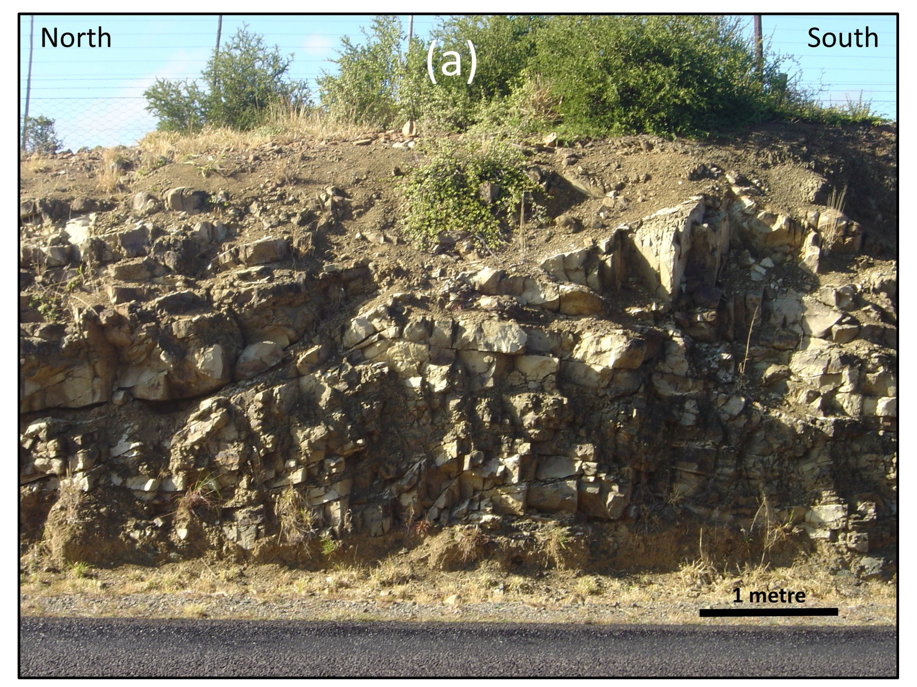

Slide 19
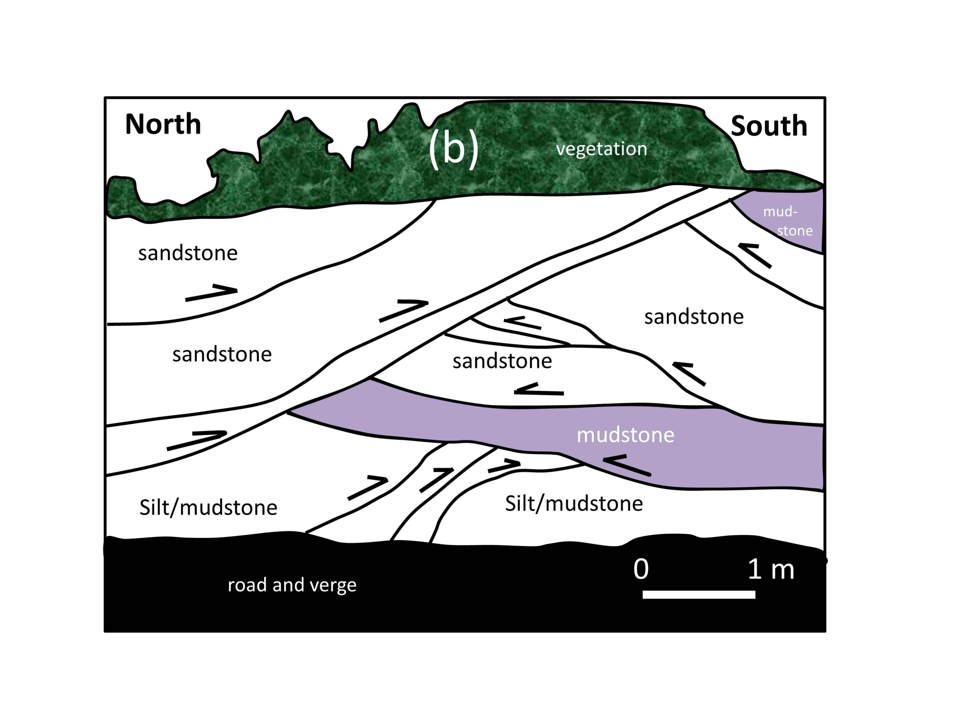

Slide 20

Triangle zone
North
South
m
m
s
s
s
s
m
s
s
m
s
m
sm
m
ss
20 metres
bedding
s = sandstone
m = mudstone
ss = siltstone
sm = silt/mudstone intercalations
Middleton Formation, Beaufort Group

Slide 21
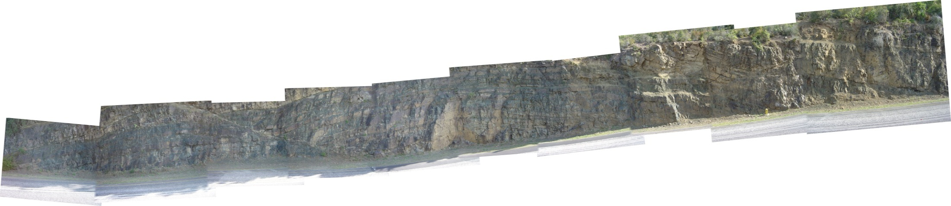
South
North
30 m
LOCALITY 2

Slide 22
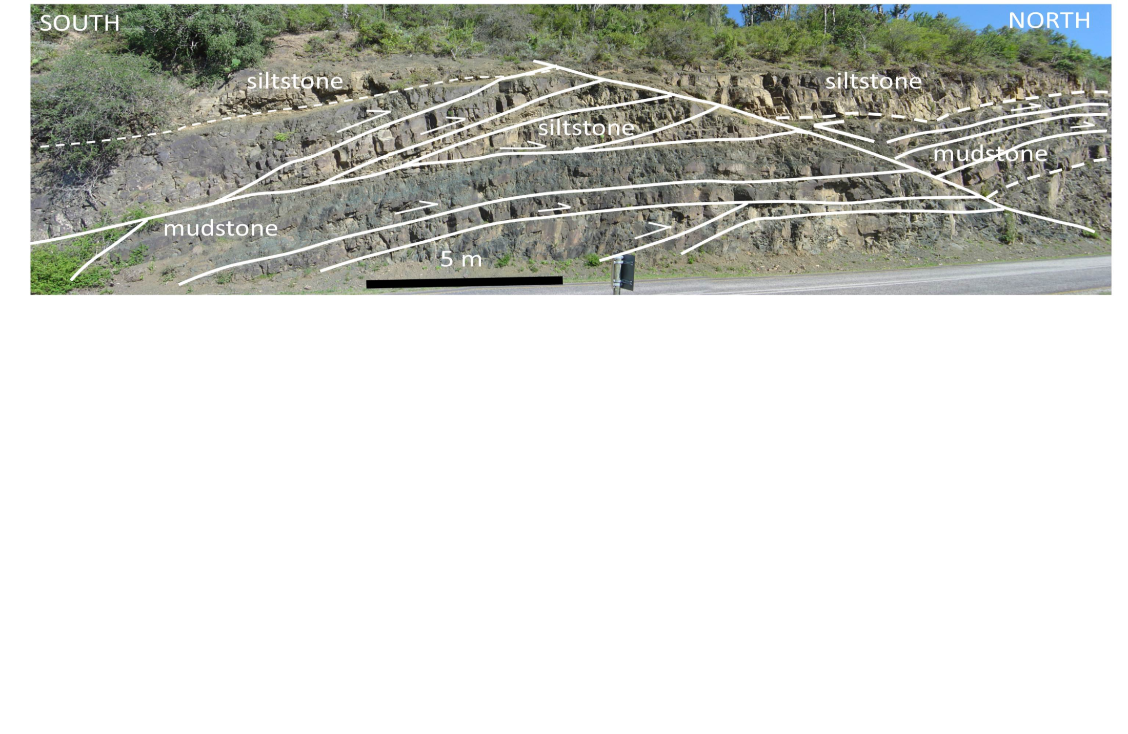
South
North

Slide 23


North
South
Road and verge
100 m
Figure
Figure
Figure
silt/mudstone
siltstone
Middleton Formation - Beaufort Group
mudstone

Slide 24
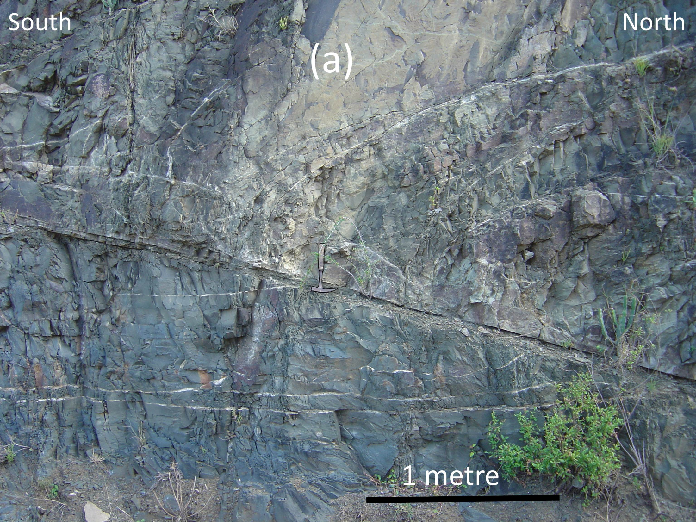

Slide 25
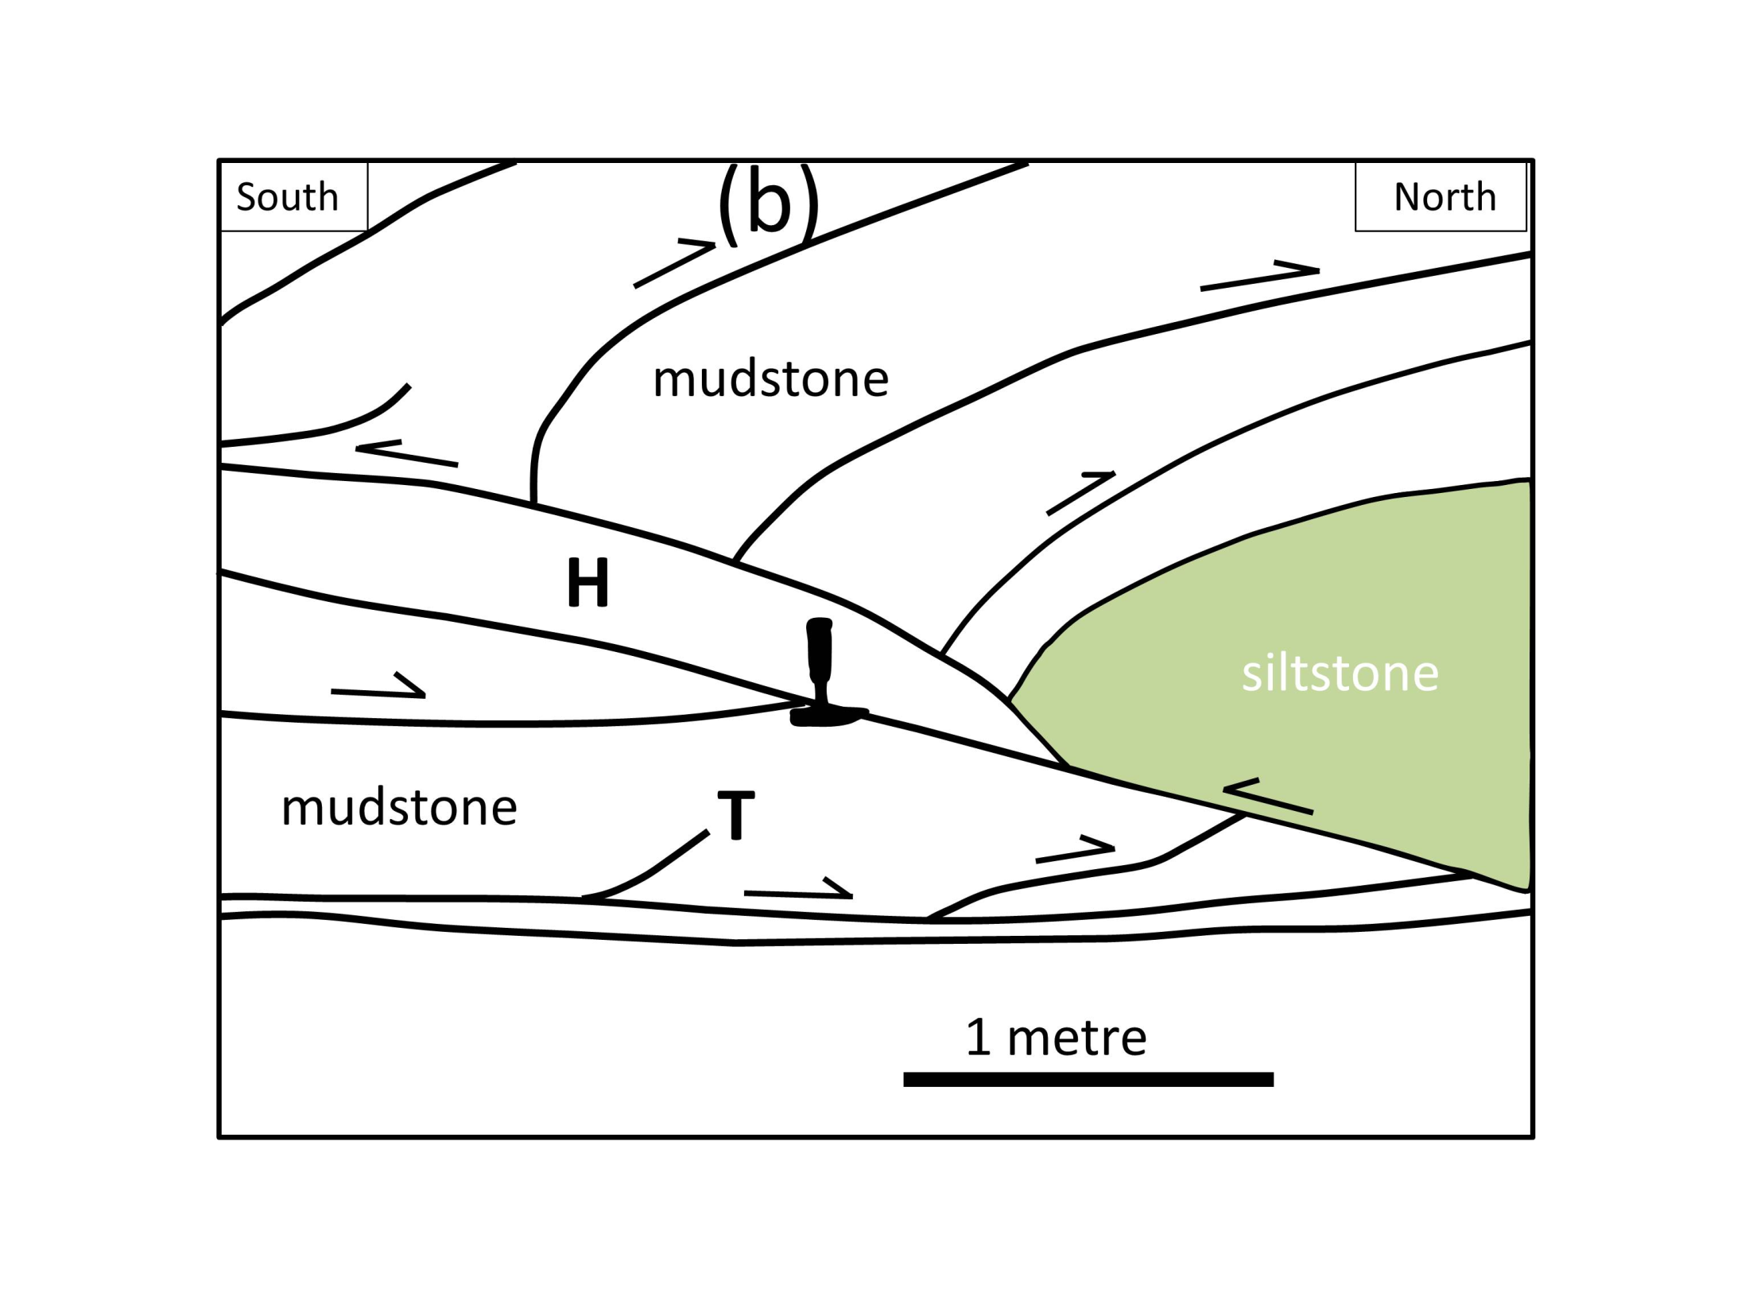
South
North
S
NoNNorthNorthNorth

Slide 26
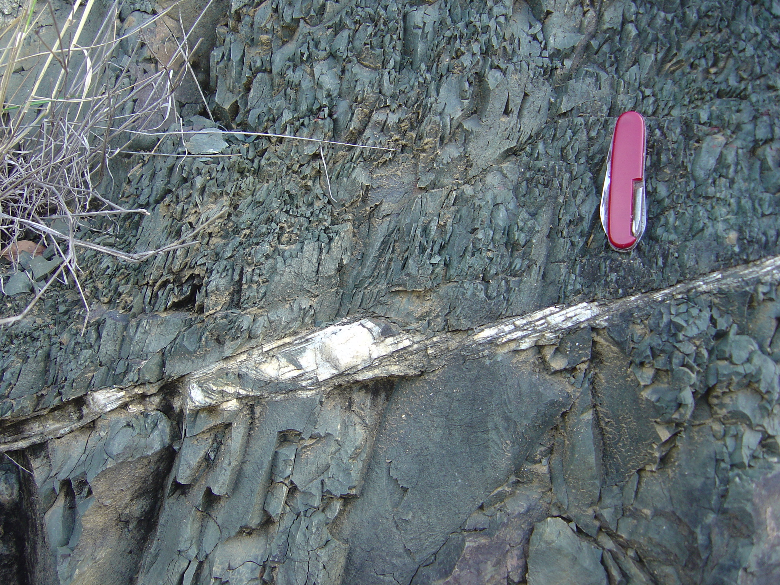
South
North
10 cm

Slide 27
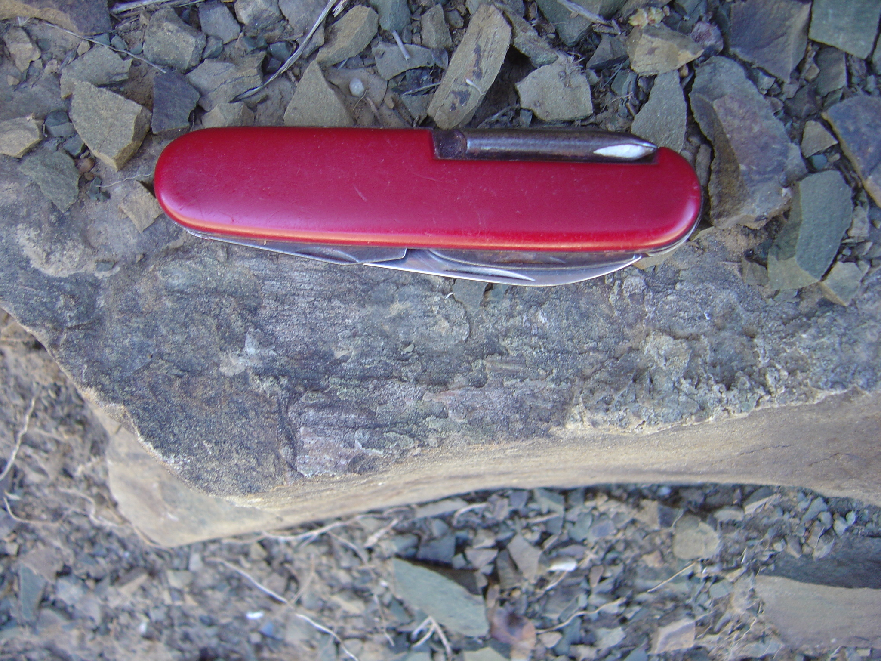
lineation

Slide 28
STRUCTURAL ELEMENTS
N
AP
FA
287/2
South
North
FA
2
n = 50
clevacge
bedding
N
South
North
199/17
n = 20
forethrusts
N
009/26
LOCALITY 1
n = 24
eatons in ckthrusts
backthrusts

Slide 29
(a)
(b)
(c)
Grahamstown
SOUTH
Fort Beaufort
Locality 1
NORTH
Locality 2
pel
30 km
Beaufort Group
Ecca Group
Karoo Supergroup
Dwyka Group
Witteberg Group
Cape Supergroup

Slide 30
(a)
(b)
(c)
Grahamstown
SOUTH
Fort Beaufort
Locality 1
NORTH
Locality 2
pel
30 km
Beaufort Group
Ecca Group
Karoo Supergroup
Dwyka Group
Witteberg Group
Cape Supergroup

Slide 31
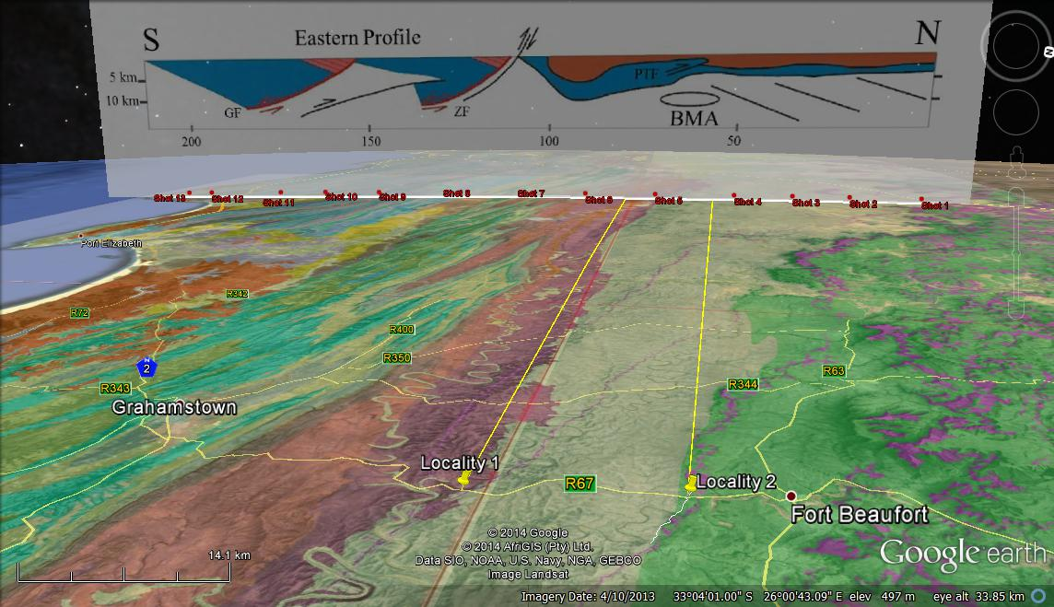
PTF
Graaff Reinet
Cape St Francis

Slide 32
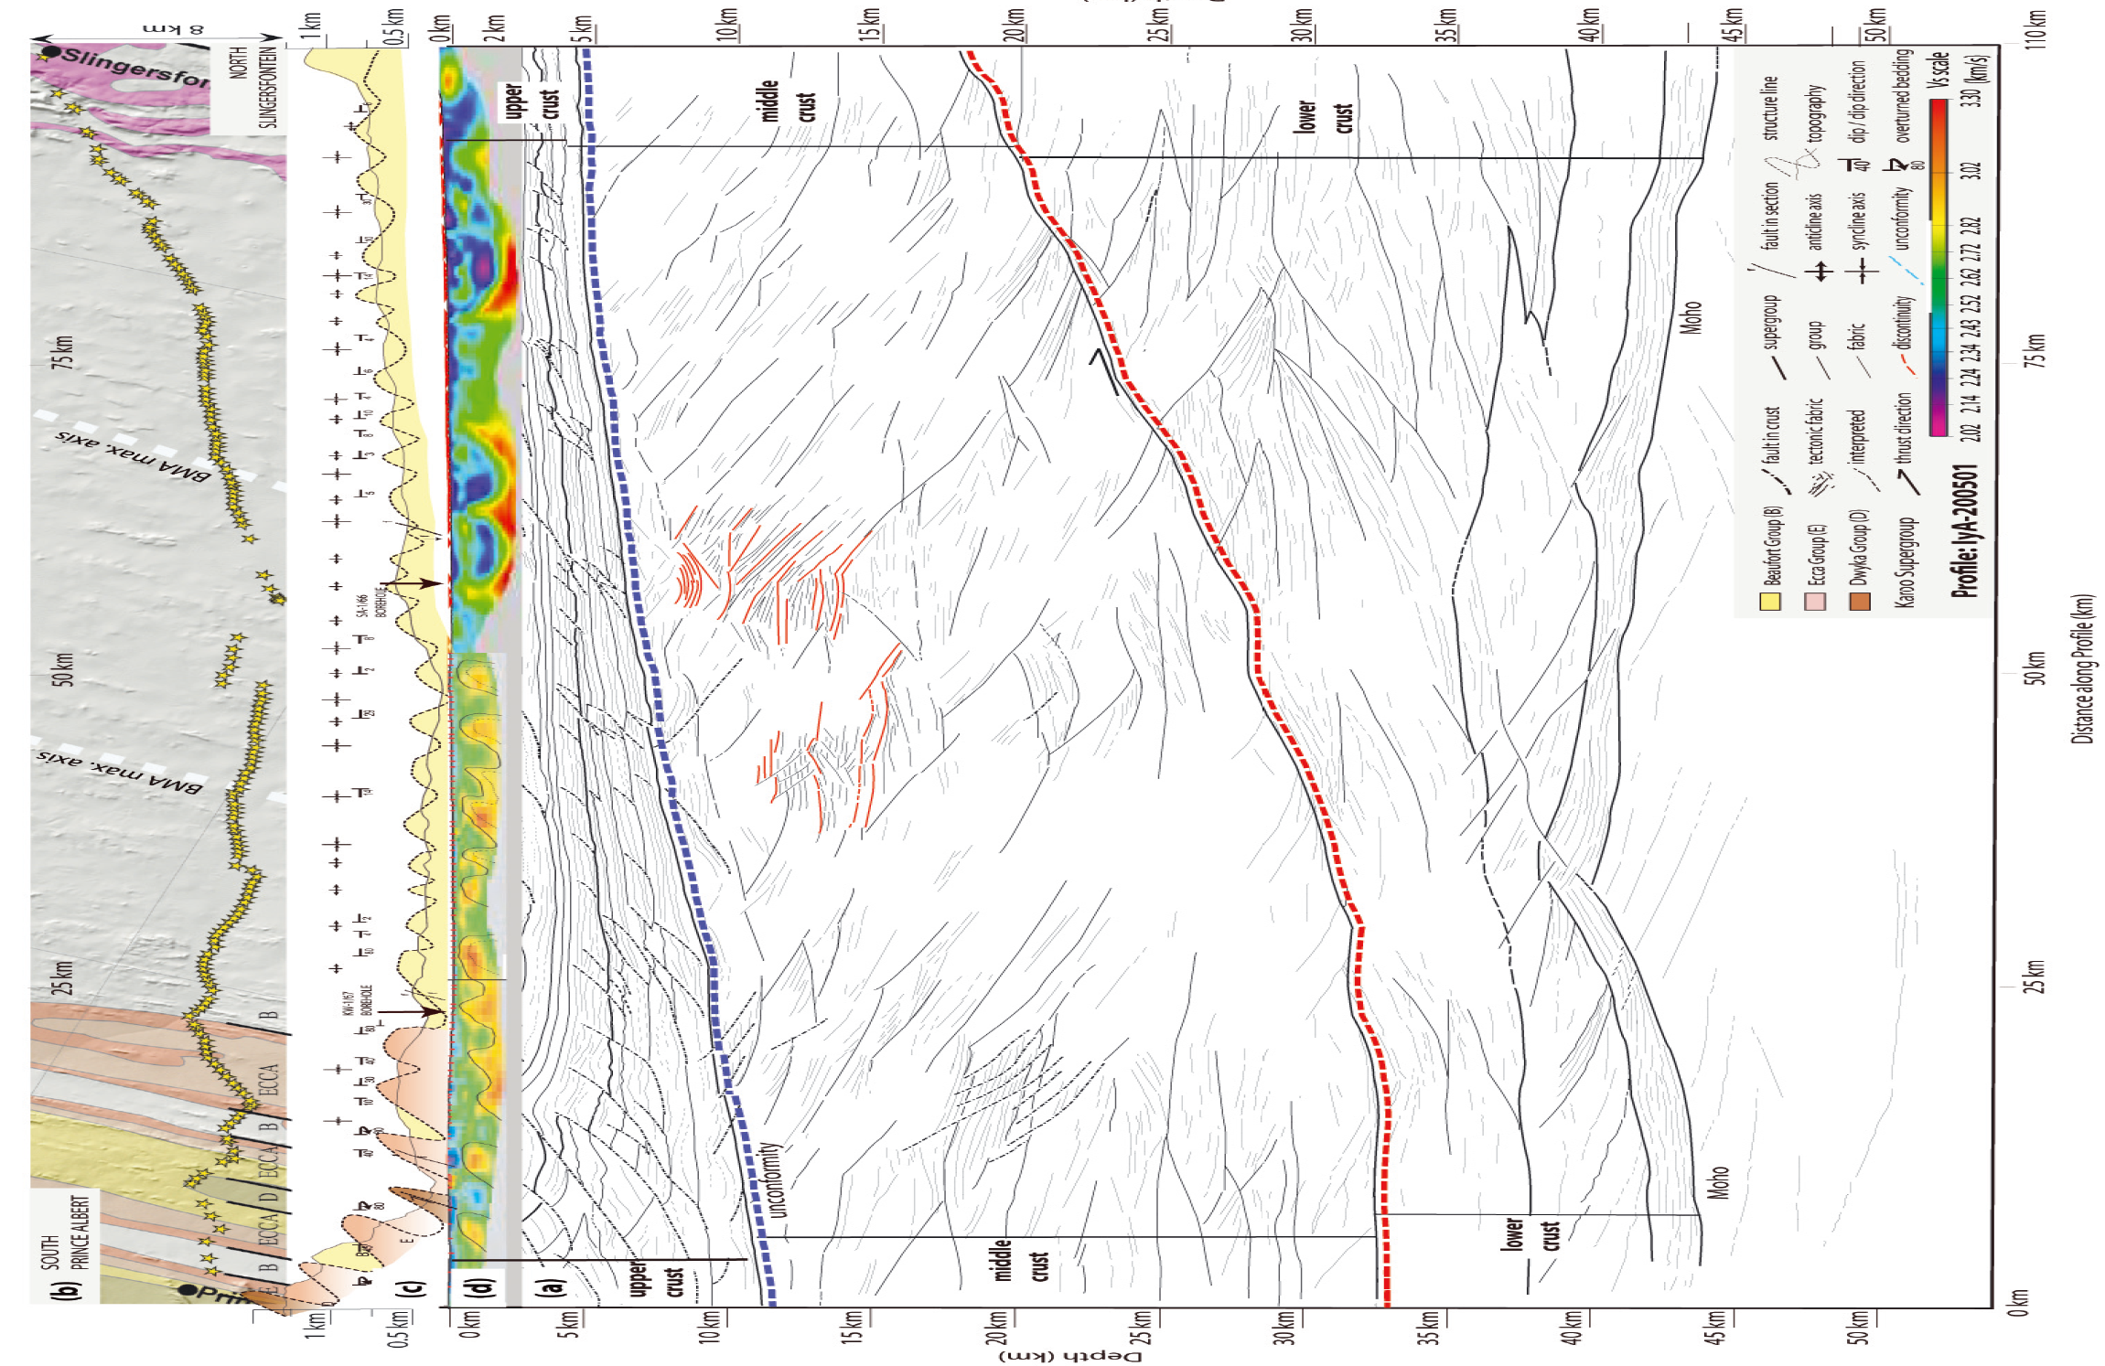
Prince Albert
Slingerfontein
Karoo
Cape
Namaqua
MOHO
0
110 km
Lindeque et al., 2011

Slide 33
B
B’
(South)
(North)
Karoo
Cape
upper crust
10 km
middle crust
Namaqua
20 km
Inferred fault
25 km
Structural grain
Karoo Supergroup
Cape Supergroup
Basement (Namaqua Metamorphic Complex?)

Slide 34
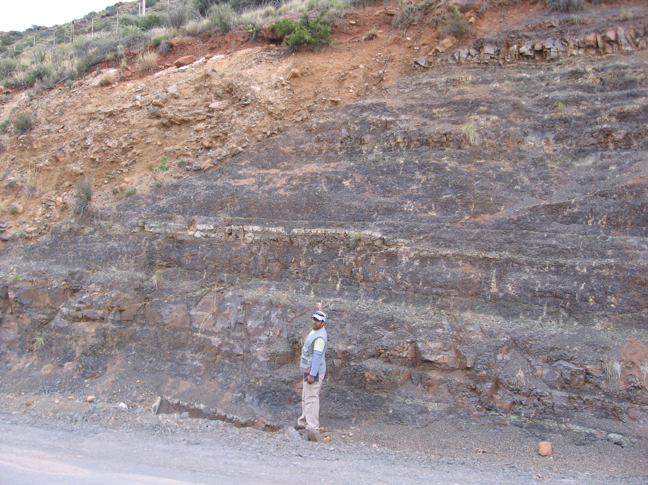
South
North

Slide 35
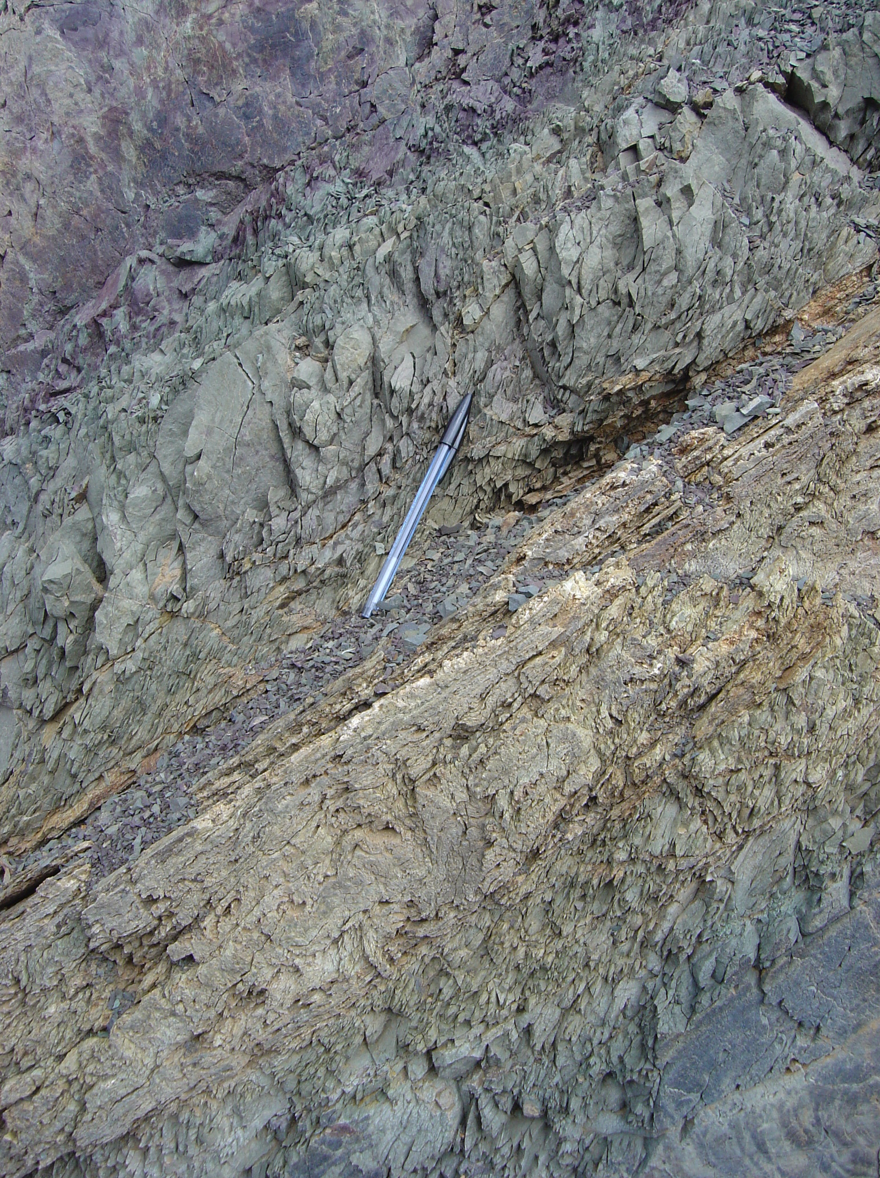
South
North
cleavage

Slide 36
SUMMARY
Ecca Group along its southernmost outcrop
= folded/ faulted/ cleavage/ jointed
Thrust faults and cleavages in the Ecca Group create channelways (conduits) for gas to escape from shales
Metamorphic imprint = greenschist facies
= no gas in shales

Slide 37
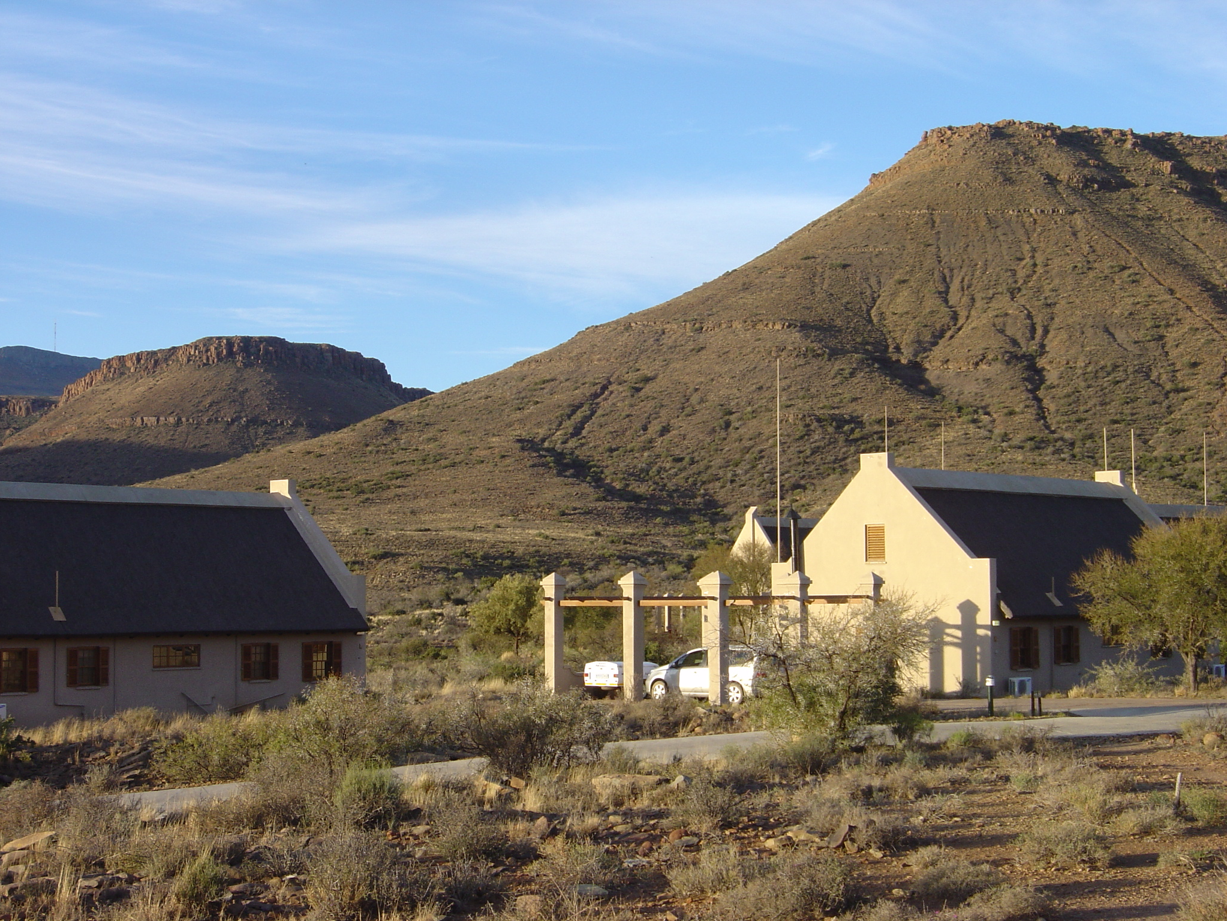

Slide 38

CONCEPTUAL MODEL
Drakensberg Gp
Beaufort Gp
Stormberg Gp
Ecca Gp
Dwyka Gp
Plume?

Slide 39
CONCLUSION 1
(a)
(b)
1. Best case scenario
Prospective area for shalegas
Grahamstown
SOUTH
Fort Beaufort
Locality 1
NORTH
Locality 2
pel
30 km
Beaufort Group
Ecca Group
Karoo Supergroup
Dwyka Group
Witteberg Group
Cape Supergroup

Slide 40
CONCLUSION 2
Width of metamorphic aureole?
Drakensberg Gp
Beaufort Gp
Stormberg Gp
Ecca Gp
Dwyka Gp
Plume?

Slide 41

CONCLUSION 3
Urgent need for geophysical surveys (seismic) to confirm faulting pattern in depth
Slingerfontein
Prince Albert
0
110 km

