Slide 1


Petrological investigation of Merensky Reef Unit lithologies at Two Rivers Platinum Mine and comparison to stratigraphically similar rocks north of the Steelpoort fault, eastern Bushveld Complex, South Africa
J.J. Beukes¹, C.D.K Gauert²
Department of Geology, University of the Free State, P.O . Box 339, Bloemfontein 9300, Republic of South Africa
jarlenb7@gmail.com¹, gauertcdk@ufs.ac.za²
logo here…

Slide 2
OUTLINE
Introduction
-background, location, stratigraphy
Methodology
Results
-Petrography, Geochemistry, Mineral Chemistry
Conclusion

Slide 3
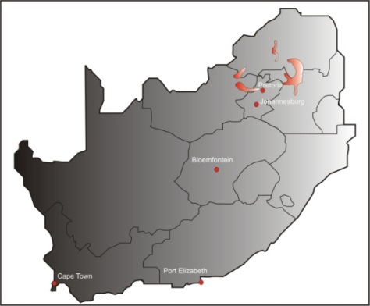
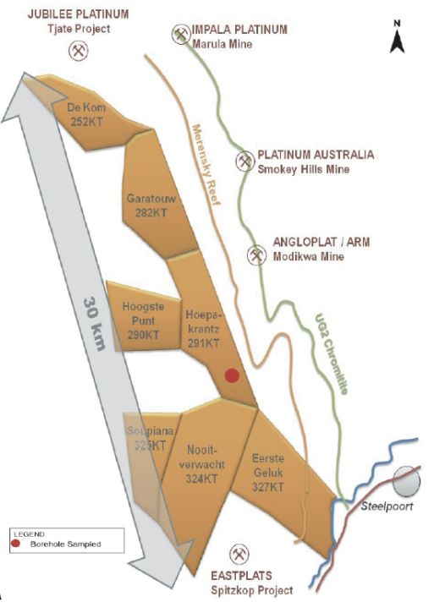
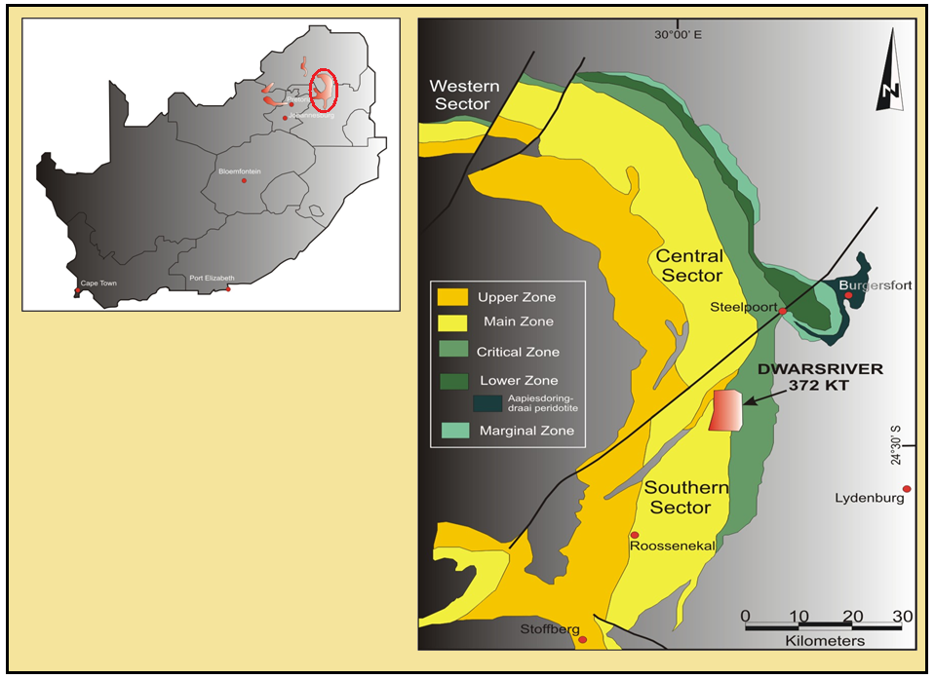
Introduction
The BIC is comprised of mafic and ultramafic rocks.
largest layered intrusion, with a large size of 65000km² and an approximate thickness of 8km
largest host of PGMs, Chromium and Vanadium
This study is based on the Merensky Reef which crops out in the TRP area (Eastern Limb)
The MR in this area is characterised as a feldspathic pyroxenite bounded by two chromitite stringers, however, the top stringer is absent in some MR intersections
Samples were compared to stratigraphically similar rocks of the MCU at the farm Eerste Geluk

Slide 4
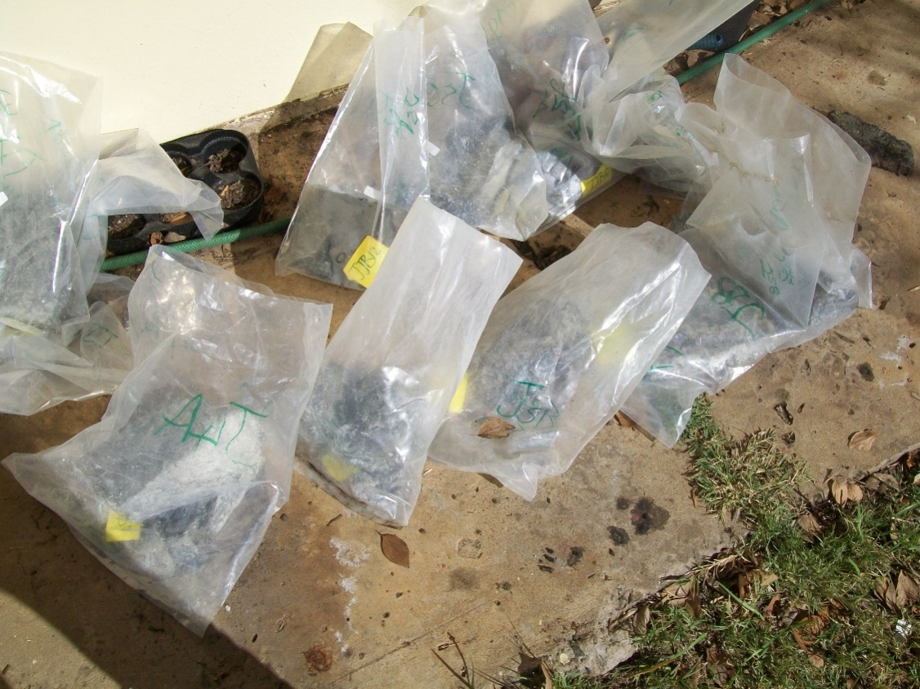
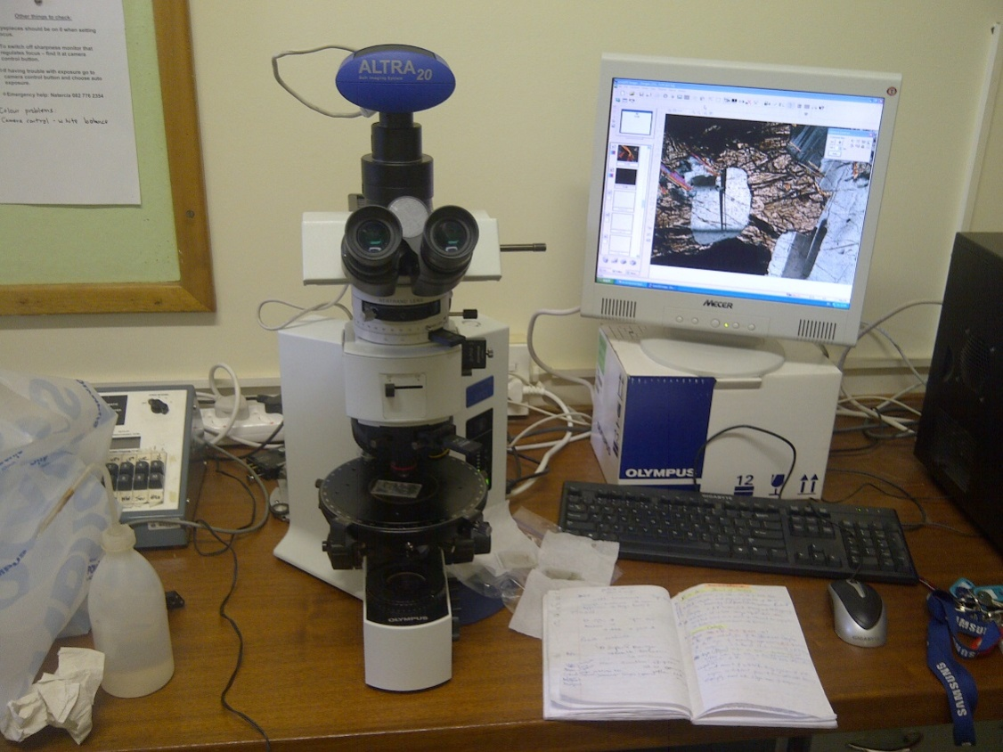
Methodology
Sampling
Microscopy
SEM Eds/Wds analyses
XRF
EMPA analyses
Mass Spectrometry analyses of plagioclase separates
Mass Spectrometry analyses of sulphides

Slide 5
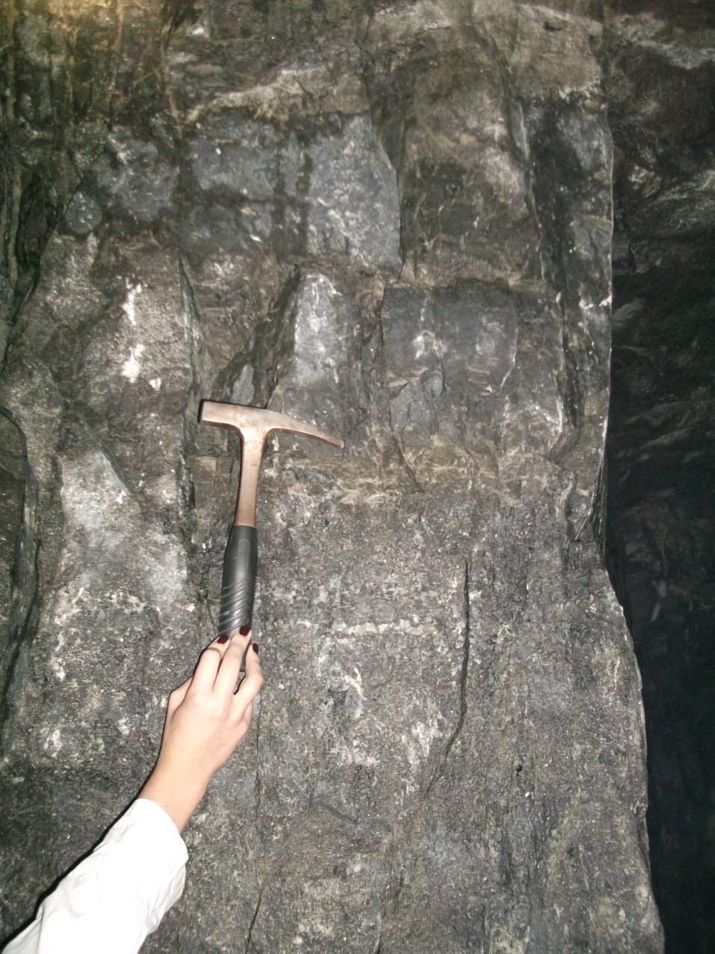
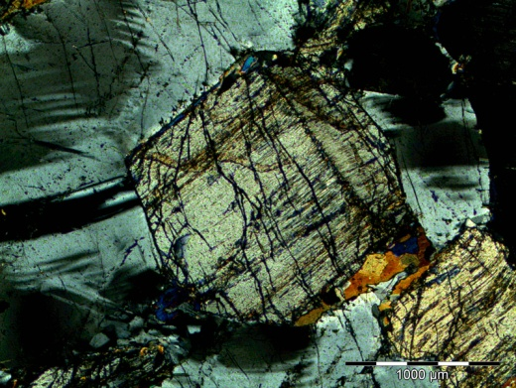
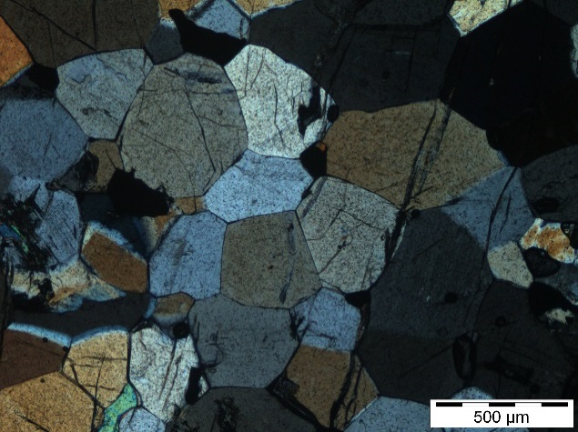
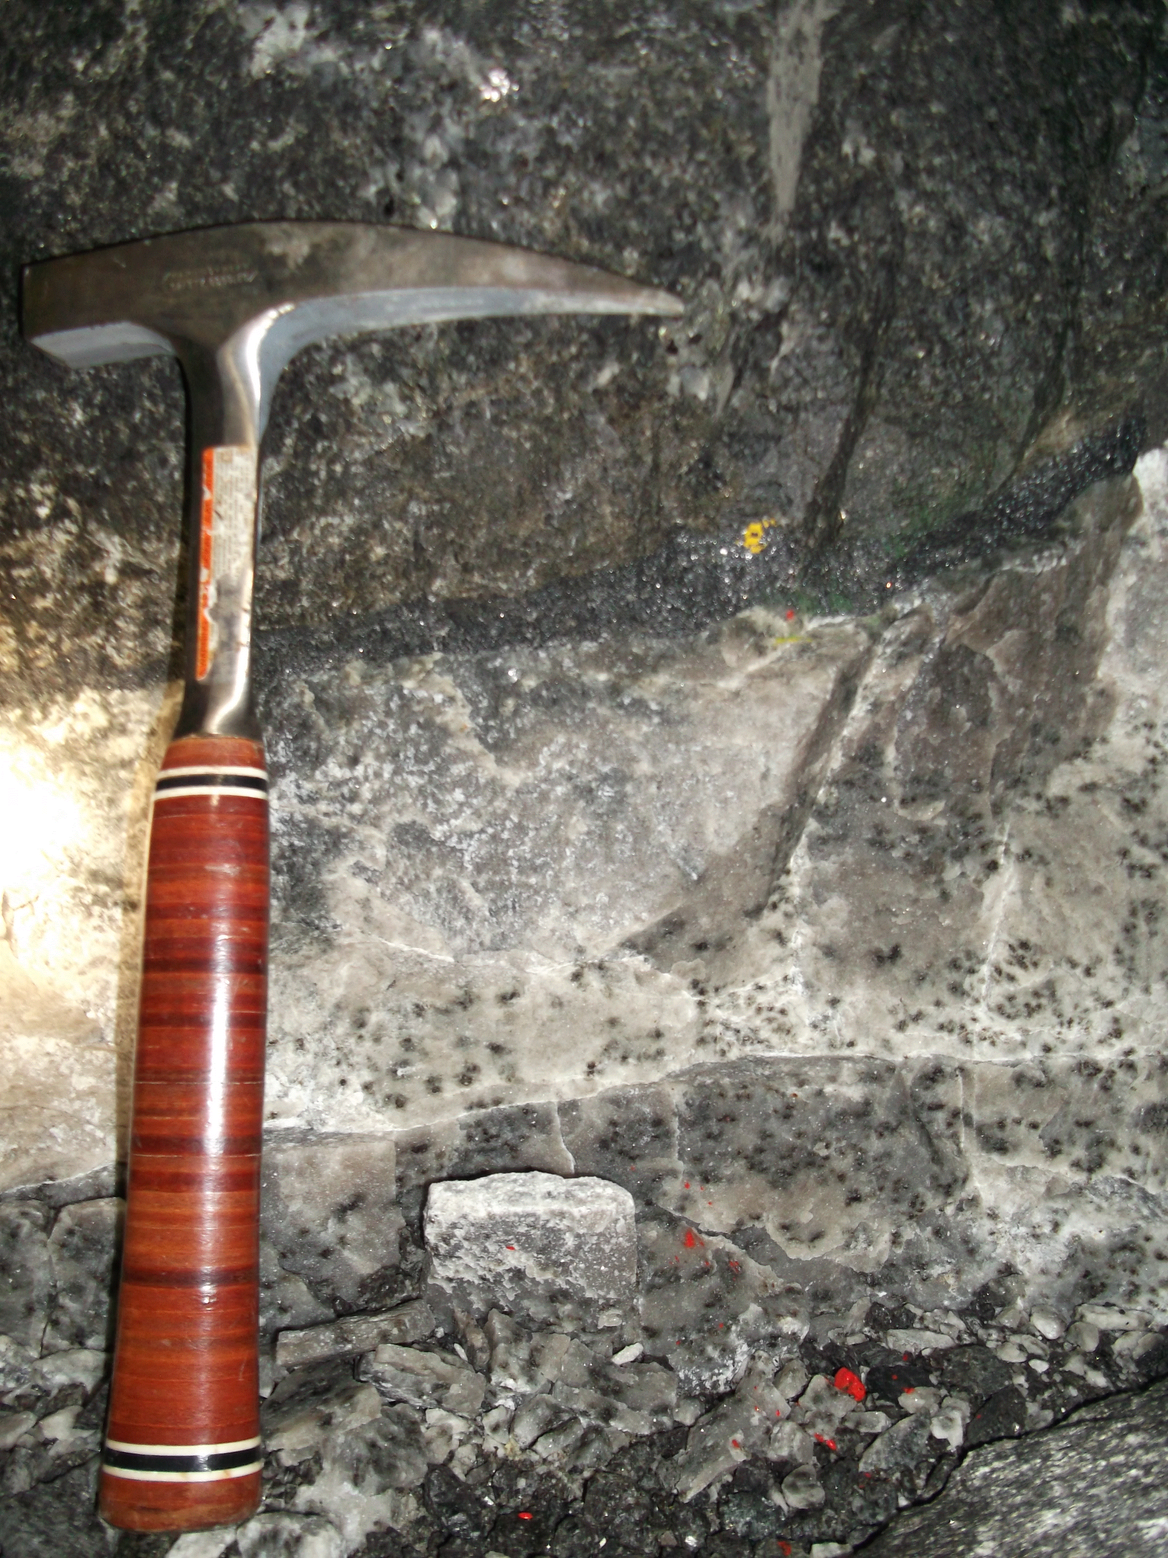
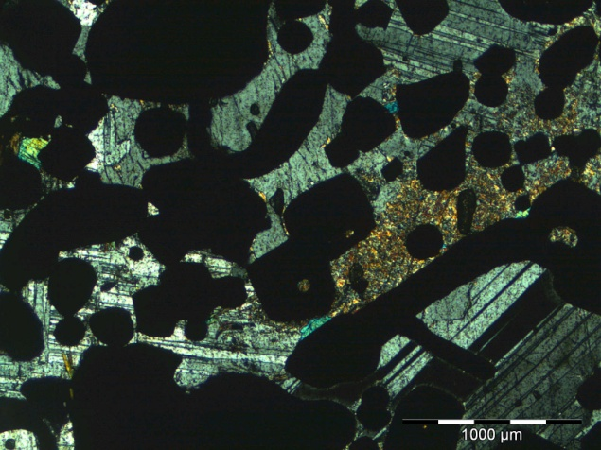
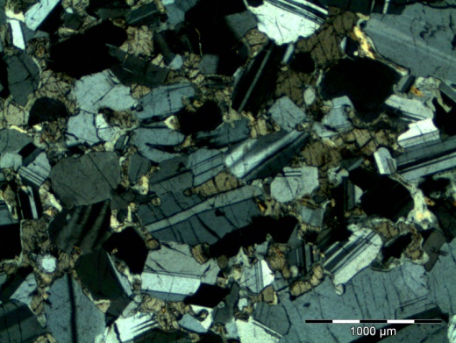
Results
Plag
Opx
BSN
Opx
Cpx
Cpx
Pxt
Chr
Chr
MAn
Plag
Chr
SAn
PXT
Opx
The MCU comprises mainly of pyroxenite (bounded by chromitite stringer/s) and is overlain by norite, anorthosite or pyroxenite to a lesser extend and has a spotted/mottled anorthositic footwall
Occurrence of enigmatic “brown sugar norite” lenses in the pyroxenite(MR) and hangingwall

Slide 6
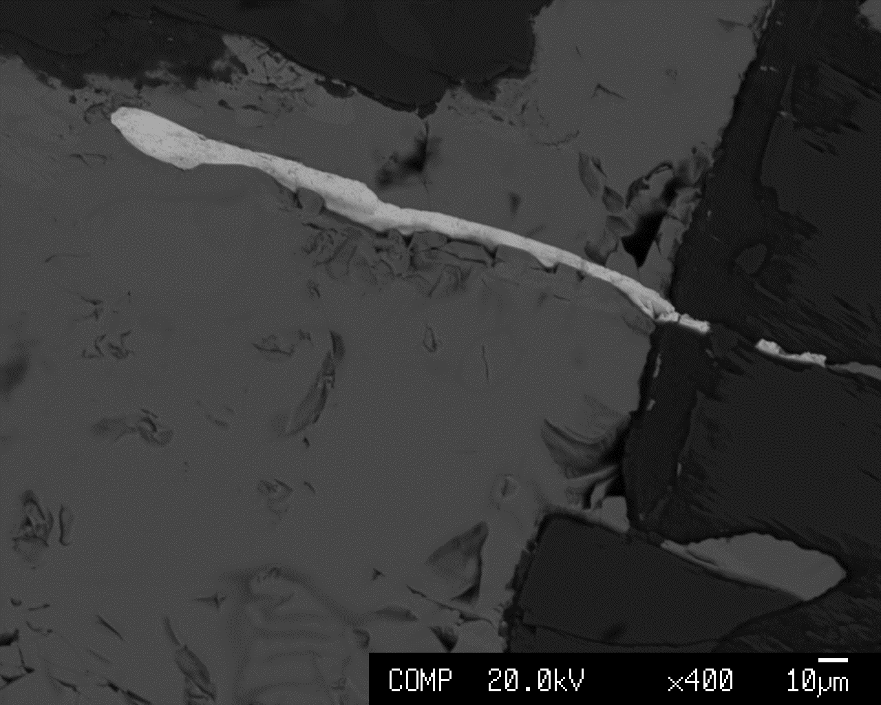
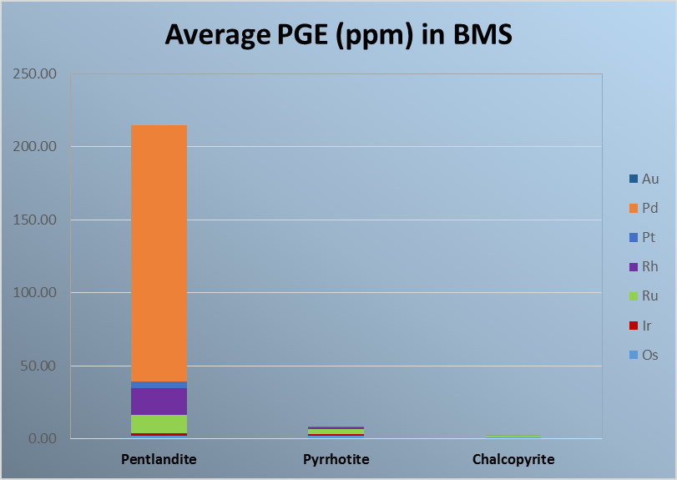



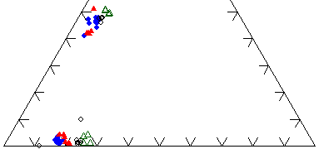

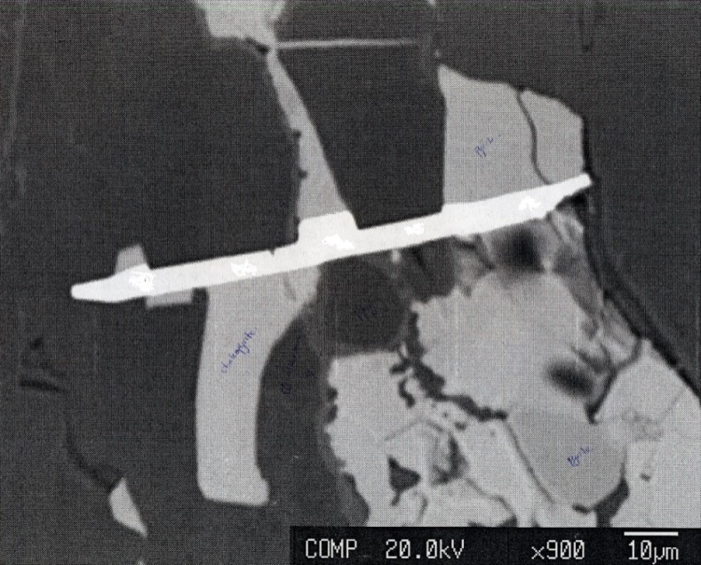
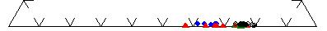
Pyrr
TRP
EST013
PtBiTe
Diopside
Hedenbergite
Plag
Enstatite
Ferrosilite
Pyrr
PtBiTe
Albite
Chalc
Anorthite
Cl-alt

Slide 7
Conclusions
The Merensky interval formed by multiple magma injections, fractionation and disequilibrium of the magma.
Dynamic magma processes were involved in the formation of rocks from the MR profile at Eerste Geluk
⁸⁷Sr/⁸⁶Sr ratios of representative rocks of TRP are typical of Critical Zone magma.
PGE mineralisation in rocks of this study are possibly from a number of processes,
BSN lenses within pyroxenite possibly formed in a sub chamber where the rate of cooling was different and was later introduced into the pyroxenite.
THANK YOU!!!!!!

