Slide 1
Understanding source rock contribution to HC accumulation and natural gas leakage in the Bredasdorp Basin- a 3D basin modelling study
Wasiu Sonibare^{1,2,*}, Rolando di Primio², Zahie Anka^{2,4}, Daniel Mikeš³,
Abraham Rozendaal¹
¹Earth Sciences, Stellenbosch University, RSA
²GFZ - German Research Centre for Geosciences, Potsdam, Germany
³Geosciences, Nelson Mandela Metropolitan University, RSA
⁴Total Exploration – New Ventures, Paris, France
*Earth Sciences, University of the Western Cape, RSA

Slide 2
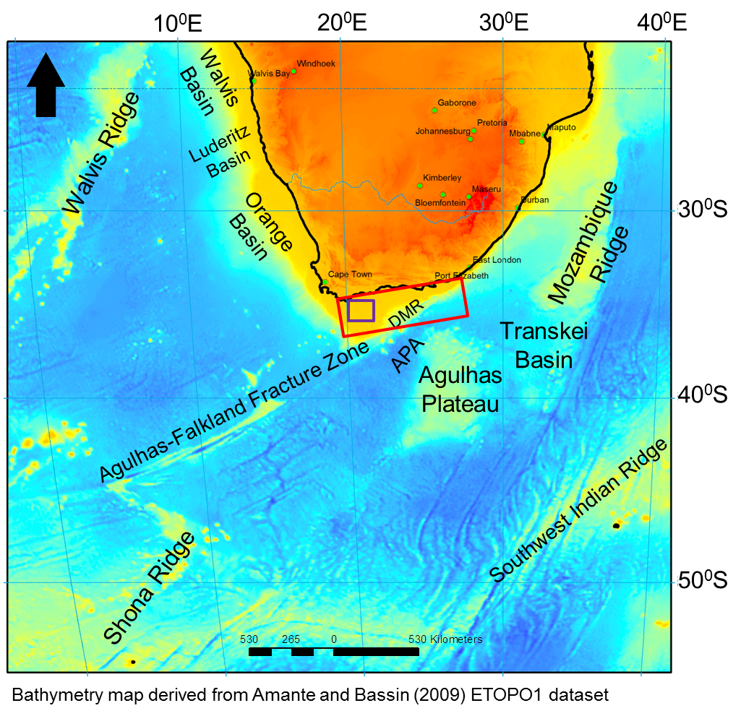
Study Area- its present regional tectonic structures
Margin segments with a documentation of rifting and transform processes
Dated as Late Jurassic – Earliest Cretaceous
DMR: Diaz Marginal Ridge
APA: Agulhas Passage
Outeniqua Basin
Study Area

Slide 3
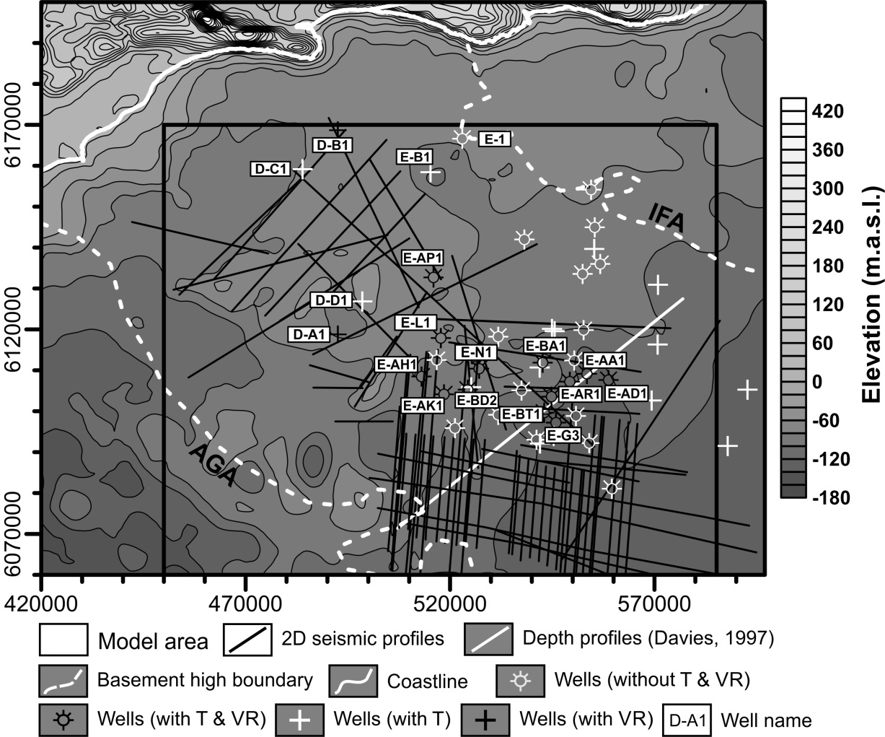
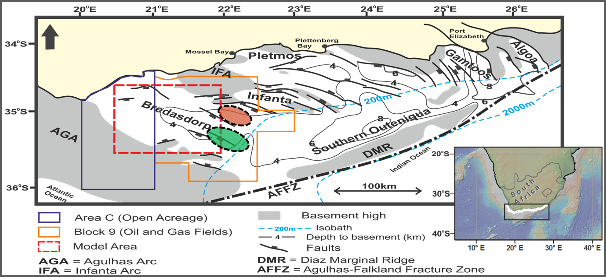
Why the Study Area?
Exploration dataset
Western Bredasdorp Basin
Gas field
Oil field

Slide 4
Previous Work (southern SA continental margin)
Studies
Area of focus
Ben-Avraham et al. (1993 &1997);
Thomson (1998);
Gohl and Uenzelmann (2001);
Tinker et al. (2008);
Wiegelt et al. (2008);
Parsiegla et al. (2009)
Plate tectonic reconstruction; Deep crustal structure; South-Atlantic margin evolution; Geomorphology; Paleoclimatic studies
Goutorbe et al. (2007)
Thermal regime and evolution
Van Wyk et al. (1994);
Broad et al. (1995);
McMillan et al., 1997;
Broad et al. (2006);
Uenzelmann-Neben & Huhn (2009);
Roux (2007)
Basin-scale studies; Seismic stratigraphy; Structural and stratigraphic evolution
Davies (1997a & 1997b);
Madyibi et al. (2009)
Petroleum system evolution
Limitations: scientific gap exists; also lack of uncertainities and risks quantification
Notes:
This shows all previous studies in the area. Studies are grouped into different disciplines. Limitations: scientific gap exists; also lack of uncertainities quantification
That is why this current study offers a multi-disciplinary approach in order to bridge this gap.

Slide 5
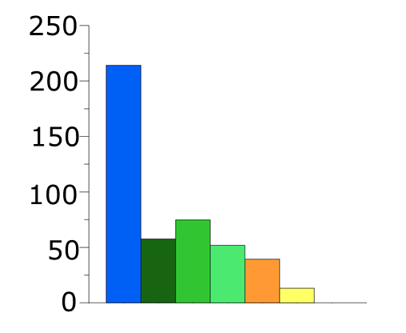
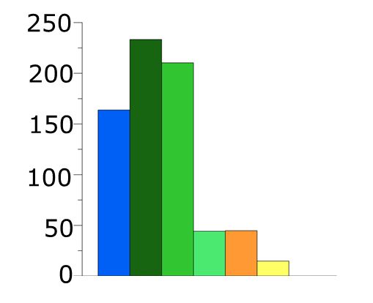
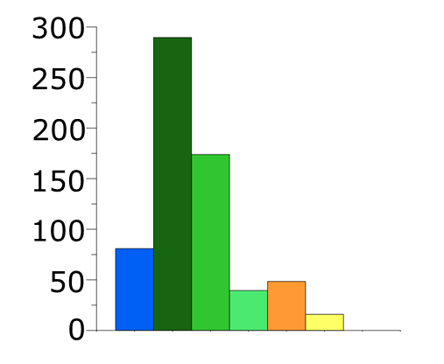
Thickness distribution + sedimentation rate
m/Ma
m/Ma
m/Ma

Slide 6
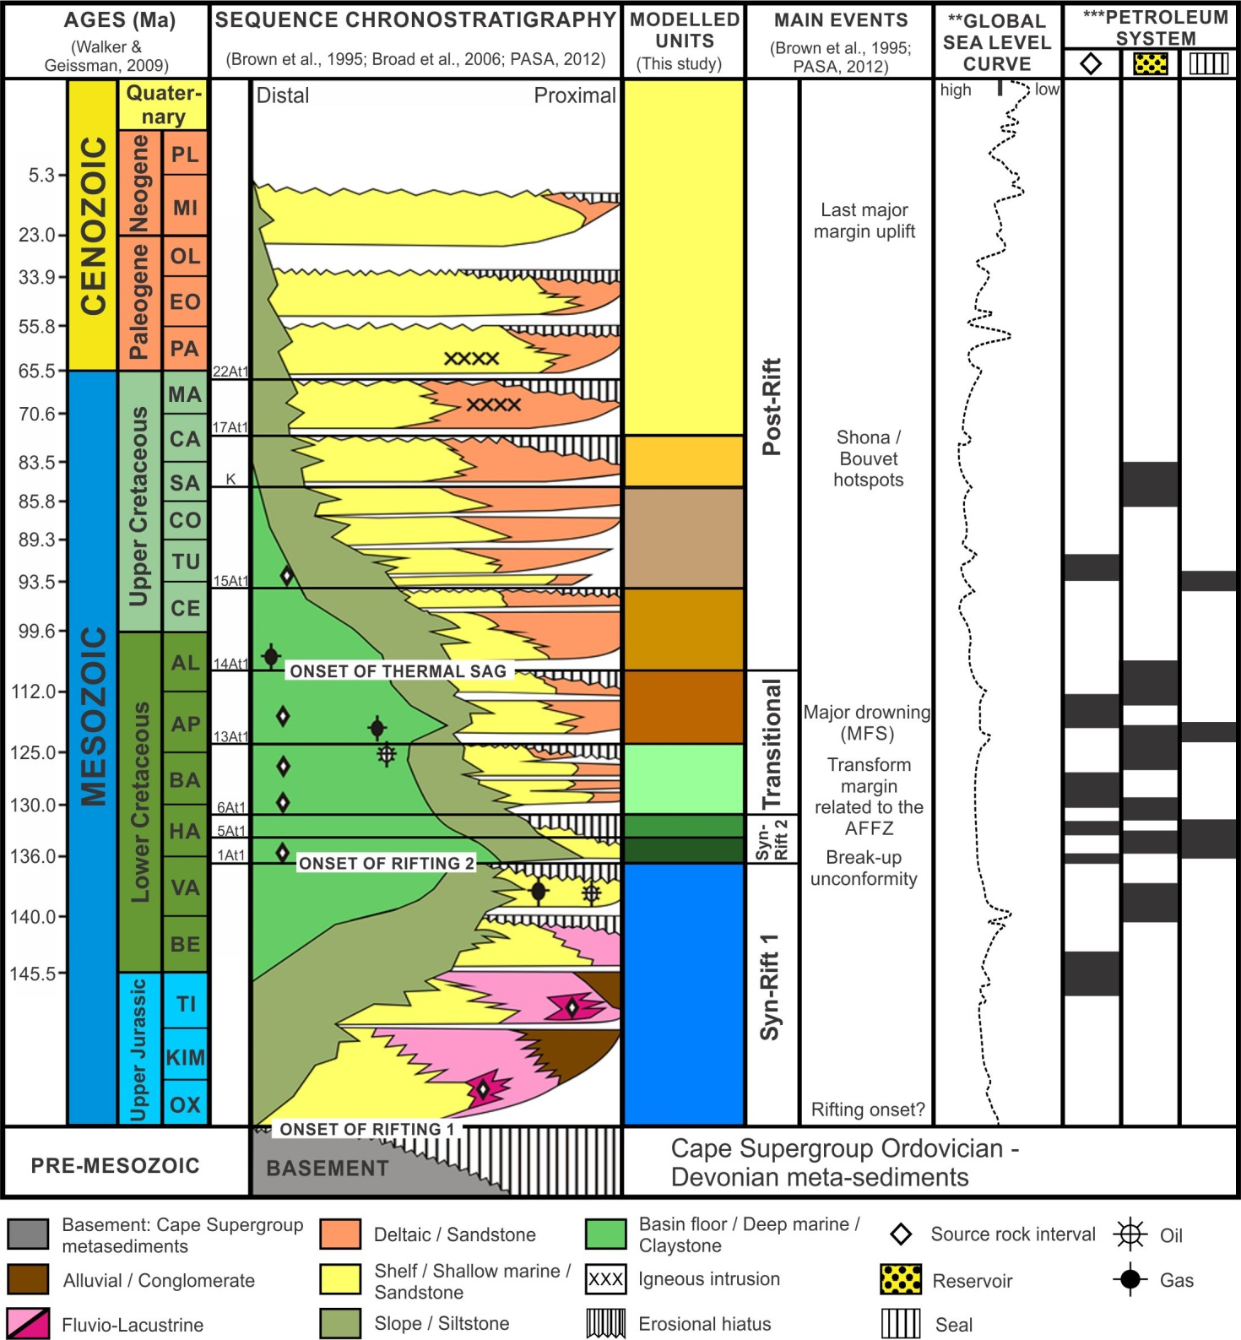
Compilation from:
seismic
well data
Cores
Reports
Biostrat info
Literature
** Haq et al. (1987)
*** Davies (1997a), Mc Millan et al. (1997), Broad et al. (2006), Roux (2007), PASA (2012) and this study

Slide 7
Problems
Contribution of syn-rift source rocks to hydrocarbon evolution largely underestimated

Slide 8
Basin-fill geometry
key basinwide unconformities + major faults in TWT
Seismic gas chimneys (gas seeps)

Slide 9
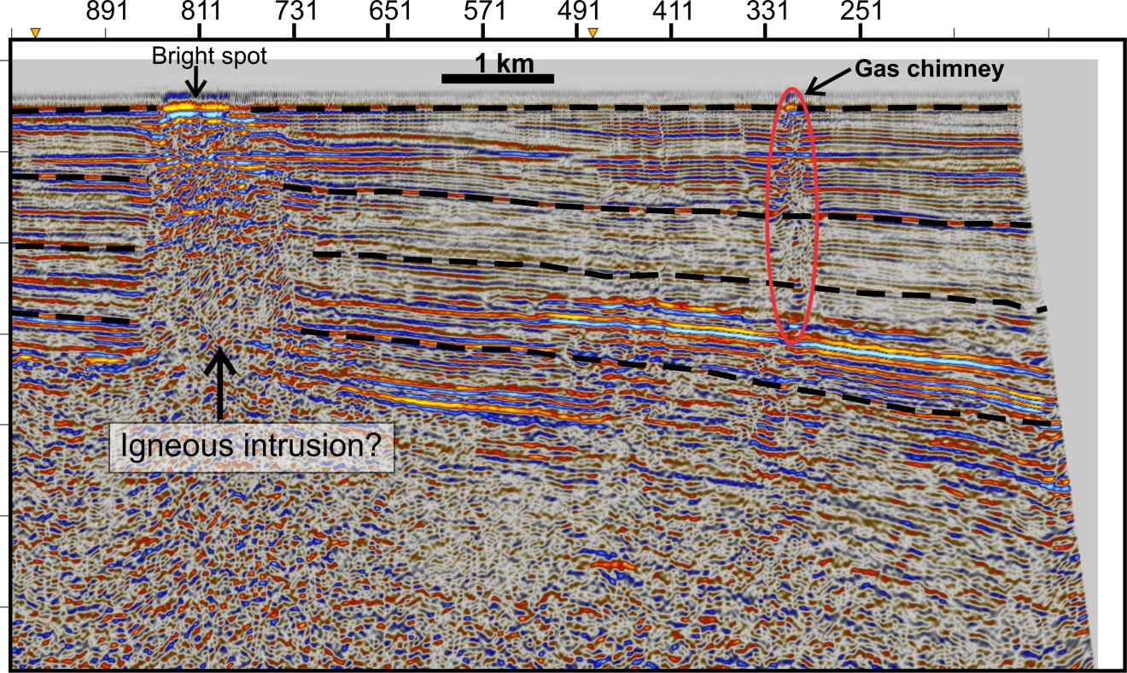
Leakage indicators
Seismic gas chimneys (gas seeps)
Igneous intrusions
Magnetic susceptibility data depicting intrusive bodies correlating to the Sniffer anomalies (GETECH, 1992)
Sniffer survey

Slide 10
Problems
Contribution of syn-rift source rocks to hydrocarbon evolution largely underestimated
Relating geological controls to the timing and extent of migration dynamics and paths still problematic

Slide 11
3D Basin modelling
Geo-Softwares:
Petrel
EarthVision
GMS
PetroMod
Basin @ Present-day
Burial history
Thermal history
Modelling the evoluion of petroleum systems

Slide 12
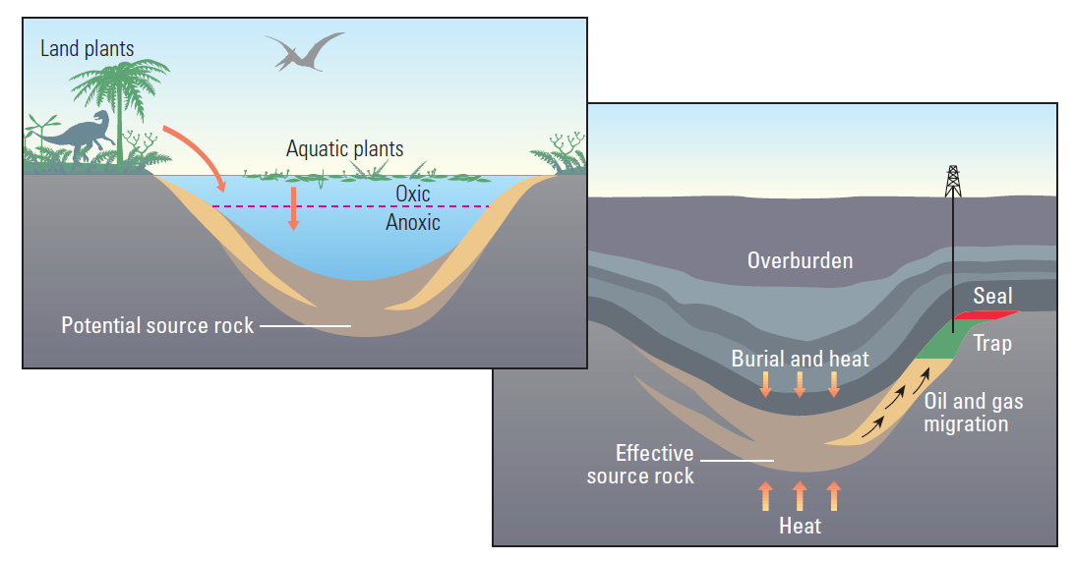
3D Basin modelling
Here, all petroleum system elements and processes are fully operational
Migration method:
Hybrid –
Darcy flow and Flowpath
(from Schlumberger Oilfield Review, 2009)

Slide 13
3D Basin modelling
Facies heterogeneity (vertical and lateral)

Slide 14
Thermal maturity
Calibrated against borehole T and VR% data
syn-rift
hotspot
Miocene
Margin uplift?
Well D-A1 (Proximal)
Well E-BD2 (Central)

Slide 15
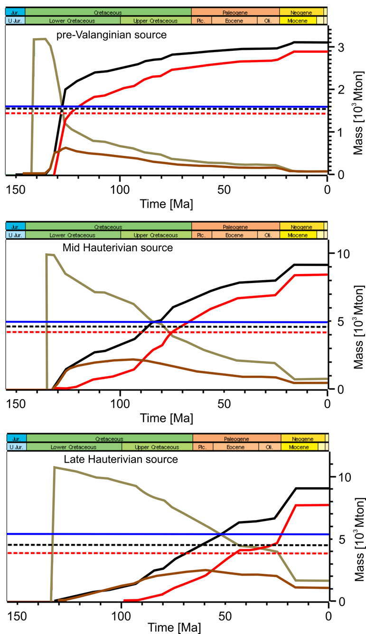
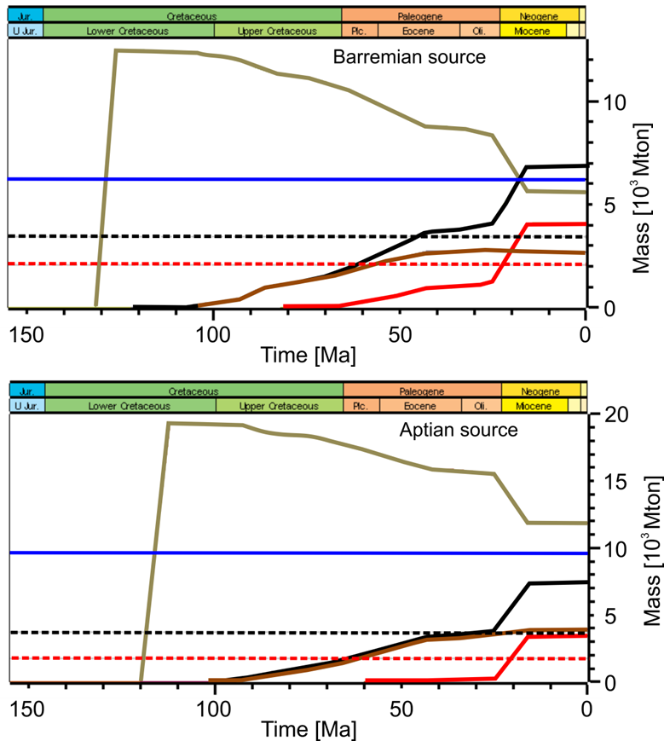
Source maturation and hydrocarbon generation /expulsion
I
II
III
I
II
III
Critical Moment
Time of 50% Transformtion ratio of each source interval

Slide 16
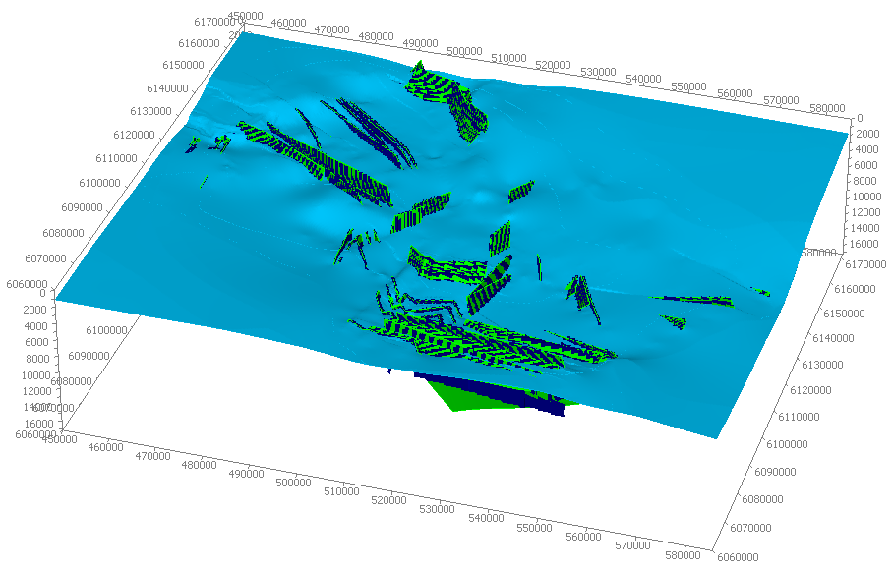
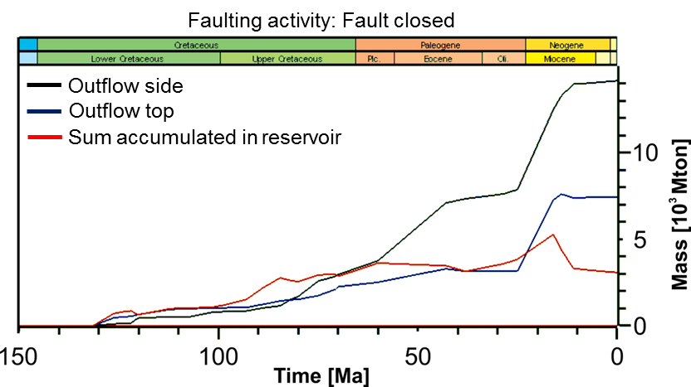
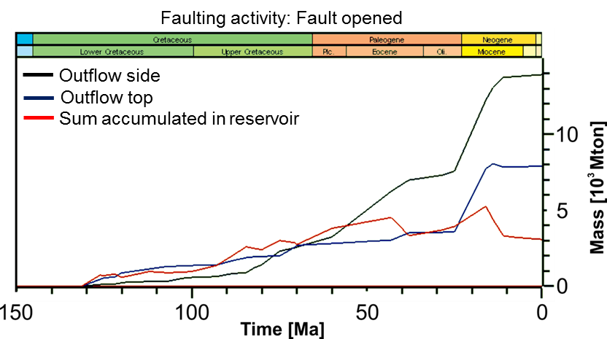
Sensitivity tests – 3D Migration modelling
Faulting activity
a total of 56 faults (listric to normal)
close or open permeability depending on tectonic quiescence or active

Slide 17
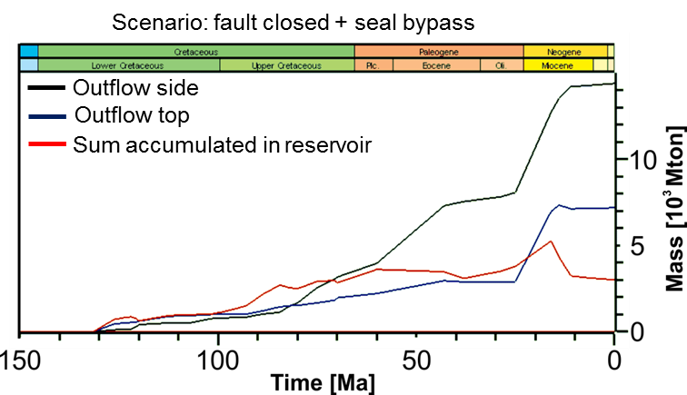
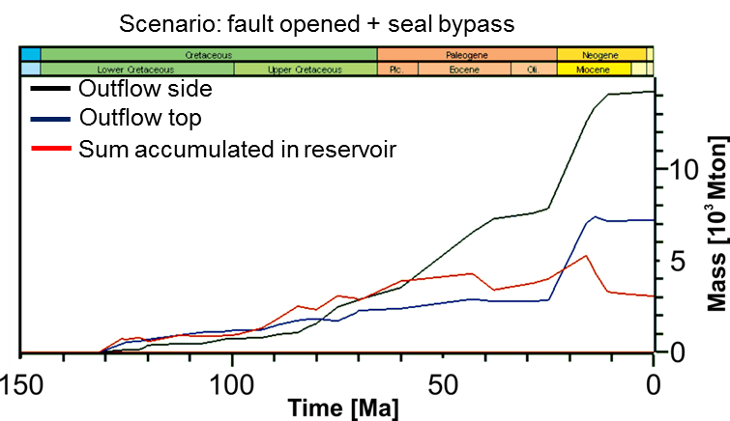
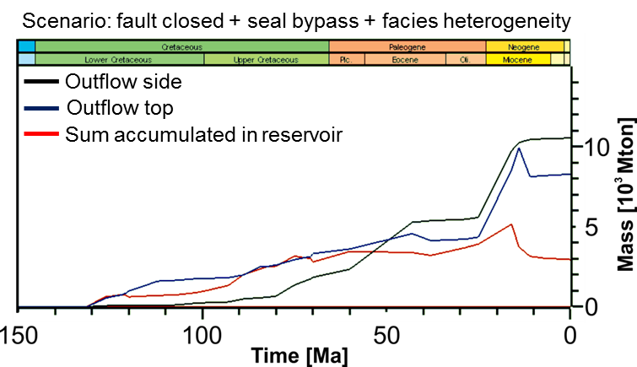
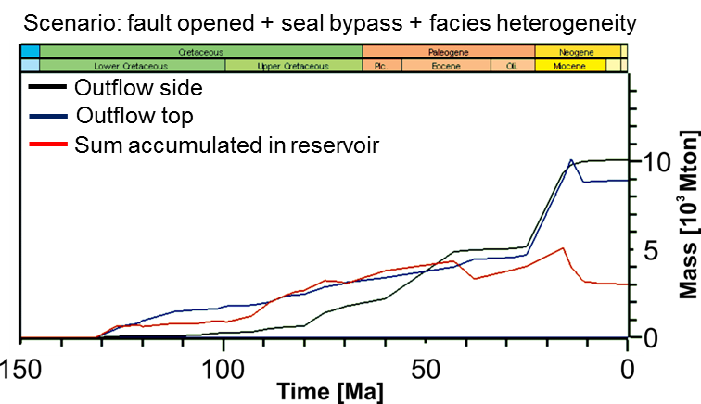
Sensitivity tests
Seal bypass = reduce efficiency by 50%

Slide 18
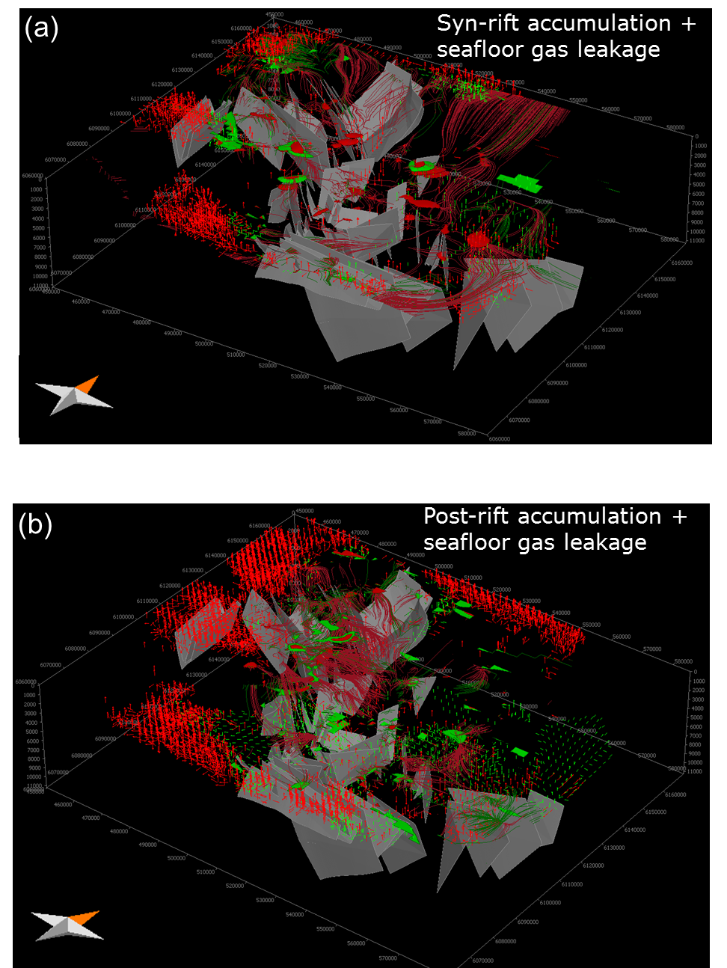
Sensitivity tests
3rd Scenario
fault + intrusion-related seal bypass + facies heterogeneity
best prediction of discovered accumulations and leakage indicators

Slide 19
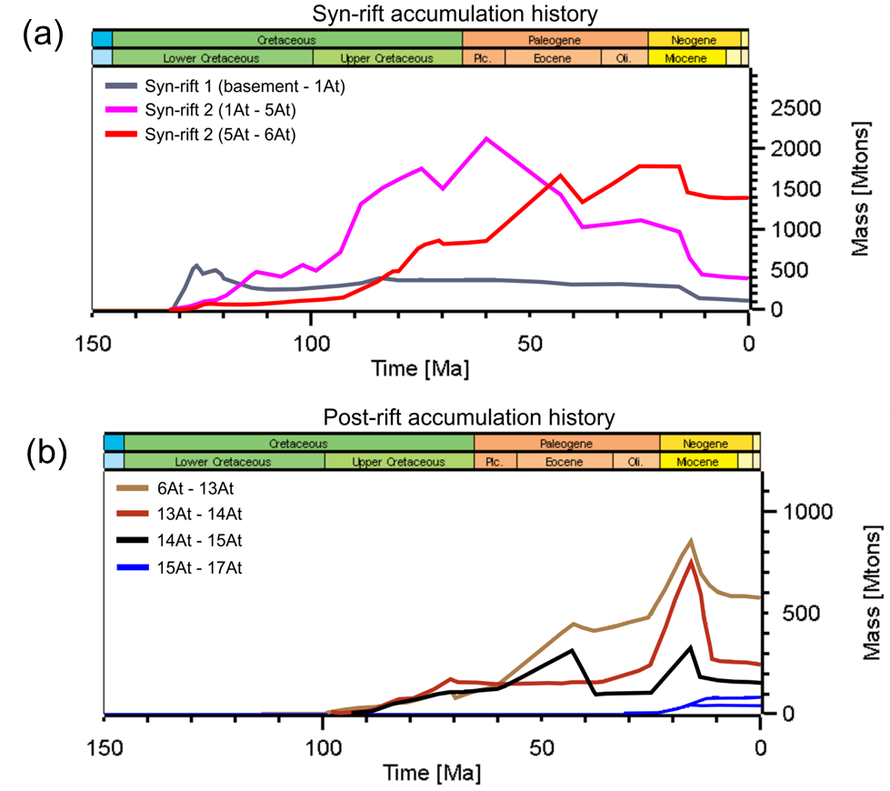
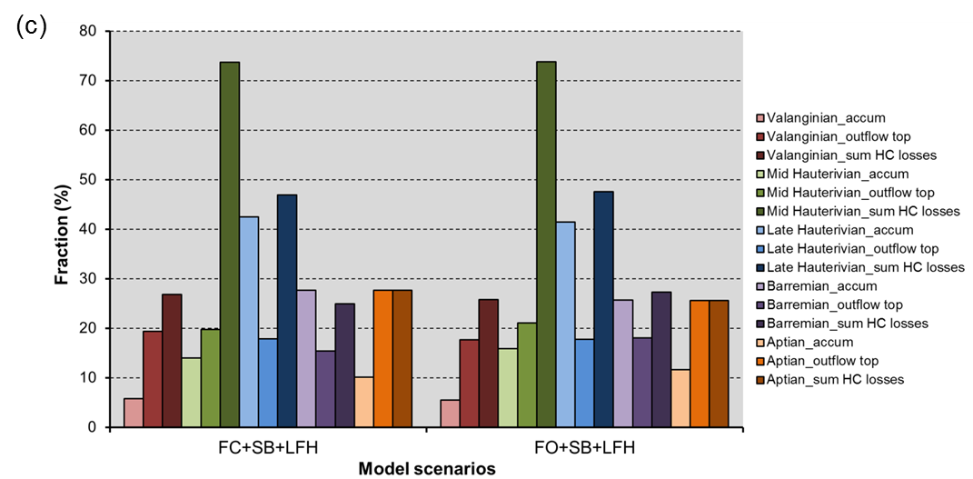
Accumulation and possible leakage of trapped hydrocarbons
Source rock contribution

Slide 20
Conclusions
Approach enables a first-order constrain on hydrocarbon evolution spatially and temporally and confirms the presence of an active petroleum system since the Cretaceous in the WBB.
Critical moments for petroleum system evolution are controlled by: Syn-rift heat flow and rapid burial, Late Cretaceous mantle-related hotspot and Miocene margin uplift and erosion scenario.
Seal bypass mechanism (linked to the roles of faults and intrusions), facies heterogeneity and uplift scenarios control the timing and extent of migration paths leading to hydrocarbon accumulation and natural gas leakage.
Syn-rift source rocks contribute the most to accumulation and leakage of HC.
Greatest risks to assessing the total petroleum system and prospectivity of the basin are the complex tectonic history, seal integrity and predictions of facies heterogeneity.

