Slide 1


Shale gas
Geohydrological Research at NMMU
Mokoena M.P
Department of Geosciences
logo here…

Slide 2
Outline
Hydraulic Fracturing (Fracking)?
Relationship between Fracking and Geohydrology
Brief review- NMMU Geohydrological Research
Study area
Methane Forensics
Methodology
Summary

Slide 3
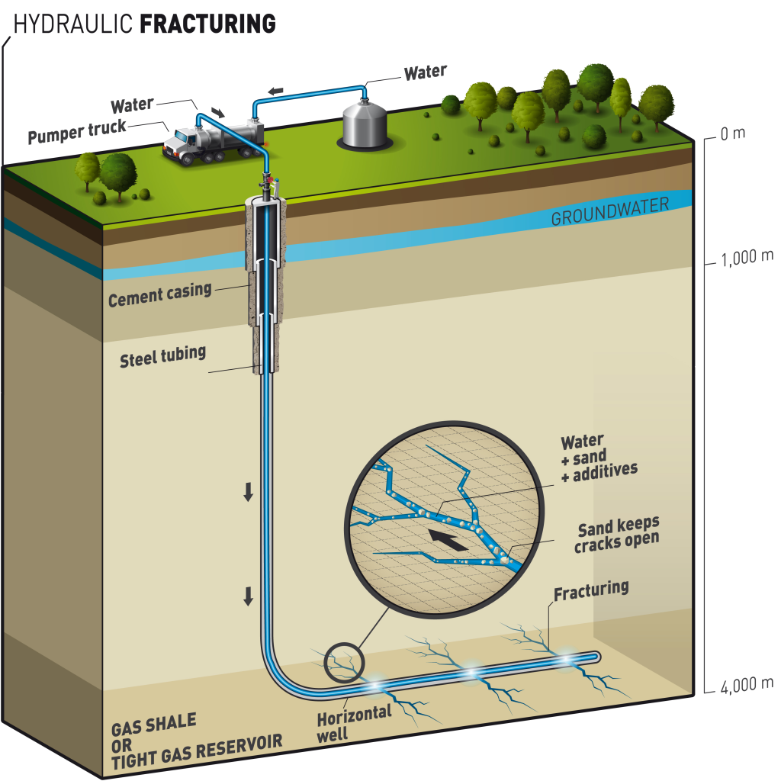
Hydraulic Fracturing (Fracking)?

Slide 4
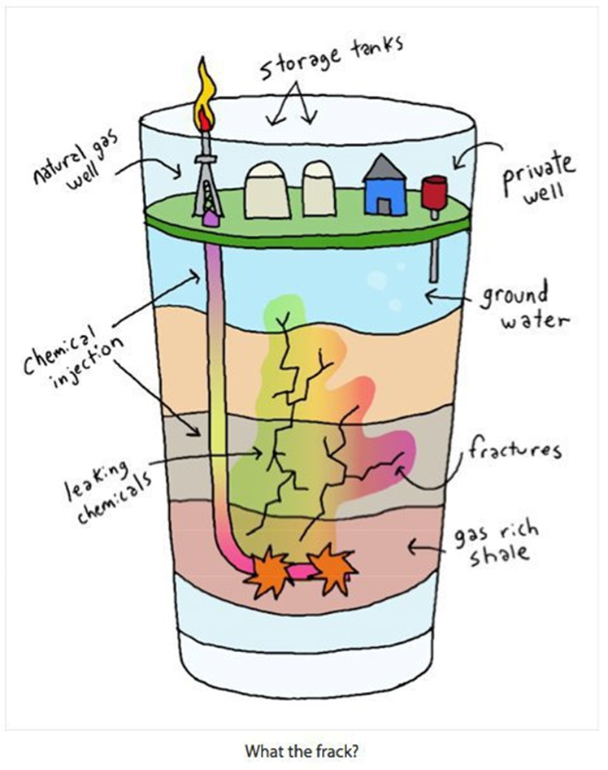
Relationship between Fracking and Geohydrology
Picture courtesy of Alex Reasbeck(2014)

Slide 5
Current Geohydrology concepts (research approaches) at NMMU
Hydrochemically characterize both the shallow and deep saline formation water
Establish baseline water quality conditions in selected Eastern Cape region wells
Collect groundwater samples in a legally defensible manner to establish benchmark
Analyze groundwater for constituents often associated with oil exploration/development activities
Compile analytical results in a water quality database by aquifer
Isotope characterization analysis (Methane forensics)

Slide 6
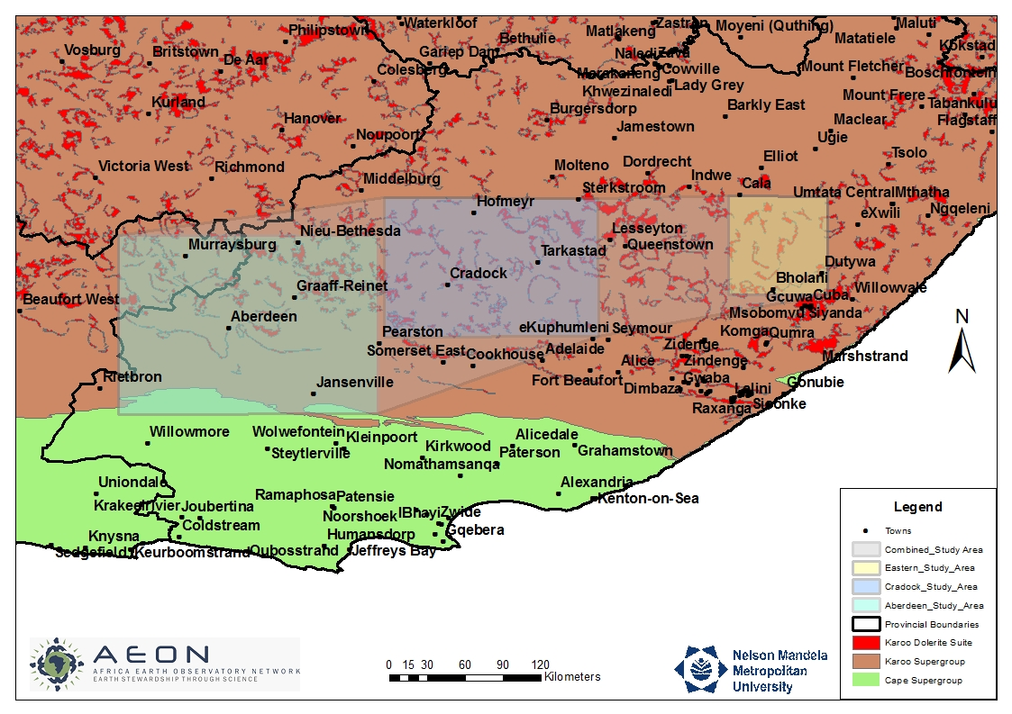
Study area

Slide 7
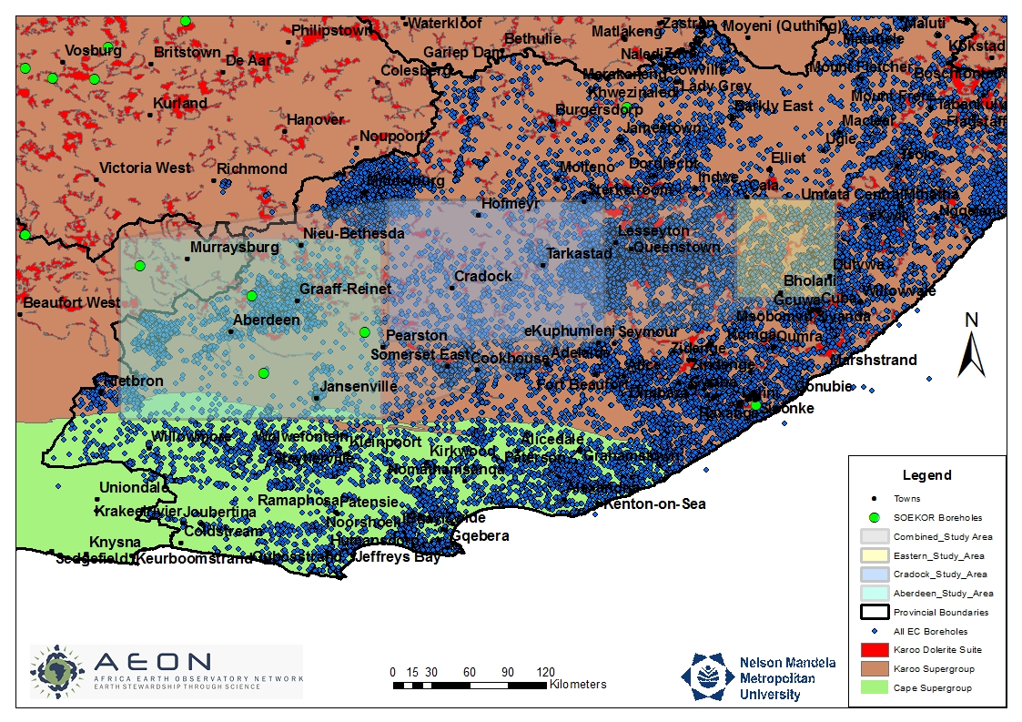
Study area

Slide 8
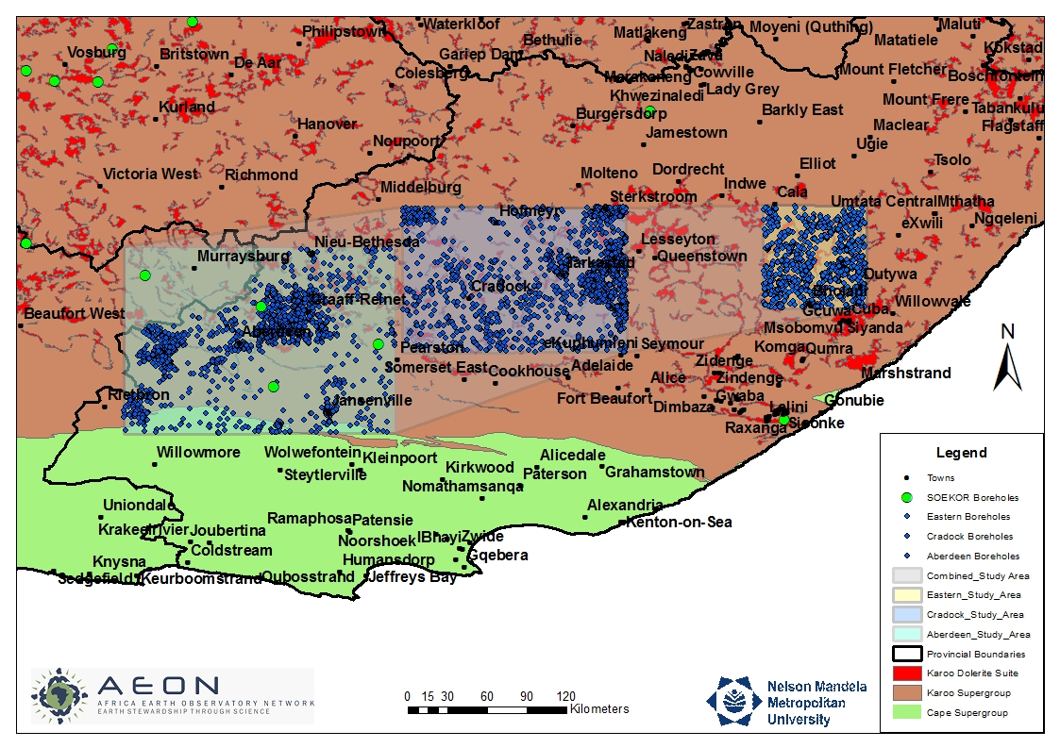
Study area

Slide 9
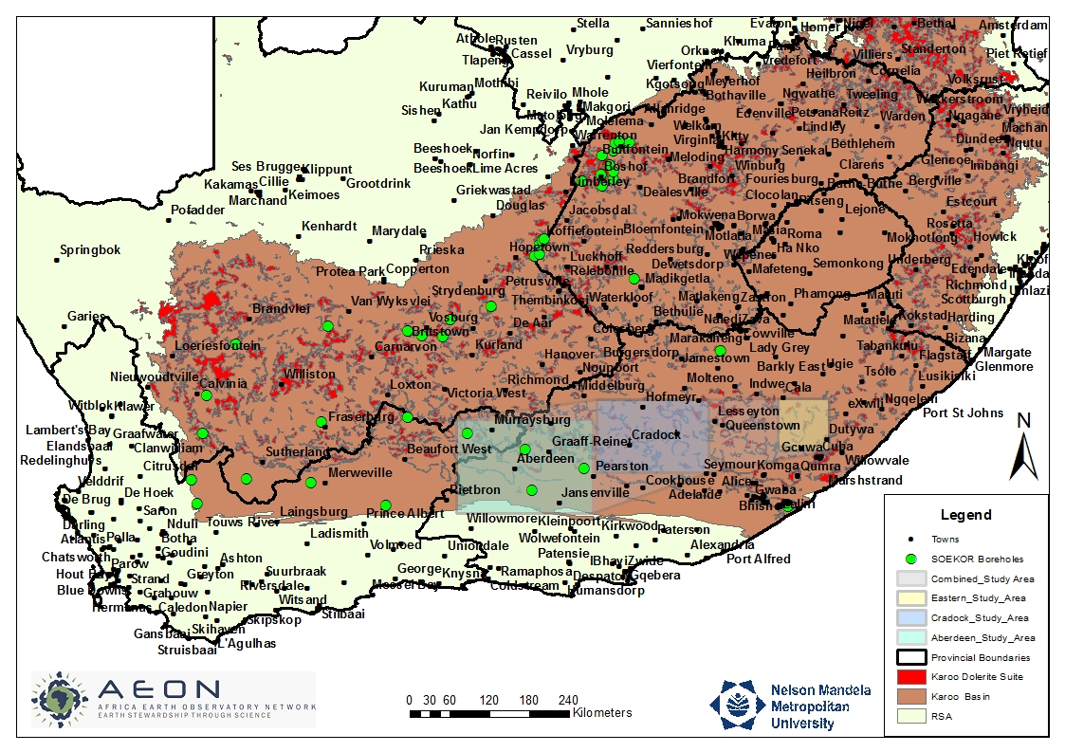
Study area: Stray gas legacy

Slide 10
Why use methane forensics?
Numerous sources of methane, differentiate methane sources
Highest standard of environmental forensics practice
Establish baseline conditions
Evaluate extent of gas migration

Slide 11
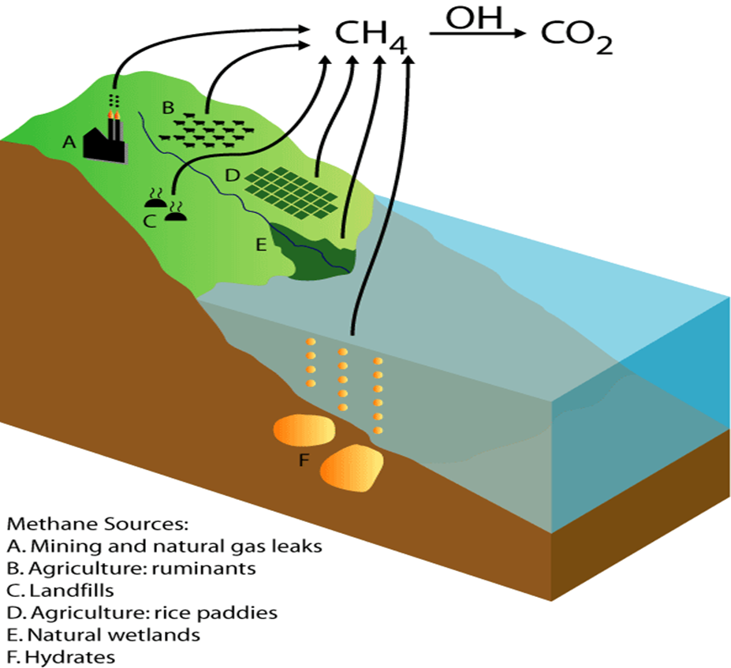
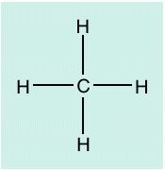
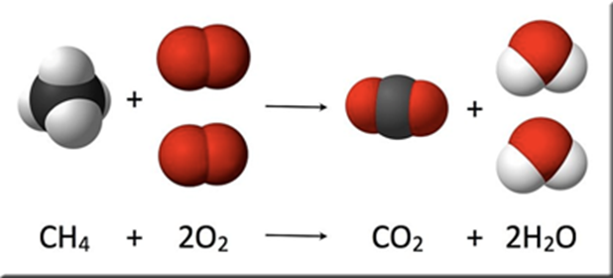
Generation mechanics of methane
Sources of methane
Methane.

Slide 12
Generation mechanics of methane
Thermogenic vs Biogenic
Thermogenic
Coal bed and oil & gas formations
Biogenic
Methanogenesis – “swamp gas” and “drift gas”
Acetate fermentation – “landfill gas”

Slide 13
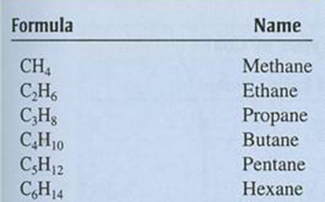
Methane forensic techniques
Geochemical Techniques
• Light hydrocarbon gas composition
Thermogenic versus biogenic
• Composition of other gases
(CO2, O2, H2, Ar, He, etc.)
Gas source, migration pathway
• Groundwater geochemistry
Differentiate water “types”
Trace CH4 generation pathway
Identify formation water

Slide 14
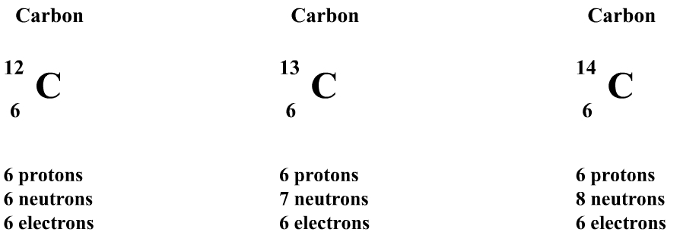
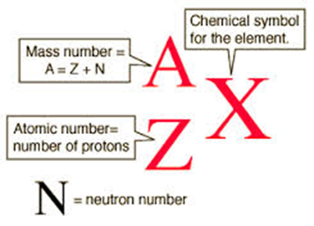
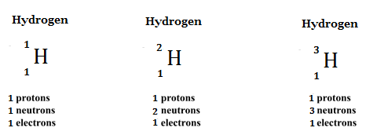
Isotopes characterization
What are isotopes
Same protons different neutrons

Slide 15
Isotopes characterization
Isotopes- methane?
δ¹³C – ¹³C/¹²C
CH₄
δ²H – ²H/H

Slide 16
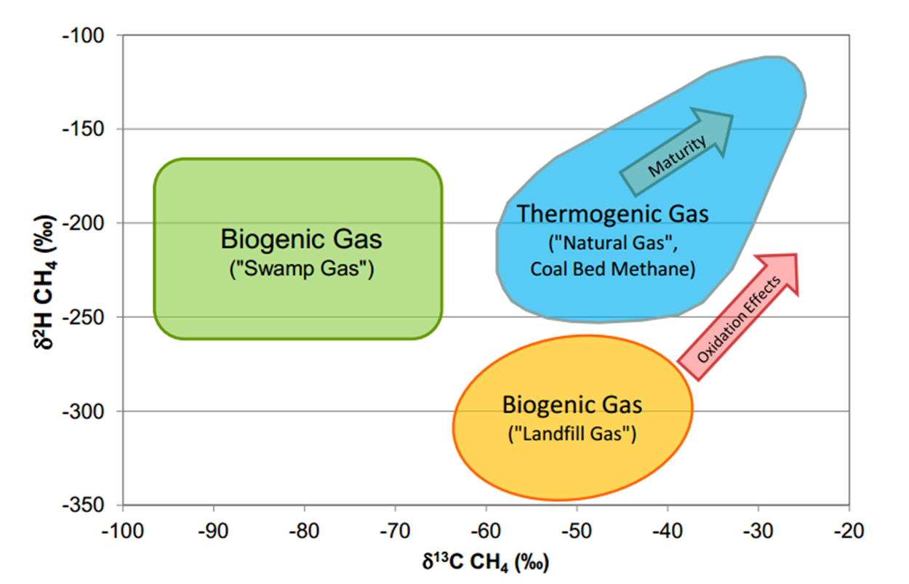
Stable isotopes
Thermogenic vs Biogenic gas

Slide 17
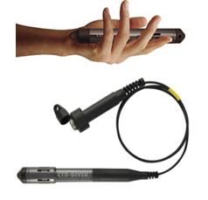
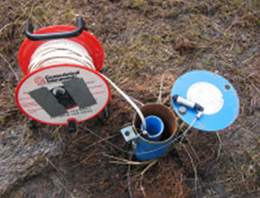
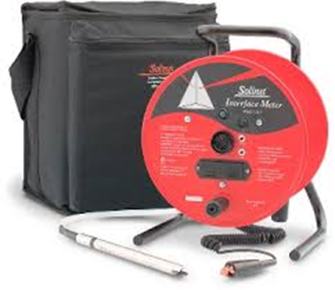
Methodology
Field Testing and Sample Collection
  Hydrocensus
  Hand Readings : Dip Meters, Picarro gas measurements
EC profiling
Installation of 10 downhole continuous logger

Slide 18
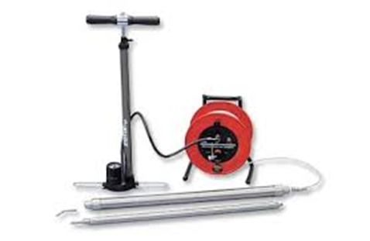
Methodology
Field Testing and Sample Collection

Slide 19
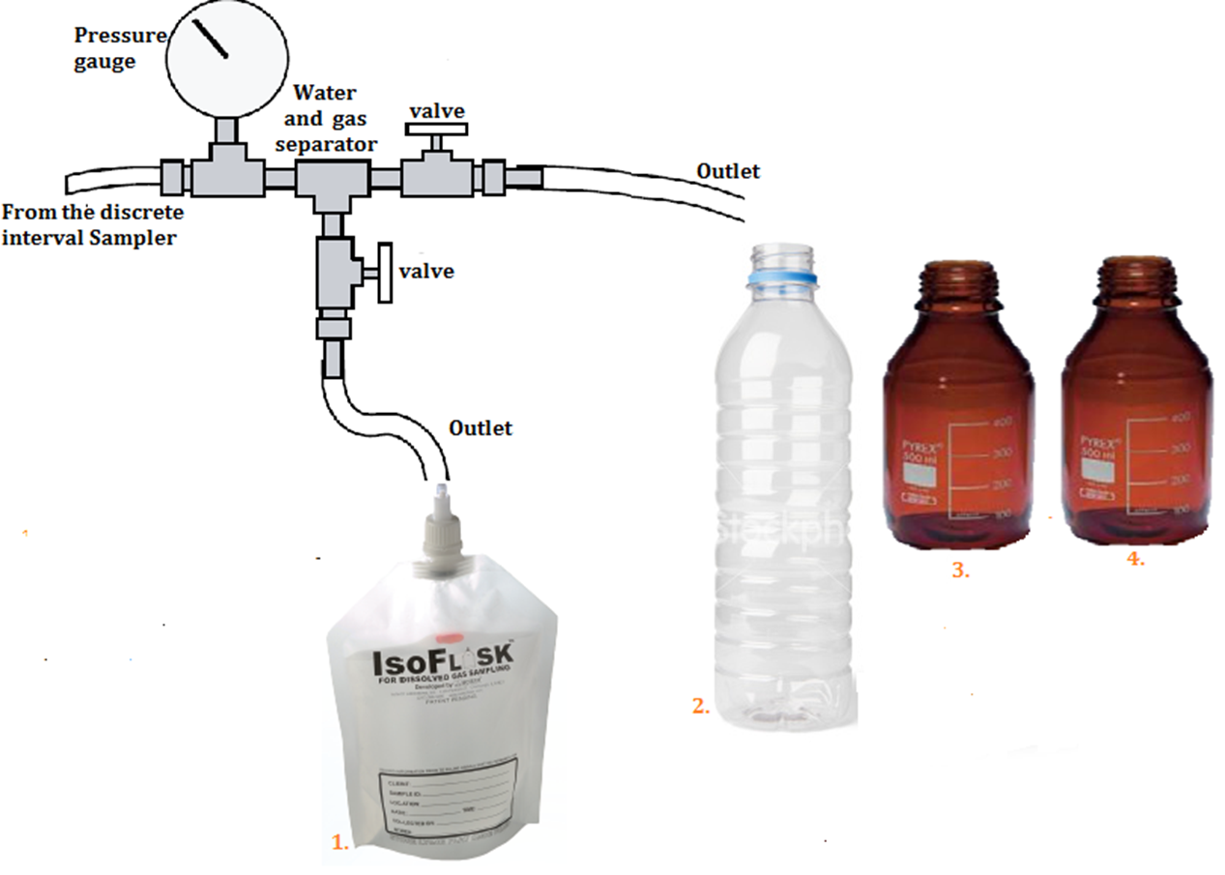
Methodology
Field Testing and Sample Collection

Slide 20
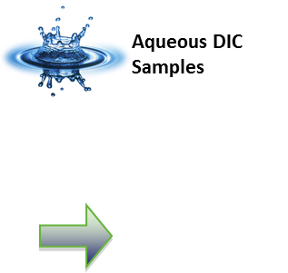
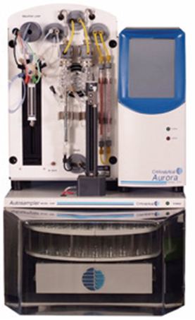
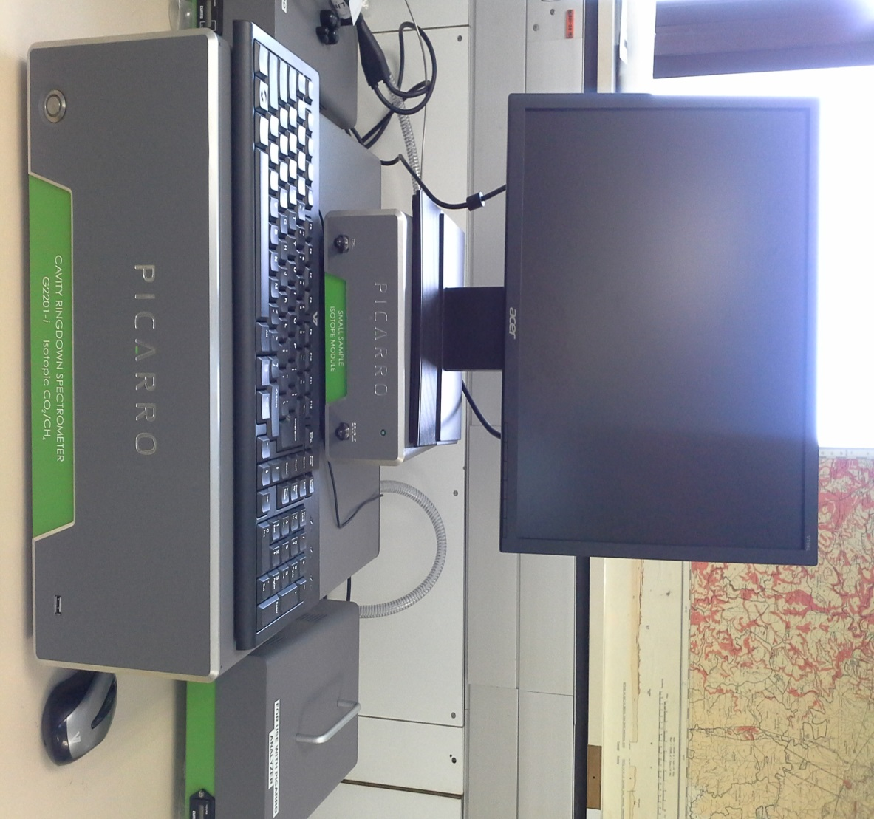


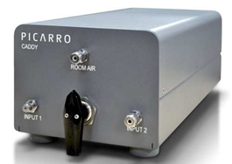
Methodology
Laboratory Techniques
High Precision DIC/TIC/TOC/NPOC and d13C of acidified, oxidized, or combusted samples

Slide 21
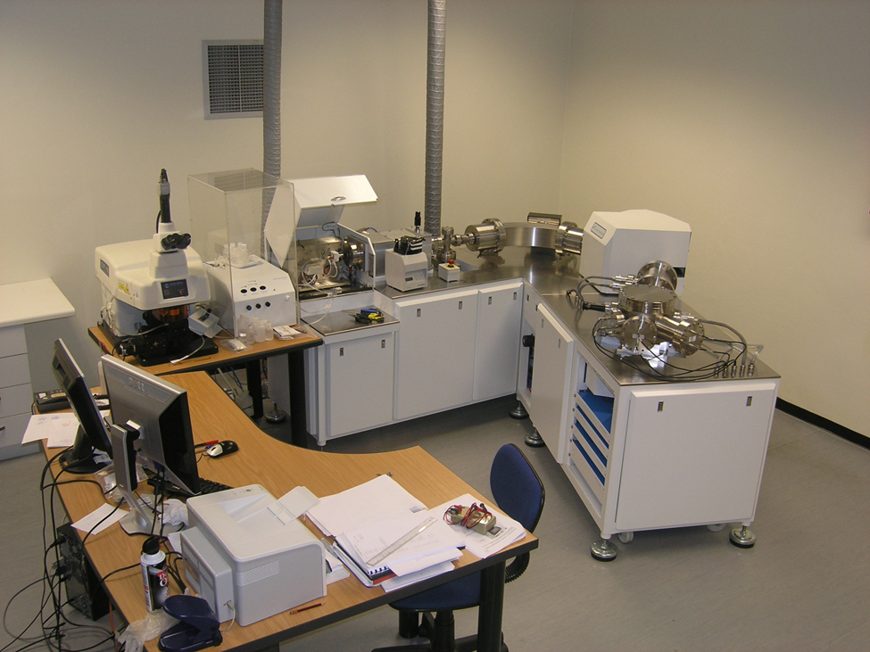
Methodology
Laboratory Techniques

Slide 22
Summary
Baseline Geochemical Studies
Field data and Sample Collection
Water Quality and Isotope analysis
Origin of methane(Thermogenic or biogenic)
Connectivity of the shallow and deeper formation water

Slide 23


Thank you for your attention
Questions?

