Slide 1


QUANTIFYING GROUNDWATER–SURFACE WATER EXCHANGE FLUXES BASED ON THE STEADY STATE RIPARIAN AREA AQUIFER WATER BALANCE
T Shakhane¹, FD Francois², M Gomo³
^{1, 2,3} Institute for Groundwater Studies (IGS), University of Free State.

Slide 2
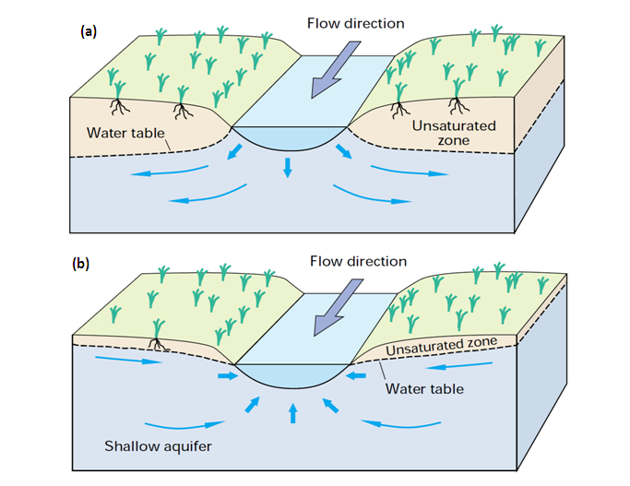
1. INTRODUCTION
Sources of water in streams include baseflow.
Conversely, groundwater originates from precipitation and/or from surface-water bodies.
The type of interaction is described by the direction of the exchange fluxes which distinguishes between influent (flowing in) fluxes and effluent (flowing out) fluxes
Based on these fluxes, the investigated stream(s) reaches are described as loosing and/or gaining
𝐼𝑛𝑝𝑢𝑡𝑠−𝑜𝑢𝑡𝑝𝑢𝑡𝑠=𝑐ℎ𝑎𝑛𝑔𝑒 𝑖𝑛 𝑠𝑡𝑜𝑟𝑎𝑔𝑒.

Slide 3
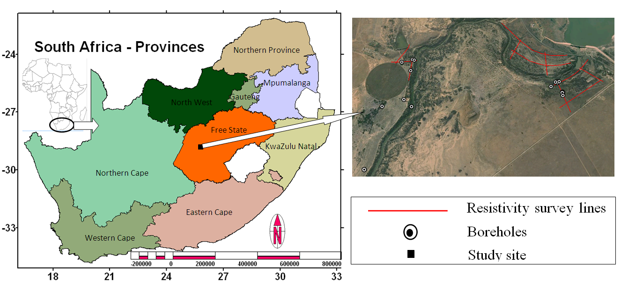
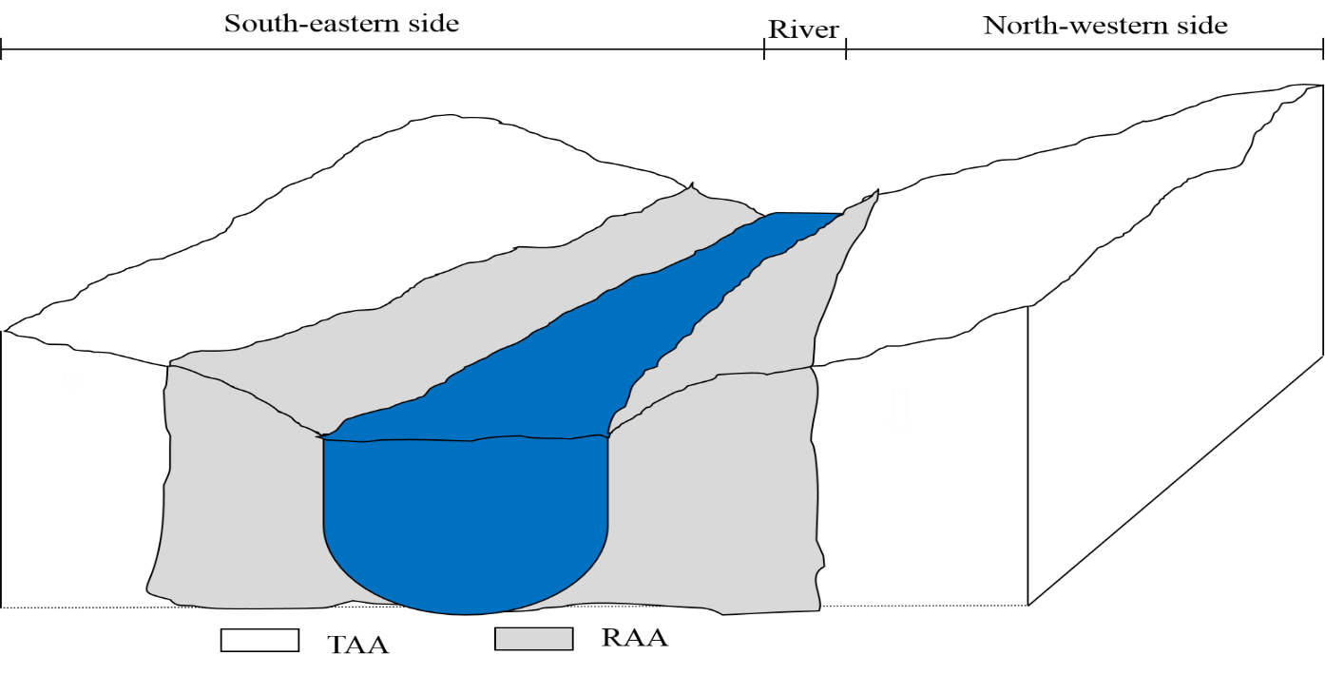
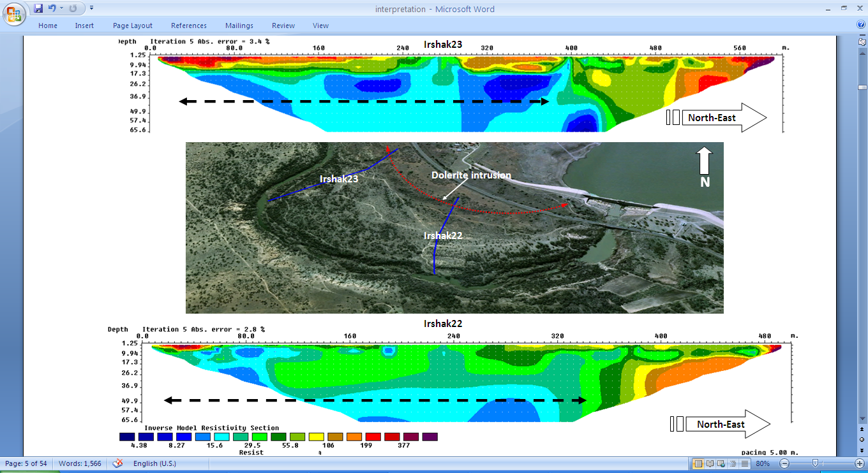
2. RAA and TAA
𝑅𝑟+𝐺𝑊𝑖𝑛−Δ𝑆𝑔𝑤−𝐸𝑇𝑔𝑤=𝐵𝑏𝑓
𝑅𝑟=recharge to the RAA,
𝐺𝑊𝑖𝑛=influx from the TAA system,
Δ𝑆𝑔𝑤= change in RAA groundwater storage,
𝐸𝑇𝑔𝑤= evapotranspiration; and,
𝐵𝑏𝑓 =baseflow.

Slide 4
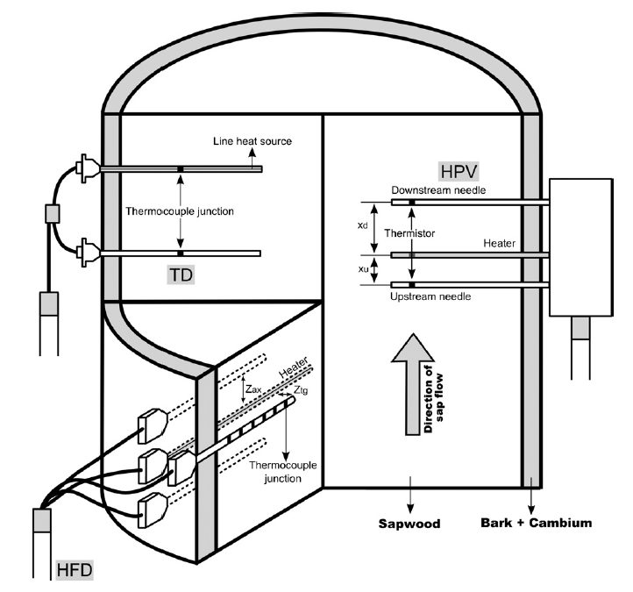
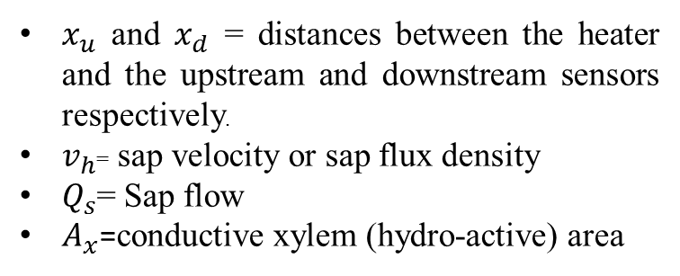
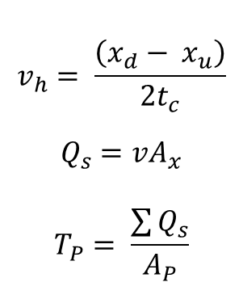
3. Riparian transpiration
$$v_{h}= \frac{\left(x_{d}− x_{u}\right)}{2t_{c}}$$
$$Q_{s}=vA_{x}$$
$$T_{P}= \frac{\sum{Q_{s}}}{A_{P}}$$
$x_{u}$ and $x_{d}$ = distances between the heater and the upstream and downstream sensors respectively.
$v_{h}$= sap velocity or sap flux density
$Q_{s}$= Sap flow
$A_{x}$=conductive xylem (hydro-active) area

Slide 5
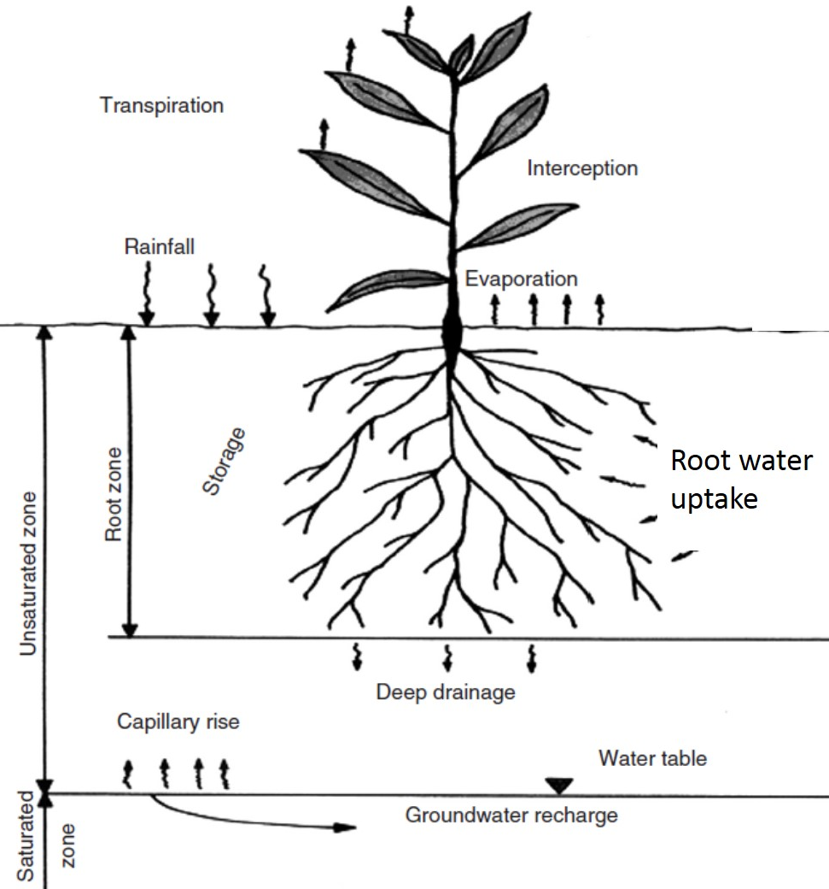

4. RIPARIAN RECHARGE
$G_{r}\left(t\right)= Q_{i}\left(t\right)− \left[\left.θ_{f}− θ(t−∆t\right)\right]D_{o}$
$Q_{i}\left(t\right)$ = part of precipitation that infiltrates,
$θ_{f}$ = soil water content at the field capacity or amount of moisture at 33kPa
$θ$ = volumetric water content
$D_{0}$ = root zone depth
$Q_{i}\left(t\right)=P\left(t\right)− I_{a}\left(t\right)$
$I_{a}\left(t\right)$ =initial abstraction (all losses before the start of surface runoff:
depression storage, interception, evaporation, and infiltration)
$θ_{f}=θ_{33t}+ \left(1.283θ_{33t}^{2}− 0.374θ_{33t}− 0.015\right)$ (Saxton and Rawls, 2006)
$θ_{33t}=−0.251S+0.195C+0.011OM+0.006\left(S×OM\right)$
$$− 0.027\left(C×OM\right)+ 0.452\left(S×C\right)$$

Slide 6
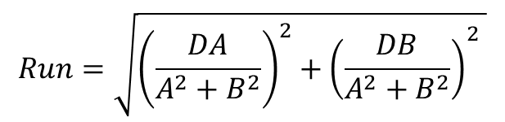


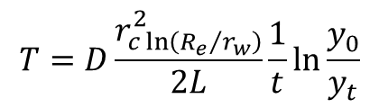
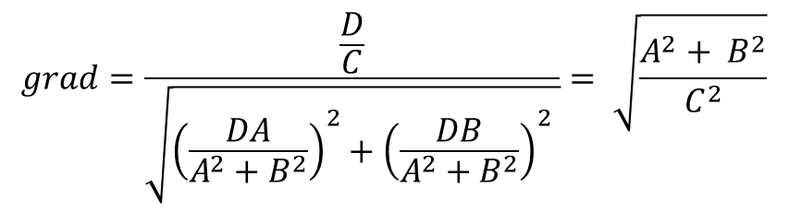
5. INFLUX FROM TERRESTRIAL AREA AQUIFER
$${GW}_{in}=TL\frac{∂h}{∂x}$$
${GW}_{in}$= the groundwater influx in to the RAA from the TAA (m³/day),
$T$ = transmissivity (m²/day),
L is the average aquifer width (m); and,
$\frac{∂h}{∂x}$ =hydraulic head gradient
$$T=D\frac{r_{c\ln\left({R_{e}}/{r_{w}}\right)}^{2}}{2L}\frac{1}{t}\ln{\frac{y_{0}}{y_{t}}}$$
Rise= height of the z intercepted above $x−y=$ $Z_{\left(0,0\right)}−Z_{\left(a,b\right)}=\frac{D}{C}−0=\frac{D}{C}$
$$Ax+By+Cz−D=0$$
$$grad=\frac{\frac{D}{C}}{\sqrt{{\left(\frac{DA}{A^{2}+B^{2}}\right)}^{2}+{\left(\frac{DB}{A^{2}+B^{2}}\right)}^{2} }}= \sqrt{\frac{A^{2}+ B^{2}}{C^{2}}}$$
$$Run=\sqrt{{\left(\frac{DA}{A^{2}+B^{2}}\right)}^{2}+{\left(\frac{DB}{A^{2}+B^{2}}\right)}^{2} }$$

Slide 7
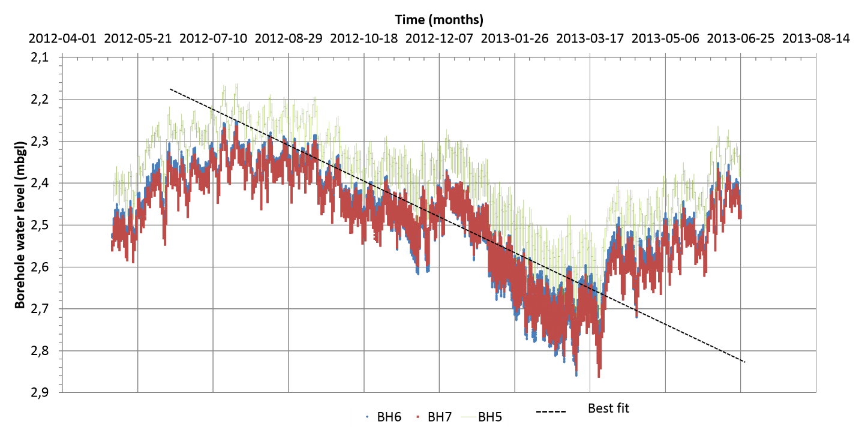
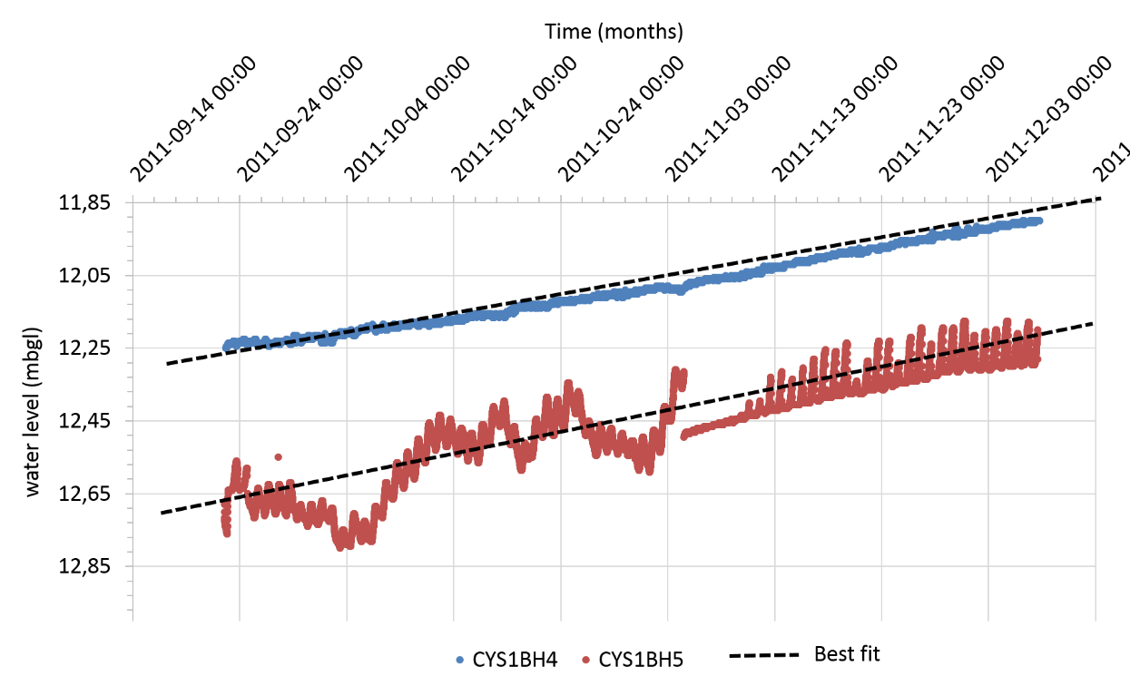

6. Change in groundwater storage
$∆S_{gw}=\frac{∆h}{∆t}AS_{y}$
$\frac{∆h}{∆t}$ = average rate of water level recession
$∆S_{gw}$ = water added or subtracted to or from storage,
$A$=drainage area of the aquifer (m²); and,
$S_{y}$ =dimensionless specific yield= ${dS}_{y}=αt→S_{y}=\frac{αt}{d}$

Slide 8
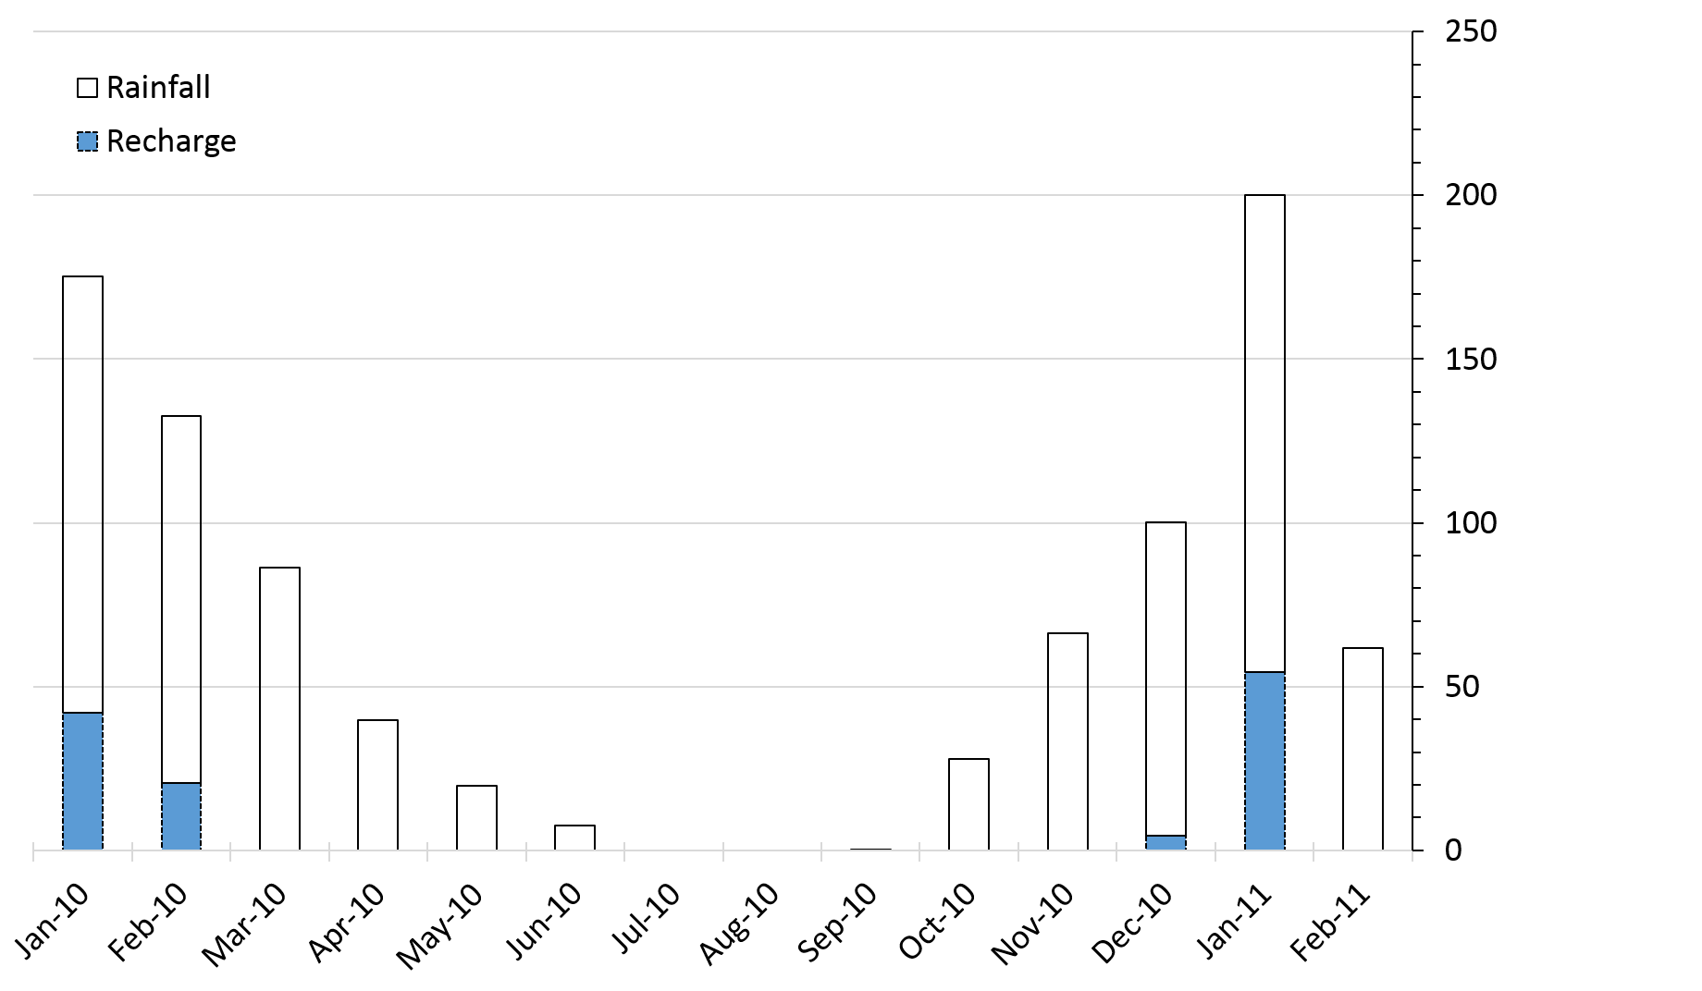
7. RESULTS
1. Evapotranspiration: 30.3Mm³/month.
2. Influx from terrestrial area aquifer: 235.68Mm³ (southeastern side) and 6.71Mm³ (northwestern side)
Change in Storage: -18087.15m³/month (southeastern side) and 5166.45m³/month (northwestern side)
Groundwater recharge:7.72mm

Slide 9
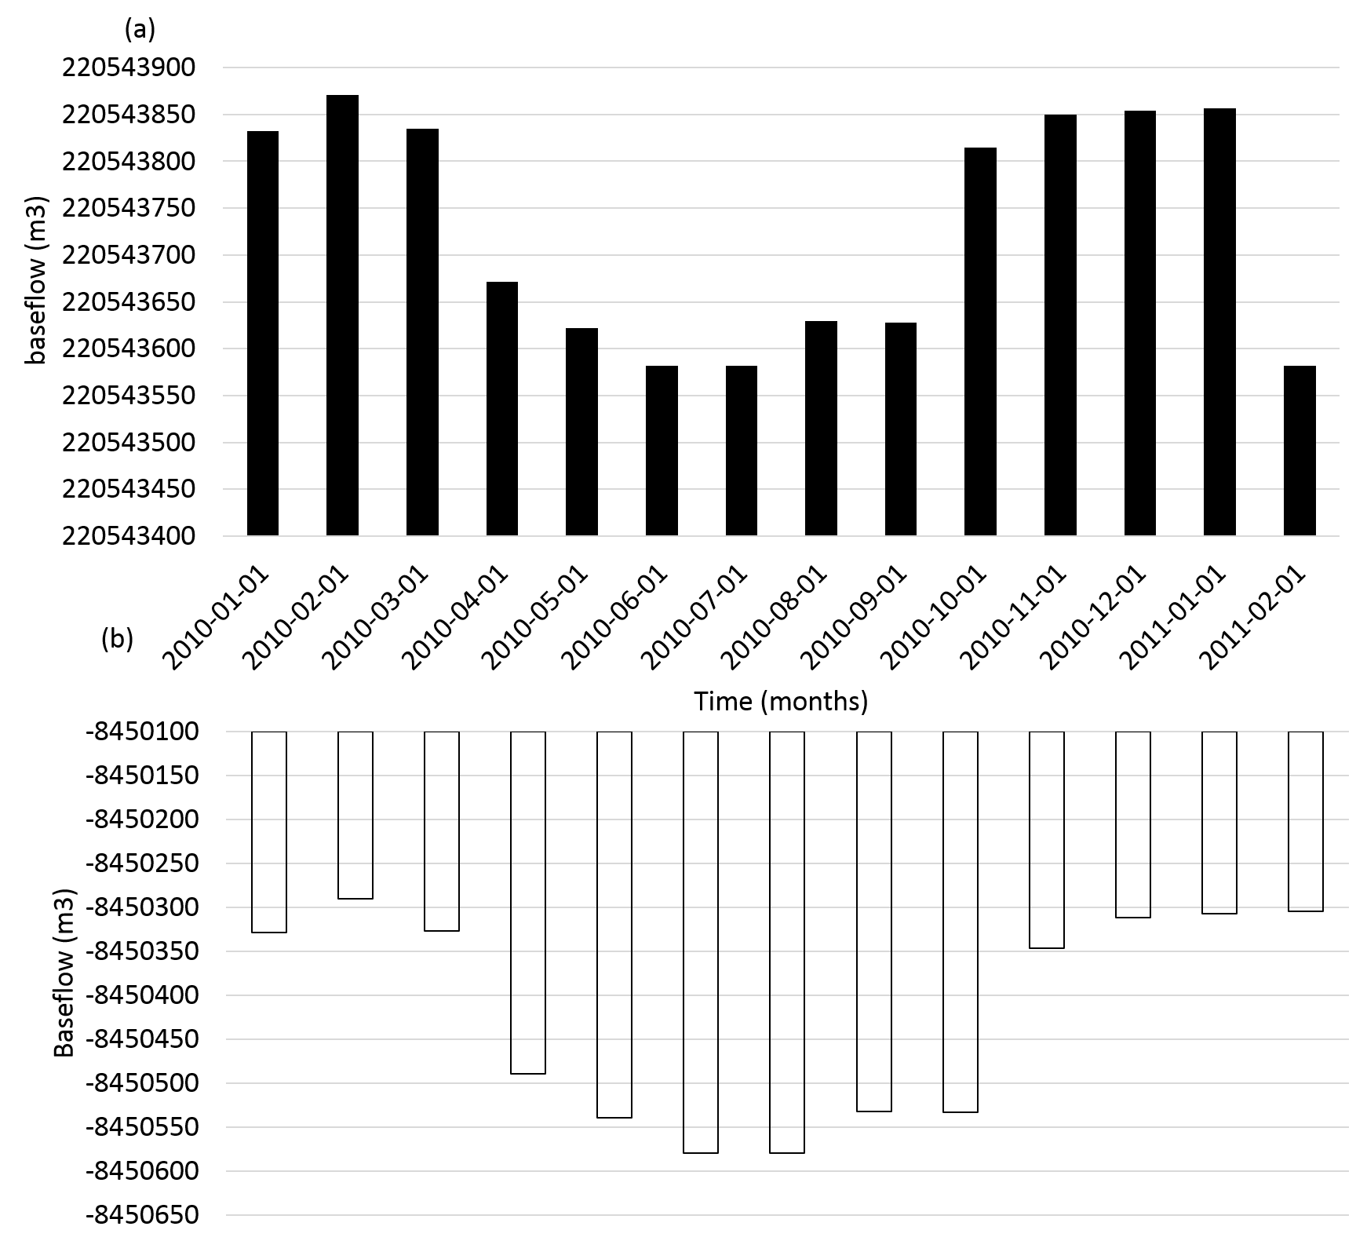
….. RESULTS
Groundwater–surface water exchange fluxes:
positive values = groundwater surplus/gaining stream.
negative values= groundwater deficit/ losing stream
For the southeastern, 220.54 Mm³/month
For the northwestern, -8.45 Mm³/month
Stream contribution= 212.09 Mm³/month

