Slide 1
Geotechnical Properties and
Foundation Requirements of the
Lunar Laser Ranger at
Matjiesfontein Space Geodesy Observatory
Susan Bothma¹, L Croukamp¹
1. Department of Civil Engineering, University of Stellenbosch

Slide 2

OUTLINE
What is an LLR?
Slope Stability Analysis
Geological Properties
Construction Risks

Slide 3
What is a LLR?
What is a Lunar Laser Ranger (LLR)?
An LLR measures the distance between the Earth and the Moon using a laser. The laser projects to a reflector placed on the moon during the Apollo era. The reflector reflects the light back to the receiver and uses the recorded travel time to calculate the distance.
The LLR needs to be very stable to:
Point at the exact location on the moon and
Ensure accurate measurements.
To ensure stability, the following need attention:
Geotechnical investigations such as slope stability and geology of the Matjiesfontein Space Geodesy Observatory (MGO) site,
Risks during construction

Slide 4
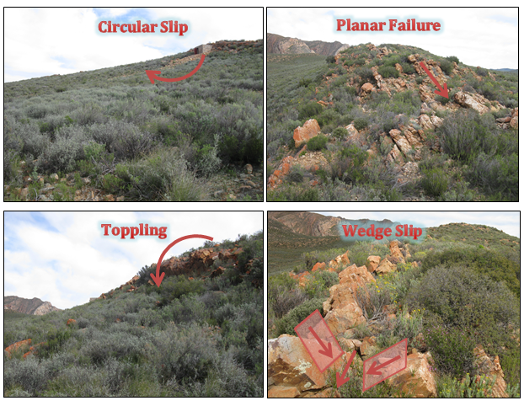
Slope Stability Analysis
To ensure that the ground on which the 7 ton LLR will be built is stable, a complete slope stability analysis needs to be done. The possible failures identified on the site were:

Slide 5
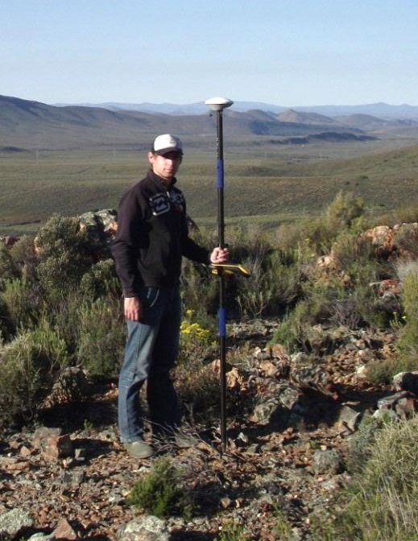
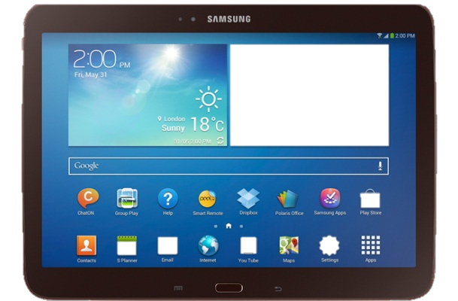
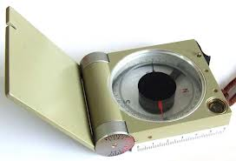

Slope Stability Analysis
GPS
Rocklogger Application
Breithaupt compass
To determine the safety, data were collected in various ways. GPS survey was done to create a 3D model of the site and to analyse circular slip. A joint survey was done in two ways, a Breithaupt compass or an Android application: Rocklogger from RockGecko. This was used to analyse wedge and planar failure.

Slide 6
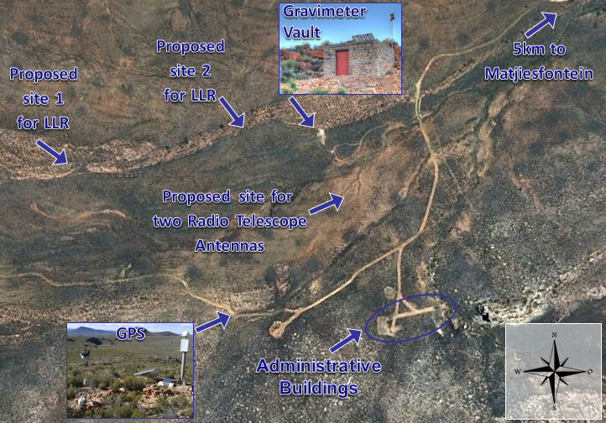
Slope Stability Analysis
Slope stability analyses have been done at the following places:
Gravimeter Vault site (Susan Bothma),
Proposed site 1 for LLR (Deon Visser) and
Administrative buildings (Guillaume de Swart).

Slide 7
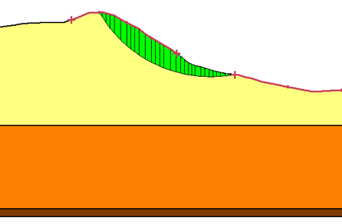
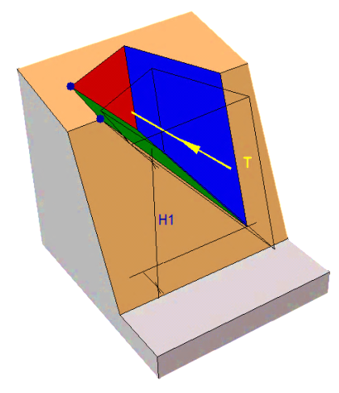
Slope Stability Analysis
Typical analysis of Circular- and Wedge-failure
Studies have determined that these areas are safe to
Circular slip,
Toppling and
Wedge failure.
The only instability that may occur on the site is possible planar failure.
A retaining wall was designed for the administrative buildings site. A cantilever retaining wall will be the best solution.

Slide 8
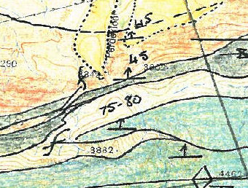
Geological Map
CPd – Dwyka formation
Cw – Waaipoort formation
Cf – Floriskraal formation
Ck – Kweekvlei formation
Dwi – Witpoort formation
CPd
Cw
Cw
Cw
Cf
Ck
Ck
Dwi
Ck
Dwi

Slide 9
Construction Risks
Possible risks that may occur during construction period:
Early thermal shrinkage,
Construction quality,
Subsurface geological and geotechnical conditions,
Site access,
Availability of resources,
Productivity of labour, labour disputes or strikes,
Damage to persons or property or
Security of site.
The main concern during construction is early thermal shrinkage. Early thermal shrinkage is an exothermal reaction due to the hydrations of cement. This causes variations of temperature within the concrete, which then leads to cracking.

Slide 10
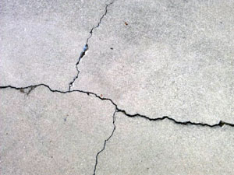
Construction Risks
Cracking as a Result of
Early Thermal Shrinkage
Possible risks that may occur during construction period:
Early thermal shrinkage,
Construction quality,
Subsurface geological and geotechnical conditions,
Site access,
Availability of resources,
Productivity of labour, labour disputes or strikes,
Damage to persons or property or
Security of site.
The main concern during construction is early thermal shrinkage. Early thermal shrinkage is an exothermal reaction due to the hydrations of cement. This causes variations of temperature within the concrete, which then leads to cracking.

Slide 11
Risks Management
Likelihood | Consequences
 | Insignificant (Minor problem easily handled by normal day to day processes) | Minor (Some disruption possible, e.g. damage equal to R5 million) | Moderate (Significant time/resources required, e.g. damage equal to R10 million) | Major (Operations severely damaged, e.g. damage equal to R100 million) | Catastrophic (Business survival is at risk, e.g. damage equal to R250 million)
Almost Certain (e.g. >90% chance) | High | High | Extreme | Extreme | Extreme
Likely (e.g. between 50% and 90% chance) | Moderate | High | High | Extreme | Extreme
Moderate (e.g. between 10% and 50% chance) | Low | Moderate | High | Extreme | Extreme
Unlikely (e.g. between 3% and 10% chance) | Low | Low | Moderate | High | Extreme
Rare (e.g. <3% chance) | Low | Low | Moderate | High | High

Slide 12
Acknowledgements
I would like to thank
Leon Croukamp,
Deon Visser,
Guillaume de Swart and
Inkaba yeAfrica.

Slide 13
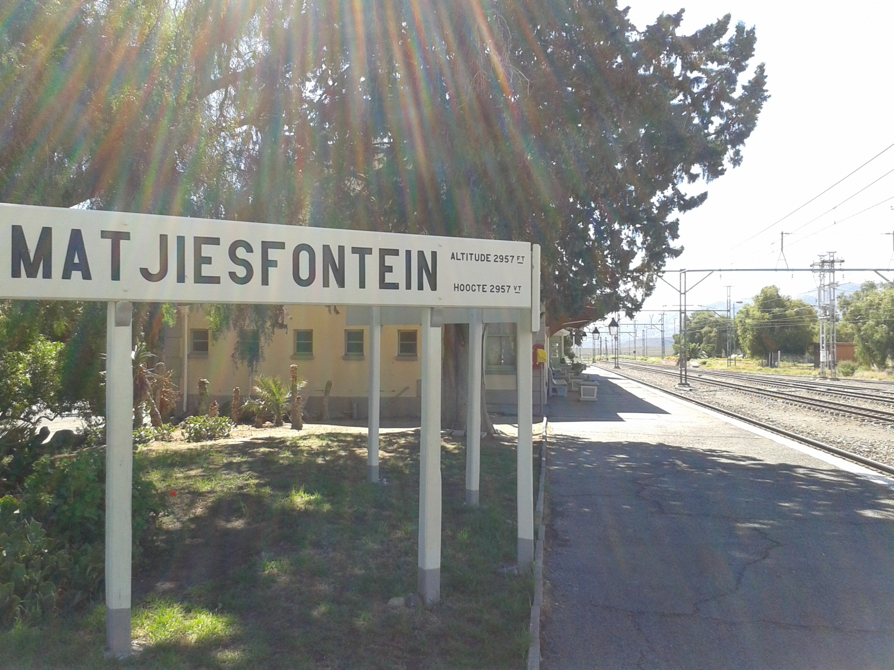
Questions?

