Slide 1


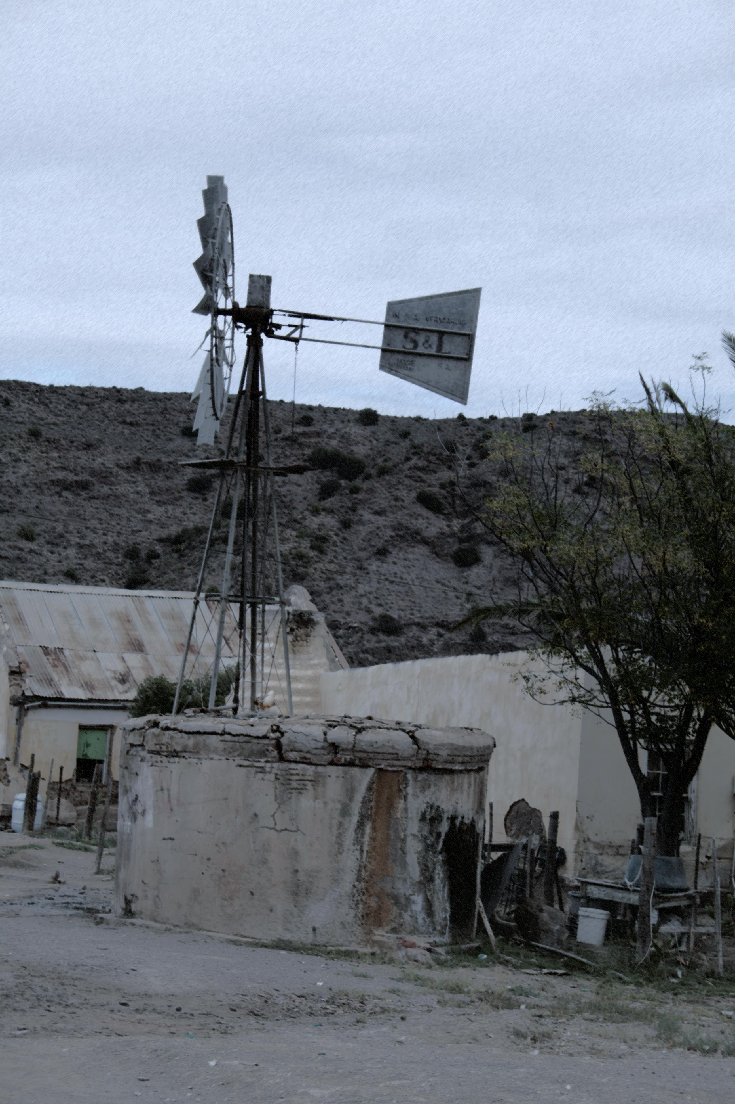

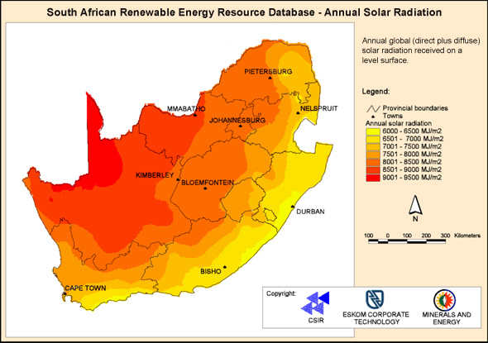
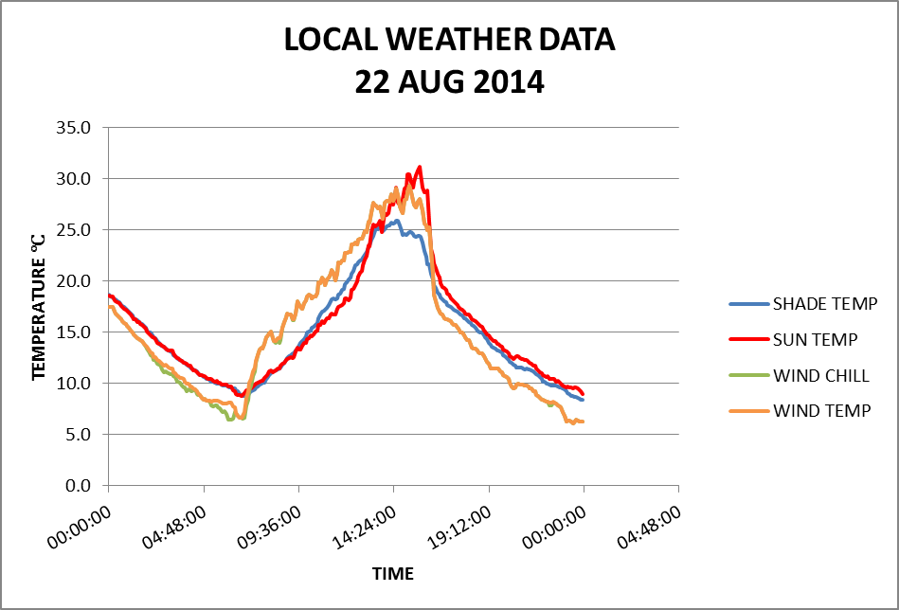
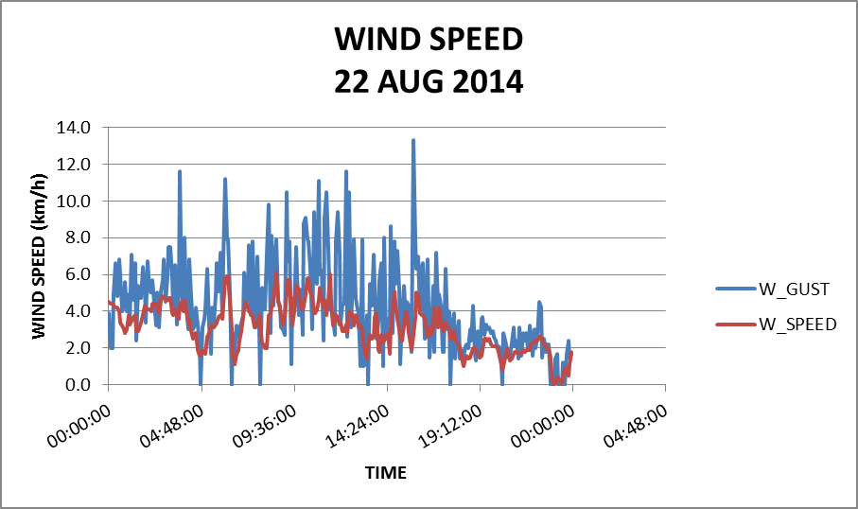
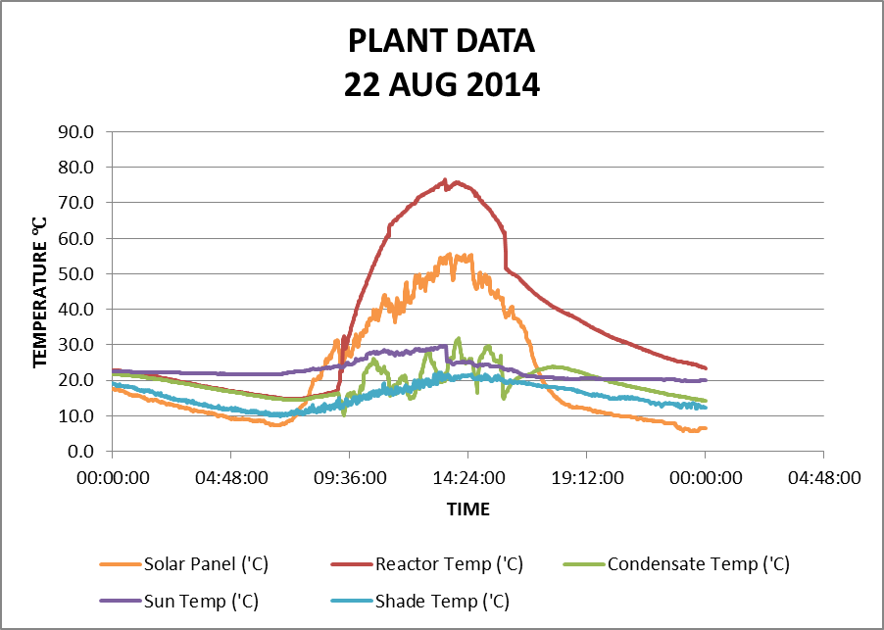
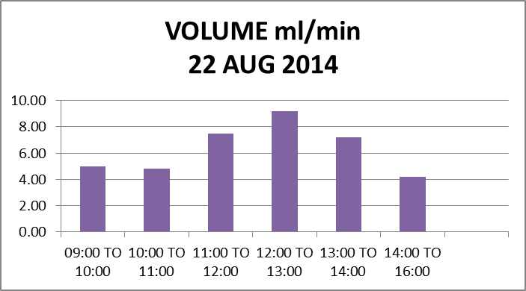
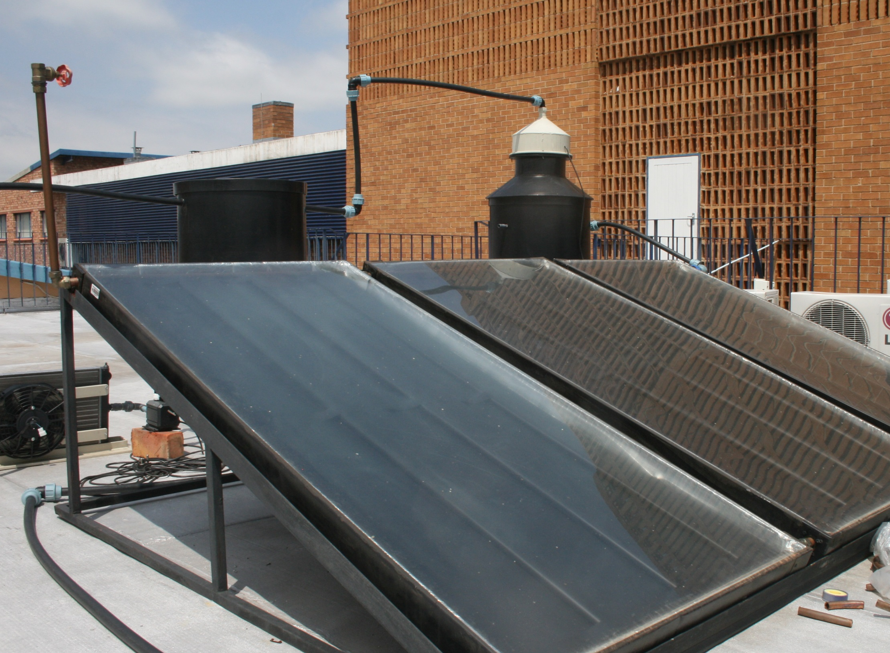



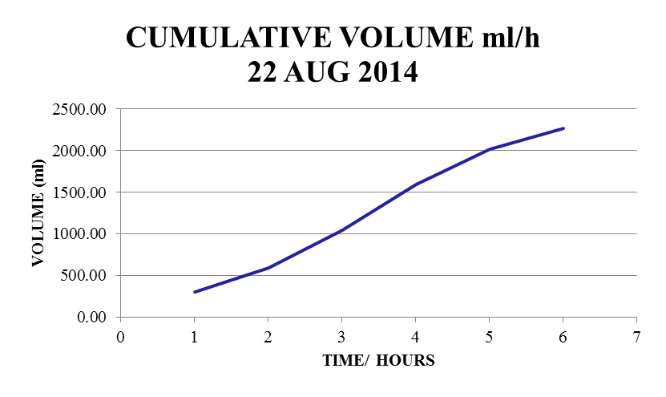
DEVELOPMENT OF A SOLAR DESALINATION PLANT
Earth Stewardship Science
Research Institute
DM van Tonder ¹, CJS Fourie ², J Maree ²
1. Department of Environmental, Water and Earth Sciences, Faculty of Science at Tshwane University of Technology, South Africa, danel.vtonder@gmail.com
Northwest University, South Africa
2. Department of Environmental, Water and Earth Sciences, Faculty of Science at Tshwane University of Technology, South Africa
Abstract
South Africa is considered a water scarce country with many parts of the country having limited access to water. Water quality is an additional stress affecting available water supply. In the semi-arid to arid regions of the country significant salt loading in groundwater occurs where anthropogenic influences can be excluded. Treatment of these water sources to potable levels requires desalination. The conventional desalination process requires large amounts of energy, either in the form of waste heat or grid electricity. Conventional grid electricity sources are not available in many rural areas in South Africa. However, many rural communities in South Africa that do not have reliable access to clean drinking water are situated in geographical areas where the annual solar radiation levels are high and where saline groundwater is available. The development of an economically viable groundwater desalination system utilizing solar energy in producing potable water for such communities is the focus of this study. The development and optimization of the solar distillation designs had to conform to the project goals of affordability, durability and performance in supplying sufficient volumes of drinking and cooking water, conforming to national health standards. For the above reasons, including societal pressures, there is a strong argument to use clean energy generation techniques to power desalination plants. The research method adopted was largely exploratory and adapted using the limited number of studies which have previously been conducted on renewable energy and desalination pairings in the South African context but also extensive review of studies conducted internationally.
  Introduction
  Over 97 % of the world’s water is seawater. Less than 0.9 % of the Earth’s water resources are available as fresh water for direct human consumption, agriculture and industrial uses. Renewable fresh water resources remain constant whereas the demand for water increases. In South Africa a large percentage of those without access to clean water live in rural arid to semi-arid areas. The scarcity of water is, however, exacerbated by poor water quality of the surface- and ground-water resources. Many rural communities in South Africa that do not have reliable access to clean drinking water are situated in semi-arid to arid regions of the country where groundwater have significant salt loading (Figure 1). These geographical areas, however, have high levels of annual solar radiation (Figures 2) (Northern Cape, Karoo).
Methodology for evaluating the desalination plant
The prototype of the solar desalination plant was set-up at the outdoor testing laboratory of the Arcadia campus of TUT, Pretoria.
The experimental set-up included:
the solar desalination prototype (evaporation tank/ reactor, condensation tank, PV panels, 12V circulation pumps and extraction fan)
PT100 temperature probes for different points of operation of the system (evaporation tank/ reactor, condensation tank, PV panels, sun and shade) with a data logger set at measurements at 1min intervals
A weather station for measurements of ambient conditions set at a recording interval of 5min
The plant temperature profile as well as ambient conditions (sun and shade temperature, wind speed, wind direction, wind chill temperature as well as rainfall) were recorded for a typical winter’s day.
Volume of product water and visual inspection of the system was conducted at hourly intervals
Water quality measurements (eC and pH) were recorded at hourly intervals throughout the day
Data from the data logger and weather station were downloaded daily and stored in Excel format together with the product water parameters
  Salinity
  Salinity refers to the total dissolved non-toxic inorganic compounds in the water - measured by total dissolved solids (TDS) and electrical conductivity (eC). Electrical conductivity is measured in mS/cm and is related to TDS. TDS is defined as all dissolved compounds within water that carry an electrical charge. Salinity is reflected by: Na, Ca, Mg, SO₄, Cl and K. Humans tolerate moderate salinity (TDS) <1 000 mg/l. At TDS levels higher than 3 000 mg/l fatal intestinal and renal damage may occur. High salt content also has a negative aesthetic effect on drinking water (bad taste).
Desalination technologies
Treatment of highly saline, ie. brackish water sources to potable levels requires desalination. Two main groups of desalination technologies exist: ie. thermal technologies and membrane technologies (Reverse osmosis (RO)). The conventional desalination process requires large amounts of energy, either in the form of waste heat or grid electricity. Conventional grid electricity sources are not available in many rural areas in South Africa.
Most areas in South Africa average more than 2 500 hours of sunshine per year, and average solar radiation levels range between 4.5 and 6.5kWh/m² in one day. Solar radiation, range from the lowest in KwaZulu-Natal province to the highest in the Northern Cape and Limpopo provinces (Figure 2). Solar energy may be used to supply the required energy for a desalination process either in the form of thermal energy or electricity.
Currently the simple solar still is the only solar thermal desalination technology which were attempted at remote rural communities near Ladysmith in Klein Karoo. Unfortunately these facilities fell in disrepair less than ten years after initiation. The maximum production rate per still was l/d (Goldie et al., 2003). A more recent technology development for grey water showed a delivery rate of 3.07ml/min and a predicted rate of 3.48ml/min (Hatwig, 2013).
Figure 1: Map indicating the TDS South Africa (http://soer.deat.gov.za)
Figure 2: South Africa solar radiation potential (http://www.sabregen.co.za/)
Preliminary results and discussion
The data presented here is for a typical late winter’s day and is representative of several weeks’ data during August 2014. Figure 4 and Figure 5 shows the ambient conditions measured for a typical late winter’s day with sun temperatures reaching a high of 30℃ around 15:30. The wind chill temperatures were slightly higher than the sun temperature before mid-day and lower after 15:30.
Figure 6 represents the temperature profiles for different points of operation of the system for a typical winter’s day measured by PT100 temperature probes (solar panel, sun, shade, evaporation tank/ reactor, condensation tank). The dip in some of the temperature readings occurred due to visual inspection of the system. Temperatures in the condensation tank in particular shows a toothcomb pattern which is related to the frequent removal of the produced distillate for various measurements. There is good correspondence between the highest temperatures in the evaporation tank and that of the ambient temperatures measured by the weather station. The maximum evaporation tank temperatures (above 60 ℃) reached between 11:00 and 16:00 correspond to the ambient temperature between 20 and 30 ℃ for the same period.
Note that the temperature in the evaporation tank lags the temperature of the PV panel up to around 09:30 after which the evaporation tank’s temperature rise steadily to a maximum temperature around 80 ℃ between 13:30 and 14:00. The initial warm-up period (up to 9:00) is required for the steady state conditions to be reached in the solar panels before the circulation pumps are activated. The warm-up time required to heat the ~50ℓ saline water is relatively short with temperatures rising to 30℃ within 15minutes and 60℃ within 120minutes after circulation pumps were activated. A similar pattern is reflected in the cooling-down period, after the circulation pumps have been switched-off around 16:00, with the PV panel temperature decreasing steadily but the evaporation tank temperature showing a more dramatic drop in temperature. Some temperature changes observed in the evaporation tank corresponds to an increased wind speed and decrease in ambient temperature, although there is a few minutes time lag.
The initial volumes of distillate produced will also be low as most of the heat required for evaporation is taken from the water itself. To maintain the water temperature heat must be supplied. For molecules of a liquid to evaporate, they must be located near the surface and have sufficient kinetic energy to overcome liquid-phase intermolecular forces. Only a small proportion of the molecules meet these criteria, so the rate of evaporation is limited. Since the kinetic energy of a molecule is proportional to its temperature, evaporation proceeds more quickly at higher temperatures. As the faster-moving molecules escape, the remaining molecules have lower average kinetic energy, and the temperature of the liquid, thus, decreases. Energy is used to break the bonds that hold water molecules together, which is why water easily evaporates at the boiling point (~ 100° C) but evaporates much more slowly at the freezing point. Net evaporation occurs when the rate of evaporation exceeds the rate of condensation. A state of saturation exists when these two process rates are equal, at which point the relative humidity of the air is 100 percent. Condensation, the opposite of evaporation, occurs when saturated air is cooled below the dew point (the temperature to which air must be cooled at a constant pressure for it to become fully saturated with water). The process of evaporation removes heat from the environment.
Water volumes for the extracted condensate in the condensation tank and condensate captured in the outer rim of the evaporation tank were combined for calculations. The flow rate is measured after the initial warm up period. The average flow rates of the experimental data sets after the steady state conditions are reached is 6.27ml/min with the maximum production rate of 9.17ml/min reached between 12:00 and 13:00 (Figure 7). The minimum production rate for the day was 2.78ml/min. 65% of the daily desalinated water production is produced from 11:00 to 14:00. Although the evaporation tank temperature is still above 60 ℃ up to 16:00, there is a sharp drop in the production rate after 14:00. The average production rate of 6.31ml/min for a typical winter’s day compares favourably with the 3.07ml/min recorded by Hatwig (2013). The production rate is highest in mid-day (12:00 to 13:00) with 550ml/h or 9.17ml/min produced.
Although the current experimental setup was for ordinary tap water, the electrical conductivity (eC) representing the water quality was found to increase from 0.33 mS/cm to 0.04mS/cm during the day, with the best quality water being produced in late afternoon (not shown here). The ph varied between 8.40 and 9.20 throughout the day (not shown here).
Figure 4: Typical winter’s day weather data
Figure 5: Typical winter’s day wind data
Problem statement
Large areas of South Africa are heavily dependent on borehole water. In many rural and agricultural areas the access to borehole water has the added constraint in that water has a high salt concentration. However, many rural communities in South Africa that do not have reliable access to clean drinking water are situated in geographical areas where the annual solar radiation levels are high and where saline groundwater is available.
Current water treatment technologies are energy intensive. Cost effective water desalination options for rural areas has not been investigated in adequate detail. Solar distillation is inherently an electricity-free technology for production of drinking water and water for livestock which has not been tested sufficiently in the arid regions of South Africa.
Figure 6: Typical winter’s day plant data
Figure 7: Typical winter’s day production rate (ml/min)
Research aim
This paper reports on the ongoing development of a solar thermal driven, modular stand-alone desalination system adapted for the local South African conditions. The objective was to develop a system which is completely driven by solar energy which is low maintenance and easy to operate. The main aim of the study was to develop and evaluate the effectiveness of a new solar powered desalination technology, with a configuration not found in literature, to supply safe water to remote rural communities.
Figure 8: Typical winter’s day cumulative production rate
Development of the prototype
Solar desalination systems require adaptation to local conditions such as water demand, ground water quality, ambient conditions, access to maintenance material, level of education and socio-economic conditions of the selected community. The design therefore had to be rugged to withstand outdoor use, and minimal supervision and maintenance. The system needed to be scalable to be easily up-gradable depending on the output volume required. Since the system is intended for remote rural areas only solar energy would be utilized with no external electrical requirements for any components.
To achieve these goals a solar desalination technique with a configuration not found in literature were developed. The design therefore represents a new configuration for a small scale modular solar desalination system adapted for the local South African conditions.
Simplification of the solar-assisted distillation design involves a temperature rise in the water due to absorbed solar energy in the solar panels and subsequent heat transfer to the water in the evaporation tank; in turn the heated water evaporates at the air-water interface which increases the humidity of the air, the humid air is cooled to condense as clean, ie desalinated water. The solar panels have been assembled in an array which face north and is inclined at 23.5 degrees to compensate for the ecliptic inclination (Figure 3). This will make sure that the solar radiation entrance angle will be perpendicular in summer and will be optimal on the solar panels for most of the year to ensure maximum transfer of radiation into the system.
The feed water inlet allows for water to enter the evaporation tank at ambient temperature and is heated by the PV panel fluid which circulates through copper coils inside the evaporation tank. The heat exchanged to the saline water will heat the water to between 60℃ and 80℃ in winter months resulting in evaporation and steam formation. The design is currently a dome-shaped roof housing an extractor fan which assists in extracting the steam from the evaporation tank and feeding into a condensation tank where the steam is cooled down and allowed to condensate in copper coils inside a 50 liter condensation tank with circulating cooling water. The PV panel fluid is recirculated from the evaporation tank coils into the PV circuit and the heat is recovered for the system. Heat of evaporation is removed from the brine and the brine temperature will decrease. However, since the PV circuit continuously replaces the heat the process of evaporation can continue uninterrupted.
Parameters affecting the output
The productivity of a solar desalination plant is affected by ambient, operating and design conditions. In this instance the ambient conditions include ambient temperature, solar insolation, and wind velocity and wind chill temperature. Operating conditions comprise water depth, orientation of the solar panels and feed water temperature, etc.
Future work
Evaluation of production rate with modifications : water depth, increased surface area
Application to highly saline water sources
Development of an economic evaluation model
Figure 3: Solar desalination plant set-up

