Slide 1
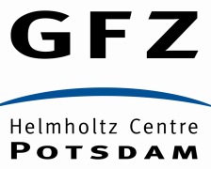
Evolving stress patterns across southern Africa since the end of Gondwana: puzzling clues to the seismicity of South Africa
MAG Andreoli^{1, 2}, A Bumby³, Z Ben-Avraham^{4, 5}, D Delvaux De Fenffe^{2, 6}, M De Wit³, R Durrheim^{7,2}, A Fagereng⁸, AO Heidbach⁸,
M Hodge⁸, A Logue^{1,8}, H Malephane², N v d Merwe², J Muoka²,
C Northcote³, K Saalmann², I Saunders¹⁰, K Tabola³ and many others…
1. Necsa, South Africa; 2. School of Geosciences, University of the Witwatersrand, South Africa; 3. University of Pretoria, South Africa; 4. Tel Aviv University, Israel; 5. University of Haifa, Israel; 6. Royal Museum for Central Africa, Belgium; 7. CSIR, South Africa; 8. University of Cape Town, South Africa; 9. GFZ Potsdam, Germany; 10. Council for Geoscience, South Africa

Slide 2
To get a grip on seismicity: must have a finite elements geodynamic model. Input data are many:
Lateral variations in the gravitational potential energy of the lithosphere - function of:
density (non-flatness)
heat flow
crustal thickness
Ridge push by surrounding ridges (strong in S Africa)
Trench pull (weak in S Africa)
Mantle flow traction vs. drag (basal traction term @ 100km): function of
Difference between velocities of lithosphere vs. convecting mantle
Viscosity asthenosphere
Eastward Rotation rate of East African Rift
Southward Propagation rate of East African Rift
Absolute Plate Motions (up to 4 different global frames).
Changes in plate boundaries
Interaction between moving plate and stationary geoid
Actual stress measurements/orientations taken in space and time

Slide 3
Vaalputs
Cretaceous Period
(Why Vaalputs?)

Slide 4
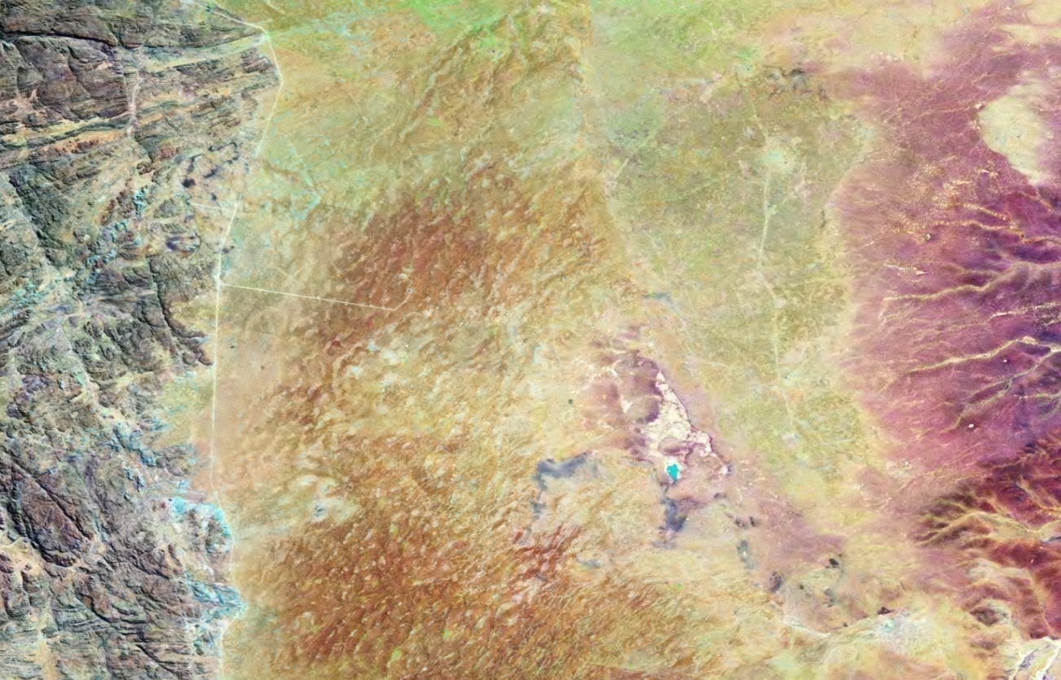
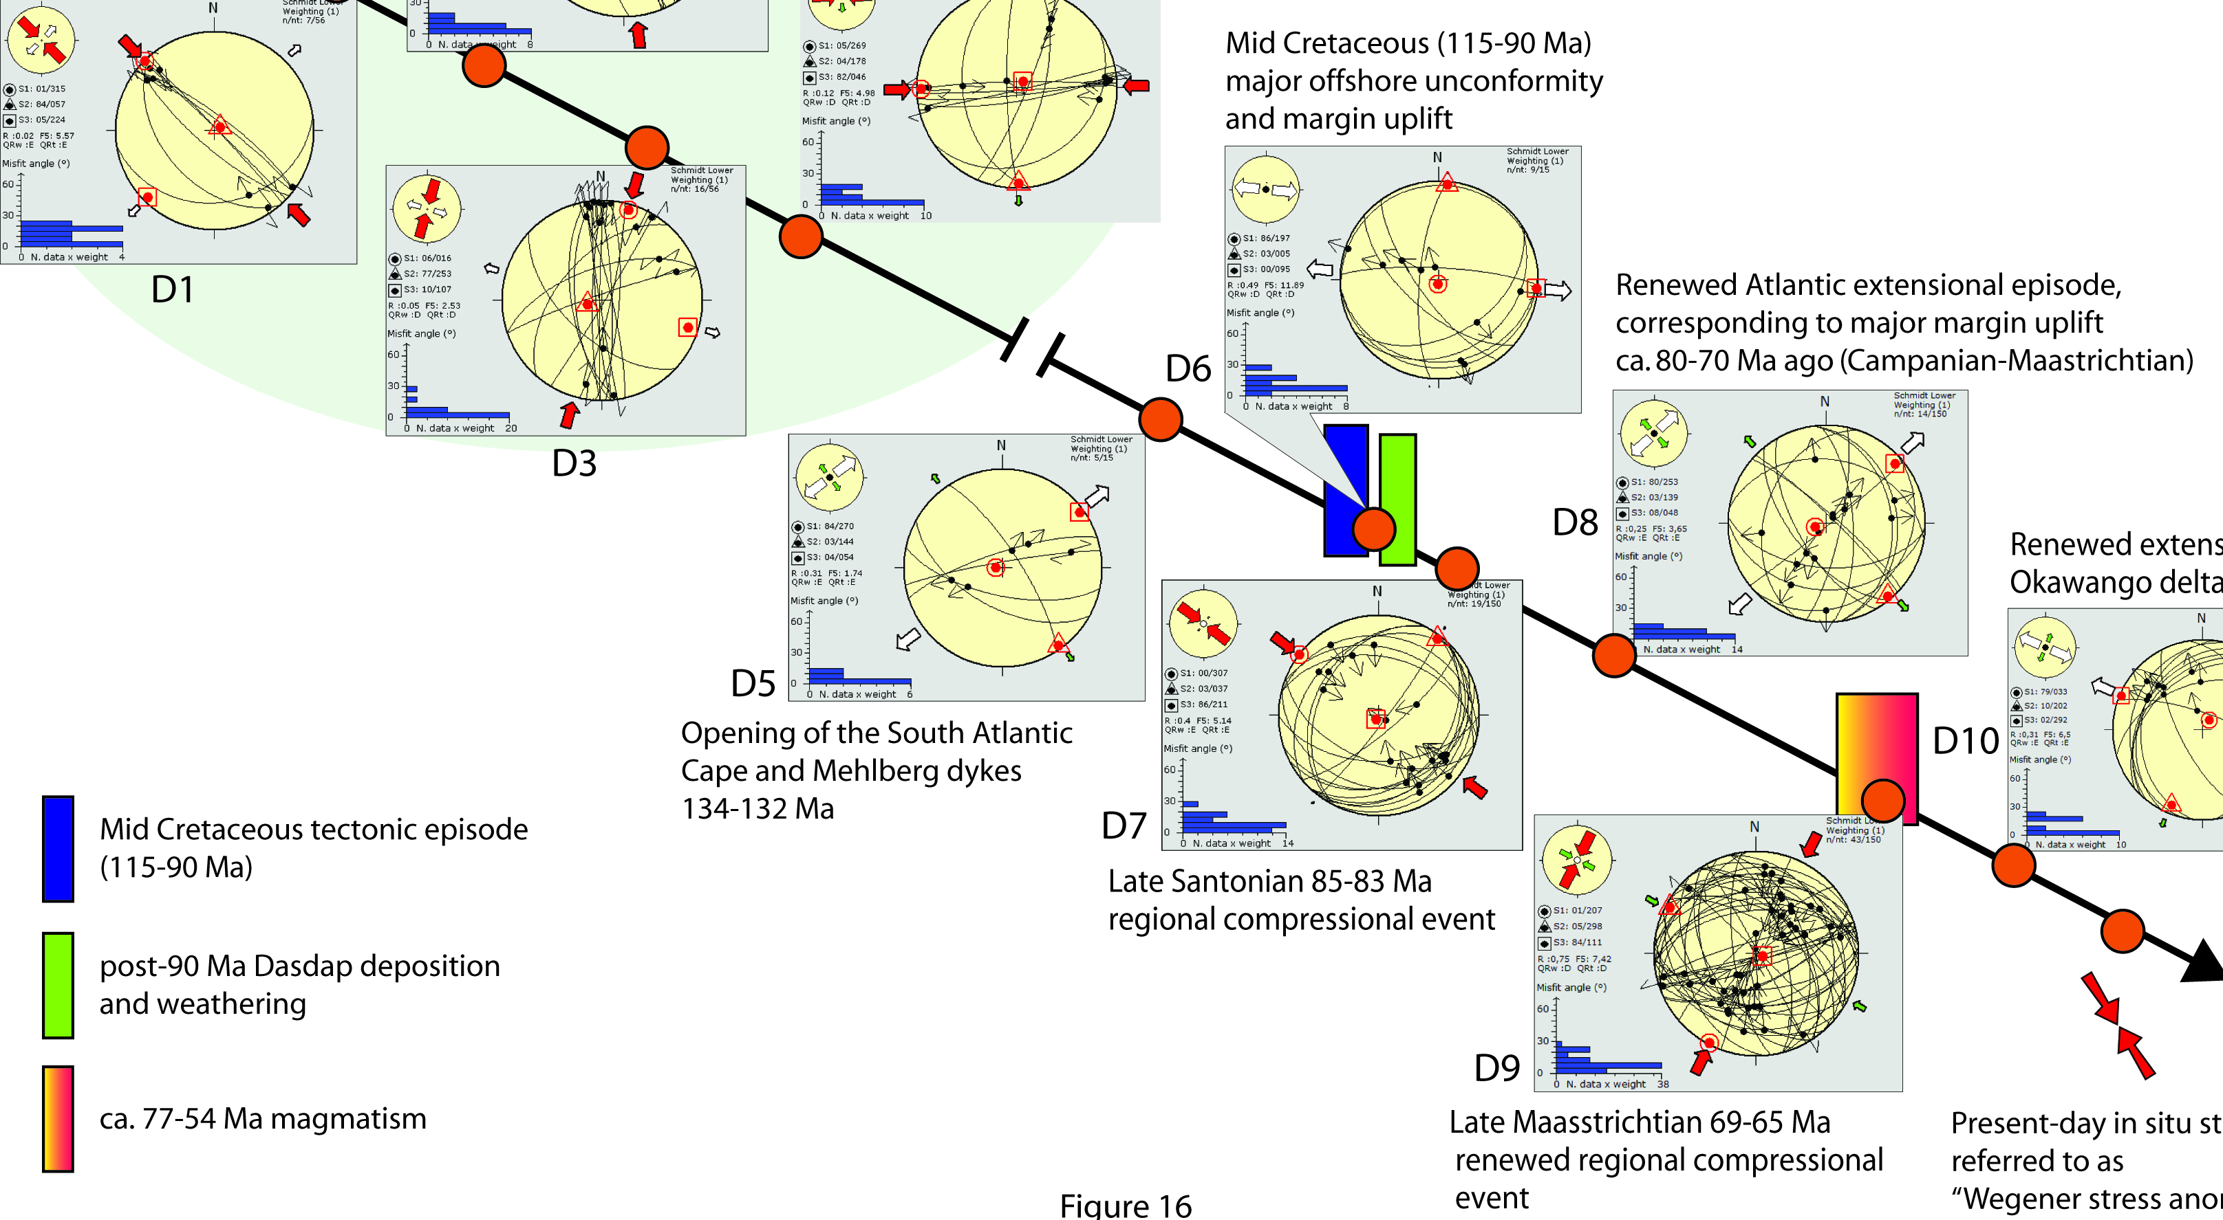
The 5 stress regimes of Vaalputs

Slide 5
Cenozoic Era
1 Extensional episode at Vaalputs…..
(precise age unknown)
Vaalputs
Santab, Koffiemeul

Slide 6
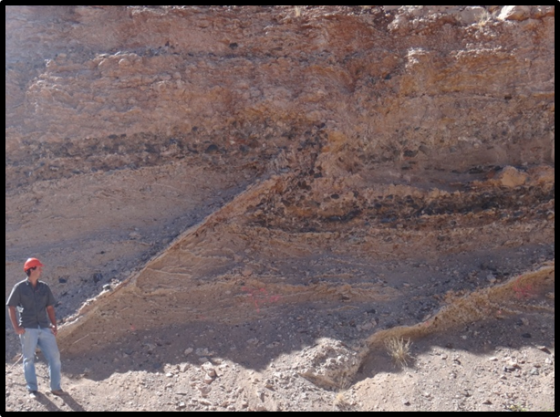
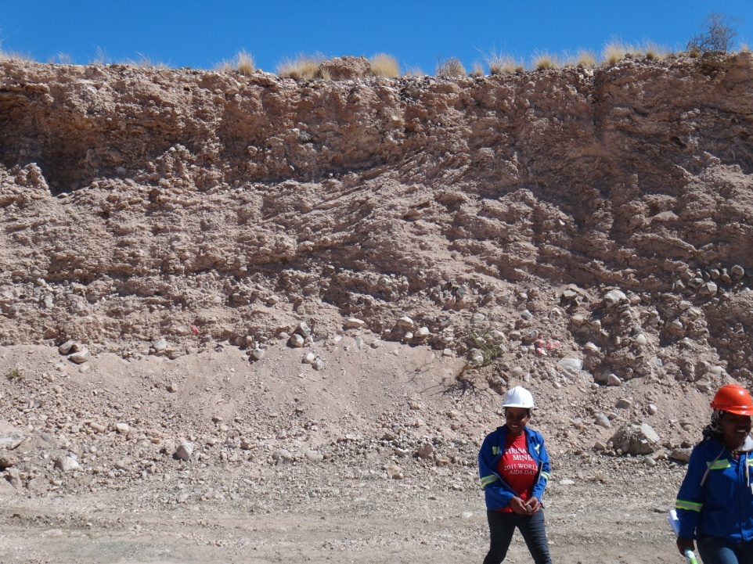
Yet a thrusting stress regime SW of Douglas
(and it is on craton)
Douglas
Rockwell diamond mine

Slide 7
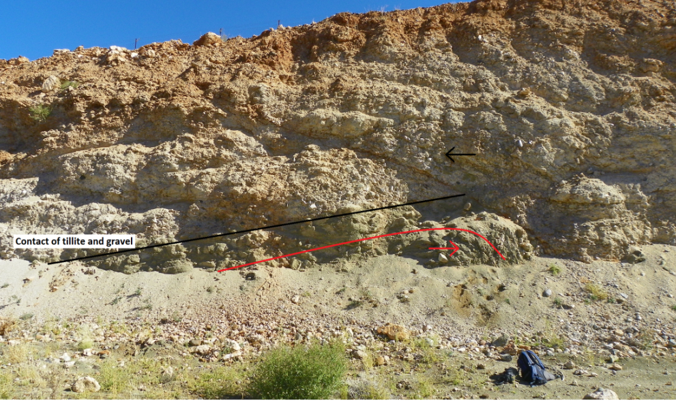
More thrusts in the open cast trenches, and tight
folding too…Windsorton? Formation
(SACS, 1980)
SE-verging thrust &
NW-verging overturned
fold in Dwyka
Folds/faults in all terraces (1020 to 985 m ) above Orange River bed (~942 m)
=
~1010-1013
~1000

Slide 8
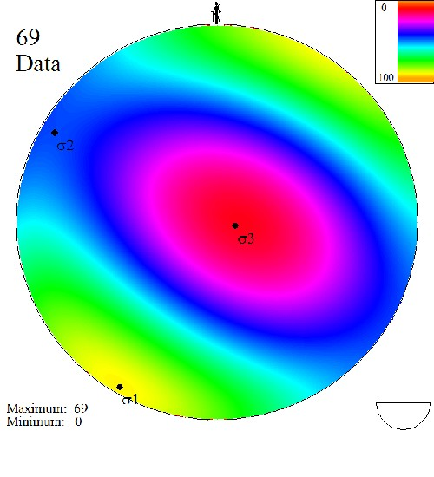
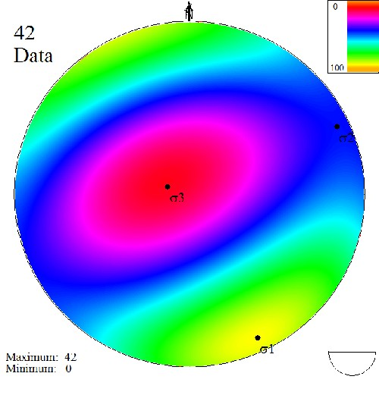
Structural orientations at Rockwell Operations
Elevation of lowest terrace where σ₁ strikes NE-SW: 985 m
Elevation of lowest terrace where σ₁ strikes NW-SE: 1000m.
Principal stress components calculated from field measurements;
Lower hemisphere projection

Slide 9
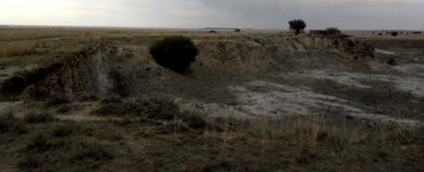
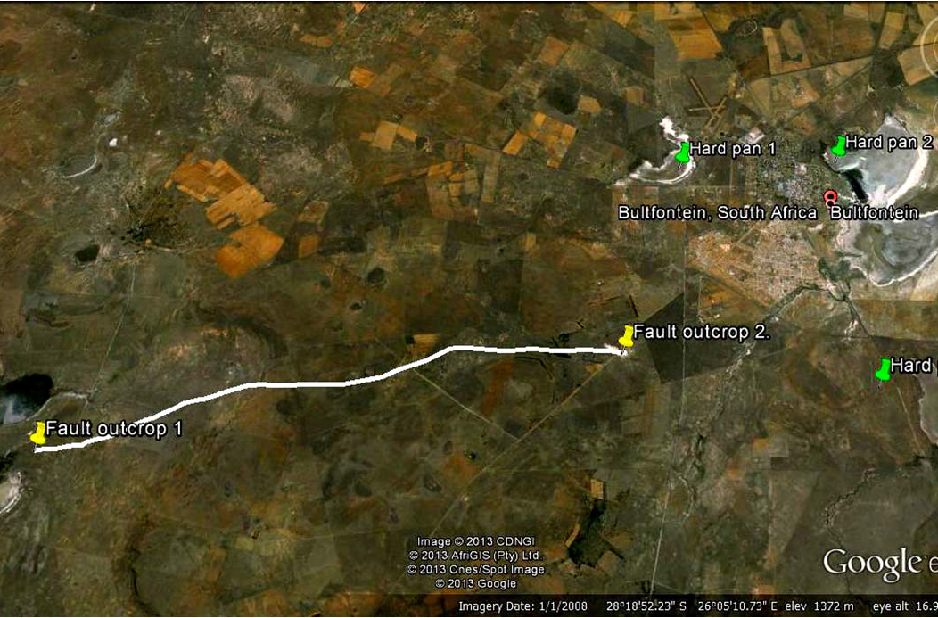
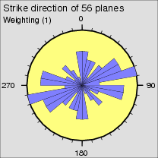
More thrusts on craton: Bultfontein quarry
(Free State)
“A”
“A”
Note higher elevation of up-thrusted block “A”(right)
Bultfontein
Quarry
Bultfontein, FS

Slide 10
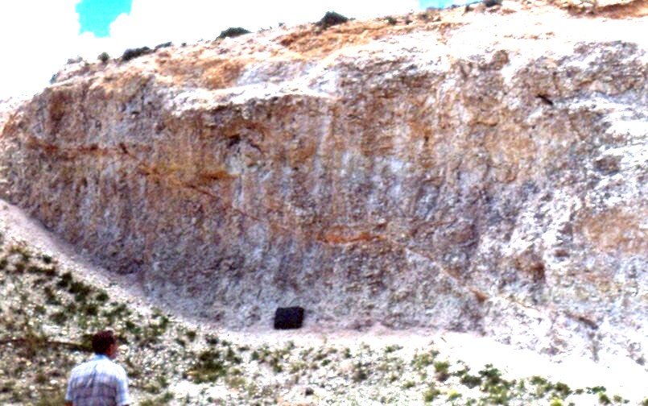
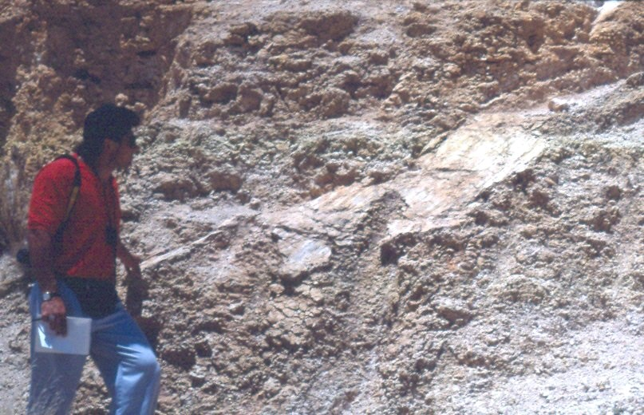
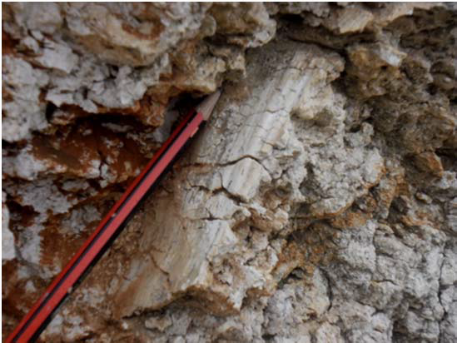
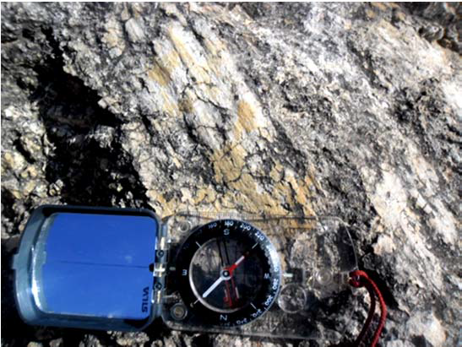
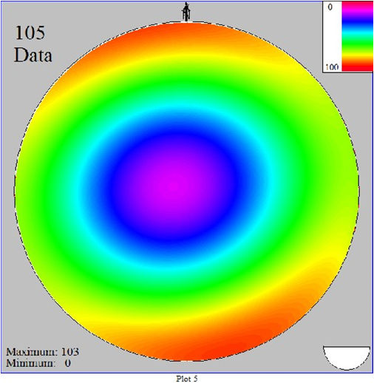
Thrust and slickensided faults, Bultfontein calcrete
Note the strike length, inconsistent with a calcrete swelling origin
“Block A”

Slide 11
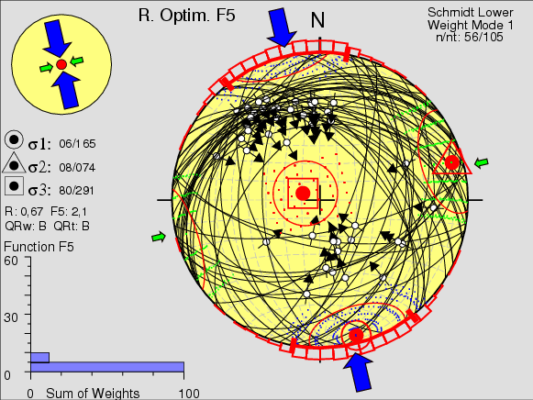
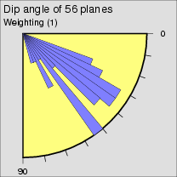
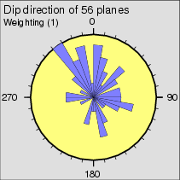
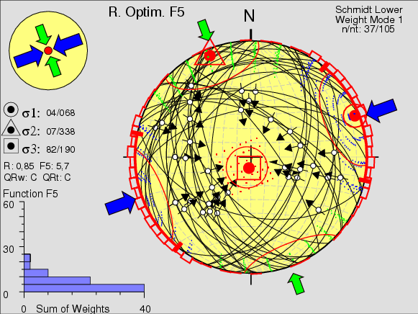
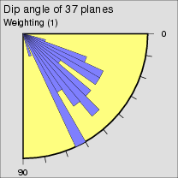
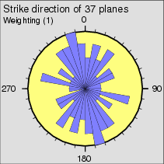
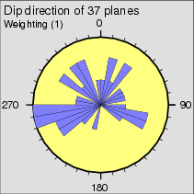
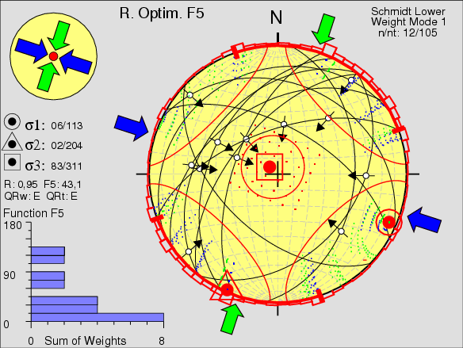
56 “tectonic” data
37 “swelling” data
12 remaining data

Slide 12
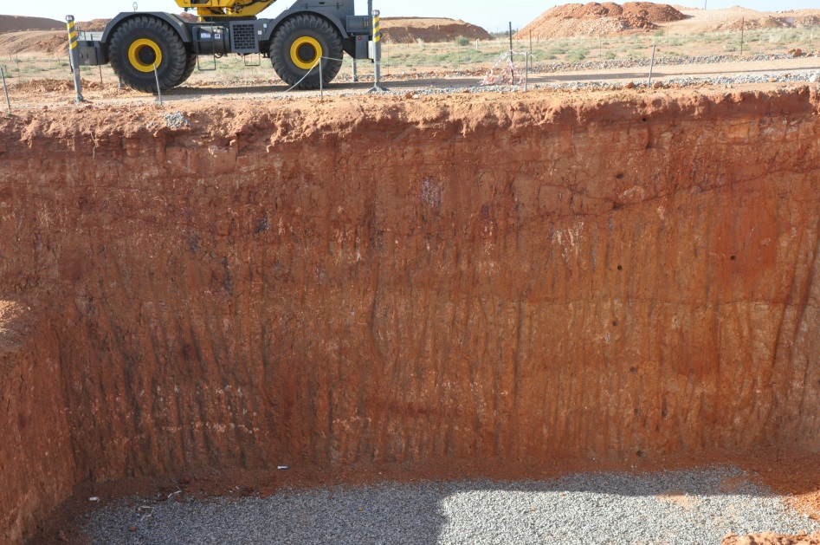
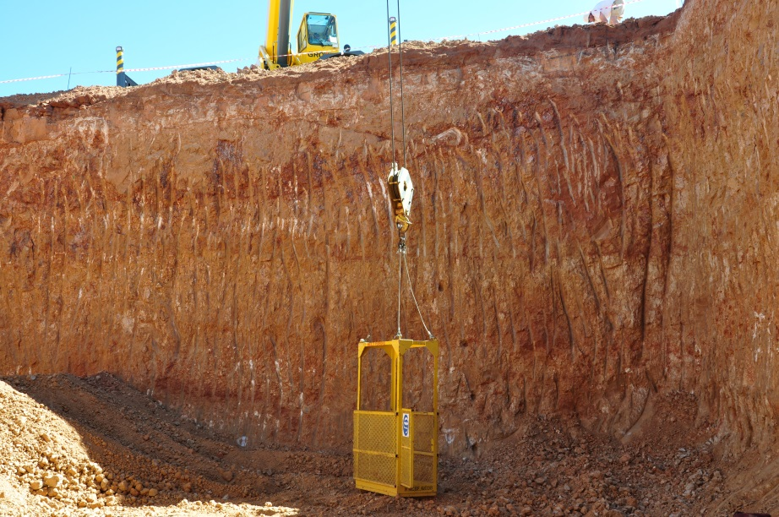
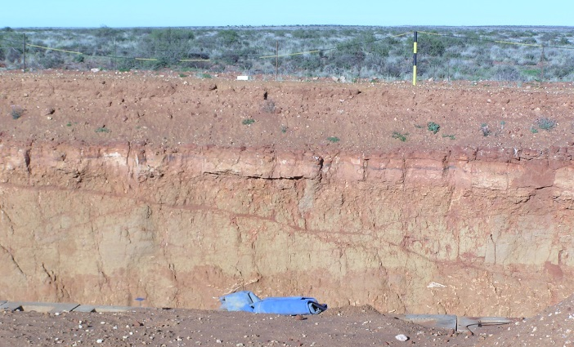
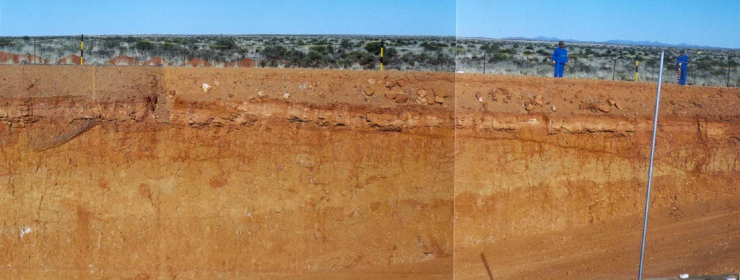
Plio-Pleistocene Epoch
Shortening direction (sigma 1): ~NW-SE

Slide 13
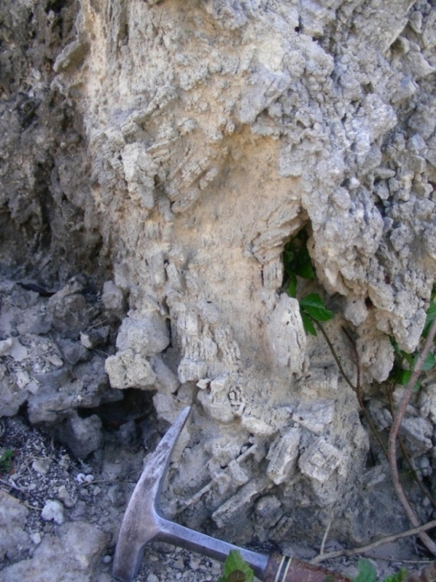
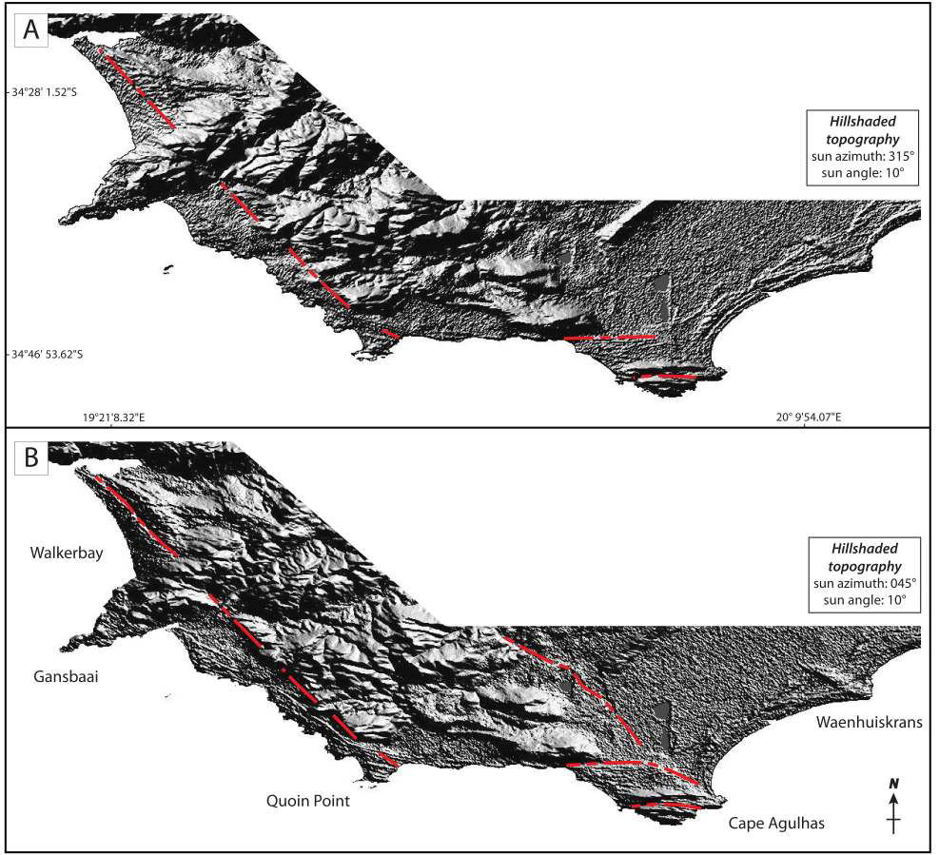
Plio-Pleistocene Blomerus Normal Fault, S Cape
Gansbaai – S Cape

Slide 14
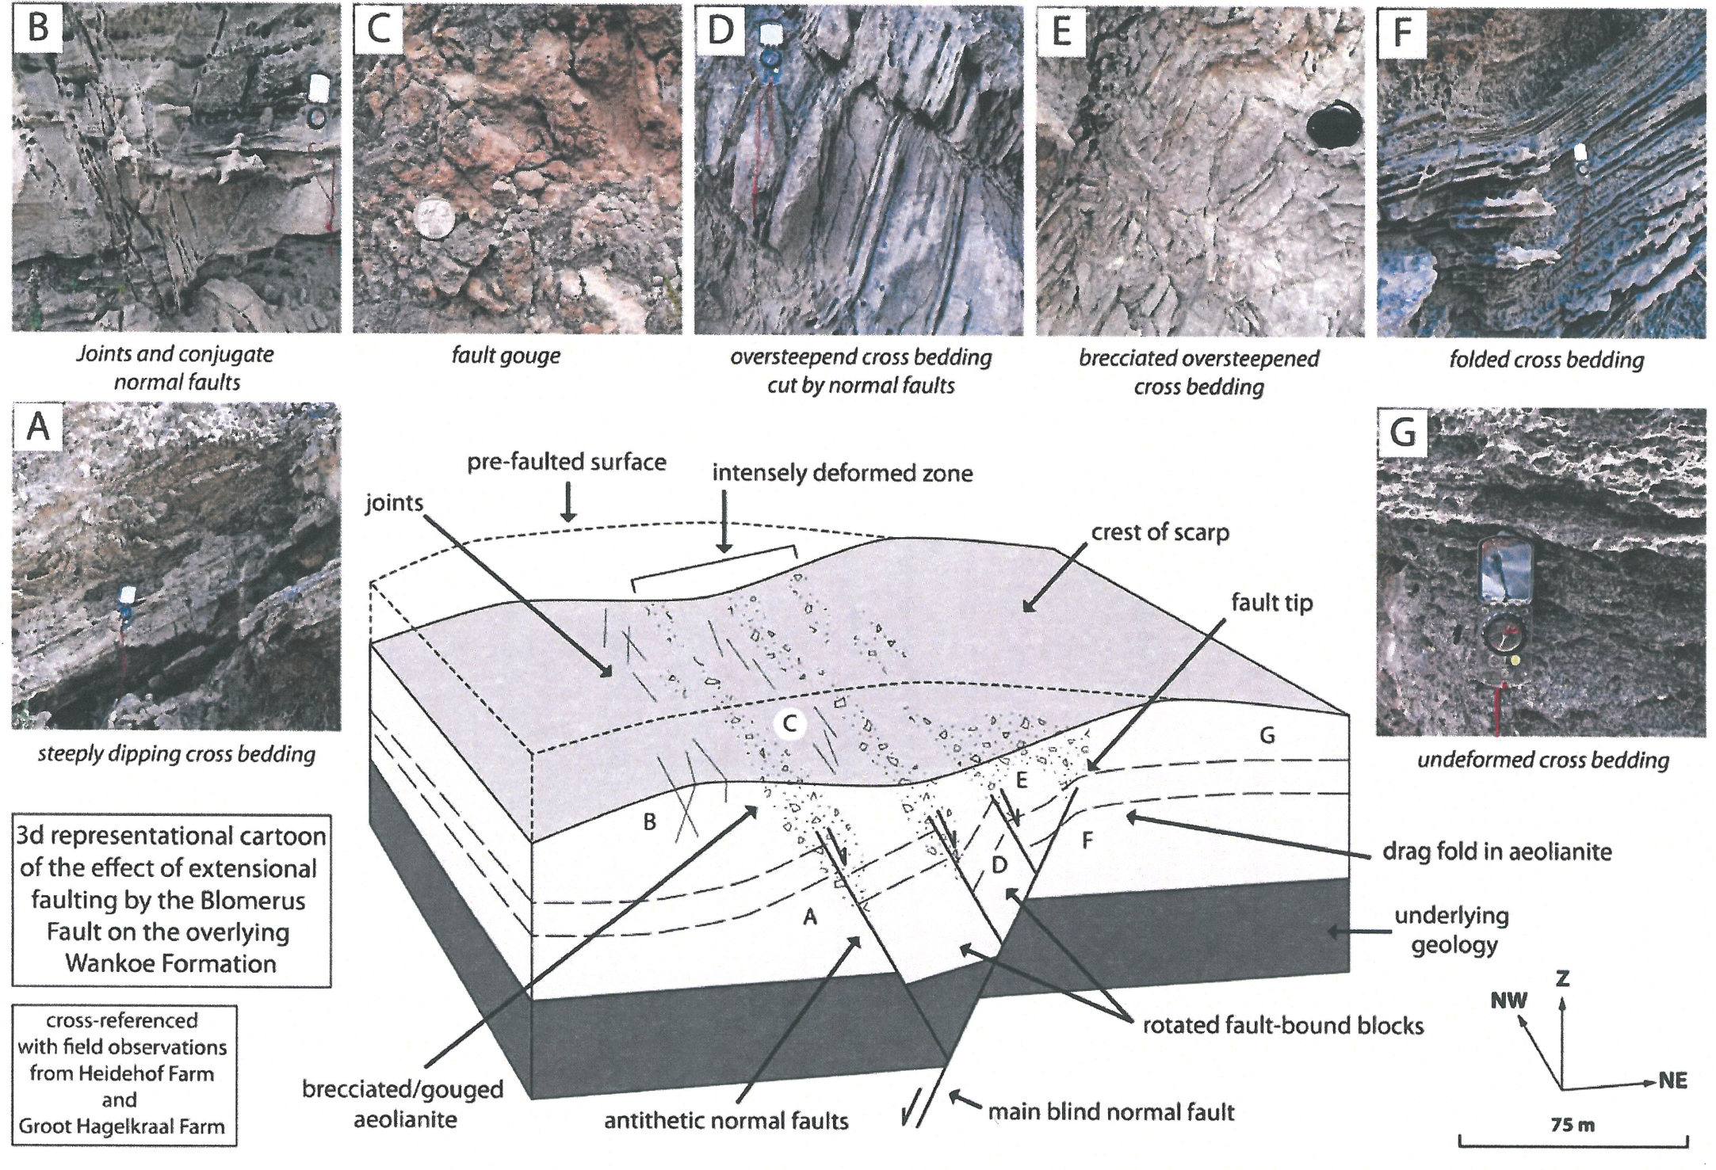

Slide 16
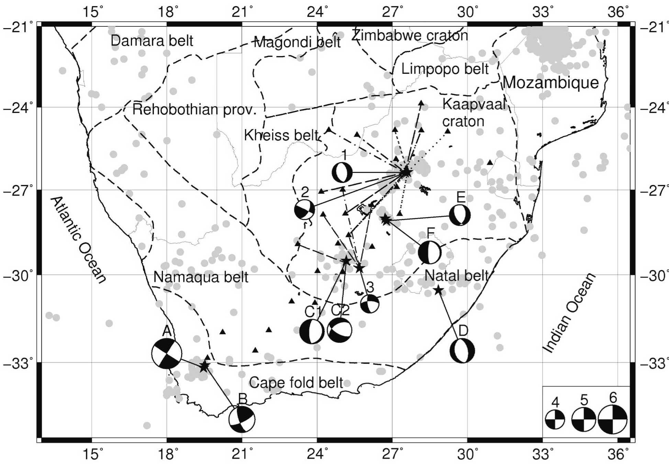
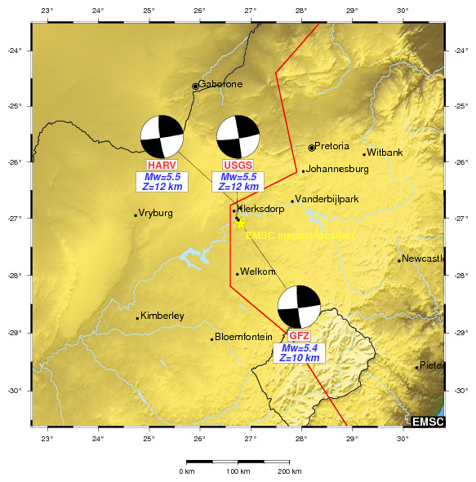
Late Holocene (Anthropocene?) Epoch
STRIKE-SLIP
NORMAL TO STRIKE-SLIP

Slide 17
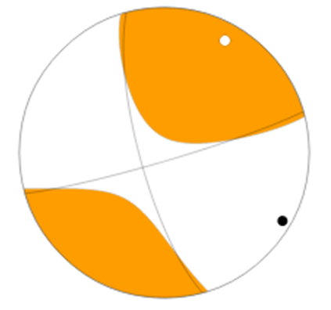
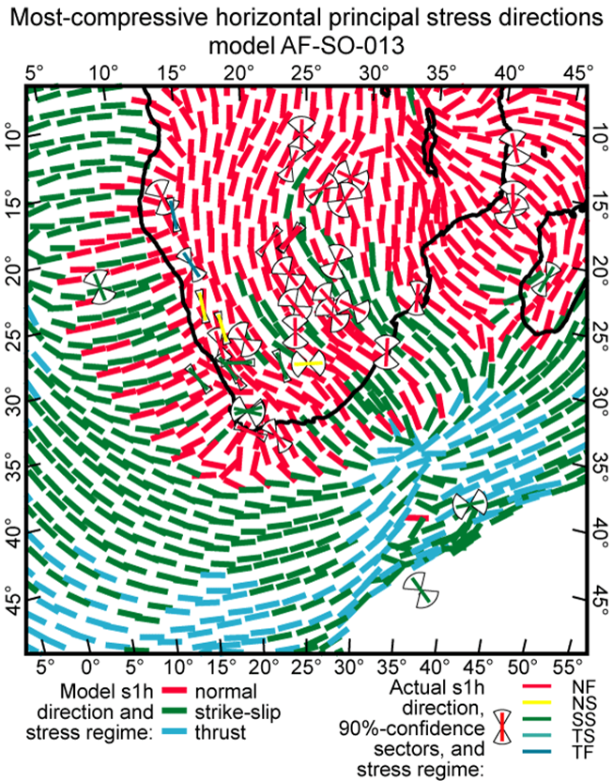
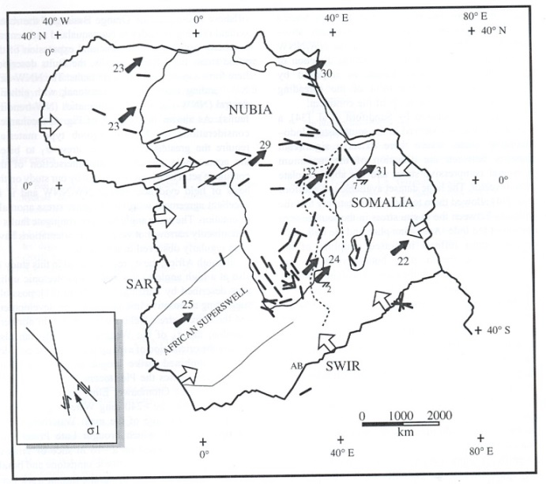
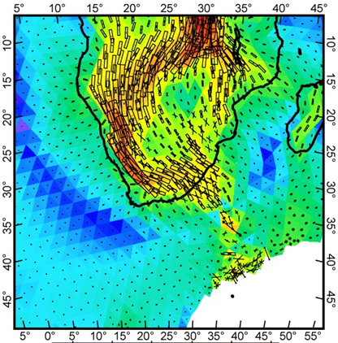
The 5 08 2014 Orkney event vs. the Bird et al., JGR B08402 (2006) model.
axis | plunge | azimuth
T | 13⁰ | 28⁰
N | 75⁰ | 235⁰
P | 6⁰ | 120⁰
M | 5.5
Strike | 350
Dip/rake | 75/-10
Depth | ~5 km
Mov. t | Strike-slip, Left-lateral
Orkney
Sources: CGS, USGS
Verdict: favourable match!

Slide 18
Verdict -Western SA: poor/no match!
N
S Atlantic Ridge push
Wegener Stress Anomaly
Azimuth of geodetic velocities Cape Town region (Malservisi et al., 2013)

Slide 19
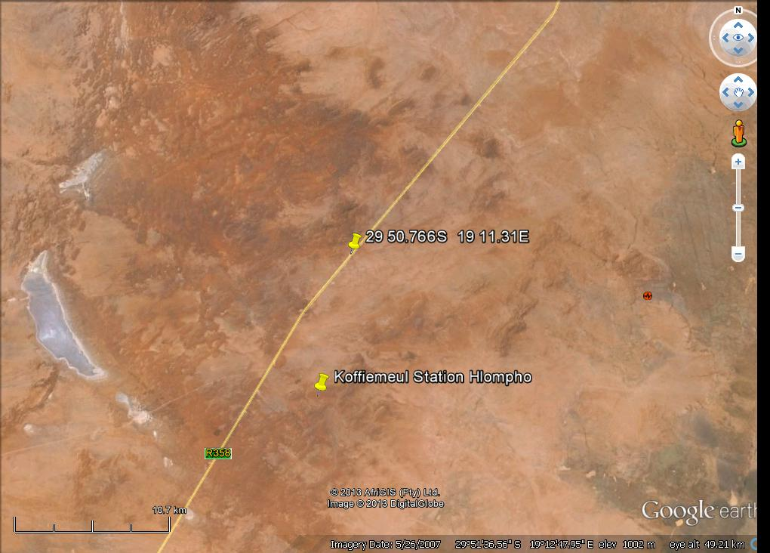
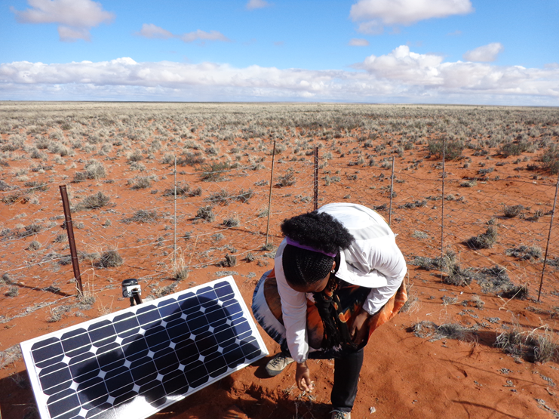
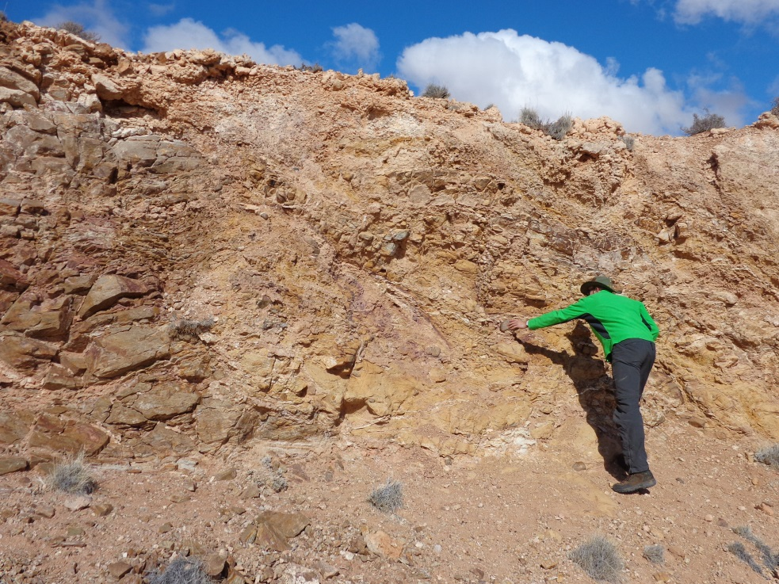
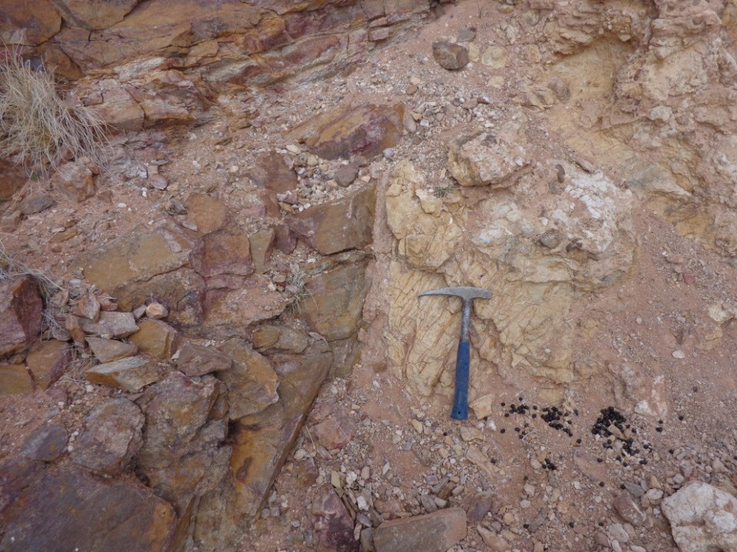
Searching for answers….
~M5.2 (1996)
To Vaalputs

Slide 20
History of stress in western SA (after Viola et al., 2012)
Major cooling events:
Wildman et al., poster ,2014; Kounov et al., Tectonophysics, 601, 177-191 (2013)
& Plio-Pleistocene reactivation S Cape
?
Mid-Pliocene ±5 Ma major uplift (G-T axis) (Maud, 2012)
?
Early Miocene ±18 Ma moderate uplift (G-T axis) (Maud 2012)
~80 -60 Ma
~90 -110 Ma
~150-130 Ma
Tectinic

Slide 21
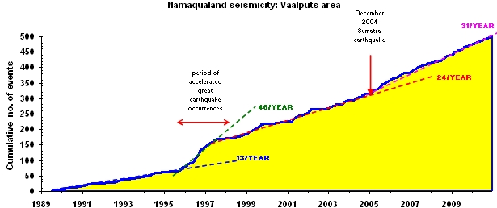
SOME CONSIDERATIONS
Since W Gondwana break-up: tectonic stress in SA has been:
- unpredictable, variable.
- difficult to model.
- particularly complex : SE Atlantic Ocean seaboard tectonics.
- strain rate in Bushmanland increased 3x from 1989 to 2009.
-possible climax: the 2012 Augrabies seismic swarm.
- Orkney seismic event 05 08 2014 triggered by mining…
-but strike slip stress arises from S propagation of E A Rift.
And finally…
what is /are the cause(s) of the Wegener stress anomaly?

