Slide 1



A systematic approach to the interpretation of conductivity anomalies recorded with the Geonics EM34-3 electromagnetic instrument across intrusive dolerite dykes and sills in the Karoo Supergroup
Dakalo Makhokha¹, Dr Francois Daniel Fourie²
Institute of groundwater studies
logo here…

Slide 2

OUTLINE
Introduction
Background
Application
Results
Conclusion
Recommendation

Slide 3

Introduction
Groundwater exploration has become increasingly dependent on the use of geophysical techniques:
  to gain insight into the subsurface conditions ;and minimise the risk of drilling unsuccessful production boreholes.
Dolerite dykes and sills are often targeted during groundwater exploration programmes in Karoo rocks.
EM34 best work in detecting deep weathered zones and fractures caused by these dolerite intrusions.
However there is uncertainty regarding the interpretation of anomalies recorded over the dolerite intrusions.
This project focuses on the development of guidelines for the interpretation of anomalies recorded with the EM34-3 system across intrusive structures of geohydrological significance in Karoo rocks.

Slide 4
Methodology
Geophysical surveys were conducted across known dykes and sills in an attempt to systematically investigate the responses recorded across these structures
Interpretation done with an aid of other geophysical techniques data such as:
  Magnetic method
  two-dimensional electrical resistivity tomography surveys
  geological borehole logs in some cases

Slide 5
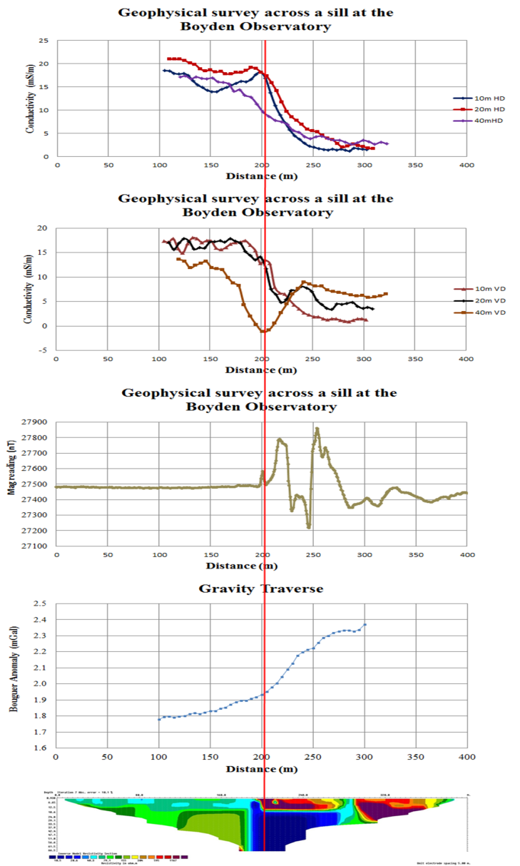
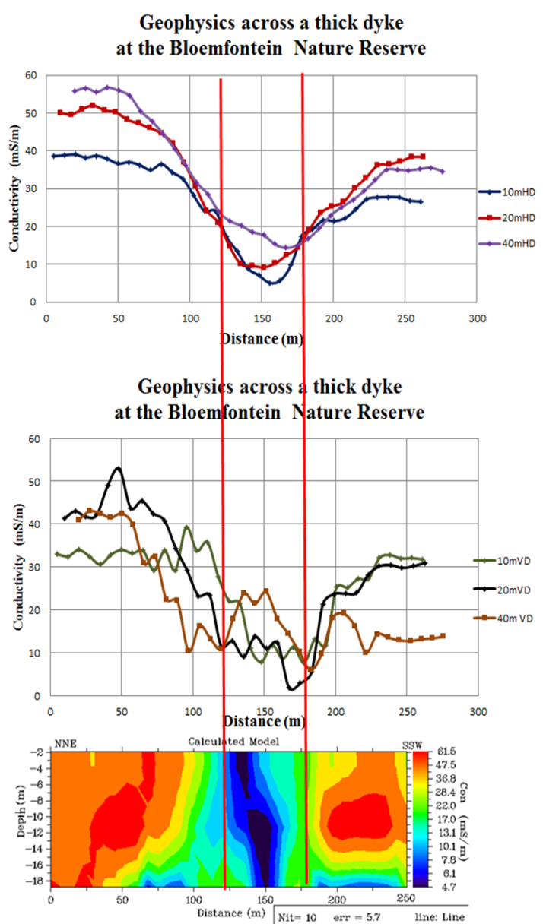
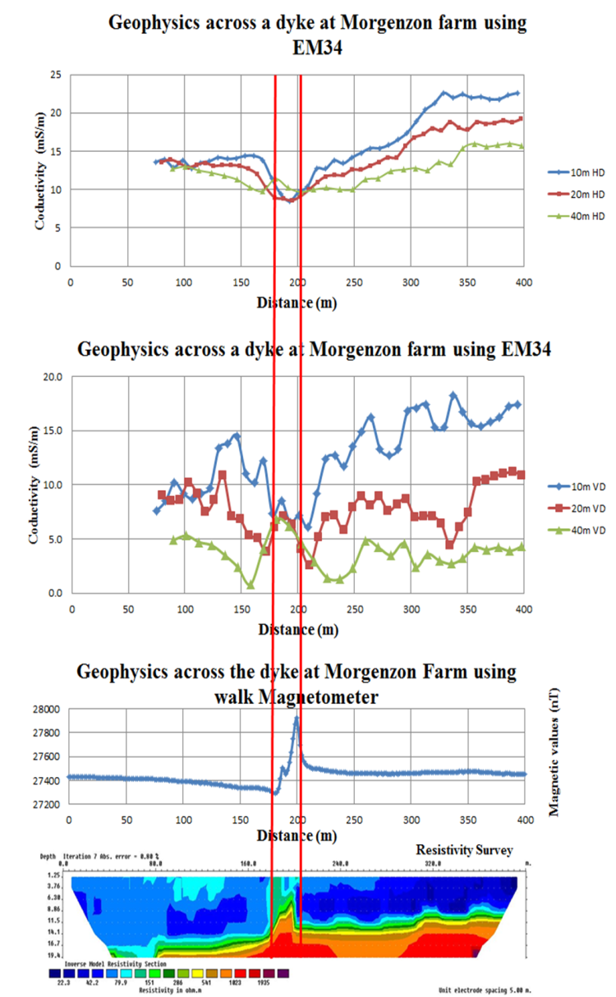
Results
Some of the survey conducted

Slide 6
Conclusions
The shapes and magnitudes of the apparent conductivity anomalies recorded with the Geonics EM34-3 system across intrusive dolerite structures in Karoo rocks contain information on the positions of these structures.
In this study, EM surveys were conducted across numerous known dykes and sills in an attempt to systematically investigate the shapes of the anomalies in relation to the positions of the known intrusives. Preliminary results suggest that the HD mode generally yields less noisy data that is easier to interpret and to relate to the positions of the intrusive structures.
This project is still ongoing and aims at providing a set of guidelines for the interpretation of EM anomalies across intrusive structures.

Slide 7
Recommendations
Interpretations of geophysical anomalies are complex, an anomaly could be attributed to an infinite number of possible sources.
It is important to note anything that might influence the data when conducting a survey
And also is advisable to use at least more than one geophysical technique when doing survey to have reliable results.
Further survey must be done using smaller spacing.
THANK YOU

