Slide 1
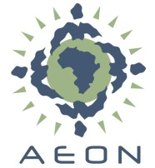

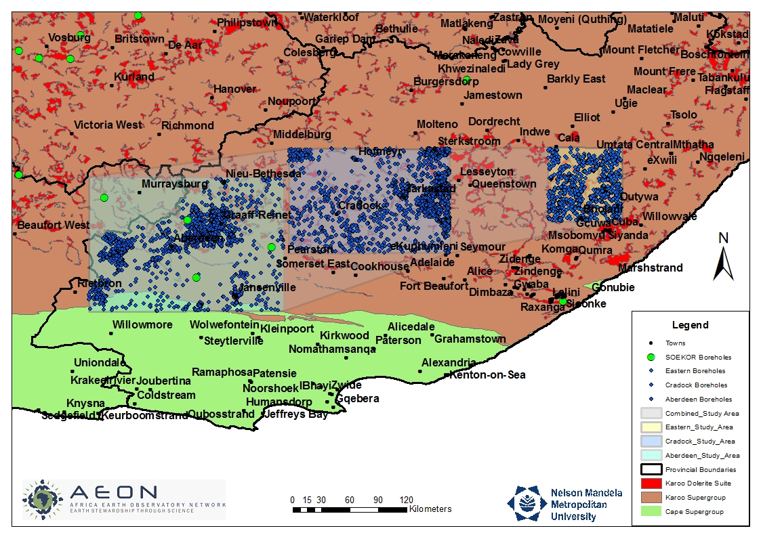
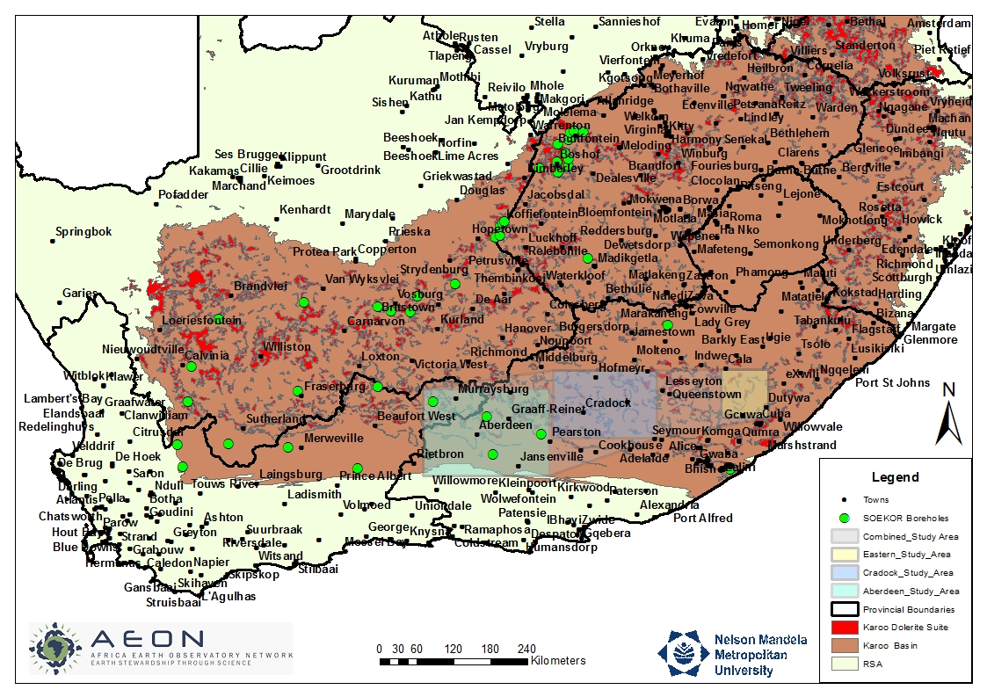
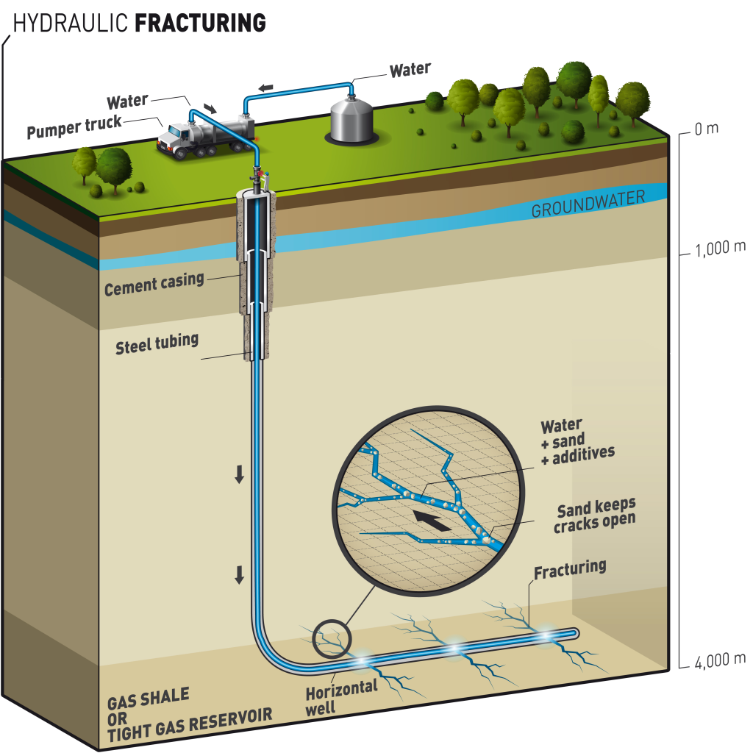

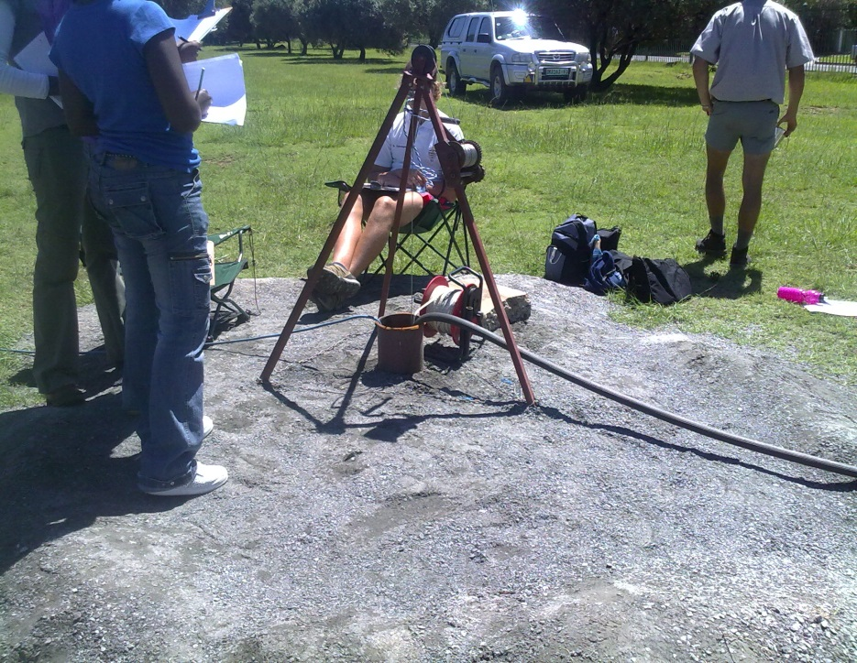

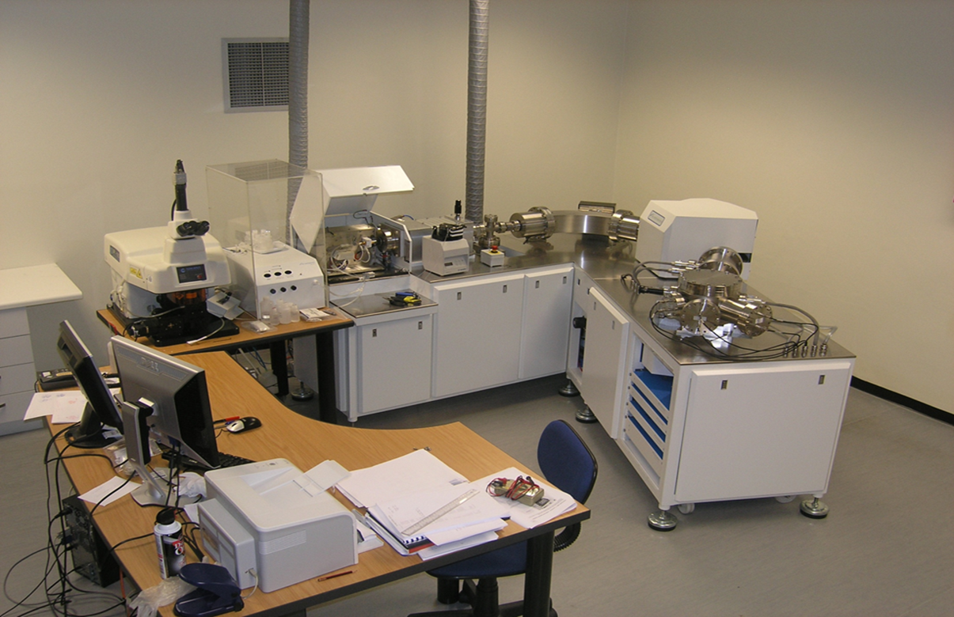
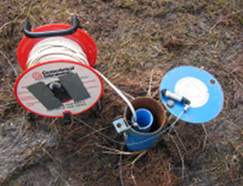
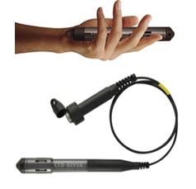

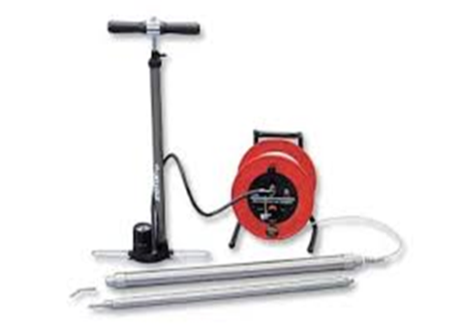
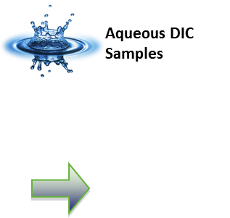
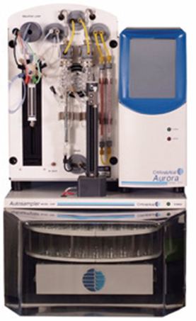


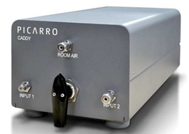
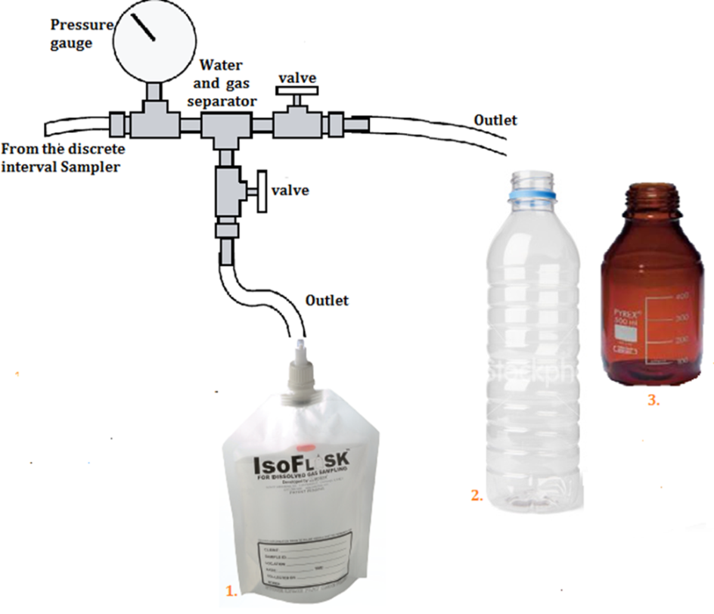
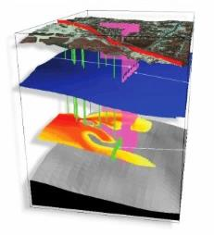

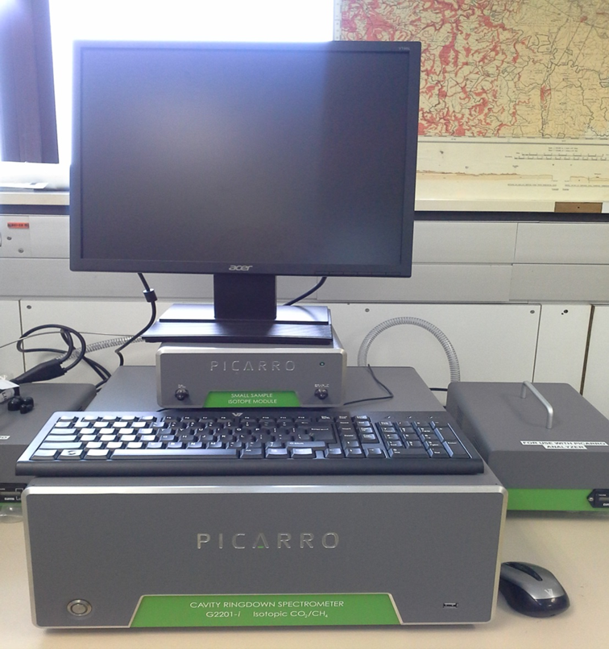
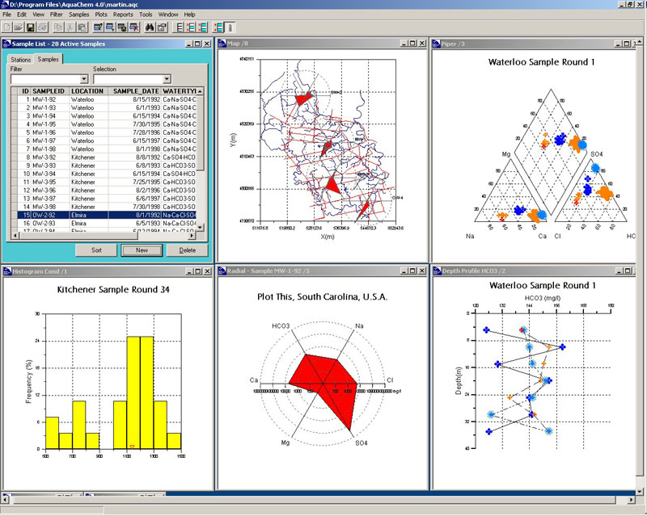
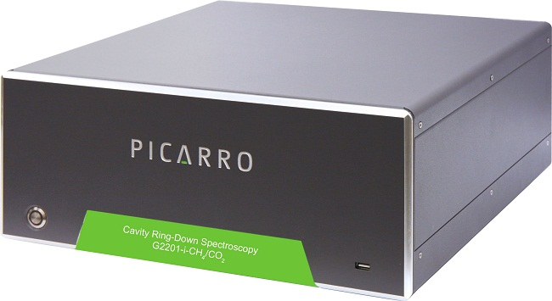
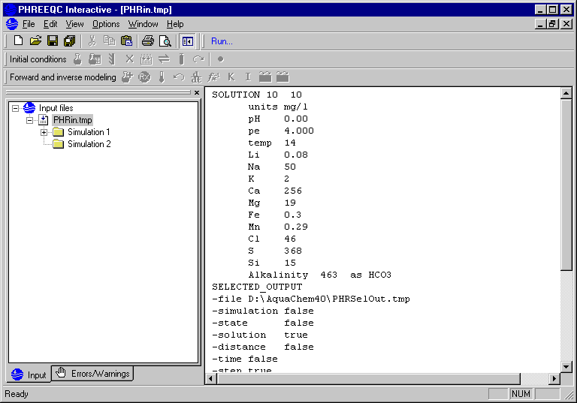

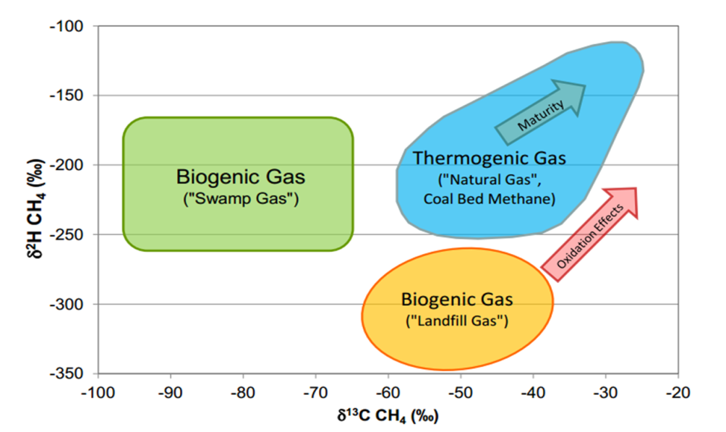
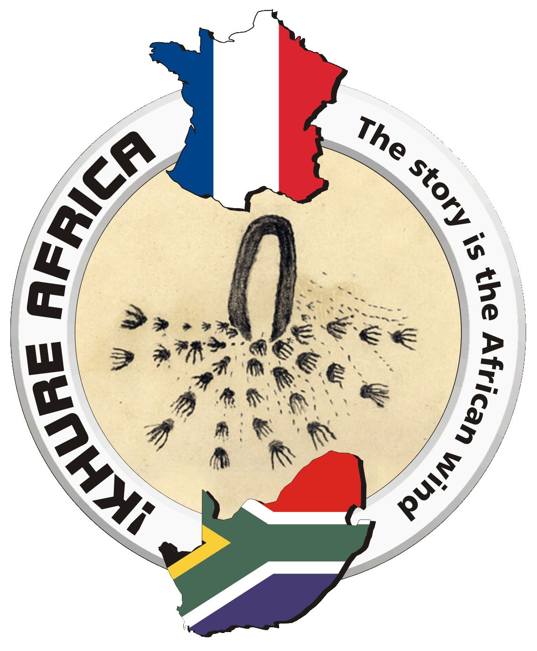


Baseline Geochemical study of the natural gas and Karoo formation waters prior to Fracking
Earth Stewardship Science
Research Institute
Mokoena M.P^{1,2} and de Wit M¹
(1) AEON (African Earth Observatory Network), and (2) Department of Geosciences, Faculty of Science, Nelson Mandela Metropolitan University, South Africa, Email: blessedmokoena@gmail.com
Introduction
The potential for natural shale gas extraction in the South African Karoo has been one of the most controversial issues because of the unknown extent of socio-economic and environmental impacts. The extraction of natural shale gas is achieved by hydraulic fracturing (fracking) of rock formations. This method of extraction involves drilling vertically and then horizontally deep into the shale rock formations with a mixture of water, chemicals, sand injected with high pressure into a well to create fractures (Figure 1). The fractures allow for natural gas to be extracted easily and used for energy (Cooley et al., 2012).
Study Area
Uniqueness of South Africa in relation to Fracking
Although we can learn about the disadvantages and advantages of Fracking from the US, South Africa’s unique geology and semi-arid region makes the extraction of gas more complex.
South African geohydrological challenges include:
Dolerites and Sills (Red spots on Figure 2 and Figure 3) - Potential release of the thermogenic gas into the shallow aquifers and dolerite intrusions associated with high yielding wells that create preferential pathways for water and/or gas between solid dolerite and adjacent Karoo sediments.
Stray Gas legacy (Figure 3) – Some Soekor boreholes drilled in the 1960/70’s for exploration of oil are known to be emitting methane gas.
Limited water resources- South Africa is a semi-arid country.
Gaps in geohydrological research
Figure 2: Boreholes (wells) of interest over the Shale gas ‘hotspot‘ in the Eastern Cape Karoo. A hydrocensus of all the boreholes indicated on the map is essential to select that will be representative of the study area to achieve the objectives
Figure 3: Soekor boreholes (wells) that were drilled in 1960/70’s. The area circled shows the boreholes that we would be looking at to help evaluate the origin of methane gas and the extent of the fugitive gas
Methodology
Field Testing and sample collection
Figure 1: Simulation of hydraulic fracturing (Fracking)
Figure 4: Step drawdown test to be performed for aquifer characterisation
Hydraulic fracturing requires deep well drilling therefore likely to encounter horizons where biogenic gas occurs and thermogenic gas is released. The release and migration of thermogenic gas into shallow aquifers or boreholes is one of the concerns related to the installation of deep boreholes (Du Toit, 2013) because of the contamination it might cause to the shallow water used for domestic and agricultural purposes.
To evaluate whether migration or release of thermogenic gas originating at deeper horizons will/ have(Soekor wells) an impact on shallow aquifers, a baseline study of the groundwater quality, methane forensics and aquifer characteristics tests prior to drilling the deep boreholes is required
Objectives
Laboratory Testing
Perform a detailed hydrocensus of the study area
Install data loggers for continuous in-situ monitoring.
Figure 5: Dipmeter to measure field pH, depth and temperature of the wells
Investigate the geochemical quality of the shallow groundwater sources including the deep Soekor boreholes.
Figure 10: An ICP-MS gas chromatograph machine to be used for hydrocarbon analysis and other chemical constituents (i.e cations and anions)
Figure 6 : Data loggers will be installed to produce in-situ continuous measurements of the well
Primary aim
Methane forensics:
Use isotope analysis
to
determine the origin and migration of gas
Figure 7: Discrete Interval Sampler will be used to take samples from distinct levels within a well. The air pump maintains a certain pressure therefore degassing is minimised for gas sample collection
To establish geochemical baseline data of natural gas and Karoo formation waters in South African Eastern Cape Karoo
Aurora
Predict the impact of methane contamination in South African deep boreholes(wells)
Picarro caddy
Geochemical Modelling
PHT-3D (Figure 15) will be used to link the PhreeqC (Figure 16) geochemical model to a more standard groundwater model such as MODFLOW and MT3D.
Figure 11: The Picarro caddy makes it easier to connect the Aurora and Picarro cavity ring down spectrometer or small sample isotope module. The connection is able to produce high precision DIC/TIC/TOC/NPOC and d13C measurement of acidified, oxidized, or combusted samples.
The small sample isotope module will measure isoflask sample gas for d13C values of methane
Figure 8: Isoflasks will be connected to an outlet tube from the discrete interval sample, gas will be seperated from water and water samples will be collected using bottle 2(major and trace elements analysis) and bottle 3 (hydrocarbon analysis)
It will be a worthwhile to study the transport and attenuation processes of compounds of concern since some wells cannot be purged, or allow tracers through them
Results presentation
This project has just started therefore data is not available as yet to present. However the following figures shows some of the most significant way to interpret and present data graphically
Figure 15: PHT-3D output image
Figure 9: The Picarro Cavity ring down spectrometer is also field deployable, it will be used to take field measurements of isotope methane and carbon dioxide directly from the wells
Software such as Pheerqc and MODFLOW will be used to determine the transport of the contaminants, residence of the hydrocarbon and aid with the prediction of potential contaminants from deeper horizons on the shallow groundwater resource.
Picarro cavity ring-down spectrometer, small sample isotope module and vacuum
References
Cooley, H. and Donnelly, K. (2012) Hydraulic Fracturing and Water Resources: Separating the Frack from the Fiction. Pacific Institute, California. Available at http://pacinst.org/wp-content/uploads/sites/21/2014/04/fracking-water-sources.pdf
Du Toit, J (2013). Karoo Fracking Update-August 2013. http://karoospace.co.za/karoo-fracking-update-august-2013. Date accessed: 14 May 2014
The significance of the study (Contribution)
Figure 12: Aquachem graphical interface showing a histogram, study map area, depth profile piper and radial diagram.
Aquachem software will be used construct diagrams such as the piper characterise the groundwater type and evaluate other geochemical analysis.
The geochemical database from this research will serve as benchmark against which future groundwater qualities can be evaluated to identify contaminant impacts that might originate from deep wells.
The understanding gained during the research is likely to be valuable to farmers, communities and government institutions affected by deep drilling, hydraulic fracturing (fracking) and other processes related to the shale gas development
Figure 16: PhreeqC interface
Acknowledgements:
M.P Mokoena would like to thank Inkaba yeAfrica, DST, NRF as well has her supervisor Maarten De Wit.
Figure 13: Hydrogen isotope values of methane versus the carbon isotope values of methane. Three methanogenic processes.
Using this graph we can use the isotope values as tracers of the origin of methane.

