Slide 1
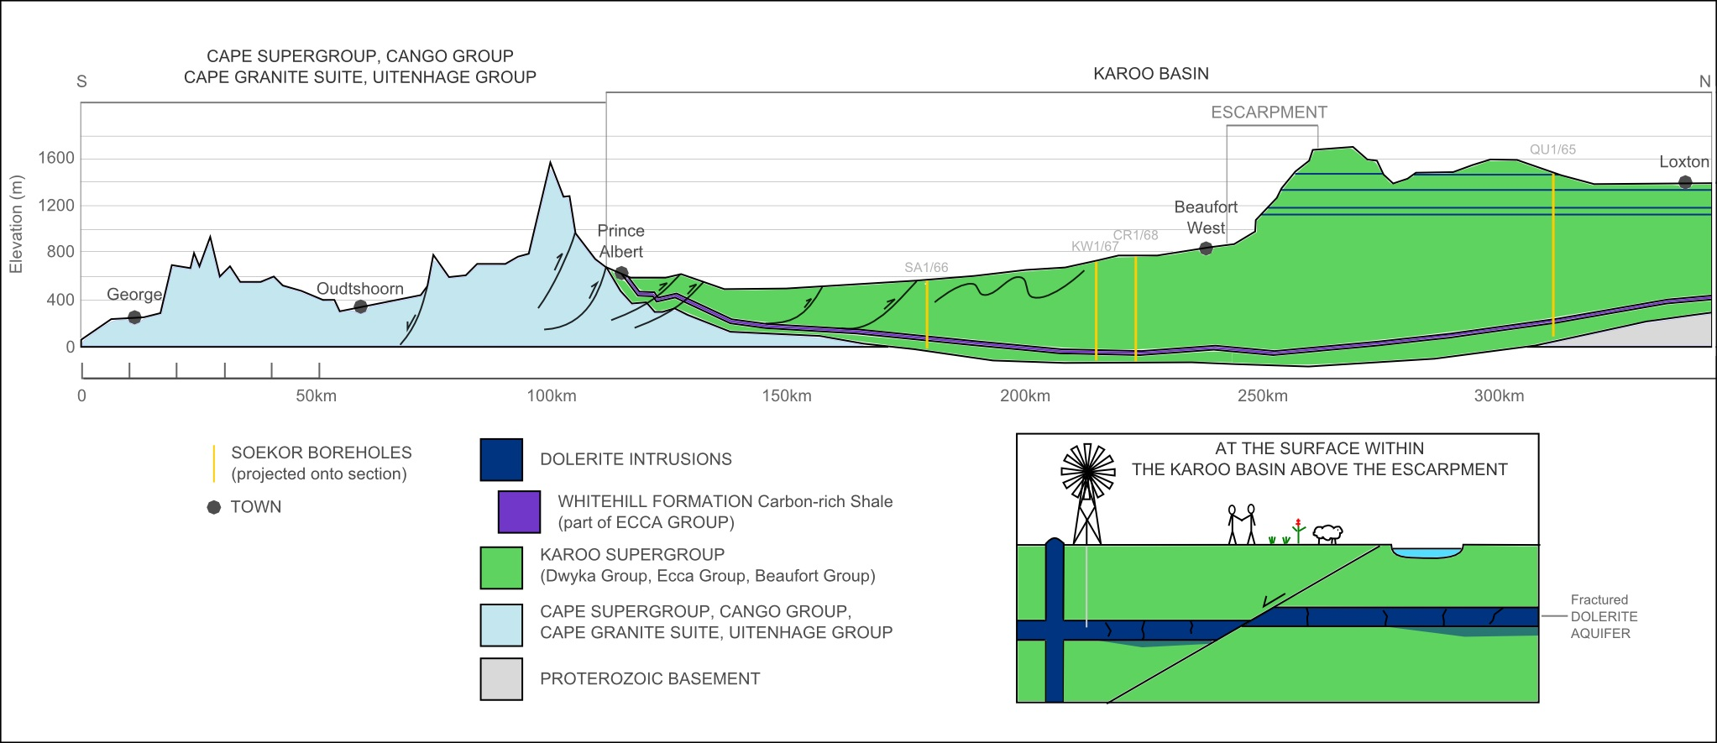

Slide 2
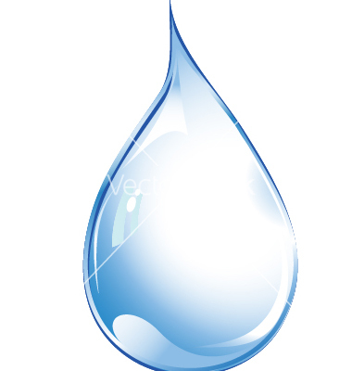

Shale gas
Geohydrological Research at NMMU
Moipone P. Mokoena(Mimi) and Divan Stroebel
Department of Geosciences
logo here…

Slide 3
Outline
Hydraulic Fracturing (Fracking)?
Relationship between Fracking and Geohydrology
Concepts of NMMU Geohydrological Research
Study area
Methodology
Results presentation
Summary

Slide 4
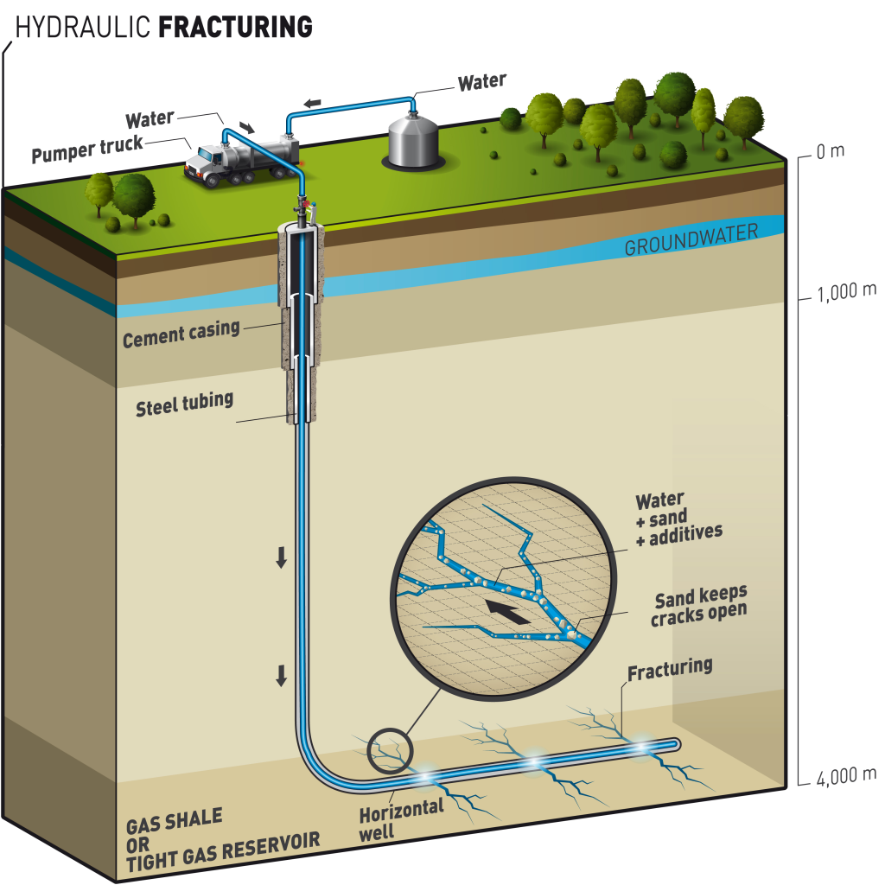
Hydraulic Fracturing (Fracking)?

Slide 5
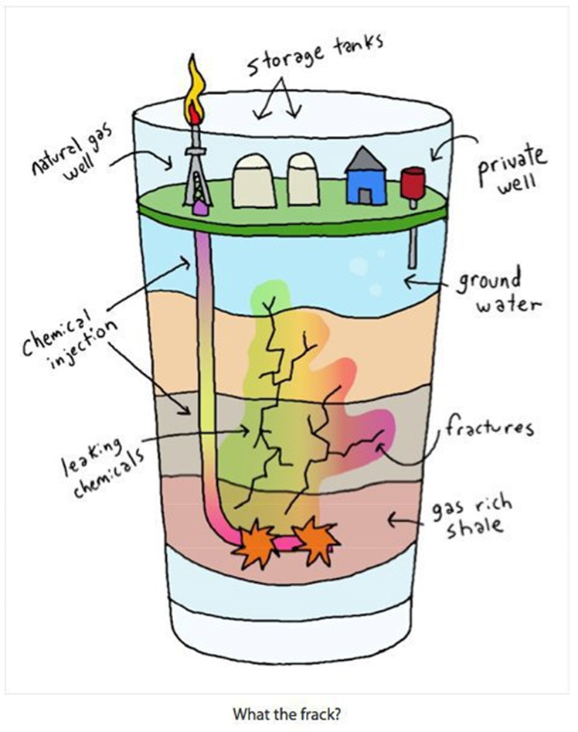
Relationship between Fracking and Geohydrology
Picture courtesy of Alex Reasbeck(2014)

Slide 6
Current Geohydrology concepts (research approaches) at NMMU
Hydrochemically characterize both the shallow and deep saline formation water
Establish baseline water quality conditions in selected Eastern Cape region wells
Collect groundwater samples in a legally defensible manner to establish benchmark
Analyze groundwater for constituents often associated with oil exploration/development activities
Compile analytical results in a water quality database by aquifer
Isotope characterization analysis (Methane forensics)

Slide 7
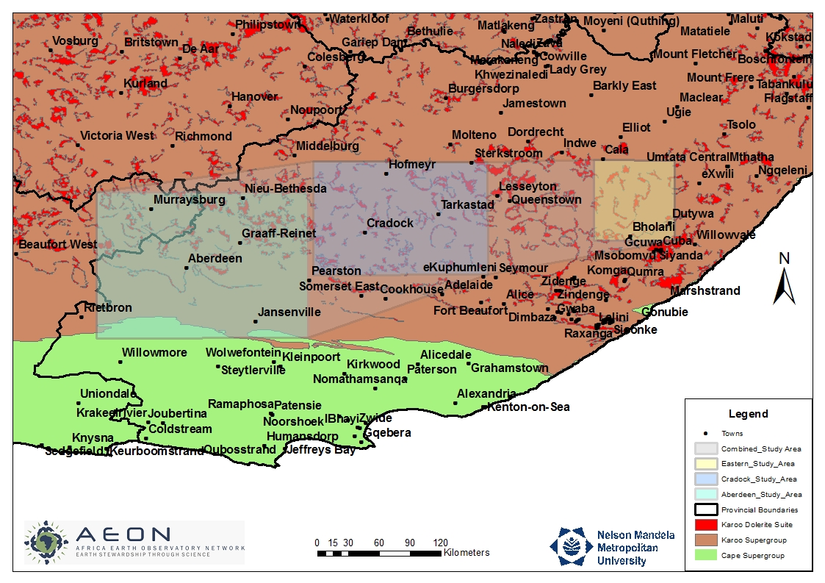
Study area

Slide 8
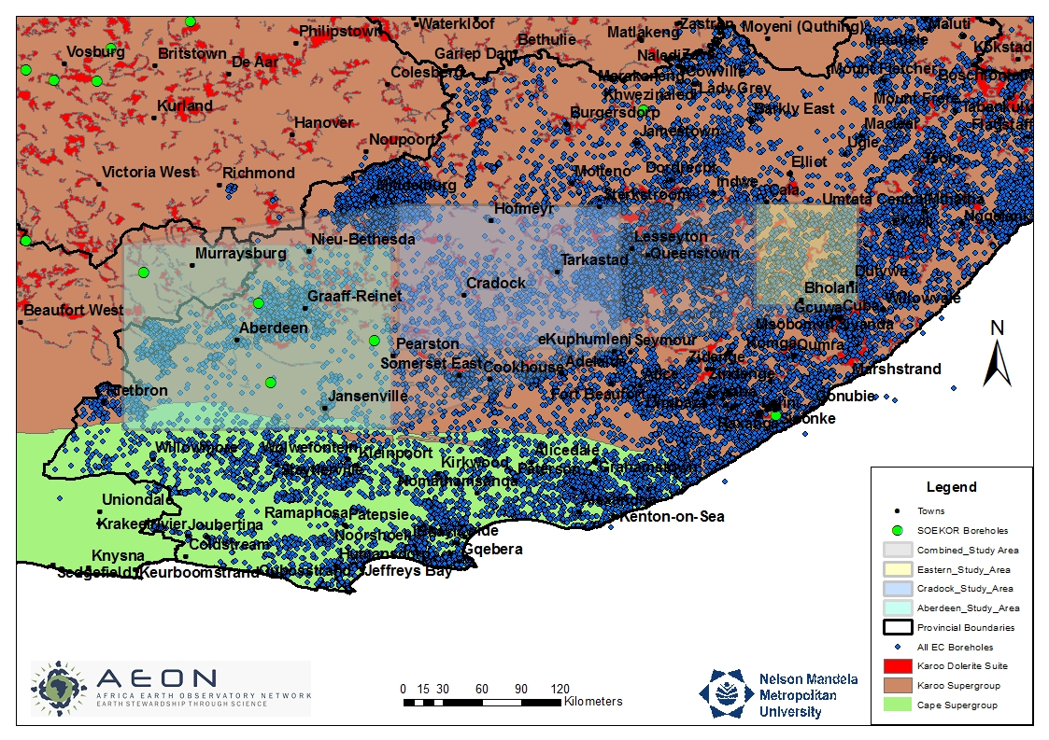
Study area

Slide 9
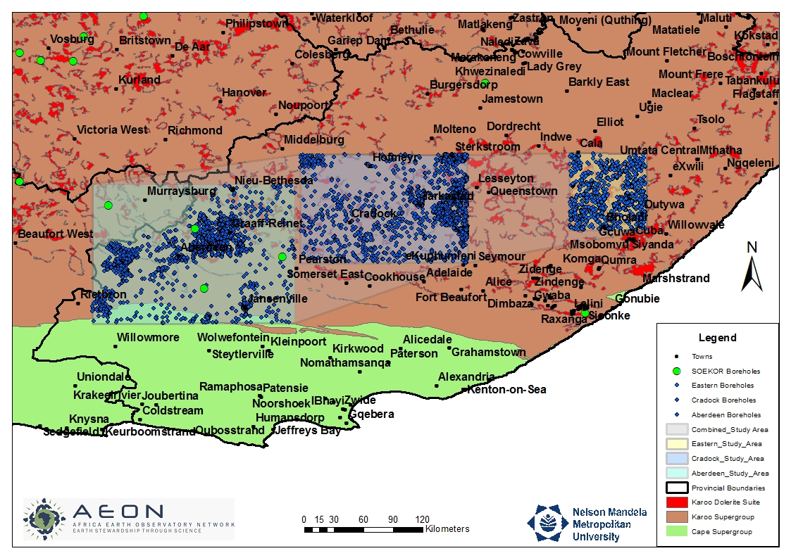
Study area

Slide 10
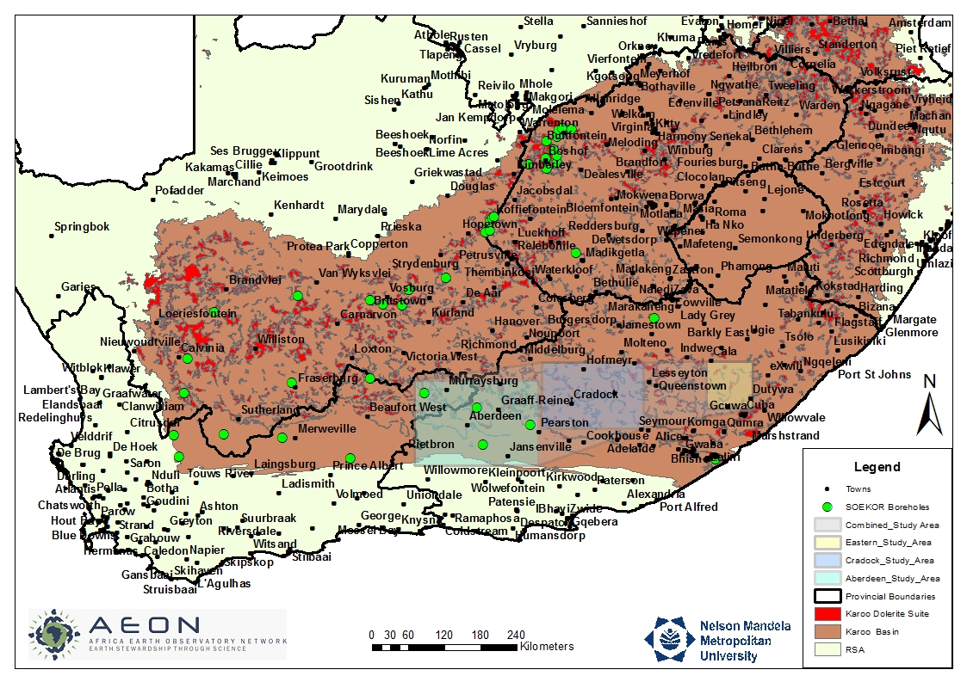
Study area: Stray gas legacy

Slide 11

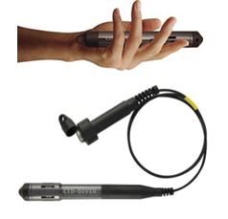
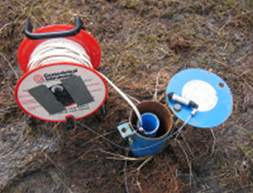

Methodology
Field Testing and Sample Collection
  Hydrocensus
  Hand Readings : Dip Meters, Picarro gas measurements
EC profiling
Installation of 10 downhole continuous logger
  Purging of non-active boreholes
  Seasonal sampling

Slide 12
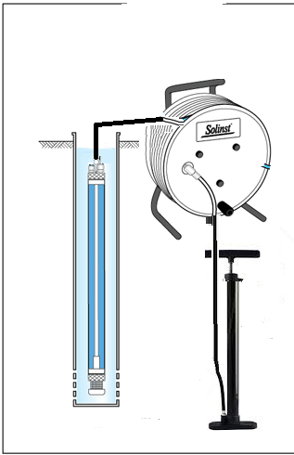
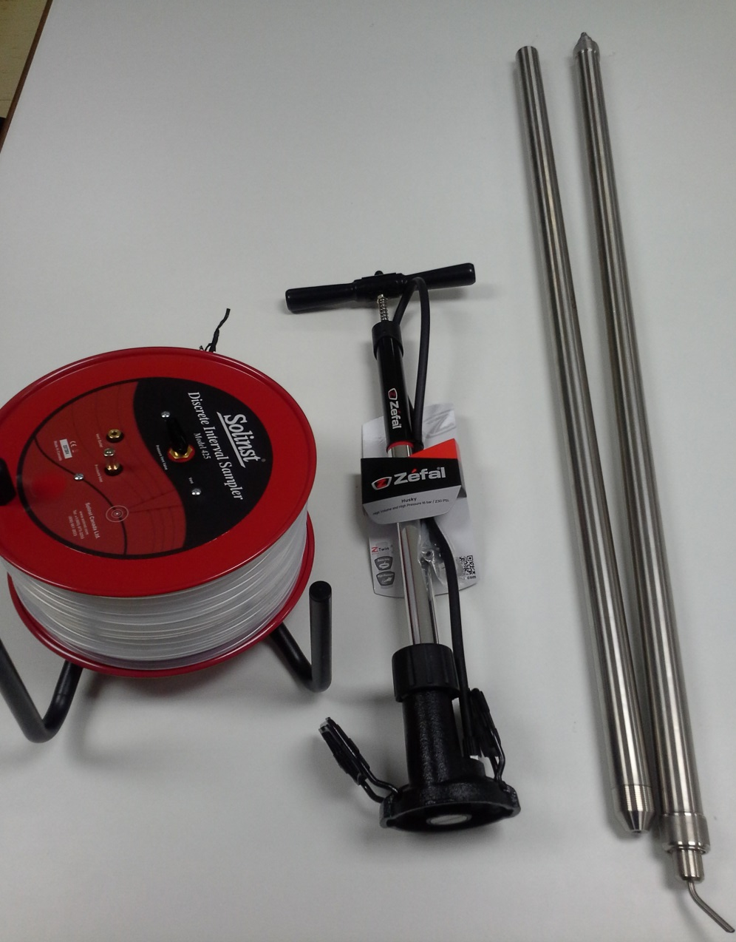
Methodology
Field Testing and Sample Collection

Slide 13
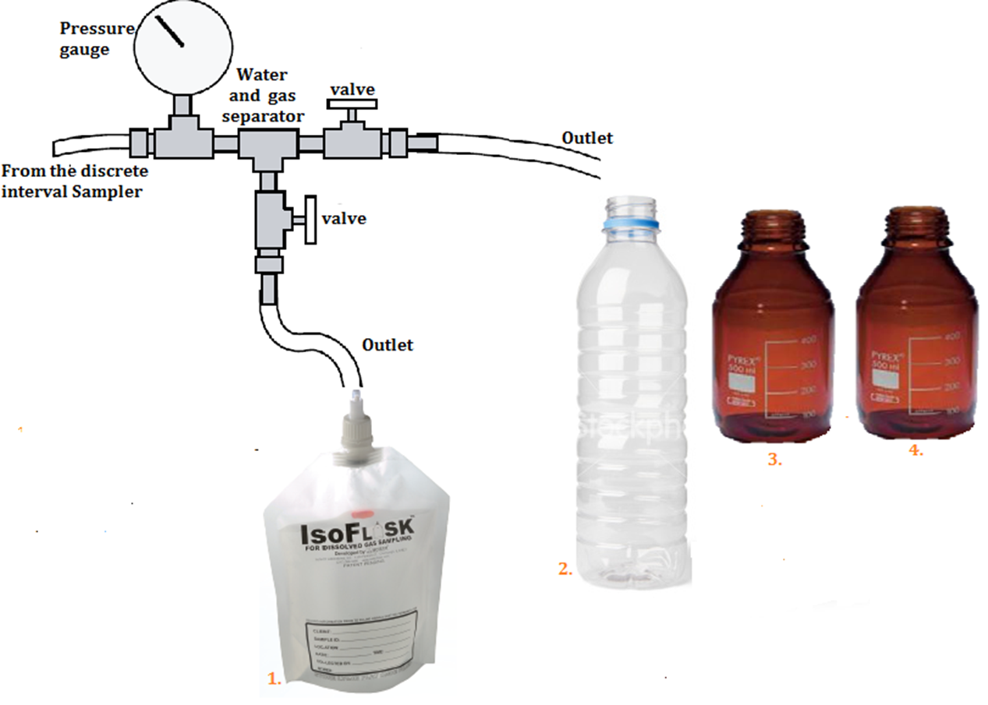
Methodology
Field Testing and Sample Collection
Water samples
UCT Lab, isotope analysis
DIC, TOC,DOC
Major and trace elements, anions and cations
Gas samples, delta 13C-methane

Slide 14

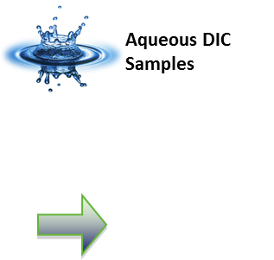
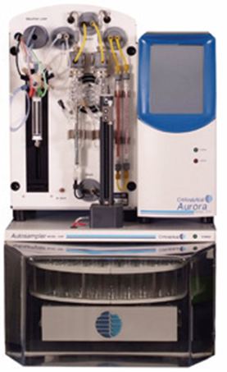
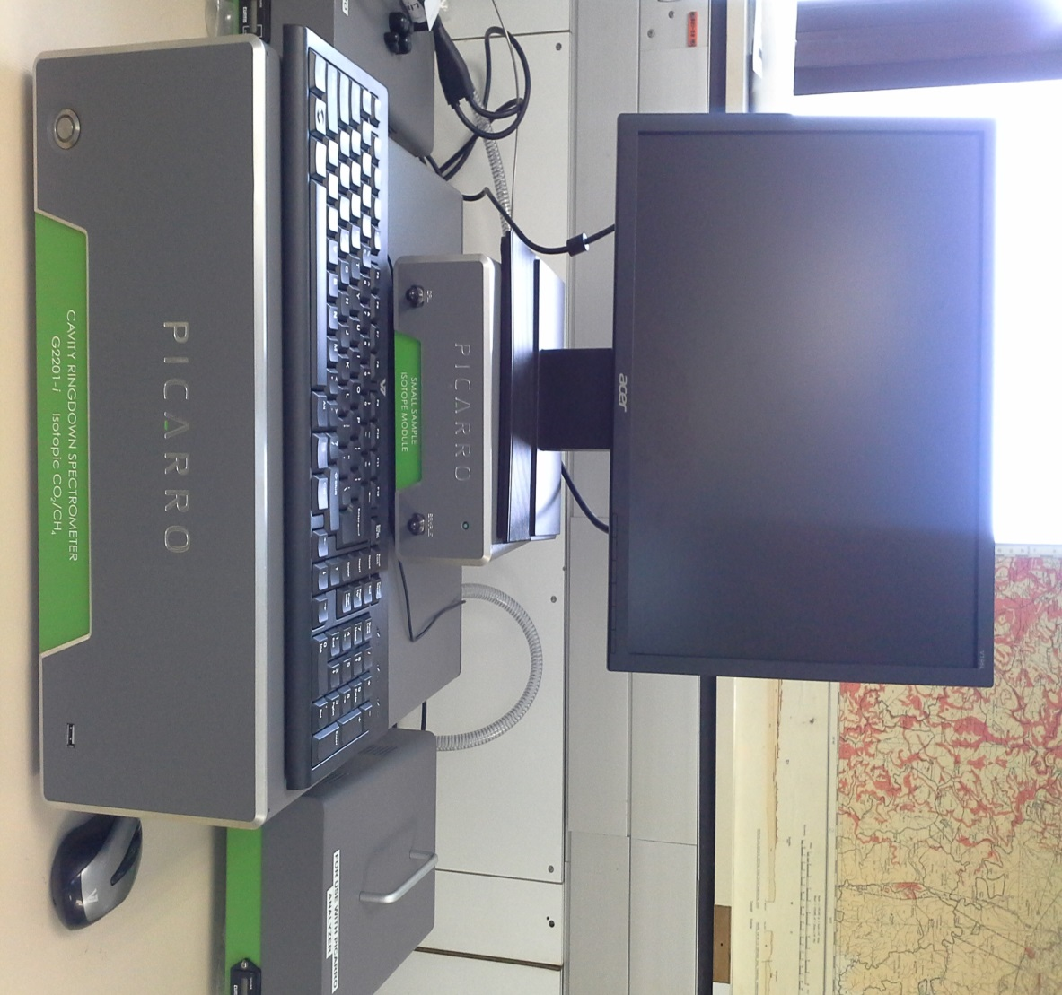


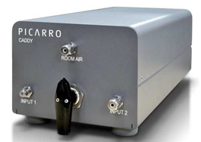

Methodology Laboratory Techniques
High Precision DIC/TIC/TOC and d13C of acidified, oxidized, or combusted samples
Gas samples

Slide 15
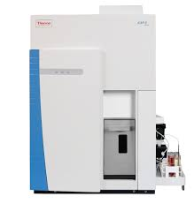

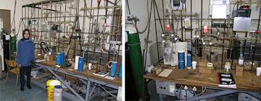
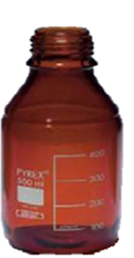
Methodology Laboratory Techniques
ICAP q ICP MS
UCT stable isotope laboratory
Delta XP dual inlet mass spectrometry

Slide 16
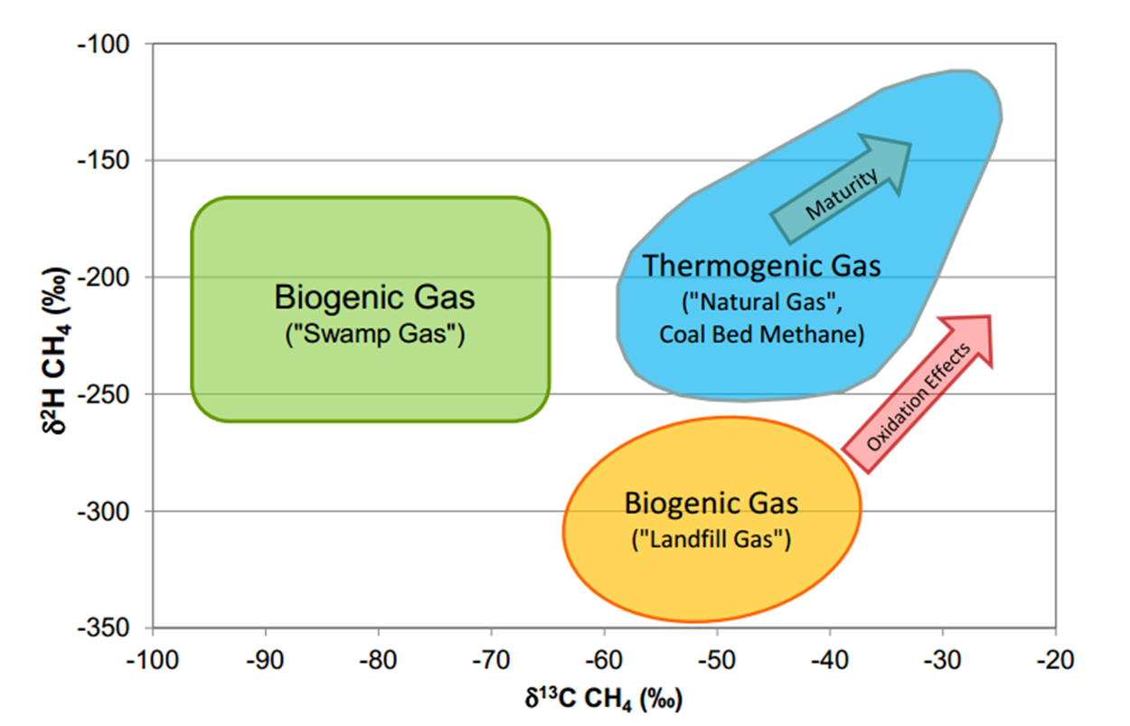
Results presentation

Slide 17
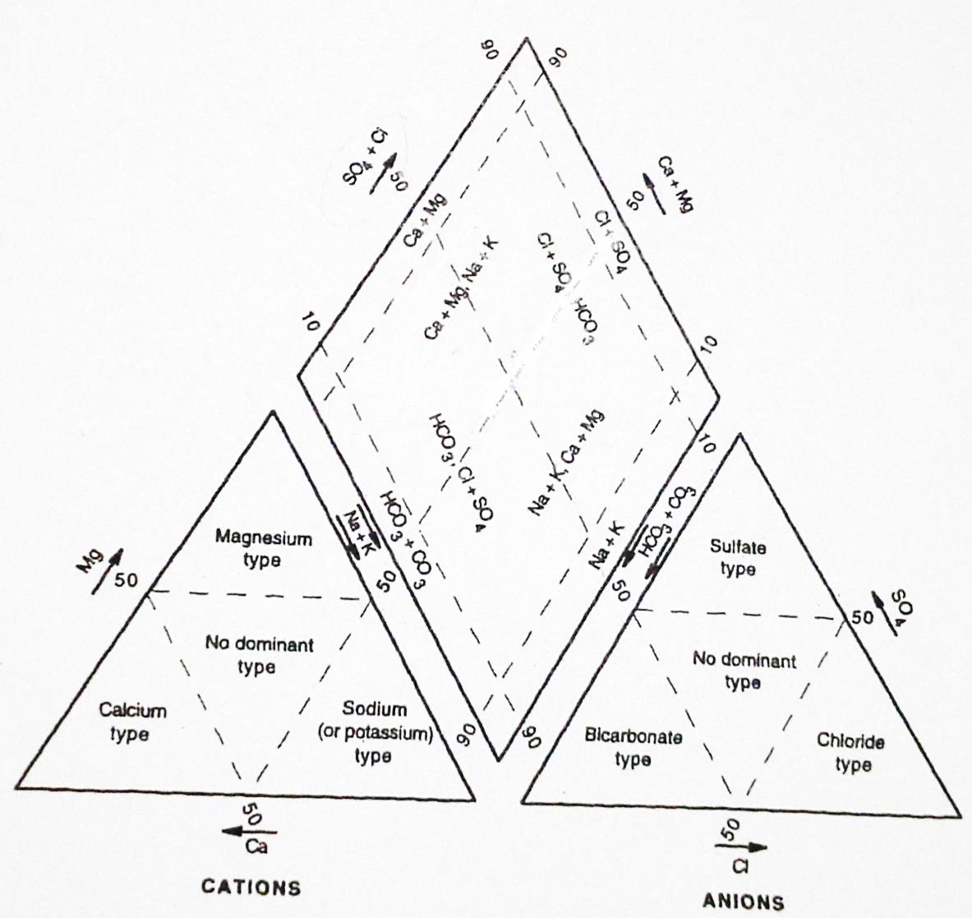
Results presentation
Classify water types

Slide 18
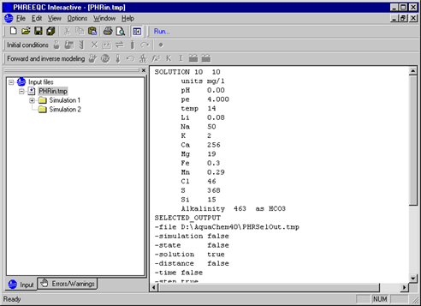
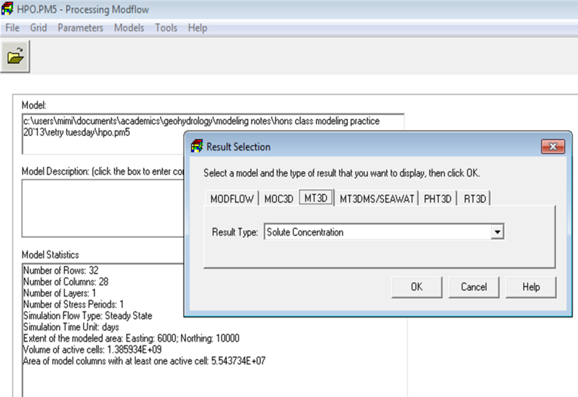
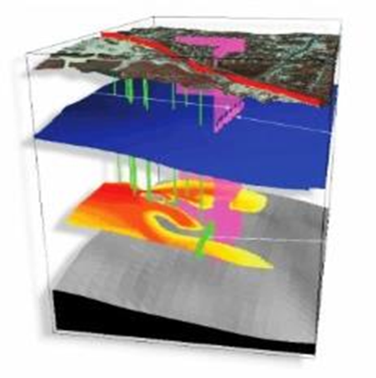
Results presentation
PhreeqC
ModFlow and MT3DMS
Performs a wide variety of low-temperature aqueous geochemical calculations.
Groundwater flow and transport simulation using finite difference method
PHT3D model
Customised to use reactive transport problems

Slide 19
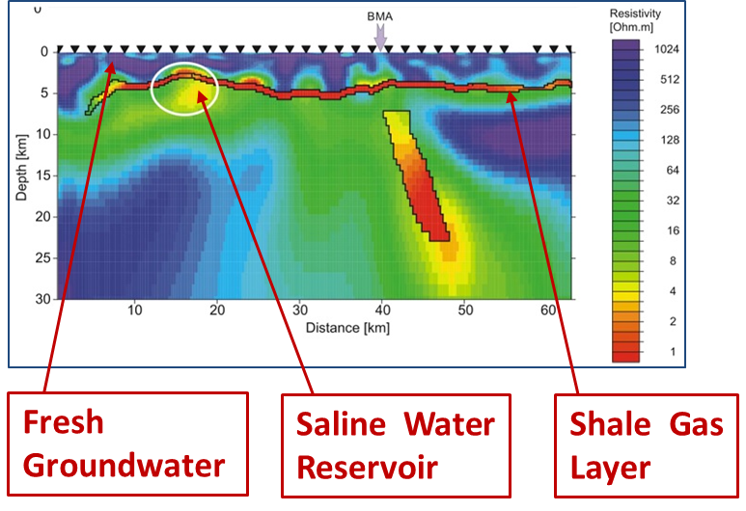
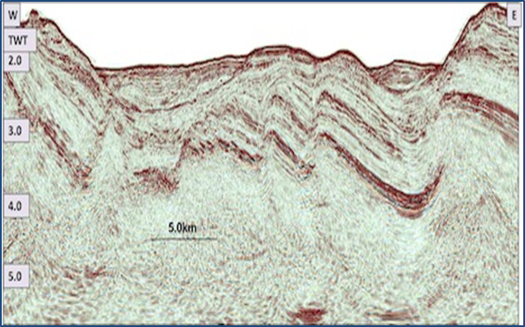
Results presentation
Example of deep penetrating magneto-telluric imaging showing the Whitehill Formation and underlying saline reservoir .
Example of passive seismic profile showing fault systems

Slide 20
The significance of the study
Benchmark against which future groundwater qualities can be evaluated to identify contaminant impacts that might originate from deep wells.
The understanding gained during the research is likely to be valuable to farmers, communities and government institutions affected by deep drilling, hydraulic fracturing (fracking) and other processes related to the shale gas development
The research will impact on the development of regulatory legislation related to industrial fracking and shale-gas harvesting

Slide 21
Summary of the Geohydrological research at NMMU
Baseline Geochemical Studies
Field data and Sample Collection
Water Quality and Isotope analysis
Origin of methane(Thermogenic or biogenic)
Connectivity of the shallow and deeper formation water

Slide 22

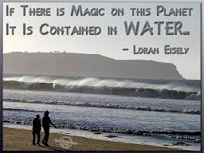
Thank you for your attention
Questions?

