Slide 1



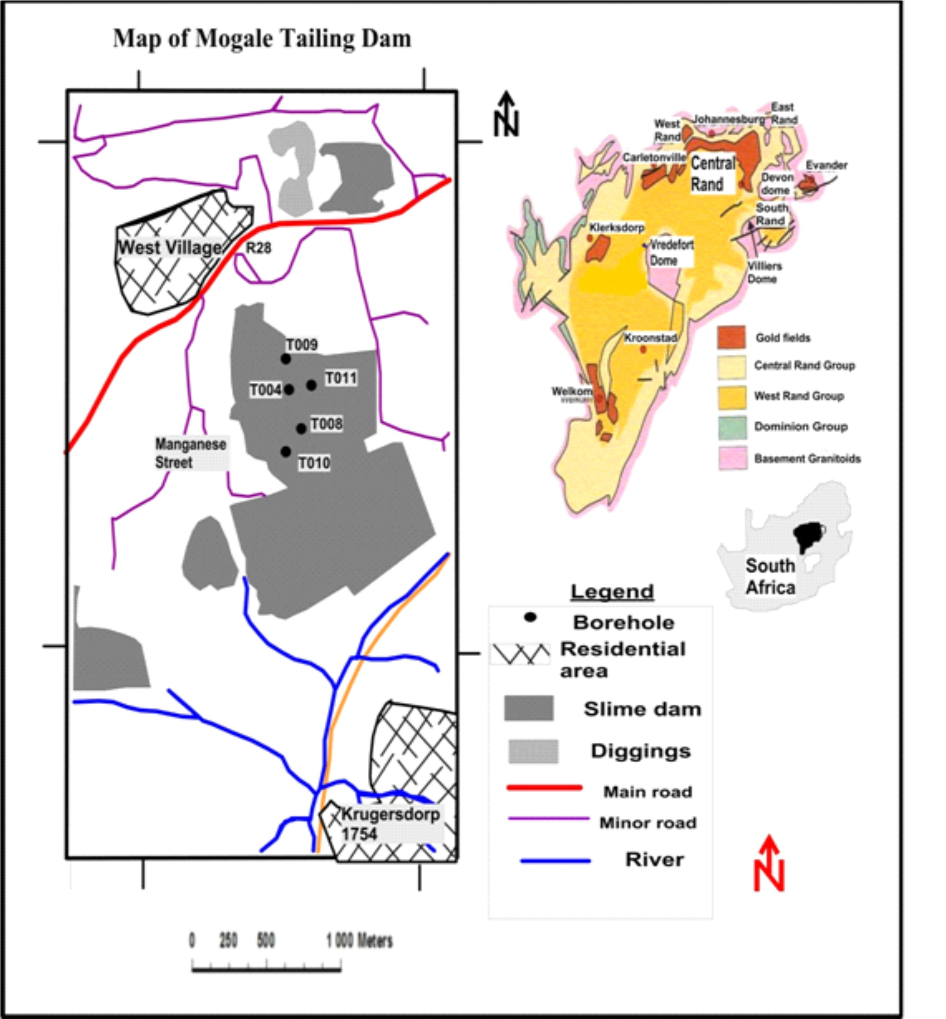
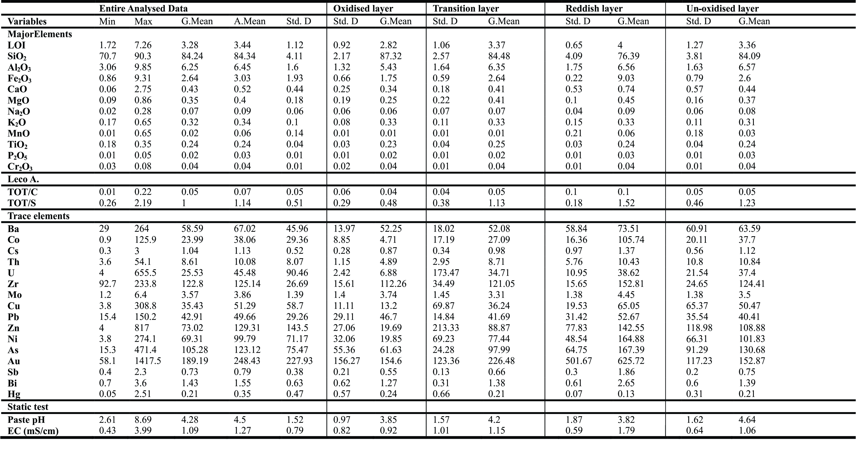
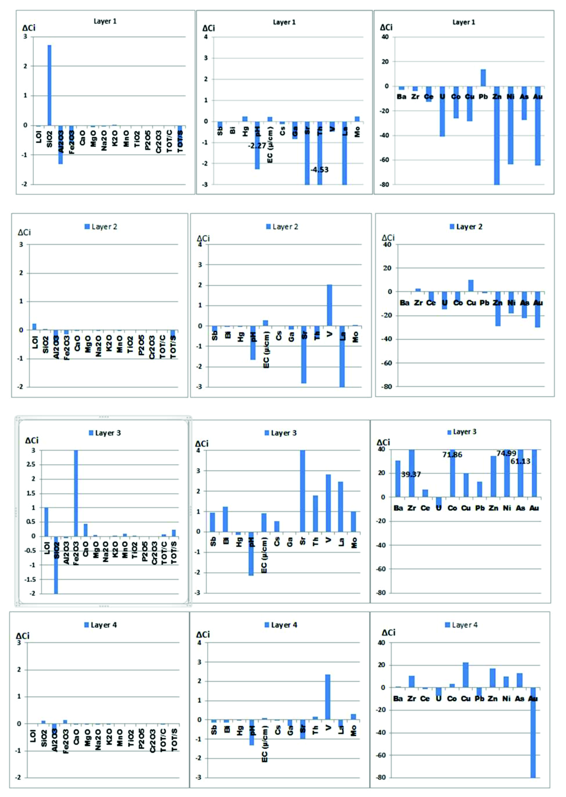
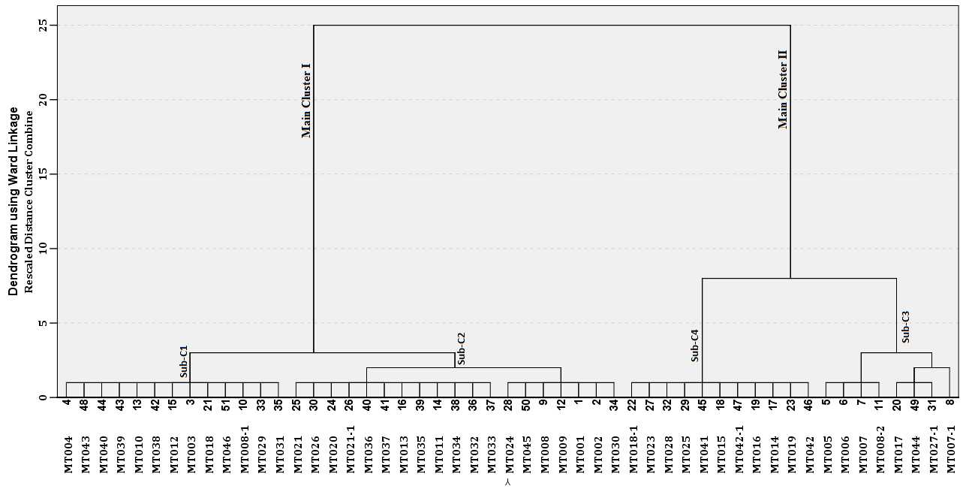
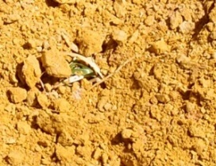
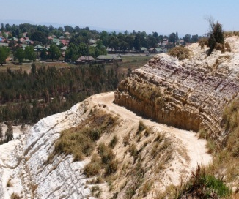
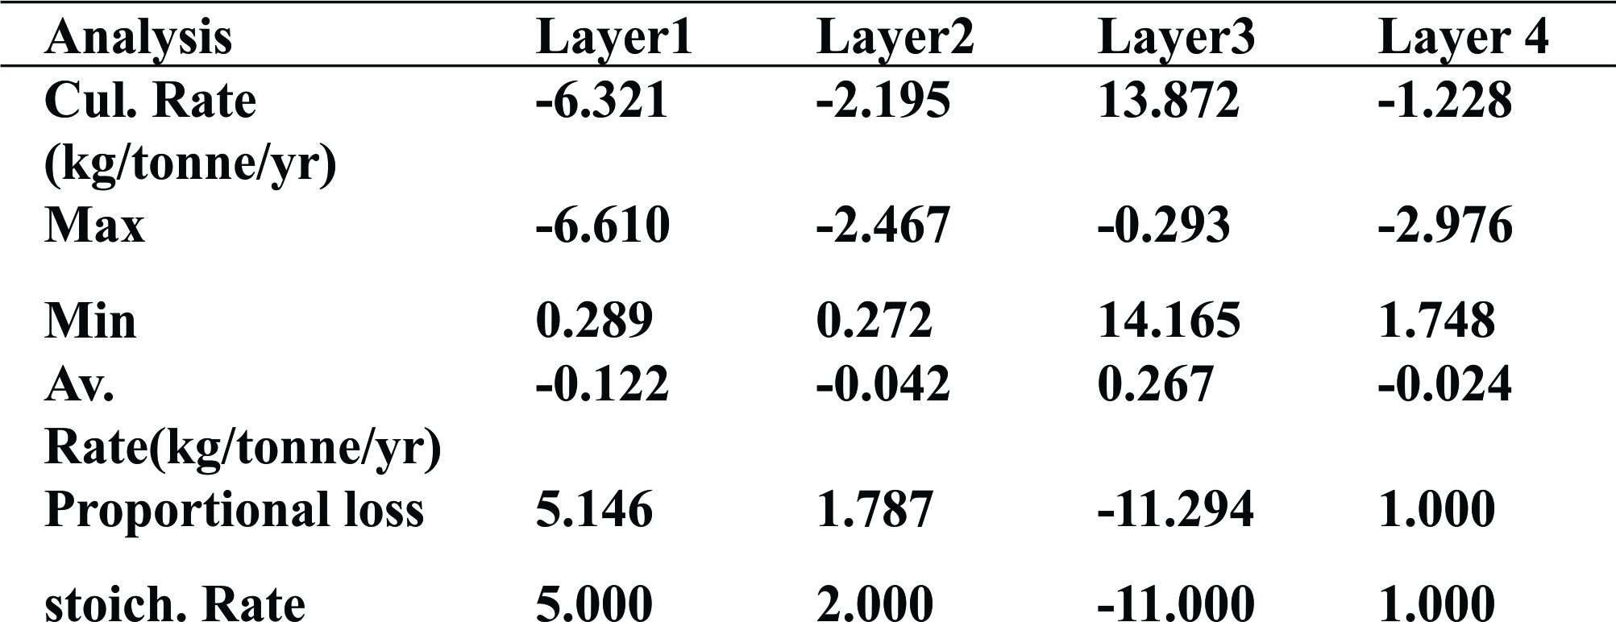
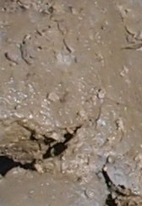
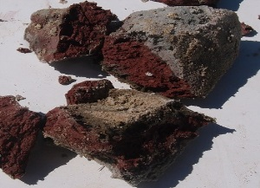
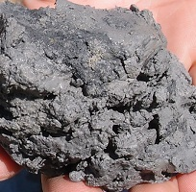
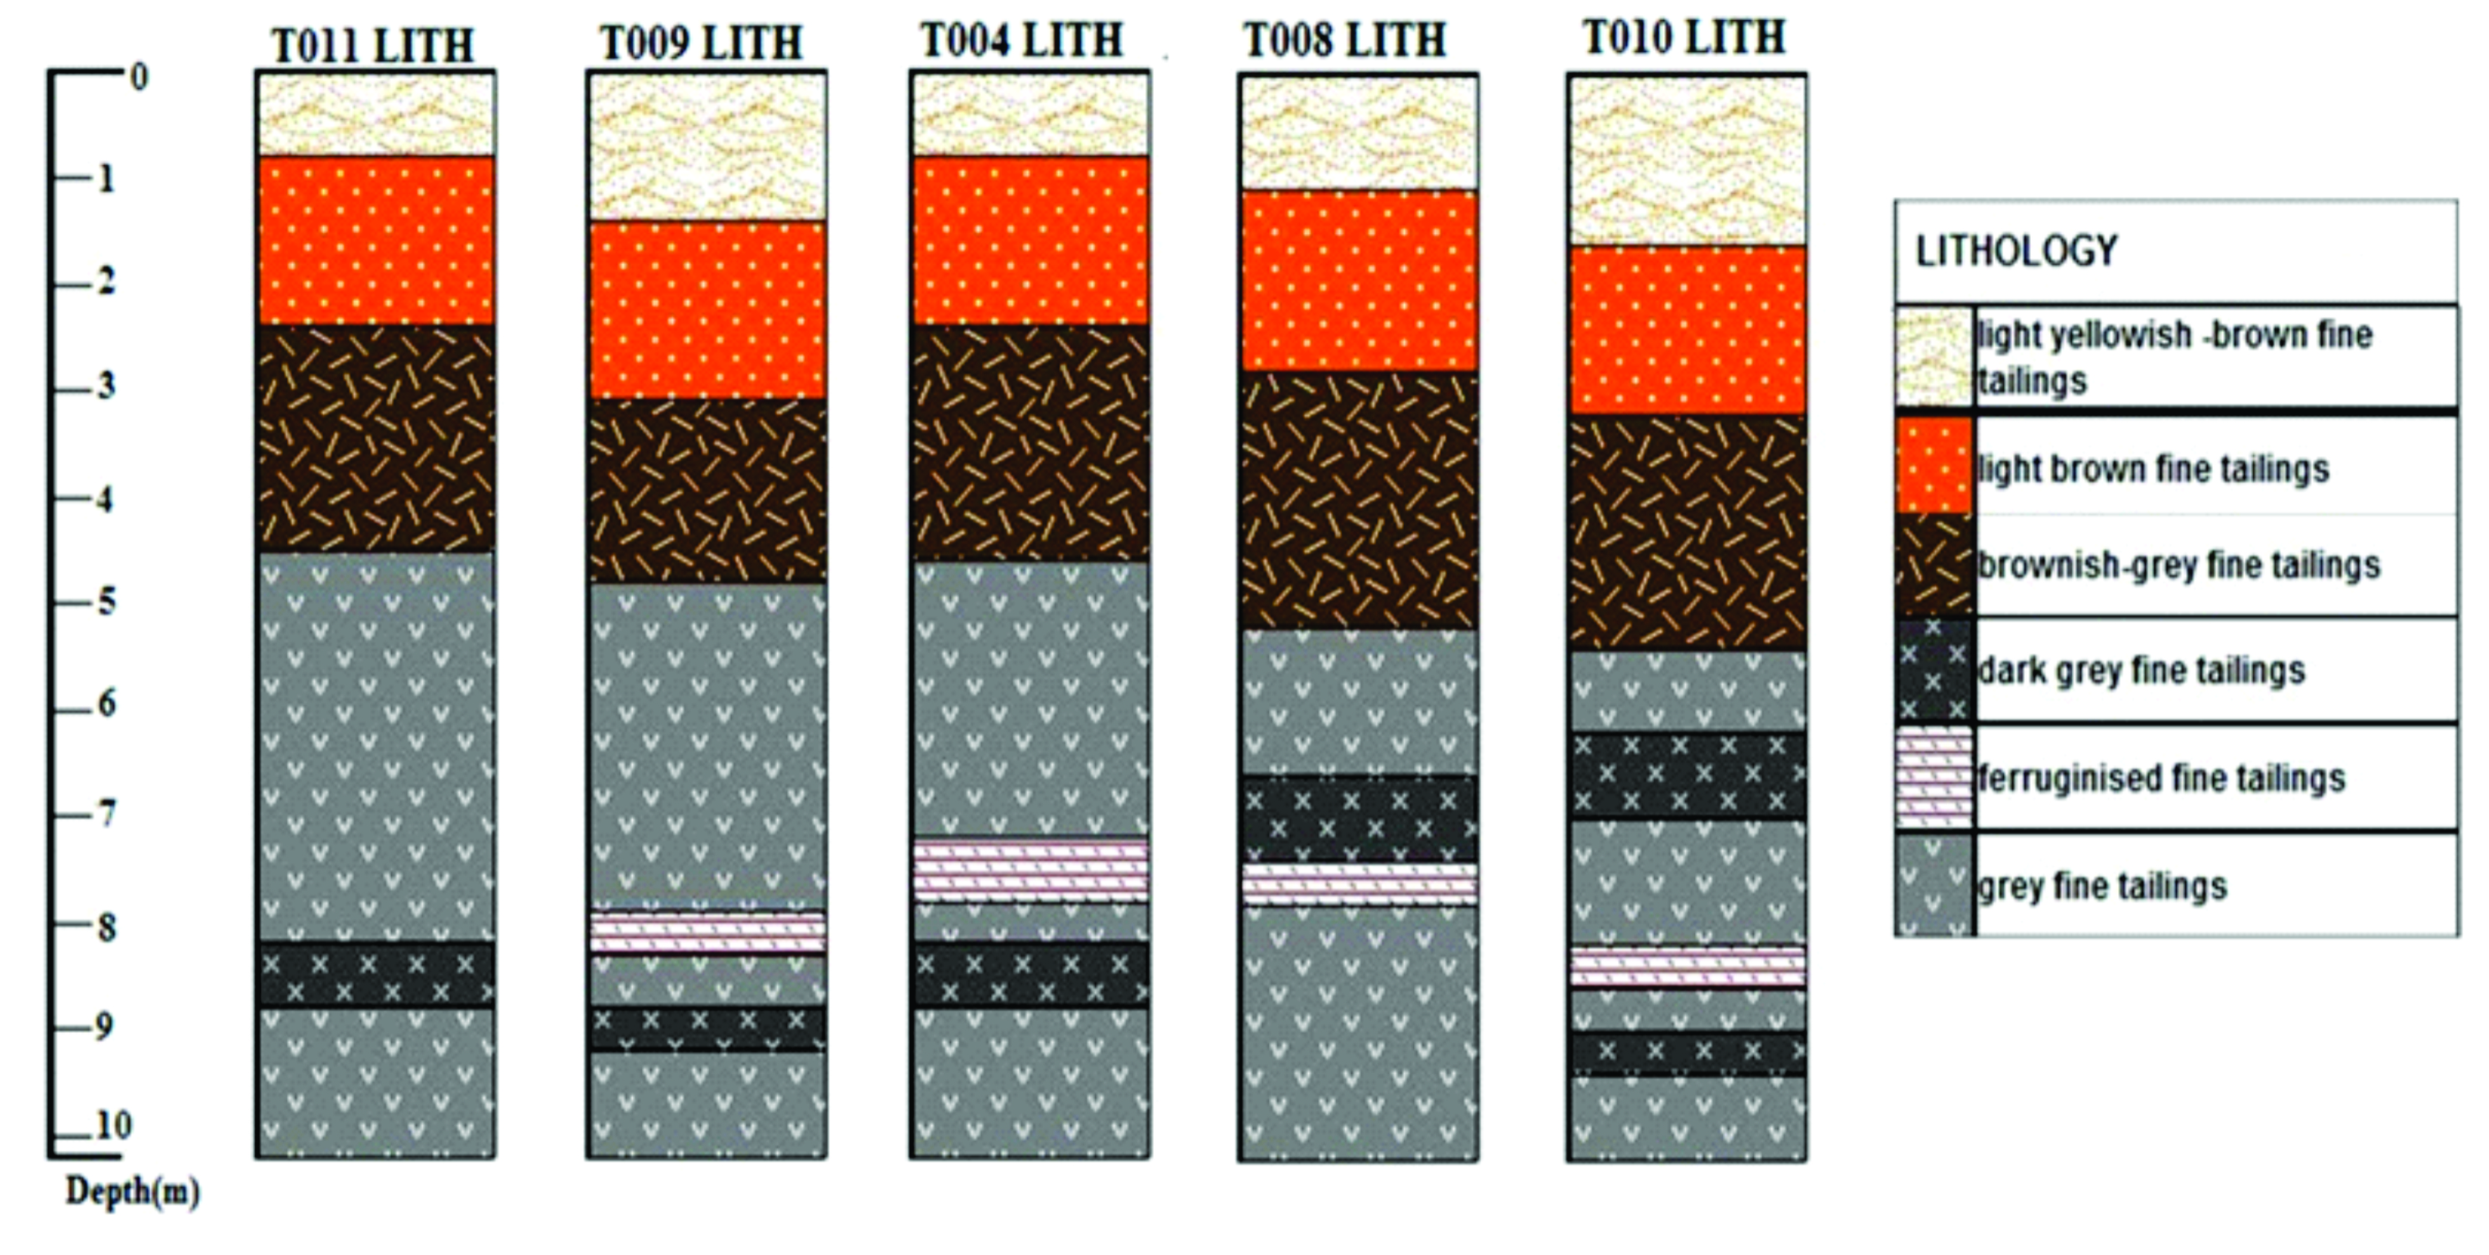
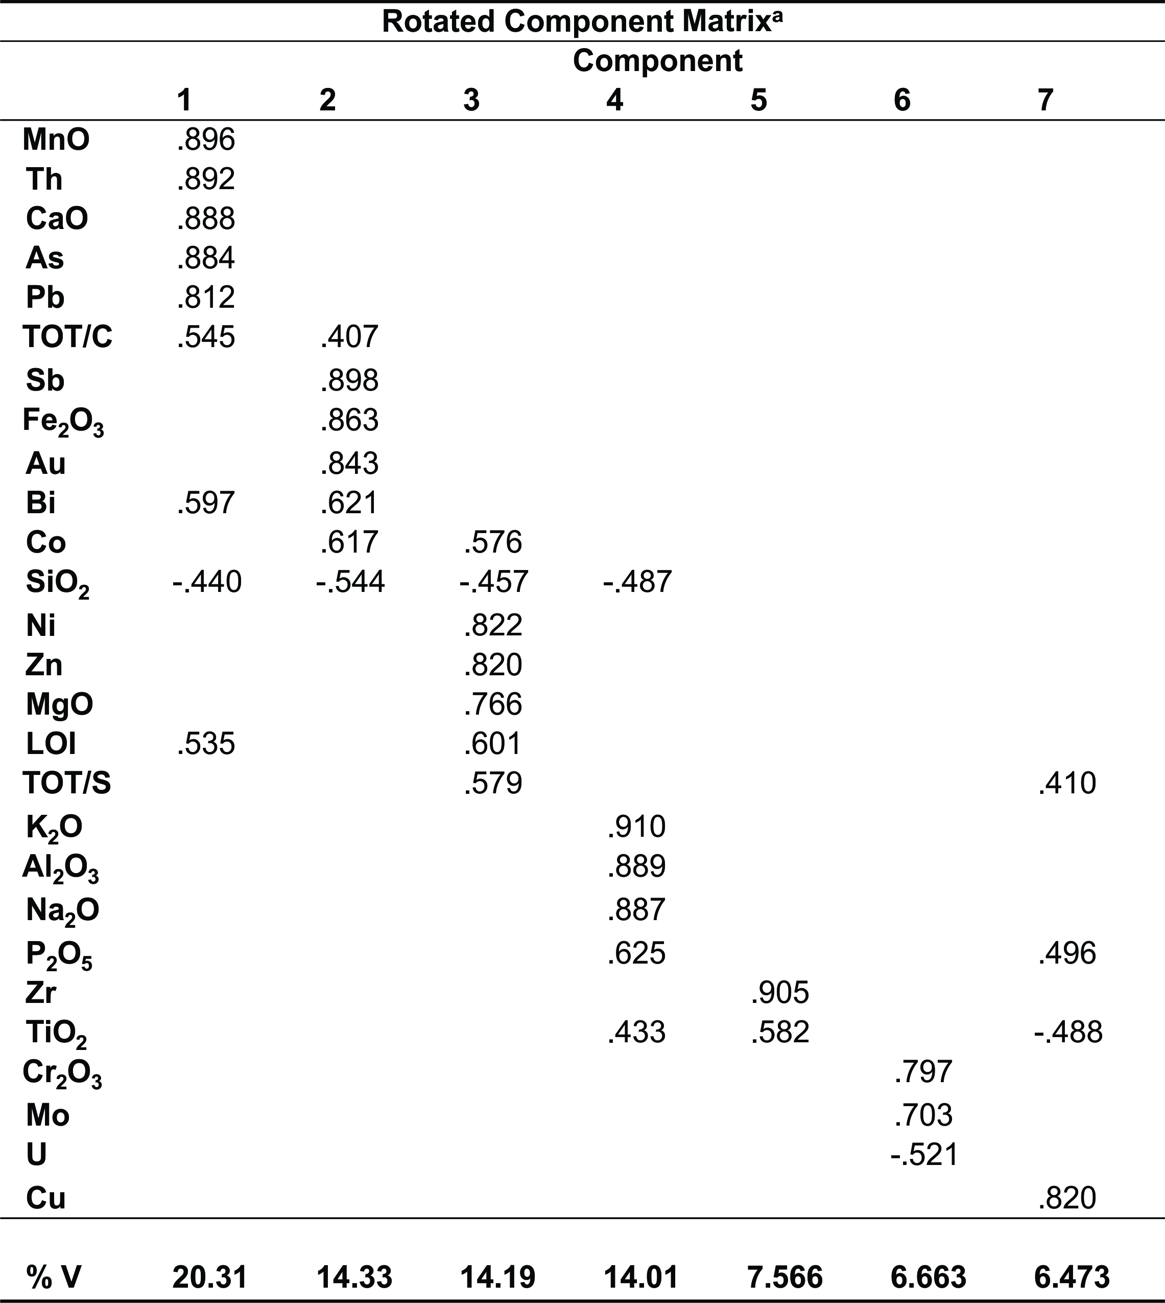



DISTRIBUTION PATTERNS OF CONTAMINANTS IN THE MOGALE GOLD TAILING DAM; CASE STUDY FROM SOUTH AFRICA
Earth Stewardship Science
Research Institute
O., Abegunde; C., Wu; C.D., Okujeni; and A., Siad
Department of Earth Science, University of the Western Cape., Bellville, Cape Town. South Africa
Correspondence to: cokujeni@uwc.ac.za
1. Introduction:
Gold mining occurs mainly in the Witwatersrand Basin and continues to expose the region to the threat of Acid Mine Drainage pollution from mine wastes and abandoned mines (Tutu et al., 2008).
In this study, multivariate statistical analysis and geochemical mass balance techniques were used to assess the magnitude of leachable metals and predict the AMD discharge into the environment over time from the Mogale tailing dam in the Randfontein area, Witwatersrand Basin, South Africa.
Geochemical Data Summary
The most prominent major elements present in the tailing dam are SiO₂, Al₂O₃, Fe₂O₃ and volatiles (LOI).
Layer 1 has highest contents of SiO₂ (87.32%) and the lowest contents in other major oxides and most trace elements_{5.}
A downwards decrease in silica contents and increase in U, Co, Cu, As, Ni, Au, Zn, Th, Zr downhole.
Peak contents of LOI, Fe₂O₃, CaO, MgO, Ba, Co, U, Zr, Cu, Pb, Zn, Ni, As and Au in layer 3.
The Paste pH value shows acidity in all layers while layer 3 showed the highest value of EC of 1.79mS/cm.
Geochemical Mass balance results
The mass balance results in Figure 4 show SiO₂ gain of 2- 3% in layer 1 coupled with a loss in Al₂O₃ and TiO₂ between 1-2 wt. %.
The trace elements loss or dispersion range from 0 to 8 ppm for Sb, Sr, V, Mo to about 80 ppm loss for Ba, Zr, , Pb, As, Co, Cu, U, Au, Ni and Zn, in increasing order.
Layer 2 shows a subdued gain in SiO₂ and a much reduced loss of Ba, Zr, Pb, As, Co, Cu, U, Au, Ni and Zn, also in increasing order.
Pronounced gains in trace elements occur in Layer 3; from 4 ppm gain for Sb, Sr, V, Mo to about 80 ppm for Ba, Zr, , Pb, As, Co, Cu, U, Au, Ni and Zn in increasing order.
Layer 4 shows insignificant loss or gain of major and trace elements with the exception of As and vanadium.
Table 1: Geochemical data summary
Cluster Analysis
From Figure 3, two main clusters further comprising two sub-clusters are defined by SiO₂ and Al₂O₃ contents.
Main Cluster I represents samples which are rich in SiO₂ but low in Al₂O₃ while main cluster II reflects samples that are rich in Al₂O₃ but low in SiO₂.
Most samples in layer 1 fall within sub- cluster 2 which shows the highest contents of SiO₂ and lower content of Al₂O₃.
All samples in layer 3 fall within in sub-cluster 3 which are with highest Al₂O₃ and lowest SiO₂.
Figure 4: Histogram showing the geochemical mass balance results
Figure 1: Map of the study Area
Mass balance prediction
Cumulative rate of alteration = Σ^{i}_{n} ΔCi/T in which ΔCi is the loss or gain for element i, T is the time of existence in years and n is the number of elements analysed for and i is the element analysed for.
From the result in table 3, 0.122% of elements in layer 1 are lost yearly while 0.042% of elements in layer 2 are lost.
Layer 3 shows a noticeable enrichment that indicates that certain portions of elements leached from layer 1 and 2 are trapped within Layer 3.Therefore, it could be said that 0.164% (±0.02%) of the tailing dam is leached yearly.
2. Methodology:
Five holes were drilled through the tailing dam to a depth of 10 meters and sampled at one meter interval. The drilled cores were logged for changes in colour, texture and mineralogy.
Fifty-one drill core samples were analysed for multi-elements and evaluated using multivariate statistical (Zhang & Selinus, 1998; Alkarkhi, et al., 2009) and geochemical mass balance techniques(Mukherjee & Gupta, 2008; Lopez-Moro, 2012).
Table 3: Rate of AMD generated in respect to time
4. Conclusions:
Quartz, Jarosite and gypsum contents are higher in the upper horizon while pyrophyllite, pyrite, hematite and muscovite contents dominate in the lower horizons.
The cluster analysis revealed that the distributions of minerals and elements are defined by SiO₂ and Al₂O₃ contents. The highest SiO₂ and Al₂O₃ concentrations occur in the upper and lower horizons respectively.
The factor analysis revealed seven factors controlling element distribution, of which clay, additives, and sulphides are the major ones.
The mass balance calculations showed that the tailing dam has been oxidised to a depth of 3-4 meters with significant loss in major and trace elements.
Overall, it is estimated that about 0.164% (±0.02%) of the tailings materials are leached yearly.
The reddish Au rich layer occurs at a depth of ~7 meters, which is of sub-economic value.
Plate 1: Side view of the tailings dam sampled
Figure 3: Dendrogram showing the results of HCA
3. Results and Discussion:
Petrography
The Mogale tailing dam comprises of 4 layers: i.) a topmost oxidized layer with a whitish yellow to yellowish brown colour, which is underlain by ii,) a brownish grey coloured layer and further down by a reddish coloured layer and grey coloured layer at the base (Figure 2).
The above horizons are composed of varying proportions of quartz, muscovite, pyrophyllite, gypsum, jarosite/hydronian, delhayelite, hematite, pyrite and clinochlore based on the XRD results.
Quartz, Jarosite and gypsum contents are higher in the upper horizon while pyrophilite, pyrite, hematite and muscovite contents dominating in the lower horizons
Factor analysis results
There are seven controlling factors of element distribution. The first four factors are considered because of their significance to the study.
Factor 1, which displays positive scores for CaO not only relates to the presence of silicate minerals but also other additives during mineral processing and tailings deposition.
Factor 2 with positive scores for Fe₂O₃, Sb and Au show the presence of Au enrichment in certain layers and its association with Sb and Fe₂O₃.
Factor 3 with positive scores for total sulphur underpins the influence of sulphides on the distribution of chalcophile elements.
Factor 4 with positive scores for Al₂O₃ underpins the enrichment of clays with depth
5. Reference:
Alkarkhi, A.F., Ismail, N., Ahmed, A. & Mat Easa, A. 2009, "Analysis of heavy metal concentrations in sediments of selected estuaries of Malaysia—a statistical assessment", Environmental monitoring and assessment, vol. 153, no. 1-4, pp. 179-185.
López-Moro, F.J. 2012, "EASYGRESGRANT—A Microsoft Excel spreadsheet to quantify volume changes and to perform mass-balance modeling in metasomatic systems", Computers & Geosciences, vol. 39, pp. 191-196.
Mukherjee, P. & Gupta, P. 2008, "Arbitrary scaling in ISOCON method of geochemical mass balance: An evaluation of the graphical approach", Geochemical Journal, vol. 42, no. 3, pp. 247-253.
Tutu, H., McCarthy, T. & Cukrowska, E. 2008, "The chemical characteristics of acid mine drainage with particular reference to sources, distribution and remediation: The Witwatersrand Basin, South Africa as a case study", Applied Geochemistry, vol. 23, no. 12, pp. 3666-3684.
Zhang, C. & Selinus, O. 1998, "Statistics and GIS in environmental geochemistry—some problems and solutions", Journal of Geochemical Exploration, vol. 64, no. 1, pp. 339-354.
Table 2: Principal component analysis for layers (Extraction Method: PCA; Rotation Method: Varimax with Kaiser Normalization)
Acknowledgements:
Figure 2: Lithology of the five drilled holes sampled
Abegunde Oluseyi would like to thank Inkaba yeAfrica, DST, NRF, GFZ as well as my supervisors Prof C. Okujeni and Dr A. Siad. I also thank Iris Wu for her support.

