Slide 1


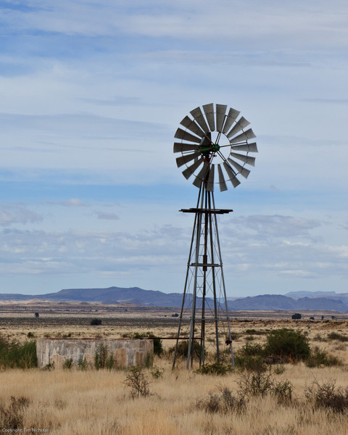
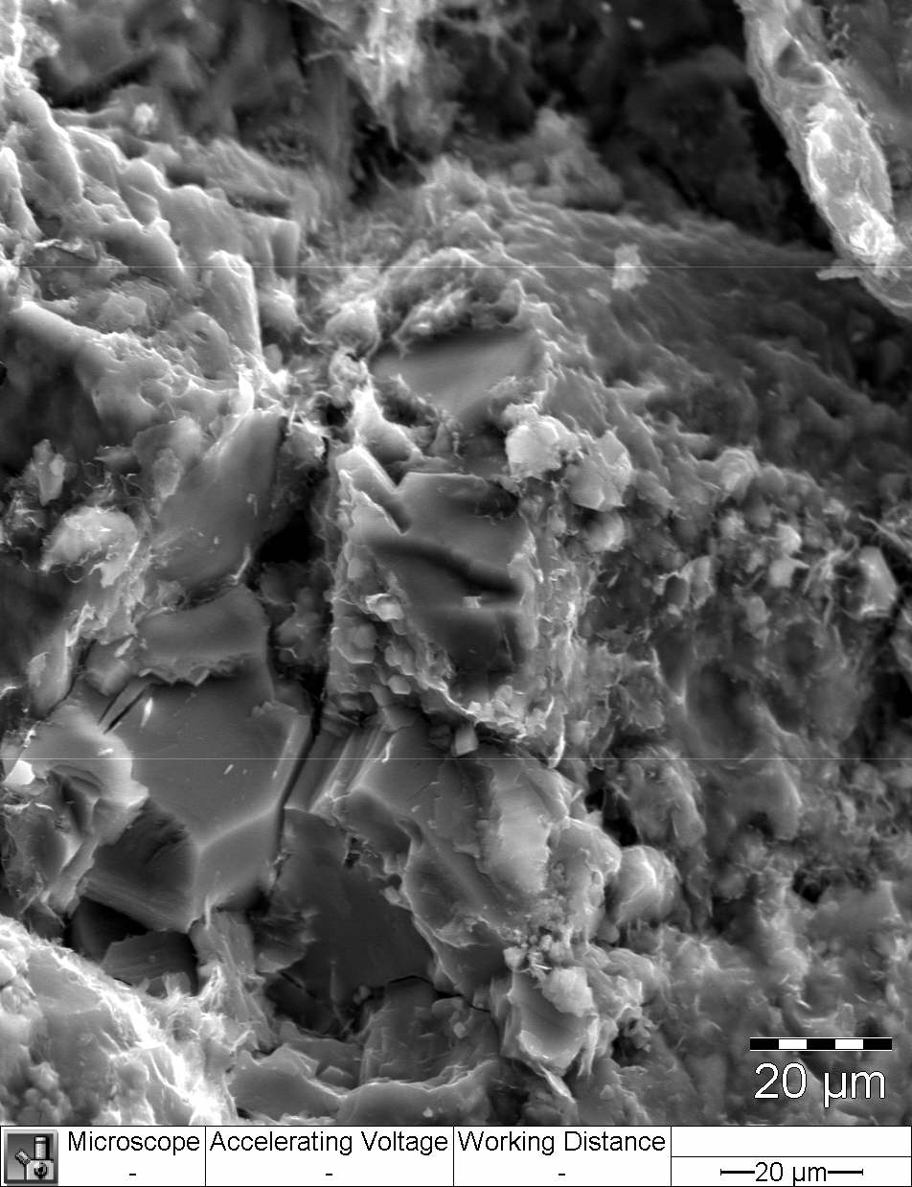
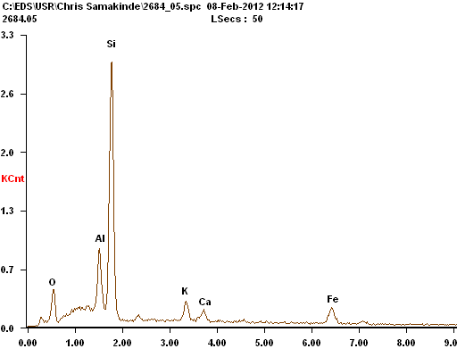
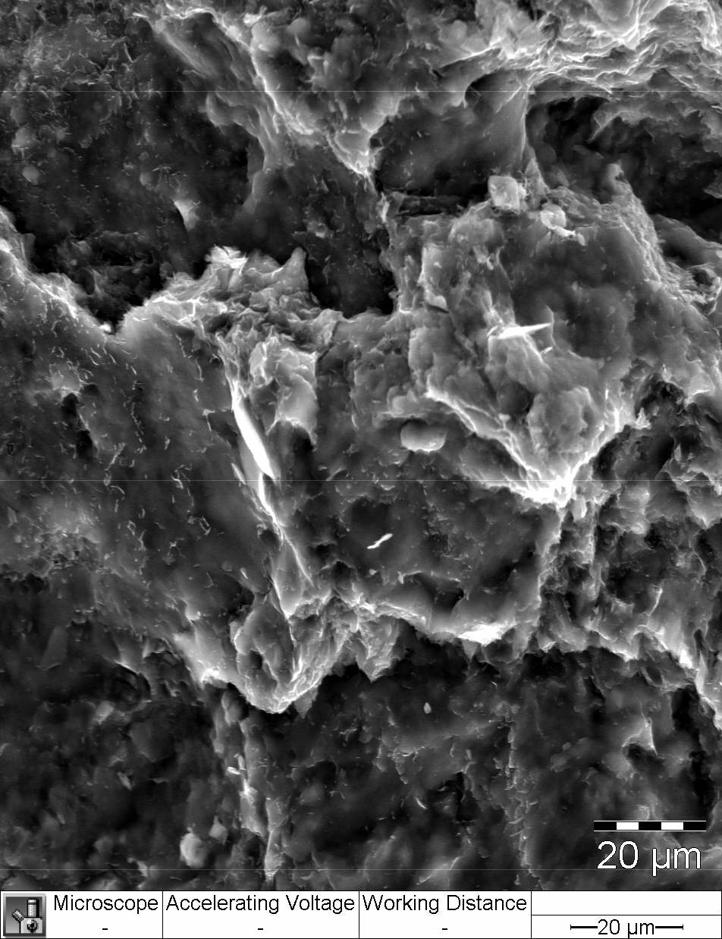
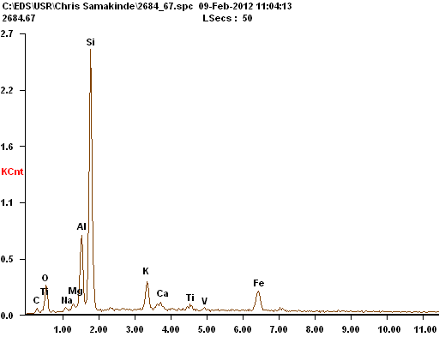
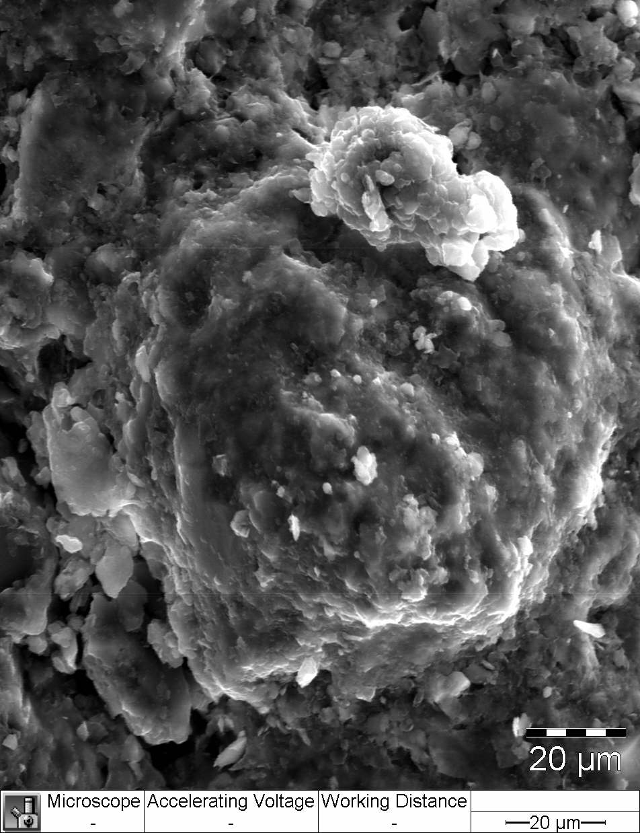
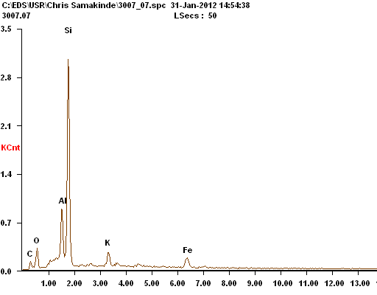
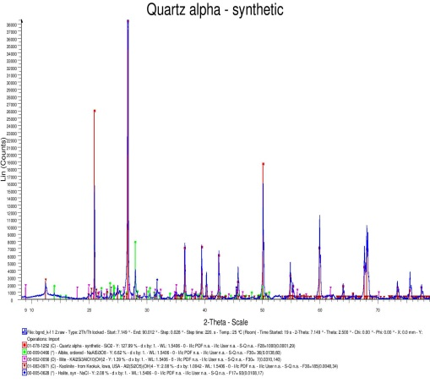
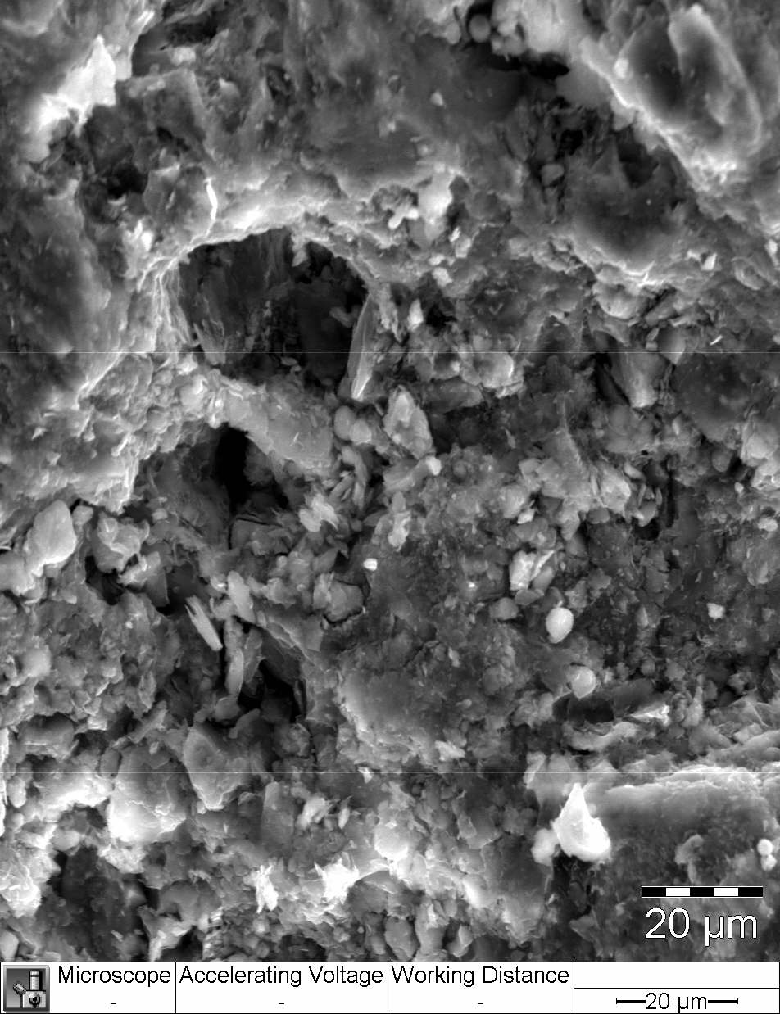
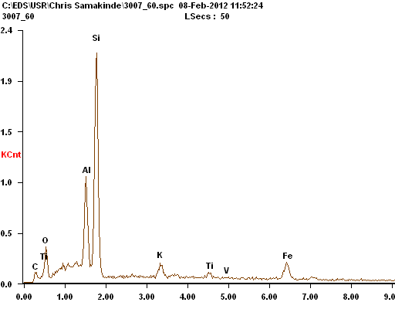
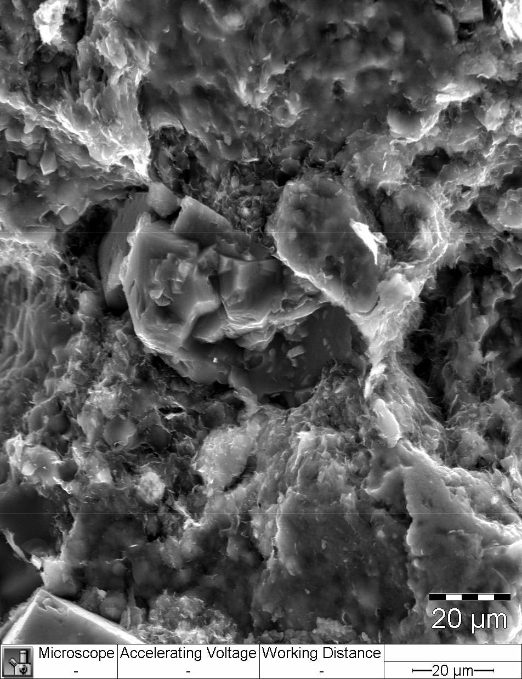
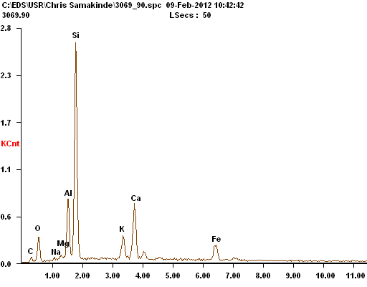
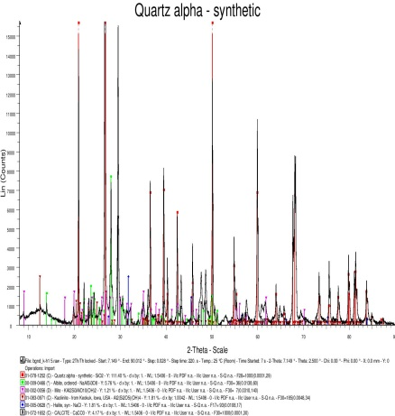
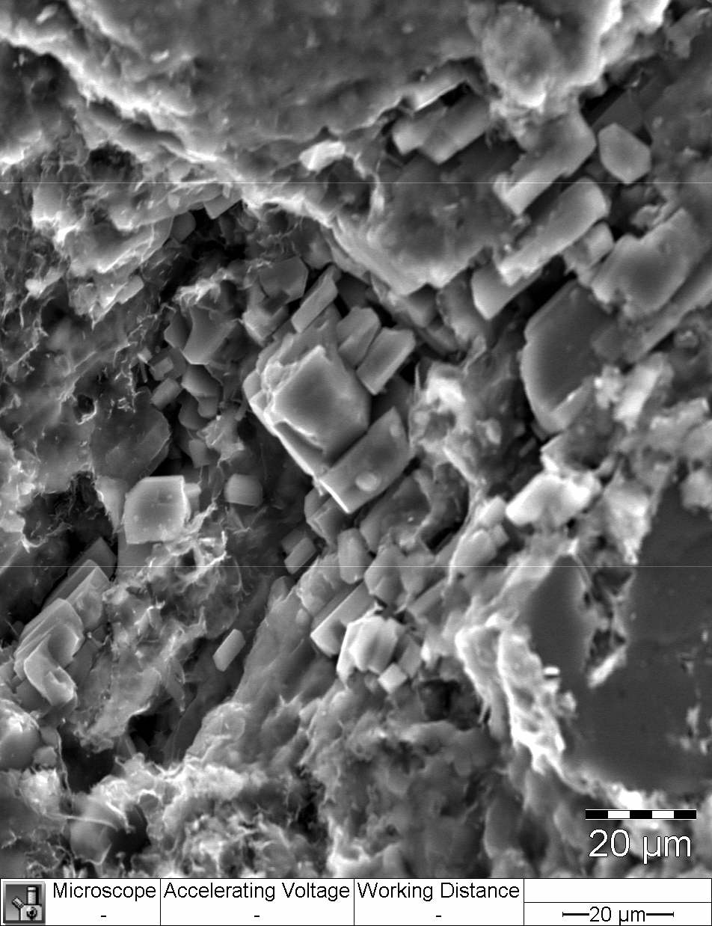
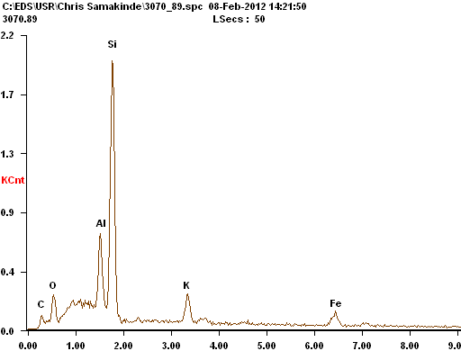
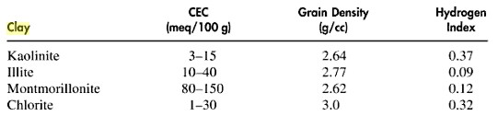
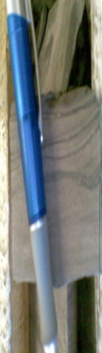
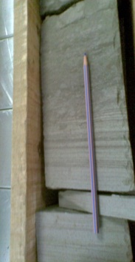
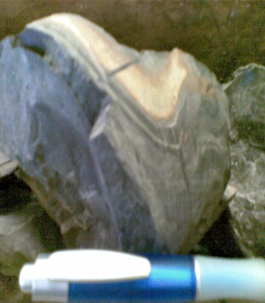



Assessments of the Effects of Clay Diagenesis on Some Petrophysical properties of lower
Cretaceous sandstones, offshore Orange basin, South Africa.
Chris Samakinde, Mimonitu Opuwari, Jan van Bever Donker,
1 1
University of the Western Cape
Department of Earth Sciences
Bellville, South Africa.
A
Introduction
Clay minerals diagenesis and its effects on the petrophysical properties of clastic reservoirs is an integral part of reservoir quality prediction and an important aspect in building an accurate reservoir model. Previous studies on the Orange basin revealed that chlorite and quartz cements have significantly compromised the reservoir quality in this basin but it is expected that the reservoirs show better improvement basinward (deeper waters), an analogy of this is displayed by Tertiary sandstones deposit, offshore Angola. This poster present results from reservoir quality evaluation performed by integrating geological, geochemical and geophysical tools to substantiate the effects of clay minerals distribution and its subsequent diagenesis on the intrinsic properties (porosity, permeability and saturation) of reservoirs encountered within three wells in block 3A (deeper waters), offshore Orange basin.
Results (Petrography
4
Q
A
P
M
Q
k
SEM, XRD AND EDS from core sample showing quartz and kaolinite at depth of 2684.05m for AU1well
SEM and EDS from core sample showing pyrite at depth of 2684.67m for AU-1 Well
K
Q
P
Po
A
i
SEM and EDS from core sample showing
pore filled kaolinite at depth of 3007.60m for
KF-1 Well
SEM, EDS and XRD from core sample showing chlorite and albitization at depth 3007.07m for KF-1 well
3A12Si2O5(OH)4 + 2KA1Si308 + 2Na 2NaAlSi308+ 2KA13Si30₁₀(OH)₂ + 3H ₂0 (Grigsby,2001)
pO
Q
K
I
K
H
I
Ca
SEM, EDS and XRD from core sample showing mixed I and Kaolinite at depth 3069.9m for KH-1 well
SEM and EDS from core sample showing pore filled kaolinite( Dickite) at depth of 3070.89m for KH-1 Well
Figure1: Location map of study area in Orange Basin, Offshore South Africa showing wells of study
Methodology and Materials
2
Figure 4: SEM, EDS and XRD at selected depth of three wells studied
Core Description for lithology identification , depositional environment determination by observing different sedimentary structure estimation.
Estimation of Petrophysical properties (Porosity, Permeability and Saturation) from wireline logs using different petrophysical models in the interactive petrophysics software and juxtaposed with the values from core analysis reports to ascertain precision.
Petrographic` analysis (SEM,XRD, EDS) to identify different types of diagenetic clay minerals present in the reservoirs, identify different elements that could be a pointer to the type of clay minerals and to observe the effects on pore spaces.
Geochemical analysis (pH, EC, TDS and CEC) to calibrate with the observations made from Petrographic analysis, understand the effects of pore water chemistry on clay minerals diagenesis and to identify in specifics the type of clay minerals in the reservoirs.
Twenty core samples were analysed for Geochemical and Petrographic purpose
Results (Geochemistry)
5
After Worden and Morad (2003)
Analytical studies
Pore water Chemistry plots of AU-1 well
Geochemical studies
Petrophysical Studies
Petrographic Studies
Illite or Chlorite likely
Mixed clay mineral
Smectite Increase
Pore water chemistry
Cation exchange capacity
X-ray Diffractometre
Porosity estimation
Permeability estimation
SEM/EDS
Thinsection Analysis
Saturation estimation
6
Conclusions
Clay Diagenetic Model
Figure 5 Porewater Chemistry and CEC plots of wells studied
Figure 2: Analytical methods
The reservoir within KF-1 well is approximately 5m thick and has an extreme low permeability value averaging 0.01 md, core porosity of 10 %, sonic log derived porosity of 14.6 % and average gas and water saturation of 18 % and 82% respectively (Simandoux model). AU-1 well reservoir is 6.5 metres thick with an estimated average value of 10 % for neutron and density porosity,10% core porosity, permeability of 0.015md, VCL (volume of clay) of 32 % and water saturation value of 65 %. KH-1 well has a reservoir thickness of about 9 m while water saturation estimated from Simandoux saturation model is 50 %, Density porosity value is low with an average of 8.9 %, VCL of 30 % and extreme low permeability value of 0.09 mD. There were consistent presence of kaolinite, montmorillonite and quartz cement within the reservoirs of the three wells from observations made from SEM, SEM also revealed the presence of chlorite at a deeper depth, chlorite might have been formed from kaolinite due to the presence of Mg and Fe as observed from EDS plus alkaline pore fluids as interpreted from the pore water pH. SEM also revealed the presence of illite in KH-1 well which is not present in the other two wells (AU-1 and KF-1).
XRD confirms the presence of these minerals as observed from SEM interpretation and specifically the presence of illite in KH-1, it however does not indicate the presence of chlorite. Other cements such as albite, siderite, calcite and halite were also detected from the XRD .Thin section analysis reveals the presence of glauconite in KF-1 well and KH-1 well, this observation implies marine environment influence in the reservoirs, this is further justified by the detection of halite from XRD. The pH of pore waters in all wells ranges from slightly acidic nature to predominant alkaline pore fluids, specifically from 6.78 - 9.5 while CEC ranges between 27 - 64.5 meq/100g for AU-1 well, 5 - 6.6 meq/100g for KF-1 well, and 7.3 - 80.5 meq/100g for KH-1 well. The values above suggest the dominance of mixed clay minerals of kaolinite-smectite and smectite-illite layers coupled with the occurrence of chlorite and illite which may have formed at a later stage of the paragenetic sequence.
It was deduced that the pervasive cementation by quartz, calcite, montmorillonite, chlorite and illite cements exerted a major effect on the porosity and permeability of lower Cretaceous sandstones in block 3A, Orange basin. Judging by this study, the peculiar Orange basin reservoir quality problems persist and ultra deep waters may be further explored for reservoirs with better quality.
Results (Petrophysics)
3
AU- 1 wavy ripple marks at depth of 2685.39m
Parallel lamination at depth 3070m
KH-1
AU-1 Well
Parallel lamination at depth 3070m
Water escape structure at depth 3006.95m
Table 1: Petrophysical values Estimated
Wells | Volume of Clay (%) | Porosity (%) | Permeability(Md) | Water Saturation (%)
KF-1 | 20 | 13.6 | 0.09 | 86
KH-1 | 30 | 8.9 | 0.15 | 50
AU-1 | 32 | 10 | 0.15 | 65
KF-1 Well
Figure 3: Petrophysical properties estimated from logs in three wells
Acknowledgements:
Chris Samakinde would like to thank Inkaba yeAfrica, DST, NRF, GFZ as well as supervisors Mimonitu Opuwari and J van bever Donker .

