Slide 1
The role of the Geoscientist in the quest for energy resources in South Africa
Jan van Bever Donker
Department of Earth Sciences
University of the Western Cape
logo here…

Slide 2
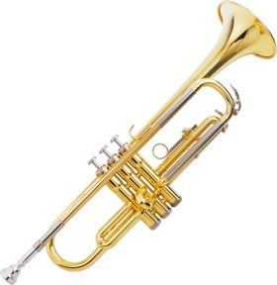
Who 111 am I?
Who am I?-1
1974 Doctorandus (=MSc) at Leiden University the Netherlands
1979 PhD University of Cape Town
1979 joined UWC as lecturer – study direction geology – in Arts faculty department of geography for physical geography students. 2 lecturers
1981 Geology moved from Arts to Science and offered 3rd year 1 student

Slide 3
Who -2 am I?
Who am I?-2
1981 Senior lecturer and Head of Department;
3rd lecturer appointed
1982 offered Honours to 3 students
1983 4th staff member
1985 Professor
1990 – 1998 Head of Department and Deputy Dean
1998 Head of Department
Mid 1998 Acting Deputy Dean- October 2000
2000 started work on Honours Petroleum Geology

Slide 4
Who -3am I?
Who am I? - 3
October 2000 – December 2011 Dean still teaching Honours
Built Life Sciences Building and Chemical Sciences Building
Grew faculty undergrad intake by 27% and grew post grad research capability dramatically.
Most PhDs at UWC from Science
11 SARCHI Chairs – 7 in Science + 1 UNESCO chair and 1 National Centre of Excellence
2012 Returned to Geology for structural Geology and Petroleum

Slide 5
Who a - 4m I?
Who am I? - 4
2013 first intake (10 students) structured MSc Petroleum Geology
April 2014 Geology moved to new building + some 50 post grads
01 May 2014 retired
May-July post retirement contract – finish semester, handing over running of Petroleum MSc and Inkaba
From 01 August Extra ordinary Professor – post grads only: 7 MSc and 3 PhD
18 September first 5 MSc Petroleum Geology students graduated

Slide 6
Why this topic
Energy crisis in South Africa
ESKOM
SA Rand
Credit Rating from Standard & Poor and others
Need to find solution
What can we here in this room do to improve the solution?

Slide 7
Energy sources
Nuclear
Pro’s
Con’s
Renewable
Solar
Wind
Fossil
Coal
Petroleum
unconventionals

Slide 8
Nuclear
Koeberg and Vaalputs
Crustal stability
Near or on a fault ……

Slide 9
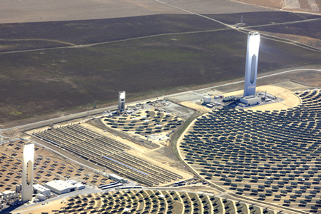
Solar
Groblershoop
Upington
Pofadder

Slide 10
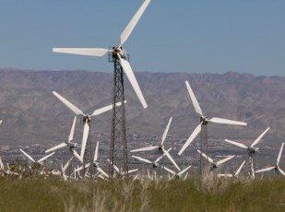
Wind
Klipheuwel test site with 4 turbines 1.5 Mw ea
Darling test site with 4 turbines 1.5 MW ea
Caledon will have
Wind farm
3500 ha
300 MW

Slide 11
Fossil
Coal
Air pollution
Acid Mine Drainage
Groundwater?
Petroleum
Air pollution
Unconventionals
Unknown resource
Energy balance?

Slide 12
Fracking
The USA experience

Slide 13
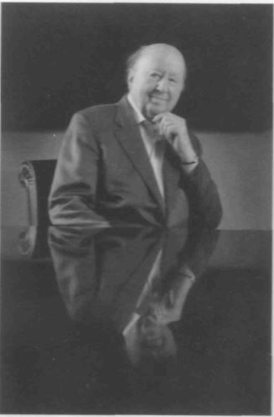
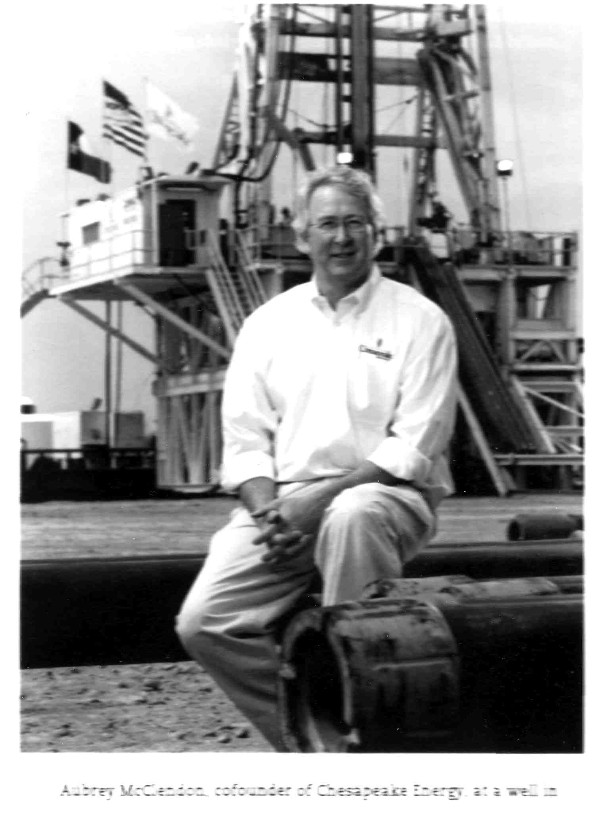
The Frackers
George Mitchel Aubrey McLendon

Slide 14
Fracking
Vertical drilling
Horizontal drilling
Fracking Fluid
Composition
Source of water
Contamination of groundwater
Disposal of fracking fluid
Pyrotechnics
SA Discussion in 2011 overwhelmingly Pro fracking

Slide 15
Fracking - some key questions
Will the full life cycle emissions be lower than that of coal?
Energy return of energy invested
Will drilling affect geological stability?
Integrity of sub-surface water resources
Picturesque character of the Karoo
Sub-contractor short-cuts

Slide 16
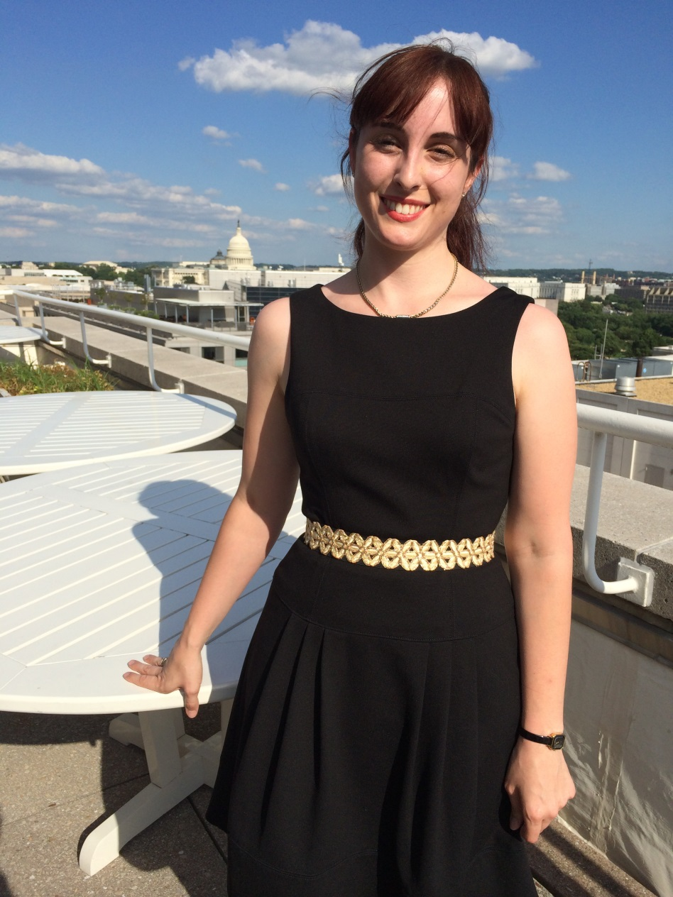
Policy making process
Jessica Ball
Policy advisor GSSA
Good experience
Helps with research
proposals

Slide 17
Which role model to follow?
George Mitchell or Aubrey McClendon the wildcatters?
Ultimately driven by greed to amass large fortunes
The opportunists who build exporting terminals
bounty hunters prepared to take huge risks
Jessica Ball who went into governance
Really the power game

Slide 18
Which role model to follow?
Mine as one of administratively facilitating of other people’s careers
Not advisable for an academic in todays academic world
Neither, rather just be yourself and find aspects of all of the above in your own life to build your own career

Slide 19
Some general rules of thumb
Never forget we are scientists and be sure to know our facts when entering a debate
Rather withhold an opinion than making a fool of yourself when later having to withdraw a wrong statement made in haste
Join the legislative side for the right reasons

Slide 20
Some general rules of thumb
Be aware that there are always two sides to an argument
Never “rubbish” the opposition
Be honest and accept you can be wrong
Apologise when necessary as it will not harm you
Don’t fight bureaucracy rather play the system

Slide 21
Thank You

