Slide 1
10th Inkaba yeAfrica/!Khure Africa (AEON) Conference/Workshop
Lord Milner Hotel, Matjiesfontein - Karoo
29 September – 3 October 2014
Numerical Analysis of Finite Strain in the Warm Zand Structure
(1)E.Saffou, (2)J. van Bever Donker , (3)R.Bailie, (4)J.Aller ^{(1,2,3)}Department of Applied Geology, University of the Western Cape(UWC) ⁴Department of Geology , University of Oviedo (Spain)
Notes:
1
The strain is a deformation produced in an object when it is placed under stress. For example if I apply a compressional force on the book it will result to a strain or a deformation call fold.

Slide 2
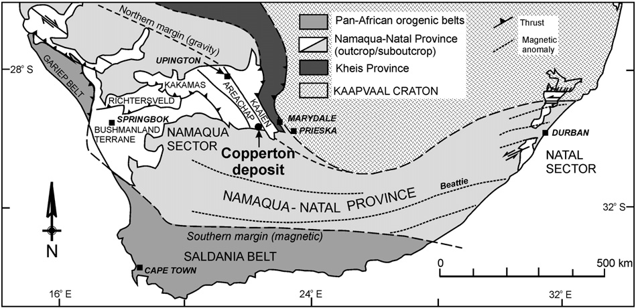
Kakamas Terrane
Notes:
In the namaqua sector we have geological terrane called Kakamas Terrane

Slide 3
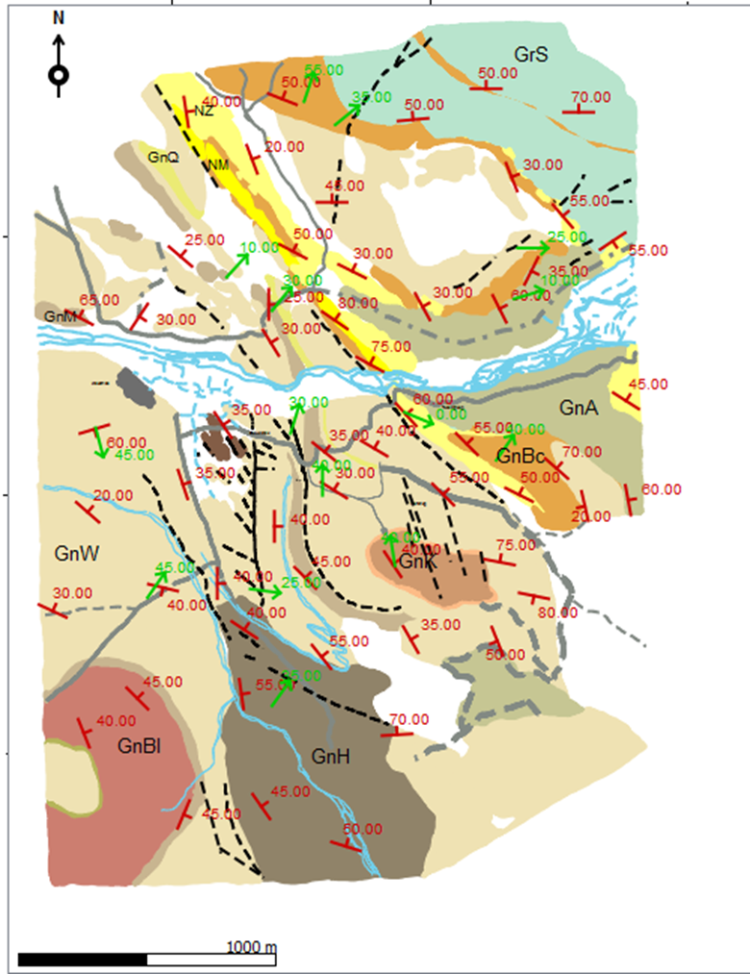
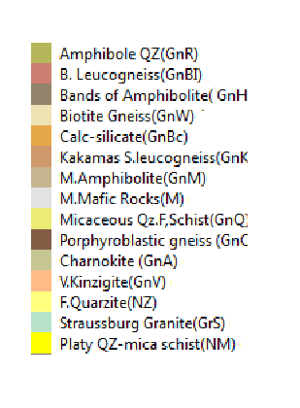
Study Area
Fault
Road
River
Lineation
Dip
(After Jan Bever Donker , 1979)
Notes:
Here is the Map of Kakamas terrane after JBD, the box here shows the Warm Zand Structure.

Slide 4
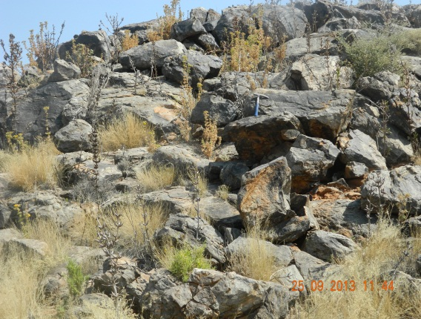
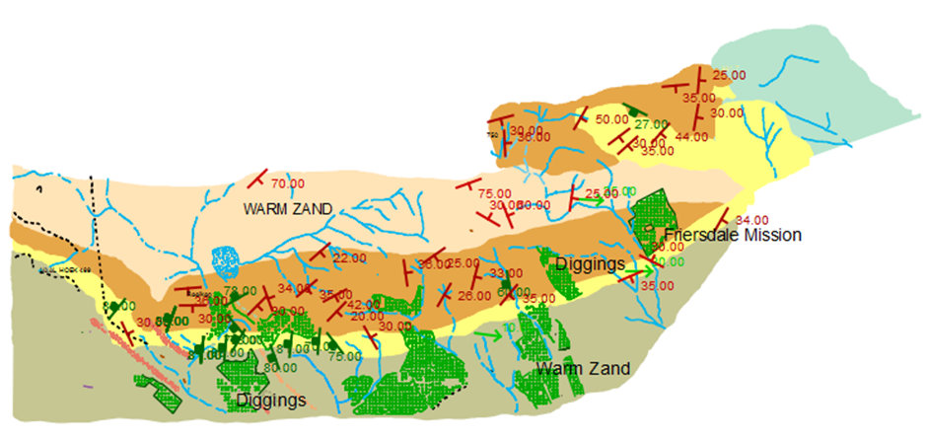
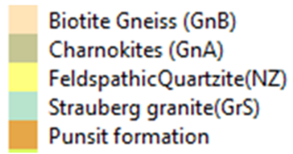
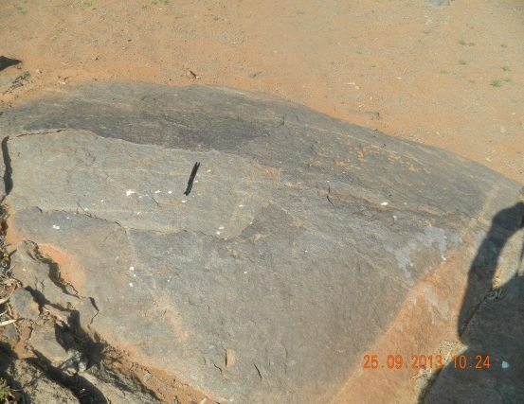
Warm Zand Structure
Notes:
The Warm Zand structure was mapped as dome originate by the interference between D2 and D3 pharse of deformation is made up of the Groede Hoop formation (Quartzites), Punsit formation (Calc-silicate) , Biotite Gneiss and post granitic intrusions, such as the Friesdales Charnokites.

Slide 5
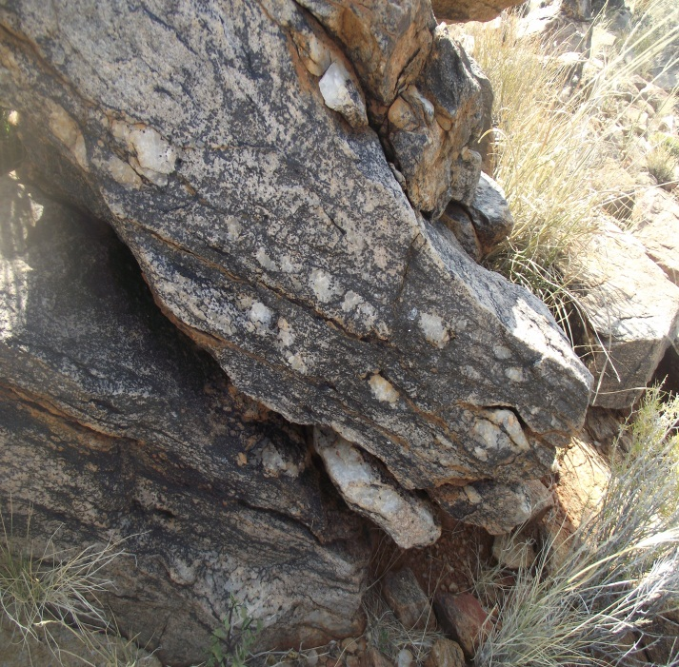
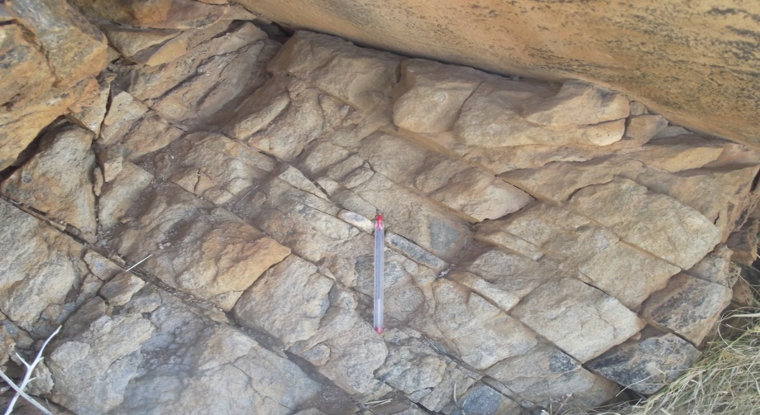
Feldspathic Quartzites
South East
d
30
Notes:
Youngest formation the in the Warm Zand structure, mainly musciovite feldspathic Quartzites, feldpathic appear massive, intense fractures and formed boulder hill, in some area or well stratified dipping south east .

Slide 6
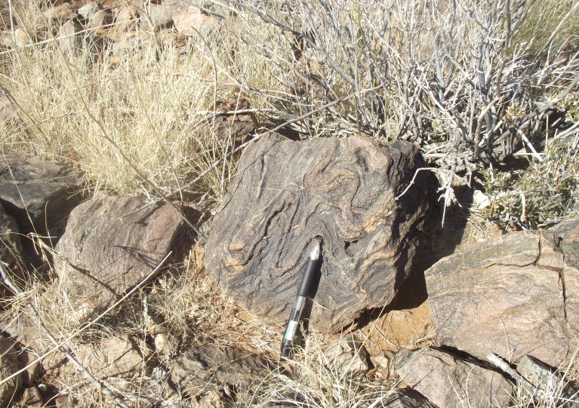
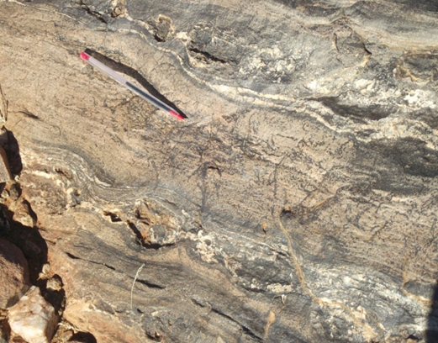
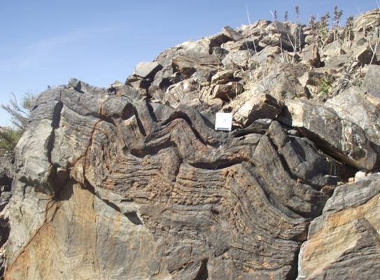
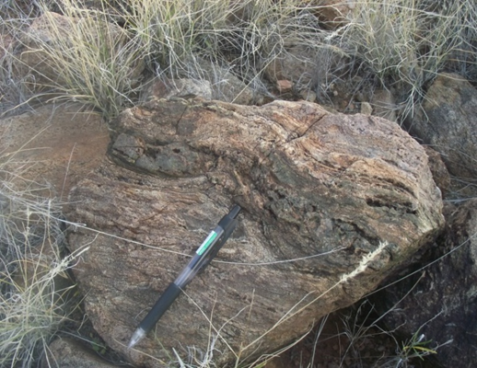
Calc-silicates
Single layer folding
Pinch-and –swell
Multilayer folding in the calc-silicates
Boundins

Slide 7
How do we measure the strain in an area that had been affected by high grade metamorphism such as the Warm Zand Structure?
Problem to solve
Challenges:
Strain markers were erased or destroyed by the metamorphism
To measure the strain you need to know the initial geometry and material properties of the rocks
Folds as strain marker
Strain Contour Map

Slide 8
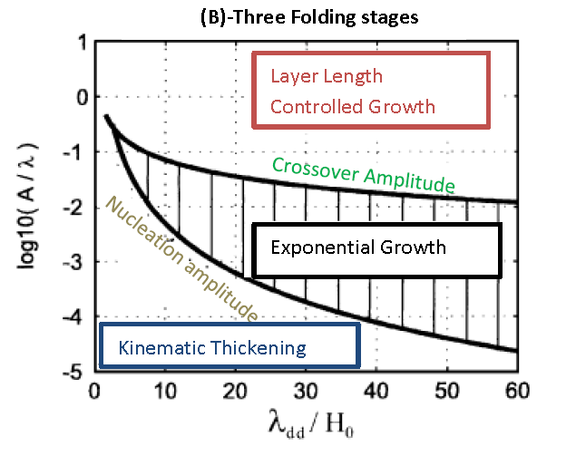
Strain Contour Map
Bulk strain accommodated by the fold
Infinitesimal strain
Notes:
Lab experiments and numerical study of folds show that the strain accommodated between the Nucleation amplitude and crossover amplitude is infinitesimal so the hence the bulk strain of the fold depends on the strain accommodated during the layer length controlled growth

Slide 9
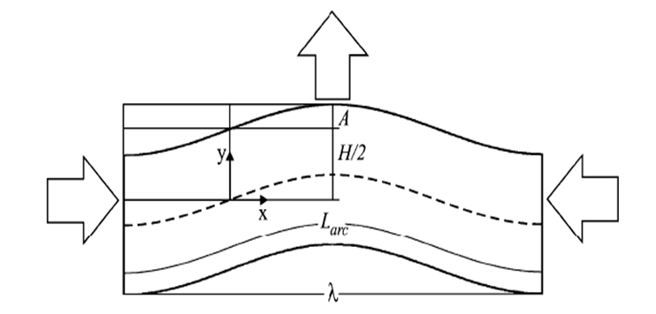
Strain Contour Map
Amplitude of Fold (A)
Thickness (H)
Wavelength ($λ )$
$$ε_{}=\frac{π^{2}Z^{2}}{1+Z^{2}(π^{2}+3)}$$
$$Z=\left\{\begin{aligned}A/λ+ C_{1 }H/ λ if H/λ/ <H_{50 } \\ A/λ+ C_{2 }H/ λ +\left(C_{1}−C_{2 }\right)H_{50 } if H/λ>H_{50 }\end{aligned}\right.$$
$$H_{50 }=(A/λ+ 0.22) / 2. 43, C_{1}=0.8, C_{2}=0.4$$

Slide 10
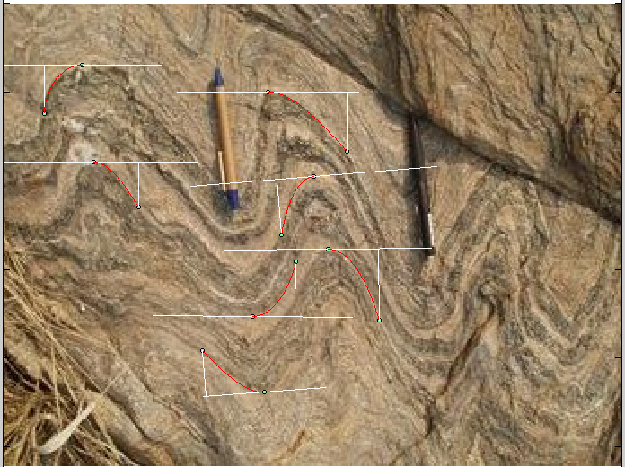
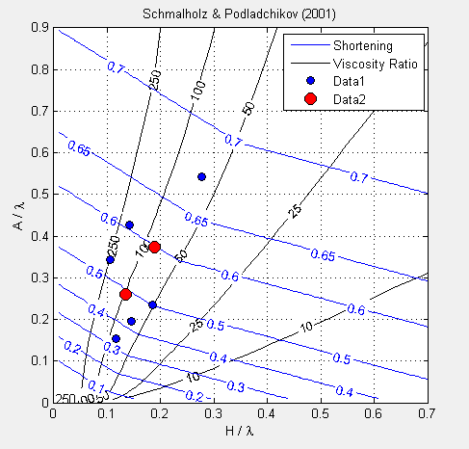
Strain Contour Map
Fold 1 (fold strain)
Bulk Strain % | Ind. Strain% | Strain Partitioning%
60 | 60 | 1
 | 55 | 5
 | 50 | 10
 | 42 | 18
 | 32 | 28
Rheology: Viscoelastic

Slide 11
How do folds accommodate strain in the Warm Zand?
We need to model the strain pattern in the folds

Slide 12
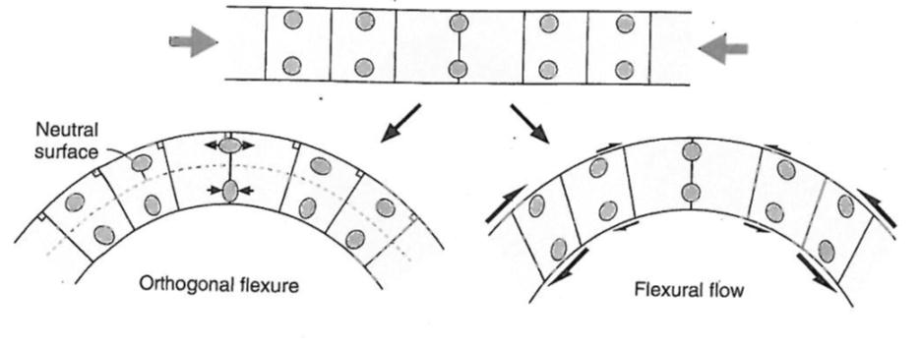
Fold Kinematic Mechanisms
Tangential longitudinal strain
Flexural Flow
Tangential Longitudinal Strain (TLS),
Flexural Flow (FF)
Flattening (FL).
Initial Layer Shortening (ILSH),

Slide 13
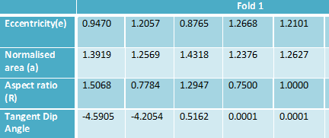
Mathematical Analysis of Fold Profile
Mathematical Modelling of Natural Folds
$$k=\frac{f^{′′}\left(x\right)}{[ {1+f′′{\left(x\right)}^{2}]}^{\frac{3}{2}}}$$
Fold Profile
$$= \left\{\begin{aligned} \frac{1−\sqrt{1−(1−e^{2})x^{2}}}{1−e^{2}} \\ \frac{x^{2}}{2} \end{aligned}\right.$$
$$f(x)$$
Conic functions
$$f(x,e)$$
Aspect Ratio
Eccentricity(e)
Notes:
It very exciting to see how we can use simple Mathematics to analyse fold. The aim here is to

Slide 14
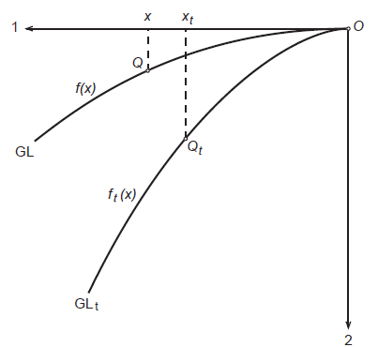
Mathematical Modelling of Tangential longitudinal Strain (TLS)
$\frac{dx_{t}}{dx}$ =$\sqrt{\frac{1+{f′(x)}^{2}}{1+{{f′}_{t}(x)}^{2}}}$ ; $x_{t}(0)$=$0$
$$h_{t}= \frac{h(2+hk)}{1+\sqrt{1+k_{t}h(2+hk)}}$$
Conic functions
$k=\frac{f^{′′}\left(x\right)}{{(1+\left\lceil {f^{′}\left(x\right)}^{2}\right\rceil )}^{3/2}}$ ; $k_{t}\frac{f^{′′}\left(x\right)}{{(1+\left\lceil {f^{′}\left(x\right)}^{2}\right\rceil )}^{3/2}}$
Computer code called TLS-1

Slide 15
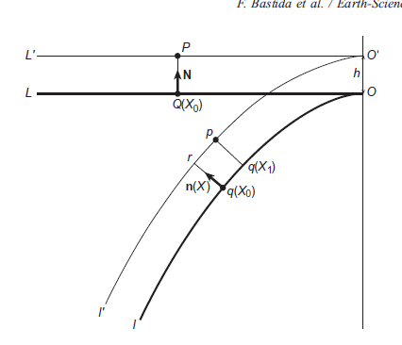
Flexural Flow(FF-2)
$\frac{dx_{t}}{dx}=\frac{\left|r′(x)\right|}{\left|r_{t}′(x)\right|}$; $x_{t}(0)$=0
$$\left[r\left(z\right)= \left\lceil ze_{1}+f\left(z\right)e_{2}+n\left(z\right)h,\right.\right.$$
$$n\left(z\right)= \frac{sign\left[f"(z)\right]}{\sqrt{1+{f′(Z)}^{2}}}\left[f^{′}\left(z\right)e_{1}−e_{2}\right]$$
Conic functions
Computer code called FF-2

Slide 16
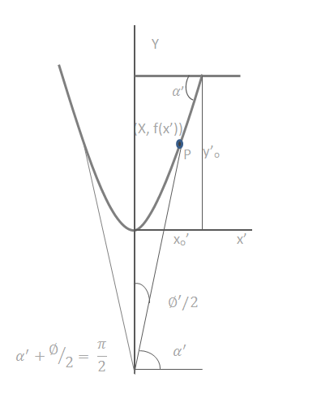
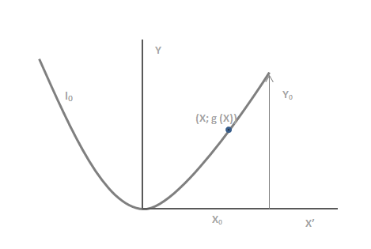
Flattening(FL-3)
Buckling
Flattening
$l_{o}=\frac{2}{\sqrt{λ_{2}}}\int_{0}^{{x′}_{0}}{\sqrt{1+{\frac{λ_{2}}{λ_{1}} f′\left(x^{′}\right)}^{2 }}}$ $dx′$
With f(x) belonging to conic sections family of functions
Computer code called FL-3

Slide 17
block1 = {2, {1, 0.5, 0}}; block2 = {1, {3, 0.5, 0}, {2, 0.5, 0}} block3 = {2, {3, matrix1}
Fold Simulation
Fold Kinematic Mechanism( 1-TLS; 2-FF; 3-FL; 4-ILSH
Block ={ n {N, h-increment, e-increment)
Aspect Ratio
Eccentricity
Pure shear
program1 = {block3, block1, block2}

Slide 18
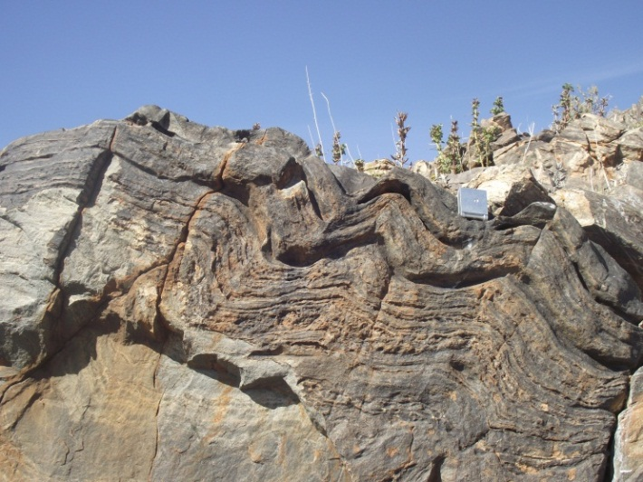
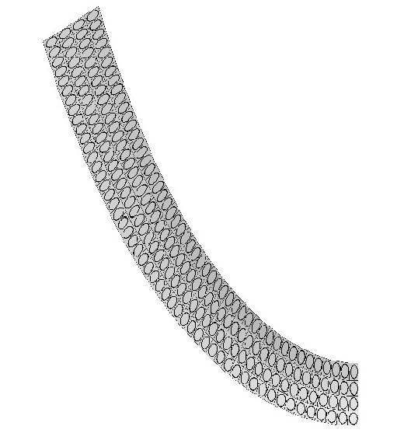
matrix = {0.8, 1.0}
block1 = {1, {1, 0.5, 0}}
block3 = {1, {3, matrix1}}
program1 = {block3, block 1 block3}
 | Theoretical fold limb f₉l₁ | Natural fold limb f₉l₁
Aspect ratio(R) | 0.9839 | 0.9761
Eccentricity(e) | 1.000 | 1.1026
Strain Pattern ( ILSH; TLS ; FL)

Slide 19
THANK YOU ?

