Slide 1


THE CAPE FOLD BELT – SOME STRATIGRAPHIC AND STRUCTURAL INSIGHTS
Peter Booth
Department of Geosciences,
Nelson Mandela Metropolitan University, Port Elizabeth.
logo here…

Slide 2
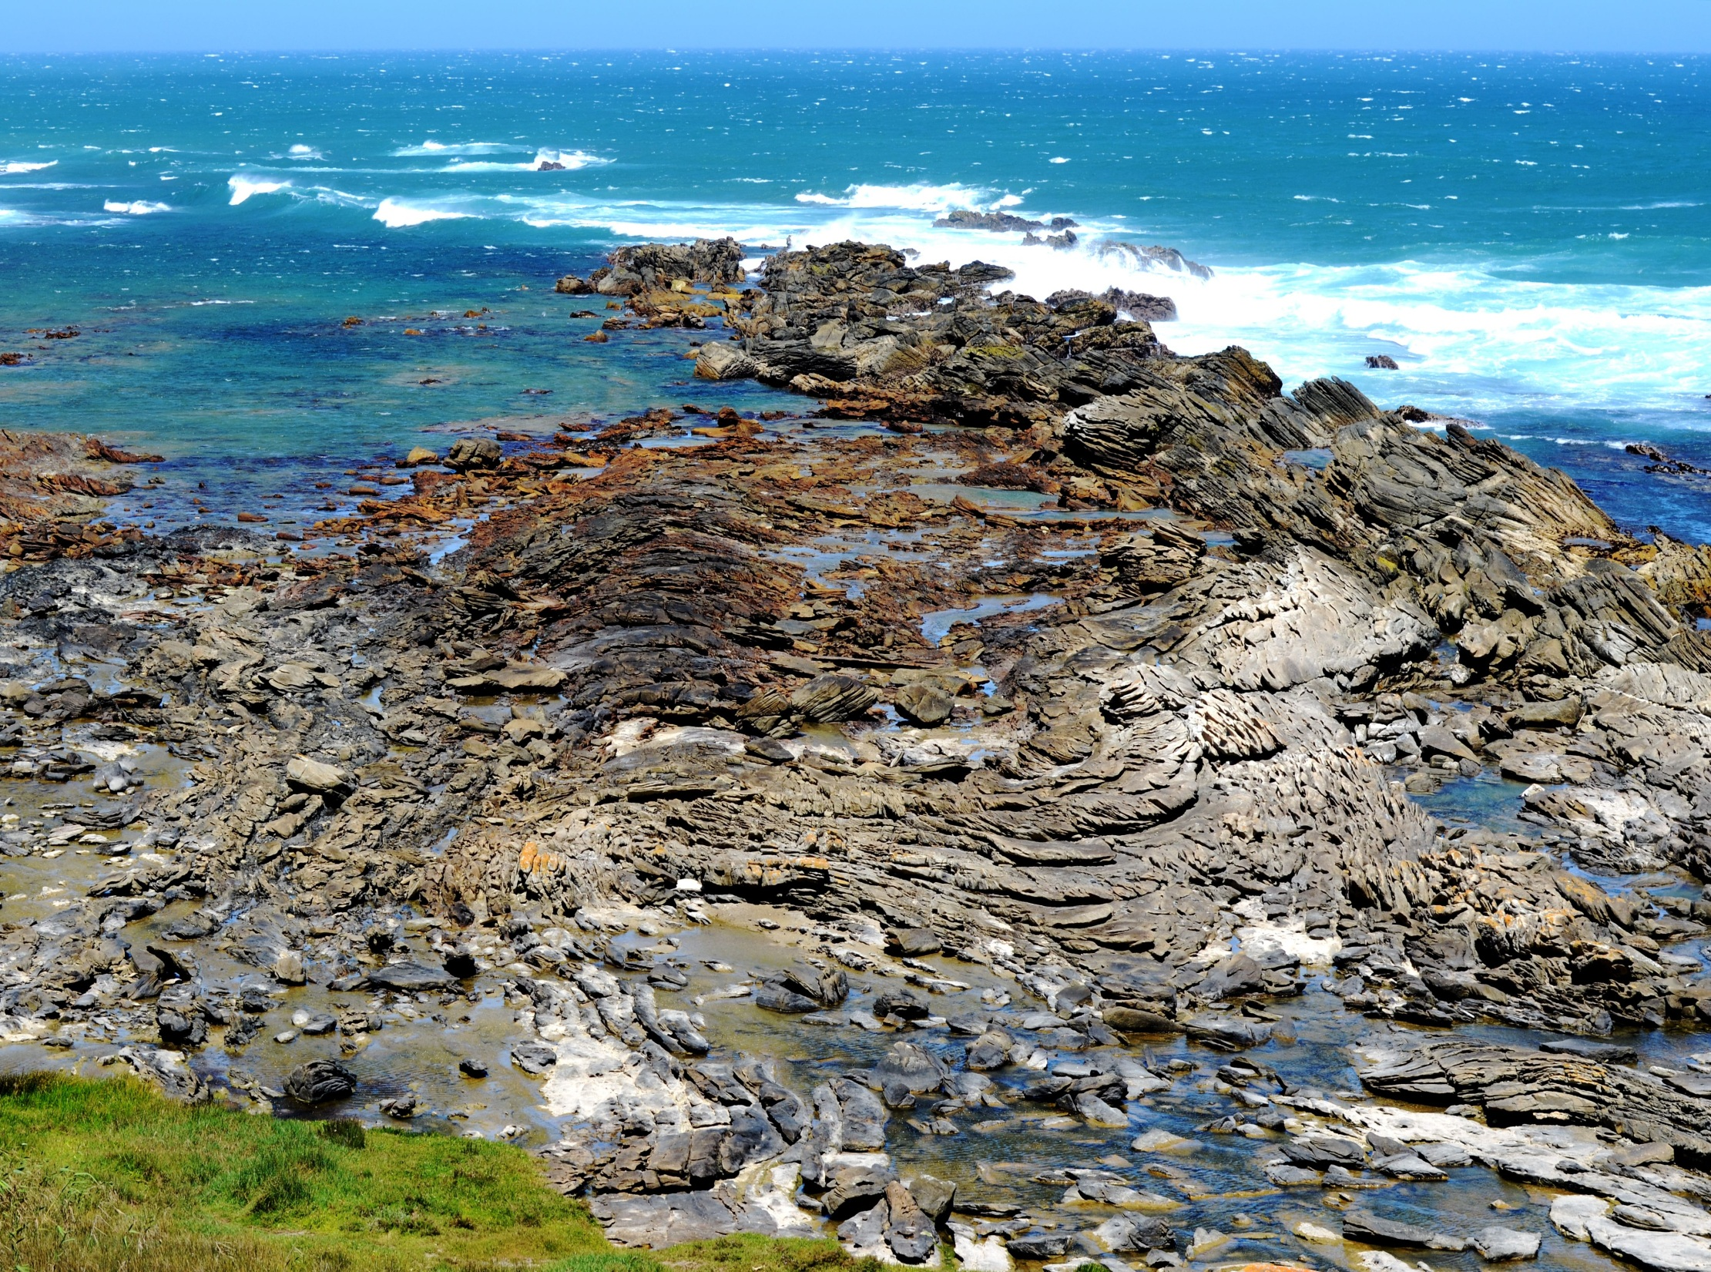
The Cape Fold Belt
Structures
Stratigraphic anomalies
Appropriate models

Slide 3
N
Mesozoic deposits
normal fault
Karoo Supergroup
thrust fault
Witteberg Group
Cape
Supergroup
structural trends
Bokkeveld Group
Table Mountain Group
Pre-Cape (basement)
32ºS
B’
limit of deformation
A’
B
S
L
S
L
O
U
Cape
Town
Port Elizabeth
George
A
200 km
AFFZ
20º E
24º

Slide 4
A
A’
Kango Fault
(South)
Ysternek
(North)
metres
Uniondale
2000
0
50 km
Karoo Supergroup
Witteberg Group
Bokkeveld Group
Cape
Supergroup
Table Mountain Group

Slide 5
STRATIGRAPHIC SEQUENCES
Ma
22O
Beaufort Group – sand/silt/mudstones (fluvial)
Ecca Group – sandstones/shales (turbidites)
KAROO
250
Dwyka Group – tillites/shales (glacial)
300
Witteberg Group – quartzites/shales
Bokkeveld Group – shales/quartzites
CAPE
470
Table Mountain Group – quartzites/shales
550
Cape Granite Suite
Malmesbury/Klipheuwel –graywacke/shales/siltst/qtzite/limestone
1100 ?
Cango Caves/Kansa – shale/graywacke/congl/limestone
Kaaimans – quartzite/schist/calc silicate
Gamtoos – graywacke/quartzite/grit/arkose/limestone
‘BASEMENT’

Slide 6
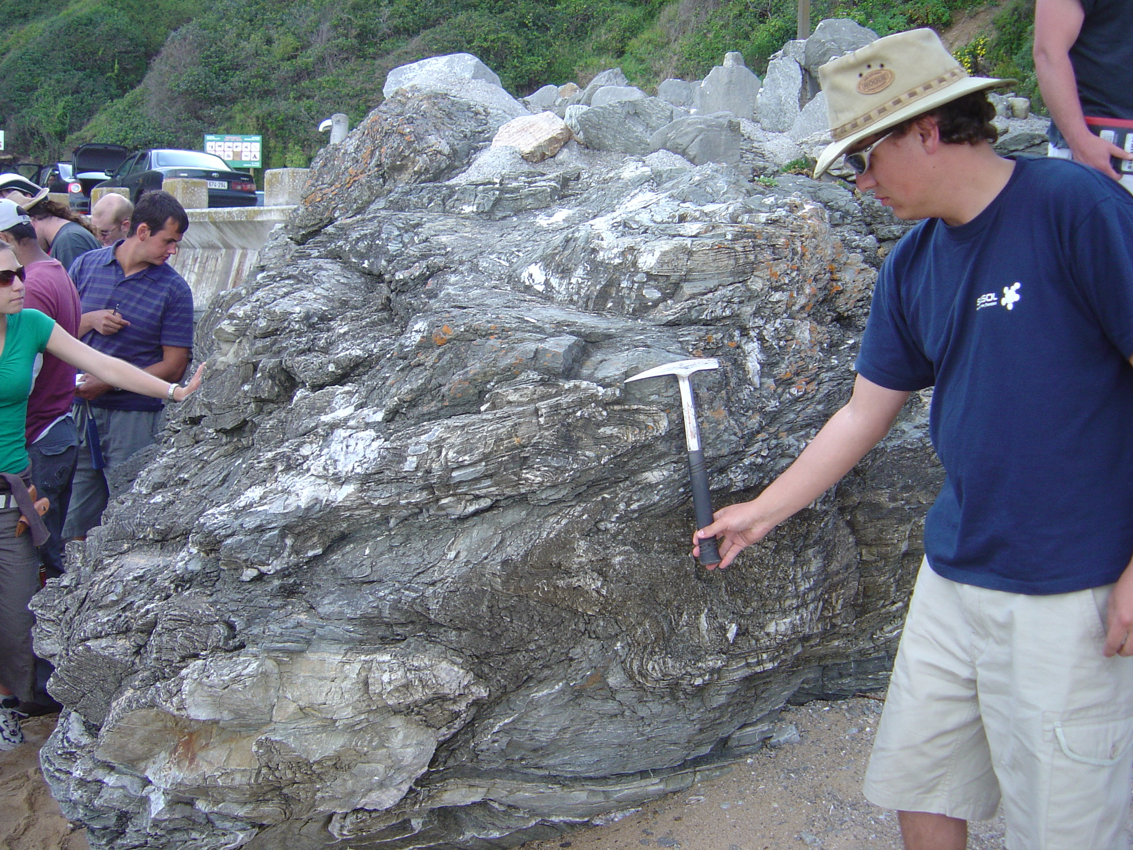

Slide 7
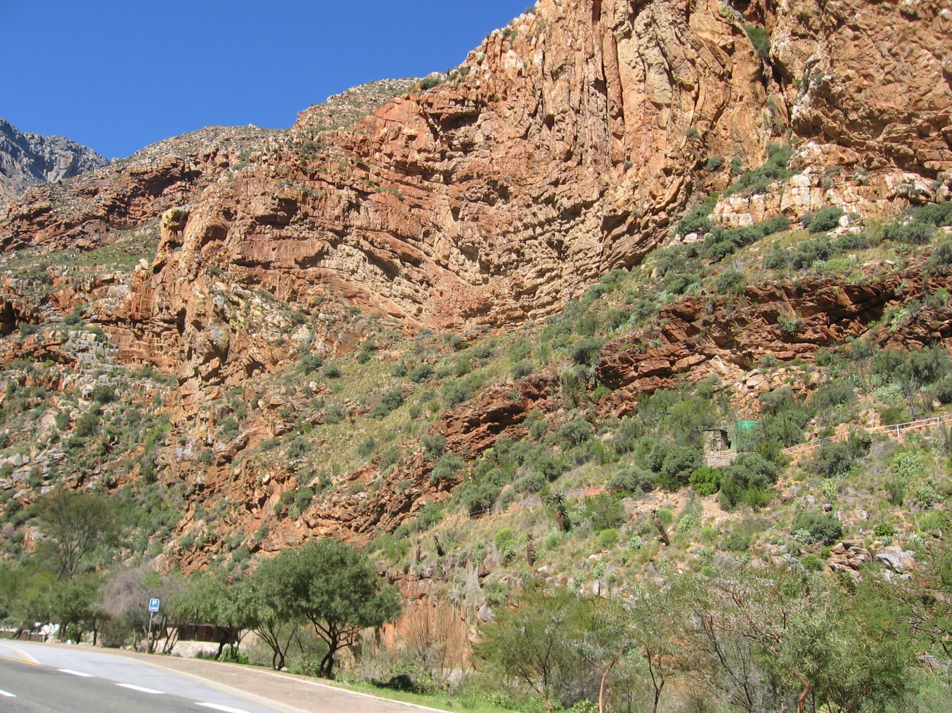
North
South

Slide 8
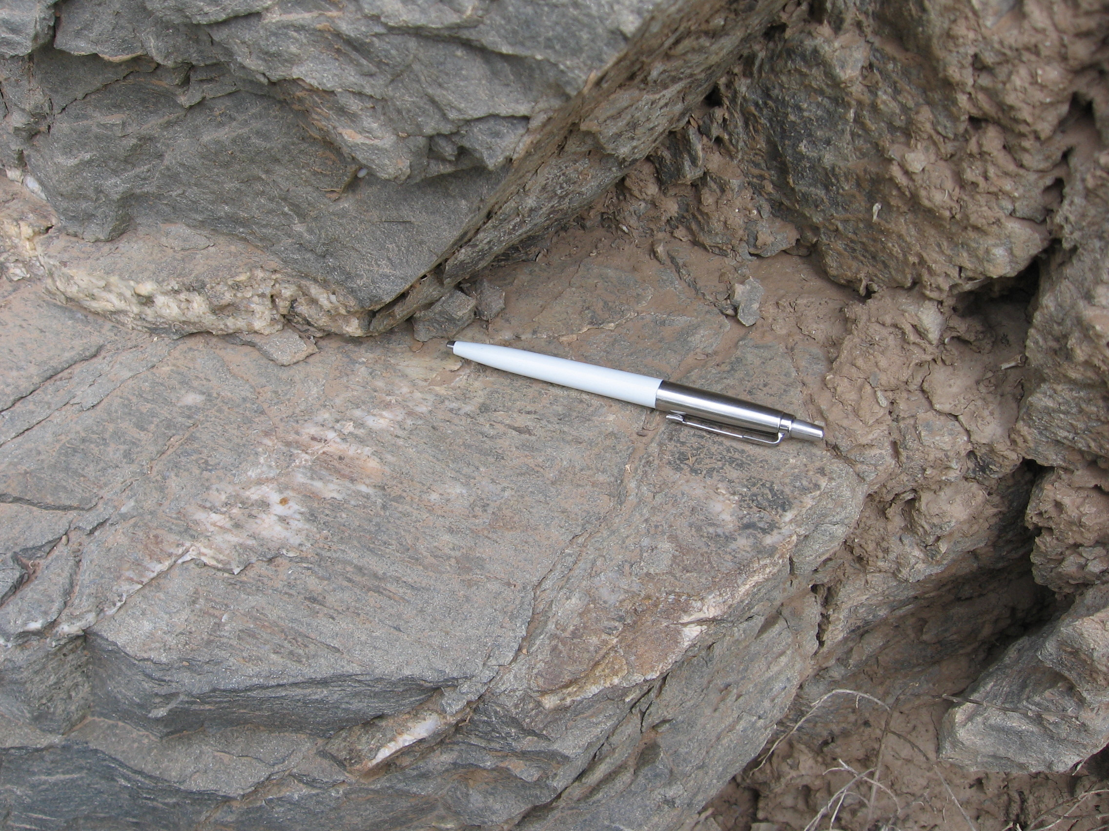

Slide 9
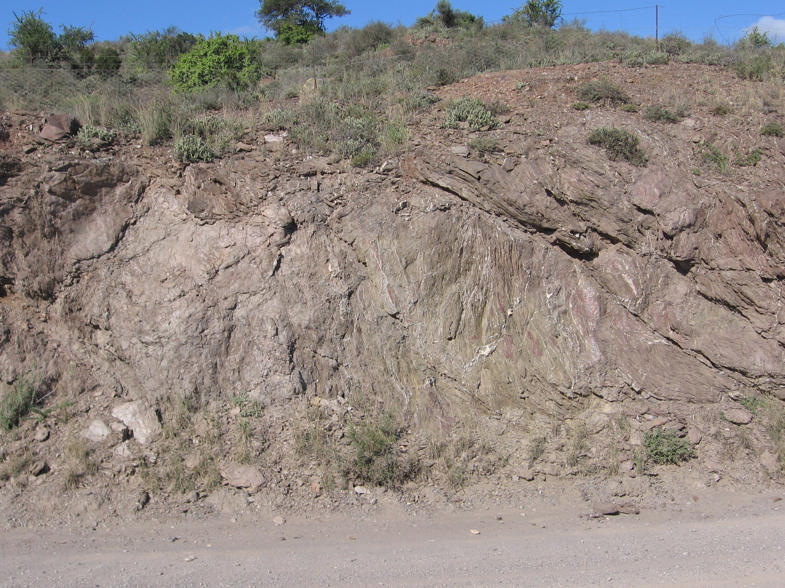

Slide 10
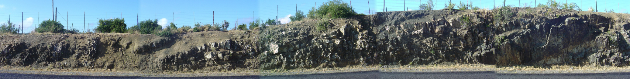
Triangle zone
North
South
m
m
s
s
s
s
m
s
s
m
s
m
ss
sm
m
20 metres
bedding
s = sandstone
m = mudstone
ss = siltstone
sm = silt/mudstone intercalations

Slide 11
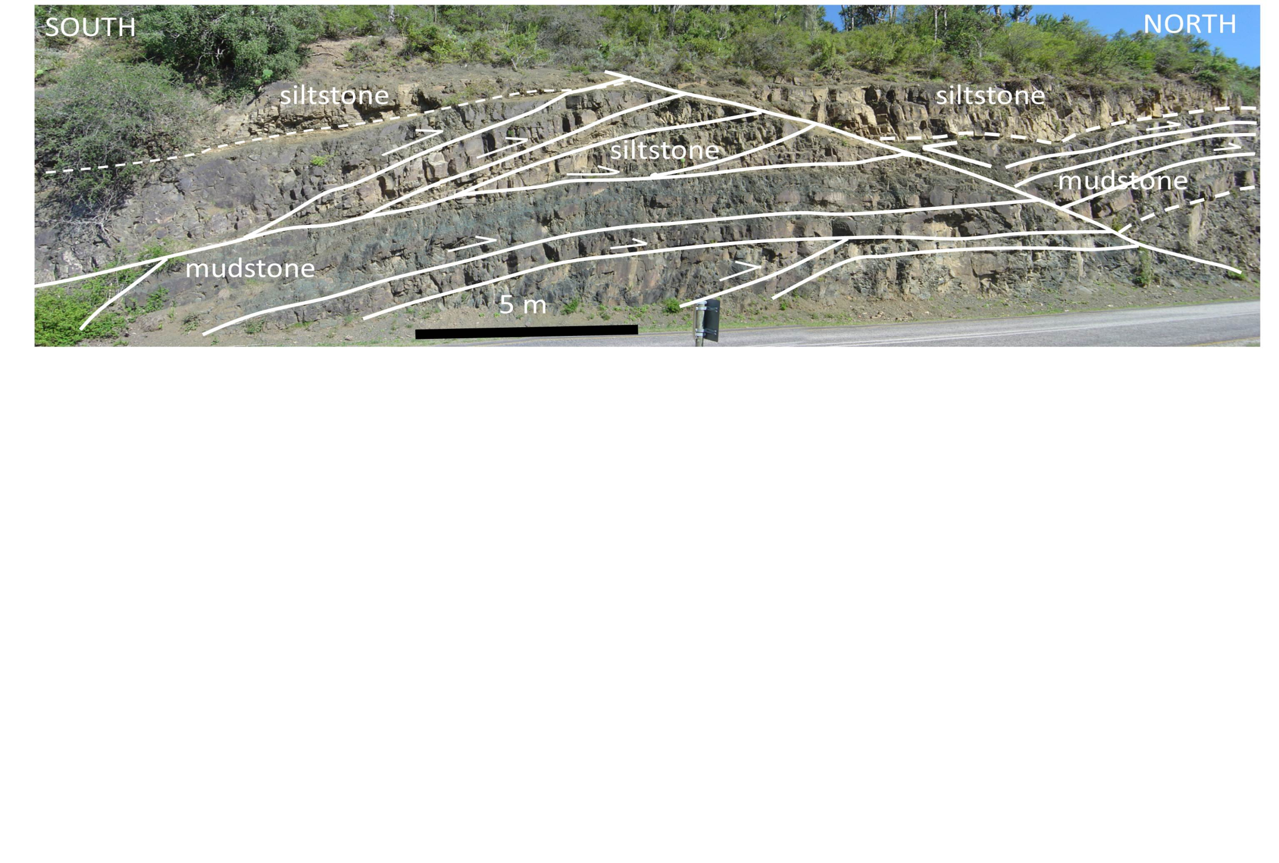

Slide 12
GONDWANA:
Late Palaeozoic to Early Mesozoic
(300 ± 75 Ma)
(de Wit 1992)
Africa
PASSIVE EXTENSIONAL MARGIN
S Am
Ant
Aus
ACTIVE CONVERGENT MARGIN

Slide 14
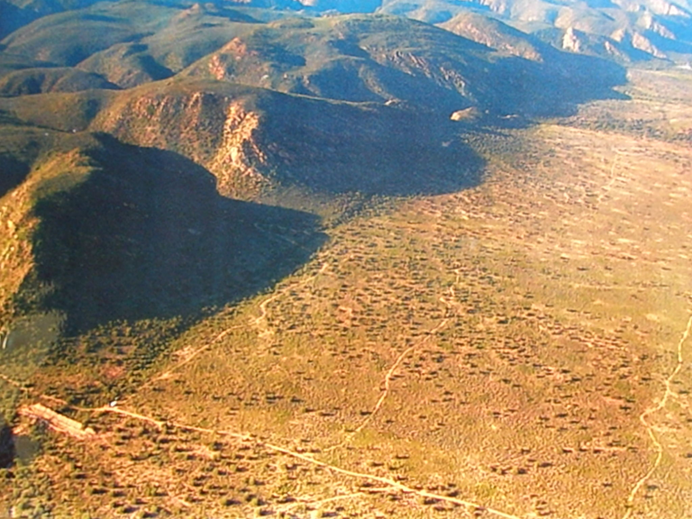

Slide 15
COMPRESSIONAL MODEL
fold-thrust belt (Cape-Karoo)
magmatic arc
retro-arc foreland basin
(Karoo strata)
Fore-arc basin
oceanic crust subducts

Slide 16
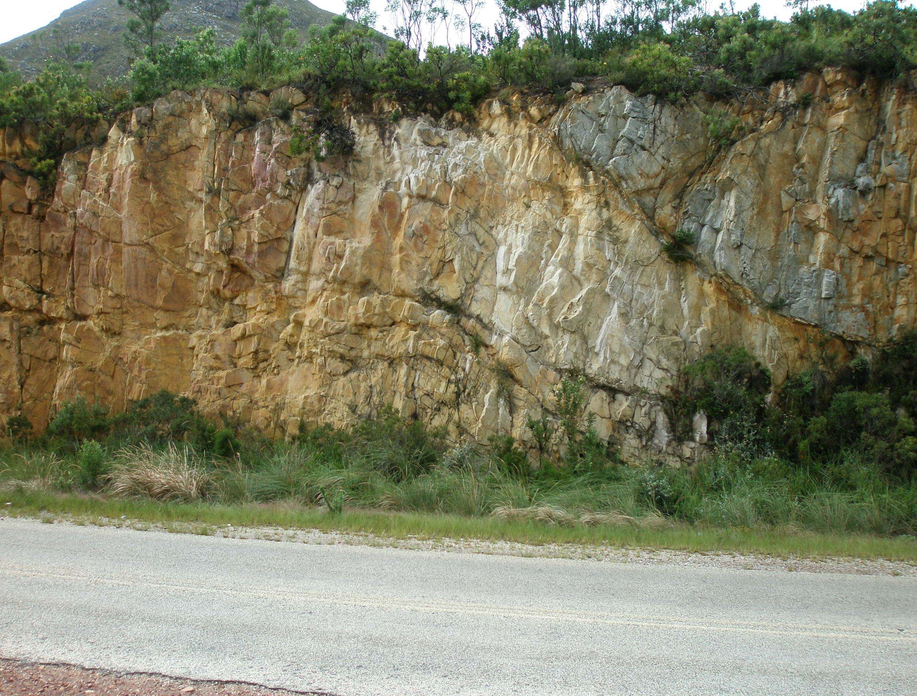

Slide 17
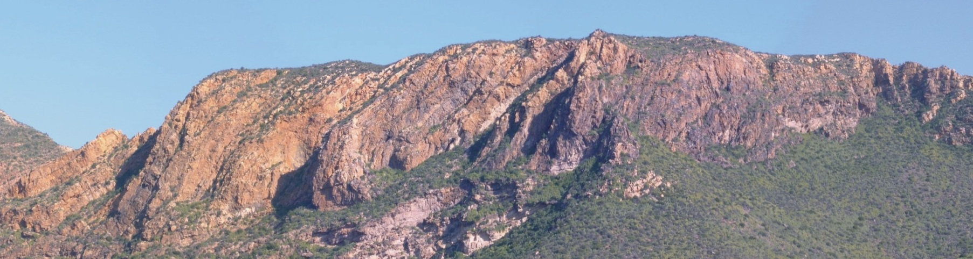
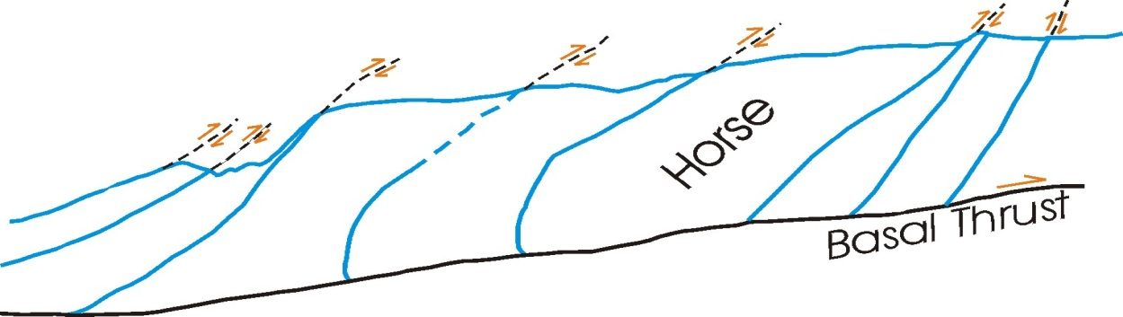
Horses within the western duplex flanking southern Kango, along the Huisriver pass
450 meters
1730 meters
duplex restoration.

Slide 18
STRIKE-SLIP MODEL
About 300 Ma ago
Africa
CFB
Johnston, 2000

Slide 19
Witteberg/Bokkeveld/Table Mountain
VRD
Cape Fold Belt
S
C
S
P
C
P
O
l
O
U
U
K
Cape
Town
K
PA
Port Elizabeth

Slide 20
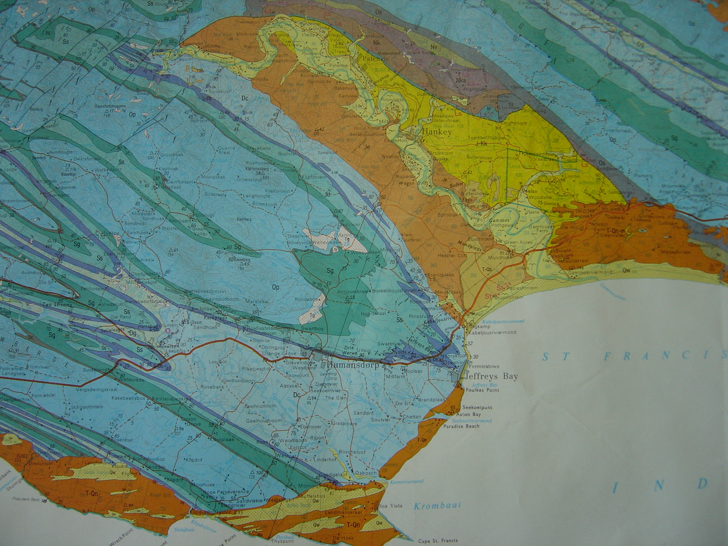
Pen Fm
Ced Sh
Sk Fm
JEFFREYS BAY

Slide 21
DUPLEX FORMATION
TECTONIC TRANSPORT DIRECTION

Slide 22
DUPLEX FORMATION
TECTONIC TRANSPORT DIRECTION
9
8
7
6
5
4
3
2
1
Mapped section

Slide 23
DUPLEX FORMATION
2
TECTONIC TRANSPORT DIRECTION
3
2
1
3
1
2
3
1
Mapped section

Slide 24
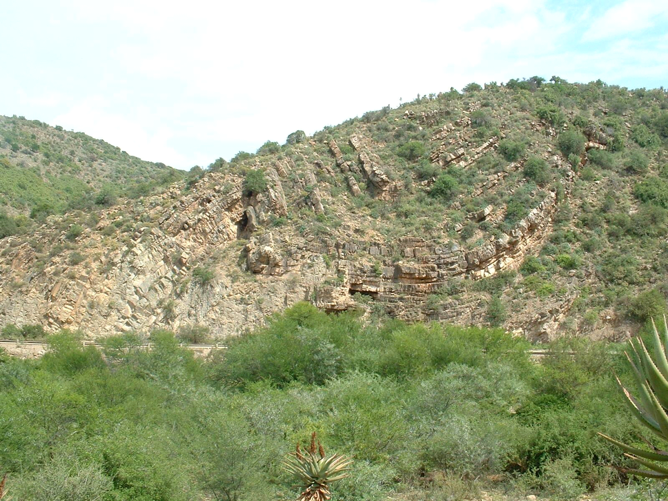
S
S
N
N
50 m
50 m
~
50 m
~
~
syncline
anticline
open fold
tight fold
thrust fault
Ramp
ramp

Slide 25
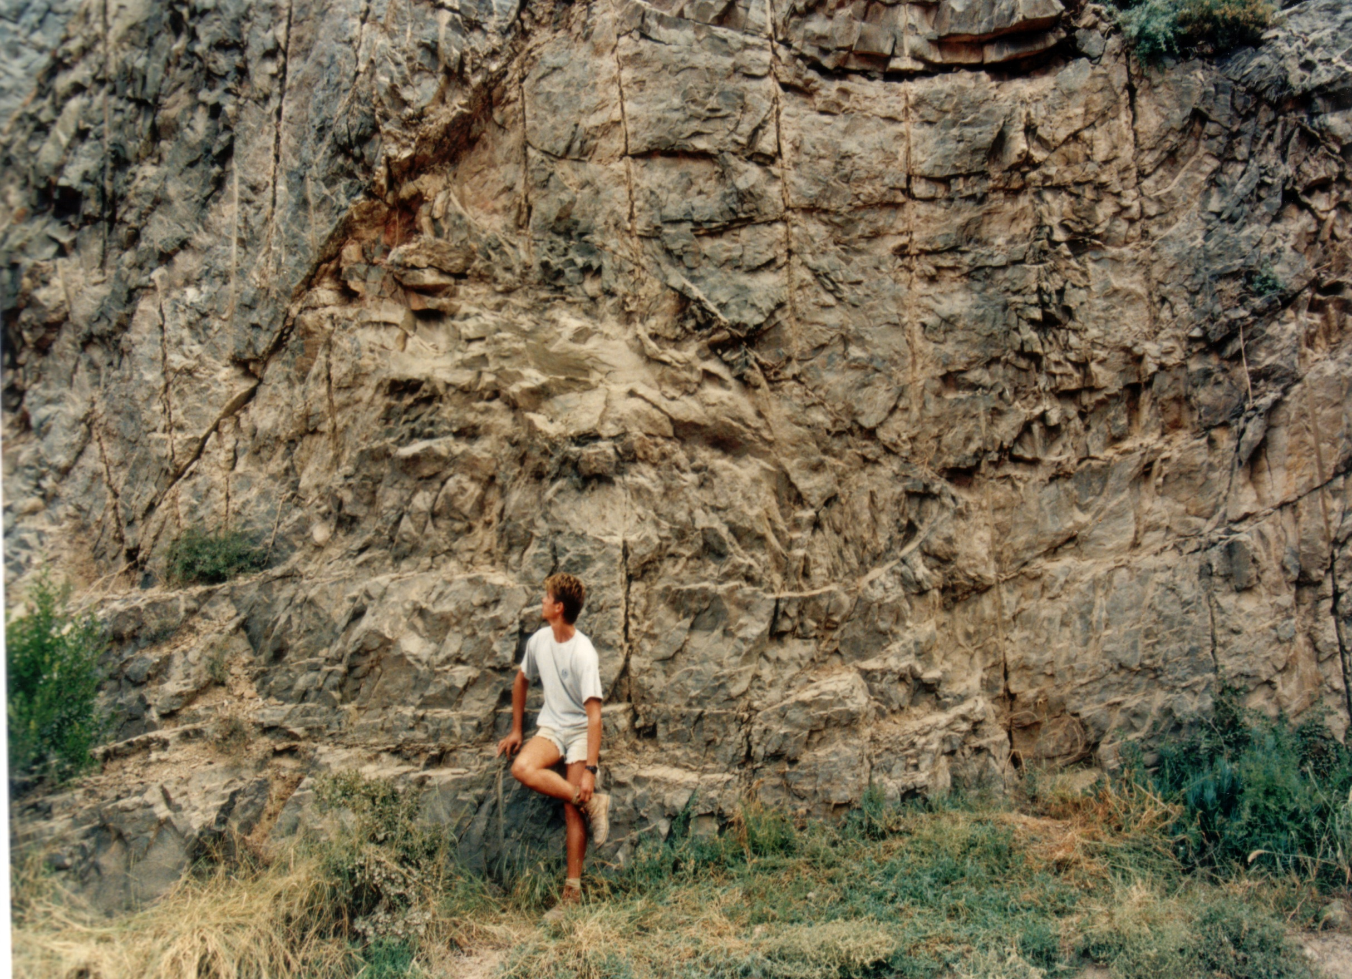

Slide 27
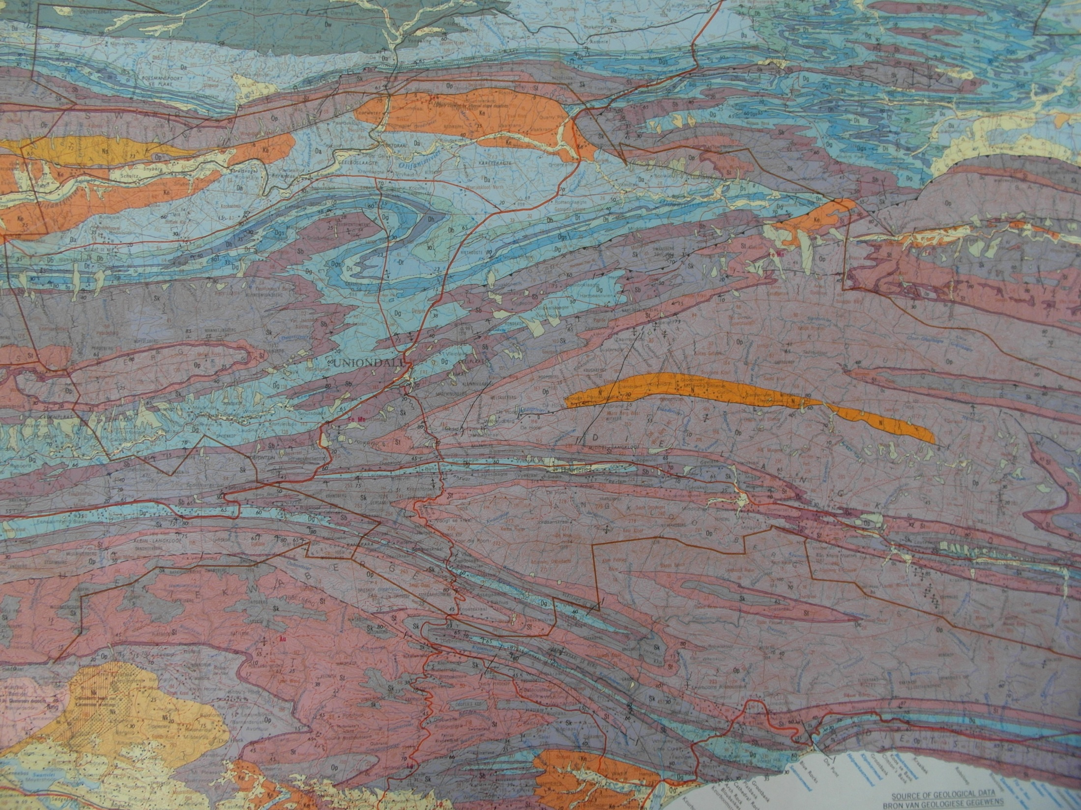
23° 00’
Baviaanskloof Thrust
UNIONDALE
Potjiesberg
Pass
Uniondale Pass
33° 45’
30 km

Slide 28
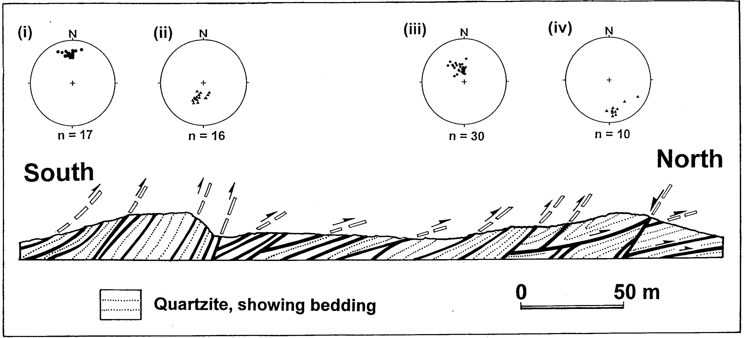
UNIONDALE PASS

Slide 29
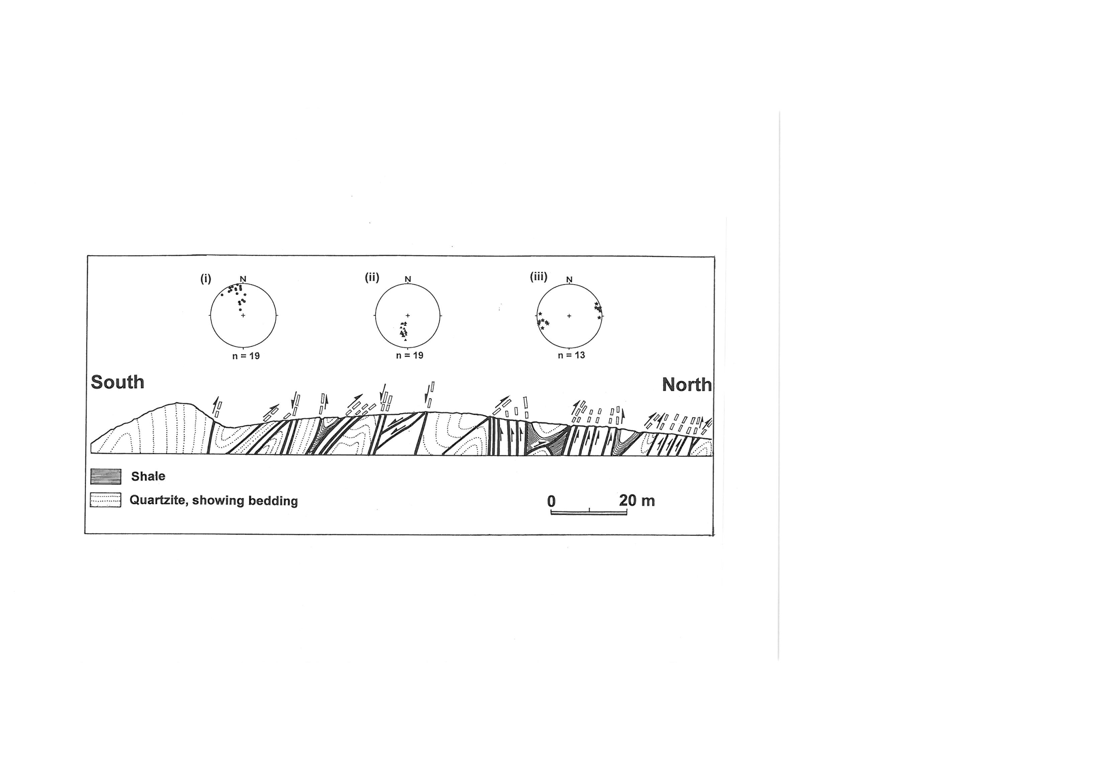
UNIONDALE PASS

Slide 30
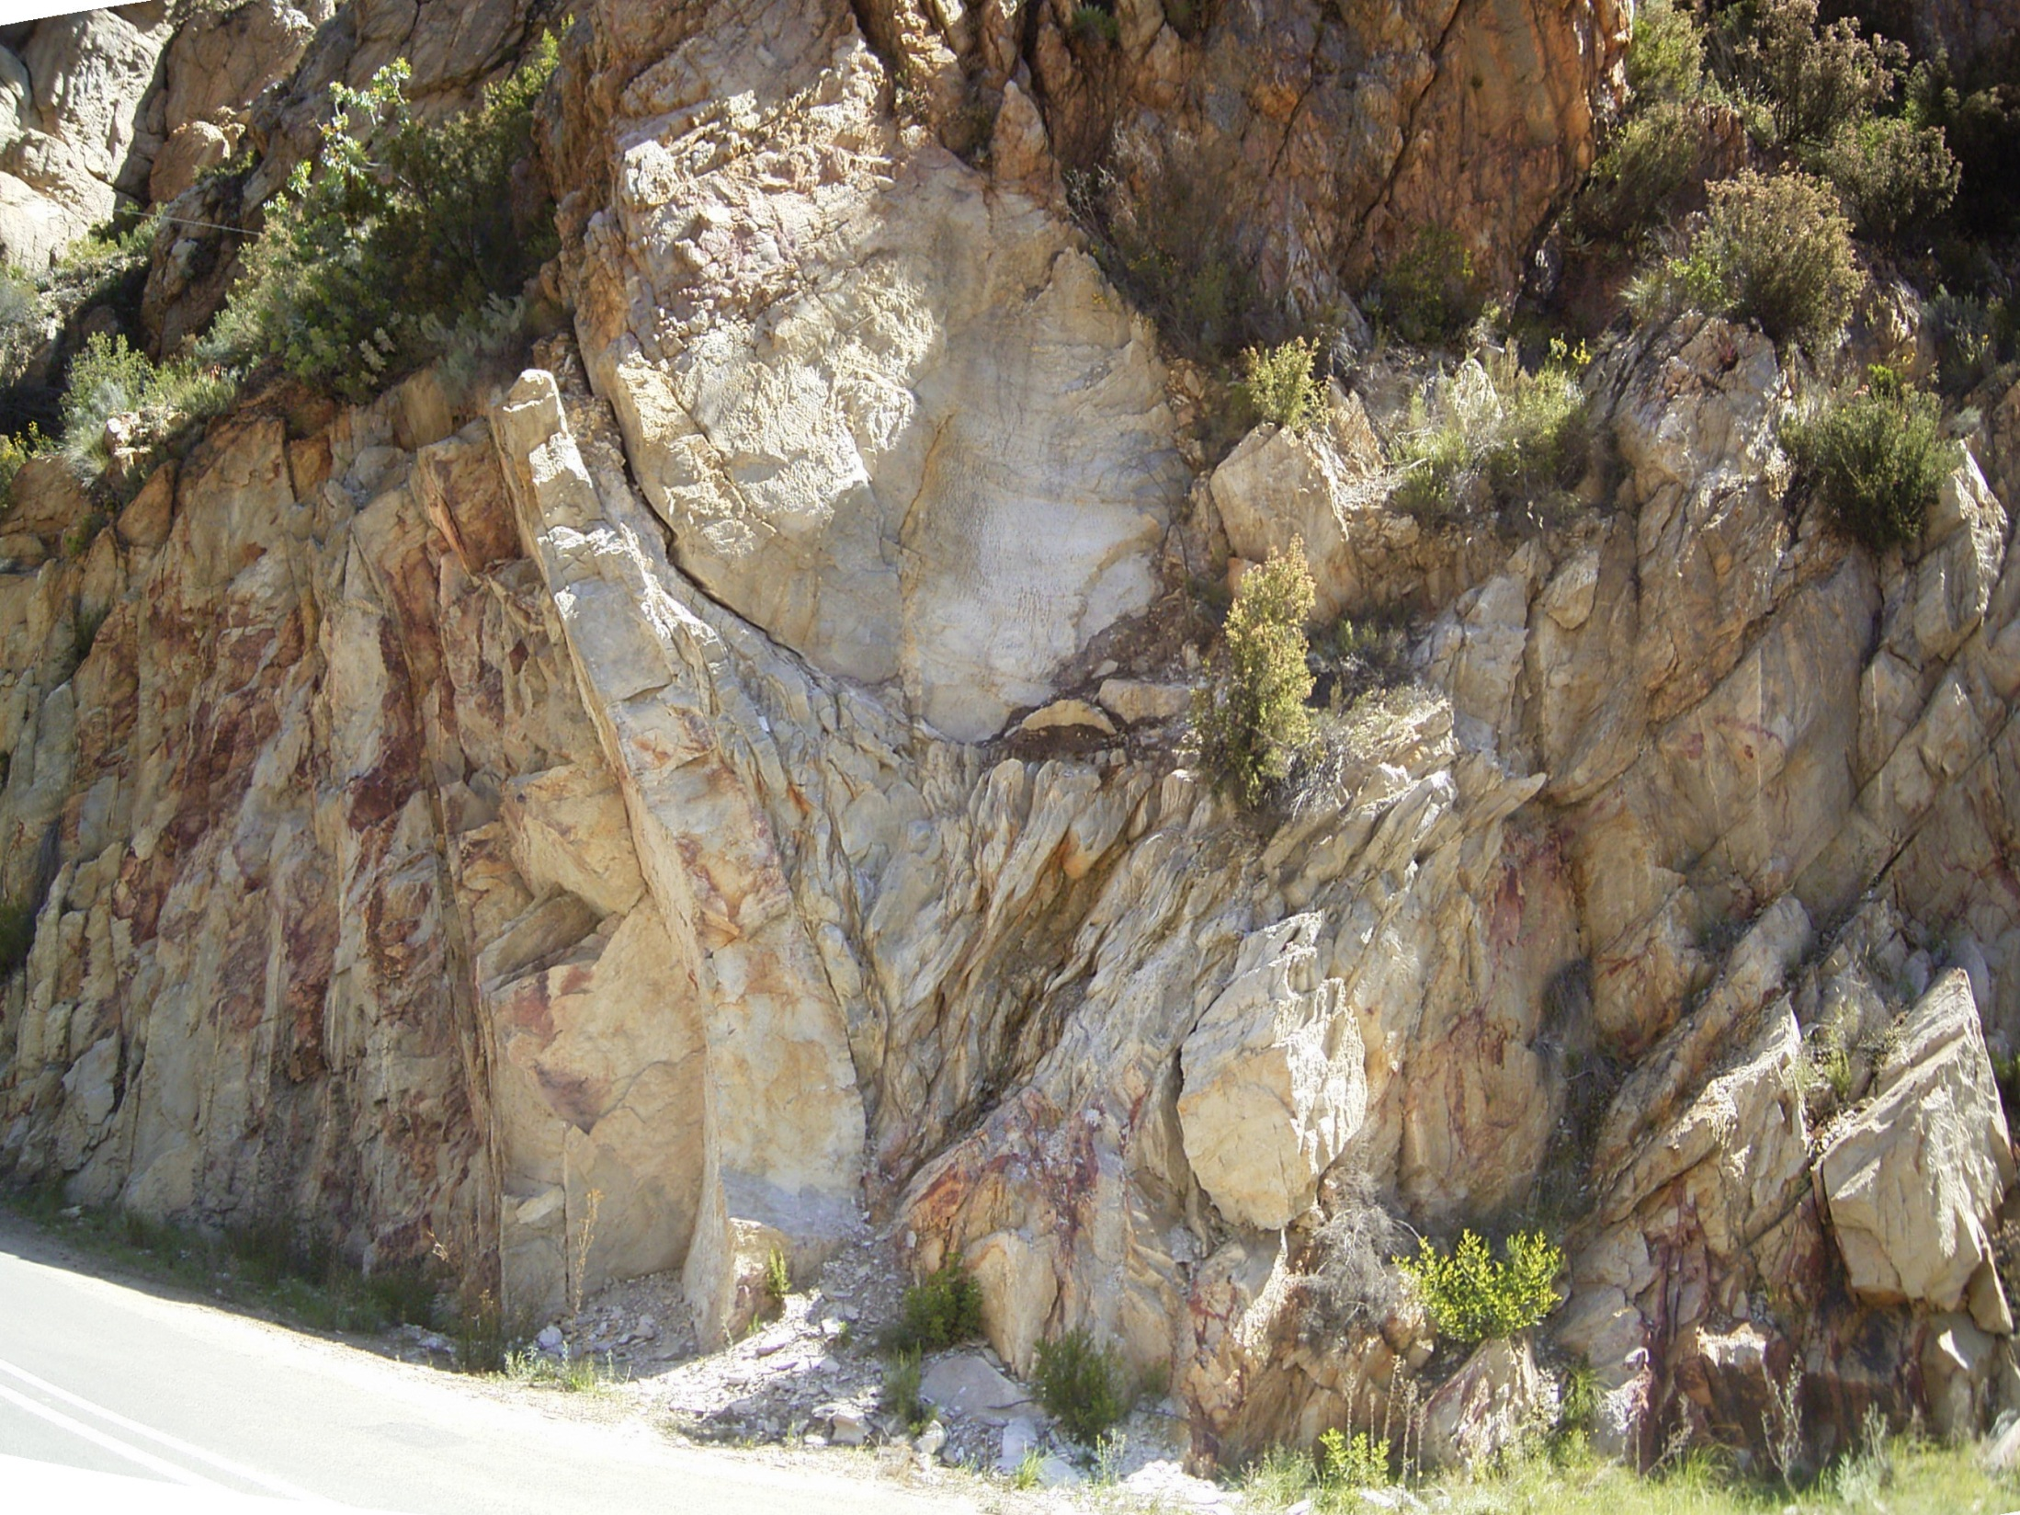

Slide 31
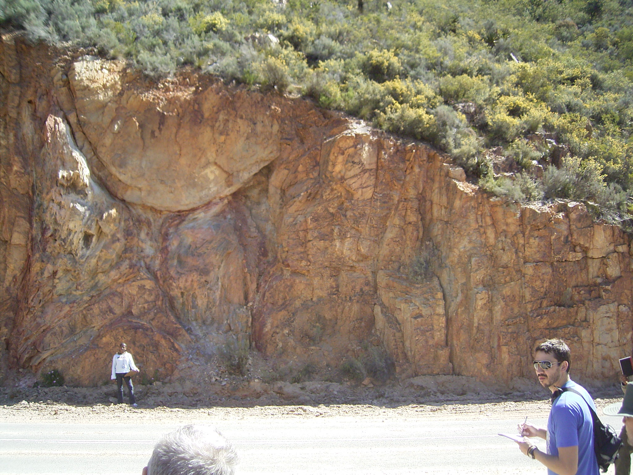

Slide 32
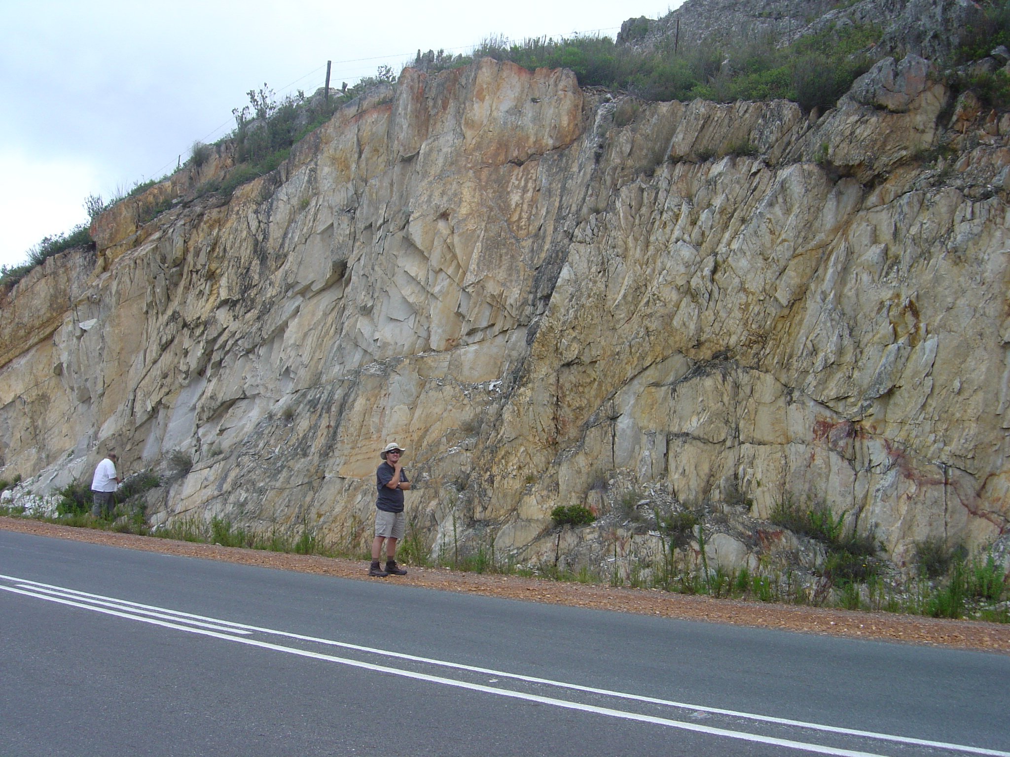

Slide 33
B
Kango Fault
Bokkeveld
C
N
Bav Thr
TMG
UNIONDALE
Pre-Cape
NATURES VALLEY
STORMS RIVER
A
60 Km

Slide 34
UNIONDALE
PASS
Kango Fault
A (South)
B (North)
TMG
50 km

Slide 35
South
North
20 km
Kango
Fault
Uniondale
Pass

Slide 36
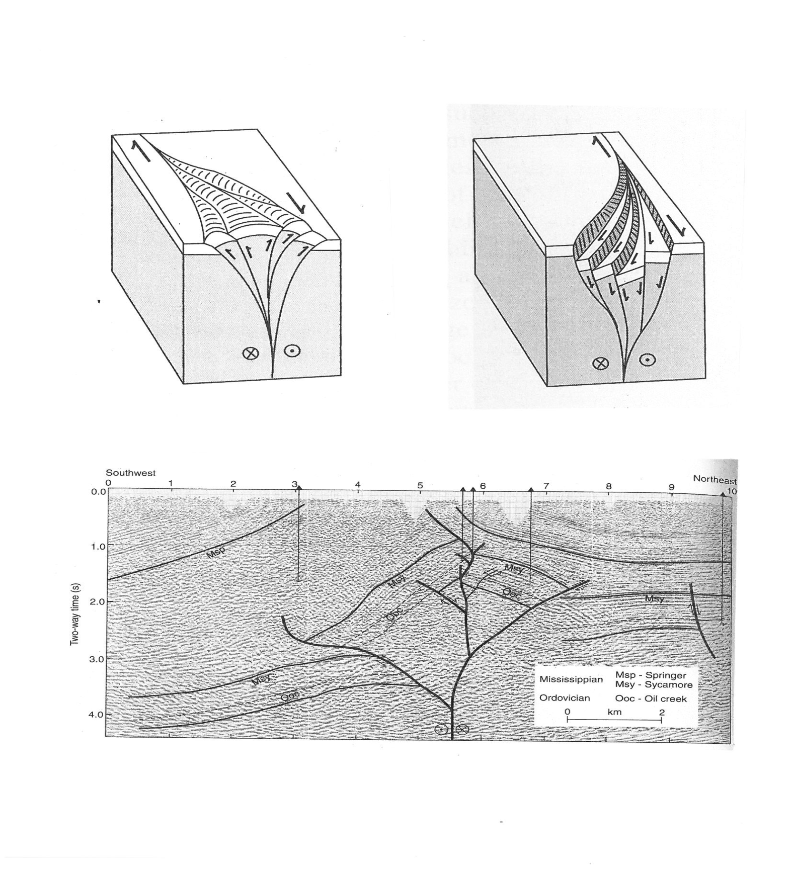
POSITIVE
NEGATIVE
SEISMIC SECTION

Slide 37
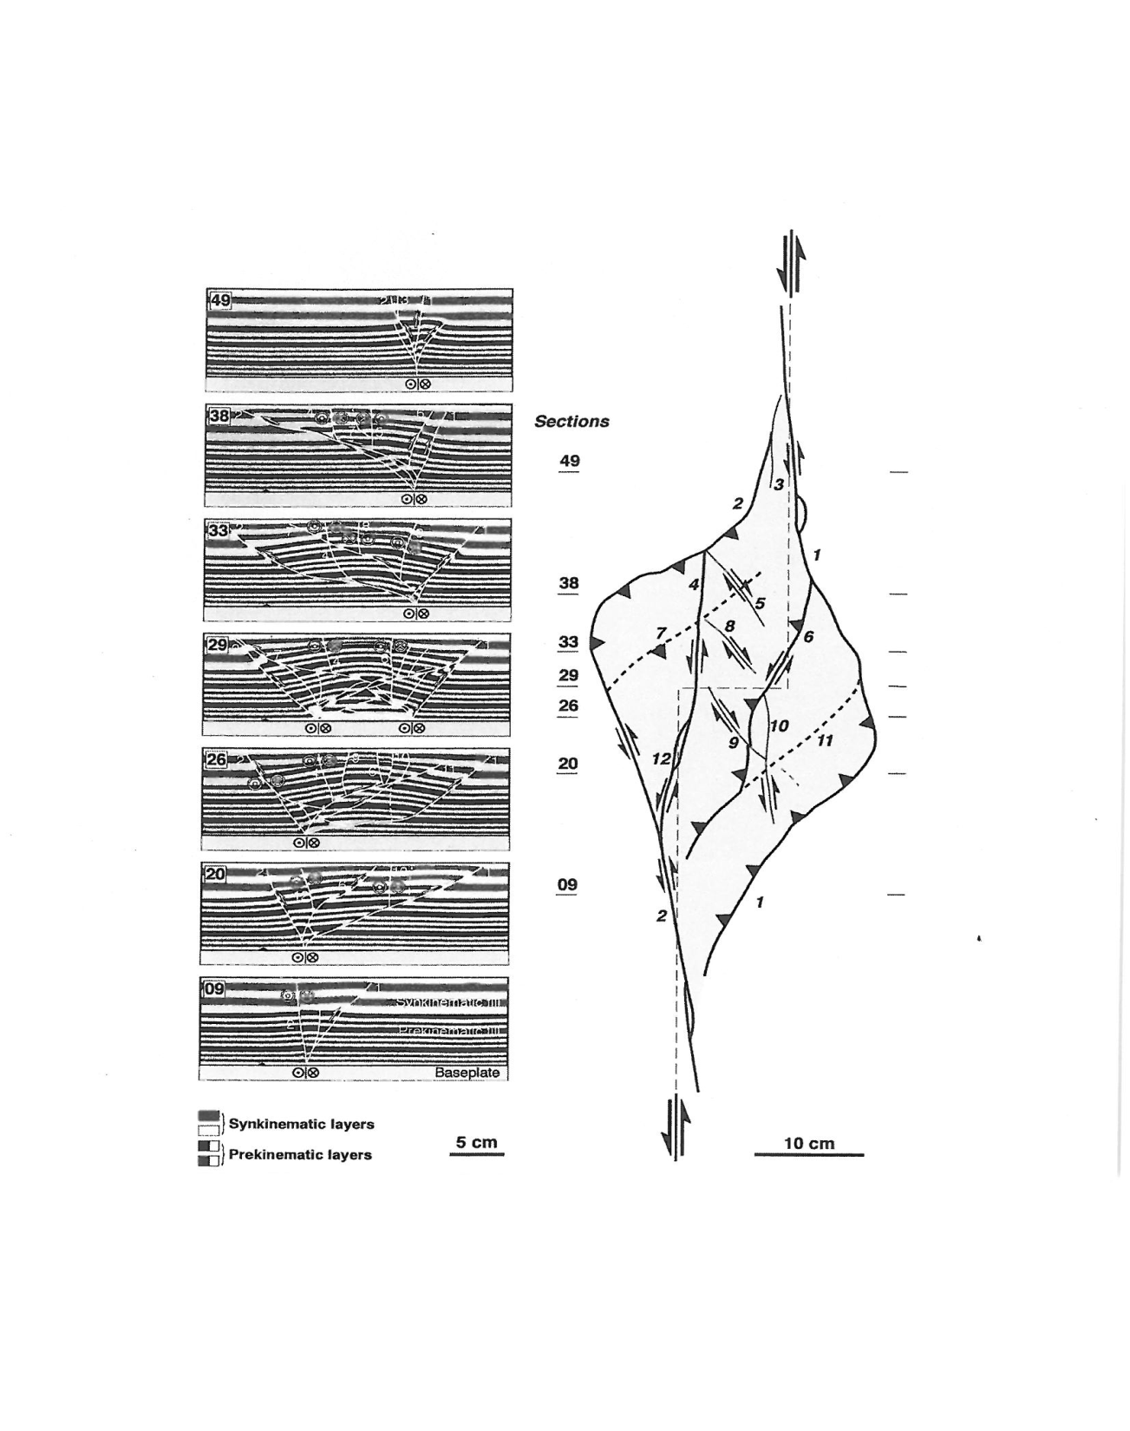
Sections through deformed areas
20 cm

Slide 38
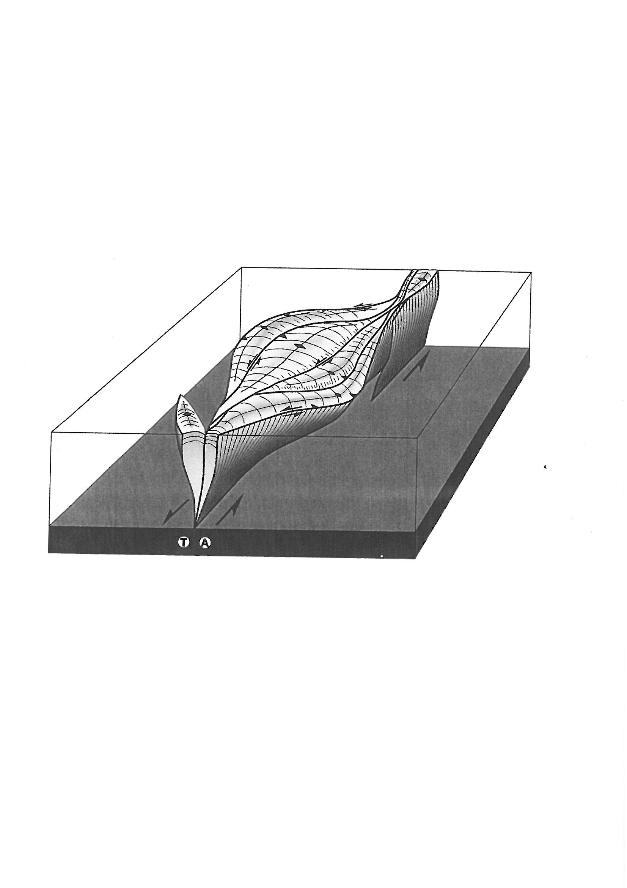
Lozenge shaped folds, bounded by strike-slip faults
From McClay and Bonora (2001)

Slide 39
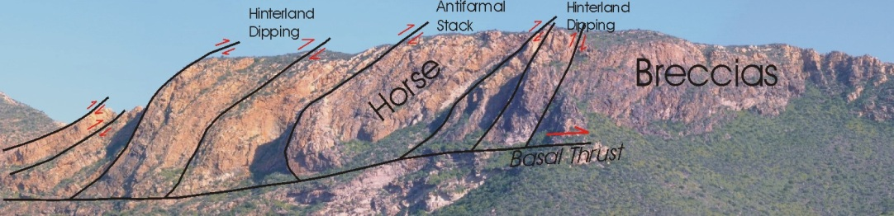
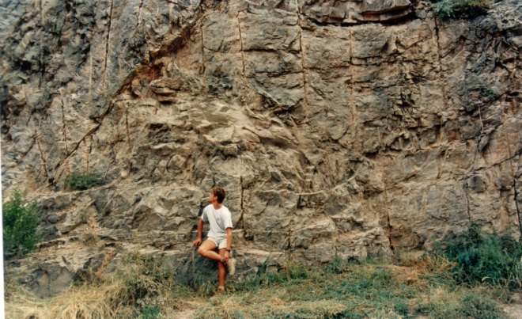
CONCLUSIONS
Future work in the CFB?
Identify the stratigraphic “anomalies”
Sequence of structural events
Kango

Slide 40
CONCLUSIONS
1
CFB
PE
CT
3
2

