Slide 1
Impact of long-term wheat production management practices on soil acidity, phosphorus and some micronutrients in a semi-arid Plinthosol
P.F. Loke , E. Kotzé & C.C. Du Preez
Department of Soil, Crop and Climate Sciences
University of the Free State, Bloemfontein, South Africa
.
logo here…

Slide 2
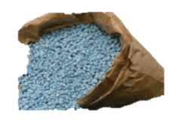
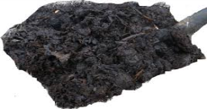
Introduction
Soil vs Bank Acc.
Objectives:
-Evaluate long-term effects of wheat production management practices on soil acidity and some essential nutrients.
-Establish whether differences in wheat grain yield occurred as a result of the applied treatments.
NB: You withdraw only what you put in.

Slide 3
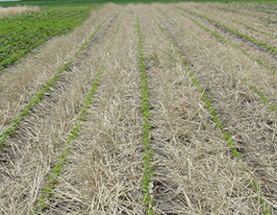
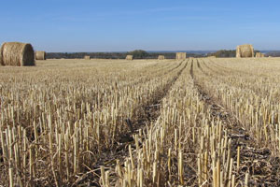
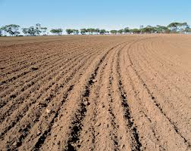
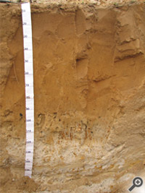
Material and methods
Treatments:
Sampling and analysis:
six soil layers and analyzed
for pH, P, Cu, Fe, Mn and Zn
No-tillage (NT)
Stubble Mulch (SM)
Ploughing (MP)
-Straw was burned (B) or left unburned (UnB)
-Weeds were controlled chemically (Chem) or Mechanically (Mech)
Layers (mm)
0-50
50-100
100-150
150-250
250-350
350-450
Plinthosol

Slide 4
Results
Weighted means of soil pH(H₂O) and some nutrients (mg kg⁻¹) to 150 mm and 250 mm soil depths inside the trial cropped annually with wheat
Soil prop. | Depth (mm) | Straw |  | Till |  |  | Weed |  | Optimum values
 |  | UnB | B | NT | SM | MP | Chem | Mech
pH | 0-150 | 6.5 | 6.4 | 6.7 | 6.4 | 6.3 | 6.4 | 6.5 | 5.5-7.5
 | 0-250 | 6.2 | 6.3 | 6.3 | 6.3 | 6.2 | 6.2 | 6.3
P | 0-150 | 23 | 26 | 29 | 23 | 21 | 27 | 21 | >12
 | 0-250 | 21 | 23 | 25 | 21 | 21 | 24 | 19
Cu | 0-150 | 1.4 | 1.3 | 1.3 | 1.4 | 1.4 | 1.4 | 1.4 | >0.3
 | 0-250 | 1.5 | 1.4 | 1.4 | 1.5 | 1.4 | 1.4 | 1.5
Fe | 0-150 | 52 | 50 | 56 | 51 | 45 | 50 | 52 | >2.0
 | 0-250 | 56 | 59 | 58 | 69 | 46 | 59 | 56
Mn | 0-150 | 26 | 28 | 27 | 29 | 25 | 25 | 29 | >2.5
 | 0-250 | 24 | 26 | 24 | 26 | 24 | 24 | 26
Zn | 0-150 | 1.6 | 1.8 | 1.9 | 1.8 | 1.4 | 1.6 | 1.8 | >0.3
 | 0-250 | 1.5 | 1.6 | 1.6 | 1.7 | 1.3 | 1.5 | 1.6

Slide 5
Effect of straw management, tillage and weeding methods on wheat grain yield (t ha⁻¹) over 32 years
Period | Straw |  |  |  | Till |  |  |  |  | Weed
 | UnB | B | HSD_{T} |  | NT | SM | MP | HSD_{T} |  | Chem | Mech | HSD_{T}
1979-10 | 2.28 | 2.12 | 0.04 |  | 2.11 | 2.19 | 2.28 | 0.07 |  | 2.20 | 2.19 | ns
1979-90 | 2.19 | 1.99 | 0.07 |  | 2.04 | 2.07 | 2.16 | 0.11 |  | 2.07 | 2.17 | ns
1991-00 | 1.94 | 1.90 | ns |  | 1.85 | 1.90 | 2.02 | 0.15 |  | 1.94 | 1.90 | ns
2001-10 | 2.47 | 2.25 | 0.08 |  | 2.33 | 2.29 | 2.46 | 0.11 |  | 2.38 | 2.35 | ns
HSD_{T} significant at P < 0.05
ns = non-significant
Conclusion
It is evident that proper crop residue management can improve soil fertility.
However, more work needs to be done to identify and rectify yield associated problems that resulted in lower yields in No-tilled and stubble mulched plots.

Slide 6
Currently
The influence of land use on organic matter content and related components on Vertisols:
Land use: -Grassland-to-cropland conversion chronosequence
-Cropland-to-grassland reversion chronosequence
-Grassland (reference)
Parameters:
1. Organic matter content:
SOC and TN stocks (Mg/ha)
2. Related components:
Labile organic matter fractions, Microbial residues (Amino sugars and Glomalin), lignin, humic substances, soil enzymes and Isotopic signatures of SOM (¹³C and ¹⁵N)

Slide 7
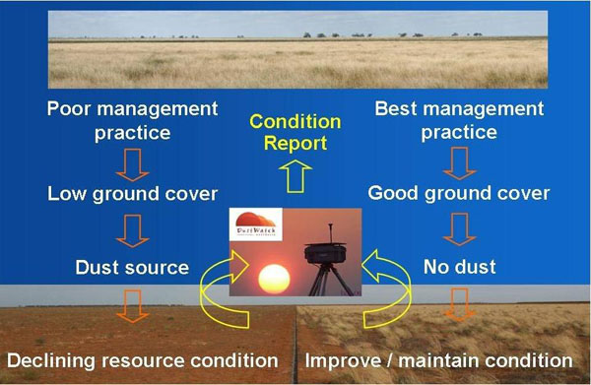
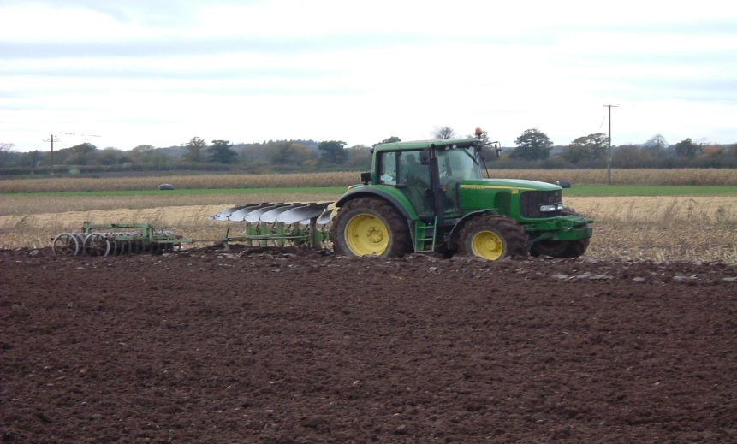
Grassland to Cropland
Cropland to Grassland
Thank You

