Slide 1
Shale gas across Africa
Preliminary results from a field reconnaissance in the Karoo of Tanzania
Bastien Linol & Taufeeq Dhansay
AEON-ESSRI (Africa earth Observatory
Network-Earth Stewardship Science
Research Institute), NMMU,
South Africa
Maarten de Wit
AEON-ESSRI,
NMMU,
South Africa

Slide 2
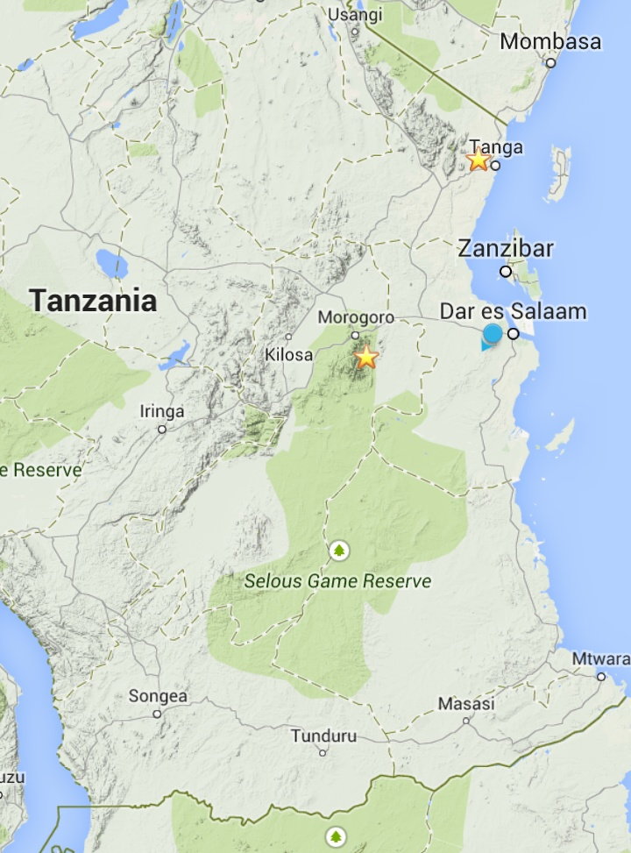
The Modus Operandi:
Find and investigate the Karoo rocks of Tanzania
Compare these to the Karoo rocks of South Africa
Establish their shale gas potential
Stay alive

Slide 3
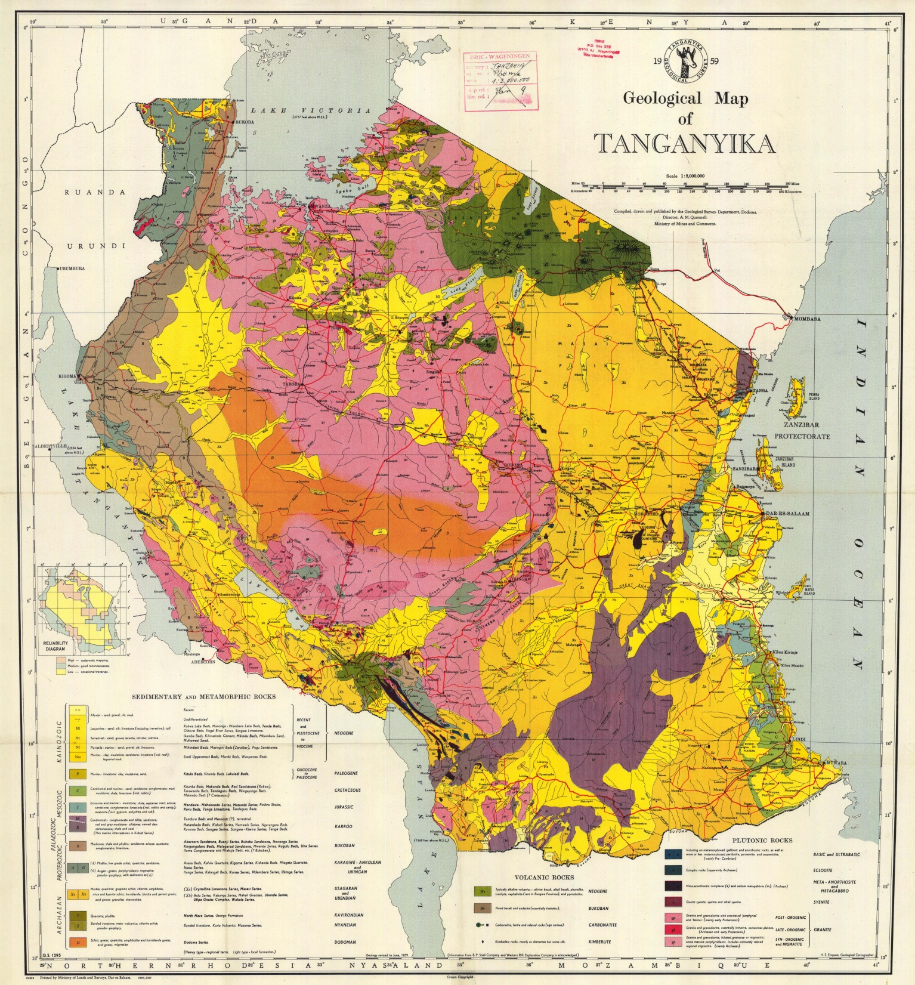
Tanga
Mvuha
Selous

Slide 4
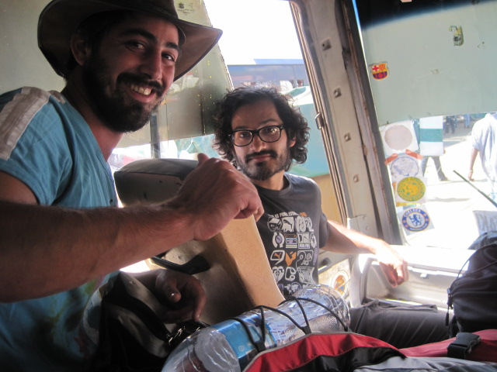

Slide 5
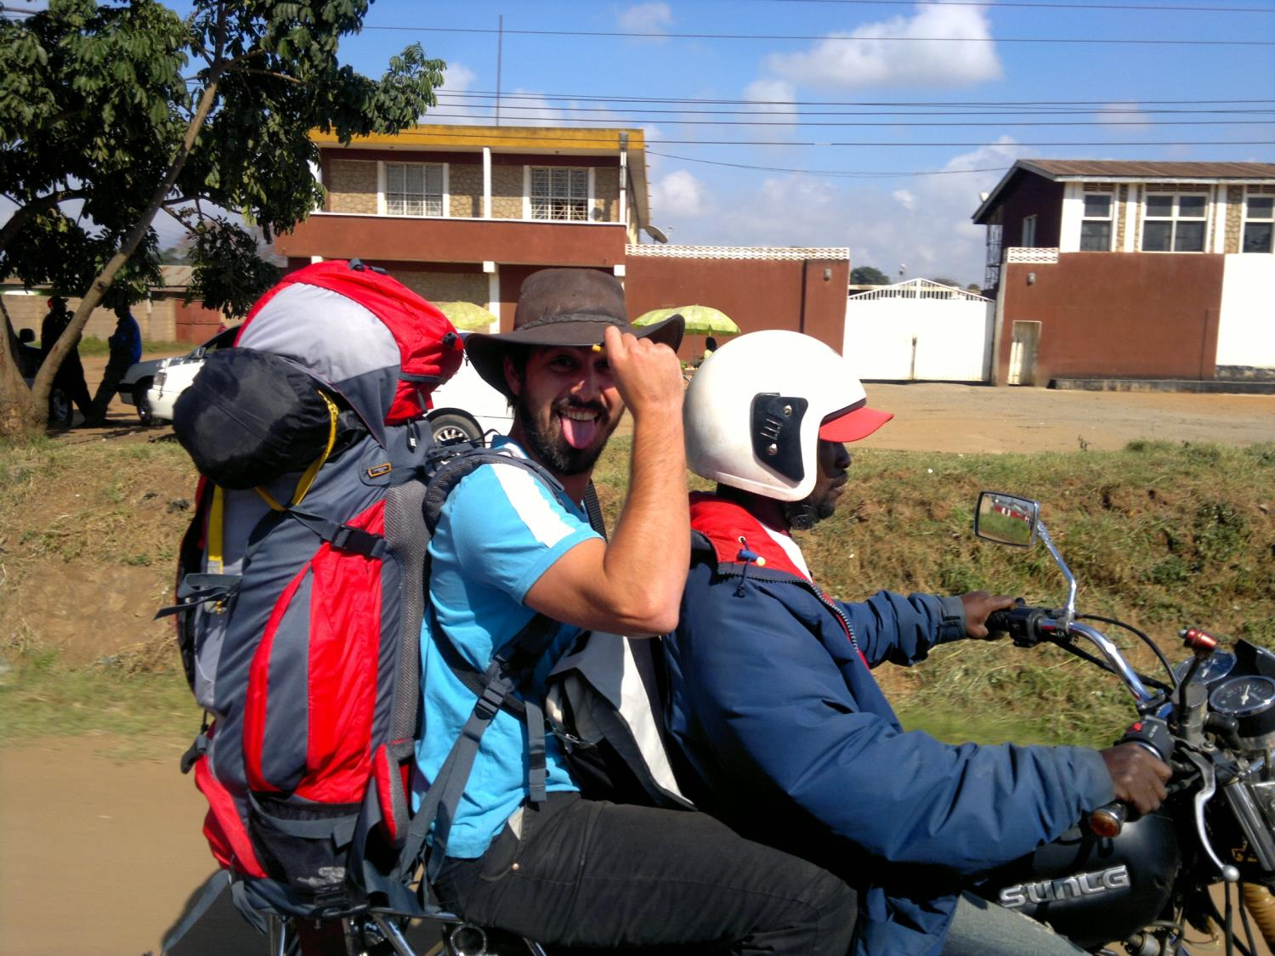
Buda-buda, Morogoro

Slide 6
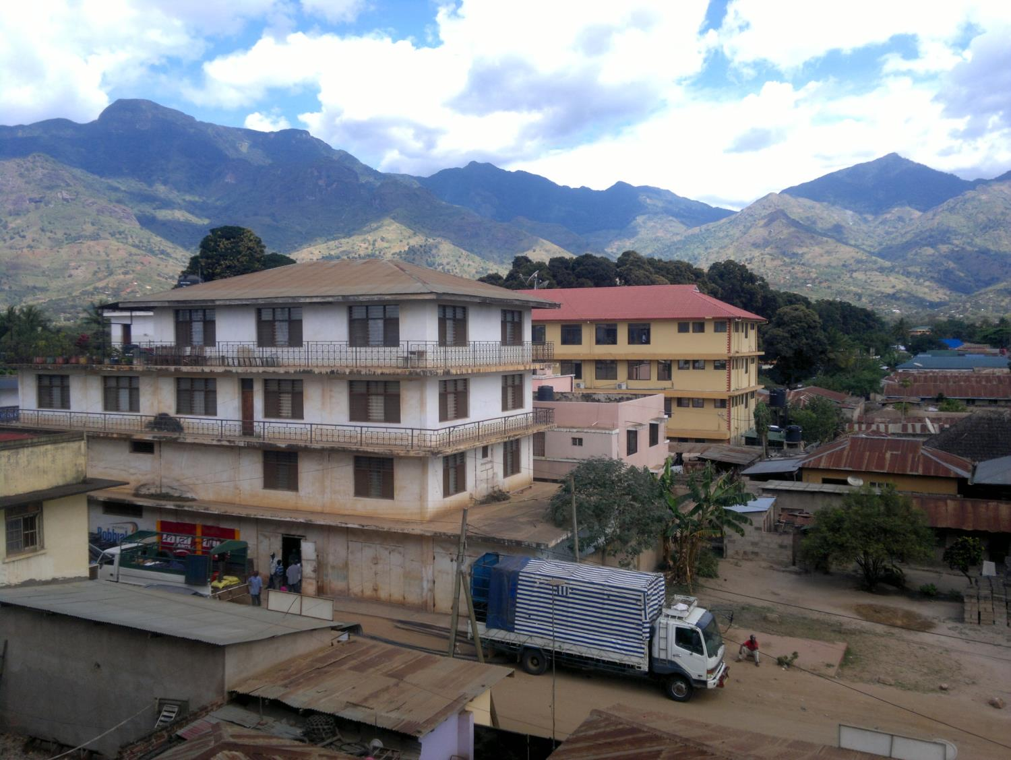
Uluguru Mountains, Morogoro

Slide 7
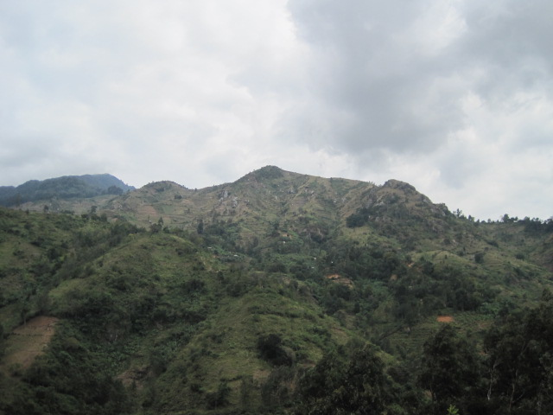
Pan-African basement, Uluguru Mountains
Pan-African tonalitic orthogneisses, part of the East African Orogen

Slide 8
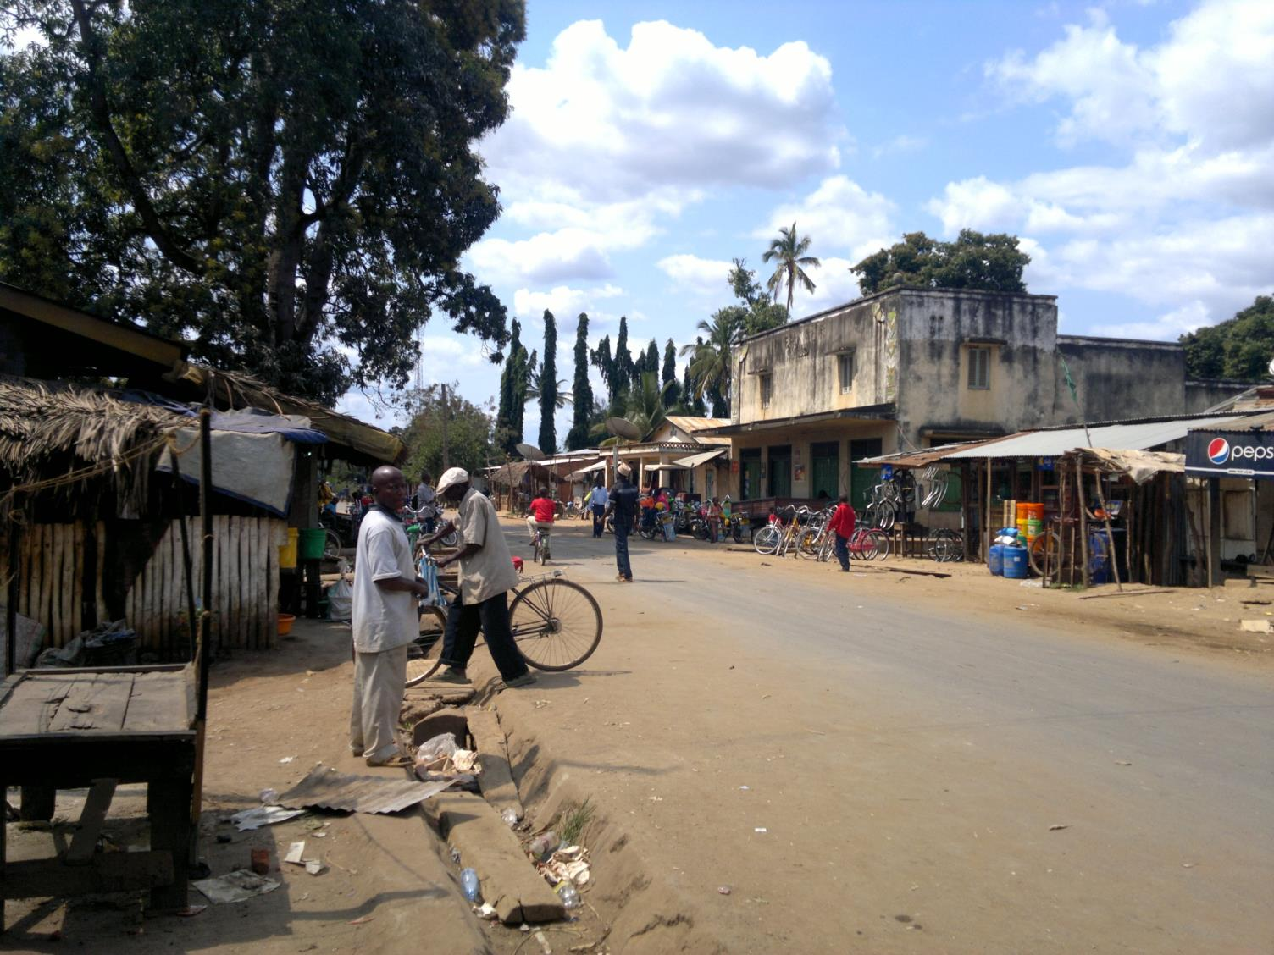
City centre, Mvuha

Slide 9
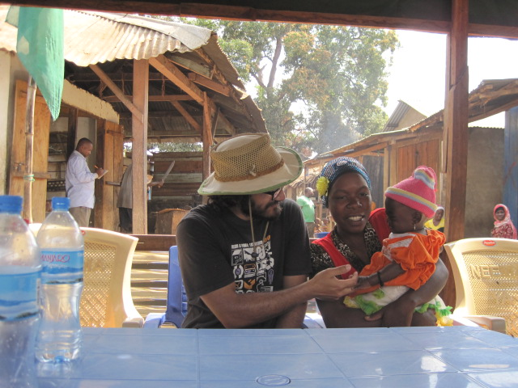
Mvuha
Baby

Slide 10
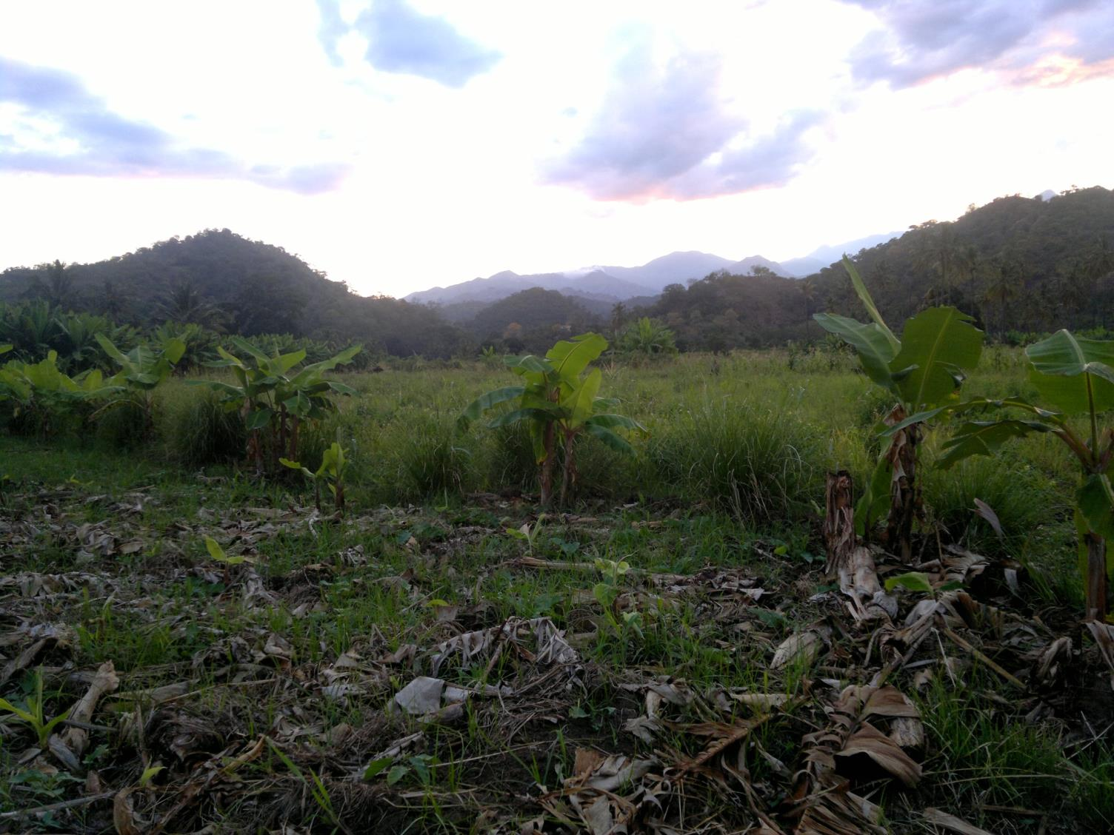
Fault-contact?, Mvuha
Basement gneiss
Fault?
Karoo?

Slide 11
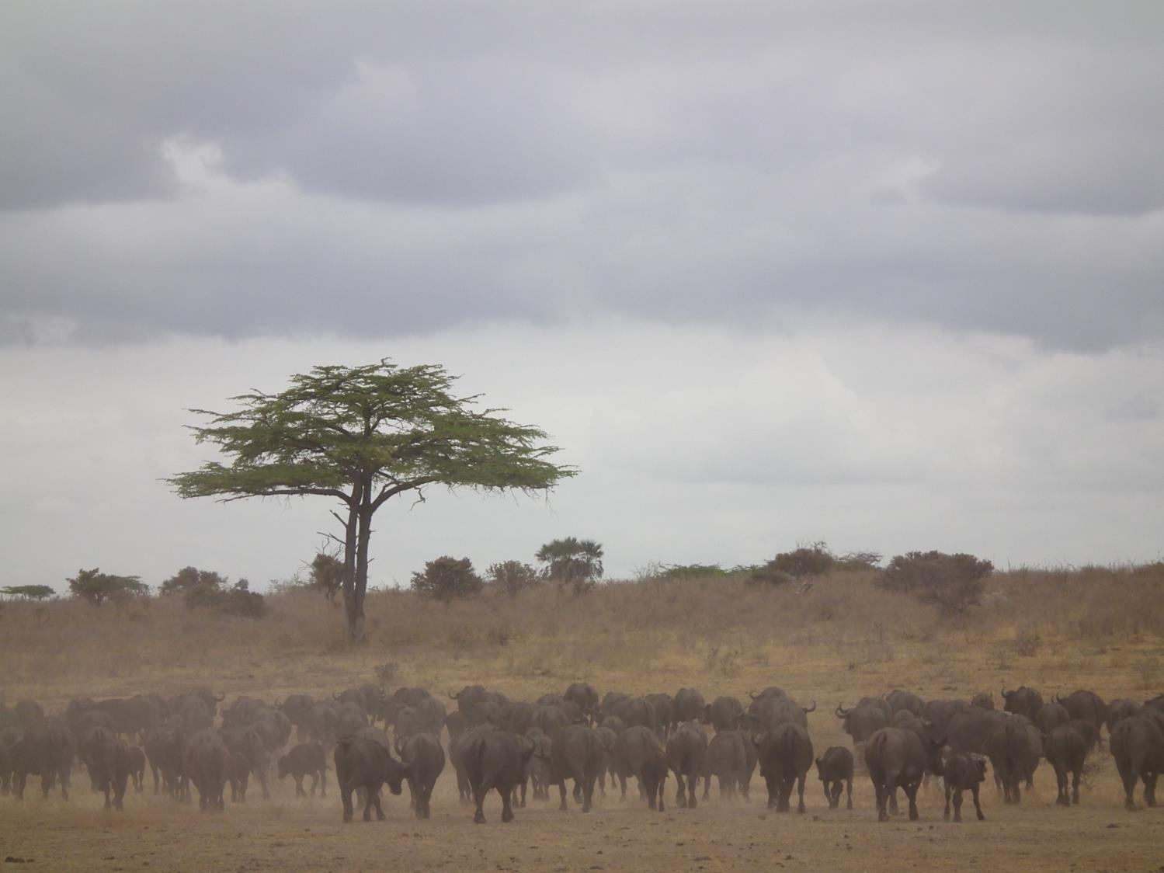
Running of the buffalos, Selous Basin
Karoo?
Baby

Slide 12
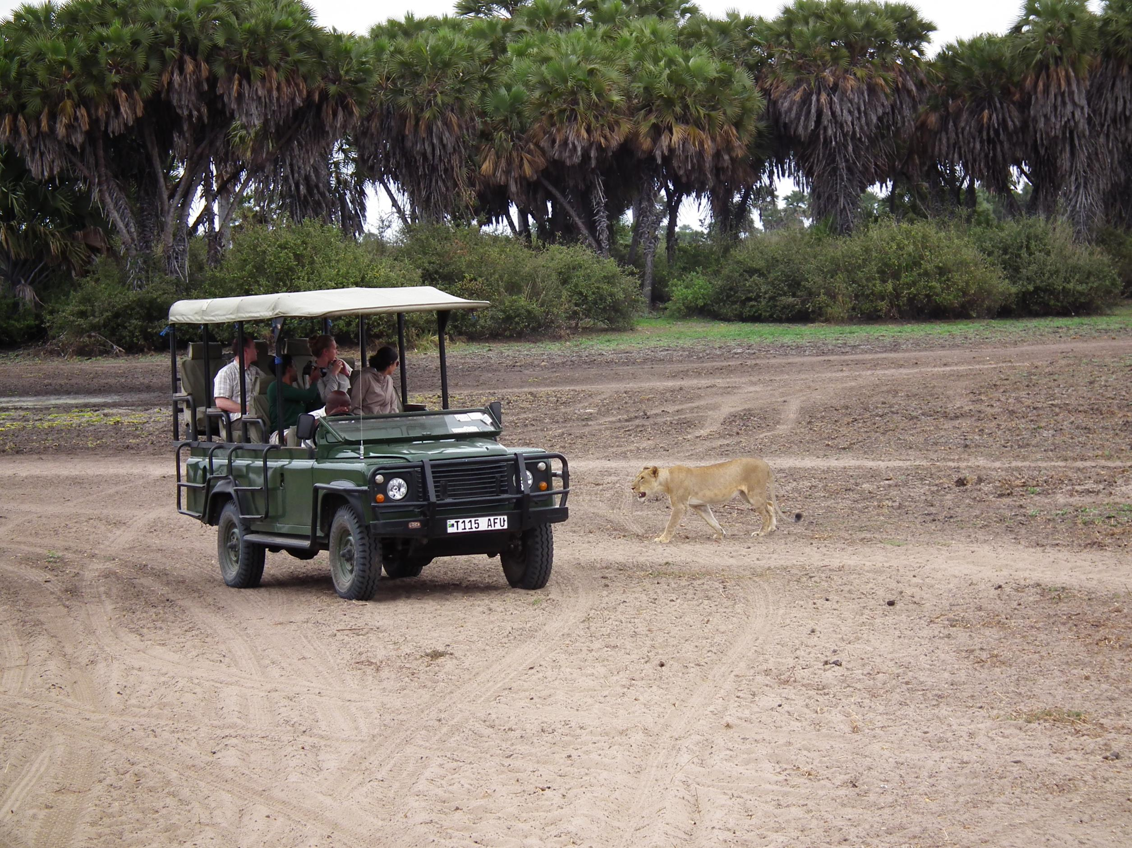
Selous Basin
BABY…

Slide 13
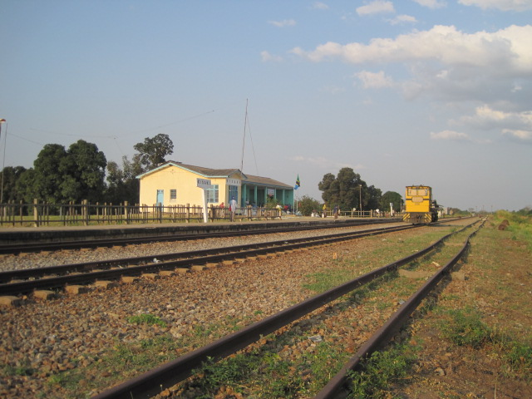
Kisaki Train Station

Slide 14
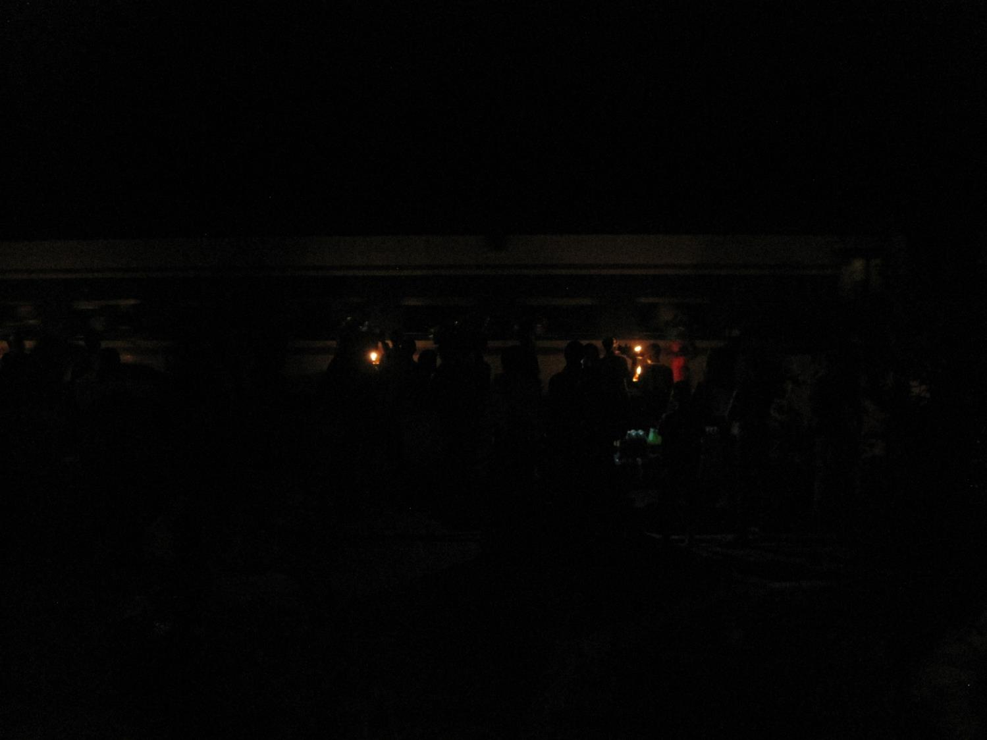
… 9 hours later
Train

Slide 15
Tanga Investigation
Black Shale

Slide 16
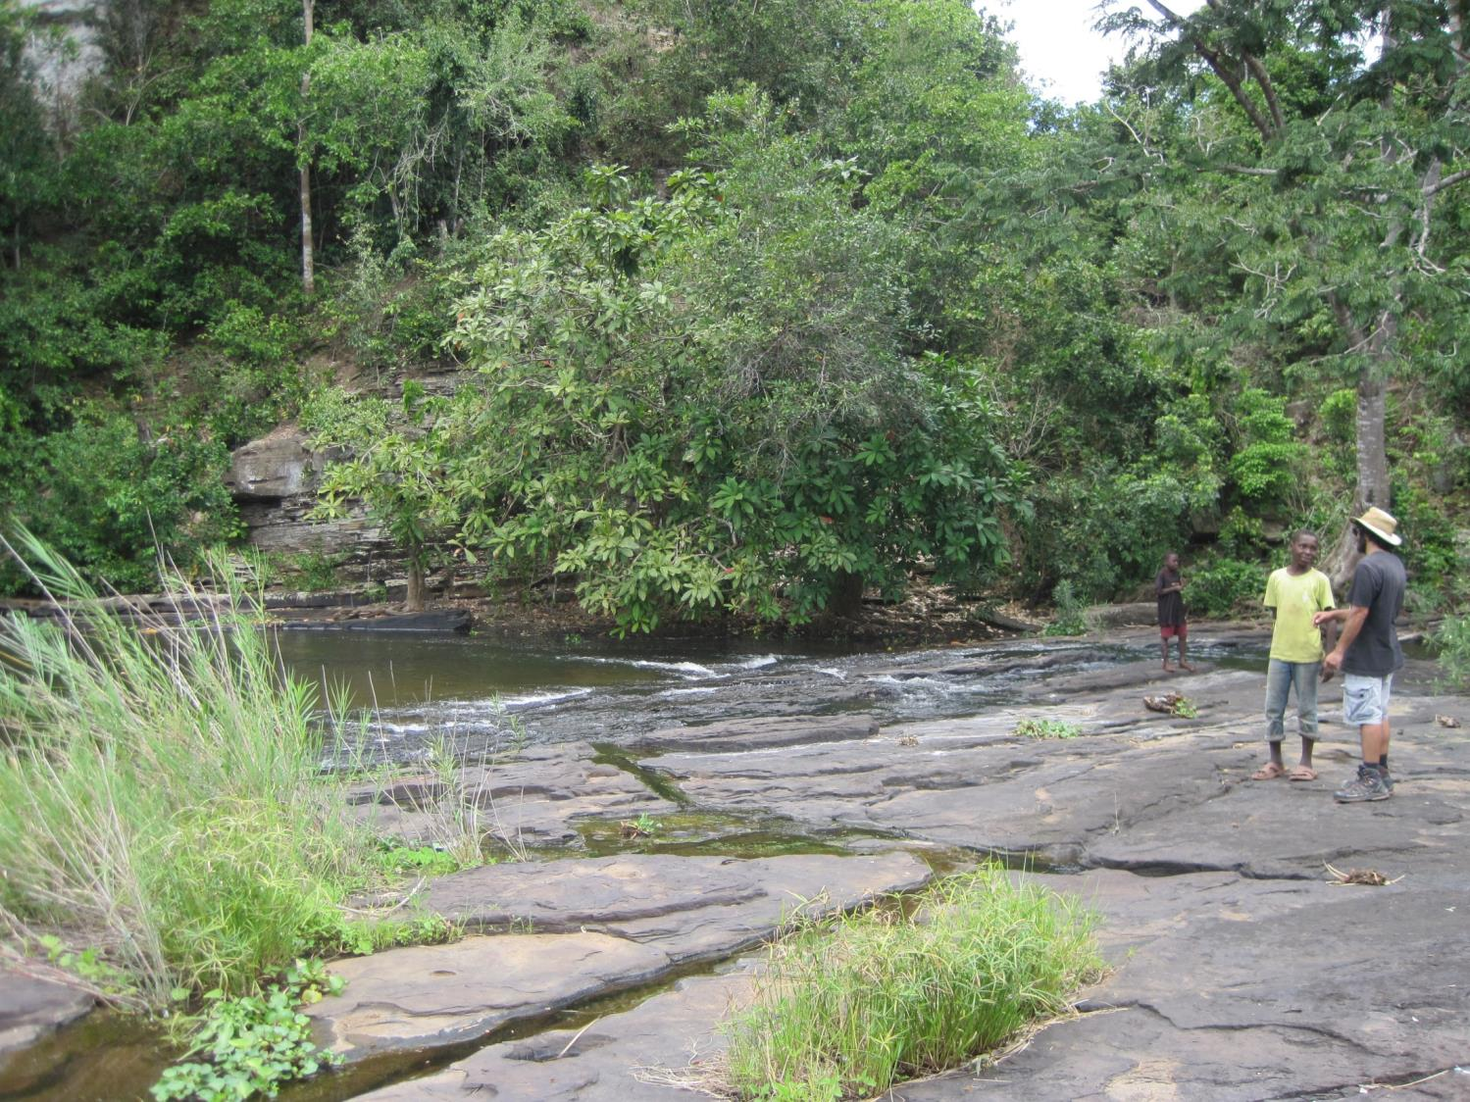
Sigi River, Tanga
Black Shale
Fine-grained gritty material

Slide 17
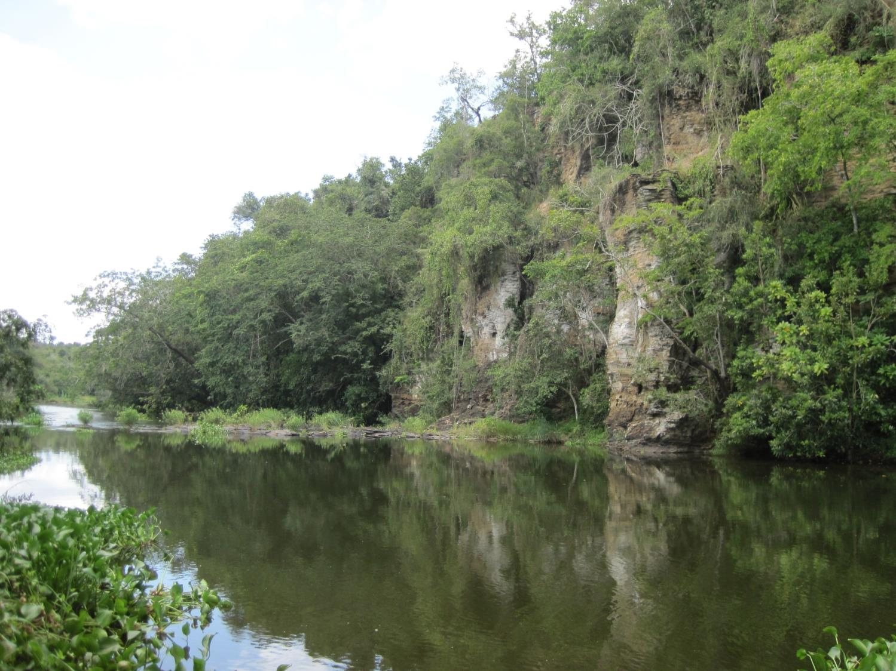
Sigi River, Tanga
Carbonaceous shale, and sample

Slide 18
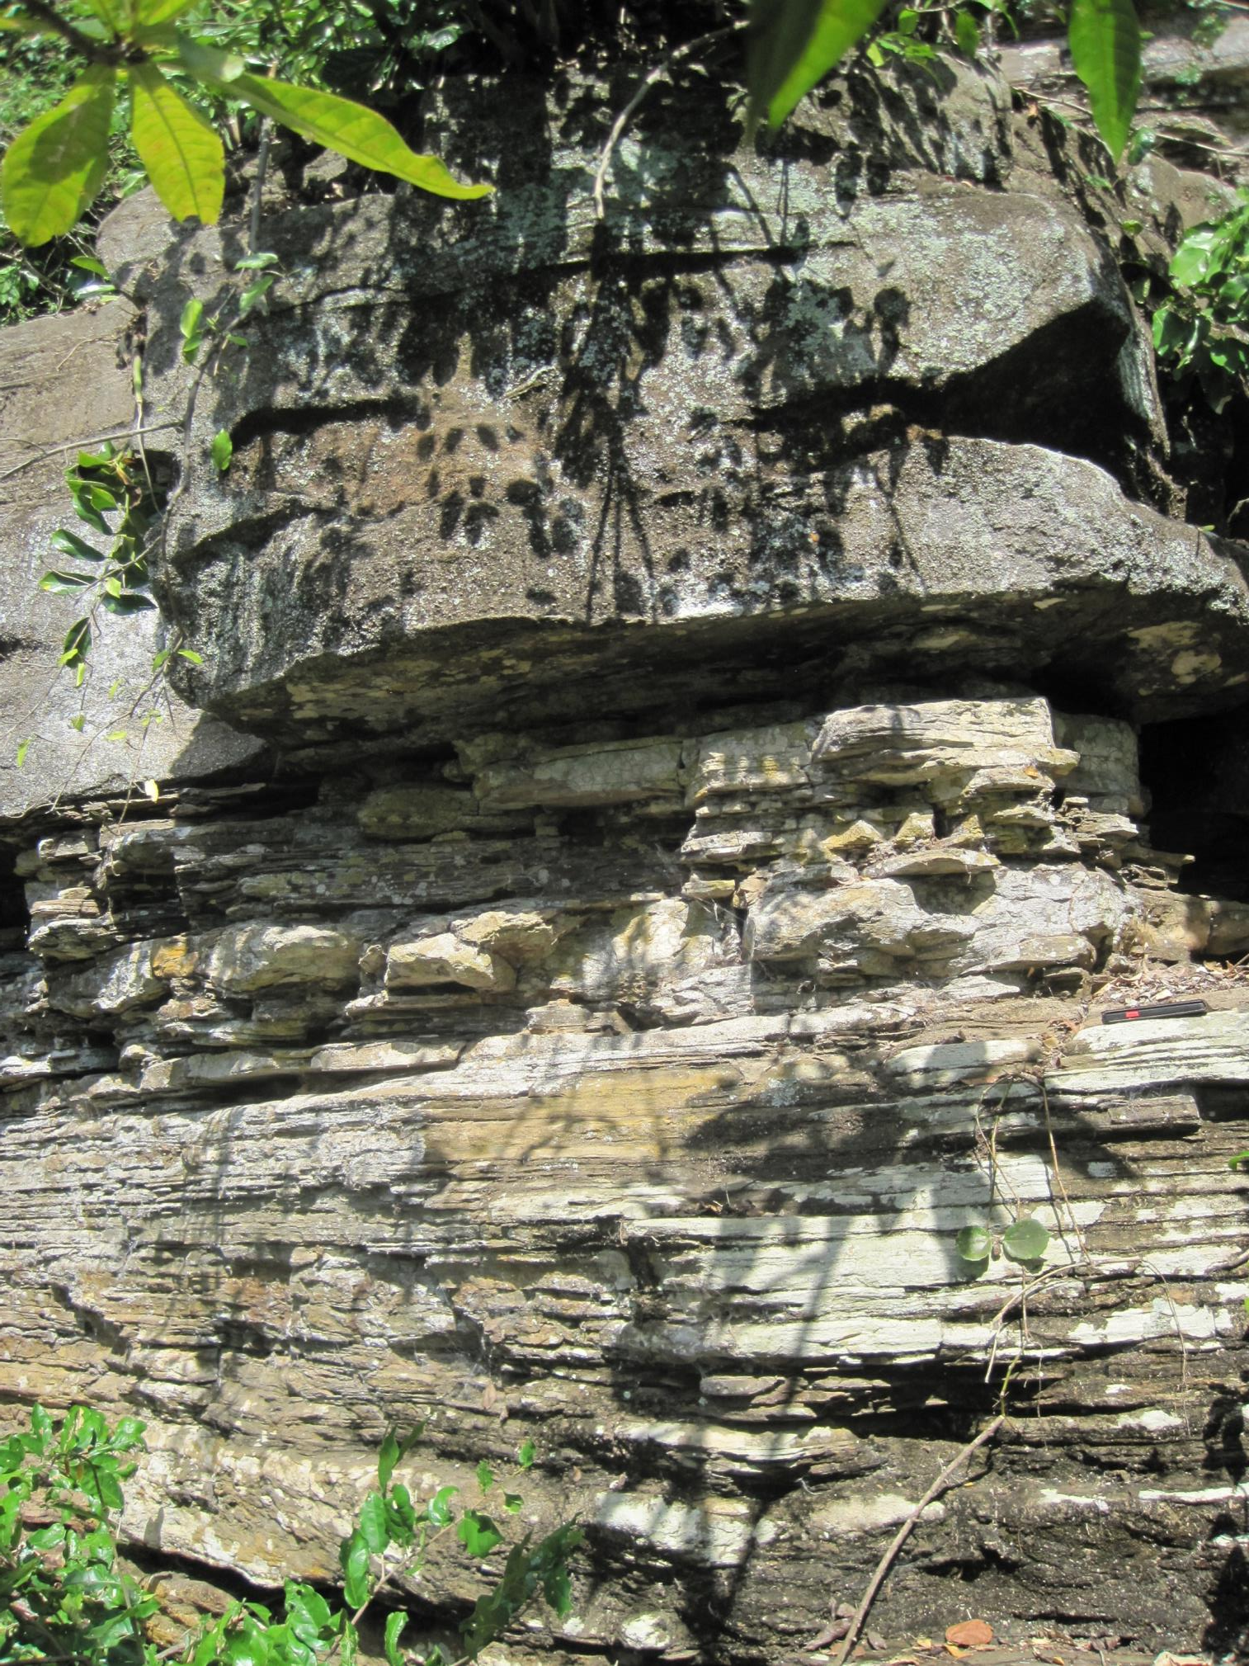
Sigi River, Tanga
White-weathering

Slide 19
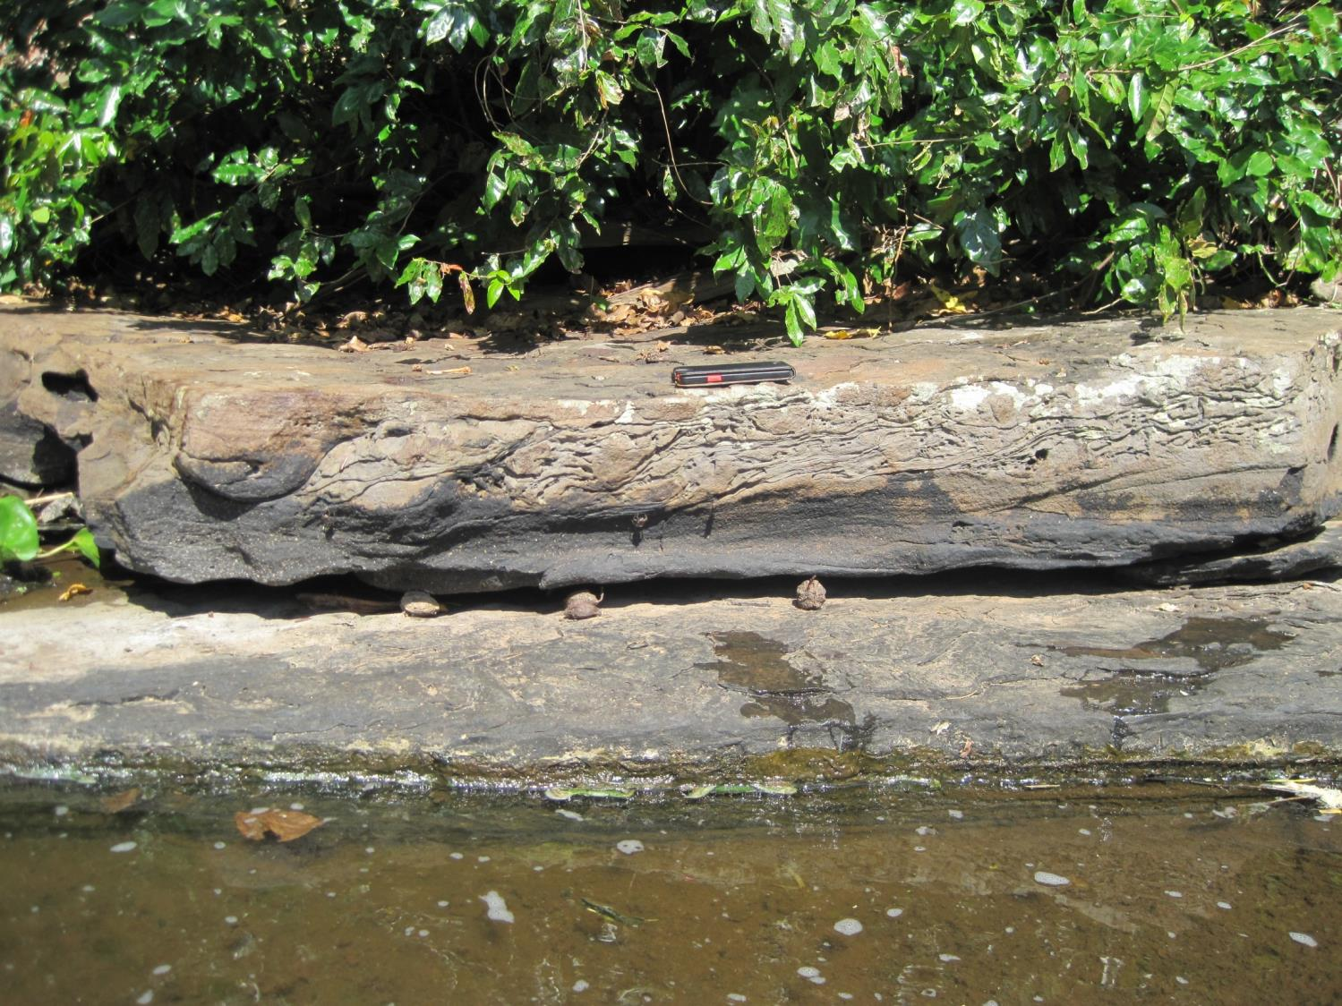
Sigi River, Tanga
Soft-sediment deformation: Glacial origin?

Slide 20
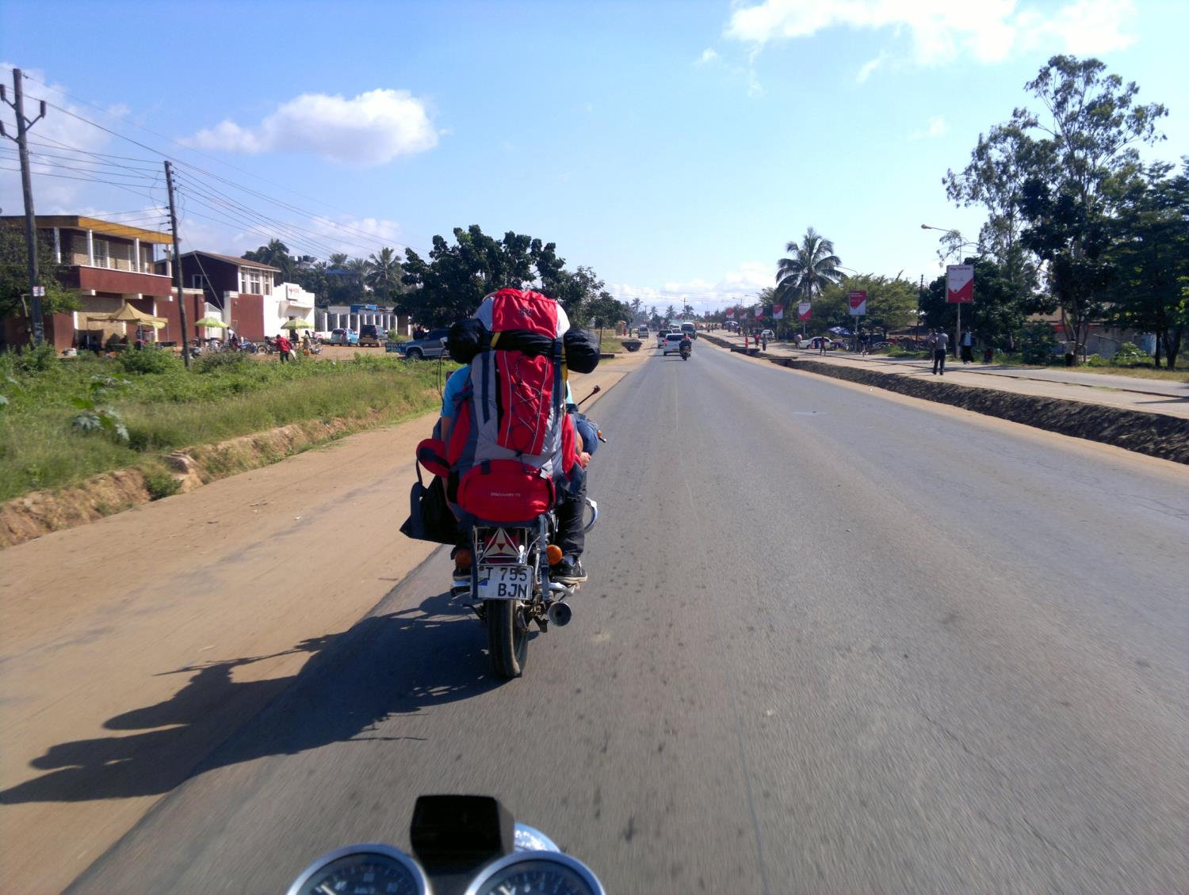
Results:
Tanga had the best exposure of Karoo rocks
These were similar to Karoo rocks of South Africa
Logistical support is vital in a project of this nature

Slide 21
THANK YOU…

