Slide 1
The Development of a General Purpose Processing Unit for the Upgraded Electronics of the ATLAS TileCal
Mitchell Cox
University of the witwatersrand, johannesburg
SAIP 2014

Slide 2
Overview
ATLAS tile calorimeter (tilecal)
The offline data problem
TileCal read-out architecture
Phase II Upgrades
Energy Reconstruction with high pile-up
General Purpose Processing Unit

Slide 3
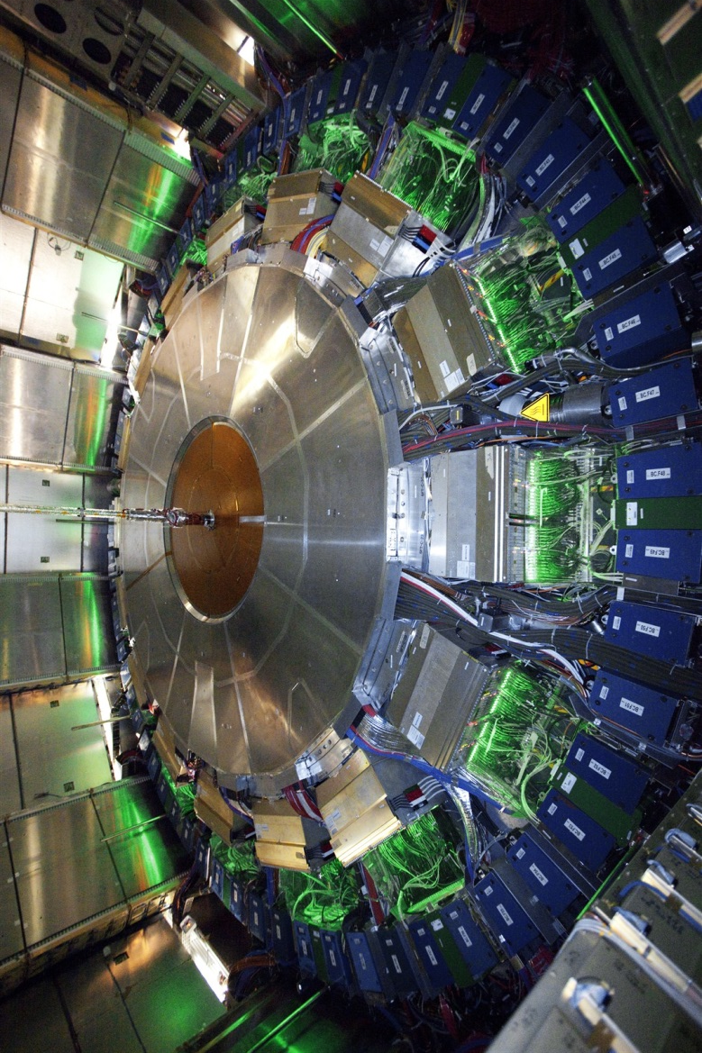
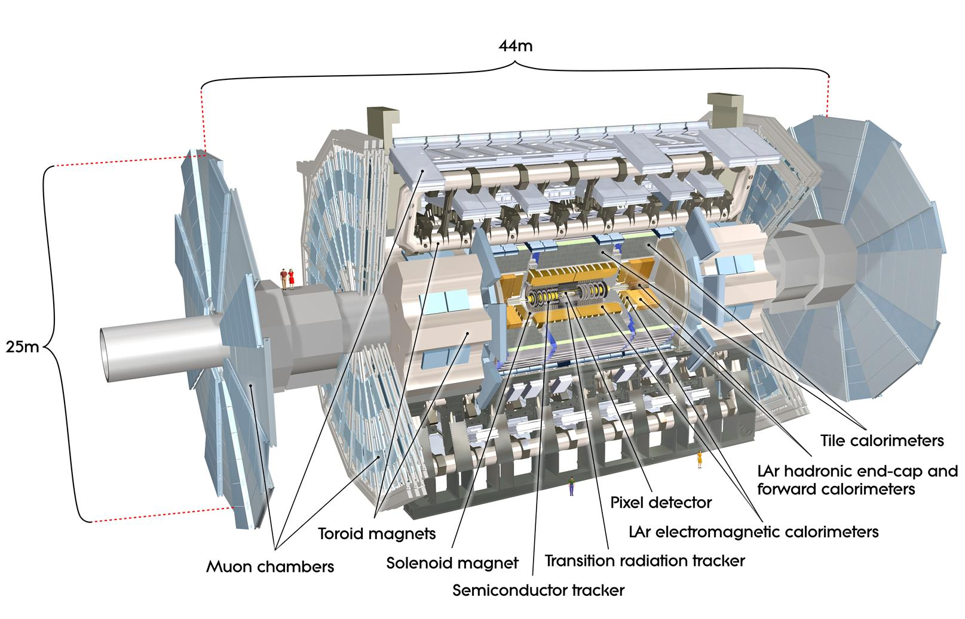
ATLAS Detector
40 MHz Bunch Crossings
1 GHz Interaction Rate
Millions of Sensor Channels
Petabytes per Second!
Photos: ATLAS Experiment © 2014 CERN

Slide 4
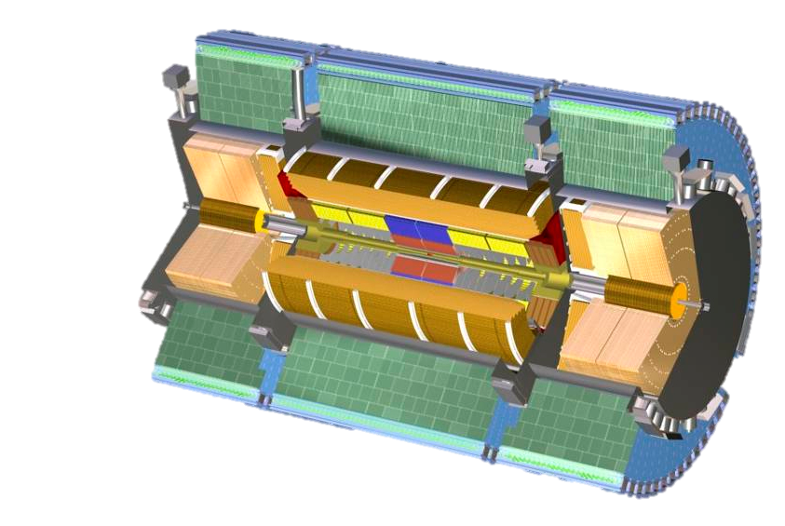
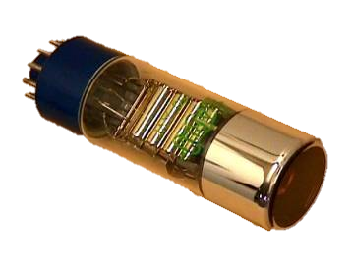
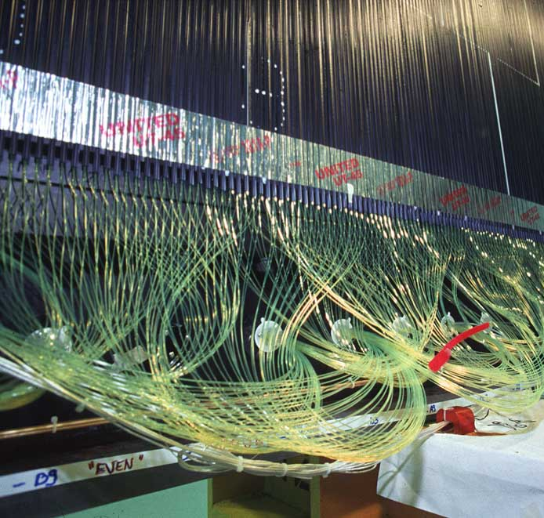
Tile Calorimeter
10 000 Photomultiplier Tubes
Steel (absorber) and Scintillator
Wavelength shifting fibres

Slide 5
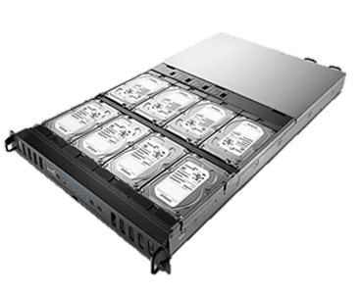
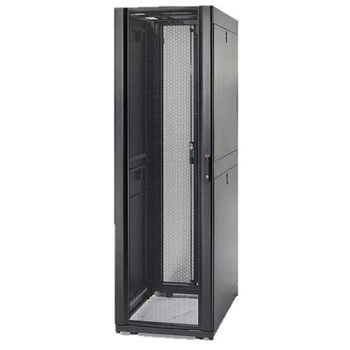
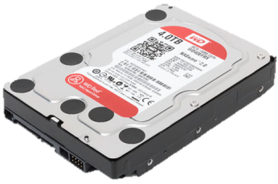
The Offline Problem
PB/s storage is not feasible.
4 TB
200 MB/s
~5 hours
32 TB
200 MB/s
~2 days
1.3 PB
8.4 GB/s
~2 days

Slide 6
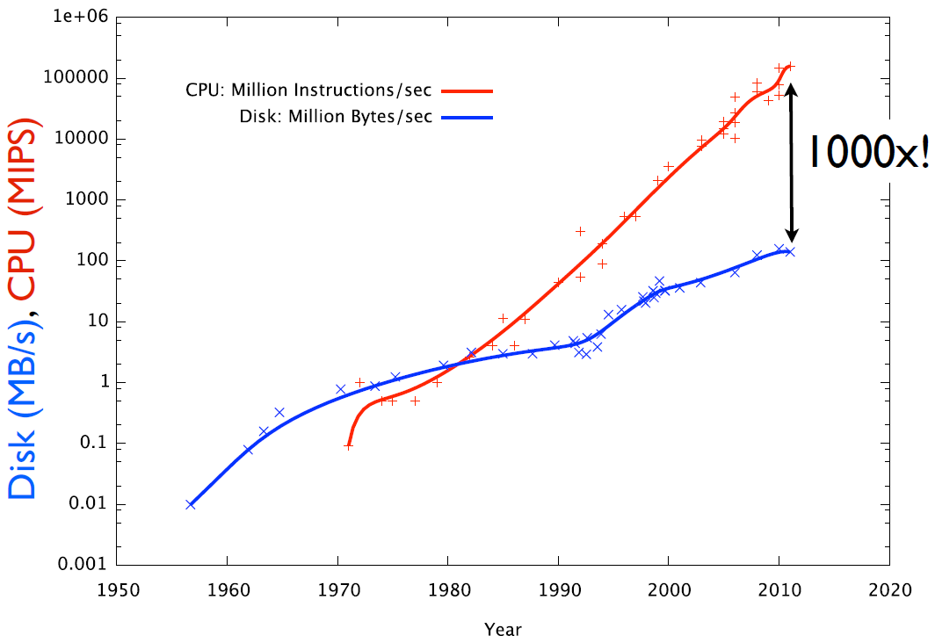
The Offline Problem
PB/s storage is not feasible.
4 TB
200 MB/s
~5 hours
32 TB
200 MB/s
~2 days
1.3 PB
8.4 GB/s
~2 days
Reference: J Dursi. Parallel I/O doesn’t have to be so hard: The ADIOS Library. 2012.

Slide 7
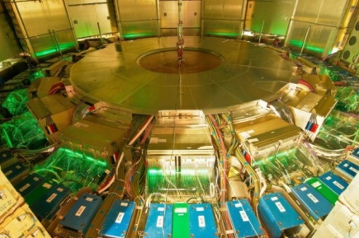
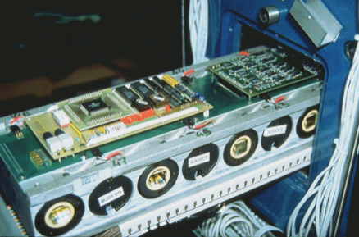
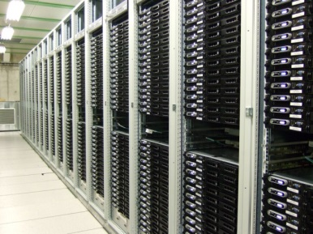
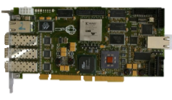
ATLAS Triggering and Data Acquisition System
PB/s Raw reduced to MB/s Interesting Data
40 MHz
PB/s
100 kHz
GB/s
200 Hz
MB/s
Algorithmic Intensity
Photos: ATLAS Experiment © 2014 CERN

Slide 8
ATLAS Triggering and Data Acquisition System
PB/s Raw reduced to MB/s Interesting Data
40 MHz
PB/s
100 kHz
GB/s
200 Hz
MB/s
Algorithmic Intensity
My contributions are here…
Photos: ATLAS Experiment © 2014 CERN

Slide 9
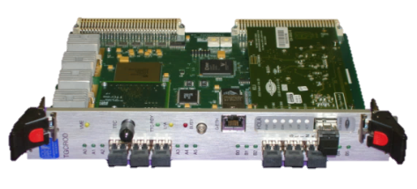
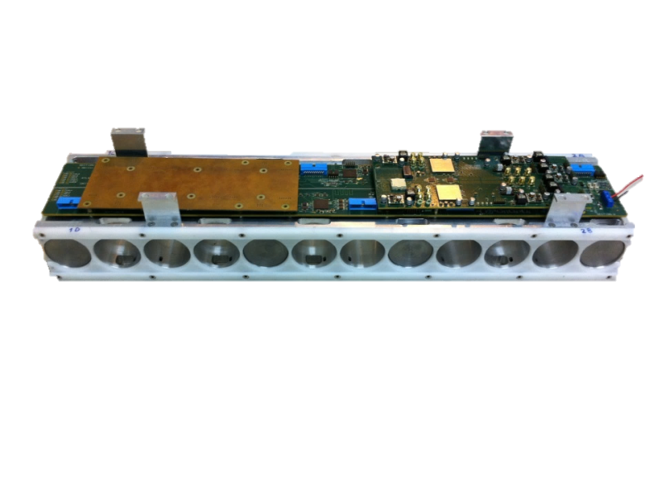
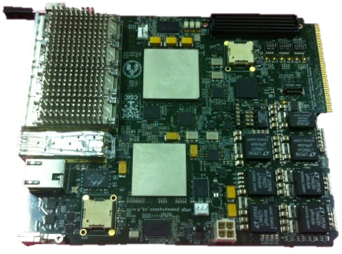
TileCal Read Out Architecture
Current:
Future:
Wits is contributing to the sROD!

Slide 10
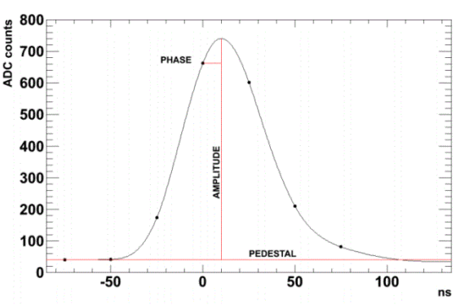
sROD PMT Energy Reconstruction
PMT signal is conditioned, digitised and sent to sROD
“Compresses” PMT Data with
Optimal Filtering
Matched Filter
Figures Reference: B S Peralva. The TileCal Energy Reconstruction for Collision Data using the Matched Filter. 2013.

Slide 11
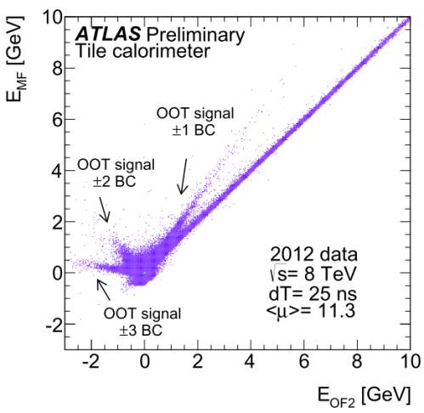
sROD PMT Energy Reconstruction
Pile-up impairs energy reconstruction performance
Could verify and tune algorithms “online”
Need a general purpose processing unit
Figures Reference: B S Peralva. The TileCal Energy Reconstruction for Collision Data using the Matched Filter. 2013.

Slide 12
Processing Unit Integration
Current:
Future:
General purpose Processing Unit links to sROD
Notes:
Add text

Slide 13
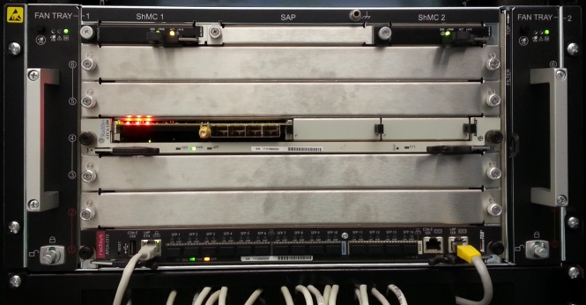
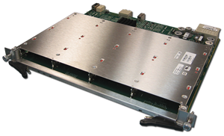
Processing Unit Integration
Not in critical data path (for now)
40 Gb/s Data Throughput
General Purpose CPUs
sROD
Processing Unit (PU)

Slide 14
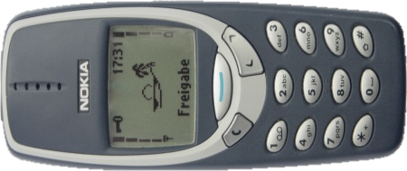
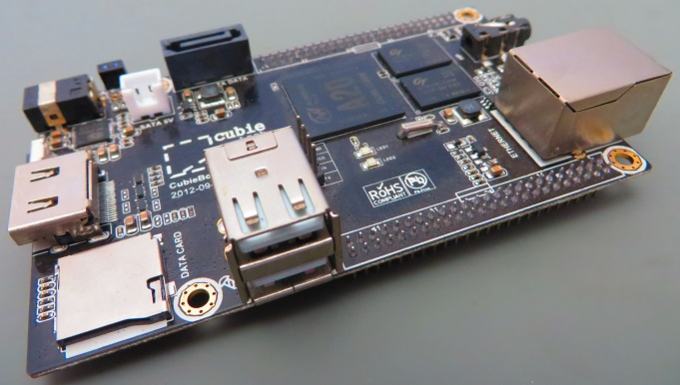
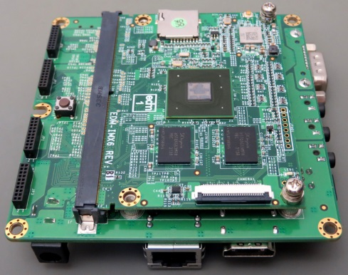
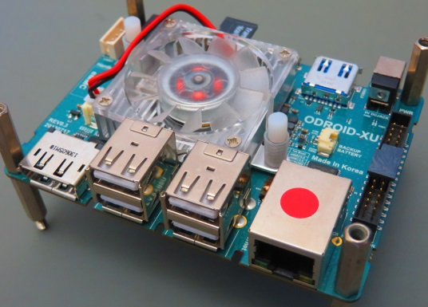
System on Chips
ARM or Intel Atom SoC
Low Power Consumption
Low Cost
High CPU Performance per Watt
What about I/O performance?
Cortex-A7
Cortex-A9
Cortex-A15

Slide 15
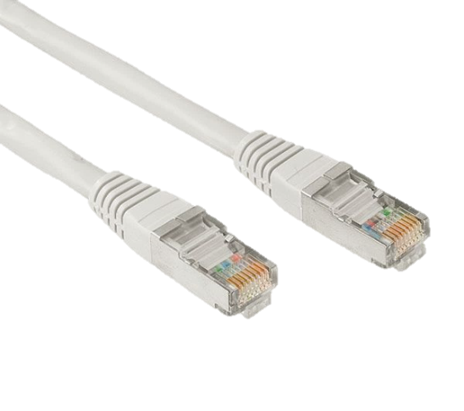
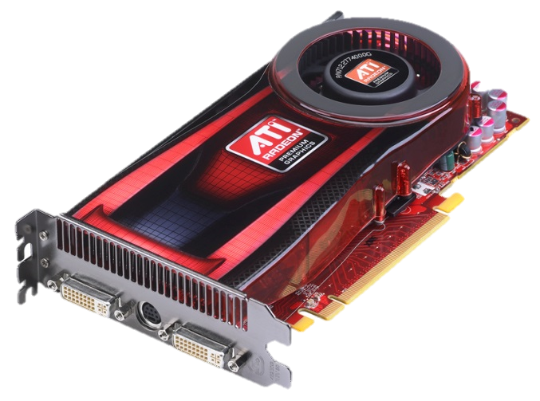
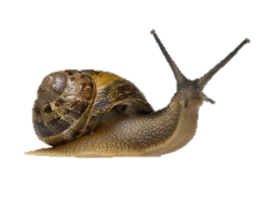
System on Chip External I/O Ports
Ethernet
PCI-Express
100 Mb/s - 1 Gb/s
10 - 100 MB/s
N x 5 GT/s
≥ 500 MB/s

Slide 16
System on Chip External I/O Ports
x
Ethernet
PCI-Express
100 Mb/s - 1 Gb/s
10 - 100 MB/s
N x 5 GT/s
≥ 500 MB/s

Slide 17
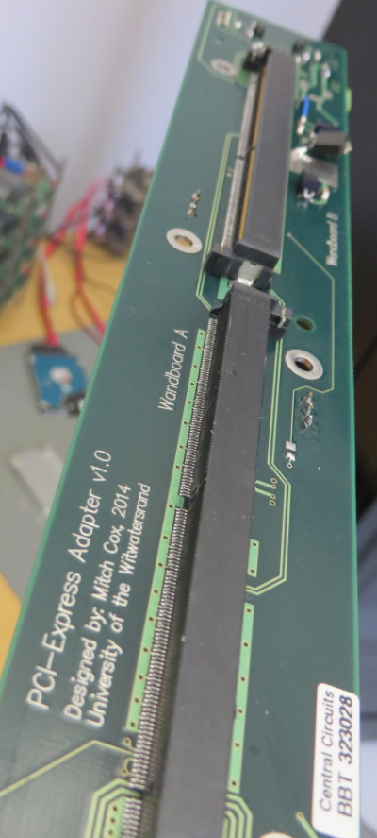
PCI-Express Benchmark Rig
Test PCI-Express with a pair of SoCs:
Wandboard is a Quad-Core Cortex-A9 at 1 GHz
Freescale i.MX6 SoC
Manufactured in South Africa

Slide 18
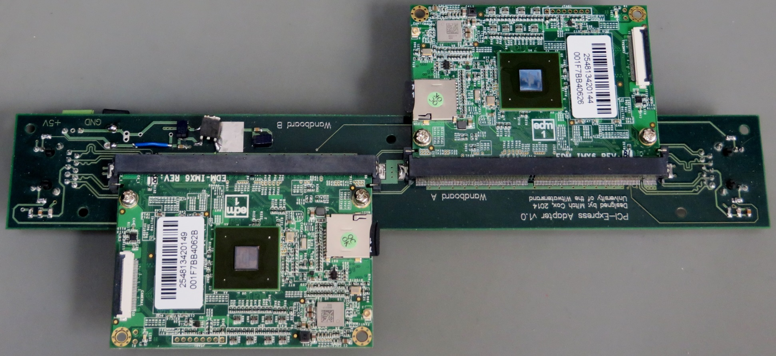
PCI-Express Benchmark Rig
Test PCI-Express with a pair of SoCs:
Wandboard is a Quad-Core Cortex-A9 at 1 GHz (i.MX6 SoC)

Slide 19
PCI-Express Test Results
PCIe x1 Link on i.MX6 SoC :
500 MB/s Theoretical
72 % of theoretical with Direct Memory Access (DMA)
Superior to Ethernet
Successful Proof of Concept
40 Gb/s PU needs 12 Freescale i.MX6 SoCs
12 x 5 W = 60 W Power Consumption
 | CPU memcpy | DMA (Slave) | DMA (Master)
Read (MB/s) | 94.8 ±1.1% | 174.1 ±0.3% | 236.4 ±0.2%
Write (MB/s) | 283.3 ±0.3% | 352.2 ±0.3% | 357.9 ±0.4%

Slide 20
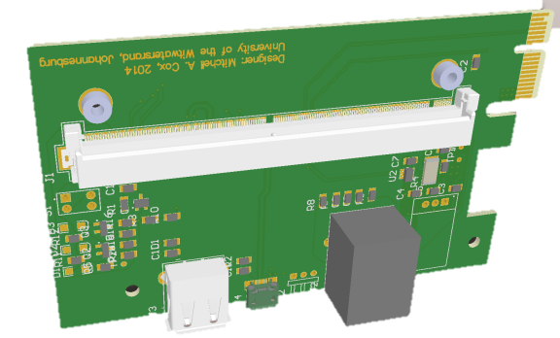
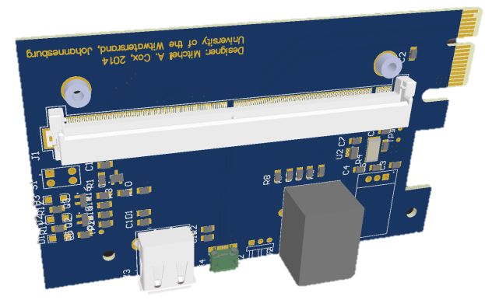
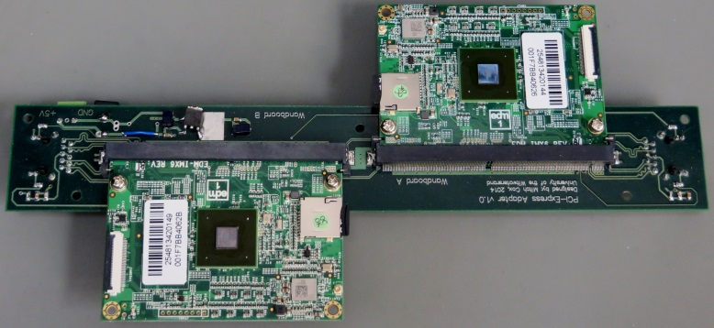
Further Prototyping
Test 8 i.MX6 SoCs via PCI-Express Switch
Develop Linux Driver:
Emulate Ethernet (RDMA)
Emulate File
“Programmer Friendly”
PCIe Development Board at Wits

Slide 21
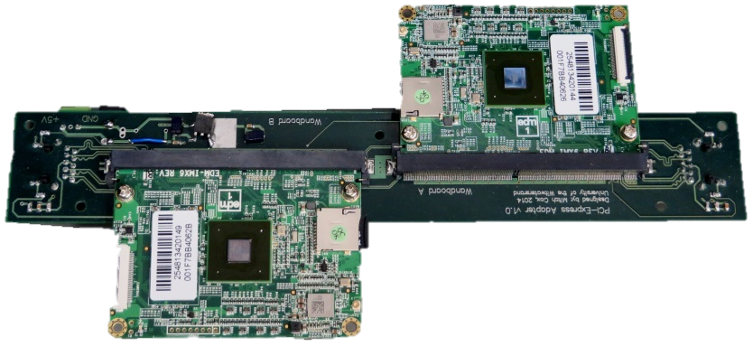
Summary
General Purpose Processing Unit
Help with the TileCal energy reconstruction pile-up issue
40 Gb/s Streaming Data Throughput
12 Freescale i.MX6 Quad Cortex-A9 System on Chips
Programmable in C++
Cost Effective
ARM SoCs are mass produced
Power Efficient
60 W
Notes:
Performance details outside

Slide 22
Questions or Comments?
mitchell.cox@students.wits.ac.za

Slide 23
Acknowledgements
The “Massive Affordable Computing Project” team:
Robert Reed, Thomas Wrigley, Matthew Spoor (Physics)
Daniel O Kwofie, Ekow Etutu (Elec. Eng.)
Carlos Solans Sanchez, Alberto Valero Biot (Valencia – CERN)
MSc Supervisors: Prof. Bruce Mellado, Prof. Ivan Hofsajer
The financial assistance of the National Research Foundation (NRF) towards this research is hereby acknowledged. Opinions expressed and conclusions arrived at, are those of the authors and are not necessarily to be attributed to the NRF.
I would also like to acknowledge the School of Physics, the Faculty of Science and the Research Office at the University of the Witwatersrand, Johannesburg.

Slide 24
Backup Slides

Slide 25
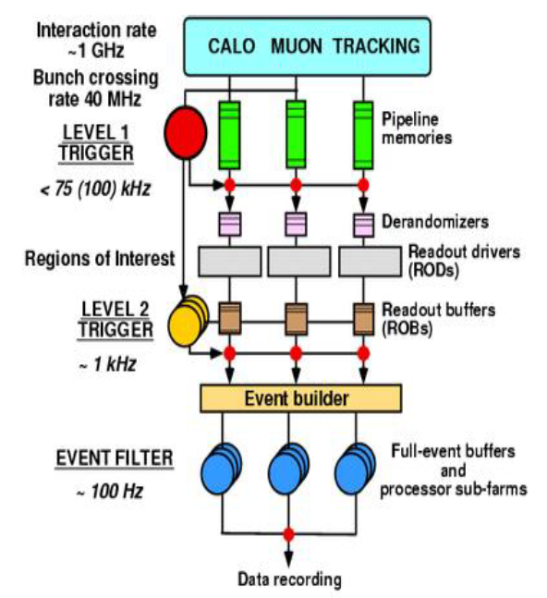
ATLAS Triggering and Data Acquisition System

Slide 26
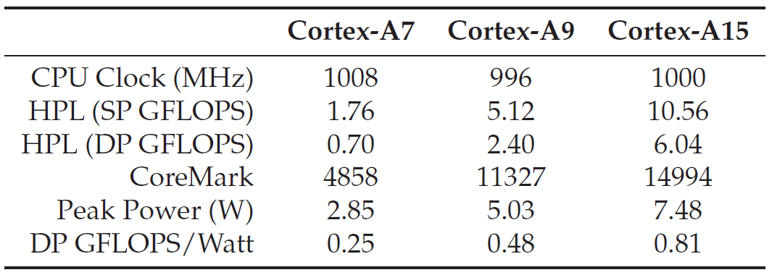
ARM Performance

