Slide 1
Sipho Shongwe - UJ Supervision: Prof A Faanhof and SH Connell (UJ and Necsa)
Re-mobilization of Uranium and Thorium from sediments contaminated by naturally occurring radioactive material (NORM) through leaching by acid mine drainage (AMD)
On 12 July 2013 at SAIP 2013
University of Zululand

Slide 2
Outline
What constitutes AMD
Solid-liquid distribution ratio
Transport models
Analytical techniques: NAA, ICP-MS
Results and Conclusions

Slide 3
The Sediment
Mixture of dissimilar particles e.g. solid phases that interact with dissolved constituents in natural waters
Sediment acts as both the sink that stores radionuclides as well as being another source from which radionuclides emanate from such as rocks, mines, etc.
A detailed investigation of the mechanisms controlling the mobility due to AMD as opposed to a survey pathways is done.

Slide 4
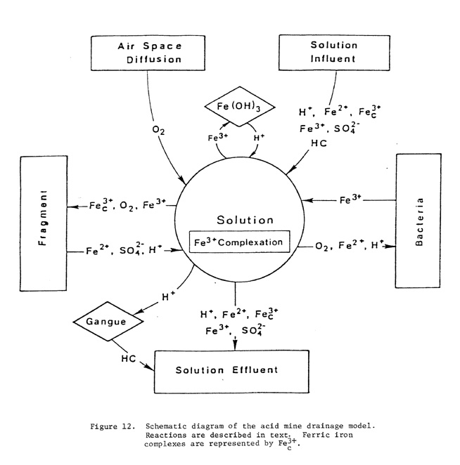
Formation of AMD- Oxidation of Pyrites-What constitutes AMD?
2FeS₂ + 7O₂ + 2H₂O 2Fe²⁺ + 4SO₄ ²⁻ + 4H⁺ (1)
4Fe²⁺ + O₂ + 4H⁺ 4Fe³⁺ + 2H₂O (2)
Fe³⁺ + 3H₂O Fe (OH)₃ + 3H⁺ (3)
14Fe³⁺ + FeS₂ + 8H₂O 15Fe²⁺ + 2SO₄ ² + 16H⁺ (4)

Slide 5
Solid-liquid distribution ratio
The ratio of adsorbed radionuclide concentrations (Cs) in suspended particulate matter (Bq.kg⁻¹) or sediments (Solid phase) to dissolved (Cw) radionuclide in the liquid (Bq.ℓ⁻¹) (Liquid phase) surrounding the solid phase
In sorption studies, the Kd value is related to the retardation factor , (unitless) in Equation 6 by the bulk density (ρ_{b}, kg m⁻³) and the
porosity (η, m³ m⁻³),
Which defines the ratio of average linear velocity of water (m/s) to average linear velocity of the contaminant (radionuclide)
Table 1. K_{d} of some radionuclides of interest in soils (ℓ. kg⁻¹ )[1] EMRAS
[1]International Atomic Energy Agency. 2007. Modeling the transfer of Radio nuclides from Naturally Occurring Radioactive Material. Report of the NORM Working Group of (Environmental Modeling for Radiation Safety) Theme 3.
Nuclide | Sand | Loam | Clay | Organic
Ac | 450 | 1500 | 7400 | 5400
Bi | 120 | 400 | 670 | 1500
Pa | 540 | 1800 | 2700 | 6600
Pb | 270 | 16000 | 540 | 22000
Po | 150 | 400 | 2700 | 6600
Ra | 490 | 36000 | 9000 | 2400
Th | 3000 | 3300 | 5400 | 89000
U | 33 | 12 | 1500 | 400

Slide 6
The Uranyl ion
From the preceding table1………
We see:
Nature obligates Uranium to re-adsorb to solids??
Uranium occurs as a U (VI) ion in aqueous uranyl ion (UO₂²⁺).
The sorption of uranyl ion to humic acid plays a role while at the same time uranyl also adsorbs to clay through cation exchange (In Table 1 there is a low k_{d} for uranium).
Let’s investigate?

Slide 7
Remobilisation
Flooding – the transport from sediment to water phase as a physical process
K_{d} The degree of radionuclide sorption on the solid phase quantified using K_{d,} to assess mobility NORMs in soils (IAEA, 2010:25)
Transport caused by the water current and magnetic stirring.
Interaction of pollutant with the sediment and the suspended matter -K_{d}

Slide 8
The schematic summary outlining the experimental setup

Slide 9
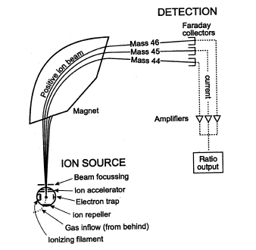
ICP-MS Sector Instrument
Sector field uses both E and B to affect the path and velocity of charged particles:
The operation of a Mass Spectrometer is based on Lorentz force equation:
F = q(E + v x B); q is charge of + ion and v its velocity
The sector instrument bends PATH of ions with different masses (B field normal to their motion) as they pass through the MS analyzer according to Mass to charge ratio in a semicircular path.
The more charged faster-moving lighter ions are deflected the most separating the ions
The ions separated based on their mass-to-charge ratio.
The detector receives an ion signal proportional to the concentration.

Slide 10
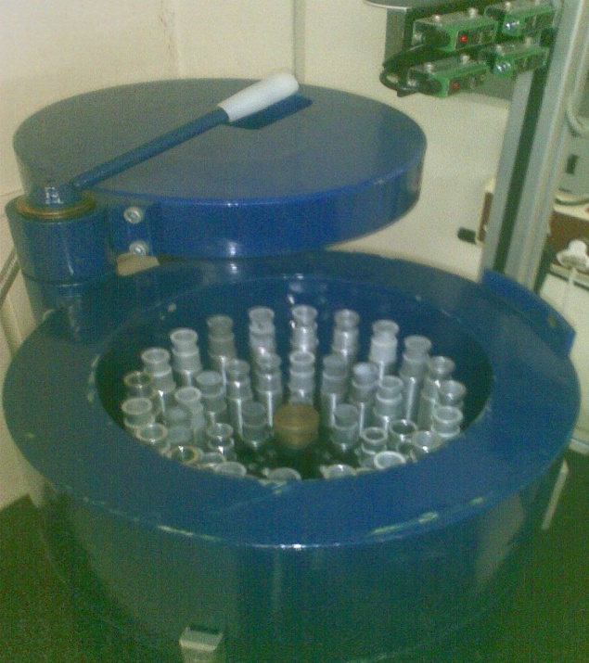
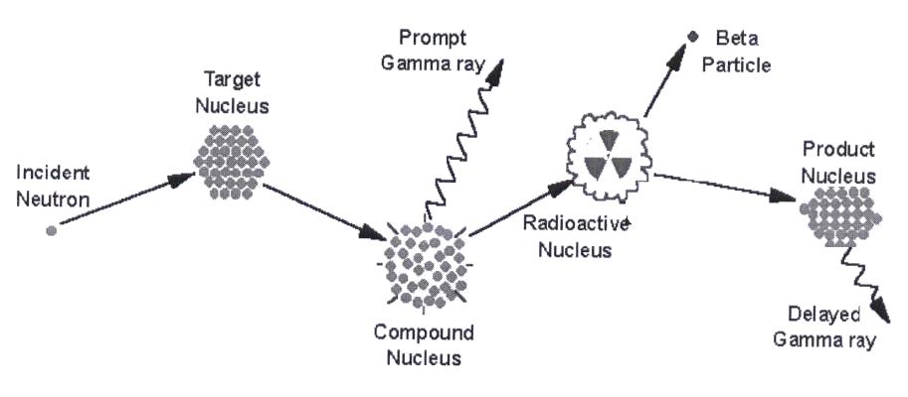
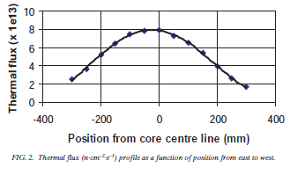
INAA principle
Fission of U-235 source of (1 MeV) n
(1 MeV) n thermalised to 0.02 eV by elastic scattering with graphite or heavy water
Delayed time measurements used
Genie2000 software used
²³⁸U (n,γ) ²³⁹U →β⁻ decay → ²³⁹Np
γ-rays of 228 keV and 278 keV
²³²Th (n,γ) ²³³Th →β⁻ decay → ²³³Pa
γ-rays of 312 keV and 300 keV

Slide 11
RESULTS AND DISCUSSIONS: The average [U] and [Th] in the sediments before and after leaching
From table 2 one can see that on average the thorium
content in the sediments decreased by about 18,8%.
This coincides well with the observed average relative
reduction of the mass of the sediments upon leaching
with the simulated AMD of 19.1%.
AMD has apparently not leached U from the sediments
into the leachate
Table 3. Uranium and Thorium in the
leachates by ICP-MS
In table 3 one observes almost no Th in the
leachate.
We conclude that part of the Th remobilized
by dissolution of the soluble part of the
sediments did not remain in the leachate
by adsorbing to filter paper, and walls of the
container
After mass corrections there is on average no
decrease in [U] confirmed by the U content of
the leachates in table 3.
Table 2: Uranium and thorium leaching as observed through INAA
Sediment mass (g) |  |  | Uranium concentration (µg) |  |  | Thorium concentration (µg)
Prior to | After | Loss (%) | Prior to | After | Loss (%) | Prior to | After | Loss (%)
25,0 | 20,22 | 19,1 | 3246,0 | 3274,9 | -0,88 | 289,3 | 234,8 | 18,8
Sediment mass (g) |  |  | Uranium concentration (µg) |  |  | Thorium concentration (µg)
Prior to | After | Loss (%) | Prior to | Leachate | Loss (%) | Prior to | Leachate | Loss (%)
25,0 | 20,22 | 19,1 | 3246,0 | 9,01 | 0,288 | 289,3 | 0,0092 | 0,003

Slide 12
CONCLUSIONS
The STUDY only established that at a pH of 4, U is not readily desorbed being part of the insoluble matrix when exposed to AMD, while thorium will be initially remobilized as part of the soluble fraction of the sediments, but will most likely be re-adsorbed to the remaining sediments.
Actual samples in the catchment areas influenced by AMD should be collected to confirm our results.
WAYFORWARD:
The potential remobilization of other nuclides from the NORM-series nuclides should also be investigated in follow-up work.

Slide 13
THANKS

Slide 14
REFERENCES
[1] International Atomic Energy Agency. 2007. Modeling the transfer of Radio nuclides from Naturally Occurring Radioactive Material. Report of the NORM Working Group of (Environmental Modeling for Radiation Safety) Theme 3.
[2] Monte et al., 2005. Review and assessment of models for predicting the migration of radionuclides through rivers. Journal of Radioactivity 79:273-296
[3] Facchetti, S. 1982. Applications of Mass Spectrometry to Trace Analysis. Elsievier Scientific Publishing: New York.
[4] van der Graaf, E. R. , Koomans, R. L., Limburg, J. & Vries, K. 2007. In situ radiometric mapping as a proxy of sediment contamination: Assessment of the underlying geochemical and physical principles. Journal of applied Radiation and Isotopes 65:619—633.
[5] International Atomic Energy Agency (IAEA). 1997. Environmental Impact Assessment for Uranium Mine, Mill and In situ Leach Projects, IAEA – TECDOC-979, Vienna.
[6] Environmental Protection Agency (EPA). 1999. Understanding Variation in Partition Coefficients, K_{d}, values for Cadmium, cesium, Chromium, Lead, Plutonium, Radon, Strontium, Thorium, Tritium (3H) and Uranium. EPA Report 402-R-99-004B, United States. EPA, Office of Air and Radiation, USA.
Websites:
[7] www.htwvmdtaskforce.com/proceedings/83/rogo/83rogo41.jpgtp://

