Slide 1
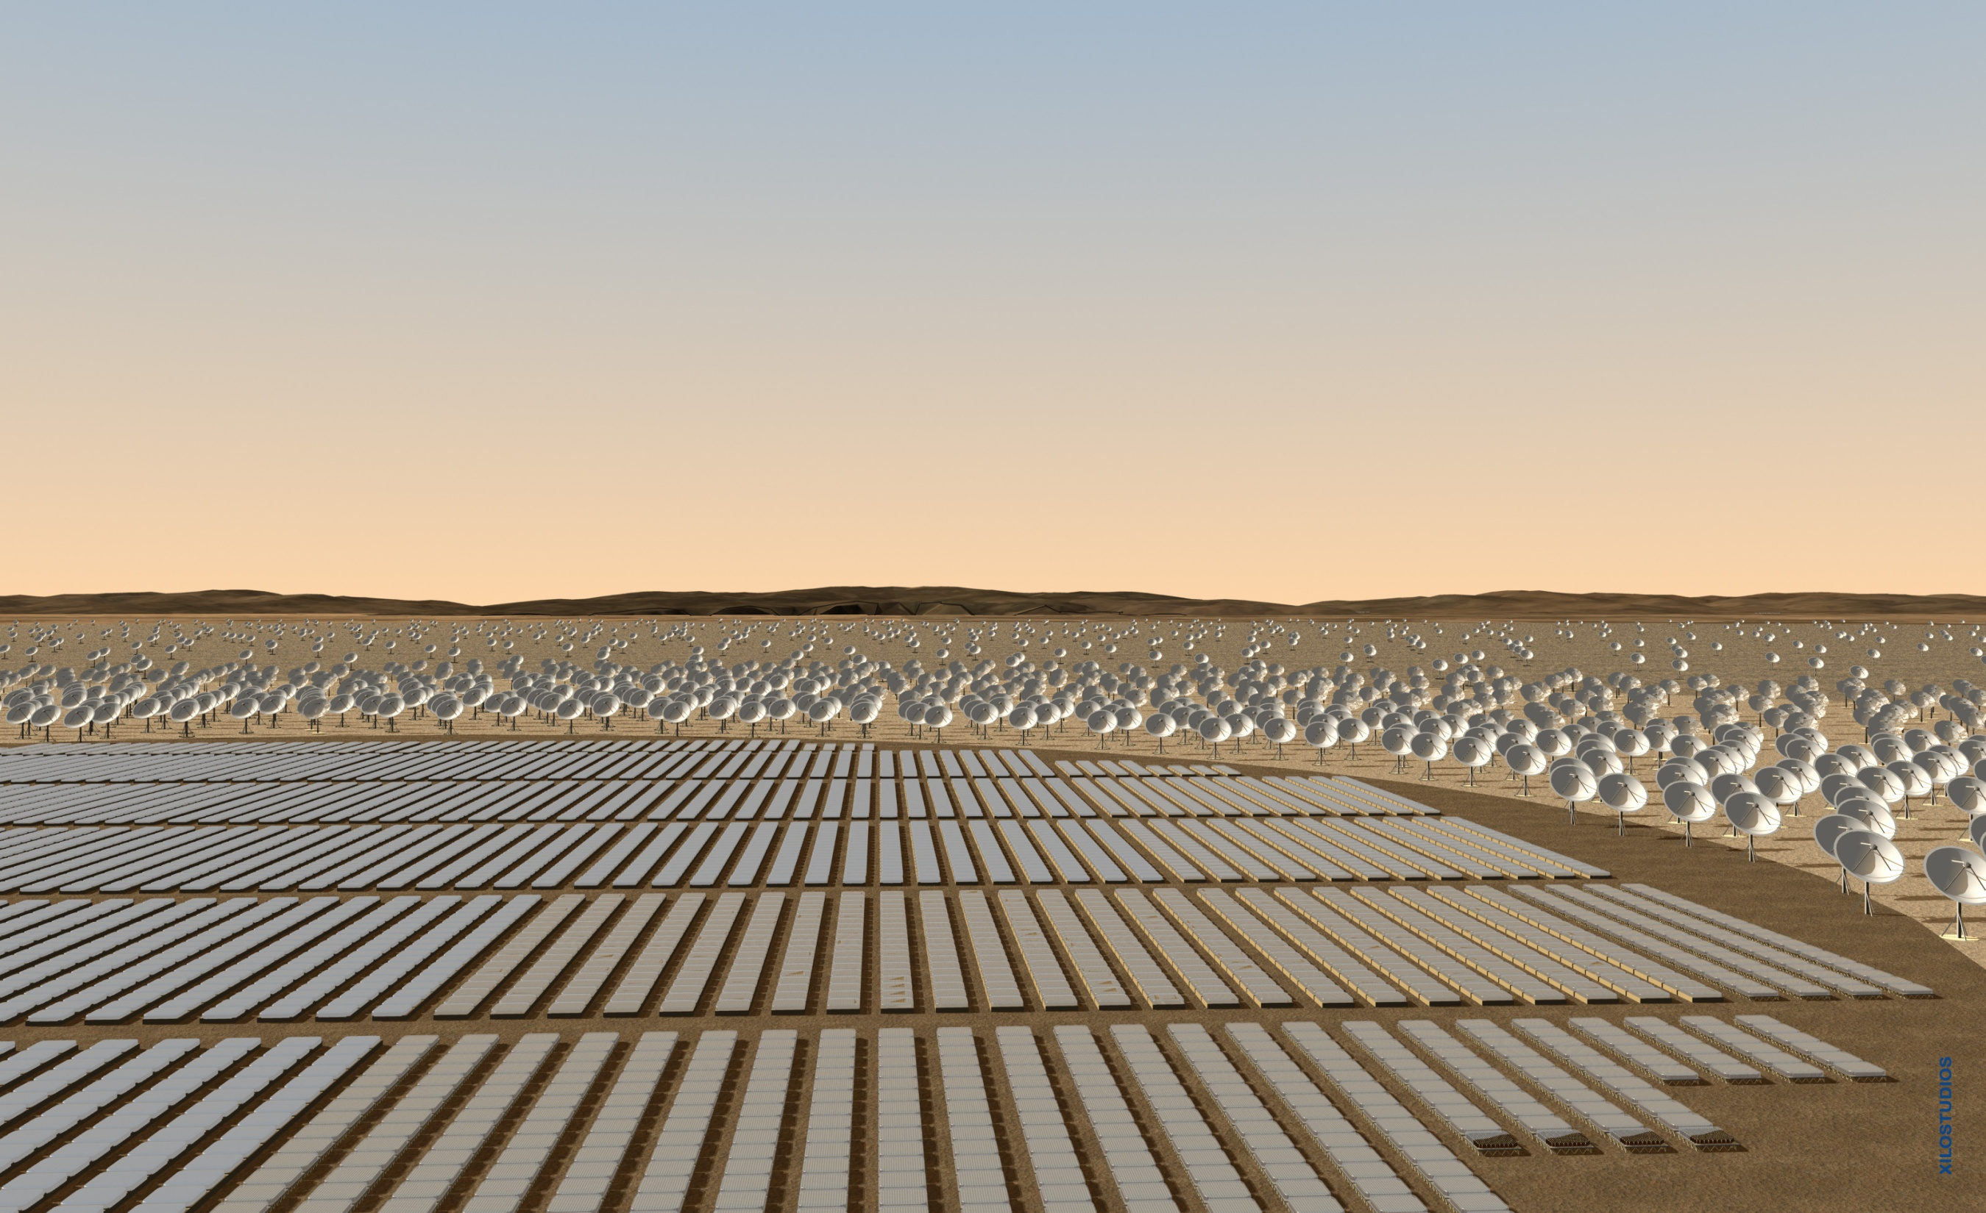

Chromatic Dispersion Compensation for VCSEL Transmission for Applications such as Square Kilometre Array South Africa
E K Rotich Kipnoo, H Y S Kourouma, R R G Gamatham, A W R Leitch and T B Gibbon

Slide 2
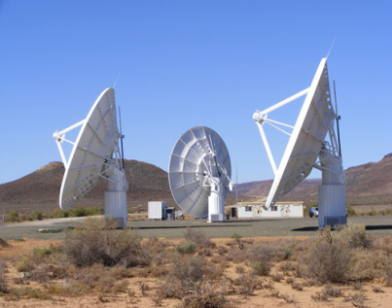


Outline
Introduction
Dispersion in an optical fibre
  Types of dispersion
  Compensation techniques
Inverse dispersion fibre
Methodology
Results & Discussion
Conclusion
Acknowledgement
Notes:
First of all, I will introduce something about UWB technology by proposing some questions, what is UWB? Why UWB? Differnt UWB technologis (OFDM-UWB and IR-UWB)
Then I will introduce UWB over fiber technology: why UWB-over-fiebr? The state of the art and what we have done? Futhermore, the research plan in the near future.
Finally, I will summarize this talk.

Slide 3
Introduction
SKA, South Africa (2024) - large radio telescope, about 100 times more sensitive than the biggest existing radio telescope in the world.
-Approx. 3,000 antennas, half concentrated in a central region (Karoo), and the rest distributed out to 3,000 km.
-The sparse aperture array (low frequency array) will be built in Western Australia
Meer KAT telescope – as a pathfinder to the SKA-Phase 1; 2016
KAT-7 The first seven dishes- complete
2009-2012: SKA preparatory phase
2013-2015: SKA Pre-construction Phase
2016-2018:Construction, verification, commissioning, Acceptance, integration and first science.
Square kilometre array (SKA) website: http://www.ska.ac.za/index.php
Notes:
First of all, I will introduce something about UWB technology by proposing some questions, what is UWB? Why UWB? Differnt UWB technologis (OFDM-UWB and IR-UWB)
Then I will introduce UWB over fiber technology: why UWB-over-fiebr? The state of the art and what we have done? Futhermore, the research plan in the near future.
Finally, I will summarize this talk.

Slide 4
Dispersion
Dispersion - time domain spreading / broadening of pulses
Types of dispersion
      Chromatic dispersion (CD)
      Polarization modes dispersion (PMD)
Chromatic Dispersion
    Deterministic
    Linear
    Independent of environmental factors
    Can be compensated
How does a pulse spread?
Light sources emit a band of spectral width, ∆λ
Speed of travel depends on the wavelength and fibre design
∆λ
Wavelength
Notes:
First of all, I will introduce something about UWB technology by proposing some questions, what is UWB? Why UWB? Differnt UWB technologis (OFDM-UWB and IR-UWB)
Then I will introduce UWB over fiber technology: why UWB-over-fiebr? The state of the art and what we have done? Futhermore, the research plan in the near future.
Finally, I will summarize this talk.

Slide 5
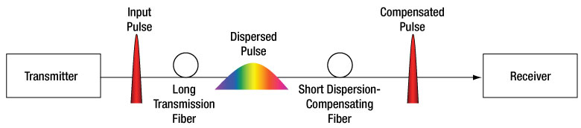
Chromatic Dispersion
In a positive dispersion fibre: short wavelength arrive before long ones
Total CD = Material contribution + waveguide contribution
  Material – depend on material and cant be changed
  Waveguide - depend on refractive index profile-can be engineered
Broad Spectrum Difference in group velocity Broadened pulse
Limits bandwidth and transmission distance esp. as the bit rates increase
1
1
1
1
1
0
Input at transmitter
Optical fibre
Output at receiver
Notes:
First of all, I will introduce something about UWB technology by proposing some questions, what is UWB? Why UWB? Differnt UWB technologis (OFDM-UWB and IR-UWB)
Then I will introduce UWB over fiber technology: why UWB-over-fiebr? The state of the art and what we have done? Futhermore, the research plan in the near future.
Finally, I will summarize this talk.

Slide 6
Dispersion compensating techniques
Electronic chirp implementation on laser diode and modulator chirp (pulse shaping-reduce width)
In-line compensation
    Dispersion compensating fibre (DCF)/reverse dispersion fibre (RDF)
    /Inverse dispersion fibre (IDF)
    fibre Bragg grating (FBG)
    phase conjugation
Post compensation scheme involving electronic equalization at the receiver.
Soliton transmission
Inverse dispersion fibre
    high negative dispersion
    negative dispersion slope
Gumaste A and Antony T 2002 DWDM Network Designs and Engineering Solutions (Indianapolis : Cisco Press)
He G S 2002 Optical phase conjugation: principles, techniques, and applications Prog. in Quant. Elect. 26 pp 131–191
Aikawa K, Yoshida J, Saitoh S, Kudoh M and Suzuki K 2011 Dispersion Compensating Fibre Module Fujikura Tech. rev. pp 16-22
Notes:
First of all, I will introduce something about UWB technology by proposing some questions, what is UWB? Why UWB? Differnt UWB technologis (OFDM-UWB and IR-UWB)
Then I will introduce UWB over fiber technology: why UWB-over-fiebr? The state of the art and what we have done? Futhermore, the research plan in the near future.
Finally, I will summarize this talk.

Slide 7
IDF compensation
Transmitting fibre - SSMF
Compensating fibre - IDF
+
Positive dispersion
Negative dispersion
Longer wavelength - slow
Longer wavelength - fast
Shorter wavelength - fast
Shorter wavelength - slow
Negative dispersion
Positive dispersion
Longer wavelength - fast
Longer wavelength - slow
Shorter wavelength - slow
Shorter wavelength - fast
Hecht J 1999 Understanding fibre optics 3rd Ed. (Upper Saddle River New Jersey:Prentice-Hall)
Notes:
First of all, I will introduce something about UWB technology by proposing some questions, what is UWB? Why UWB? Differnt UWB technologis (OFDM-UWB and IR-UWB)
Then I will introduce UWB over fiber technology: why UWB-over-fiebr? The state of the art and what we have done? Futhermore, the research plan in the near future.
Finally, I will summarize this talk.

Slide 8
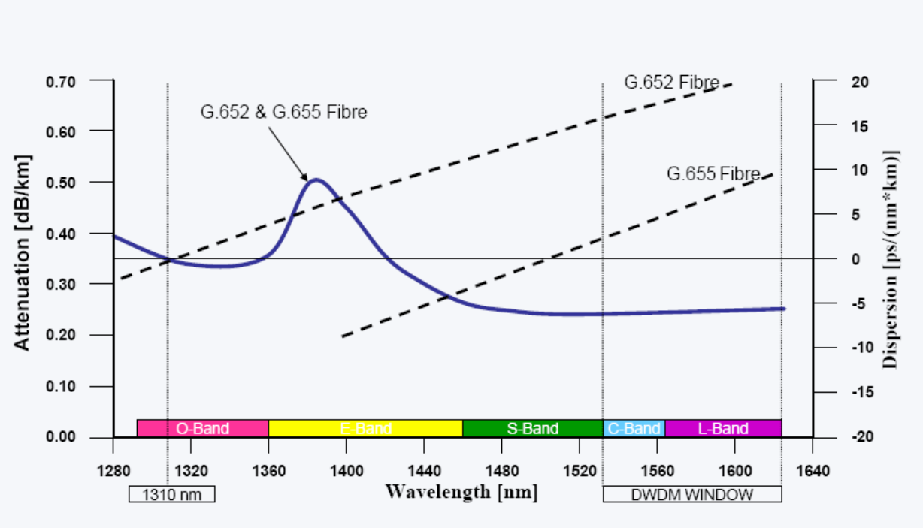
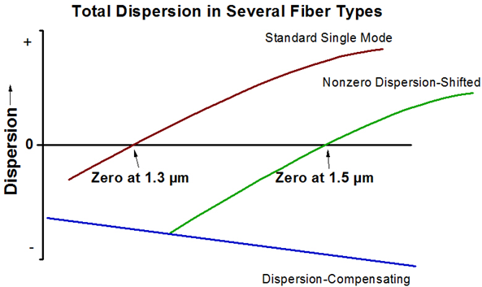
Research design
.
Experimental set up used. PPG - pattern generator, LDC - laser diode control, BT - bias tee, SMF - single mode fibre, IDF - dispersion compensation fibre, VOA - variable optical attenuator, PD - photo detector, EA - electrical amplifier and BERT - bit error rate tester.
1550nm transmission
Inverse dispersion fibre
http://www.thorlabs.com/images
Notes:
First of all, I will introduce something about UWB technology by proposing some questions, what is UWB? Why UWB? Differnt UWB technologis (OFDM-UWB and IR-UWB)
Then I will introduce UWB over fiber technology: why UWB-over-fiebr? The state of the art and what we have done? Futhermore, the research plan in the near future.
Finally, I will summarize this talk.

Slide 9
Results and discussion
(a)Unmodulated VCSEL
low power
wavelength tuneability-suitable for wavelength division multiplexing (WDM)
(b)BER for different transmission lengths
Receiver sensitivity at about -25dBm
Error floor above 35 km transmission
Notes:
First of all, I will introduce something about UWB technology by proposing some questions, what is UWB? Why UWB? Differnt UWB technologis (OFDM-UWB and IR-UWB)
Then I will introduce UWB over fiber technology: why UWB-over-fiebr? The state of the art and what we have done? Futhermore, the research plan in the near future.
Finally, I will summarize this talk.

Slide 10
CD compensation
(a) Simulation using IDF
Fibre length, L=10.4 km
Dispersion, D= -54 ps/nm.km
Dispersion slopes -0.18 ps/nm².km
SSMF
L =35 km,
D=17 ps/nm.km
S=0.08 ps/nm².km
3.72 dB achieved
0.4 dB residual dispersion
(b) IDF compensation
Compensated power increase with fibre length-cumulative effect
Inset: IDF vs SMF ; derived from equation (1)
Notes:
First of all, I will introduce something about UWB technology by proposing some questions, what is UWB? Why UWB? Differnt UWB technologis (OFDM-UWB and IR-UWB)
Then I will introduce UWB over fiber technology: why UWB-over-fiebr? The state of the art and what we have done? Futhermore, the research plan in the near future.
Finally, I will summarize this talk.

Slide 11
G652 (SSMF) + SRS G.655 (NZ-DSF-)
SSMF
SSMF
L =11 km
D=17 ps/nm.km
S=0.08 ps/nm².km
SRS NZDSF-
L =25.4 km
D=-2.8 ps/nm.km
S<0.045 ps/nm².km
Dispersion penalty 0.4 dB
SRS NZDSF-
Signal noise ratio (SNR)
SRS cancels some dispersion in SSMF
– improved SNR
Open eye signify signal clarity.
With compensation, 11.5km SSMF+25.4km SRS comparable to 11.5km
Notes:
First of all, I will introduce something about UWB technology by proposing some questions, what is UWB? Why UWB? Differnt UWB technologis (OFDM-UWB and IR-UWB)
Then I will introduce UWB over fiber technology: why UWB-over-fiebr? The state of the art and what we have done? Futhermore, the research plan in the near future.
Finally, I will summarize this talk.

Slide 12
Conclusion
Too much dispersion in a system leads to power penalty and poor quality of service
Inverse dispersion fibre (IDF) compensation is one of the most important items to be considered for design of high bit rate long transmission links/networks.
Dispersion Management or optimization may be required for SKA future networks, i.e., phase 1 and phase 2.
With effective compensation on VCSEL technology - the reach on access networks is improved
Notes:
First of all, I will introduce something about UWB technology by proposing some questions, what is UWB? Why UWB? Differnt UWB technologis (OFDM-UWB and IR-UWB)
Then I will introduce UWB over fiber technology: why UWB-over-fiebr? The state of the art and what we have done? Futhermore, the research plan in the near future.
Finally, I will summarize this talk.

Slide 13









Acknowledgement
OFS Denmark

Slide 14
THANK YOU!
Notes:
First of all, I will introduce something about UWB technology by proposing some questions, what is UWB? Why UWB? Differnt UWB technologis (OFDM-UWB and IR-UWB)
Then I will introduce UWB over fiber technology: why UWB-over-fiebr? The state of the art and what we have done? Futhermore, the research plan in the near future.
Finally, I will summarize this talk.

Slide 15
info
Why Optical fibre?
Speed, bandwidth, immunity to electromagnetic interference, lower loss, low maintainance.
Group velocity Time delay Dispersion
Group velocity dispersion (GVD) Dispersion
Dispersion slope
v_{g} is the group velocity and β is the propagation constant, φ is the optical phase and ω is the optical frequency.
Band | Description | Wavelength range
O band | original | 1260–1360 nm
E band | extended | 1360–1460 nm
S band | short wavelengths | 1460–1530 n
C band | conventional (“erbium window”) | 1530–1565 nm
L band | long wavelengths | 1565–1625 nm
U band | ultralong wavelengths | 1625–1675 nm
Notes:
First of all, I will introduce something about UWB technology by proposing some questions, what is UWB? Why UWB? Differnt UWB technologis (OFDM-UWB and IR-UWB)
Then I will introduce UWB over fiber technology: why UWB-over-fiebr? The state of the art and what we have done? Futhermore, the research plan in the near future.
Finally, I will summarize this talk.

Slide 16
RDF has several advantages compared with DCF,
  lower loss,
  lower nonlinearity,
  lower PMD
soliton is a self-reinforcing solitary wave (a wave packet or pulse) that maintains its shape while it travels at constant speed
properties to solitons:
They are of permanent form;
They are localised within a region;
They can interact with other solitons, and emerge from the collision unchanged, except for a phase shift.
K. Yonenaga, A. Matsuura, S. Kuwahara, M. Yoneyama, Y. Miyamoto,K. Hagimoto, and K. Noguchi, “Dispersion-compensation-free
40-Gbit/s4-channel WDM transmission experiment using zero-dispersion-flatted transmission line,” in OFC’98, 1998.
T. Yamamoto, E. Yoshida, K. R. Tamura, K. Yonenaga, and M.Nakazawa, “640-Gbit/s optical TDM transmission over 92 km through
a dispersion-managed fiber consisting of single-mode fiber and reverse dispersion fiber,” IEEE Photon. Technol. Lett., vol. 3, pp. 353–355, 2000
Agrawal G P 2001 Nonlinear Fibre Optics 3rd Ed. (San Diego: Academic)

