Slide 1
Evaluating the aerosol loading in Johannesburg during the COVID-19 lock-down period in 2020.
Institution: University of Johannesburg
Department of Physics
Supervisor: Prof. H. Winkler (UJ)
Co-supervisor: Dr. K. Roro (CSIR)
Student: C.H. Fourie

Slide 2
Introduction
The start of the COVID-19 pandemic resulted in a brief period (Lockdown Level 5) where the day to day activities of a large portion of the South African and the global population was brought to a halt. Residents were confined to their houses, and the economic driving power in South Africa was brought to a near standstill with only the essential services continuing production (at reduce capacity). The global downscaling of industrial production and human confinement resulted in a reduction in pollution around the world.

Slide 3
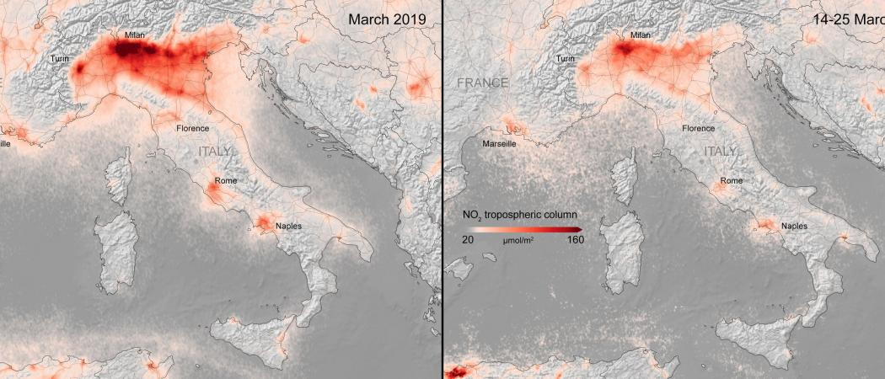
Introduction
Source: https://www.esa.int/ESA_Multimedia/Images/2020/04/NO2_concentrations_over_Europe

Slide 4
Aim & Objectives
This investigation aims to detect variations aerosol concentrations by looking at incoming solar irradiance data in an attempt to determine whether the implemented lockdown restrictions due to the pandemic resulted in a brief reduction in the production of Urban and Industrial type aerosols.
The objective is to evaluate solar irradiation intensity by looking at the number of clear-sky days, and the associated broadband and spectral profiles for each of the select days before and during the lockdown period

Slide 5
Location & Apparatus
Elevation : 1449 m
CSIR Energy Building (Building no.34)
25°45’00’’ S 28°16’43’’ E
Broadband Irradiance W/m²
Pyranometer : GHI, DHI Pyrheliometer: DNI
Spectral Irradiance: W/m²/µm
Spectro Radiometer: DNI
Integrated weather sensor
https://www.csir.co.za/

Slide 6
Method
Determination of Clear-Sky days
Adnot-Bourges-Campana-Gicquel (ABCG): Clear-sky Model
$$GHI=951.31×{cos⁡(SZA)}^{1.15}$$
Evaluation and comparison of Broadband Irradiance data
$$GHI=DHI+DNI×cos⁡(SZA)$$
Global horizontal irradiance - Total “Global” solar irradiance at ground level
Diffuse horizontal irradiance - Diffused light due to scattering etc.
Direct normal irradiance - Light which had not undergone scattering
Evaluation and comparison of Spectral irradiance data

Slide 7
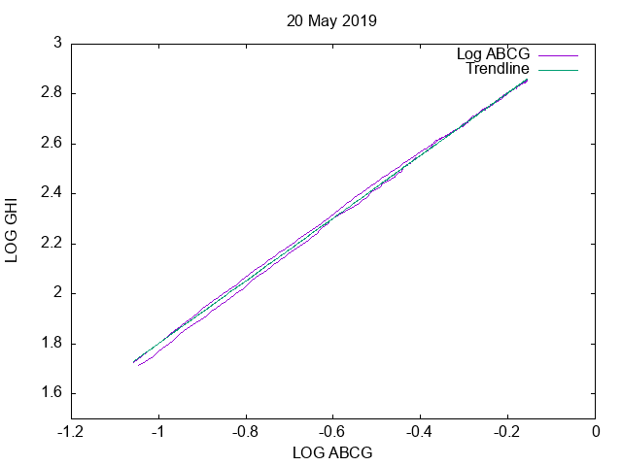
Results: Clear-sky days
$$GHI=A×{cos⁡(SZA)}^{B}$$
$$A\sim 1140.00 ;B\sim 1.2$$
$$\log\left(GHI\right)=\log\left(A\right)+B×log(\cos\left(SZA\right))$$
For SZA < 85.0 °
RMSE < 15.00
R²> 0.980

Slide 8
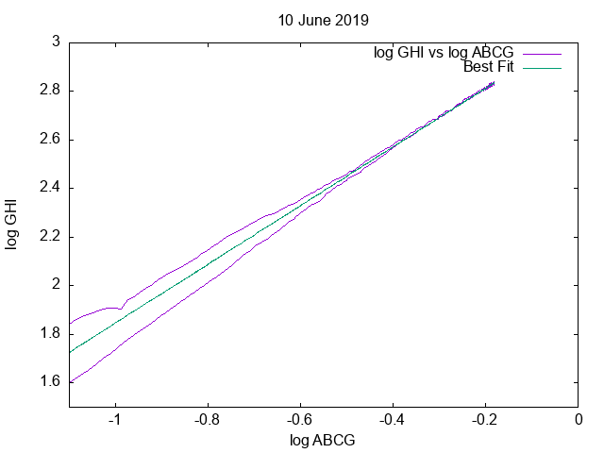
Results: Clear-sky days

Slide 9
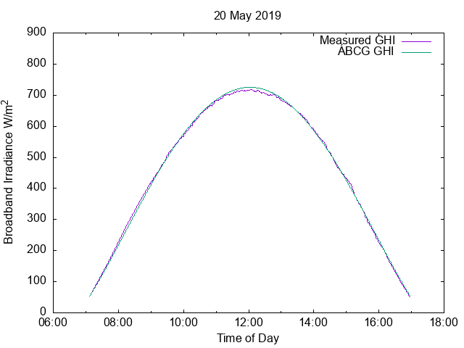
Results: Clear-sky days
Date |  | A | B | R² | RMSE
22/04/2018 | 3.0604 | 1149.21 | 1.210 | 0.998 | 9.36
25/04/2018 | 3.0581 | 1143.14 | 1.218 | 0.999 | 7.34
05/05/2018 | 3.0552 | 1135.53 | 1.175 | 0.998 | 10.51
08/05/2018 | 3.0552 | 1135.53 | 1.222 | 0.992 | 6.63
26/05/2018 | 3.0648 | 1160.91 | 1.246 | 0.988 | 13.54
01/03/2019 | 3.0594 | 1146.57 | 1.209 | 0.998 | 12.03
15/03/2019 | 3.0630 | 1156.11 | 1.209 | 0.997 | 10.54
19/04/2019 | 3.0489 | 1119.18 | 1.226 | 0.999 | 6.02
27/04/2019 | 3.0600 | 1148.15 | 1.208 | 0.999 | 8.39
02/05/2019 | 3.0654 | 1162.52 | 1.241 | 0.999 | 8.53
20/05/2019 | 3.0561 | 1137.89 | 1.254 | 0.999 | 6.64
06/03/2020 | 3.0545 | 1133.70 | 1.157 | 0.998 | 12.93
12/04/2020 | 3.0582 | 1143.40 | 1.214 | 0.998 | 6.92
30/04/2020 | 3.0573 | 1141.04 | 1.211 | 0.998 | 8.51
01/05/2020 | 3.0563 | 1138.41 | 1.183 | 0.999 | 6.81
12/05/2020 | 3.0677 | 1168.69 | 1.255 | 0.998 | 12.71
18/05/2020 | 3.0704 | 1175.98 | 1.268 | 0.997 | 14.16
23/05/2020 | 3.0665 | 1165.47 | 1.332 | 0.999 | 9.24

Slide 10
Results: Clear-sky days

Slide 11
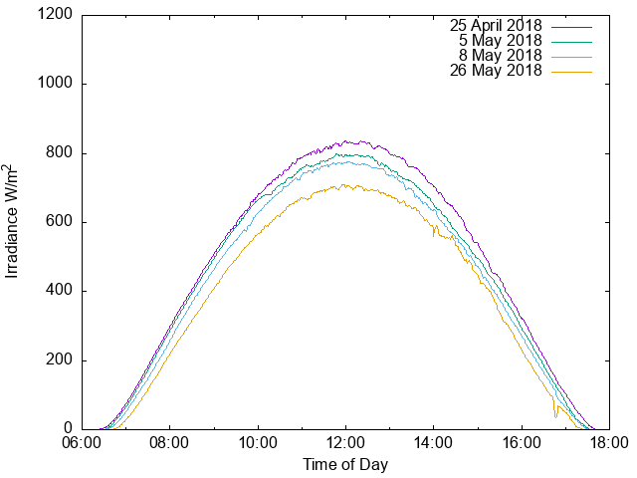
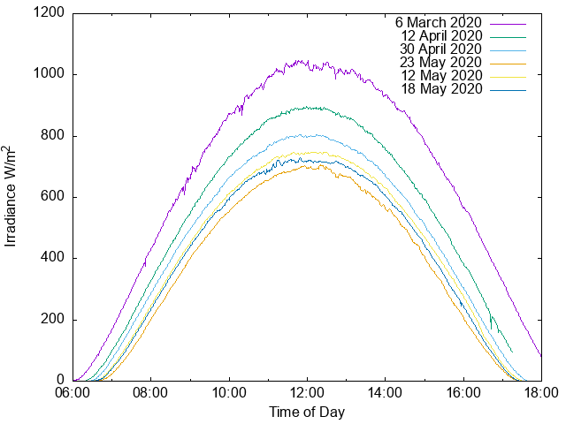
Results: Broadband Data
Seasonal Variation

Slide 12
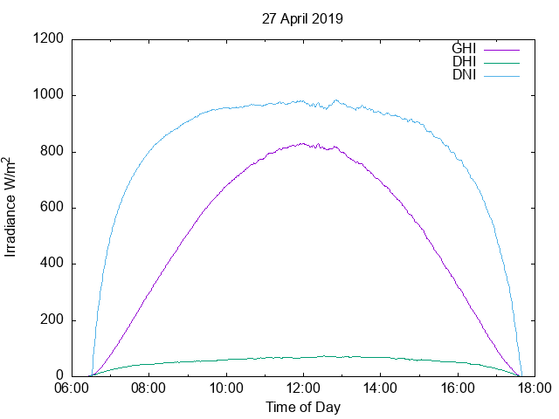
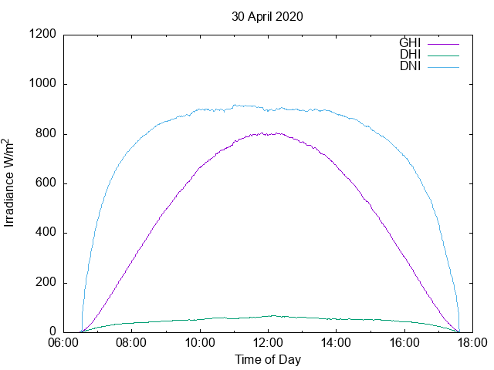
Results: Broadband Data
Seasonal Variation

Slide 13
Results: Broadband Data
$$GHI=DHI+DNI×cos⁡(SZA)$$
 | Broadband Irradiance W/m²
Date | GHI | DHI | DNI | SZA ° | Time
25/04/2018 | 834.32 | 76.14 | 957.82 | 38.99 | 12:05
05/05/2018 | 794.17 | 61.15 | 972.28 | 42.05 | 12:04
08/05/2018 | 774.62 | 82.07 | 929.56 | 42.88 | 12:03
26/05/2018 | 706.23 | 72.87 | 911.29 | 46.90 | 12:04
01/03/2019 | 1063.81 | 75.14 | 1019.32 | 18.13 | 12:19
15/03/2019 | 1156.11 | 85.94 | 998.54 | 23.57 | 12:15
19/04/2019 | 844.58 | 101.13 | 926.36 | 36.89 | 12:06
27/04/2019 | 825.98 | 69.48 | 973.88 | 39.56 | 12:04
02/05/2019 | 800.65 | 83.37 | 948.82 | 41.10 | 12:04
20/05/2019 | 716.60 | 102.09 | 875.05 | 45.71 | 12:02
06/03/2020 | 1020.53 | 132.02 | 906.58 | 20.35 | 12:15
12/04/2020 | 888.63 | 72.44 | 895.11 | 34.68 | 12:07
30/04/2020 | 799.00 | 66.41 | 897.20 | 40.73 | 12:04
01/05/2020 | 808.84 | 56.38 | 926.30 | 41.03 | 12:04
12/05/2020 | 745.51 | 89.72 | 845.51 | 44.05 | 12:03
18/05/2020 | 720.67 | 95.66 | 817.44 | 45.45 | 12:03
23/05/2020 | 695.42 | 122.60 | 760.79 | 46.45 | 12:03

Slide 14
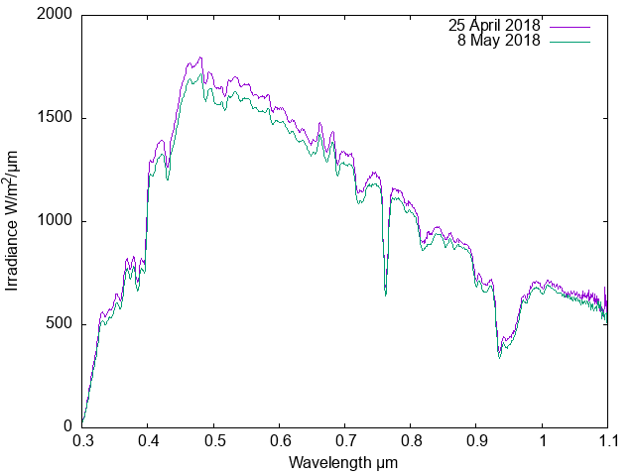
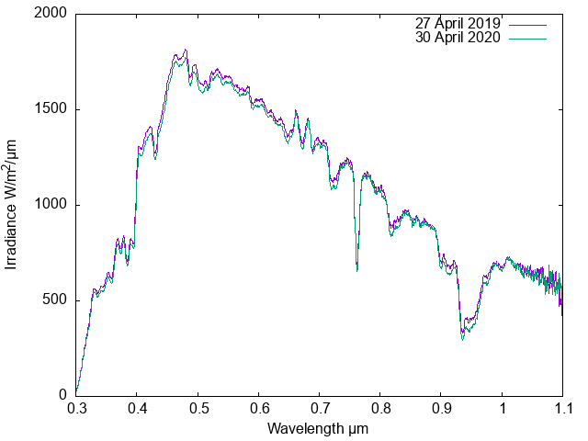
Results: Spectral Data

Slide 15
Analysis & Conclusion
2018, 2019 and 2020 year showed a similarity in the frequency and quality of Clear-sky days when comparing GHI to SZA for the given time period.
Broadband data could not show any concise evidence to indicate that there was a significant reduction in aerosols when comparing 2020 to years prior.
Spectral data did not show any clear sign of absorption, which could be attributed to Urban industrial aerosols which only affect incoming solar radiation at higher wavelengths (> 1.5 µm )

Slide 16
Acknowledgements
University of Johannesburg
CSIR Energy Division

Slide 17
Thank you

