Slide 1
Investigation of a novel iron-based cubic compound RhFe₃C
Nyawasedza Magoda
Materials Physics Research Institute, School of Physics
University of the Witwatersrand, Johannesburg, SA
Supervisors:
Prof. Deena Naidoo
Dr. Abhishek Pandey

Slide 2
Outline
Introduction.
Background on $Rh{Fe}_{3}N.$
Motivation for studying $Rh{Fe}_{3}C.$
2. Experimental Details + Results.
3. Conclusion.

Slide 3
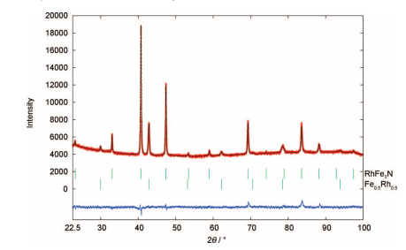
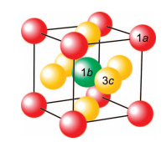
Introduction – B$ackground on Rh{Fe}_{3}N$
Synthesis of $Rh{Fe}_{3}N$:
Two step process combining high temperature sintering reaction with a low temperature nitriding reaction.
1a: Rh
1b: N
3c: Fe
RhFe₃N
Fe_{0.5}Rh_{0.5}
2. Two phases were formed:
- $Rh{Fe}_{3}N$ with a = 3.8337$\left(3\right) Å$
- ${Fe}_{0.5}{Rh}_{0.5}$ with a = 2.983$\left(1\right) Å$
Reference: A. Houben et al. Chem. Mater. 21, 784-788 (2009)

Slide 4
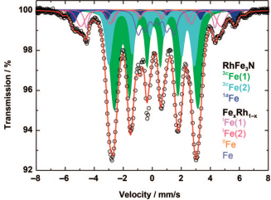
Introduction – B$ackground on Rh{Fe}_{3}N$
Rietveld refinement+ Mössbauer analysis prove that the Rh, N and Fe atom occupies Wyckoff position 1a, 1b and 3c respectively.
Reference: A. Houben et al. Chem. Mater. 21, 784-788 (2009)

Slide 5
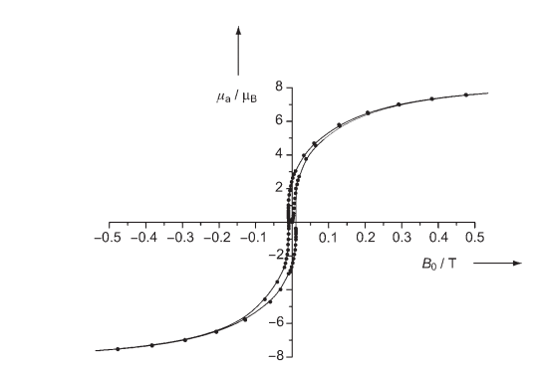
Introduction – B$ackground on Rh{Fe}_{3}N$
Applications:
High density storage material.
High performance magnetic recording devices.
Soft ferromagnetic material.
Reference: A. Houben et al. Angew. Chem. Int. Ed.44. 7212 (2005)

Slide 6
Introduction - RhFe₃C
Aim of work:
Synthesize and study a new cubic compound similar to $Rh{Fe}_{3}N \text{using} \text{simple} \text{techniques}\text{.}$
- No impurities.
- High $T_{c}$ with better magnetic properties.
Synthesis:
Arc melting.
Experimental techniques:
Powder X-ray Diffraction
Mössbauer Spectroscopy
Heat Capacity
Resistivity
Wavelength Dispersive Spectroscopy

Slide 7
Experimental Details & Results

Slide 8
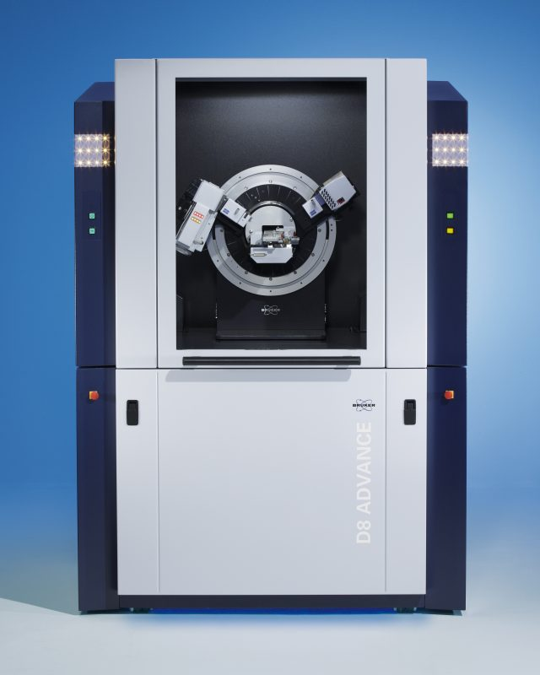
X-Ray Diffraction
Mo X-ray tube
Detector
theta-theta goniometer
A Le Bail fit was performed.
No impurities found.
Cubic crystal structure with lattice parameter a = 5.8907$\left(3\right) Å$.
A detailed Rietveld analysis is underway.
Bruker D9 diffractometer, Mo radiation with a wavelength of $0.7107 Å$.

Slide 9
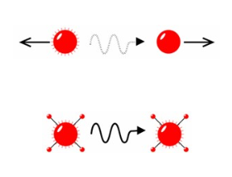
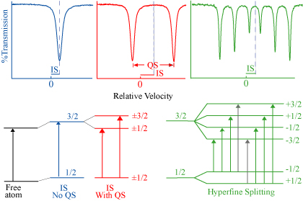
Mössbauer Spectroscopy
Recoil effect during radiation emission/absorption.
Electric monopole Interaction (Isomer shift).
Electric Quadrupole Interaction (Quadrupole splitting).
Magnetic Dipole Interaction (Magnetic splitting).
Energy level diagrams with corresponding spectra observed.
Reference: M. Darby Dyar et al. Annu. Rev. Earth Planet. Sci. 34:83–125 (2006)

Slide 10
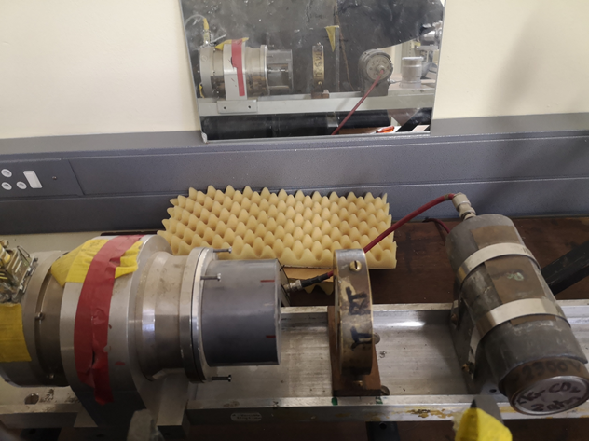
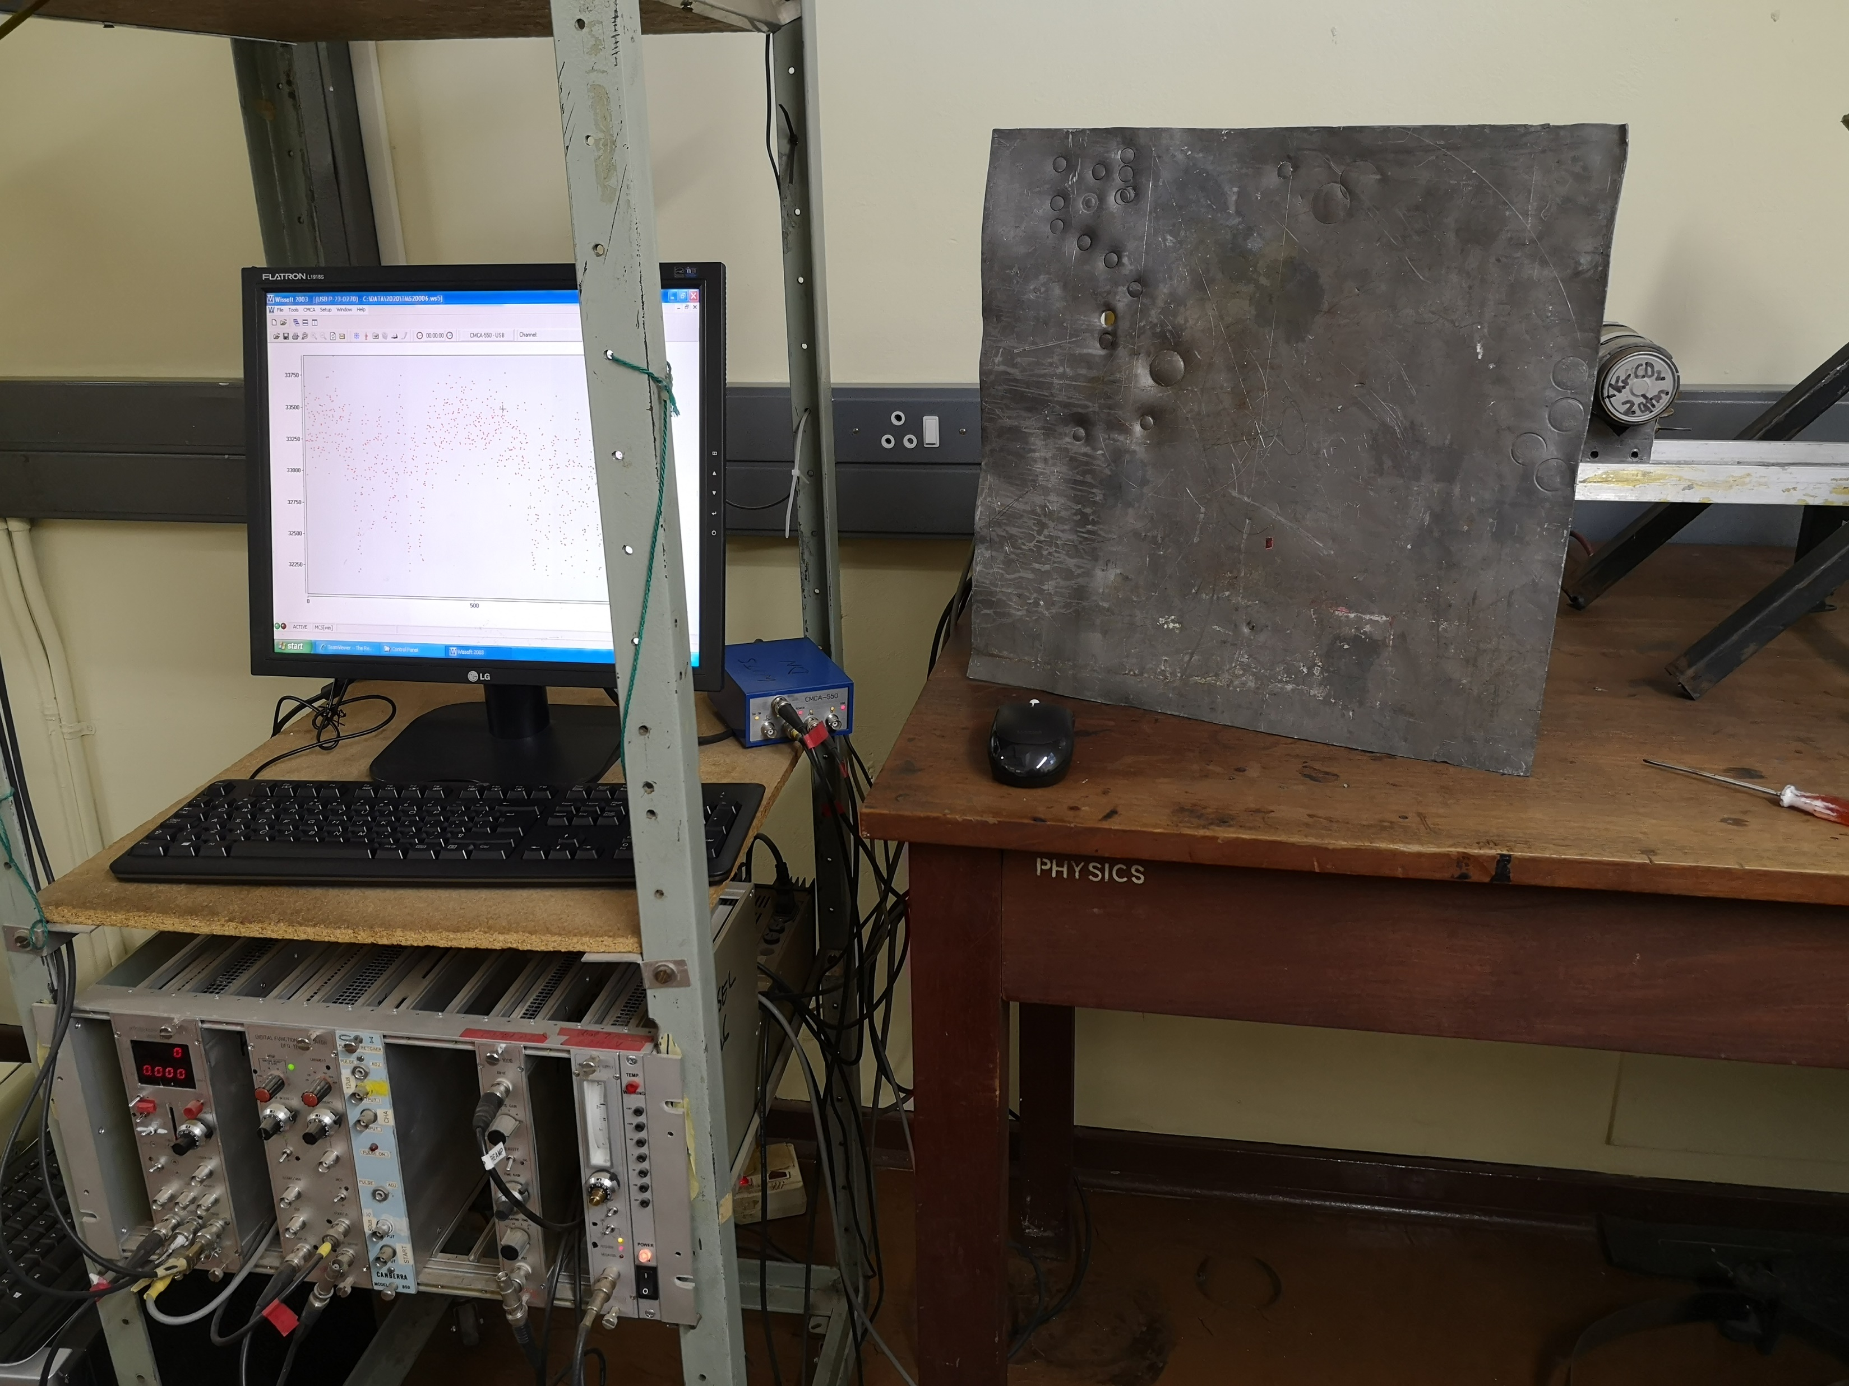
Mössbauer Spectroscopy
Lead shield
Lead shield
Mössbauer drive
Absorber
Detector
Drive unit
Drive unit
Source
HV Power supply
Amplifier
HV Power supply
Amplifier
Transmission Mössbauer Spectroscopy set-up.

Slide 11
Mössbauer Spectroscopy
RhFe₃C
Component | $$B_{hf}$$ $$(T)$$ | IS (mm/s) | $$∆E_{Q}$$ $$(mm/s)$$ | Relative area (%) | Assignments
Sextet 1 | 39.19 | 0.14 | 0.03 | 21.61 | Fe³⁺
Sextet 2 | 36.18 | 0.09 | 0.01 | 35.59 | Fe³⁺
Sextet 3 | 33.75 | 0.04 | 0.003 | 41.77 | Fe³⁺
Singlet | - | 0.01 | - | 1.02 | -

Slide 12
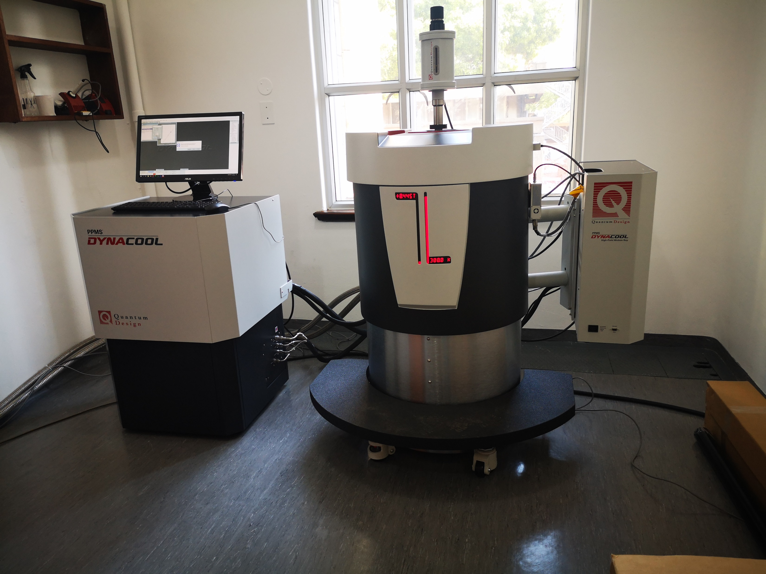
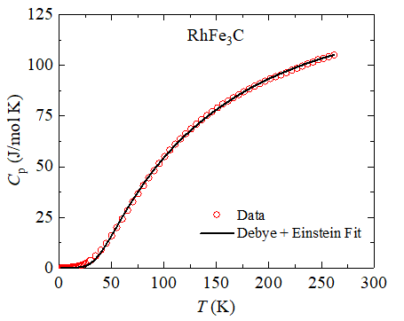
Heat Capacity
Linear transport motor
Electronic cabinet
Dewar
Temperature: 2K – 250K
$C_{P}\left(T\right)=γT+\left(1−α\right)C_{Debye}+α$ $C_{ Einstein}$
$γ:$Sommerfeld coefficient.
$α:$Fraction of Einstein contribution to the $C_{P}\left(T\right).$
$$Θ_{D}\left(all T\right)=783±14 K$$
$Θ_{E}(all T)=$ 237 $± 3 K$

Slide 13
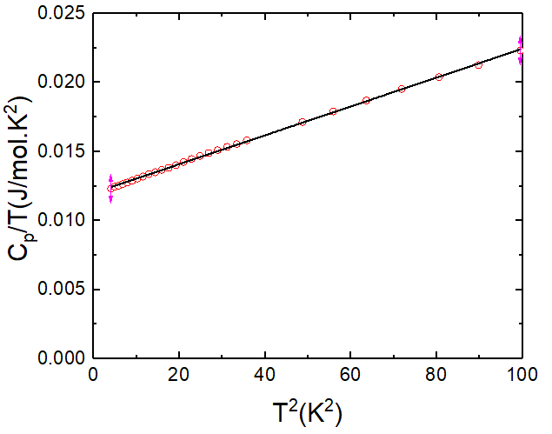
Heat Capacity
$$\text{Temperature}\text{: 2}\text{K}\text{ – 10}\text{K}$$
$$\frac{C_{P}}{T}=γ+βT^{2}$$
$γ=12.00$ $± 0.02 mJ/mol{.K}^{2}$
$$β=0.1045±0.0005 mJ/mol{.K}^{4}$$
$${C(T)}_{T→0}=C_{el}\left(T\right)+C_{ph}\left(T\right)$$
$$=γT+βT^{3}$$

Slide 14
Conclusion
RhFe3C is a single-phase compound which has a cubic structure with a = 5.8907$\left(3\right) Å$ .
Three different iron sites were identified with oxidation state Fe³⁺ .
One of the iron phases was found to be the same a$s α−Fe.$
Identification of iron phases will be confirmed when detailed analysis of XRD data has been performed.
Analysis of the Heat capacity data resulted in
$Θ_{D}\left(all T\right)=783±14 K$.

Slide 15
Future Plans
The following research works will be conducted:
Detailed XRD analysis.
Magnetization measurements.
Magnetoresistance measurements.

Slide 16
Acknowledgements
Collaborators: Abhishek Pandey¹, D. Naidoo¹ , S. Chakraborty², S. Gupta², S. Dan³, A. Shnier⁴, D. G. Billing⁴, Chandan Mazumdar² and D. Wamwangi¹ .
¹Materials Physics Research Institute, School of Physics, University of the Witwatersrand, Johannesburg, Gauteng 2050, South Africa.
²Condensed Matter Physics Division, Saha Institute of Nuclear Physics, Kolkata, Bengal 700064, India.
³Department of Physics, University of Burdwan, Burdwan, Bengal 713104, India.
⁴School of Chemistry, University of the Witwatersrand, Johannesburg, Gauteng 2050, South Africa.
Supported by:

Slide 17
Any Questions?

