Slide 1


The study of amorphous GaAs following Ar⁺ and Si⁺ ion implantations
Ongeziwe Mpatani
Ongeziwe.Mpatani1@students.wits.ac.za
SAIP Conference 27 July 2021

Slide 2
Presentation Outline
Introduction
  About GaAs
  Objective
Experimental details
  Lattice disorder: ion implantation
  Physical properties: X-ray characterization
  Structural properties: Raman scattering
  Elastic properties: surface Brillouin scattering (SBS)
  SBS: scattering geometry
Results
  Structure of [100] GaAs: initial state
  Study of induced damage layer on [100] GaAs
  Properties of amorphous GaAs: thickness/density
  Elastic properties of amorphous GaAs: C₁₁ and C₄₄
Conclusion and what is next
Acknowledgments
Abstract

Slide 3
Introduction

Slide 4
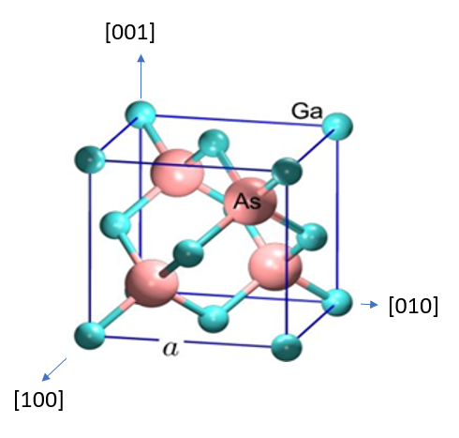
Gallium arsenide - GaAs
III-V semiconductor
Direct band gap,
High e⁻ mobility
Ion implantation → n-type thin films
Potential applications
  Optoelectronic integrated circuits (OIEC’s)
  Microwaves
  Radiation spectrometer, etc
  7

Slide 5

The objectives
Implantation of c-GaAs → a-GaAs
Objectives of project is to determine:
  Elastic constants of c-GaAs and a-GaAs: SBS
  Amorphous layer thickness: HRTEM
  Quantitative disorder analysis
    XRR
    GIXRD
    Raman spectroscopy

Slide 6
Experimental Details

Slide 7
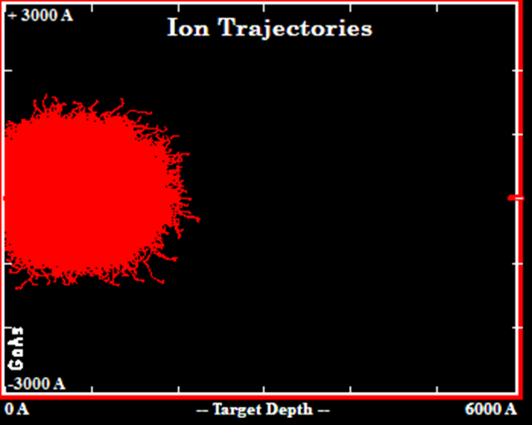
Lattice disorder: ion implantation
Ion type | Implantation condition (at room temperature)
Argon ions (100 keV) | 1×10¹⁴, 5×10¹⁴, 1×10¹⁵, 5×10¹⁵, 1×10¹⁶, 5×10¹⁶ ions/cm²
Argon ions (1×10¹⁶ ions/cm²) | 30, 60, 90, 120, 150 keV
Silicon ions(100 keV) | 1×10¹⁴, 5×10¹⁴, 1×10¹⁵, 5×10¹⁵, 1×10¹⁶, 5×10¹⁶ ions/cm²
Silicon ions (1×10¹⁶ ions/cm²) | 30, 60, 90, 120, 150 keV
Energetic ions bombard surface
  Create lattice damage → amorphous near-surface layer
  Channeling effect → often undesired outcome
SRIM simulates the damage event, can estimate penetration

Slide 8

Physical properties: X-ray characterization
X-ray characterization carried out using Bruker AXS D8 Discover x-ray diffractometer
  CuK_{α} x-ray source with wavelength λ = 1.504Å

Slide 9
Structural properties: Raman scattering
Raman spectroscopy was used to study the transition from crystalline to amorphous state
Jobin-Yvon spectrograph and λ = 514.5 nm Ar laser
→

Slide 10
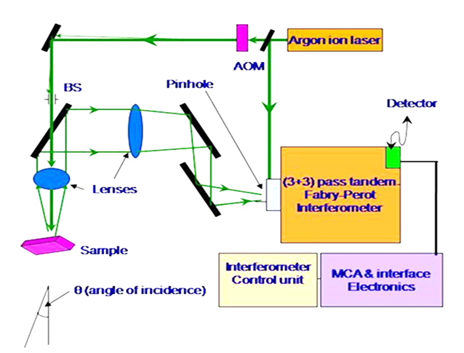
Elastic properties: surface Brillouin scattering (SBS)
SBS spectra was acquired using a DPSS laser of λ = 532 nm
Backscattering (BS) geometry guides light to (3+3) TFPI

Slide 11
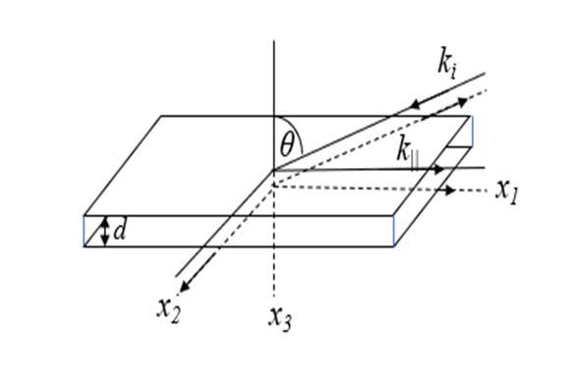
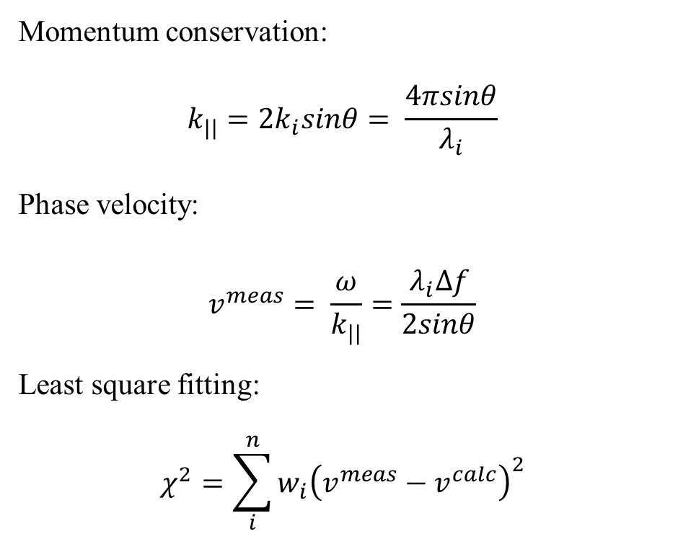
SBS: scattering geometry
Momentum conservation:
$$k_{||}=2k_{i}sinθ= \frac{4πsinθ}{λ_{i}}$$
Phase velocity:
$$v^{meas}= \frac{ω}{k_{||}}=\frac{λ_{i}Δf}{2sinθ}$$
Least square fitting:
$$χ^{2}=\sum_{i}^{n}{w_{i}{\left(v^{meas}−v^{calc}\right)}^{2}}$$

Slide 12
Results

Slide 13
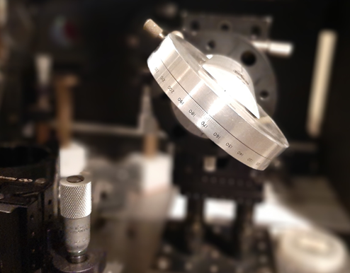
Structure of [100] GaAs: initial state
 | Measured | vs | Literature | vs | Literature
ρ (g/cm³) | 5.37 |  | 5.31 |  | 5.34
C₁₁ (GPa) | 134.7 |  | 118.8 |  | 120.0
C₁₂ (GPa) | 46.6 |  | 53.8 |  | 57.4
C₄₄ (GPa) | 74.8 |  | 59.4 |  | 58.0
c-GaAs is anisotropic
[100] direction at φ = 30°
[110] direction at φ = 75°
Literature:
1. W Pang, PhD thesis, University of the Witwatersrand, 1997
2. K. Jakata and A.G Every, Physical review B 77, 2008

Slide 14
Study of induced damage layer on [100] GaAs
Raman Spectroscopy
SBS
GIXRD

Slide 15
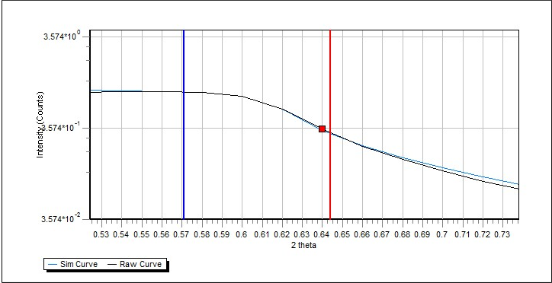
Properties of amorphous GaAs layer: thickness/density
Implantation ion | Energy | Thickness (nm) | Density (g/cm³)
Argon | 30 | 60 | 4.787
 | 60 | 120
 | 90 | 150
 | 100 | 162.5 | 4.69 – 5.338
 | 120 | 187.5
 | 150 | 225 | 5.319
Silicon | 30 | 75 | 5.261
 | 60 | 137.5
 | 90 | 190
 | 100 | 212.5 | 5.270 – 5.323
 | 120 | 245 | 5.272
 | 150 | 287.5 | 5.314

Slide 16

Elastic properties of amorphous GaAs: C₁₁ and C₄₄
a-GaAs is isotropic, therefore
$${C_{12}=C}_{11}−{2C}_{44}$$
And
$$C_{11}=ρV_{L}^{2}$$
$$ρV_{RSAW}^{2}={\left(\frac{C_{11}}{C_{44}}×\frac{C_{44}−ρV_{RSAW}^{2}}{C_{11}−ρV_{RSAW}^{2}}\right)}^{\frac{1}{2}}×\left(C_{11}−\frac{C_{12}^{2}}{C_{11}}−ρV_{RSAW}^{2}\right)$$
Implantation ion | Implantation condition | C₁₁ decrease (%) | C₄₄ decrease (%)
Argon | 30 – 150 keV & 1×10¹⁶ ions/cm² | 19.9 | 25.4
Argon | 1×10¹⁴ - 5×10¹⁶ ions/cm² & 100 keV | 22.7 | 30.2
Silicon | 30 – 150 keV & 1×10¹⁶ ions/cm² | 15.4 | 24.6
Silicon | 1×10¹⁴ - 5×10¹⁶ ions/cm² & 100 keV | 14.5 | 21.1
Literature C₁₁ ↓ 17% and C₄₄ ↓ 41%
Literature: P Mutti, Z Sklar, and G.A.D Briggs, Journal of Applied Physics 77, 1995

Slide 17
Conclusion & what is next
Implantation: c-GaAs → a-GaAs
SRIM thickness
Characterization: XRD
      XRR
      GIXRD
      Raman scattering
Elastic constants: SBS
Raman spectroscopy simulations
SBS simulations
Determine thickness
  high-resolution transmission electron microscopy
  Synchrotron XRR

Slide 18
Abstract
Ion implantation is a technique of choice for inducing disorder in semiconducting materials such as crystalline GaAs. Interestingly, the properties of these amorphous materials such as the medium range order (MRO) and small range order (SRO) depend heavily on the material of interest and its implantation conditions. Understanding the crystalline to amorphous phase transformations is vital for the continued use of GaAs in optoelectronic applications. In the present work, the configuration of the disordered layer in GaAs generated using argon and silicon ions at different energies and different fluences, and the elastic properties are investigated. Raman spectroscopy was used to determine the structural configurations and phonon confinement of the damage layers after ion implantation. The crystal structure and the physical properties were determined using GIXRD and XRR for phonon dispersion simulations. The dynamics of acoustic propagation of the disordered layer are investigated using surface Brillouin scattering in the backscattering geometry. The derived phonon dispersion curves are fitted using surface elasto-dynamic Greens function to yield elastic constants of the disordered layers on the (001) GaAs substrate.

Slide 19
Thank you for listening
Acknowledgments
My Supervisors
  Prof Daniel Wamwangi
  Dr Kudakwashe Jakata
  Dr Hilary Masenda
Dr Rudolf Erasmus – Raman spectroscopy
Mr Adam Shnier – X-ray measurements

