Slide 1
Heavy Ion Beam Analysis of Ion Implanted Polymer Nanocomposites Master of Applied Science (Industrial Physics)
Student: Mashamba Dakalo Rollet
Supervisor: Prof M. Msimanga [TUT-iThemba LABS]
Co-Supervisor: Dr T.P. Sechogela [iThemba LABS]

Slide 2
Presentation outline
Introduction
Problem statement
Aim & objectives
Experimental setup
Results and discussion
Conclusion
References
Acknowledgements

Slide 3
1. Introduction
Ion Beam Analysis (IBA) is a cluster of nuclear analytical techniques used to determine elemental composition and depth profiles of layers in solid samples.
The analysis is based on interaction between the incoming beam of ions and the target material.
The interaction may lead to emission of particles which characterize the elemental concentration and depth profile of the target material through the detector system.
IBA Techniques | Detection mechanism | Unique strength
RBS (Rutherford Backscattering Spectroscopy) | Detection of backscattered particles | Analysis of heavy elements in light matrices
ERDA (Elastic Recoil Detection Analysis) | Detection of elastically recoiled particles | Analysis of light elements in heavy matrices

Slide 4
1.1. ERDA theoretical considerations
Energy E_{r} of the recoiled atom:
$\frac{E_{r}}{{ E}_{0}}$ = K_{r} = $\frac{\text{4}{\text{M}}_{\text{1}}{\text{M}}_{\text{2}} }{{\left({\text{M}}_{\text{1}}\text{+}{\text{M}}_{\text{2}}\right)}^{\text{2}}}$cos² α
Where K_{r} is the recoil kinematic factor
Probability σ of a target atom to be recoiled in a particular direction α:
${\left(\frac{d\text{σ}}{\text{d}\text{Ω}}\right)}_{r}$= ${\left(\frac{{{{\text{Z}}_{\text{1}}\text{Z}}_{\text{2}}\text{e}}^{\text{2}}}{\text{2}{\text{E}}_{\text{0}}}\right)}^{2}$ ${\left(\text{1+}\frac{{\text{M}}_{\text{1}}}{{\text{M}}_{\text{2}}}\right)}^{\text{2}}$ $\frac{\text{1}}{{\text{COS}}^{\text{3 }}\text{α}}$
σ $∝$ Z₁²
Where E₀ is given in MeV, e² = 1.4398 x 10⁻¹³ MeV.cm and $\left(\frac{dσ}{dΩ}\right)$ is in cm². Z₁ and Z₂ are atomic numbers of the projectile and target element respectively
Kinematics
Cross section
Schematic diagram of scattering and recoil events, before and after collision.
Where M₁ is the mass of the projectile ion, M₂ is the mass of the target element.
E_{S} and E_{r} are energies of scattered and recoiled ions respectively
α is the scattering angle and β is the recoil angle

Slide 5
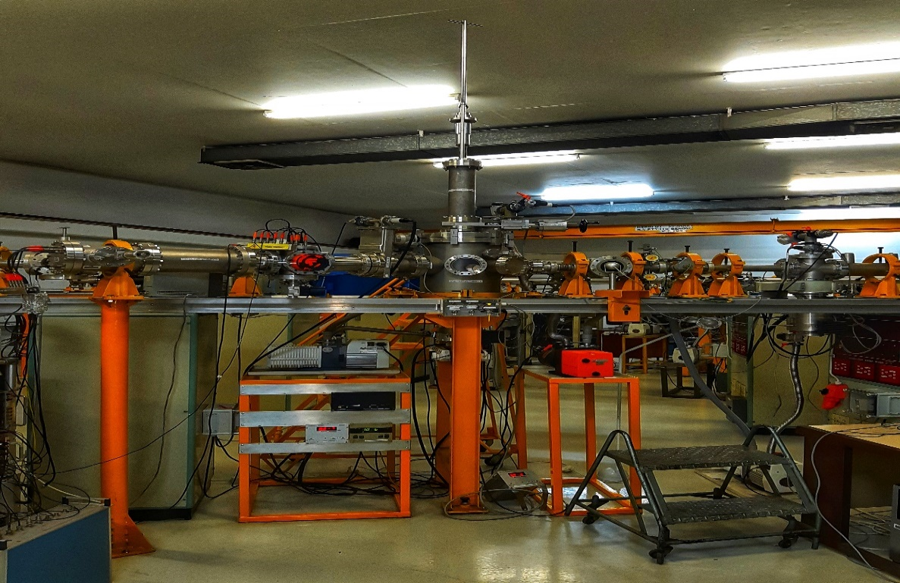
2. Problem statement
During ERD analysis using heavy ions, the projectile beam may cause damage to the sample under analyses, this is especially true the case of soft target materials like polymers.
It then becomes necessary to determine the most suitable experimental conditions, i.e beam type, energy and fluence to minimize sample damage during analysis.
3. Aim
The aim of this study was to optimize the Time of Flight-ERDA set up at iThemba LABS to minimize beam dose on organic polymeric films during analysis, but still obtain sufficient measurement statistics.
Time of flight ERDA setup at iThemba LABS, TAMS

Slide 6
4. Objectives
Ion implantation of polyethylene terephthalate (PET) with different ion fluences of 5 x 10¹⁵ , 2 x 10¹⁶ , 5 x 10¹⁶ ions/cm² with 80 keV Ti⁺ ions.
Carrying out RBS to confirm implantation fluence and thickness of the modified layer.
Carrying out ERDA depth profiling using 18 MeV ⁶³Cu⁵⁺ beam.
Carrying out ERDA depth profiling using 30 MeV ¹⁹⁷Au⁷⁺ beams.

Slide 7
5. Results and discussions

Slide 8
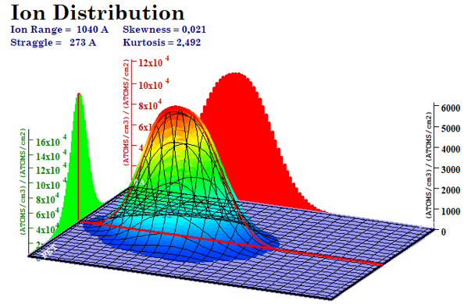
5.1. SRIM/TRIM simulations
3D ion distribution of ions as a function of depth in PET

Slide 9
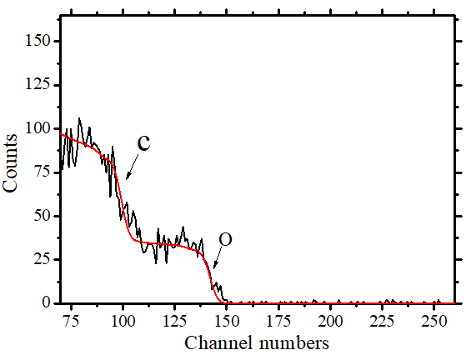
5.2. RBS: Pristine PET
RBS experiment was performed with 2 MeV He⁺ ions.
The observed edges correspond to He⁺ backscattered from PET surface composed of carbon (C), oxygen (O) and hydrogen (H).
It was expected that the hydrogen edge will not appear because He⁺ does not backscatter from H.
Experimental
Simulated
Experimental and simulated RBS spectra of pristine PET sample

Slide 10
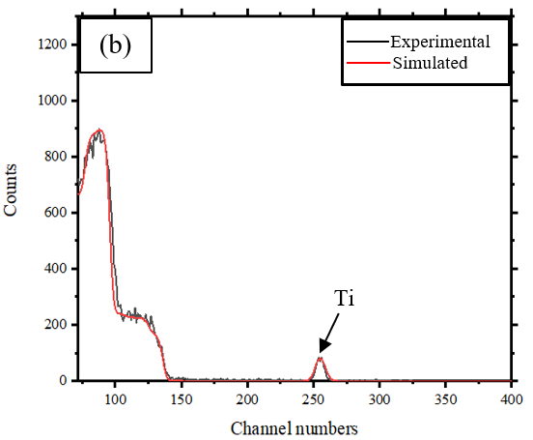
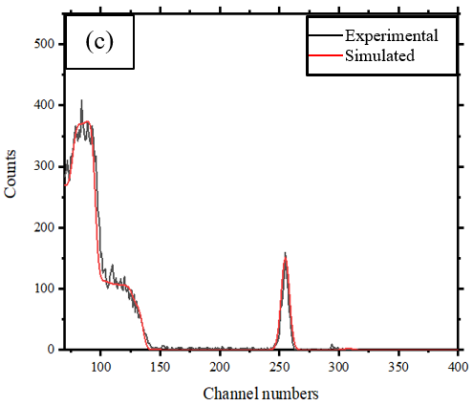
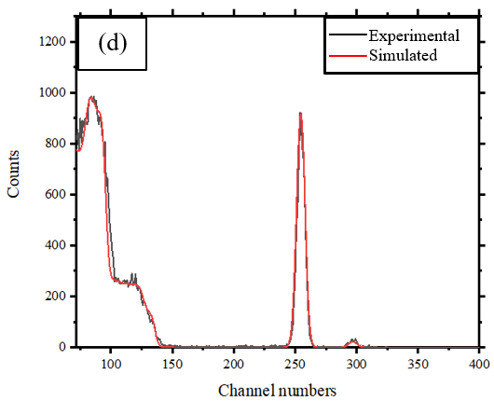
5.2.1 RBS : Implanted PET
(a) PET-Ti 5 x 10¹⁵ ions/cm²
(b) PET-Ti 2 x 10¹⁶ ions/cm²
(c) PET-Ti 5 x 10¹⁶ ions/cm²
Thickness of the implanted layer was found to be approximately 1300 x 10¹⁵ at./cm² or 135 nm.
(a)
(b)
(c)

Slide 11
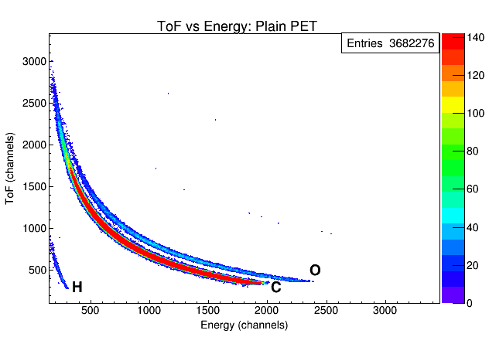
5.3. ERDA: Pristine PET
Coincidence measurement of flight time and energy during ERDA experiments lead to generation of a mass separated 2-D scatter plot.
ERDA measurements were done using 18 MeV ⁶³Cu⁵⁺ and 30 MeV ¹⁹⁷Au⁷⁺ beams at constant current of 11 nA.
Potku software, developed by the Finnish group has been recently developed for depth profiling ERD analysed samples.
2D ToF-Energy scatter plot of recoils from analysis of PET with 18 MeV Cu⁵⁺ beam

Slide 12
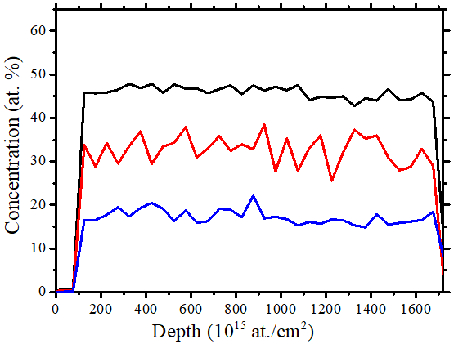
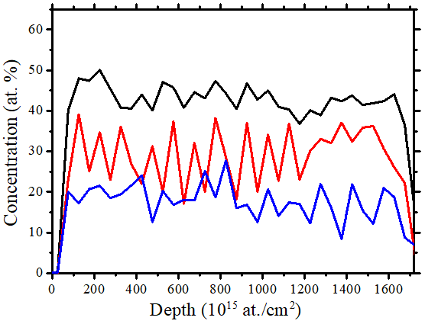
5.3.1. Comparative ERD analysis with 30 MeV ¹⁹⁷Au⁷⁺ and 18 MeV ⁶³Cu⁵⁺ beams
C
H
O
C
H
O
Depth profile of 30 MeV Au⁷⁺ analysed pristine PET
Depth profile of 18 MeV Cu⁵⁺ analysed pristine PET

Slide 13
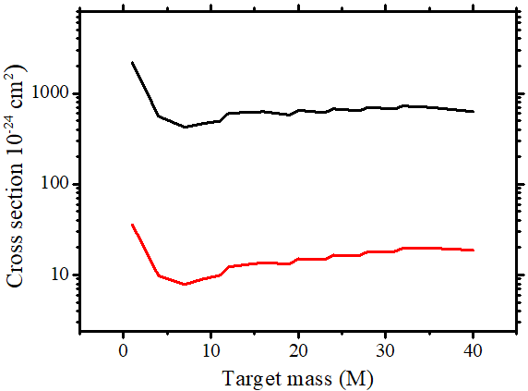
5.3.2. Comparative ERD analysis with 30 MeV ¹⁹⁷Au⁷⁺ and 18 MeV ⁶³Cu⁵⁺ beams
Theoretical considerations
Experimental observations
Au _{recoil-X-section}
Cu _{recoil-X-section}
¹⁹⁷Au⁷⁺ analysis
⁶³Cu⁵⁺ analysis
Energy spectra for hydrogen yield in counts for 30 MeV ¹⁹⁷Au⁷⁺ and 18 MeV ⁶³Cu⁵⁺ incident beams
Variation of recoil cross section with target mass for ¹⁹⁷Au and ⁶³Cu incident beams
Ф = $\frac{It}{qeA}$
¹⁹⁷Au⁷⁺ time of analysis (t) & fluence (Ф) : 9 min & 9.8 x 10¹² ions/cm²
⁶³Cu⁵⁺ time of analysis (t) & fluence (Ф) : 20 min & 3 x 10¹³ ions/cm²

Slide 14
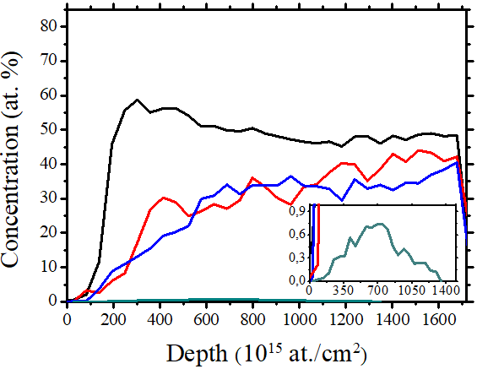
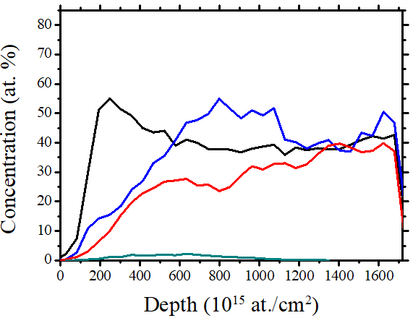
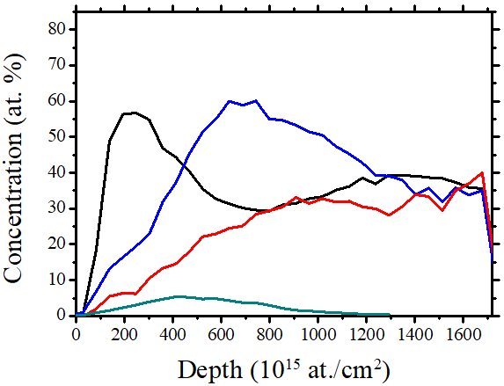
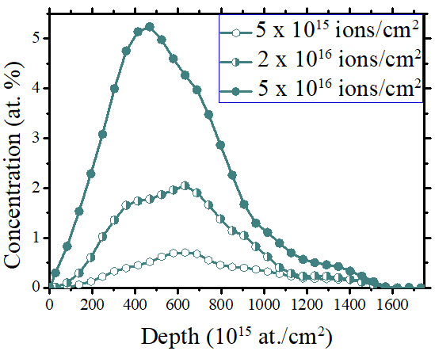
5.3.3. Depth profiles of ion implanted PET with 30 MeV ¹⁹⁷Au⁷⁺ beam
5 x 10¹⁵ ions/cm²
C
H
O
Ti
2 x 10¹⁶ ions/cm²
C
H
O
Ti
5 x 10¹⁶ ions/cm²
C
H
O
Ti

Slide 15
6. Conclusion
It is preferable to use heavy ions during materials analyses due to obtainable sufficient experimental statistics compared to light ions.
Beam induced damages can be minimized by reducing the time of analysis.
During ion implantation polymers undergo carbonization, dehydrogenation and oxidation.
The occurrence of these processes may result in improved electrical and optical properties of the polymers.

Slide 16
7. References
Schmidt B. et. al. Materials Analysis by Ion Beams. Ion Beams in Materials Processing and Analysis, (2012), 301–376. doi:10.1007/978-3-211-99356-9_6
Ziegler J F. SRIM 2013 [Cited 2021/07/08]. Available from www.srim.org.
Arstila K. et.al. Potku-New analysis software for heavy ion elastic recoil detection analysis. Nucl. Instr. Meth. B (2014); 331:34-41. https://doi.org/10.1016/j.nimb.2014.02.016.
Moro M.V. et al. Accurate high-resolution depth profiling of magnetron sputtered transition metal alloy films containing light species: A multi-method approach, Thin Solid Films, (2019), https://doi.org/10.1016/j.tsf.2019.137416
A. Mackova, P. Malinsky, R. Miksova, Characterisation of PEEK , PET and PI implanted with 80 keV Fe⁺ ions to high fluencies, Nuclear Instrument and Methods in Physics B 331 (2014) 176-181

Slide 17
8. Acknowledgements
Tshwane University of Technology
NRF-iThemba LABS
Prof M. Msimanga
Dr T.P. Sechogela

Slide 18
Thank You
?

