Slide 1
Nuclear New Build, history and prospects
David Nicholls
University of Johannesburg

Slide 2
History of Eskom Plans
(beyond Koeberg 1&2)
Koeberg 1976 contract included consideration of a third unit to be contracted in 1978.
In late 1980s Bridging Program of limited new build proposed – stopped in 1989 with policy to privatise Eskom.
In 2006 as part of Eskom expansion to meet expected demand (55,000MW peak by 2020), Nuclear-1 program started (25,000MW by 2025)
EIA process initiated by Eskom on 5 potential sites
17 November 2007 RFP issued to Areva and Westinghouse for 4,000MW of nuclear plant
Tender Documents returned by 31 Jan 2008 (6 weeks)
Tender Negotiations began March 2008
Final Evaluations and Contract details October 2008
Project terminated due to Eskom’s financial pressures late 2008 (along with coal 3 etc.)

Slide 3
History of Eskom Plans
(beyond Koeberg 1&2)(cont)
IRP 2010 (issued March 2011) included 9600MW nuclear commissioned from 2023.
IRP 2010 stated the first two units should be contracted before the next IRP revision.
Eskom defers the project to the National Government.
DoE initiates a Nuclear New Build Program and has overseas study tours in 2013 and holds Vendor Parades in 2014-2015 with all viable vendors.
In 2016 the key procurement role for the NNBP was passed back to Eskom, who issued a no obligation Request for Information in December 2016, following a section 34(1) determination by the Minister of Energy.
Court Judgement in April 2017 (two days before the RFI responses were to be opened) stopped process.

Slide 4
Current Status
EIA approval for 4000MW at Koeberg site has been appealed to the Minister of Environment for final ruling.
Eskom Nuclear Installation Site Licenses for Thyspunt and Koeberg are under review by NNR.
Draft 2018 IRP did not support new nuclear (at least until post 2030).
Gazetted IRP in 2019 does not see nuclear before 2030 but calls for preparatory work for commissioning 2,500MW of “Modular Reactors” as a “no regret” option.

Slide 5
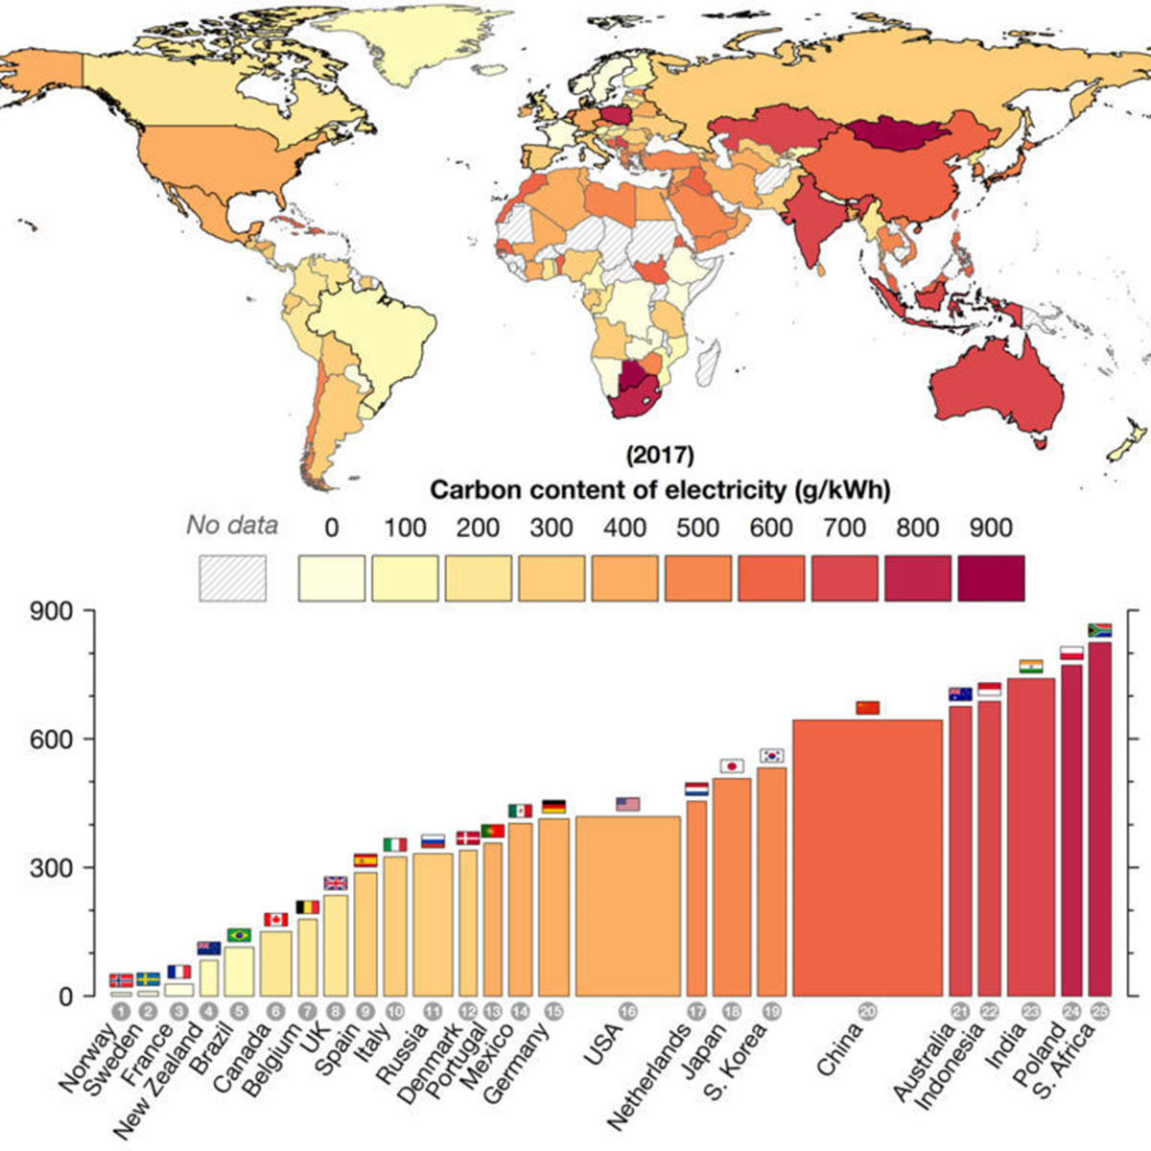


Slide 6
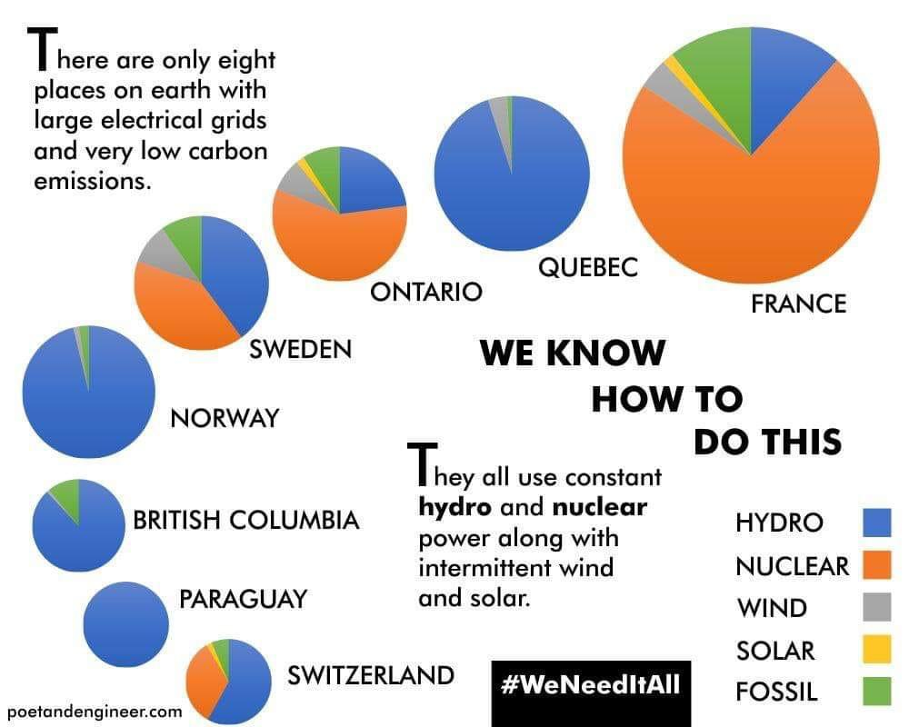

Slide 7
Key Questions?
How much do nuclear power plants actually cost?
How do we get funding?
How much does the actual power cost from nuclear plants?
How fast can we do it?

Slide 8
Can we get funding?
Full vendor financing of nuclear export contracts is standard (and was offered for Nuclear-1 in 2008 by USA & France)
(Egypt has lower credit rating that RSA!)
What is the about Nuclear Economics?
Nuclear is less costly than you think
Analysis for the Energy Technologies Institute (an organisation backed by the government and a number of energy companies) looked at 34 delivered nuclear projects round the world.
First of a Class in USA/EU $9,000-$12,000/kWe
But overall project costs were:-
15% > $5,500/kWe
45% $5,500-$3,500/kWe
40% < $3,500/kWe
Financial Times - Opinion Inside Business 27 Jan 2019
What is the actual cost of nuclear plants?
Virtually all current export nuclear plants are fixed price turnkey deals (UAE, Pakistan, Bangladesh, Turkey, Egypt etc) and are largely on budget (as was Koeberg)
Russia to lend Egypt $25 billion to build nuclear power plant
CAIRO (Reuters) - Russia will loan Egypt $25 billion to finance building and operating a nuclear power plant in Egypt, the official gazette said on Thursday.
Egypt and Russia signed an agreement on Nov. 19 for Russia to build Egypt’s first nuclear power plant in Egypt and to extend Egypt a loan to cover the cost of construction.
It was not clear at the time what the deal was worth, but Egypt’s president Abdel Fattah al-Sisi said the loan would be paid off over 35 years.
Egypt will pay an interest rate of 3 percent annually, according to the country’s official gazette. Installment payments will begin on Oct. 15, 2029.
“The loan will be used by the Egyptian side for a period of 13 years between 2016-2028 ... the Egyptian side will repay loan amounts used over 22 years in 43 installments,” the gazette said.
Reuters - MAY 19, 2016 / 1:41 PM /

Slide 9
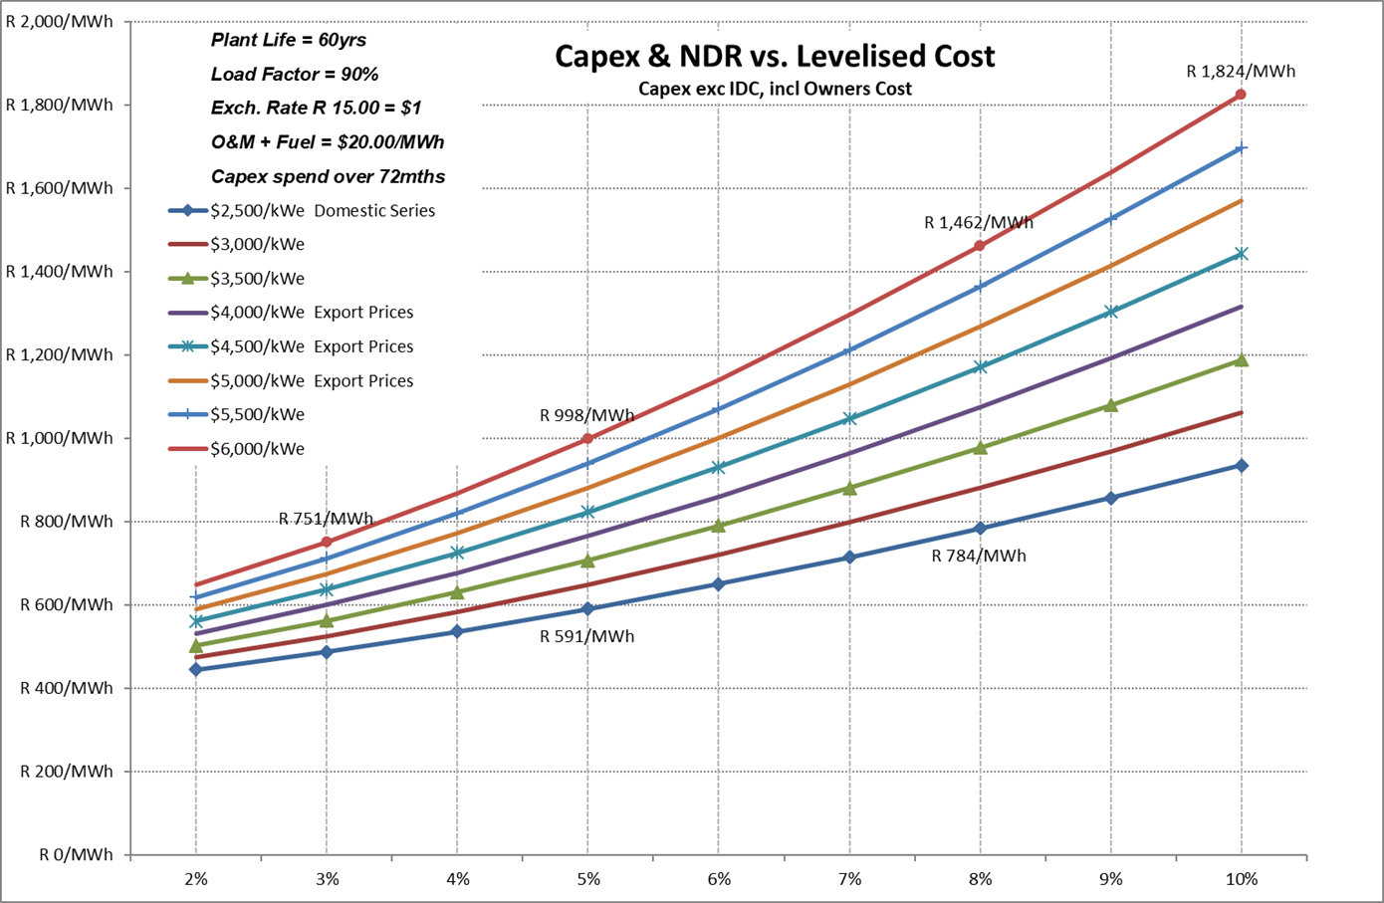
Cost of Power vs CAPEX and Cost of Capital?

Slide 10
What does that mean in the real world?
IRP Assumptions
Real World Experience

Slide 11
How fast can nuclear be deployed?

