Slide 1
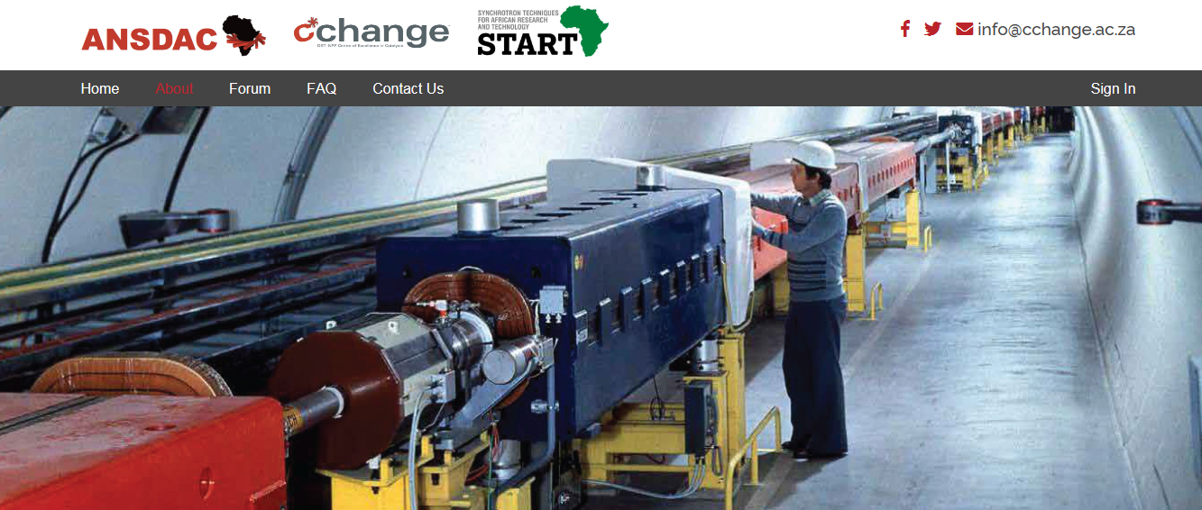
https://ansdac.com/
Esna du Plessis, Nico Fischer, Emma Gibson

Slide 2
African Neutron and Synchrotron Data Analysis Competency

Slide 3
Why?
Africa’s energy need:
Renewable energy solutions: decrease continent’s dependency on fossil fuels.
Research and technology solutions: high quality analyses and characterization capacity.
Synchrotron and neutron facilities provide required analytical resolution.
Access to properties of materials which are not accessible via routine laboratory analyses.
South Africa an associate member of the ESRF.
A limited number of SA academia fully funded access to this facility upon successful beam time application.

Slide 4
Our Purpose
The ANSDAC project aims to train emerging African-based faculty researchers in the art of analysing data collected at synchrotron and/or neutron facilities.
One of the hurdles for local researchers to engage with international large-scale facilities is limited experience with synchrotron and neutron data.
Focus of ANSDAC school is data analysis. International lecturers share insights on how to write successful beamline applications.
Beyond the workshops the project aims to provide an online platform for researchers in (South) Africa to share experiences, news and to find support.
ANSDAC project specifically designed for faculty researchers with the clear expectation that the knowledge provided will be shared with colleagues and students at the respective home institutions.

Slide 5
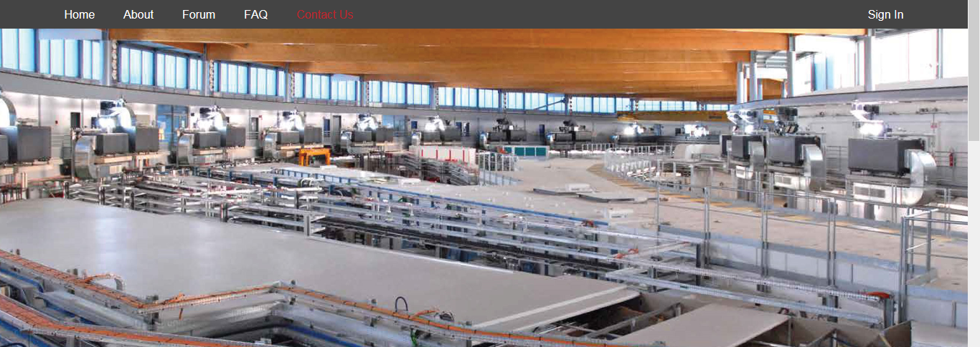
Structure
Funded by the Newton Fund administered by the Royal Academy of Engineering, and the DST-NRF Centre of Excellence in Catalysis c*change, in kind contributions by the Universities of Glasgow, the Western Cape and SASOL and partnering with the Global Challenges Research Fund project START (Synchrotron Techniques for African Research and Technology).
Three workshops on synchrotron and neutron data analysis from 2018 to 2020.
Lectures by experts from the Diamond Light Source, ISIS Neutron and Muon Source in the UK and South African specialists.
In 2020, ten of all workshop attendees will travel to the Diamond Light Source and the ISIS Neutron and Muon Source in the UK to experience beam time first hand. This is possible through a collaboration with the UK Catalysis Hub.

Slide 6
From 2019 ANSDAC is partnering with START: we can extend the ANSDAC programme by a full year to 2020.
Support to a wider group of students and post-doctoral assistants.
Working on experiments at the UK’s synchrotron, Diamond Light Source, START researchers and students will bring insights to sustainable energy and improvement in health that will have long-lasting legacies across Africa.
African researchers are keen to apply synchrotron techniques to their research problems.
START funds research posts in Africa and the UK.
Focuses on energy materials and structural biology for healthcare.
Motivation comes from African societal challenges: 70% of population in sub-Saharan Africa lives without electricity.
START researchers will investigate energy materials, including solar cell structures, catalysts and batteries. Structural biology for unprecedented insight into the mechanisms behind diseases such as HIV and malaria.

Slide 7
ANSDAC 2018
41 Applications to attend the school – factor 2.7 oversubscribed.
Applicants from Senegal, Kenya, Botswana and South Africa.
28 November to 7 December 2018.
Crystallography and powder XRD: Johan de Villiers (University of Pretoria), Sabine Verryn (Malvern Panalytical) and Esna du Plessis (Sasol).
EXAFS: Diego Gianolio (Diamond Light Source).
Neutron: Ian Silverwood (ISIS Neutron and Muon Source).
Workshop curriculum: theory & practical sessions, focused on X-ray diffraction and absorption spectroscopy, neutron scattering techniques and writing successful applications.

Slide 8
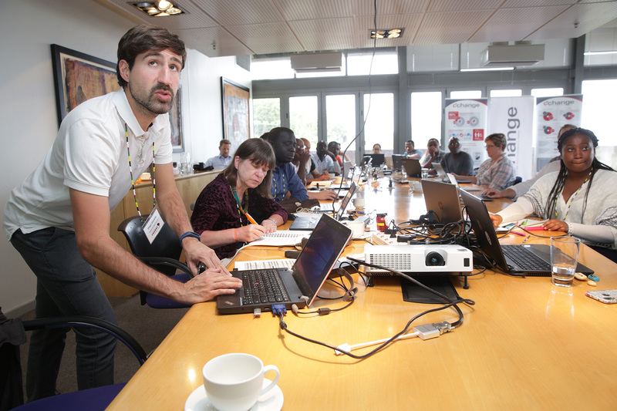
Workshop: 2018
Beamline scientist Diego Gianolio, from the UK’s national synchrotron Diamond Light Source, lectures the students during the workshop.
Source: UCT newspaper December 2018

Slide 9
ANSDAC 2019: 16th to the 24th of October 2019

Slide 10
Not only work, also some sightseeing

Slide 12
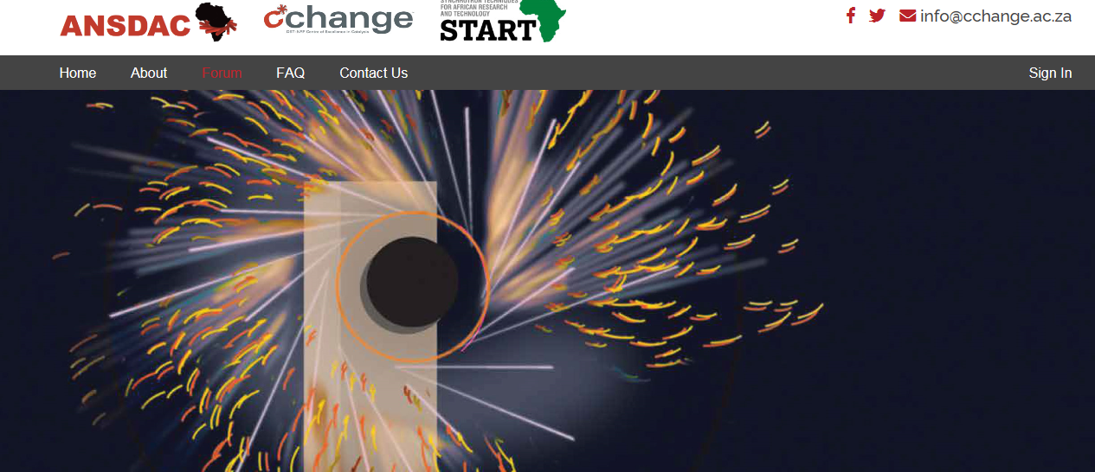
ANSDAC FORUM
Continued support/opportunities to discuss after completion of the workshop.
Provides a platform for workshop participants and other interested researchers to exchange results, share news and seek support in all topics related to synchrotron and neutron sources/data. If you want to join the discussion forum, please follow the link below

Slide 13
Support and build African network
Join and promote activities of PCCr, IUCr and AfLS.
Strengthen catalysis and characterisation knowledge throughout Africa.

Slide 14
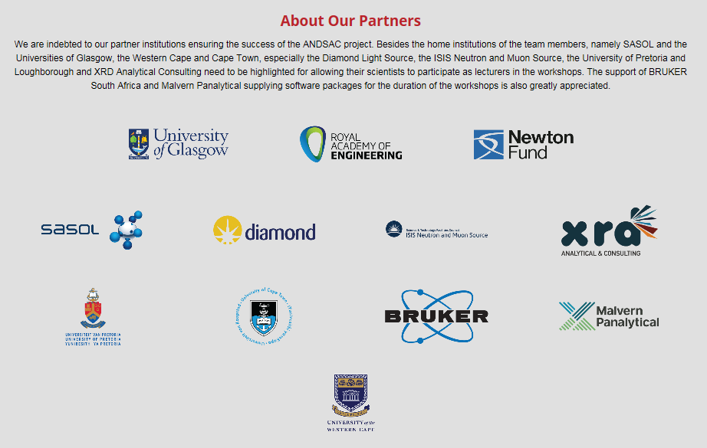

Slide 15
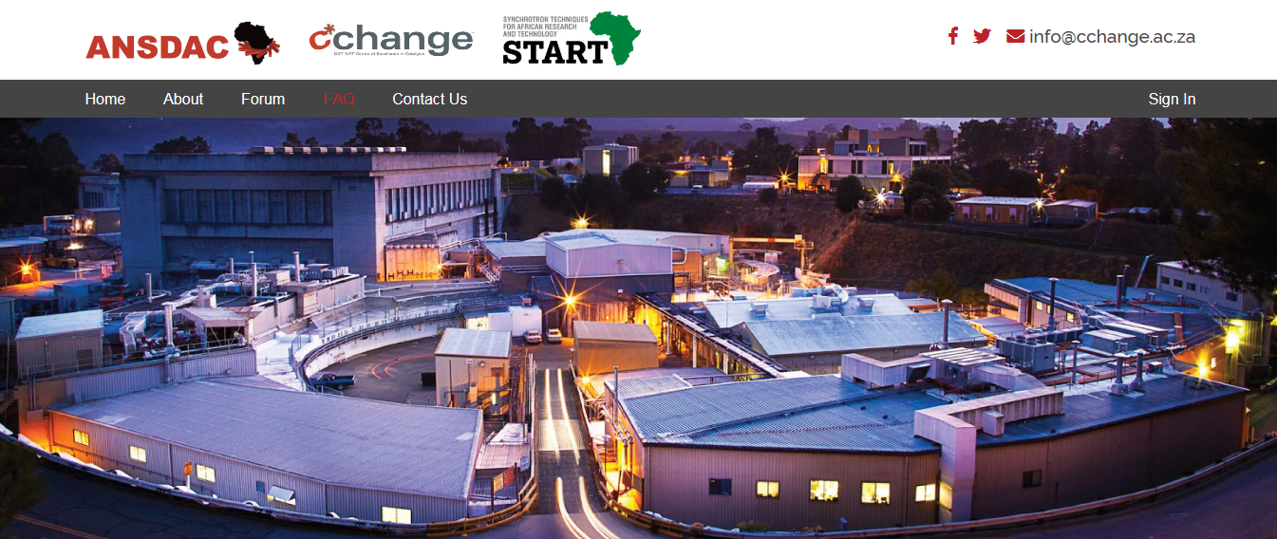
2020 workshop
Letter of motivation & short CV

Slide 16
Thank you

