Slide 1
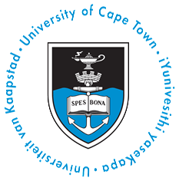
The Aaron Klug Centre for Imaging and Analysis
The need for feeder infrastructure
Trevor Sewell

Slide 2
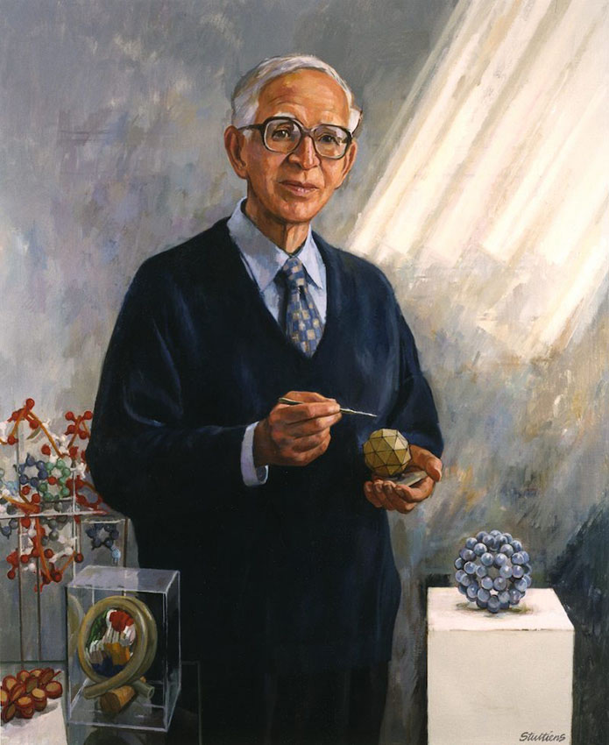
Name of the Centre
Aaron Klug Centre for Imaging and Analysis
Sir Aaron Klug (Nobel Prize in Chemistry 1982) introduced the idea of making three dimensional images from electron micrographs
Portrait by Jeff Stultiens RP
Klug was a student of RW James in Cape Town (Professor of Physics and VC) – one of two Nobel laureates trained by James – the other was Allan Cormack who used some of Klug’s ideas to make three dimensional images from two dimensional medical X-rays. His contributions include: The principles of virus structure, the structure of the nucleosome, the structure of tRNA and the structure and mechanism of zinc fingers among others.
Notes:
Klug was a student of RW James in Cape Town – one of two Nobel laureates trained by James – he discovered how to make three dimensional images from two dimensional images in the electron microscope – a principle used by Allan Cormack in creating computer aided tomography for medical X-rays
To an insider it is not really surprising that the science of structural biology did not emerge in South Africa during the beleaguered years of the twentieth century. The priorities were simply different. The barriers were too large and if you wanted to do advanced bioscience like Sydney Brenner and Aaron Klug, you went abroad. When the barriers to international contact and funding came tumbling down at the end of the century several people at UCT were able to exploit their international contacts. In particular the Wellcome trust funded collaborations between Heln Saibil in London and Trevor Sewell and between Ravi Acharya in Bath and Ed Sturrock, These resulted in the first EM structure (nitrilase) and the first crystal structure (a domain of angiotensin converting enzyme) published by South African authors. In the first instance the Wellcome Trust enabled the acquisition of a second-hand cryo EM by UCT and in the second case the data were collected at the Daresbury Synchrotron. It is interesting to reflect on the greatest barriers that needed to be overcome in the two cases – Publication in the case of the nitrilase – the spiral enzyme structure was just too different to be immediately accepted and the paper was rejected many times essentially until a prominent German group published a paper describing a different spiral enzyme structure. The barrier in the case of the ACE was crystallization – it is a glycoprotein. Ed sturrock solved the problem by mutating the glycosylation sites in every possible combination until he produced an active enzyme that crystallized. The huge medical significance of the structure assured immediate acceptance by Nature.

Slide 3
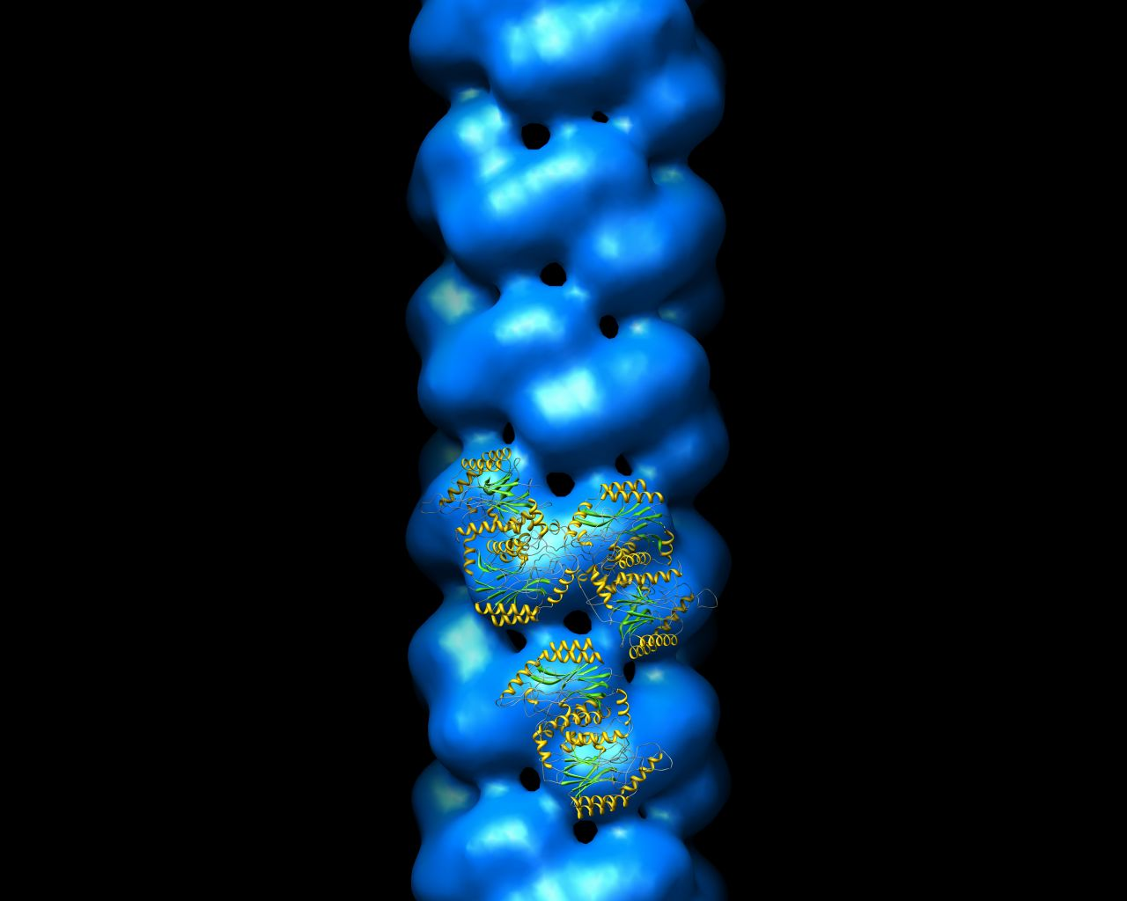
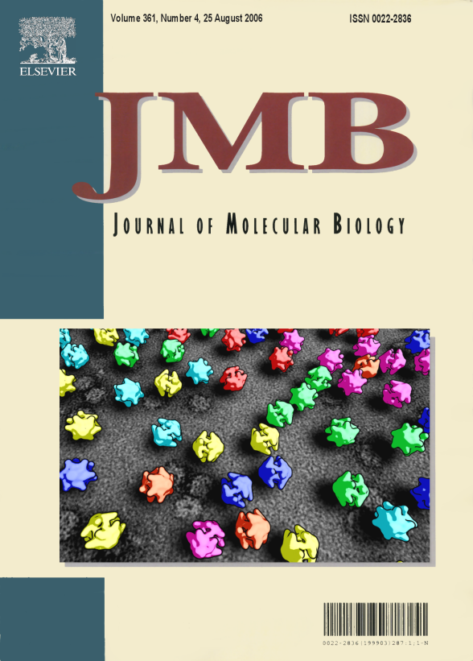
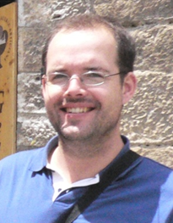
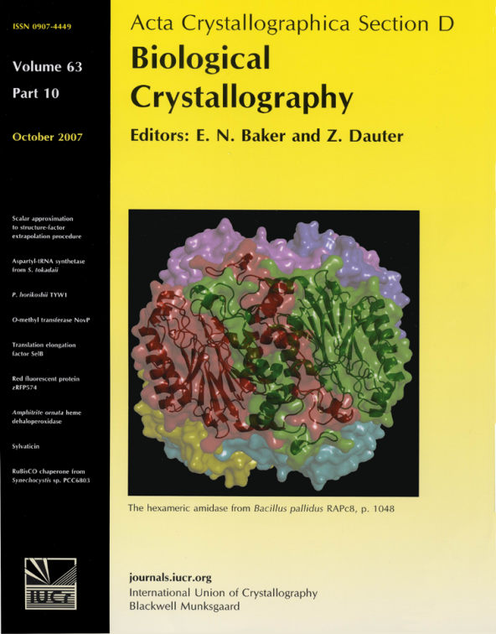
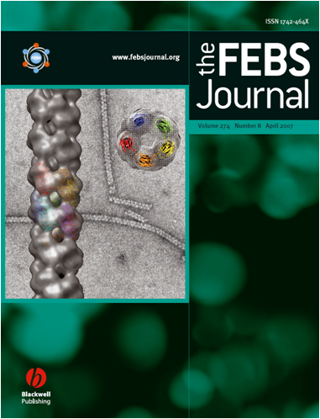
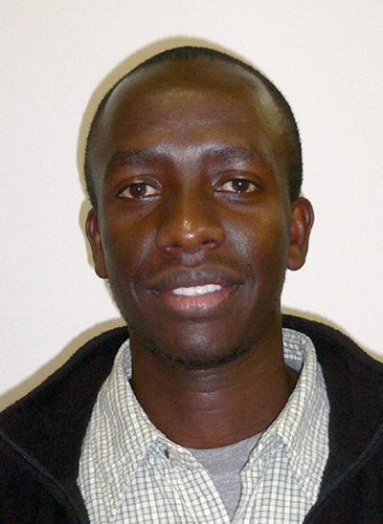
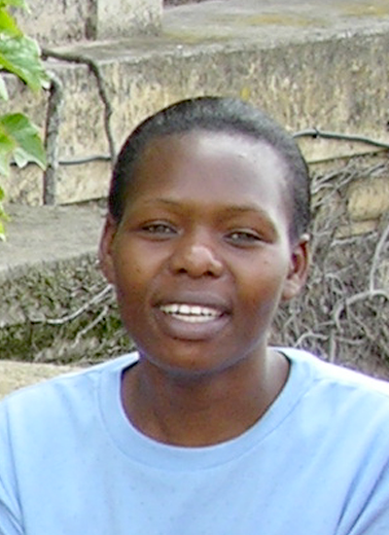
Structural Biology at UCT
Papers written by our students have been given front cover prominence in major journals
Jason van Rooyen
Serah Kimani
Ndoria Thuku
Notes:
The Dean of Science once asked me to prepare some slides to show Minister of Science and Technology Naledi Pandor why it was important to do structural biology especially at UCT – I am going to take the liberty of showing you those slides.
Firstly, I believe that the role of the University is to follow scholarly pursuits, that is, to gain new knowledge and publish it in the open literature. There is no doubt that the determination of the structure of biological macromolecules is challenging, current and good science. The insights are sound – in the words of one of our post-docs – “what sets us apart is that we actually see the molecules we are studying”.

Slide 4
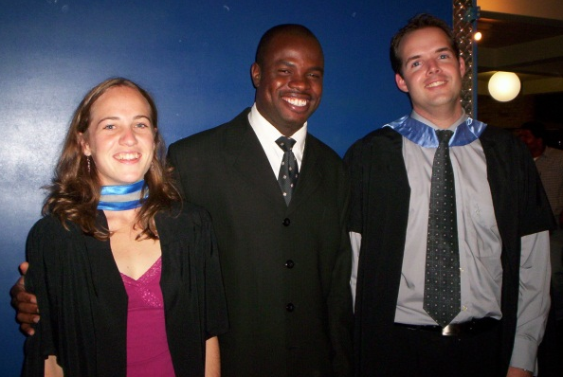
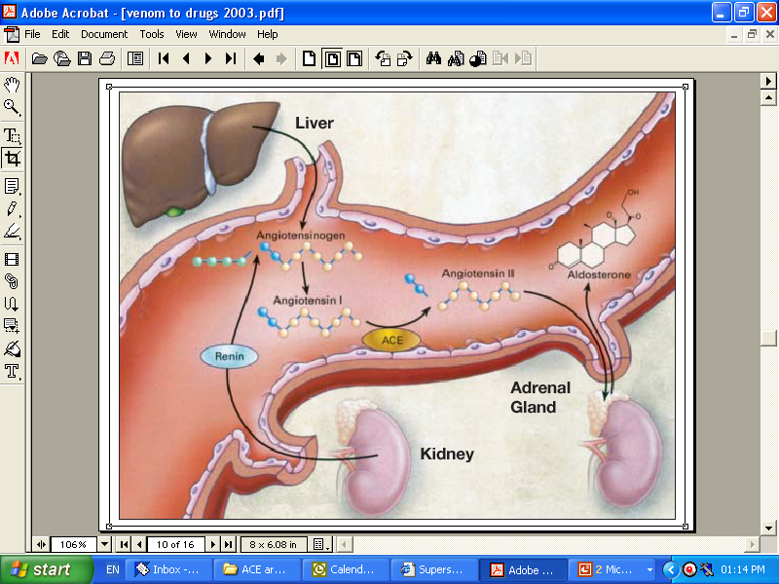
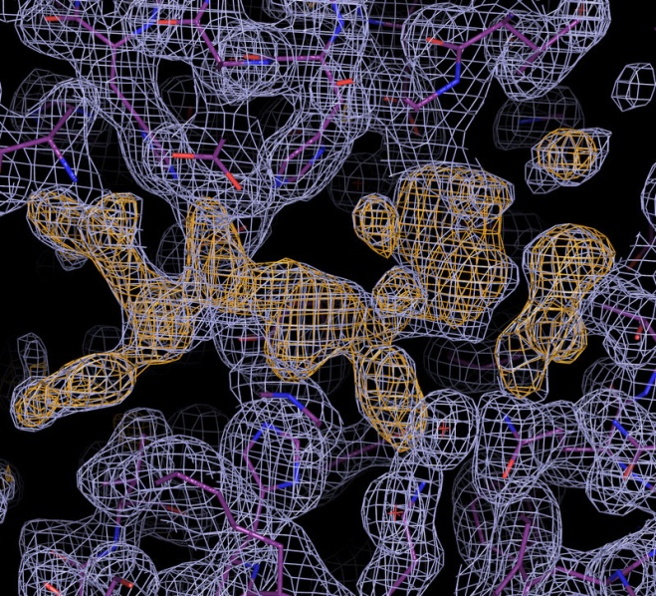
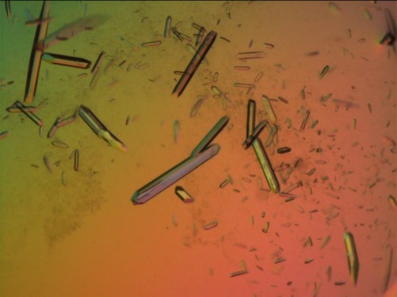
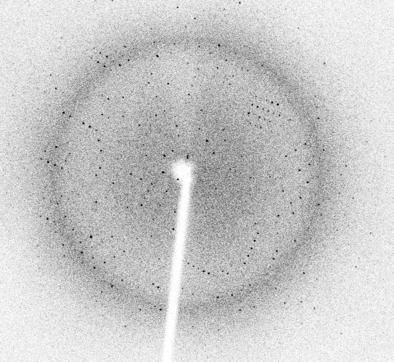
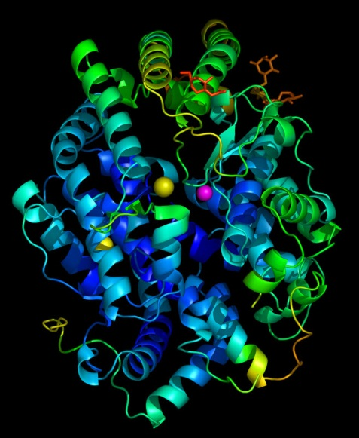
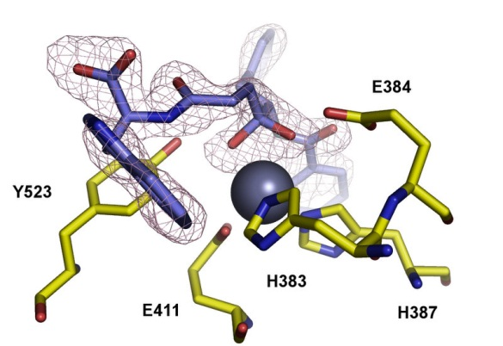
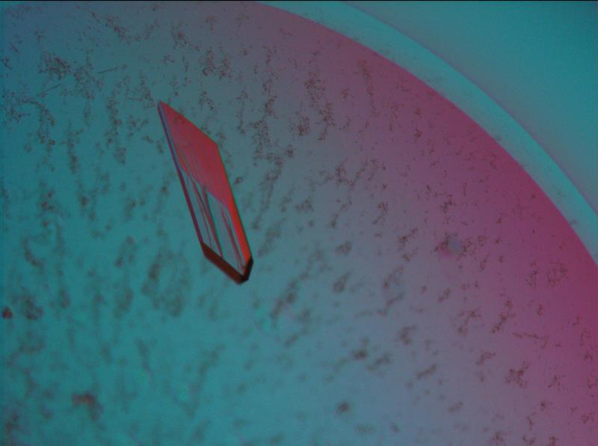
Drug design for hypertension
High blood pressure is treated using inhibitors of angiotensin-converting enzyme.
X-ray crystallography allows visualisation of locally-designed, novel inhibitors binding to the enzyme.
Dr. Jean Watermeyer
Notes:
Thirdly, we want to help make sick people better. In this case I am highlighting the work of our colleague Professor Ed Sturrock who has used our ability to see the atoms in a particular protein molecule to make better drugs to control high blood pressure.

Slide 5
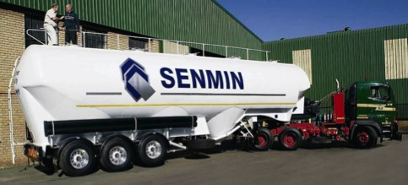
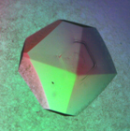
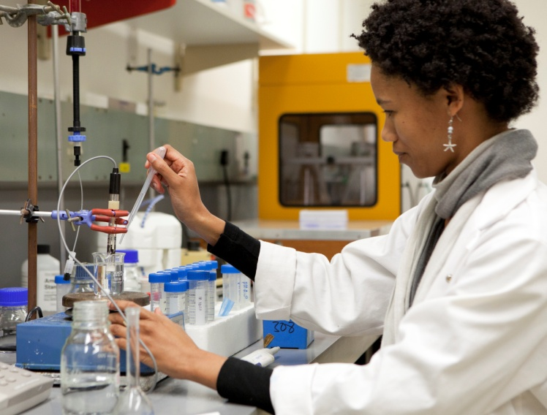
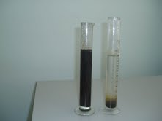
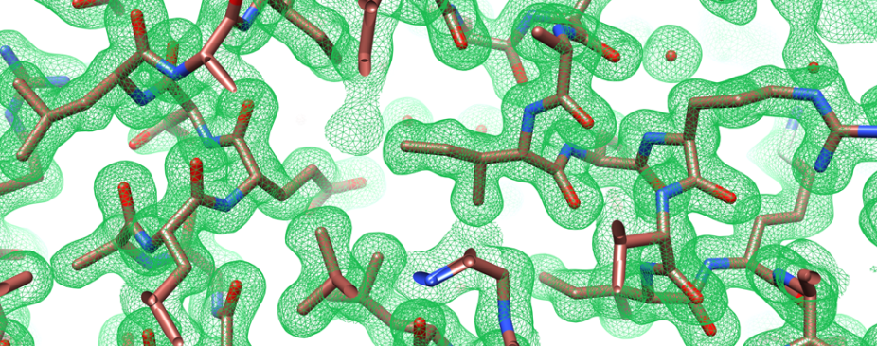
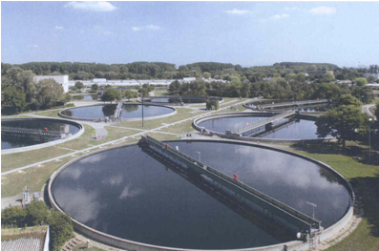
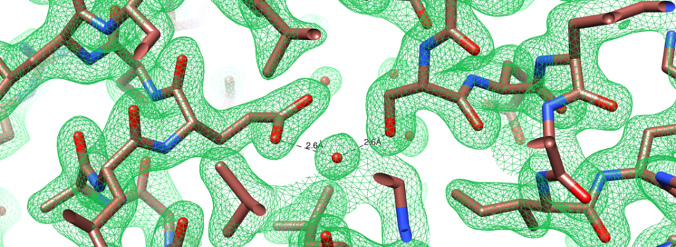
Water purification is achieved through polyacrylamide flocculation
Acrylamide is made in kiloton quantities using nitrile hydratase
Dr Jennifer van Wyk
Naturally occurring nitrile hydratase
Enzyme modified for greater thermostability
Better enzymes for acrylamide manufacture are designed using structural knowledge
Notes:
Fourthly, we want to contribute to the technology that affects ordinary people. In most of South Africa water is scarce and needs to be recycled- the process of recycling involves flocculation of impurities using polyacrylamide gel. Acrylamide is made in kiloton quantities using an enzymatic process. Our work has shown how to improve the enzyme so that the acrylamide can be made more efficiently. In particular for the chemists in the audience the substitution of a leucine by a serine enables the formation of a water-mediated hydrogen bond that increases the thermostability

Slide 6
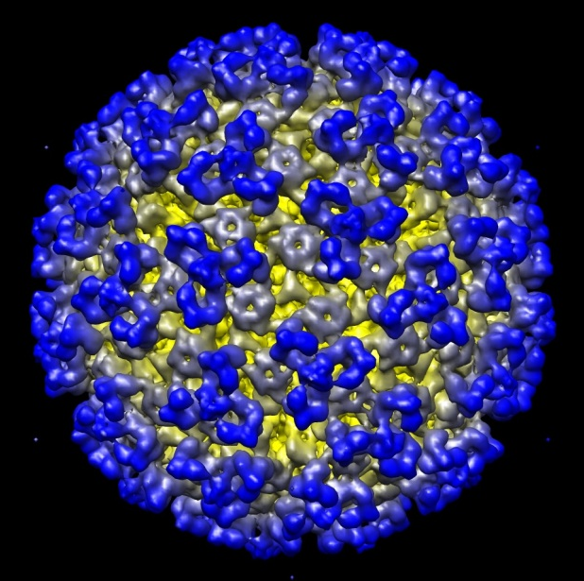
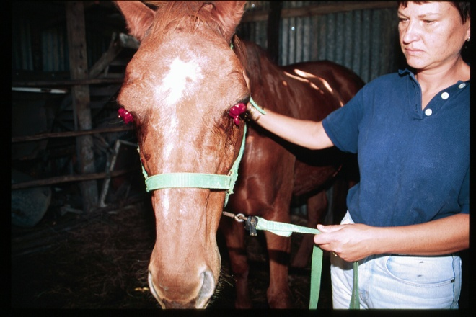
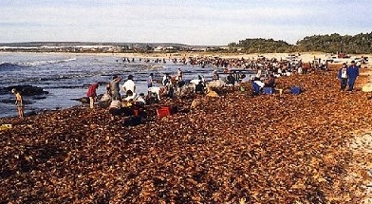
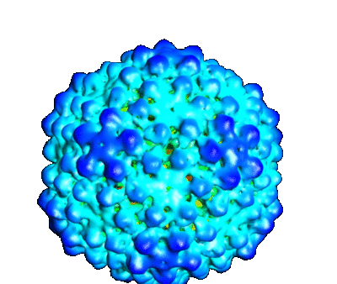
Virology
African Horsesickness Virus
threatens the South African
thoroughbred industry
Red tide
Marine Algal viruses
can be used to protect the
shellfish industry which is
threatened by Red tide.
Notes:
Finally, we have visualized harmful viruses like AHSV and the viruses hat we seek to deploy as biological control agents to kill the algae that cause red tide.

Slide 7
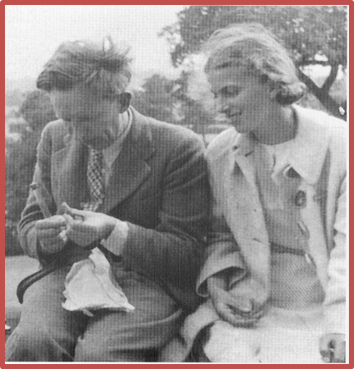
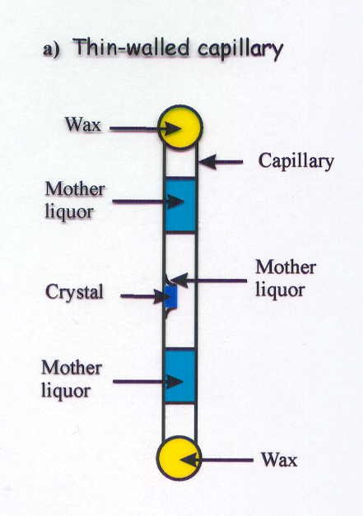
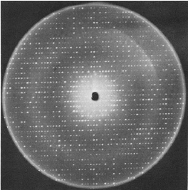
The initial experiments at producing diffraction patterns from protein crystals failed
JD Bernal and Dorothy Hodgkin tried keeping the crystals wet, and obtained a beautiful diffraction pattern, indicating that water was required for retention of protein architecture
"Now that a crystalline protein has been made to give X-ray photographs, it is clear that we have the means of checking them and, by examining the structure of all crystalline proteins, arriving at far more detailed conclusions about protein structure than previous physical or chemical methods have been able to give."
Notes:
Lawrence Bragg also taught J.D. Bernal. Bernal was the first person to seriously pursue the idea of making crystals from proteins. It was not initially clear that proteins would form crystals – indeed the formation of crystals was regarded as proof that all protein molecules of the same type were identical. The first crystals did not diffract and it was only when his student Dorothy Hodgkin conceived the idea of keeping them wet that diffraction patterns were seen.

Slide 8
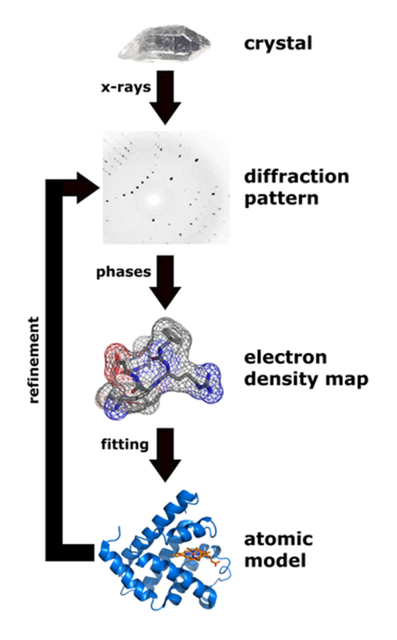
How to do protein crystallography
Prepare pure protein
Grow a crystal
Put it in an X-ray beam – preferably at a synchrotron
Collect and process diffraction data
Produce an electron density map
Interpret structure
Notes:
While I was studying in London I was struck by the fact that I was immersed in a society whose will it was that all the things I was doing should and would happen and that somehow I was a cog in the machine that would benefit society by making the knowledge of protein structures easily and readily accessible.
Society seemed to be investing in so many things that seemed to be made to make my life as a student of protein structure not only possible but easy and enjoyable. Among these things were computer networking that enabled me to sit in an office in London and use computers near Oxford and Liverpool, computer graphics that enabled me to interactively manipulate my structures and the electron density maps that gave rise to them. Computers that were powerful enough to make my calculations happen in a day or so, an operating system called Unix that was in the public domain and enabled sharing of code and algorithms, a program repository called CCP4 in which useful code could be deposited by all interested people, a homogeneous data format so that I could easily see the results of work done by colleagues from other labs and a place called the Protein Data Bank that accepted the results of your work and let you “download” by mail and magnetic tape all the fifty or so protein structures that were known at the time.
Another thing that was happening at the time was the building of a thing called a synchrotron radiation source near the country village of Daresbury in Cheshire – synchrotrons had been an instrument of the physicists for some 20 years but the structural biologists of the time realized that collecting data in your own lab was absurdly difficult – the x-ray beams you could generate were simply too weak. To get data from a “home source” you needed to make many large crystals requiring amounts of protein that could only be obtained in rare cases. Synchrotrons could make x-ray beams that were hundreds of times brighter that you could make with even the most powerful x-ray generators that could be accommodated in a laboratory. I witnessed the huge effort in putting the first synchrotron that was built specifically as a light source and largely for the protein crystallographers taking place over five years.
I returned to South Africa to work with Professor Claus von Holt in the Biochemistry Department at UCT. Somewhat to my dismay there was nothing in place to do the sort of work that I had been doing. Putting everything together took more than 20 years – during which time many things happened – so we must fast forward.

Slide 9
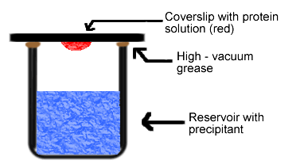
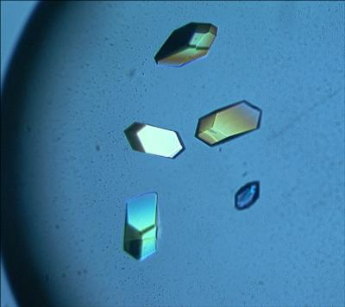
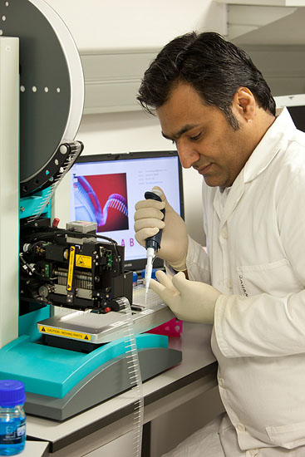
Making protein crystals
Even today growing good crystals is often the rate limiting step of a crystallographic experiment
A pipetting robot helps find suitable conditions for crystallization
Notes:
Today it is comparatively easy to set up a protein crystallization experiment. Indeed the experiment has succeeded so often that some people believe that all proteins will form crystals if the correct conditions are found.

Slide 10
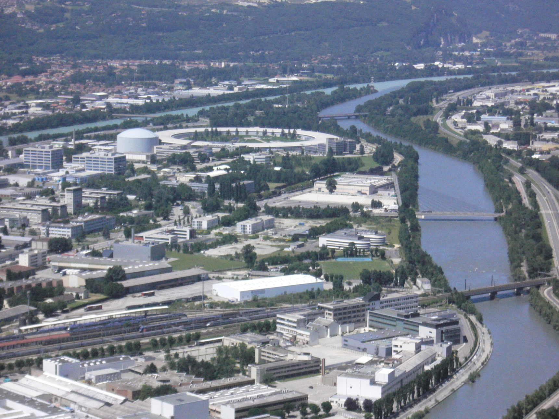
The European Synchrotron Radiation Facility (ESRF)
at Grenoble in France
Notes:
On the 25th May this year South Africa became a member a country of the world’s most successful synchrotron giving an enormous boost to structural biology locally.

Slide 11
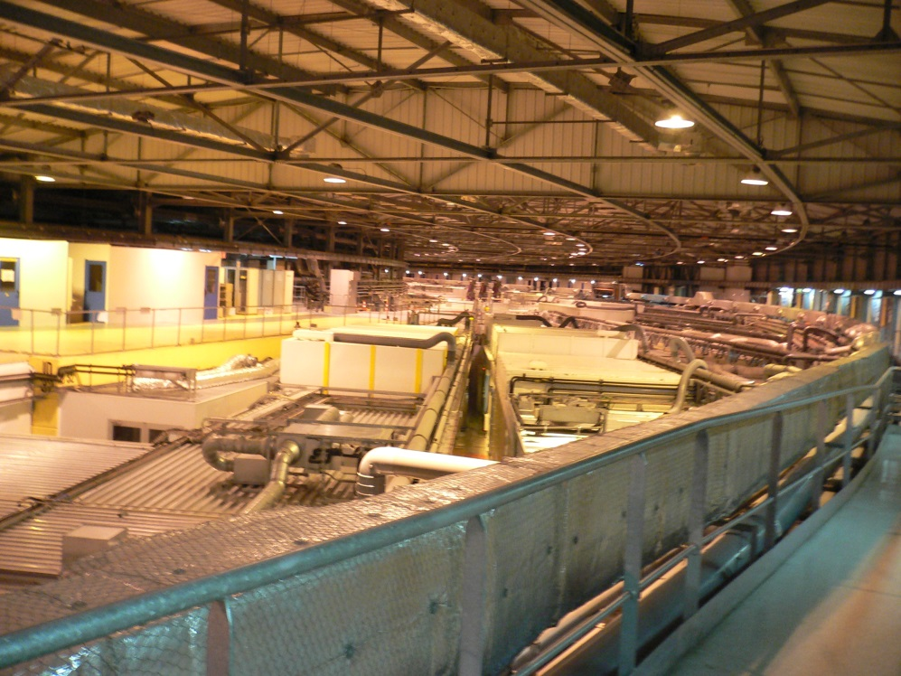
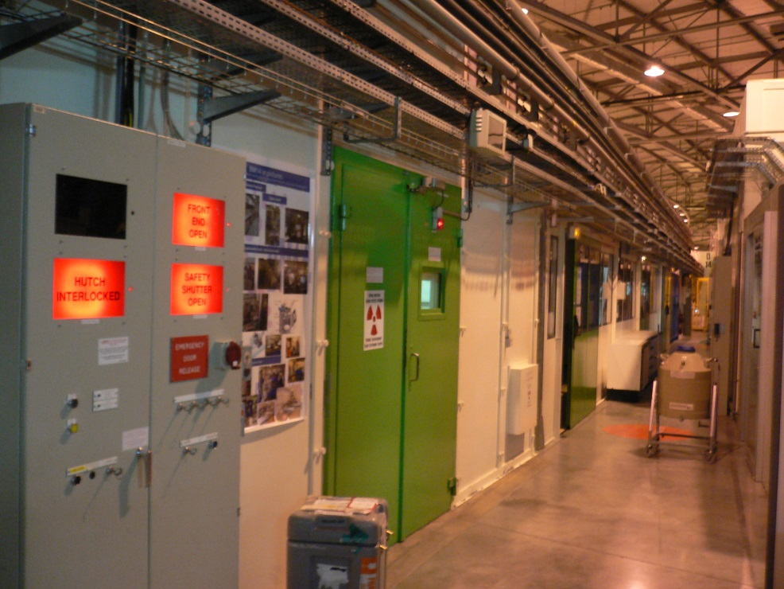
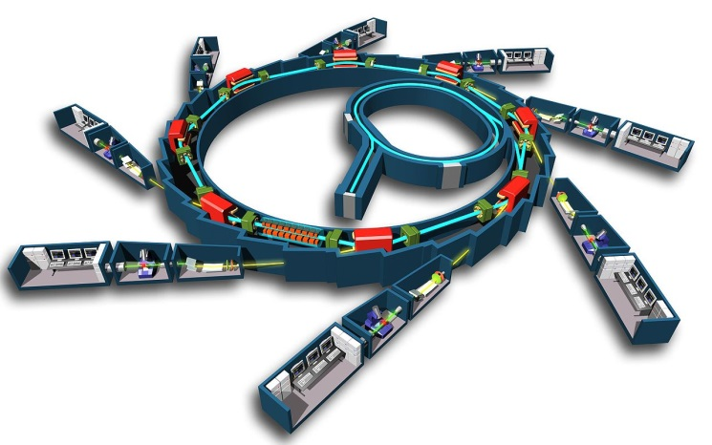
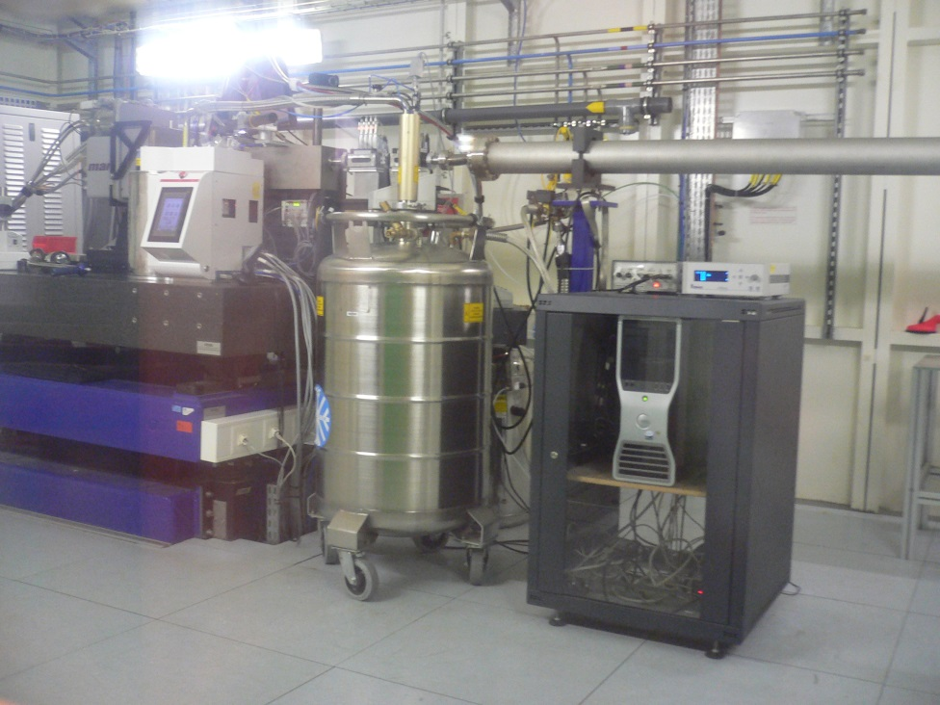
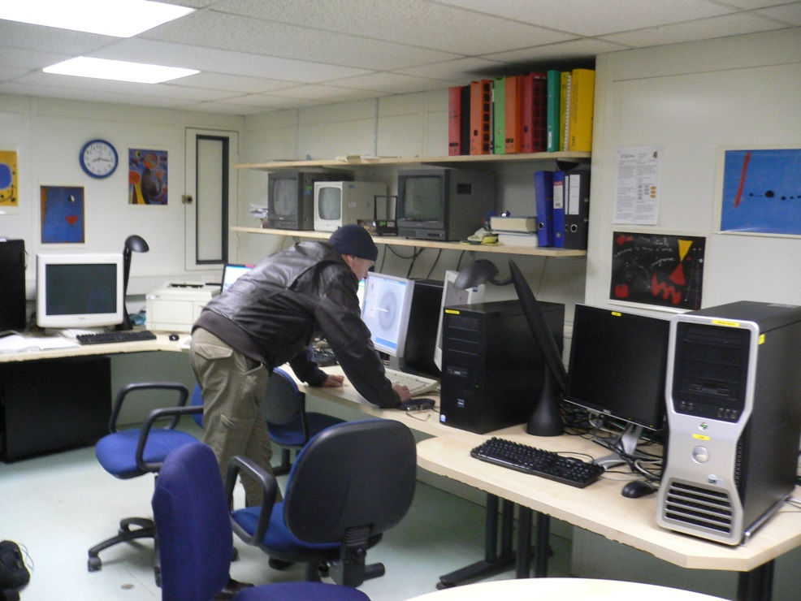

Slide 12
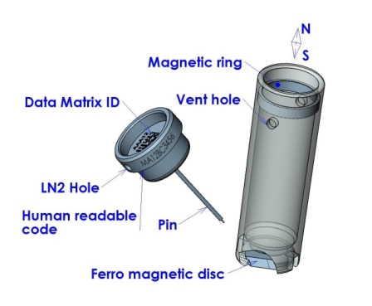
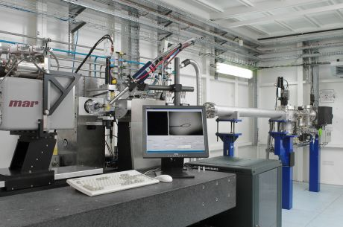
Put the crystal in the beam

Slide 13
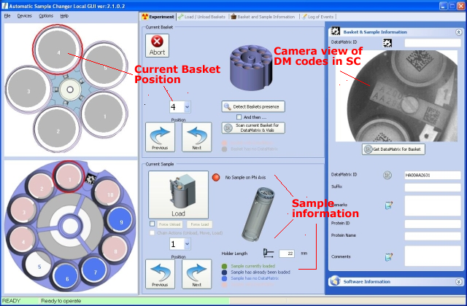
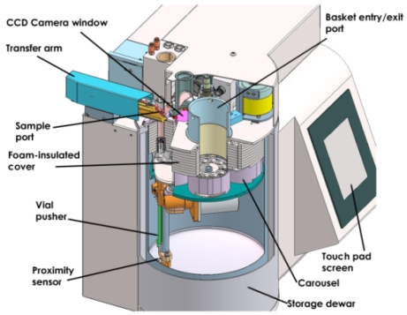
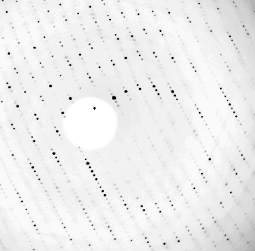
Usually a robot does it for you!

Slide 14
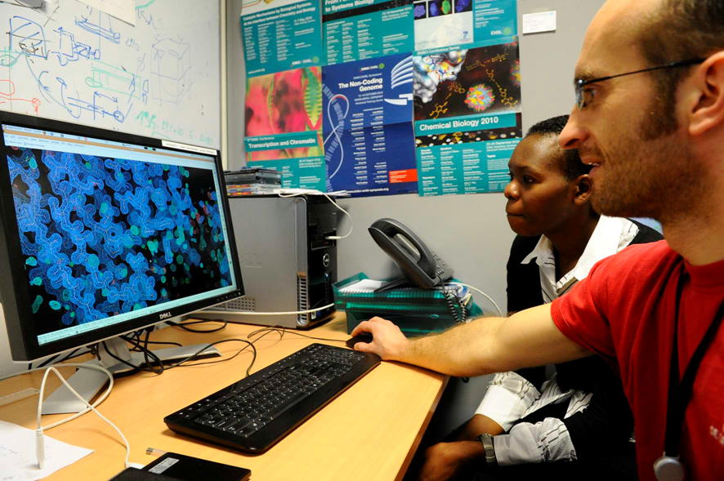
One can often see the results almost immediately!

Slide 15
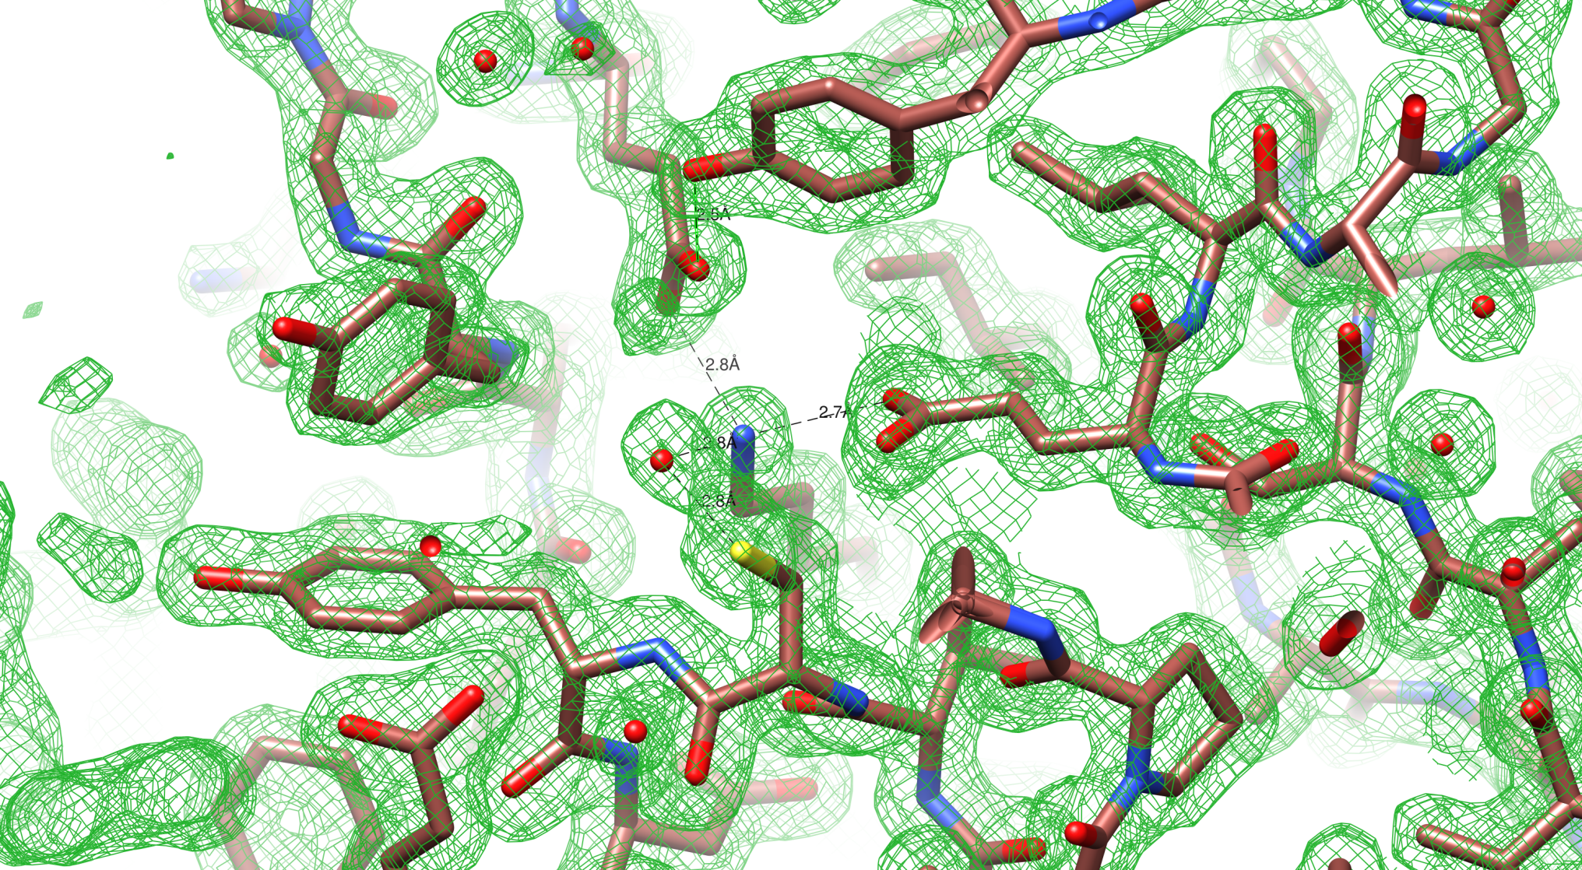
The green contour map is the actual result of the experiment.
The “sticks” connect non-hydrogen atoms.
In this 1.6 Å resolution map, atom locations are accurate to better than 0.1 Å

Slide 16
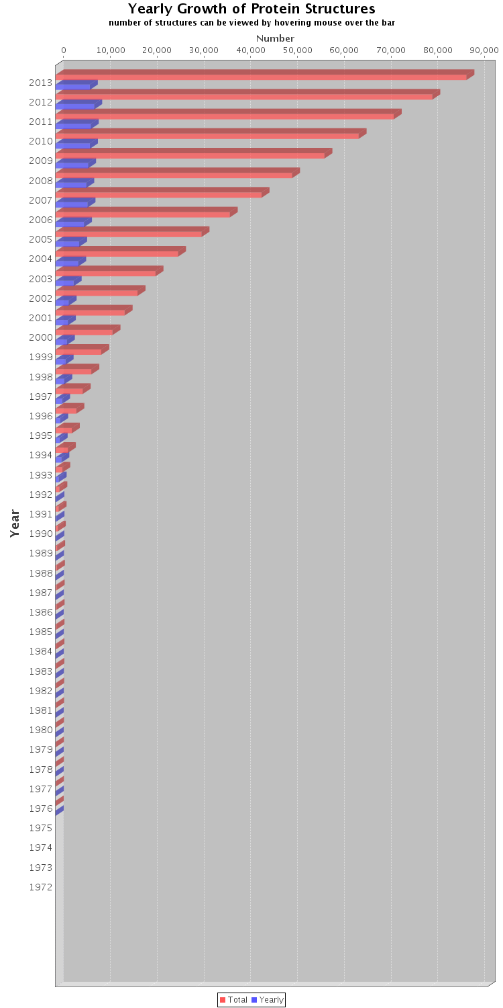
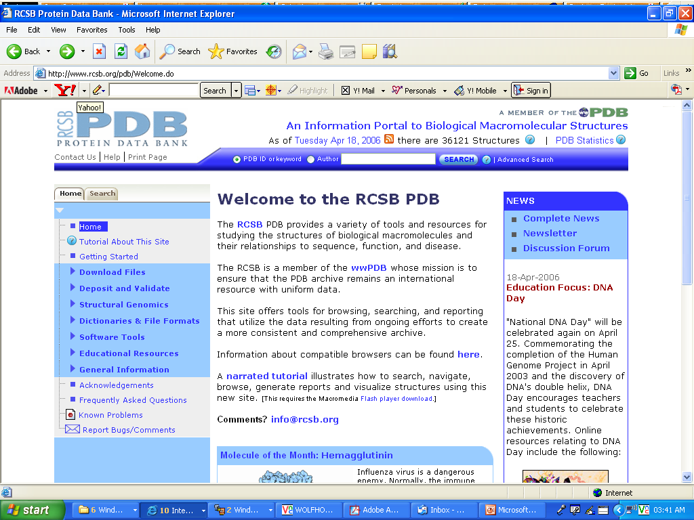
The output of a crystallographic experiment needs to be deposited in a public database called the Protein Data Bank
The intensities of diffraction spots
Three dimensional co-ordinates of the atoms
141,842 at present
Year
57 structures by 1981
First structure deposited, 1976
Notes:
The development of structural biology was as much a social phenomenon as a scientific one and it continues to be just that. The Europeans, Americans, and Asians ( Indians, Chinese, Japanese and Koreans) have bought into the highly competitive intellectual paradigm that drives discovery and they have resourced it properly so that the leading protagonists have a highly supportive social infrastructure. In general there is a good feedback loop so that the man on the street has sufficient knowledge and education to be aware of the benefits of research. This has been far from the case in South Africa.

Slide 17





Structural biology … pipeline
1. Sample selection
2. Soluble expression
3. Purification
4. (Crystallization)
5. Data collection
6. Data processing
7. Interpretation
8. Publication
Notes:
It’s also very important to note that Biophysics is only one aspect, often the celebrated for the visual insights it brings, but no more important that the other stages of the experiment.
Often more than half the battle is in preparing sample and a considerable portion of our efforts in growing capacity have centred around equipping world class protein production facilities and growing the skills to execute this critical part of all aspects of the pipeline.
We have not been alone in this pursuit and the developments in our collaborators labs have been essential for them accessing our resources.
Entering at different points in the pipeline e.g. collaborations with partners providing excellent protein samples skip ahead in the experiment. Or collaborations with overseas partners have allowed us to access resources we don’t posses in the country.

Slide 18




Chromatography
Crystal trials
Crystals
Data collection

Slide 19
Shipping crystals to a synchrotron is non trivial!
Problems:
Access to carousels/mounting pins/shipping containers
Customs documentation
Shipping costs
A lot goes wrong:
Shipment detained in customs
Shipment damaged in transit
Shipment delayed for various reasons – doesn’t reach synchrotron in time
Arbitrary decisions by shipping company, airline loading officers, customs officials

Slide 20


Cryo Electron Microscopy is the fastest developing method for determining macromolecular structure
Richard Henderson of the MRC LMB enabled UCT to get an instrument when they upgraded. We have added a direct electron detector to this platform – but it’s primary use is sample validation

Slide 21







Gel filtration chromatography
SDS PAGE gel
Protein Purification
Liquid ethane
-188 °C
Vitrobot
Cryo grids preparation
Images collected at a magnification of 165 000 X
FEI Titan Krios microscope
Data collection

Slide 22








Plasmodium falciparum Glutamine Synthetase
$$Glutamate+ATP+{NH}_{3}\underset{↔}{2M^{2+}}Glutamine+ADP+P_{i}$$
Sinalo Gqunu
Trevor Sewell
Refined final atomic model
Relion processing
Binding pocket
3.2 Å Resolution map!

Slide 23
What has to happen to ensure sustainability
Separate the functions of Education, Research and Service
Unlike Materials Engineering , Chemical Engineering, Physics and Chemistry, the discipline of structural biology had no established departmental home and no infrastructure for research

Slide 24
UCT is in the process of creating infrastructure
The future infrastructure will have three parts:
A new department: Integrative Biomedical Sciences
A new research unit: The Structural Biology Research Unit
A new service facility : The Aaron Klug Centre for Imaging and Analysis (AKCIA)

Slide 25
Existing and New Research Units and Departments will supply projects that will fund the Aaron Klug Centre for Imaging and Analysis (AKCIA).
A sympathetic management structure will ensure that everyone’s interests are met.
CME
CMR
SBRU
Department X
AKCIA
Research Outputs

Slide 26


The Aaron Klug Centre
for Imaging and Analysis
Purpose: To provide the instrumental resources and expertise for structural analysis in all disciplines including structural biology for all as part of the National Research Infrastructure

Slide 27


Space: 660m^{2,}, vibration free, magnetic field compensated, temperature controlled, humidity controlled
Equipment: 3 TEMs, 4 SEMs, Protein Diffractometer, Preparative equipment, computer infrastructure
Staff: Total 15: Director, scientists, technicians , data professional, administrator
Automated acquisition systems
Web-based image processing interfaces
Integration with UCT HPC

Slide 28








What is in place today?
Building: Complete, all but one rooms occupied
Instruments: 4 Scanning Electron Microscopes and 2 Transmission Electron Microscopes operational, Raman Confocal microscope, X-ray diffractometer operational, crystallization facility operational , most preparative equipment operational
Staff: Half-time Director, 4 scientific officers, 2 technical officers employed by UCT
Scientist and two technical officers on secondment from Centre for Minerals Processing
Data processing technician and Principal Scientific Officer employed by START

Slide 29

Protein Expression
Gerhardt Incubator
New Brunswick refrigerated Incubator

Slide 30
Protein Purification
Äkta Explorer and Äkta Prime
Gilson chromatography systems (X3)
  Preparative 321
  HPLC SEC
  Preparative SEC

Slide 31
Macromolecular Crystallization
Mosquito
Rigaku diffractometer
Cryo-Electron Microscopy

Slide 32








Staff
The Centre depends on people
It will ultimately have fifteen people comprising a mix of scientists and techncians supported by engineering, administrative and computer staff
Sewell
Waldron
Yorath
Jaffer
Karriem
Hanief
Weber
Woodward

Slide 33
eResearch
Computer technology will permeate every aspect of the Centre
User management
Workflow management
Instrument control
Data acquisition
Data storage
Data processing
Data dissemination
Automatic data collection with direct electron detectors produces multiple terabytes of data per experiment, with today’s technology

Slide 34










Crossing the Potential Barrier
How START stimulated Structural Biology in South Africa
Notes:
Story of the development of an SBIO programme at UCT.
Talking on behalf of Trevor who is unfortunately indisposed following elective surgery.
My authority to tell this story comes from honour of being one of the first graduates of the SBIO MSc programme.
I am going to reveal the developments that led to where we are today but also the projects that drove the need for develpoing these capabilities.
Deputy vice-chancellor, Deans, colleagues, students, friends and family. Thank you Professor le Roex for the introduction.
It goes without saying that we humans are concerned about (1) food (2) health (3) products for our comfort and convenience – in arbitrary order. We are driven by the need to have more and better. Our curiosity also drives us to look towards Nature and to observe how things happen in the world around us.
Biological systems hold a particular fascination – they replicate and propagate in a sustainable way – they live!
There are many ways to try and understand biological systems. The way I have chosen is to rationalize the way the systems function by visualizing biological macromolecules, especially proteins, at atomic resolution. This approach brings Biology into the domain of Chemistry and Physics and it is enabling for Biotechnology – especially such things as rational design of medicines and industrial enzymes. The discipline that is concerned with every stage of the visualization and interpretation of the structures is called Structural Biology. It is a very large field attracting significant investment internationally in both the academic and industrial spheres. No fewer than twenty-two Nobel prizes have been awarded to Structural Biologists since 1953. The impact of the field touches our daily lives in many ways – crops that are grown using herbicides and pesticides designed by structural biologists, , the drugs we take have almost certainly passed through the hands of structural biologists, if not in their discovery then in their synthesis or in the determination of their mechanism of action, even the water that we drink may have been purified with gels made by enzymes that have been designed by structural biologists and the fuel that you put in your car in the future will be made using tailor-made enzymes that have been designed by structural biologists.

Slide 35
START aims to create a UK-Africa partnership to develop a programme of world class research based around energy materials (strand 1) and protein structure determination (strand 2).
The grant will fund:
Extended training in Synchrotron techniques - The nexus of START is Diamond Light Source, the UK synchrotron.
Researchers who will study emerging and neglected diseases of direct importance to the African continent through an extensive programme of structural biology.

Slide 36
What will be funded for three years:
Nine Research Assistants (post-docs), including a research budget and travel costs
A local resource centre in Cape Town
Two posts in the resource centre
Annual workshops in South Africa
Annual meetings in South Africa
Travel between Diamond and South Africa for both South African and British participants

Slide 37
9 South African co-investigators at 7 institutions
Trevor Sewell
University of Cape Town
Ed Sturrock
University of Cape Town
Jeremy Woodward
University of Cape Town
Wolf-Dieter Schubert
University of Pretoria
Yasien Sayed
University of the Witwatersrand
Dirk Opperman
University of the Free State
Erick Strauss
Stellenbosch University
Lynn Morris
National Inst for Communicable Diseases
Albie van Dijk
North West University

Slide 38
Extension
Paul Kappo
University of Zululand
Kevin Naidoo
University of Cape Town
Anwar Jardine
University of Cape Town
Addmore Shonhai
University of Venda
Penny Moore
NICD
Post docs
Ana Ebrecht
University of North West
No appointment
University of Pretoria
Lauren Arendse
University of Cape Town
Andani Mulelu, Stanley Makumire
University of Cape Town
Lizelle Lubbe
University of Cape Town
Thandeka Moyo
NICD
Carmien Tolmie
University of the Free State
Ramesh Pandian
University of the Witwatersrand
Anton Hamann, Blake Balcomb
University of Stellenbosch

Slide 39
Upcoming projects
CCP4 Crystallographic School in South Africa
Data Collection to Structure Refinement and Beyond
University of Cape Town, South Africa
31 March 2020 - 08 April 2020
Organizers: Trevor Sewell, Carmien Tolmie
Formation of the
South African Society for Biophysics and Structural Biology
Raise funds for the continued membership of IUPAB
Establish an MoU with INSTRUCT

Slide 40
National use of the Diamond Light Source is co-ordinated through:
MX BAG – led by Wolf-Dieter Schubert
eBIC BAG – led by Jeremy Woodward
Have enabled the determination of over 200 crystal structures and 2 cryoEM structures

Slide 41



With sincere thanks

Slide 42
The combined resources of the SBRU and the CIA make it possible to do structural biology experiments in one location
Chromatography
Crystal trials
Crystals
Data collection

Slide 43

An Example of what can be done:
Cyanide dihydratases – remove cyanide from mining wastewater.

Slide 44


The three-dimensional images can be interpreted to give a location of every atom in the molecule

Slide 45

The polypeptide chain was fitted ab initio to the central 18 subunits with coot and refined using Refmac 2 as described by Murshudov (2016) Methods Enzymol. 579:277

Slide 46







Centre for Materials Engineering
Department of Mechanical Engineering
100µm

Slide 47
THE BEGINNING

Slide 48

Frouws et al Biophysical Journal

Slide 49

Experimental Structure Determination
Song et al (2014) Science 344,376

