Slide 1
The effect of Cs content in the structural and photo-physical properties
OF mixed cation hybrid-perovskites.
November 2019
Adam Shnier supervised by:
Prof. Dave Billing, Dr Daniel Wamwangi and Dr. Caren Billing
Research collaborators (University of Sheffield):
Claire Greenland, Joel Smith and David Lidzey

Slide 2
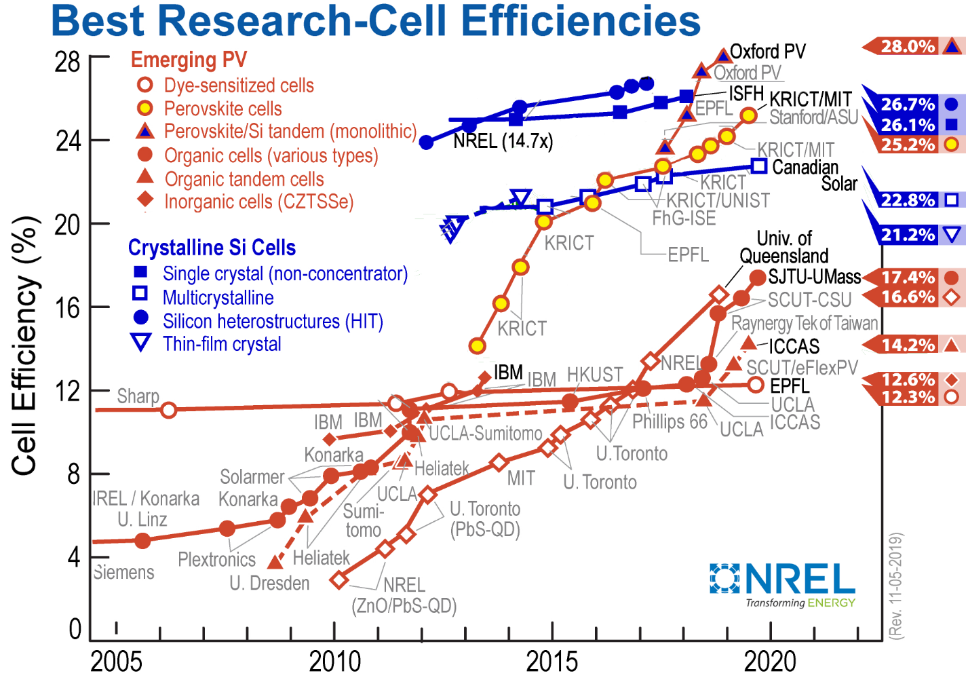
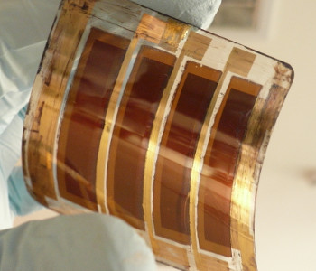
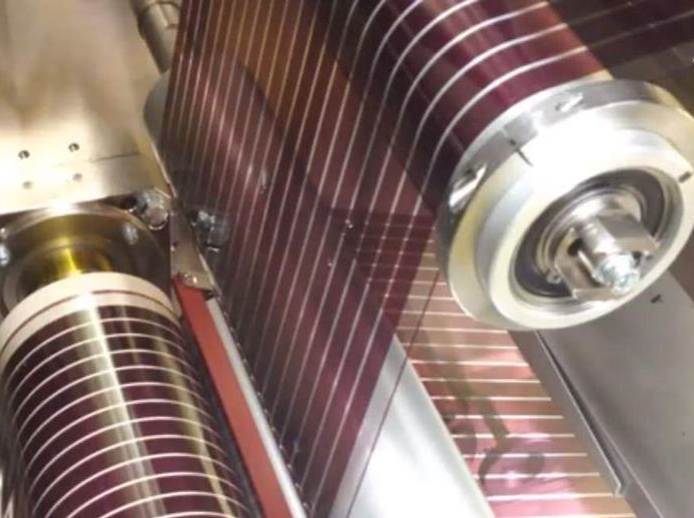
Why: Perovskites
Notes:
https://www.nrel.gov/pv/assets/pdfs/best-research-cell-efficiencies.20191106.pdf
Efficiency
Direct band-gap
Solution processing
Defect tolerence

Slide 3
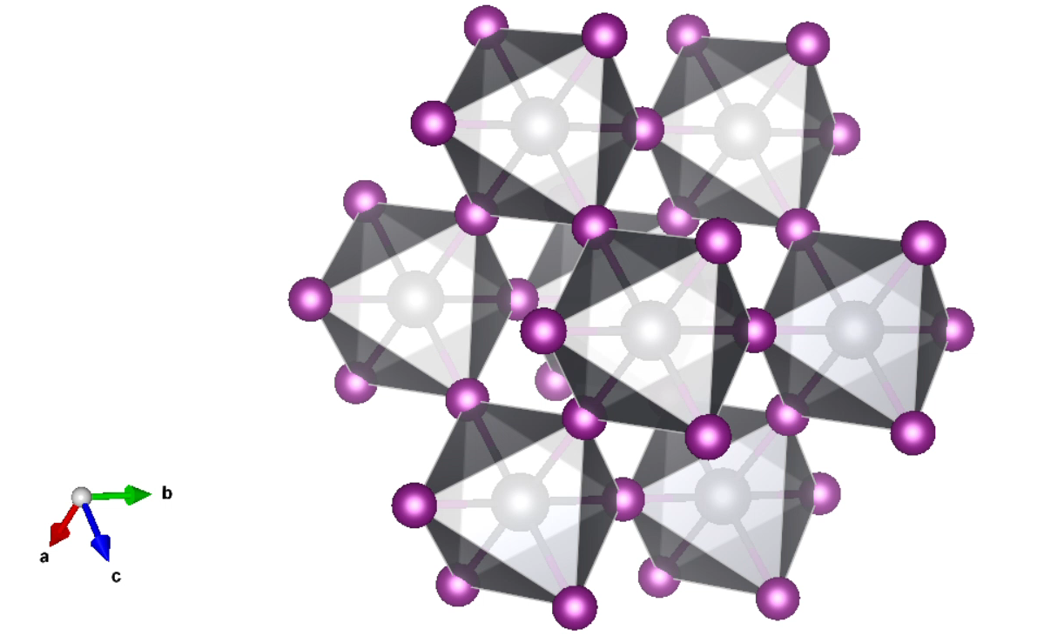
Perovskite structure
Halide
Organic Cation
Lead

Slide 4
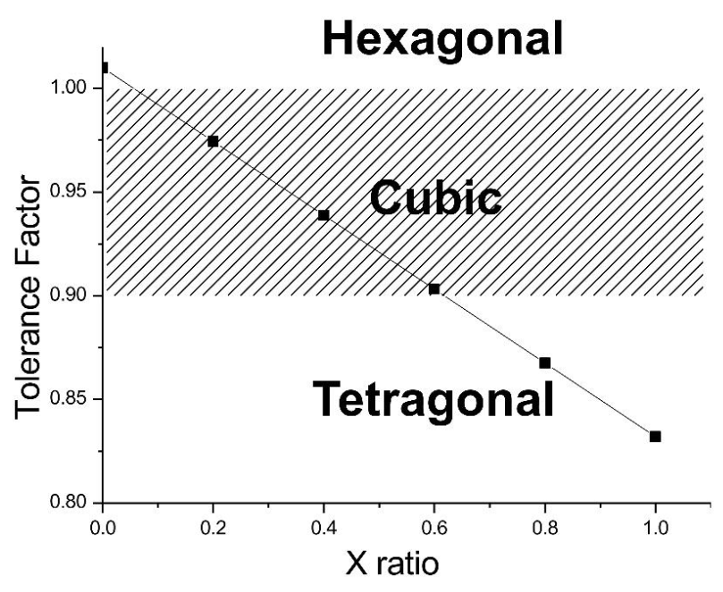
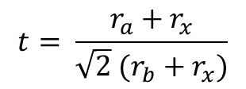
Why: Mixed Cation
Goldschmidt tolerance factor:
Importance of mixed cations (Cs,FA,MA) and mixed halide (Br,I) phases
  Energy band-gap tuning
  Reduced moisture sensitivity
  Improved long-term stability
  Morphology control to enhance charge transport and stability
$$t= \frac{r_{a}+r_{x}}{\sqrt{2} (r_{b}+r_{x})}$$
MA_{x}FA_{1-x}PbI₃
Ahn, Namyoung, et al. "Trapped charge-driven degradation of perovskite solar cells." Nature communications 7 (2016): 13422.
Notes:
Goldschmidt tolerance factor

Slide 5
This is some order here
Why:
  Perovskite
  Mixed Cation
Diffraction Measurement
FAMA Perovskite: (FA_{0.85}MA_{0.15})Pb(I_{0.85}Br_{0.15})₃
  Data
  Model development
  Results
  Optical Results (brief)
Adding Caesium
Next steps

Slide 6
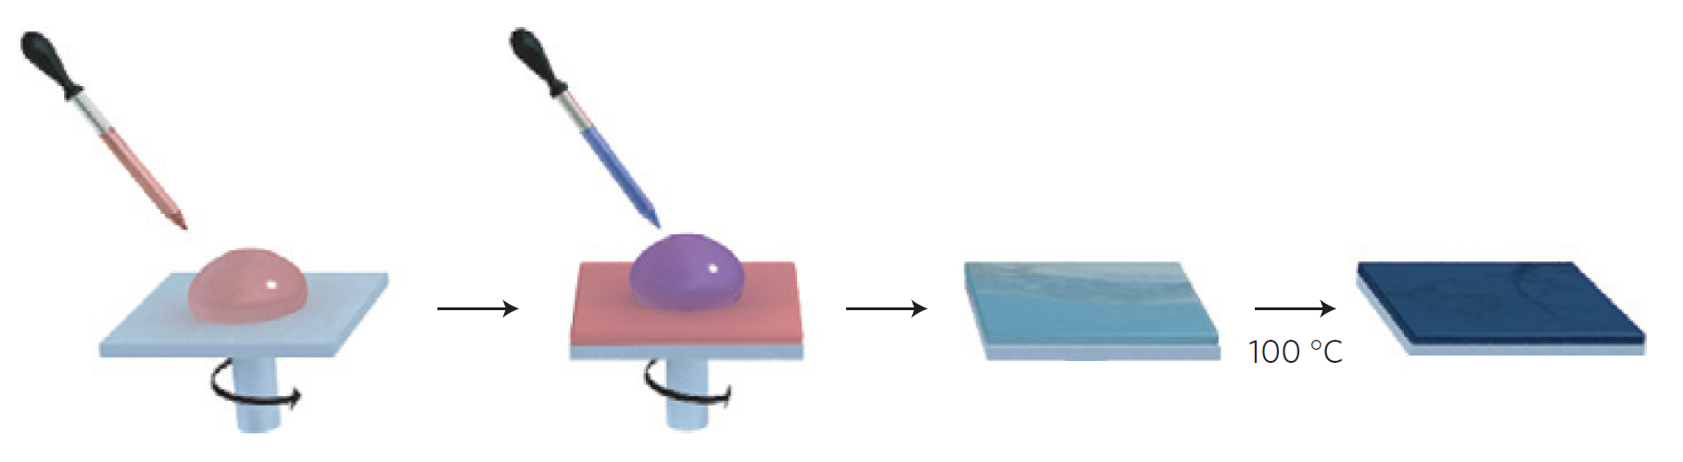
Diffraction Measurement
spin
Intermediate film
Perovskite film
drop precursor
drop anti-solvent
(chlorobenzene)
Figure adapted from:
Jeon, Nam Joong, et al. "Solvent engineering for high-performance inorganic–organic hybrid perovskite solar cells." Nature materials 13.9 (2014): 897.
Notes:
Why sample prep is important:
The processing will affect the microstructure
Anneal at 100C for 30 min
If we measure the perovskite film as is here, at least on the films I make I get nice 001, 002, 003 peaks all from a single axis
Jeon, Nam Joong, et al. "Solvent engineering for high-performance inorganic–organic hybrid perovskite solar cells." Nature materials 13.9 (2014): 897.

Slide 7
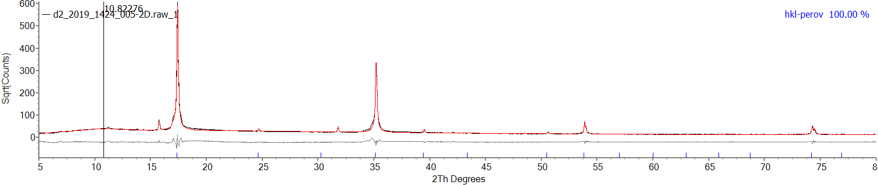
Diffraction Measurement
Bragg-Brentano measurement of a hybrid-perovskite film
(100)
(200)
(300)
(400)
# This scan is of (PA_{0.05}MA_{0.95})PbBr₃
Notes:
To show preferred orientation

Slide 8
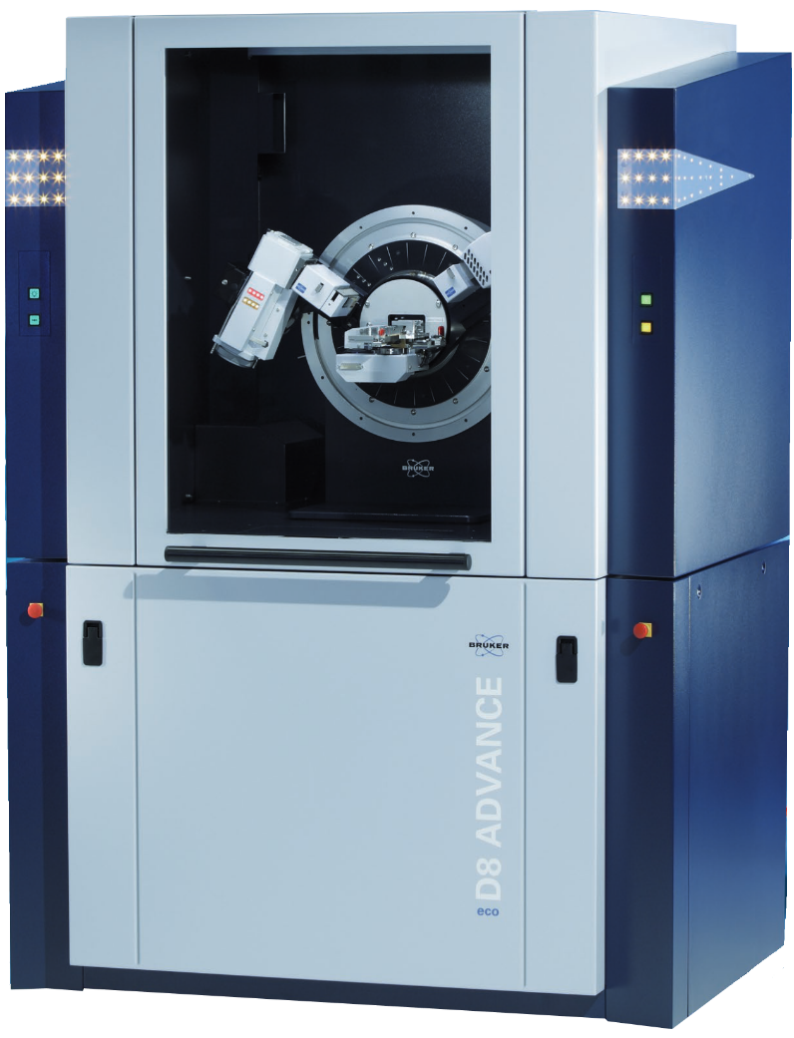
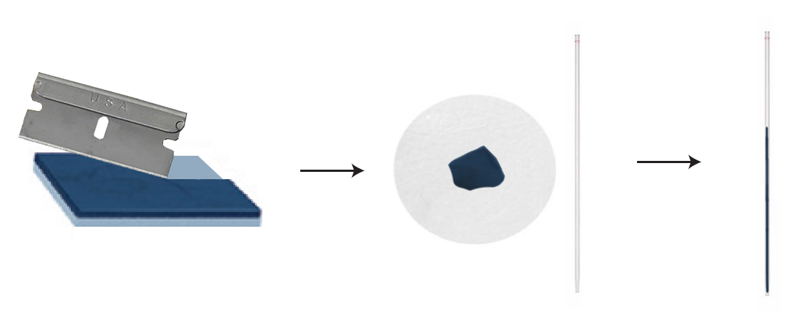
Diffraction Measurement
Scrape of the film
Somehow pack the powder into a capillary
Notes:
Spin coating
Annealing
Scraping
Packing in a capillary
VT-measurement to 90 K
Jeon, Nam Joong, et al. "Solvent engineering for high-performance inorganic–organic hybrid perovskite solar cells." Nature materials 13.9 (2014): 897.

Slide 9
This is some order here
Why:
  Perovskite
  Mixed Cation
Diffraction Measurement
FAMA Perovskite: (FA_{0.85}MA_{0.15})Pb(I_{0.85}Br_{0.15})₃
  Data
  Model development
  Results
  Optical Results (brief)
Adding Caesium
Next steps

Slide 10
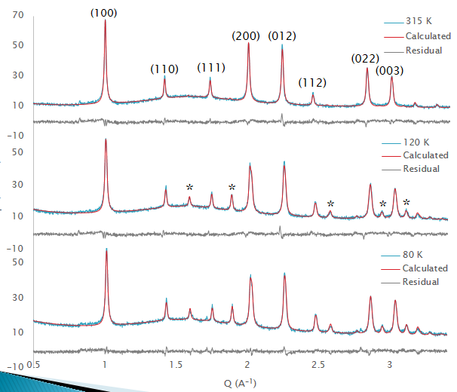
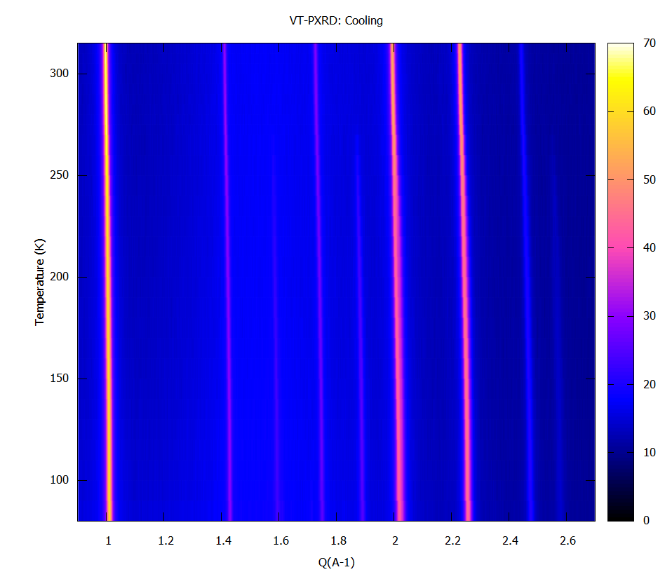
FAMA data set: Model development
Variable Temperature XRD – On Cooling
α
β
x
x
Q (A⁻¹)
Notes:
About 10 points above FWHM
The evolution of new peaks show breaking symmetery

Slide 11
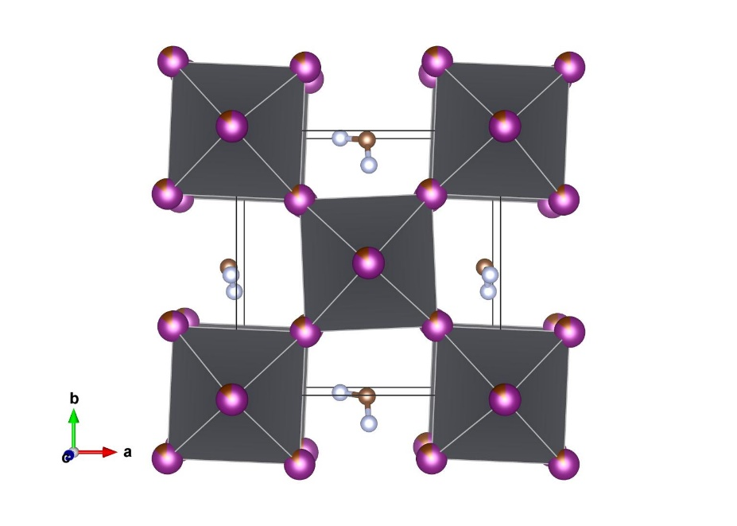
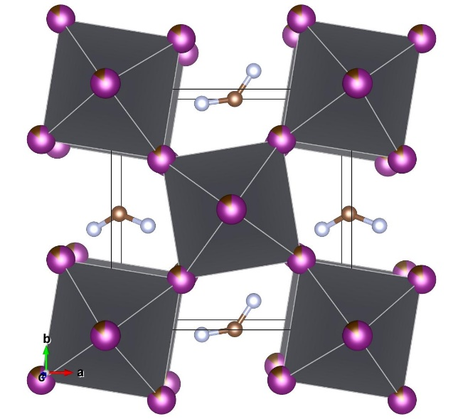
Perovskite phase changes
Ambient temperature:
Pm-3m phase
Sub-ambient:
P4/mbm phase
Weber, Oliver J., et al. Chemistry of Materials 30.11 (2018): 3768-3778.
Glazer notation
a⁰a⁰a⁰
Glazer notation
a⁰a⁰c⁺

Slide 12
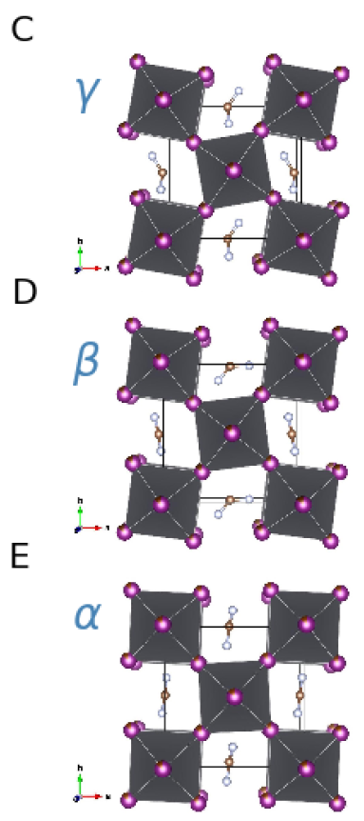
FAMA data set: Model development
x
x
Notes:
About 10 points above FWHM
The evolution of new peaks show breaking symmetery

Slide 13

FAMA data set: Refinement method
TOPAS
Notes:
Phase-flexible model
A single model was designed and refined across each full dataset. This model could adopt the features of the lower symmetry phases
Refinements use a fundamental parameters approach
Cs 5, 8, 10 % Cs in (Cs,FA,MA)Pb(I,Br)₃
These compositions could be well described by a P4/mbm tetragonal phase across their phase transitions.
This phase allows tilt of the octahedra around the c-axis.
Cs0 (FAMA) perovskite
The Cs0 data set was not suited for the P4/mbm phase.
A “rigid body” model was developed. The unnecessary freedoms in the “rigid body” were identified and removed.
Sequential refinements of this set produced unstable results influenced by the direction of the sequence.
Fewer freedoms and Monte-Carlo assisted sequential refinement removed this dependence.
Parametric refinements were faster without loosing consistency

Slide 14
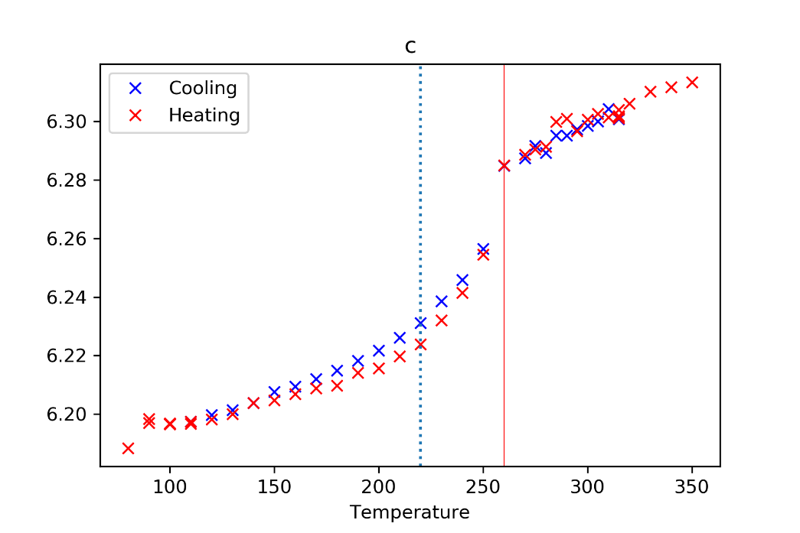
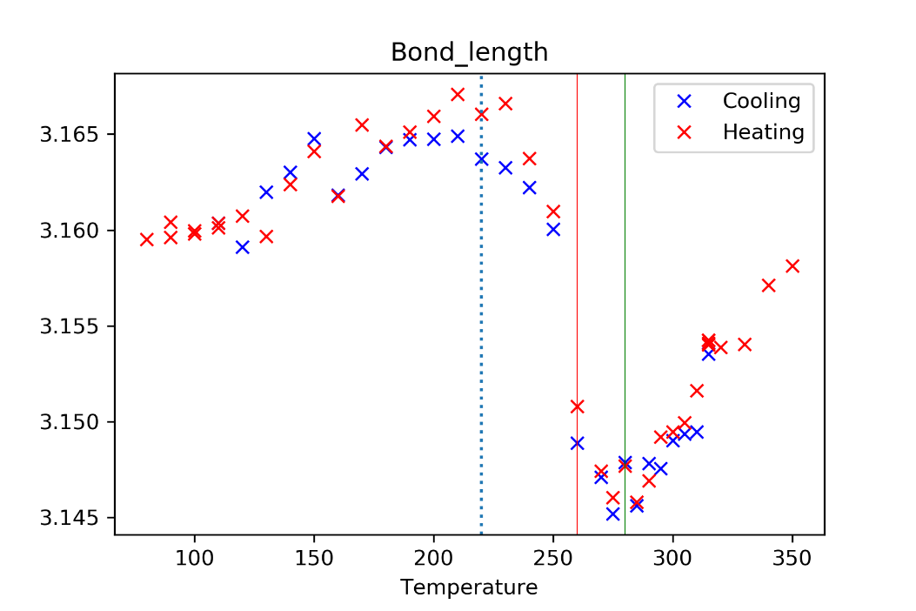
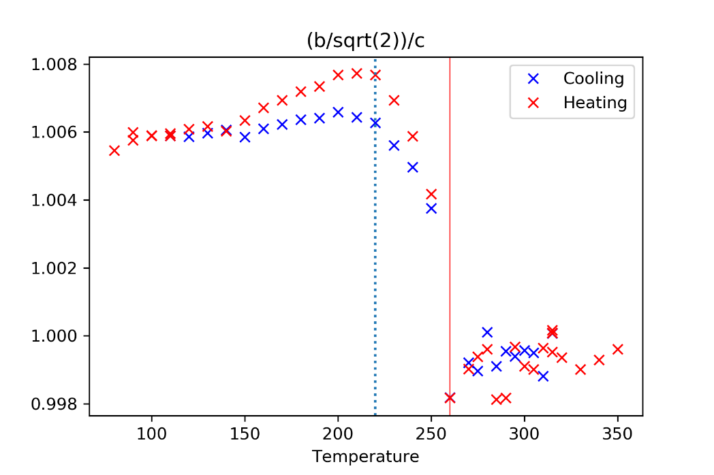
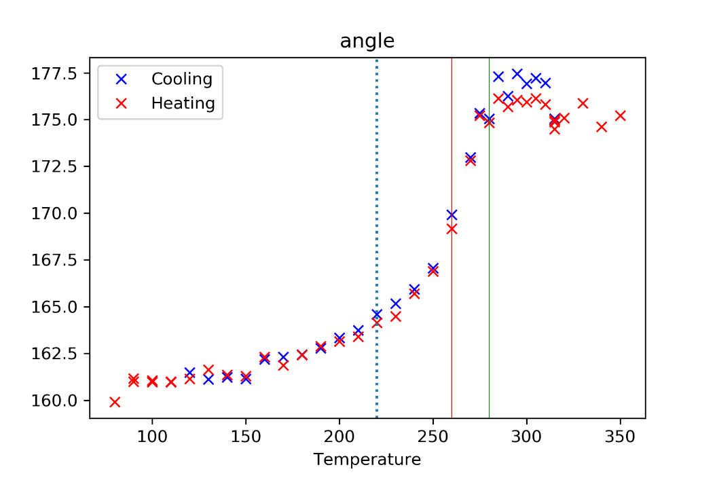

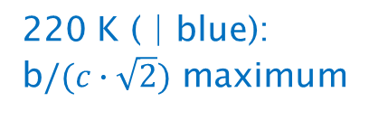
FAMA data set: Results
c-axis
Pb-X-Pb bond length (ab plane)
280 K ( | green):
Phase change onset
260 K ( | red):
Phase change α -> β
b$/(c∙\sqrt{2})$
Pb-X-Pb bond angle (ab plane)
220 K ( | blue):
b$/(c∙\sqrt{2})$ maximum
Notes:
FA_{0.85}MA_{0.15}Pb(I_{0.85}Br_{0.15}): Cs0
> 260 K: pseudo-cubic α-phase
250 to 220 K: β-phase where the octahedra gradually rotate about the c-axis breaking the symmetry of the cubic unit cell. This is seen in the change in the $a/(c∙\sqrt{2} )$ ratio for “Cs0”

Slide 15
FAMA data set: Optical results
The is strong correlation between optical and structure properties.
There is a drop in the photoluminescence intensity (PLQY) at the α to β phase transition (260 K)
The Stokes shift reached a maximum at the red line. This is where the Pb-X-Pb bond angle stabilizes after the α to β phase transition (220 K)
The slope of the band gap is reduced after the β to γ transition (90 K)
Notes:
Importance to impedance and performance (thickness and roughness)

Slide 16
This is some order here
Why:
  Perovskite
  Mixed Cation
Diffraction Measurement
FAMA Perovskite: (FA_{0.85}MA_{0.15})Pb(I_{0.85}Br_{0.15})₃
  Data
  Model development
  Results
  Optical Results (brief)
Adding Caesium
Next steps

Slide 17
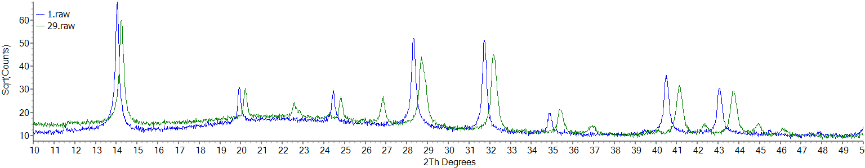
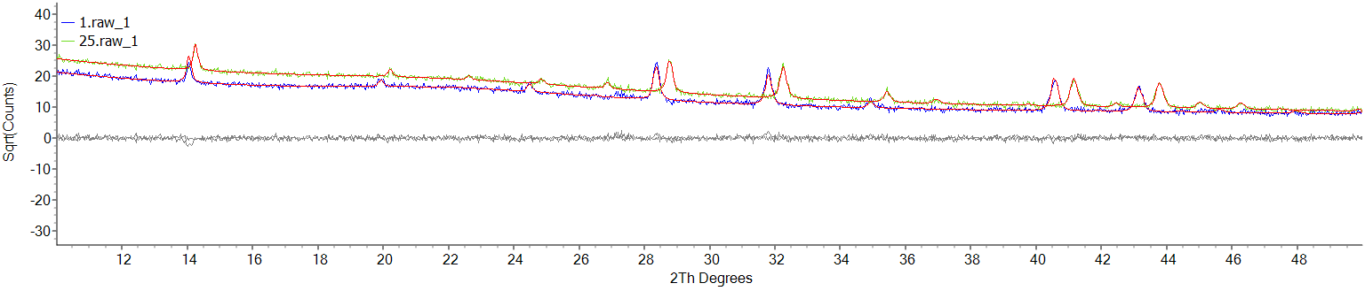
Adding Cs: Data quality
FAMA/Cs0 dataset
Cs10 dataset

Slide 18
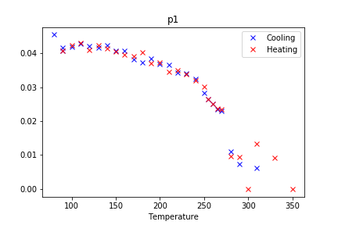
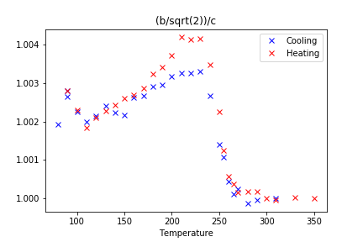
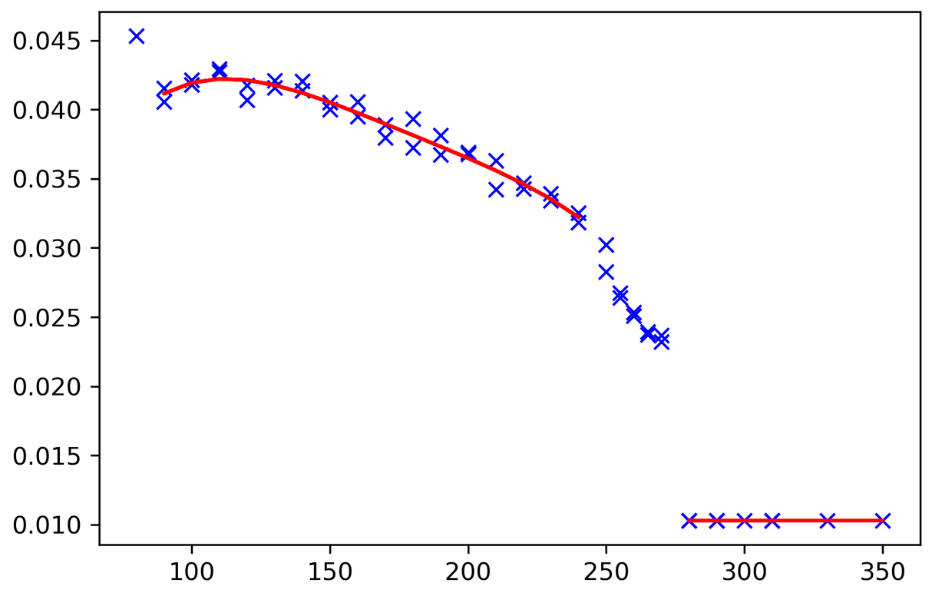
Adding Cs: Approximations

Slide 19
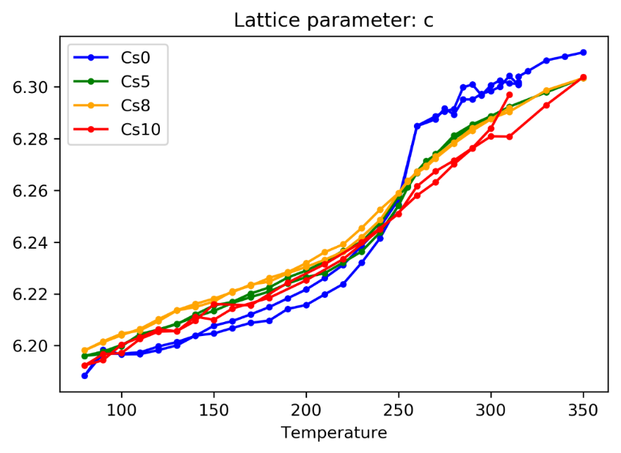
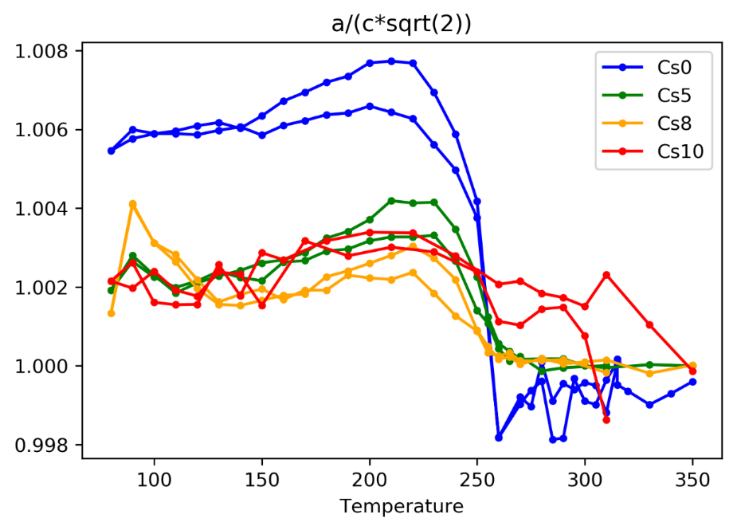
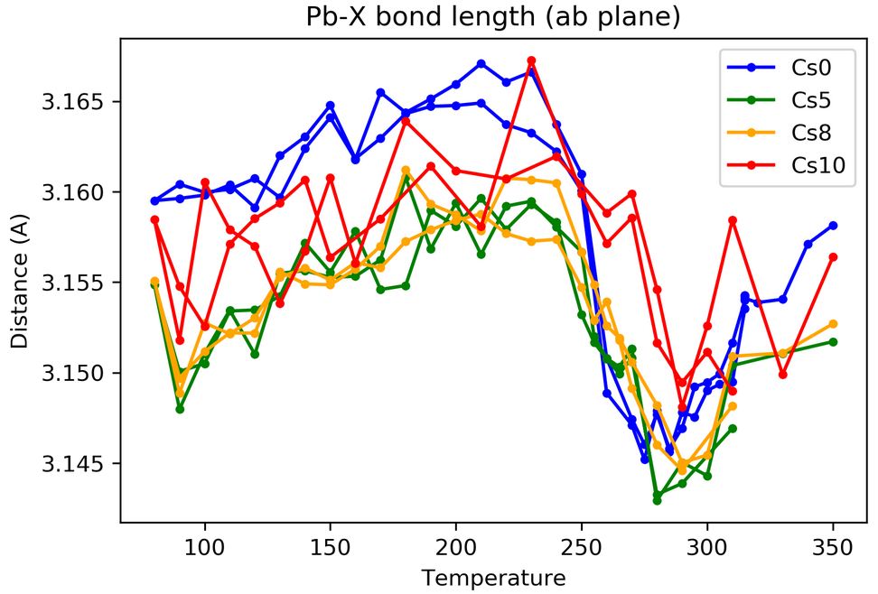
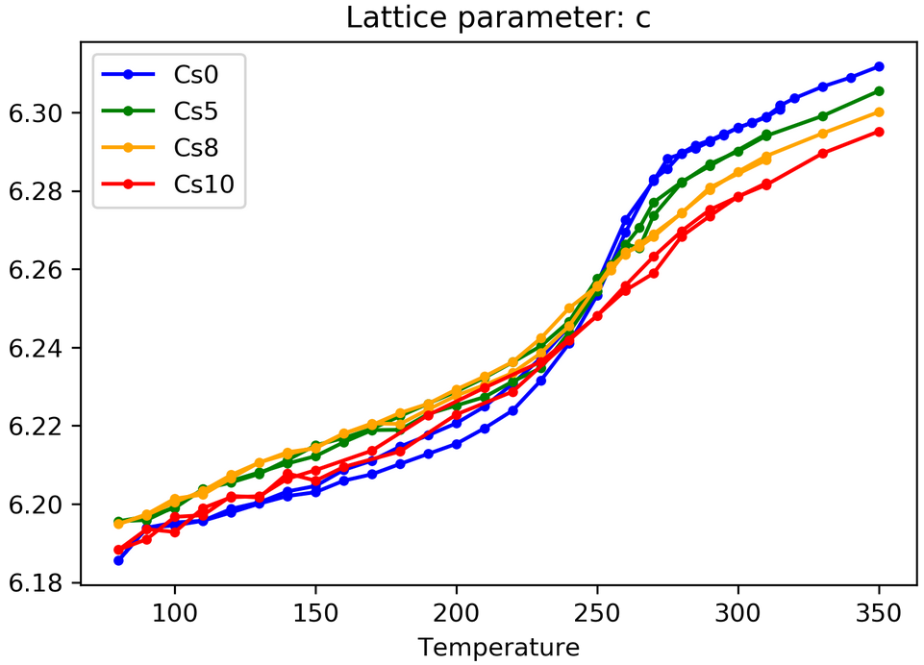
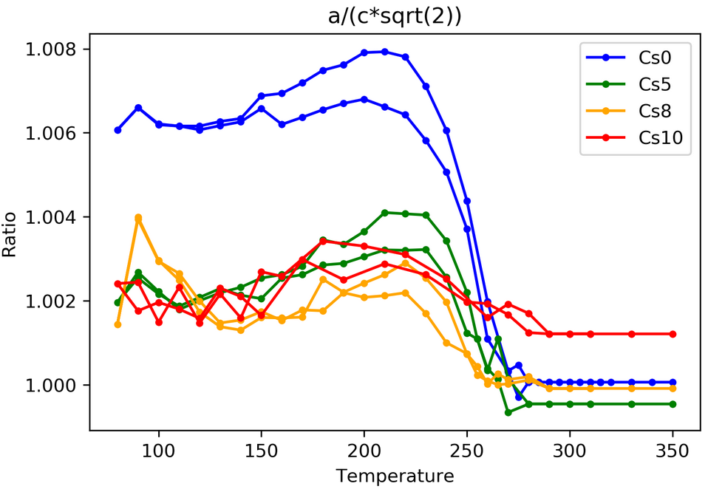
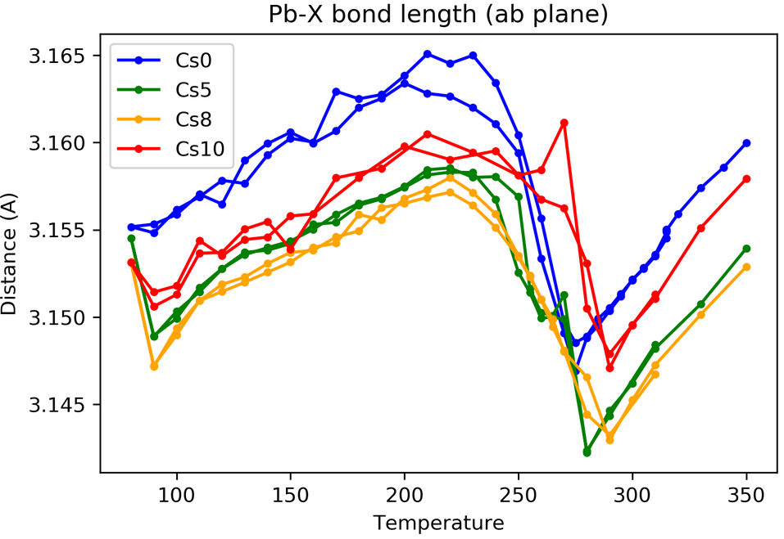
Adding Cs: Results
Top: Simple parametric
Bottom: More extensive parametric
Distance (A)
Length (A)
Ratio
Distance (A)
Length (A)
Ratio

Slide 20

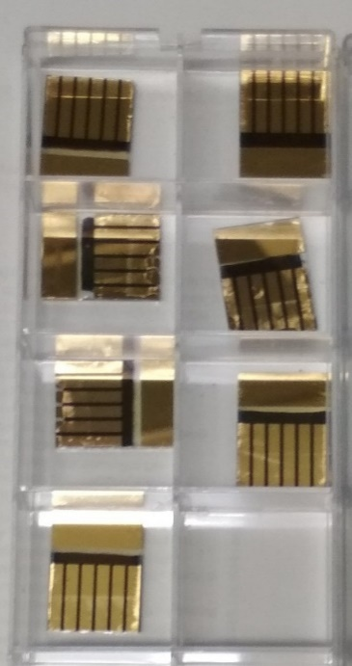
Next steps:
Stability and aging
  Literature has already shown the potential of a similar composition. This series may provide additional insights on the relation between Cs concentration and stability.

Slide 21









Acknowledgements
University of Sheffield
Craig Robertson
Tea room in physics building
Gate-house kitchen and fridge

Slide 22

Thank you
End of presentation
Any questions?

Slide 23
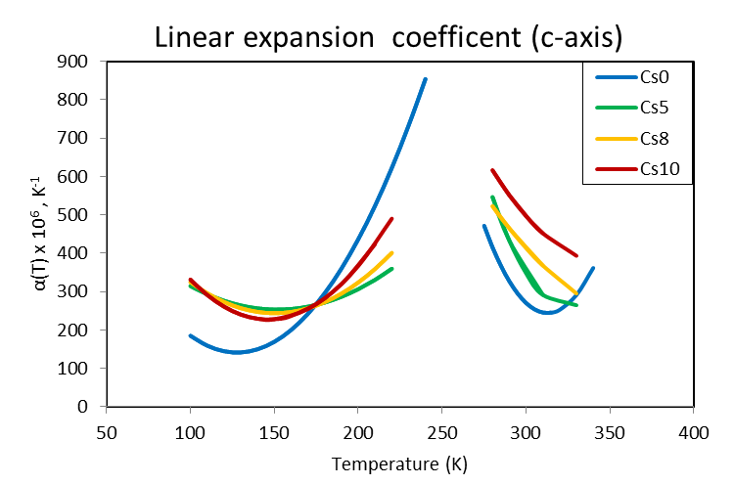
Adding Cs: Results
Length (A)
Notes:
Delamination?
Thermal expansion tuning

Slide 24
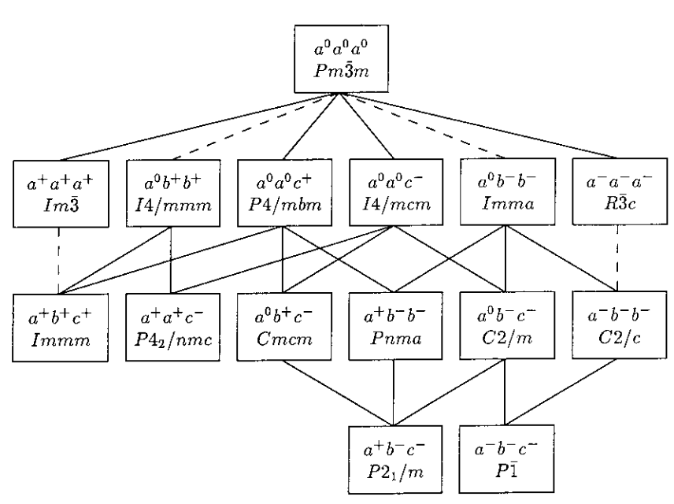
Perovskite structure
Stokes, Harold T., et al. "Group-theoretical analysis of octahedral tilting in ferroelectric perovskites." Acta Crystallographica Section B: Structural Science 58.6 (2002): 934-938.
Group-subgroup relationships.
A dashed line joining a group with its subgroup indicates the phase transition is required 1st order by Landau theory.

Slide 25
Perovskite structure
Glazer notation
a⁰a⁰a⁰
Glazer notation
a⁰a⁰c⁺
Weber, Oliver J., et al. Chemistry of Materials 30.11 (2018): 3768-3778.

Slide 26
