Slide 1
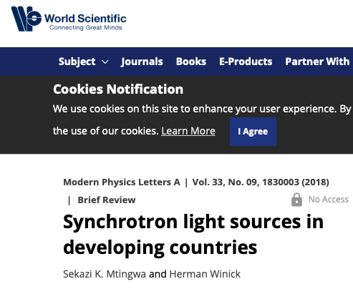
Johannesburg – Soccer World Cup 2010
Update on the AfLS
AfLS History : 2 decades → AfLS
AfLS Motivations
Roadmap – Stories
Perspectives
Upcoming
https://www.worldscientific.com/doi/abs/10.1142/S0217732318300033
http://lamp.ictp.it/index.php/aphysrev/article/view/1610/586

Slide 2
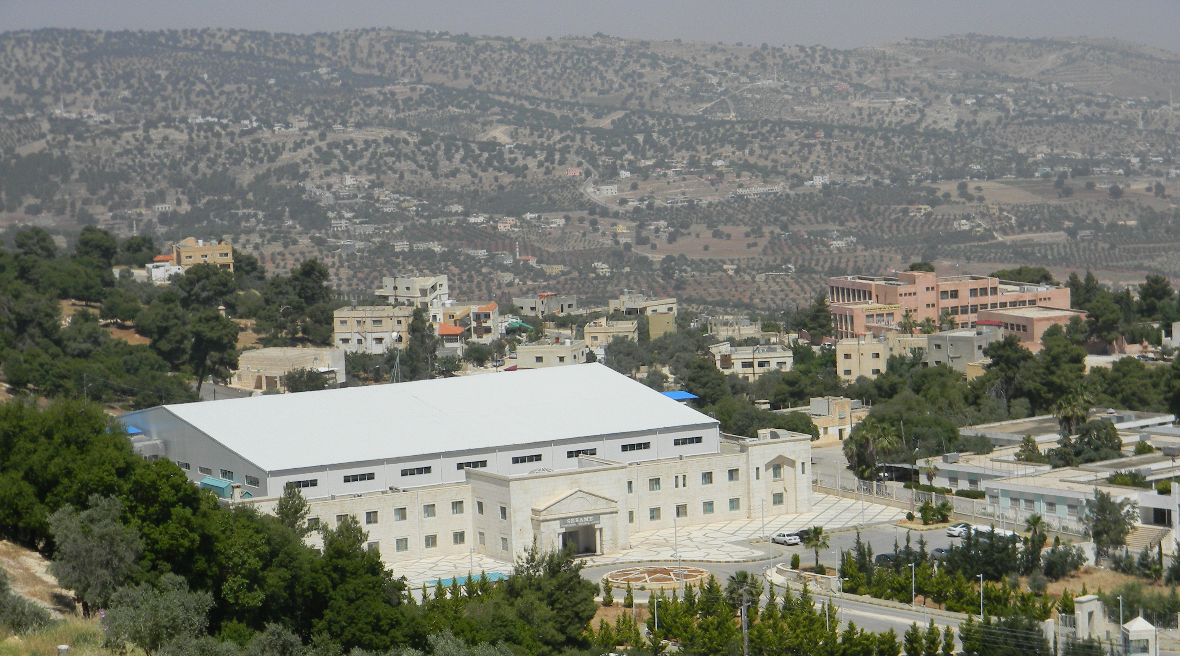
What is a synchrotron
Johannesburg – Soccer World Cup 2010
SESAME in the Middle East
Egypt is the first African country to have country-based membership of an international light source. It participates as a member of SESAME along with the Middle East countries of Cyprus, Iran, Israel, Jordan, Pakistan, the Palestine and Turkey

Slide 3
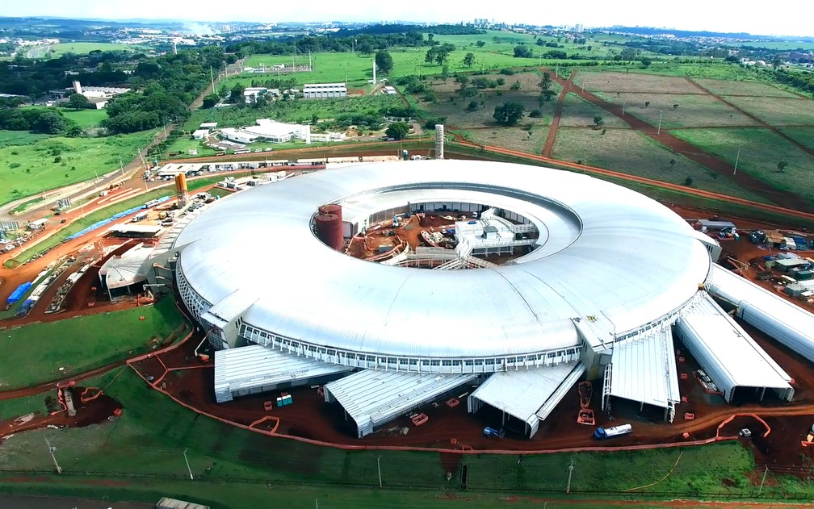
What is a synchrotron
Sirius in Brazil
90% local manufacture

Slide 4
The African Light Source
Project
Socio-economic benefits
Boost African Scientific Research, Research Capacity (Continent, regions, Institutes), Capacity Building - African Science Renaissance
Global Research Community
Tackling Diseases (Malaria, TB, Aids, Ebola ....)
Unique African Research Opportunities attracting international collaboration : Energy opportunities, African Environment, Cradle of Humankind, Cradle of Culture, Mineral beneficiation, Agriculture.
Mobility, Conferences, Schools, International Mentoring partnerships in student training, Regional Centres of Excellence, Local feeder instrumentation
Build Research capacity in Industry, competitive industry
Science for Peace (eg CERN, SESAME)
Return of the African Science Diaspora - new opportunities for young excellent scientists
For African countries to take control of their destinies and become major players in the international community

Slide 5
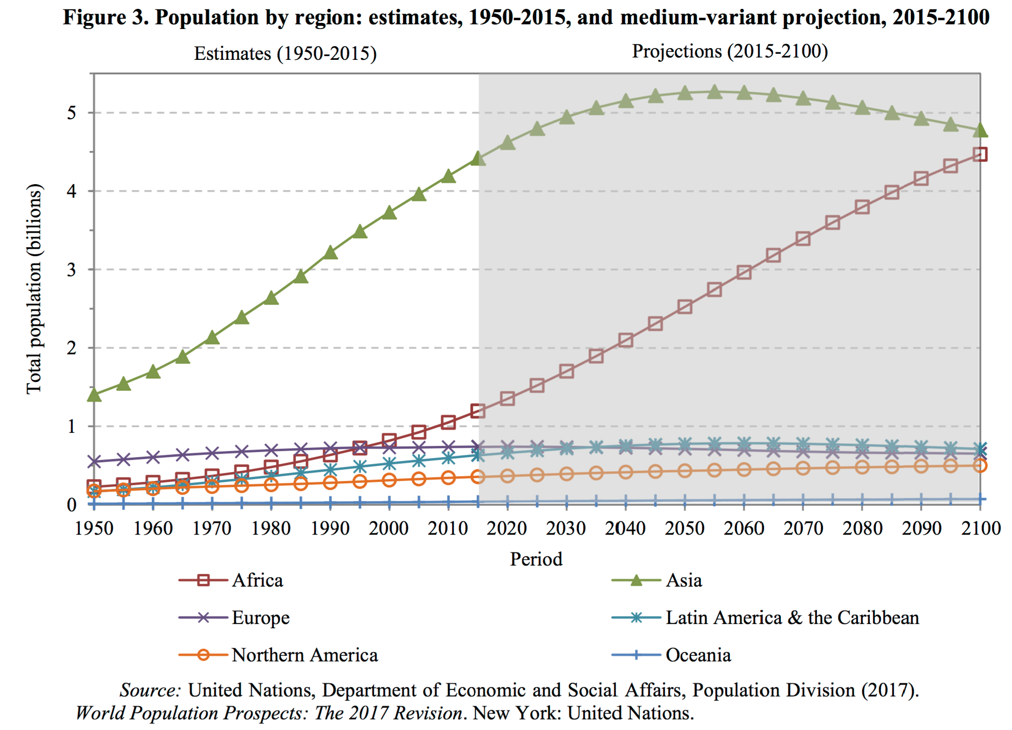
The African Light Source
Project
UN Report “World Population Prospects” (2017)
More than half of global population growth by 2050 will happen in Africa
This means a lot of young people, and points to an urgent need for human capacity building
Africa

Slide 6
The African Light Source
Project
Africa has 1.2 billion people
169 scientists per million people (UNESCO Science Report 2015)
Italy : 2600/million
Germany : 7600/million
Africa needs at least ……
1 000 000 scientists to get 1/6 of <1st world>

Slide 7
Example motivation based on Bio Science
Structural information helps to elucidate function, the mechanisms of enzymes → inspires the design of new drugs.
Africa should lead research of this nature → cures for diseases of particular relevance to Africa
Synchrotrons are extremely important facilities for the imaging of bio-molecules.
Development of 210 new drugs that depended on protein structural information [Westbrook et al. 2019].
Development of drugs for treating HIV-AIDS, [Wlodawer et al. 1998].
Listing of about drugs, their targets “Practical Fragments” Website [Prac. Frag 2018].
Development of new treatments for tuberculosis [Blundell 2017a ].
Interplay between academia and industry [Blundell 2017b].

Slide 8
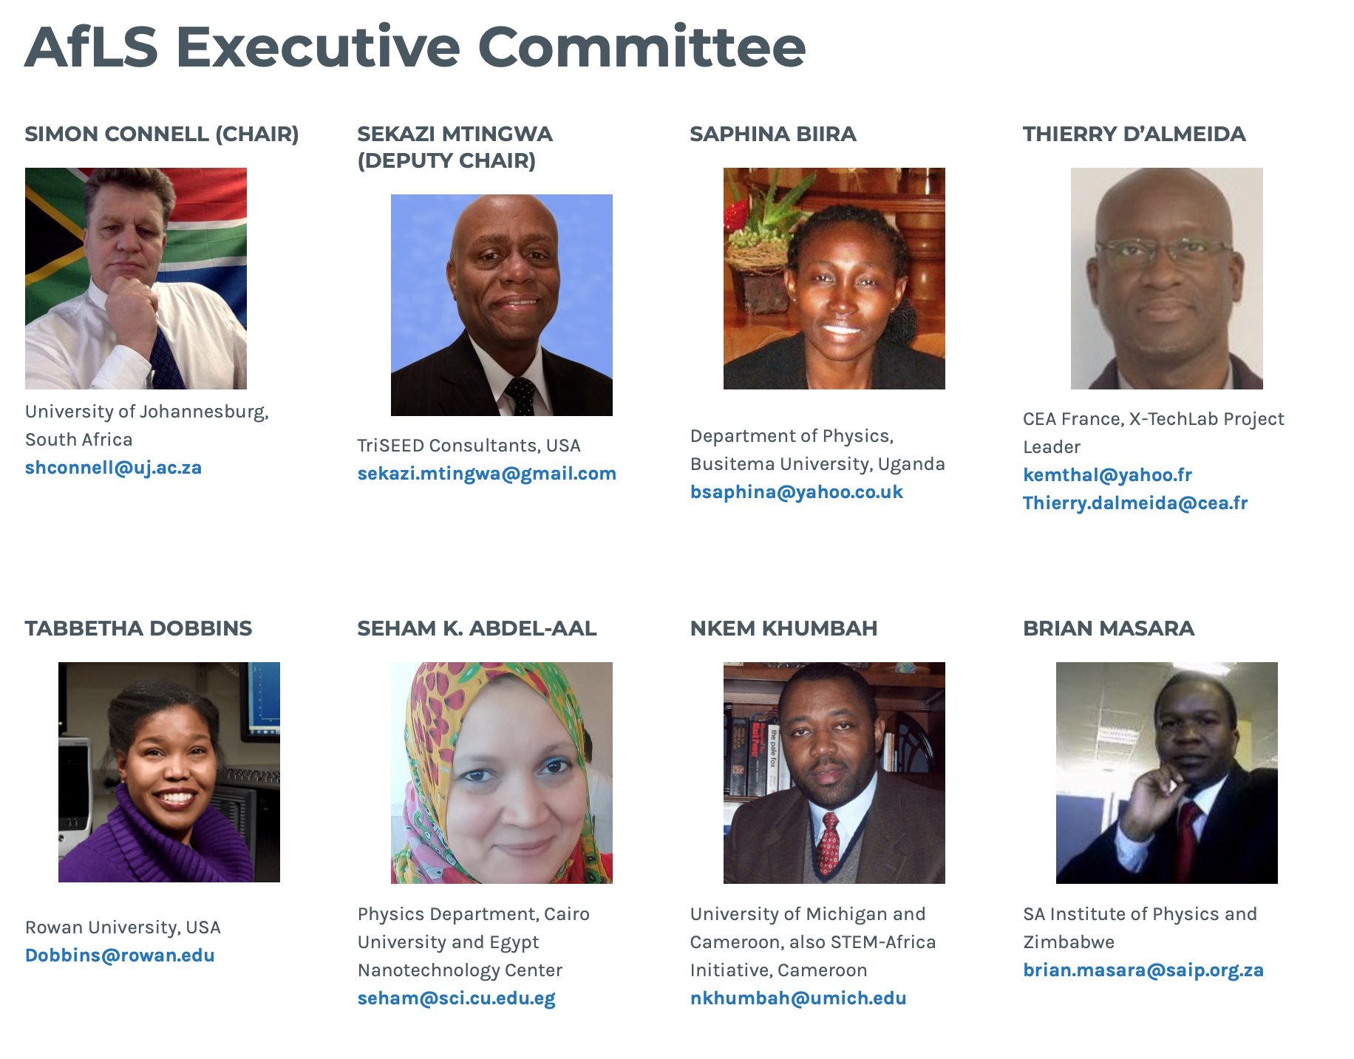
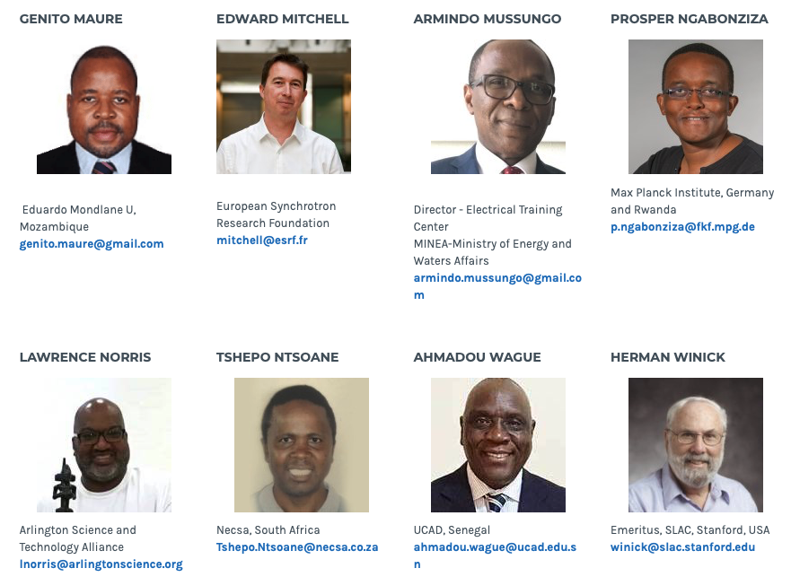
Visit us at : http://www.africanlightsource.org

Slide 9
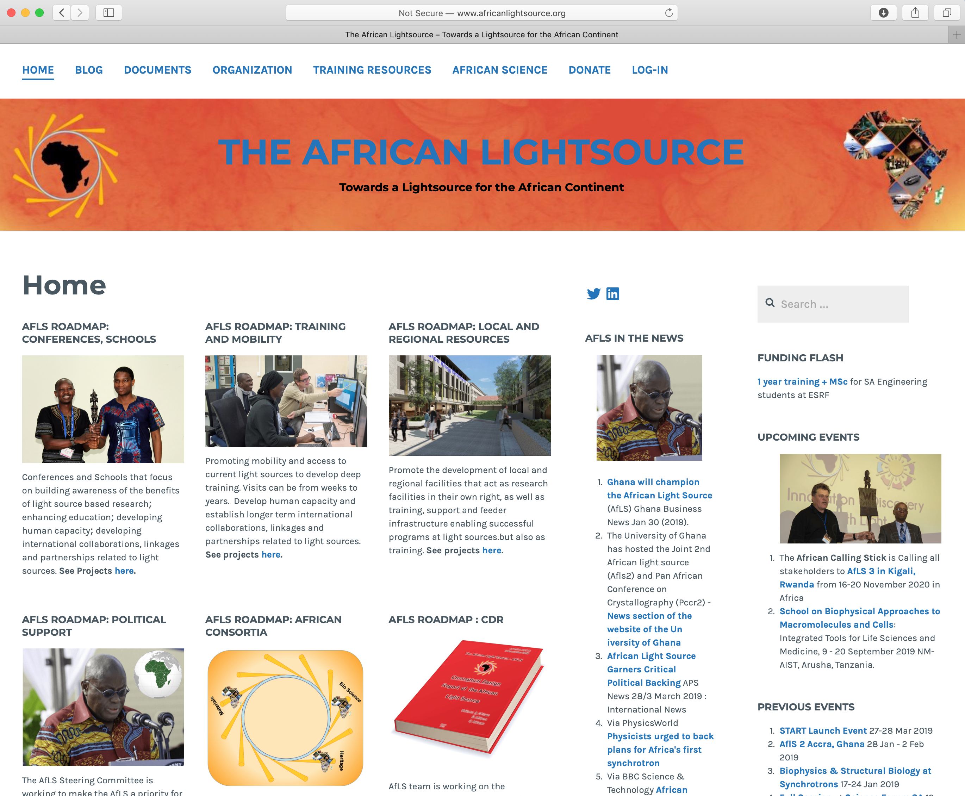
Visit us at : http://www.africanlightsource.org

Slide 10
AfLS
Legal Entity
Registered as a Trust
With a Constitution
Bank Account established
Receiving funds
Appointed Auditor
Access to staff (SAIP Exec Office)
Registration as a Public Benefit Organisation (PBO)
Special tax status
In progress

Slide 11
AfLS meeting : 2016 Conference - Concrete outcomes.
Grenoble Resolutions.
See http://events.saip.org.za/conferenceDisplay.py/getPic?picId=70&confId=61
Terms of Reference.
See http://events.saip.org.za/conferenceDisplay.py/getPic?picId=67&confId=61
Roadmap summary.
See http://events.saip.org.za/conferenceDisplay.py/getPic?picId=66&confId=61
Steering Committee to drive this roadmap forward.
fully mandated
globally elected
See https://docs.google.com/spreadsheets/d/1NlULgrE7Bu9t2aeiKIYd3zgFALoLbksfEFTqNC8p0q0/edit#gid=0

Slide 12
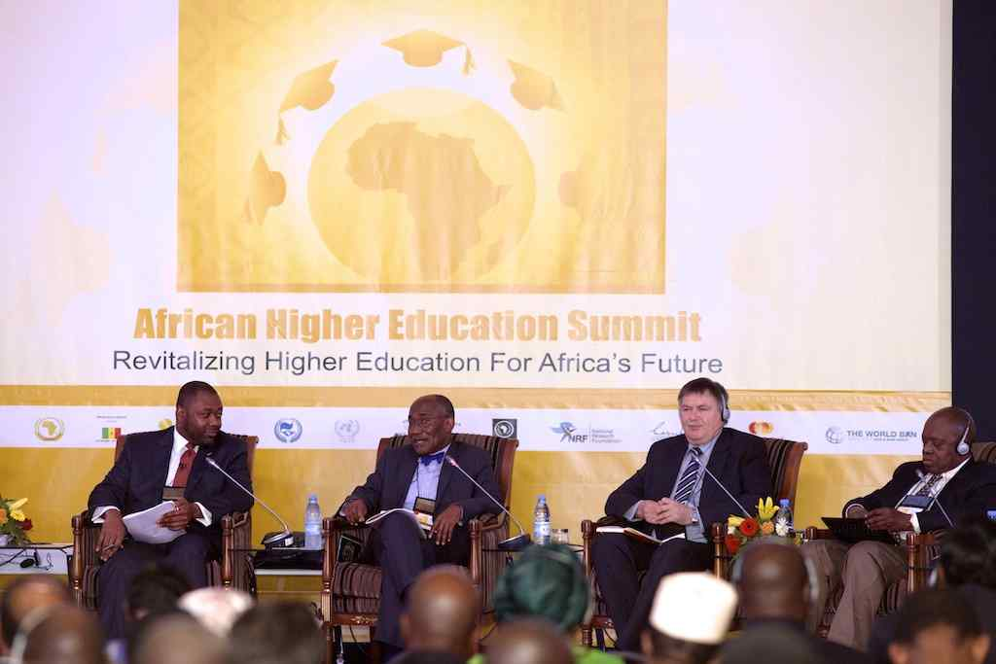
The African Light Source
Project
Declaration and Action Plan
1st African Higher Education Summit on Revitalizing Higher Education for Africa’s Future,
10-12 March 2015, Dakar, Senegal.
Article 5.3.2 p 22 : Recommends establishing a Synchrotron as a centralized African scientific facility.
Co written by
Dr Nkem Khumbah,
STEM-Africa Initiative

Slide 13
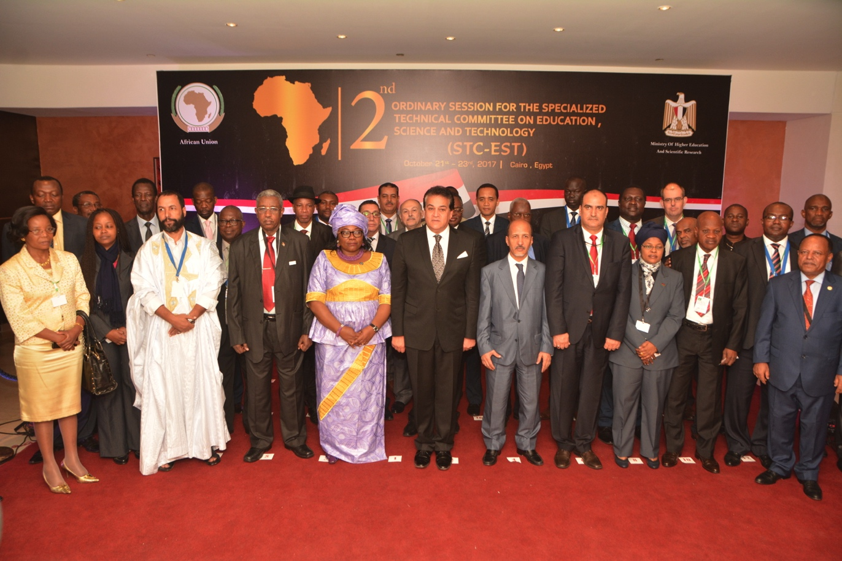
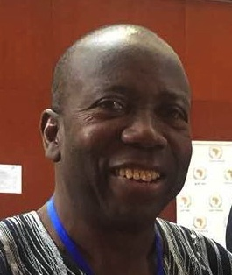
The African Light Source
Project
Specialized Technical Committee on Education, Science and Technology
Africa Union : STC-EST
20 October 2017 Egypt
H.E. Prof. Sarah Anyang Agbor
AU Commissioner for Human Resources, Science and Technology.
African Academy of Science
President Prof. Felix Dapare Dakora
Presentation on African Light Source

Slide 14
AfLS at the AU : Jan 2018
DECISION ON THE REPORTS OF THE
SPECIALISED TECHNICAL COMMITTEES (STCs)
The Executive Council,
C. STC ON EDUCATION, SCIENCE AND TECHNOLOGY
CALLS UPON Member States to support the Pan-African Synchrotron Initiative;

Slide 15
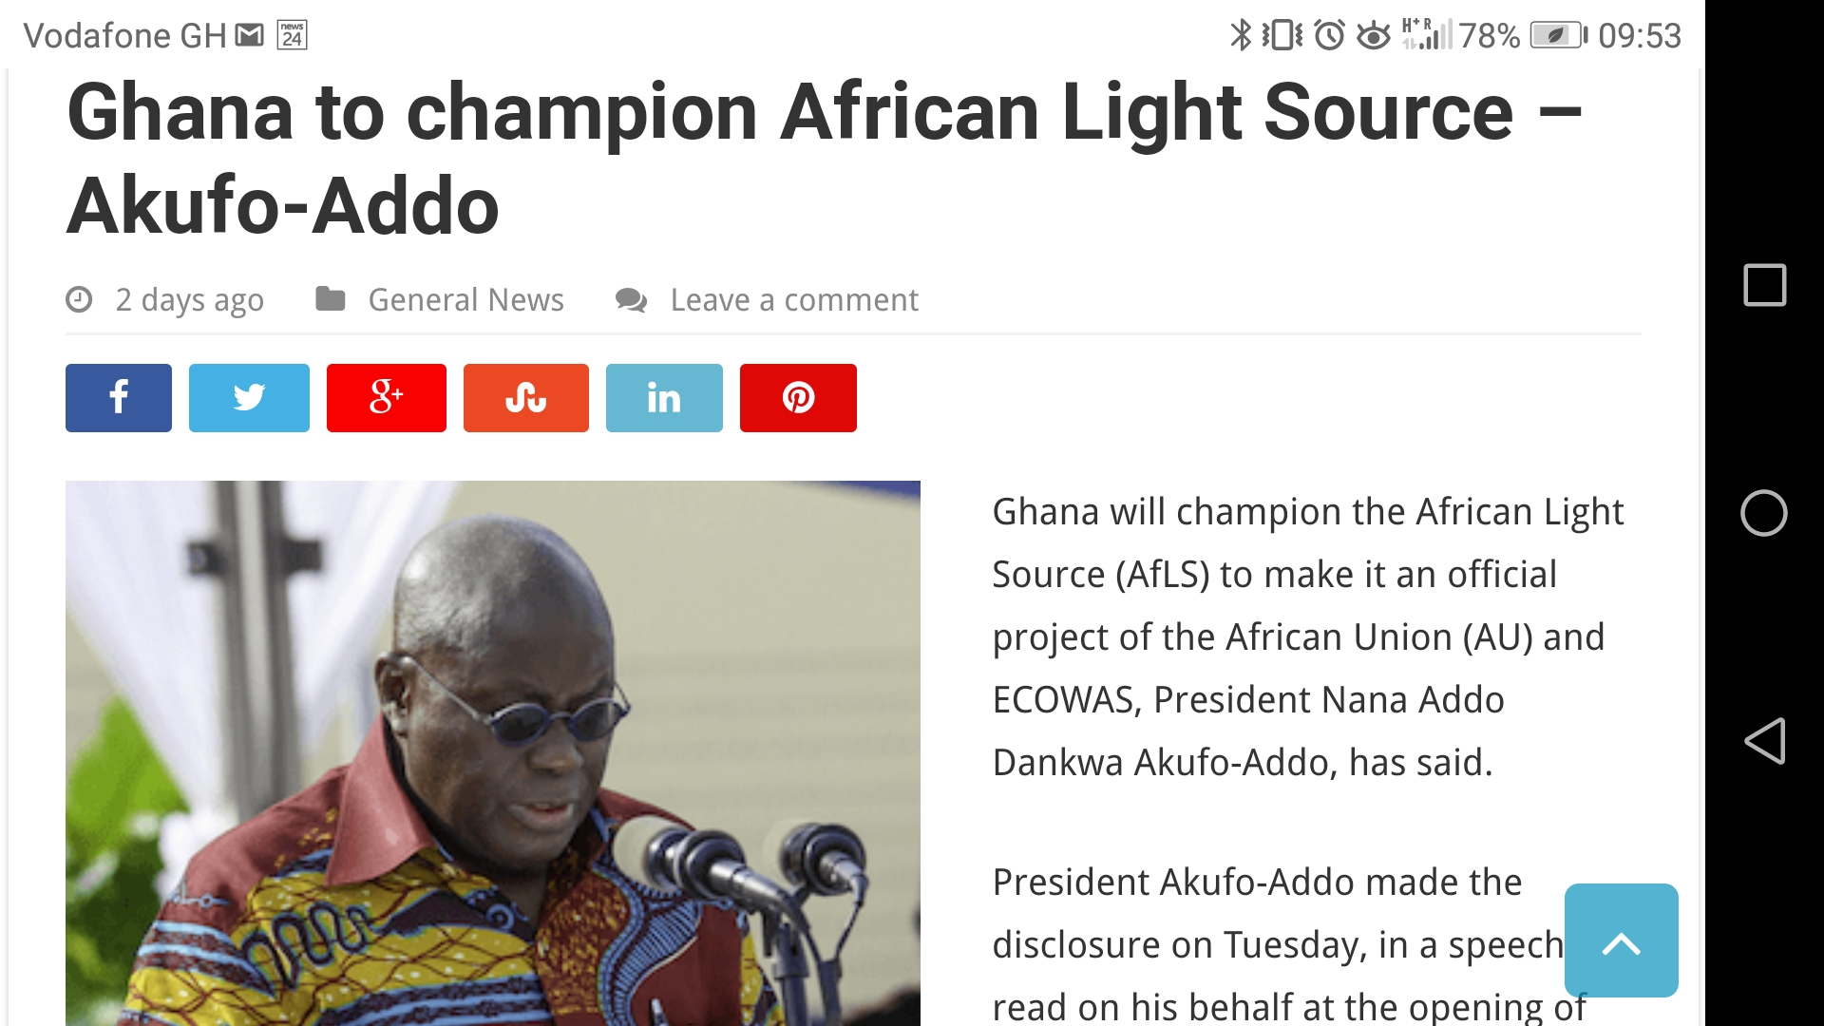

Slide 16
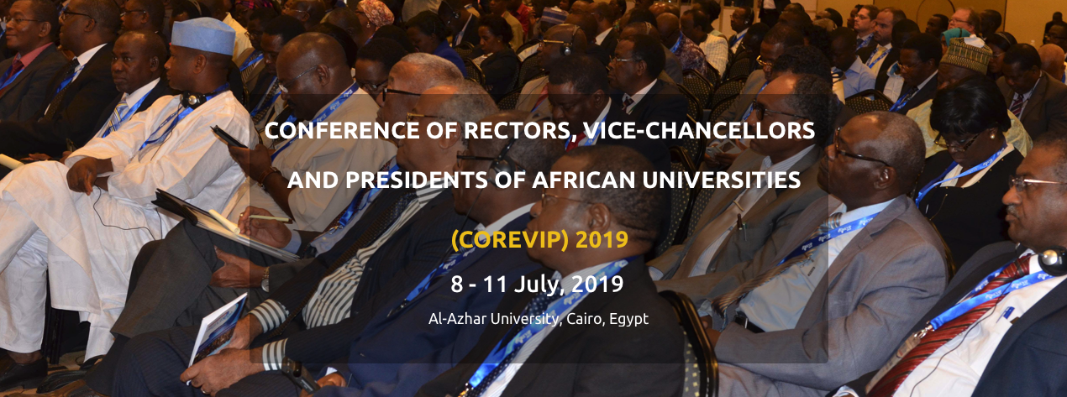
The African Light Source
Project
Recent AfLS Events
AfLS : Plenary Session at COREVIP 2019
The AfLS was endorsed in a Conference Resolution
Proceeding to develop MoU for Formal Collaboration

Slide 17
The African Light Source
Project
AfLS and LS world wide
Long history of association of many synchrotrons with AfLS
ESRF, SESAME, Elettra, Alba, SOLEIL, Diamond, Sirius and UVX, DESY, LNLS, CHESS, SLAC, SPRING8, Taiwan, ALS, CANDLE, APS, …. (others too, and no particular order)
AfLS encourages connections that enhance its vision to all.
Driven by :
Bottom up (scientists, collaborations, training, history ….)
Top Down (strategy and policy

Slide 18
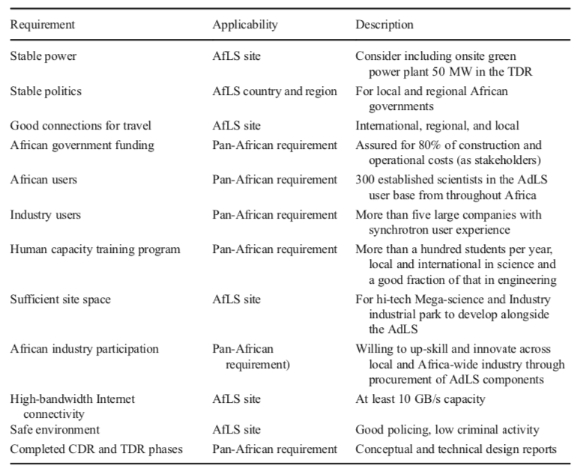
The African Light Source
Project
CDR for AfLS
The AfLS should be seen in the context of
Pan Africanism
Science as a Global Endeavour
Science for Development
Science for Innovation
Innovation for Wealth Generation
Decolonisation of Africa
Massive training
Africa must sustain costs ($1Bn + $2BN over 20 years)
Competitive machine (no pass-offs)

Slide 19
28/52 > 50%
PhD / Paper / Programme

Slide 20
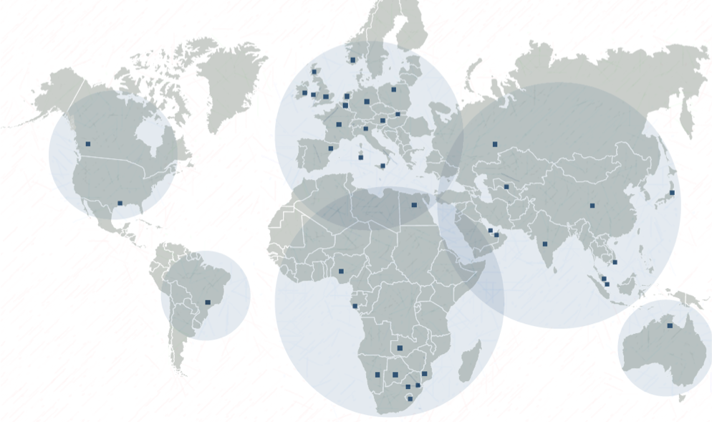
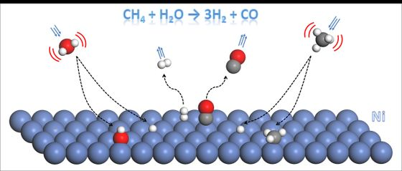
The African Light Source
Project
Example of African Industry :
SASOL investment in R&D and HC
SASOL capacity, achievements in catalysis studies – local and at light sources
20
from Dr E du Plessis at AfLS2015

Slide 21
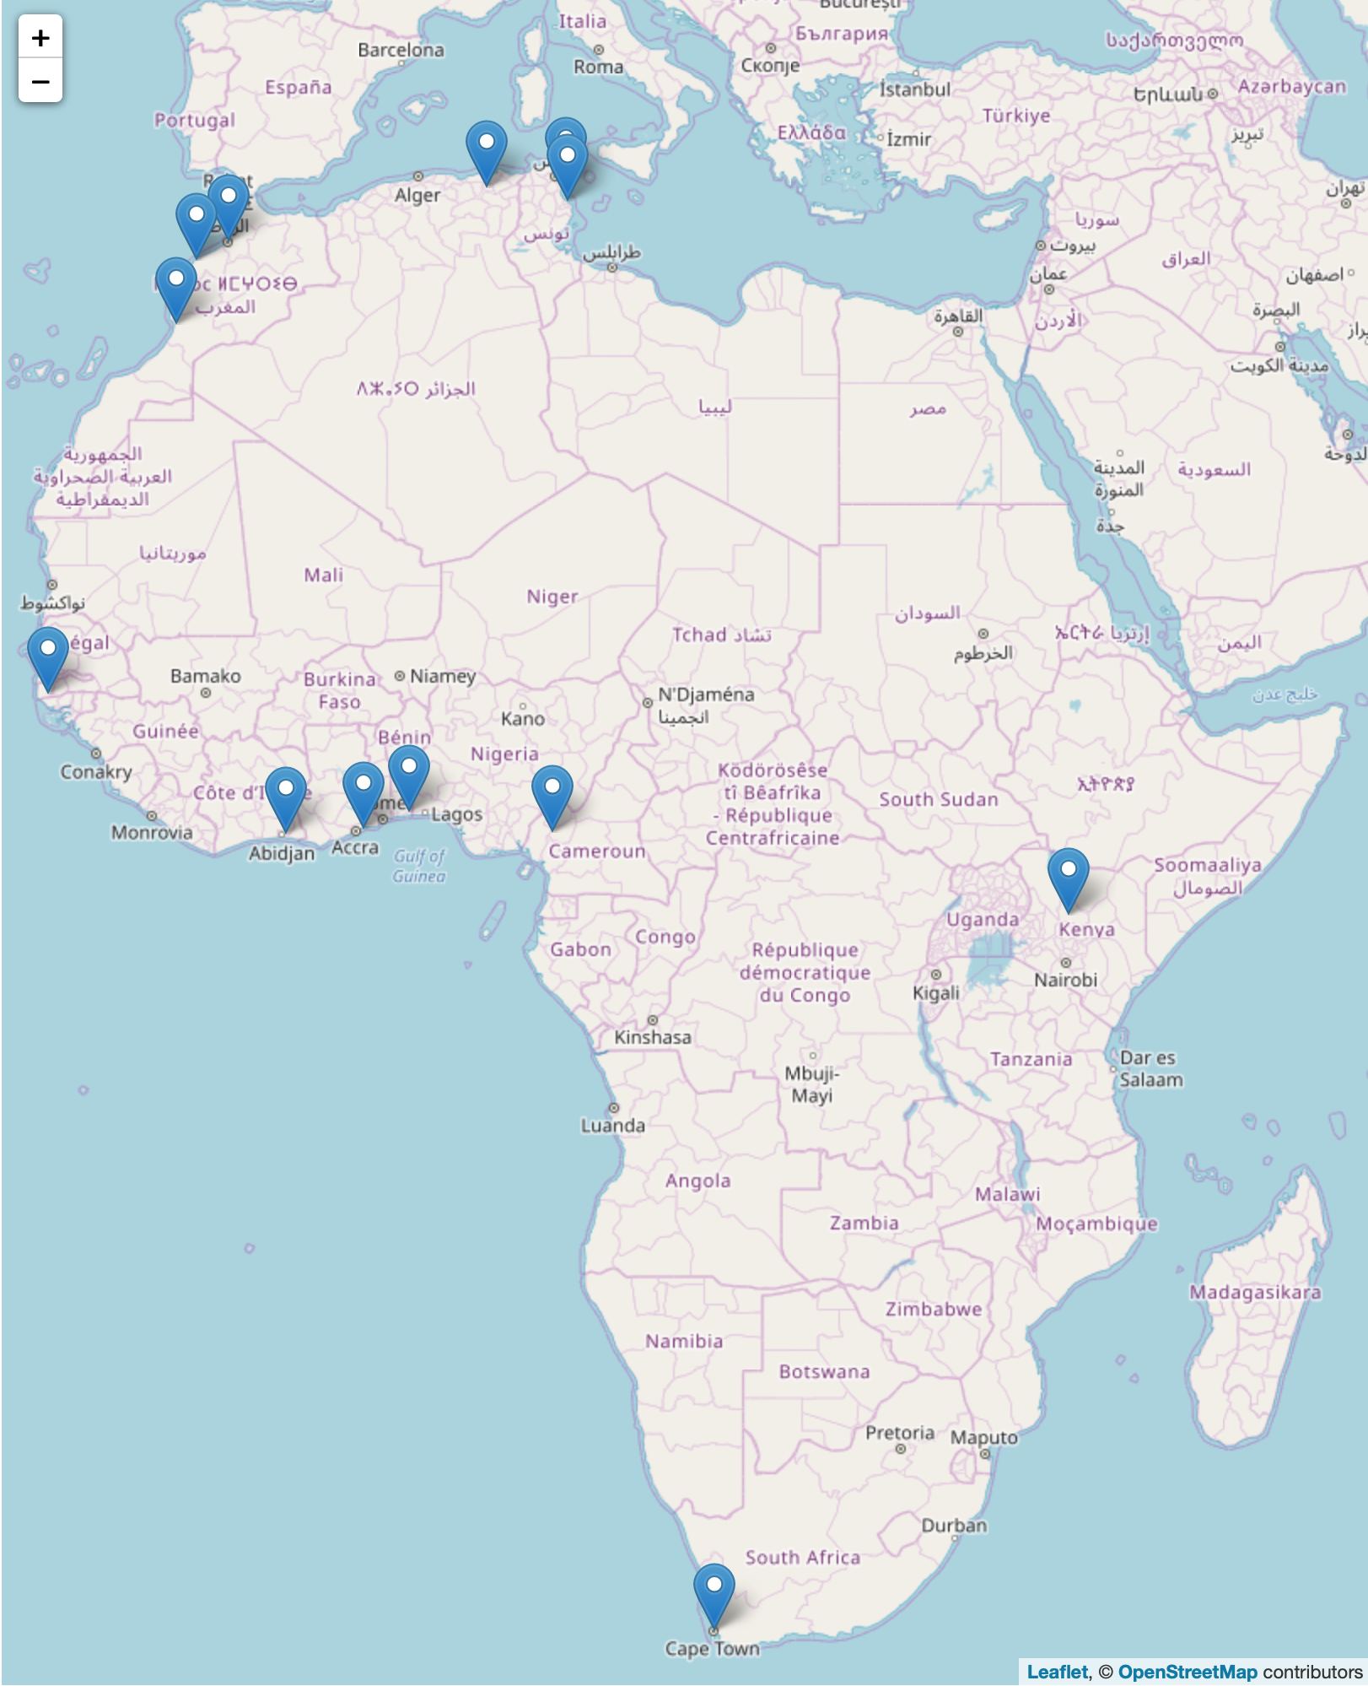
The African Light Source
Project
Feeder Facilities
South Africa
Aaron Klug Centre, UCT, link, U Witwatersrand, U Free State, U Stellenbosch, iThemba
Benin, X-TechLab, Benin, link
Ghana, U Ghana, link
Côte d'Ivoire, LaCPM, Universite Felix Houphouet Boigny, Abidjan, link
Senegal, Ziguinchor, link
Cameroon, Dschang, link
Kenya, Kenyatta University, link
Tunisia
Monastir, link, Nabuel, Tunisia, link
Algeria, Constantine 1, link
Morocco
U Rabat,, link, El Jadida, Morocco, link , Agidir, Morocco, link
Significant facilities
IUCr OpenLab venues with facilities

Slide 22
The African Light Source
Project
Bio-Science Capacity in Africa
Example of a local facility growing into a regional facility

Slide 23
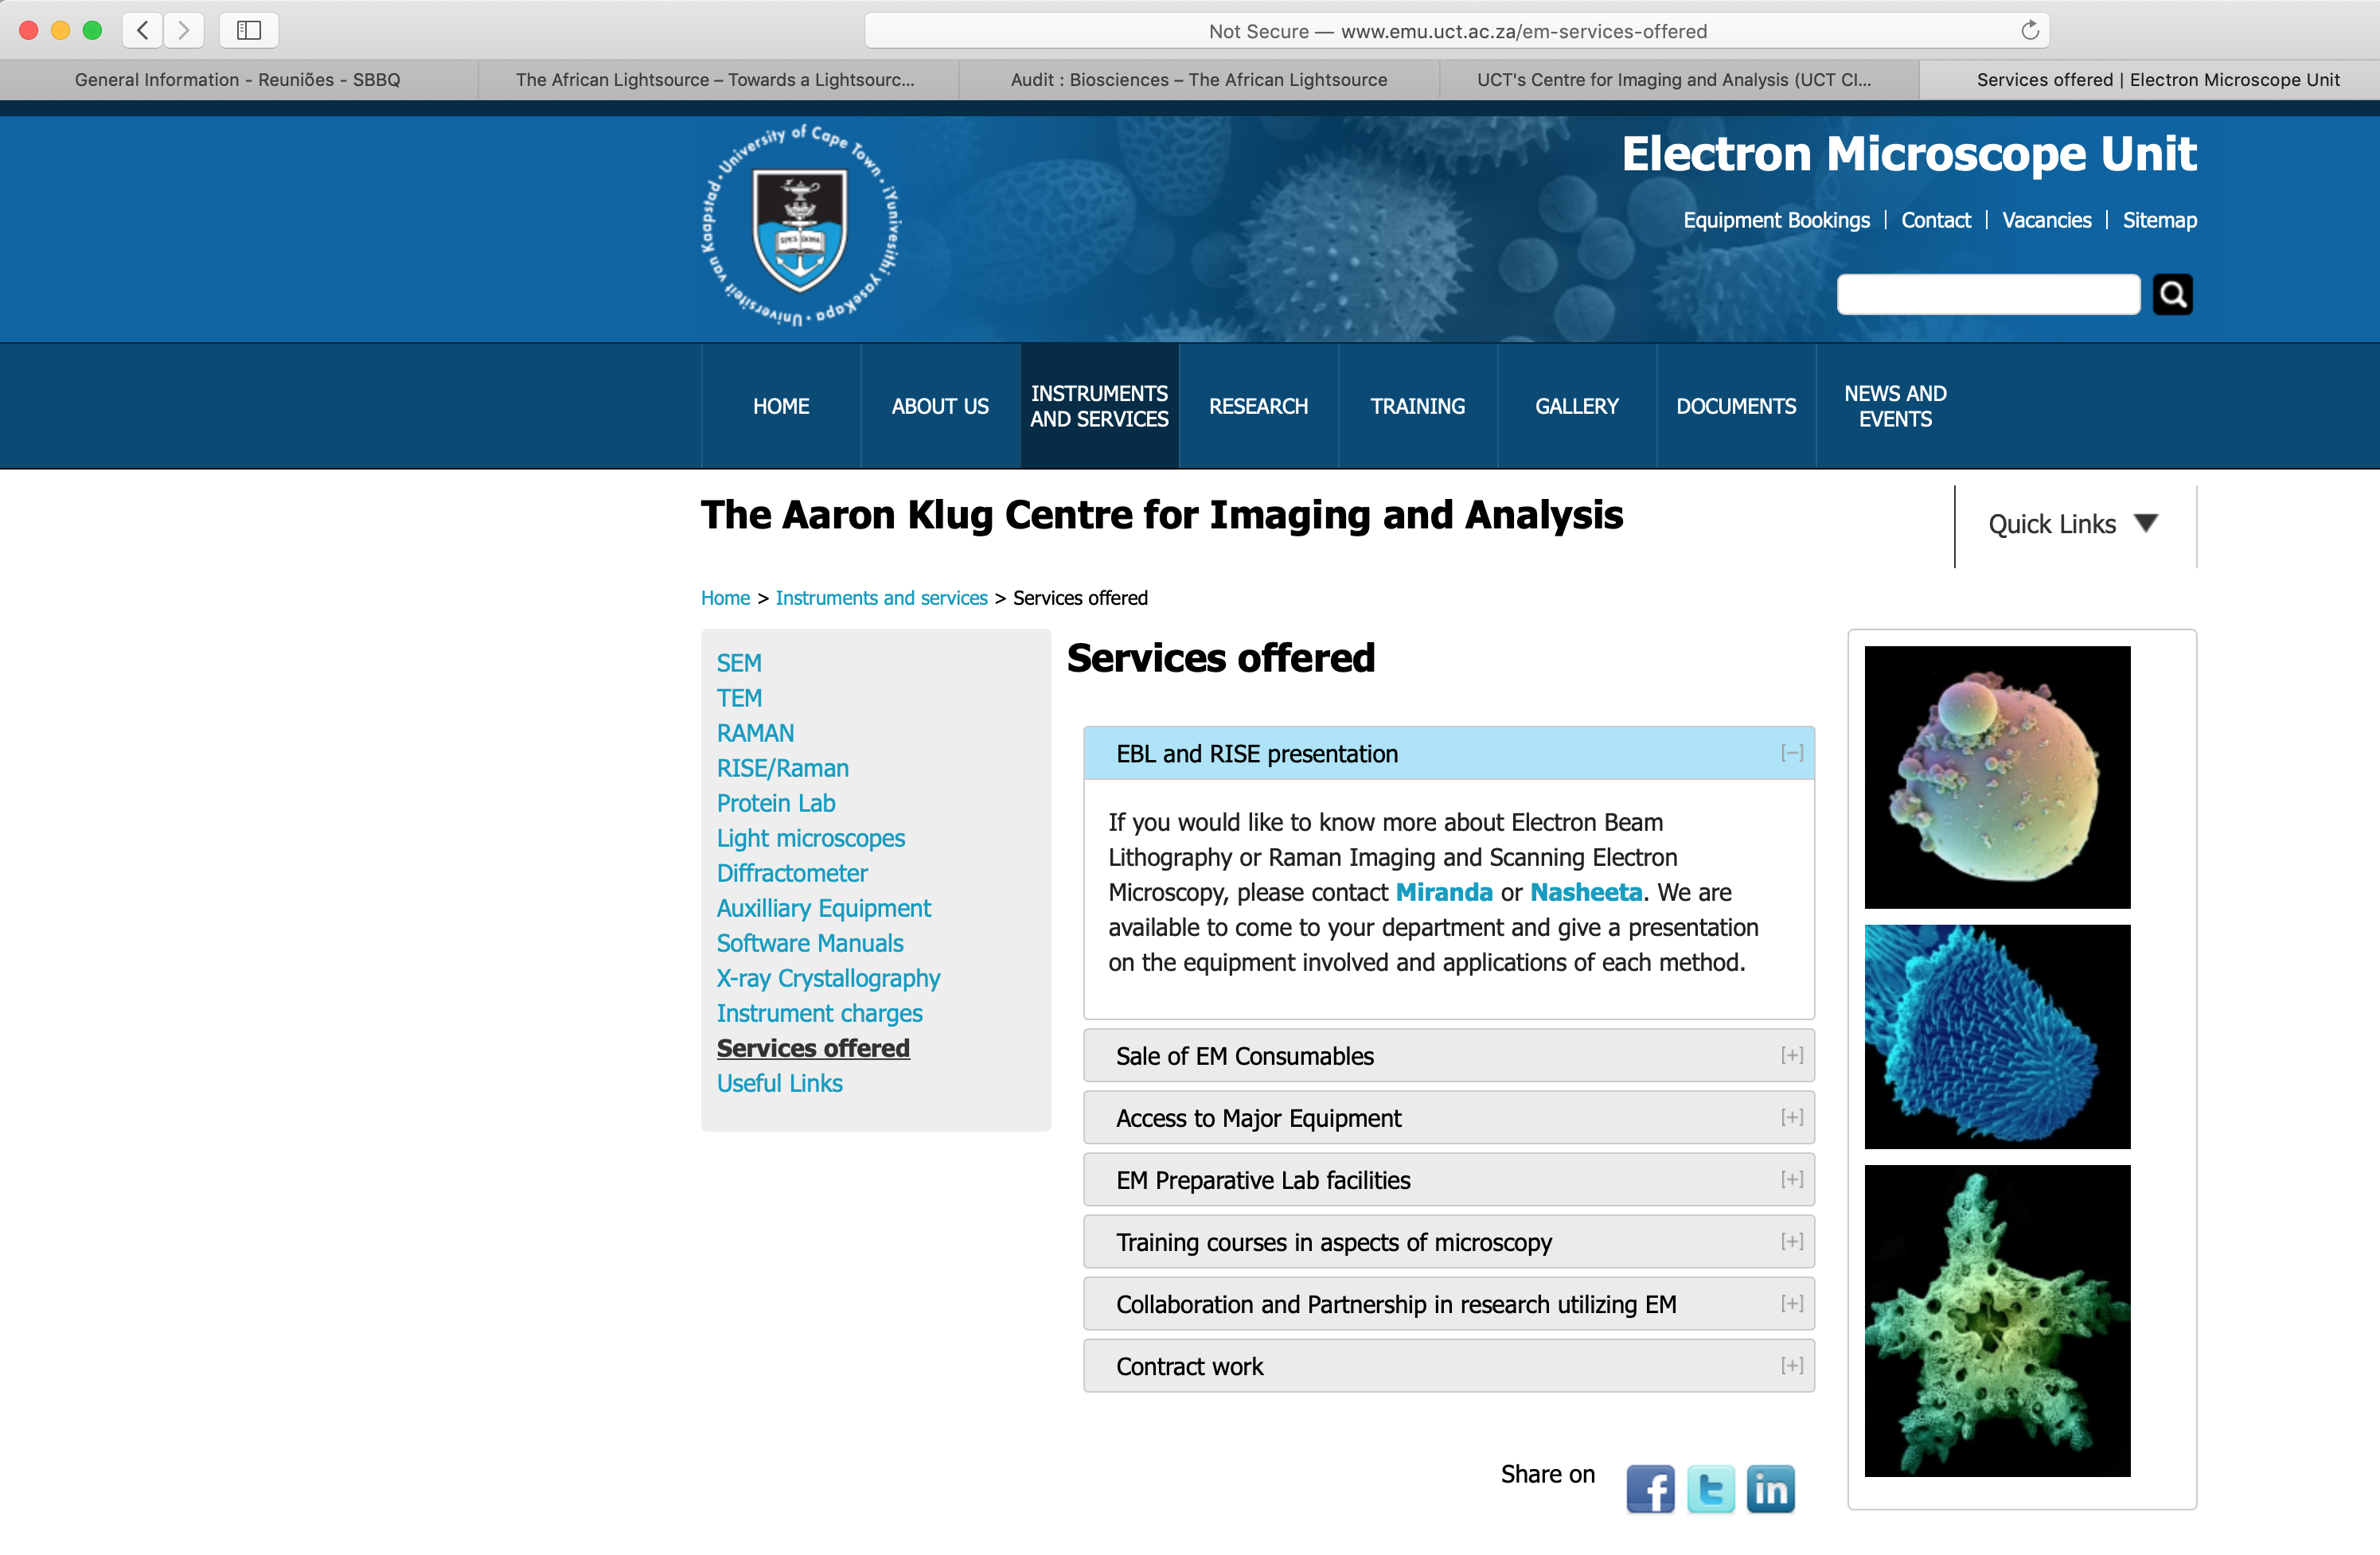
The African Light Source
Project
Bio-Science Capacity in Africa
Example of a local facility growing into a regional facility

Slide 25
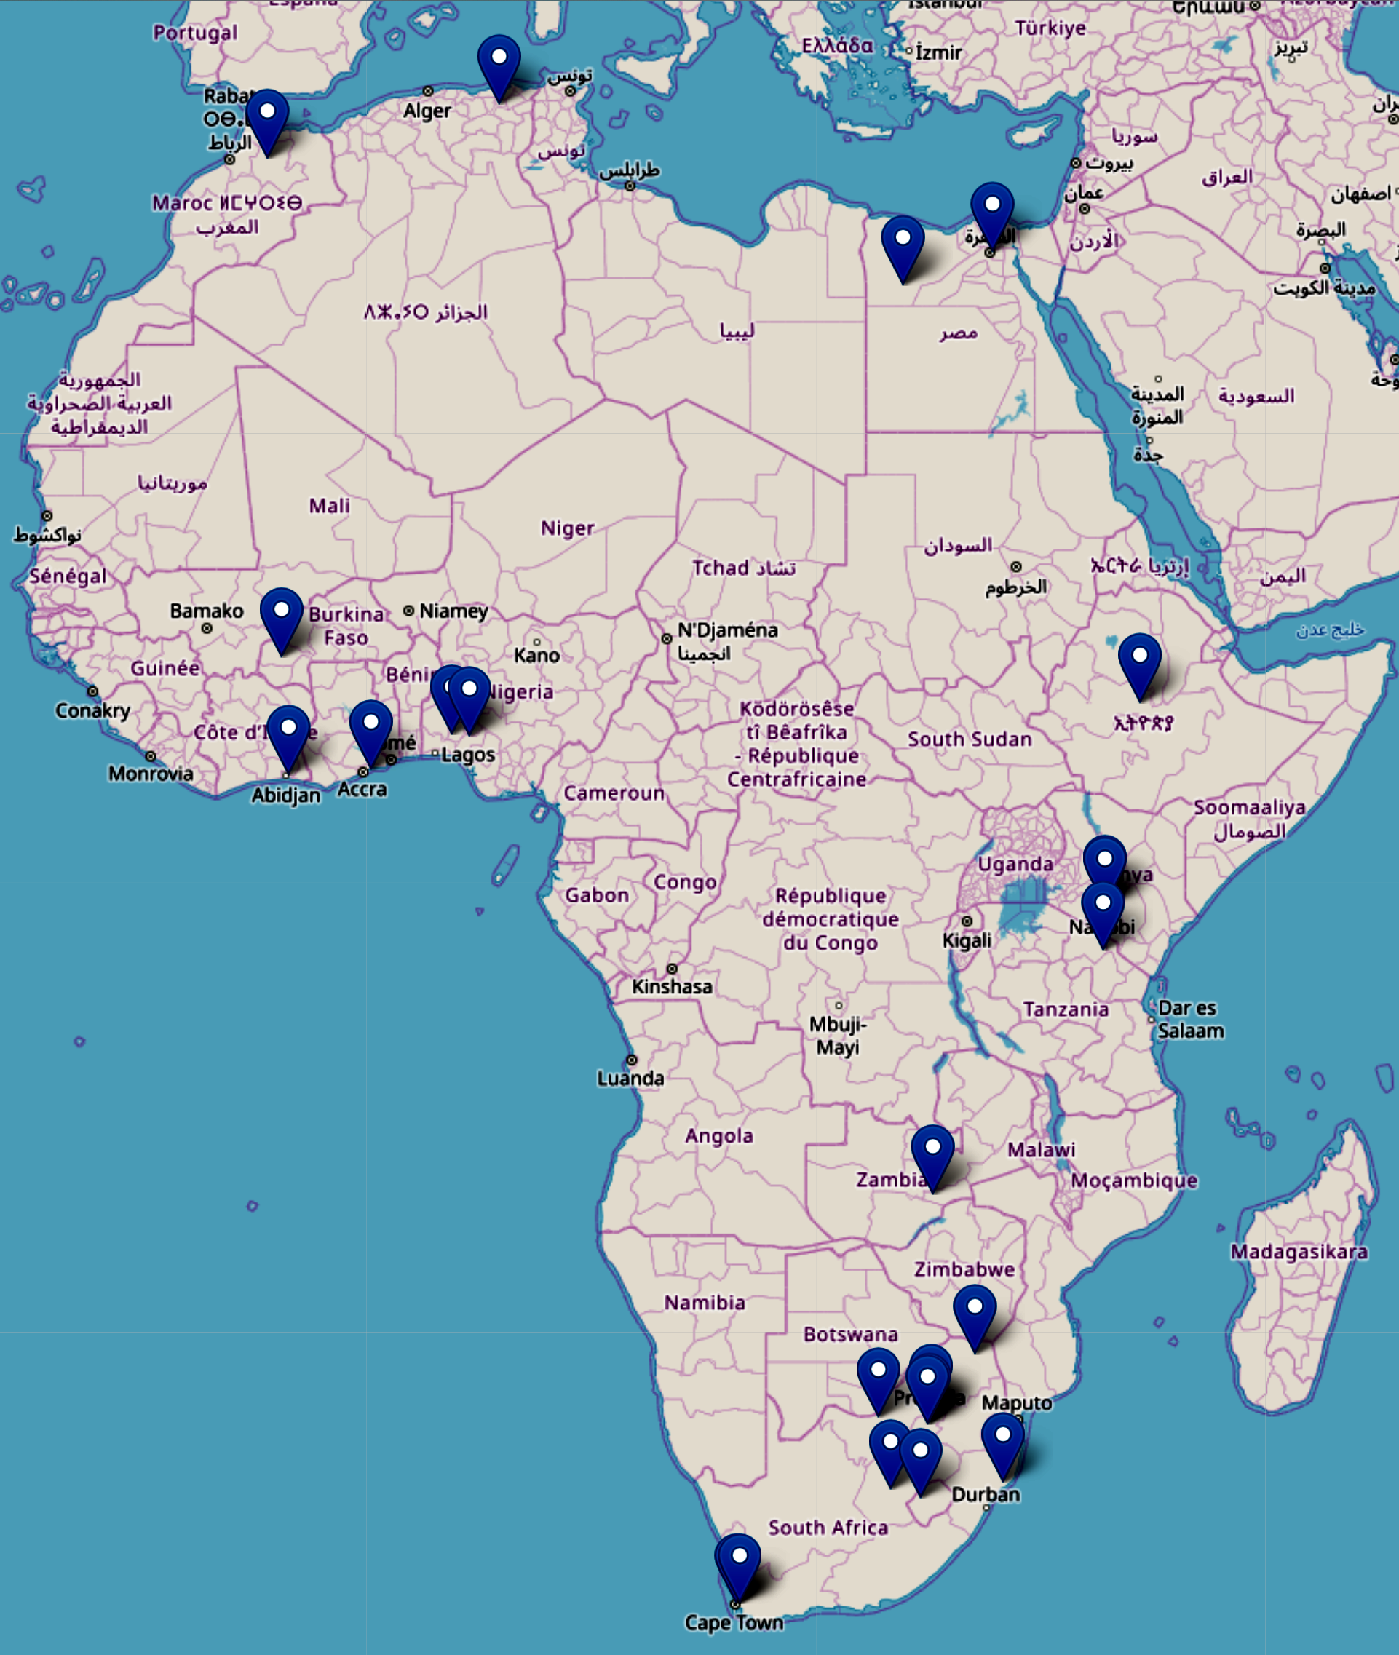
The African Light Source
Project
Bio-Science Capacity in Africa
Ghana
University of Ghana
Zambia
The University of Zambia
Algeria
Ecole Nationale Polytechnique de Constantine
Nigeria
Federal University of Technology, Akure
University Ile-Ife
Burkina Faso
Institute of Research in Health Sciences, Burkina Faso
Morocco
University Sidi Mohamed Ben Abdellah
Ivory Coast
Universite Felix Houphouet Boigny
Egypt
Helwan University, Ain Shams University
Lesotho
National University of Lesotho
Ethiopia
Addis Ababa University

Slide 26
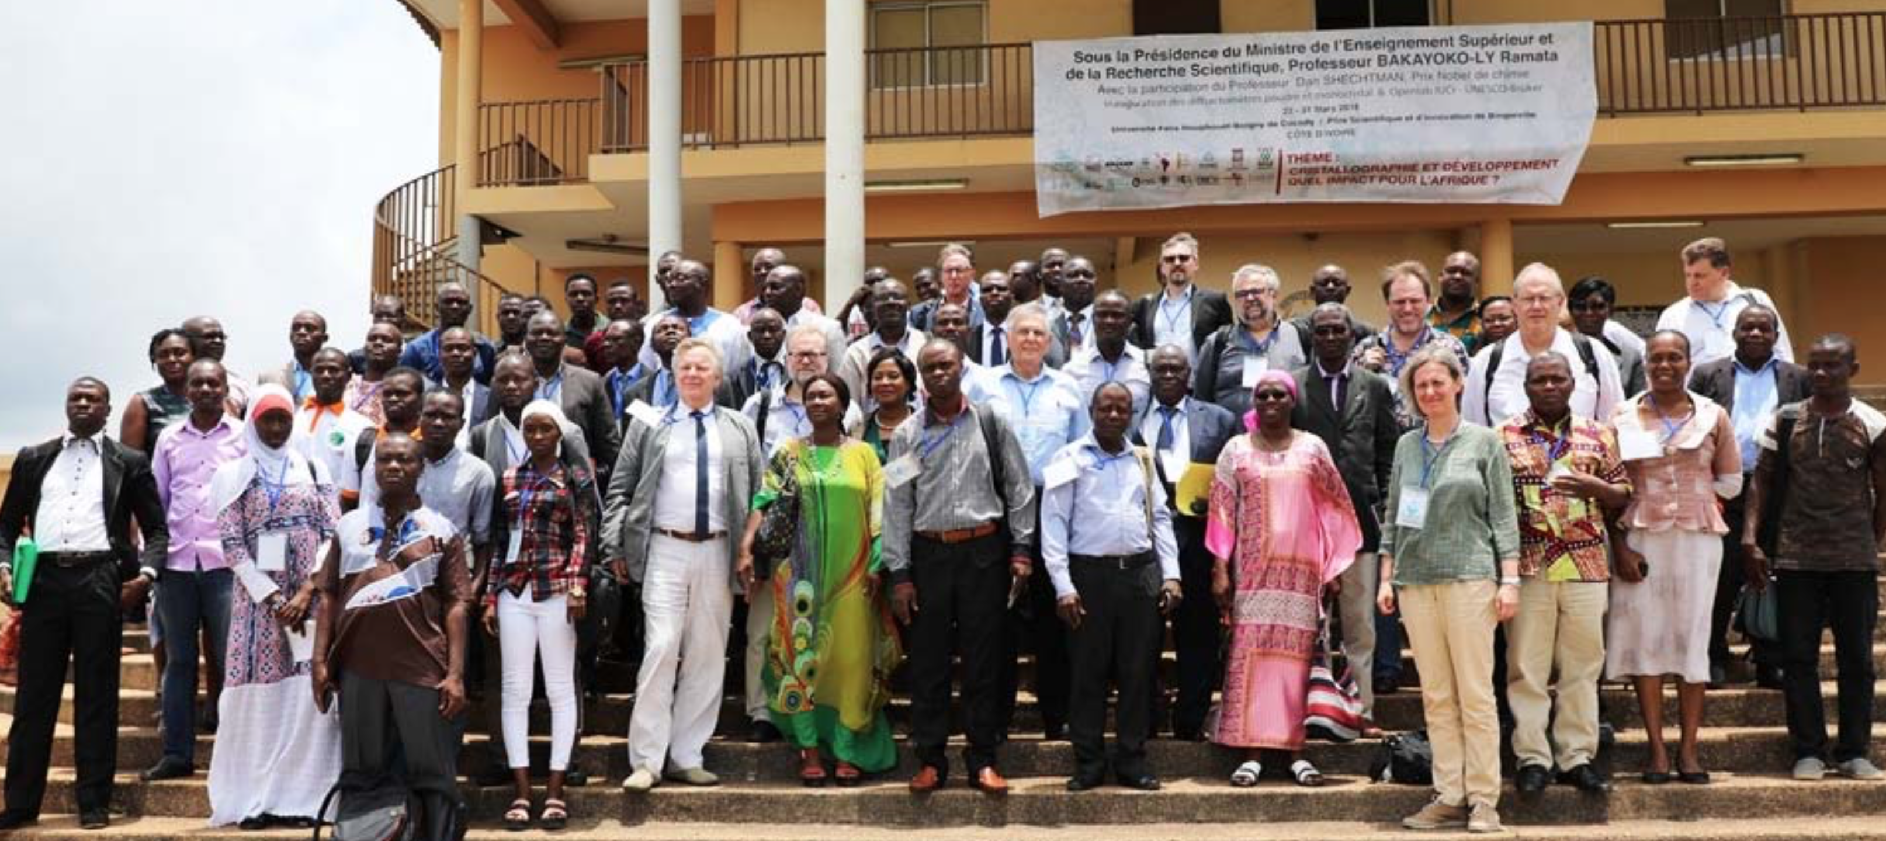
The African Light Source
Project
Capacity in Africa
Several significant training interventions

Slide 27
The African Light Source
Project
Bio-Science Capacity in Africa

Slide 28
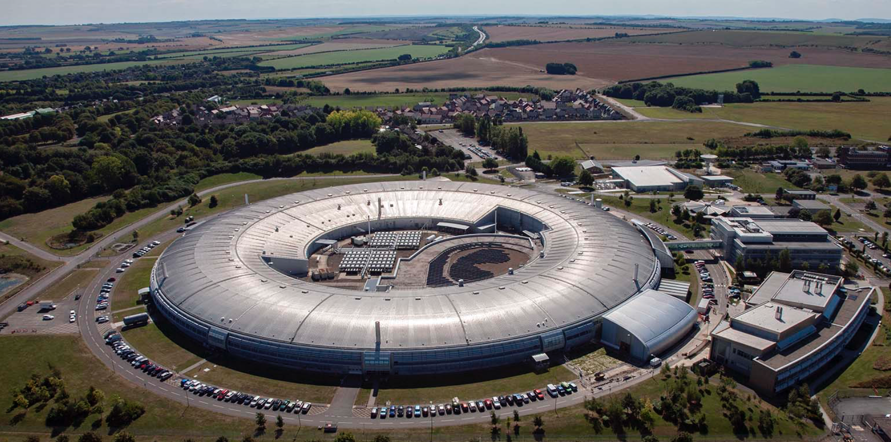
The African Light Source
Project
Capacity in Africa
START is a collaborative project that seeks to foster the development of Synchrotron Techniques for African Research and Technology.
Two lines of scientific investigation:
New energy materials (eg solar cells, novel catalysts)
Structural biology studying diseases and develop drug targets.
Jump-start Africa’s entry into synchrotron based bioscience.
SA, Lesotho, Ethiopia participation so far ……

Slide 29
The African Light Source
Project
Capacity in Africa

Slide 30
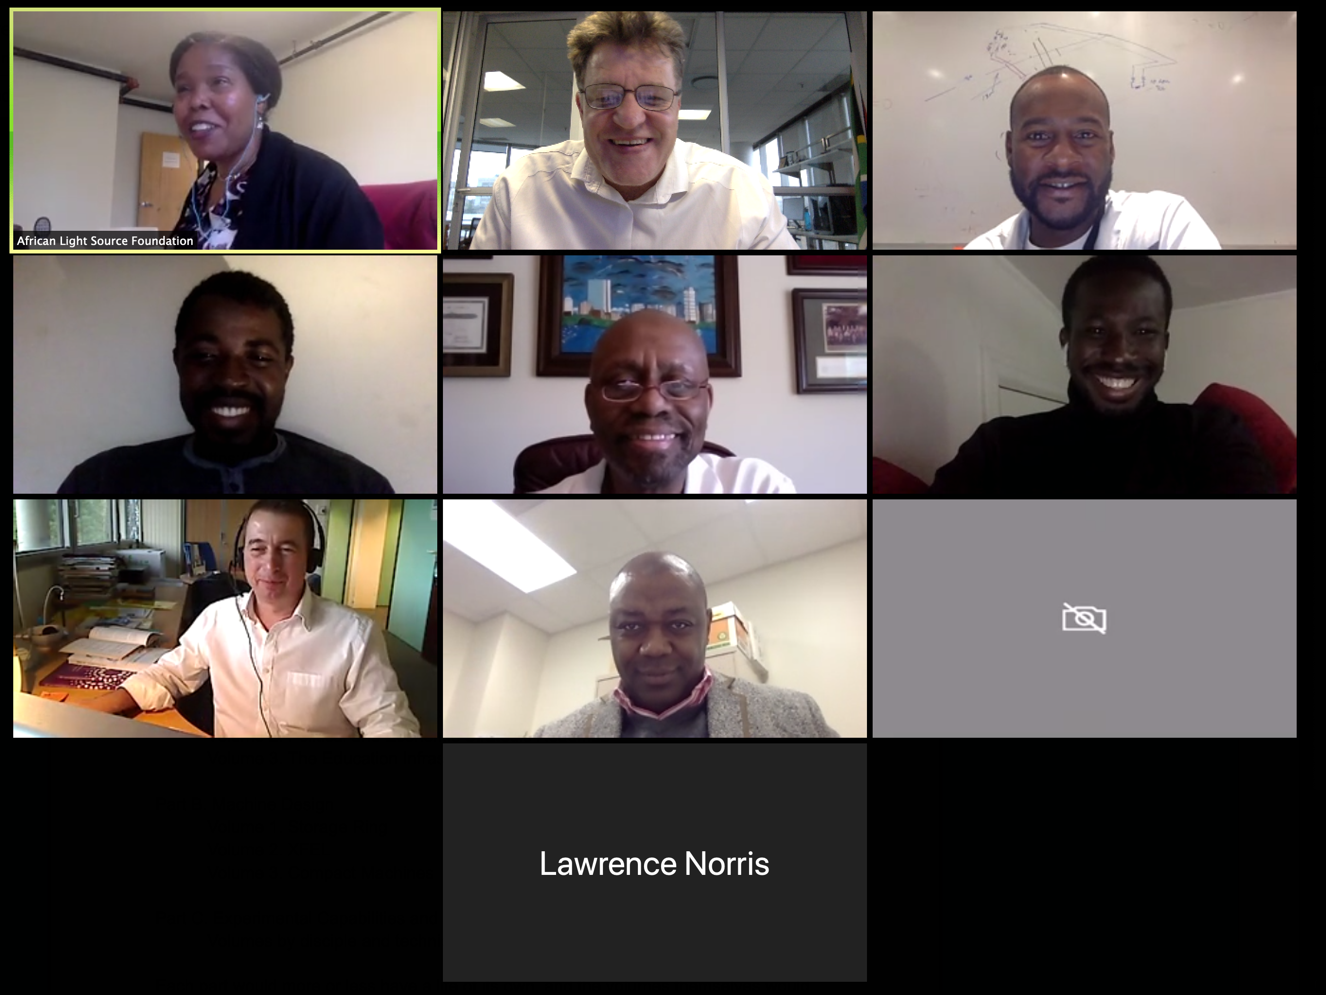
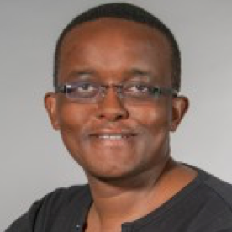
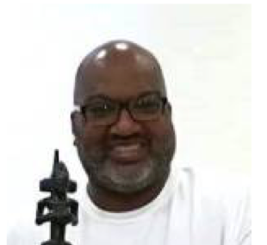
The African Light Source
Project
Capacity in Africa
Beginnings
of a
CDR Team
One senior experienced Accelerator Physicist
Two young interns
from Africa

Slide 31
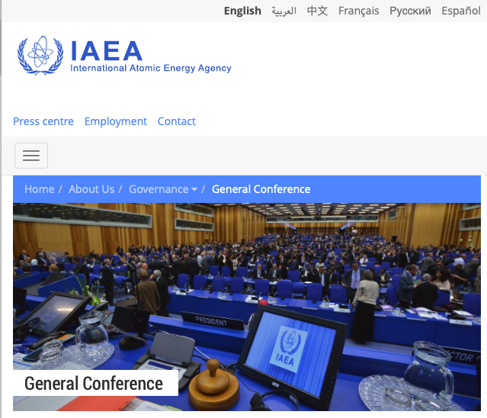
The African Light Source
Project
Recent AfLS Events
63rd IAEA General Conference
AfLS, Thais, SESAME and Elettra, African govt reps.
September 16-21 2019
90-min slot dedicated to synchrotron applications, showing usefulness to both developed and developing countries, “side event”, of Sep 17.

Slide 32
The African Light Source
Project
Upcoming AfLS Events
ICTP sponsored ALS School : 4-15 May 2020
Leonardo Building : Budinich Lecture Hall

Slide 33
The African Light Source
Project
Upcoming AfLS Events

