Slide 1
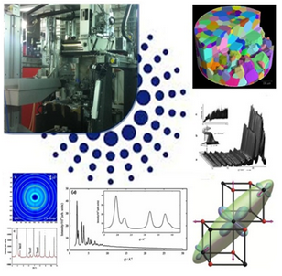
X-ray diffraction using the ESRF-EBS for materials science
Jon Wright
Johannesburg 2019
Notes:
Thanks for bringing me here to Johannesburg, I will try to give an overview of the different upgrades which are underway and how you can use these for your research

Slide 2
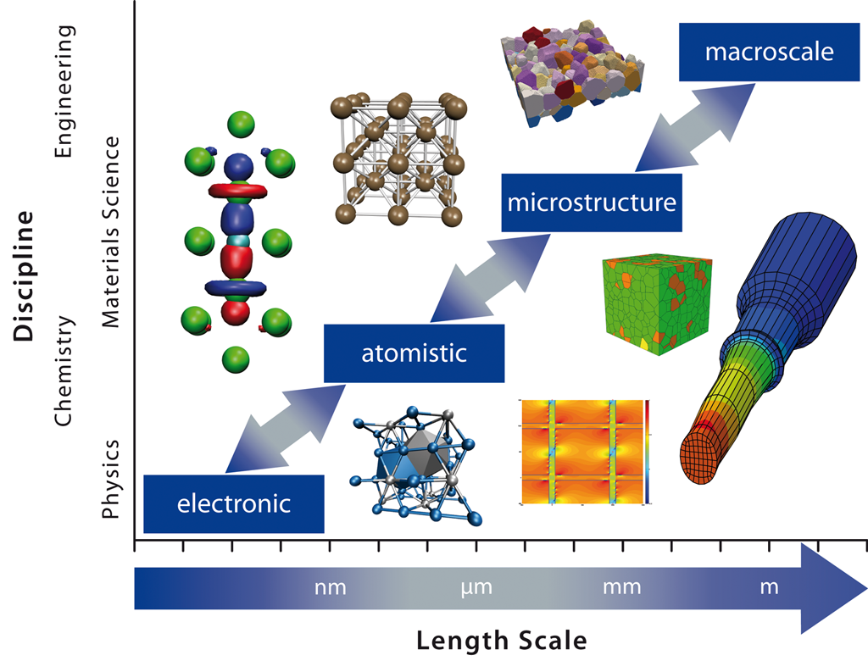
Diffraction Based Imaging…
Image from: ICAMS, Bochum http://www.icams.de/content/research/
Notes:
You saw the same picture yesterday for biology –here it is for materials science
We want to understand structures and properties from the atomic scale up to macroscopic objects

Slide 3
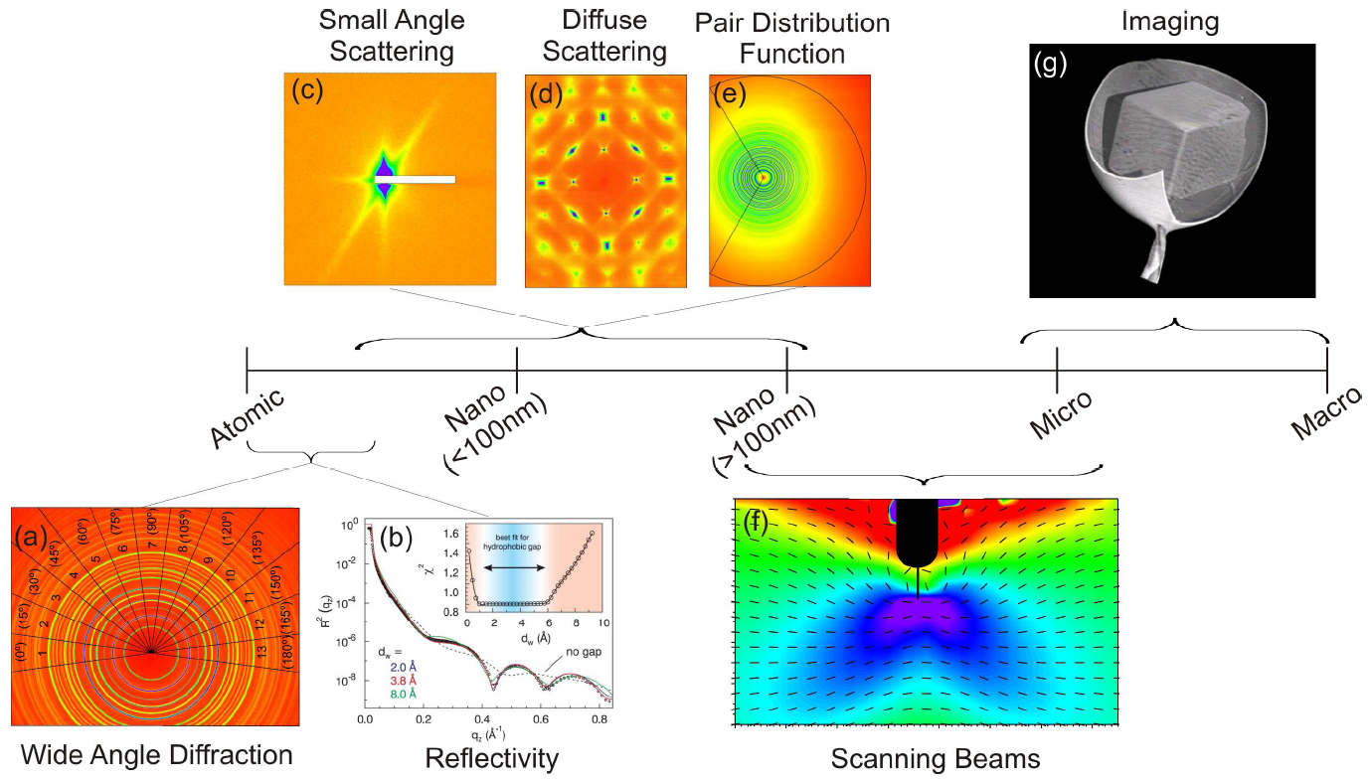
Notes:
X-rays are a wonderful tool for doing this.
So we can see atoms and objects somehow at the same time by using different X-ray techniques
Wavelength is right for diffraction and high energies can pass through solids
Complementary to electrons – but easier to do in-situ and non-destructive.

Slide 4
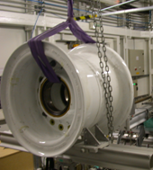
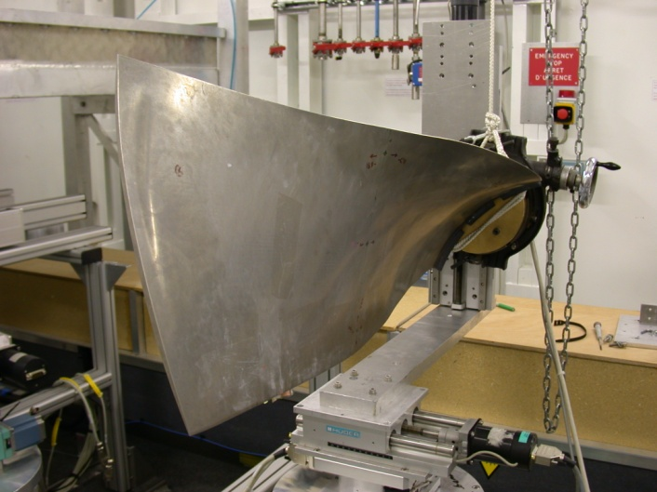
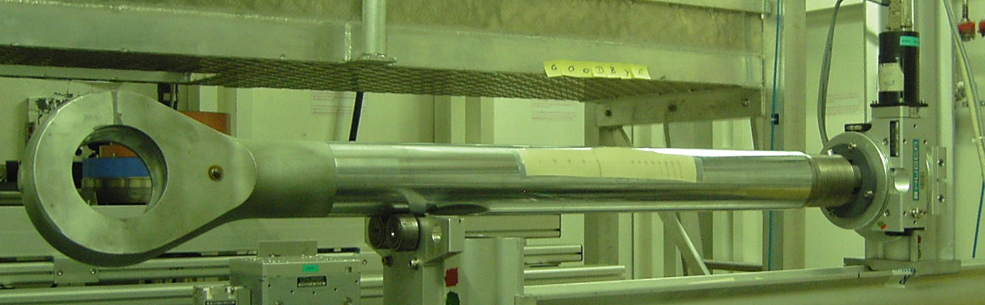
  Energy Dispersive Diffraction – Very High Energy
strain scanning
large samples: penetration depth up to 10cm of steel
spatial resolution: 50µm×50µm×1mm
strain resolution: 2·10⁻⁴
Dunlop aircraft wheel
(Ø50cm×50cm, 30kg)
Rolls Royce Trent-700 chord fan blade (Ti-6Al-4V)
900×400×20mm3
  Airbus Landing gear piston rod
  Thomas Buslaps : buslaps@esrf.fr
Notes:
Here is one of the ultimate examples for going through a thick sample – very high energy diffraction to measure residual stresses.
For example to study the stresses in the landing gear rod of Airbus you have to go through about 8cm of steel.
This work is complementary to neutron diffraction and I won’t say more because there is a talk coming up this afternoon from Daniel Glaser and a talk tomorrow about neutron methods.
For more information get in touch with Thomas Buslaps, he will be really happy to hear from you as there is a new experimental hutch for the energy dispersive measurements.

Slide 5
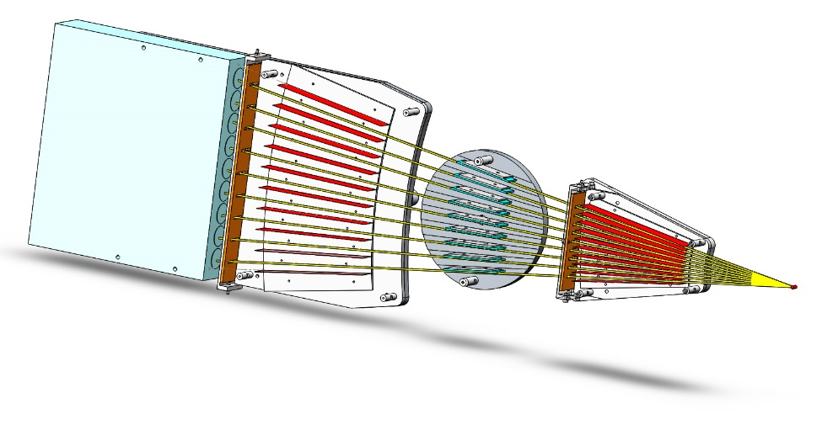
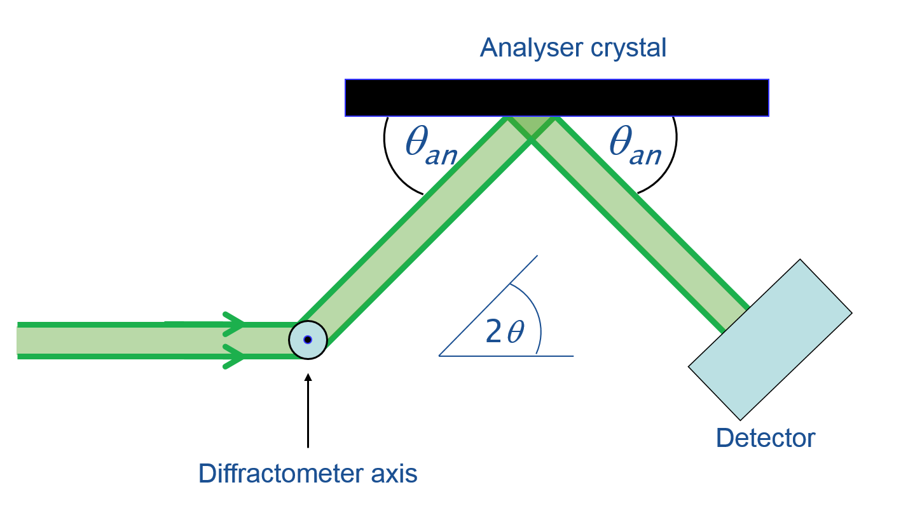
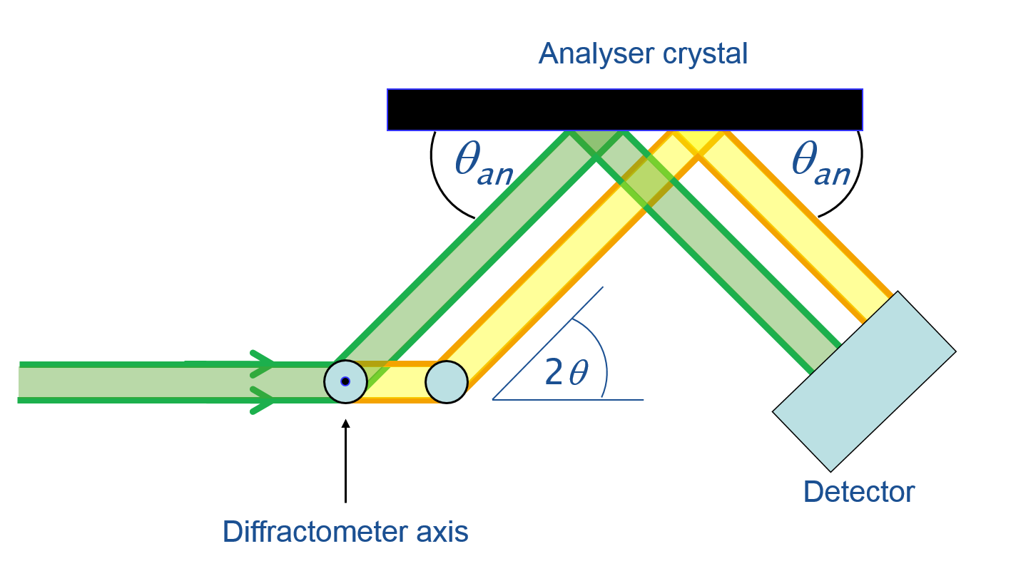
9-channel multi-analyser stage : ID22 – A.Fitch / C.Dejoie
9 detectors
LaBr₃ scintillators
Second collimation box
9 Si 111 analyser crystals
First collimation box
Sample
Narrow peaks (sample-limited) with accurate positions
Peak positions insensitive to misalignment, transparency, specimen size/shape/surface effects, etc.
Widths independent of any θ/2θ parafocusing condition
Suppresses fluorescence, Compton, parasitic scatter
But relatively slow as it needs to be scanned and transmits photons only within the narrow “Darwin width” of the analyser crystal - (hence 9 in parallel)
➔ Stringently defines a true 2θ angle
Notes:
Here is some news from ID22 which is the high resolution powder diffraction beamline.
Many of you will be familiar with measuring powder data on laboratory instruments.
This is the beamline at the ESRF which gives the extremely good angular resolution.
So the peaks are extremely sharp and you can resolve overlapping peaks in your data.
It is the reason I went to Grenoble. It is where Wilson was working.
A quick idea how it works, is that the X-rays go via an analyser crystal, so you measure the diffraction angles independently of the position in the sample. No geometrical effects.

Slide 6
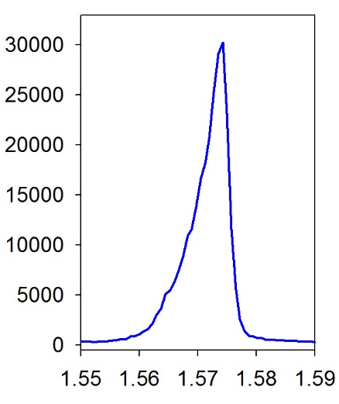
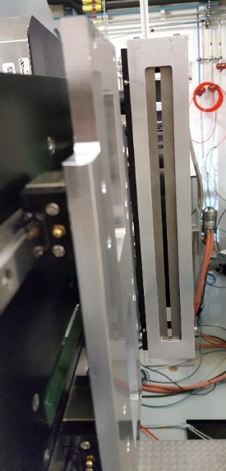
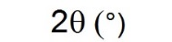
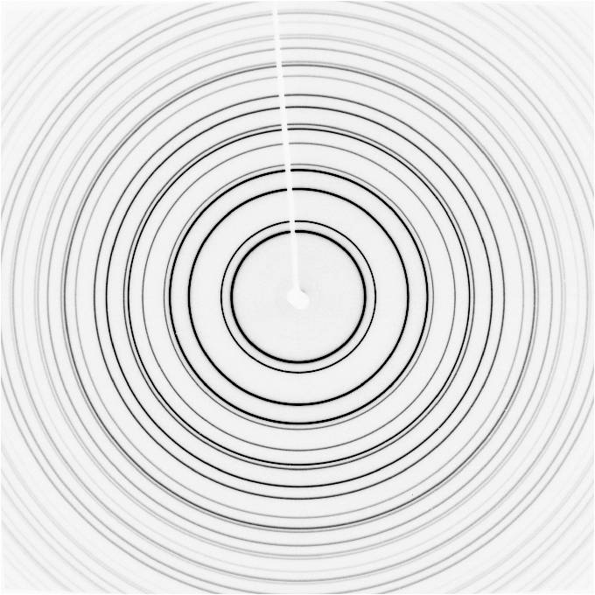
Asymmetry effect
To reduce the asymmetry effect, decrease the axial aperture
But, if we decrease too much, we loose statistics, especially at high angles
ID22: 4 mm fixed aperture
Up to now, a compromise between broadening and asymmetry at low angle and statistics at higher angle
Notes:
This beamline is upgrading and it happens to coincide with the EBS upgrade.
They are getting a new detector and this slide is to explain a what it should do.
Because of the curvature of the diffraction rings at low angle, we are starting to intercept part of the diffraction ring at a lower 2theta, resulting in asymmetry and peak broadening at low angle. In order to decrease/reduce this asymmetry effect, we can reduce the acceptance of the axial aperture using slits.

Slide 7
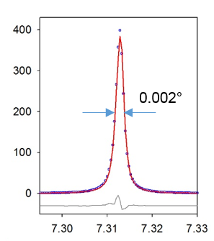
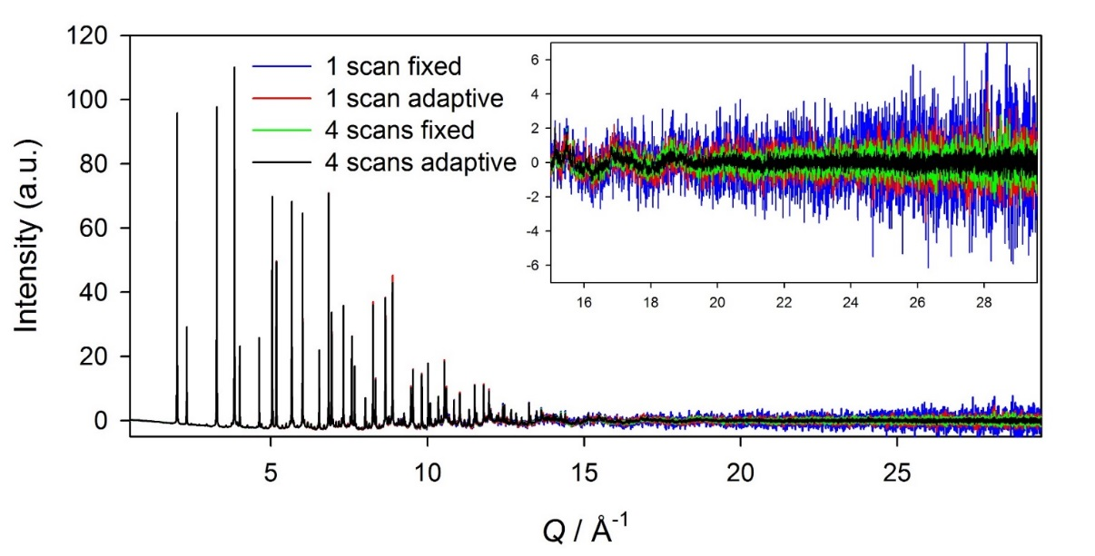
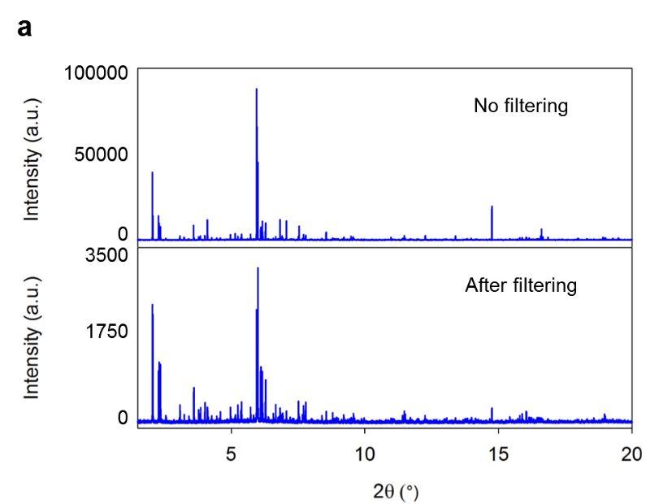
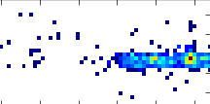
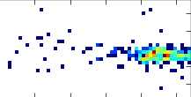


Combining analyser and 2D detector - Benefits
Peak shape vs. statistics: no compromise anymore
Si 111 NIST 640c
Gd-doped ceria
0.002°
Factor 3 at high angle
2θ (°) – 0.4 Å
Better powder average
ZSM-5 zeolite
Mix of small and large crystals
→ Filtering out large grain contribution
Notes:
What I hope Wilson will show in more detail later.
Essentially it is a fast 2D detector behind the analyser crystals.
Get better peak resolutions
Get better counting statistics
Get extra / new information
… graininess – large crystallites in the sample
… depth / spatial resolution in the sample.

Slide 8
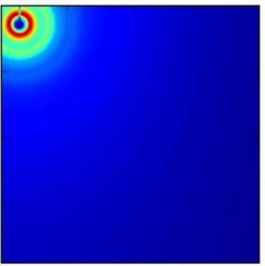
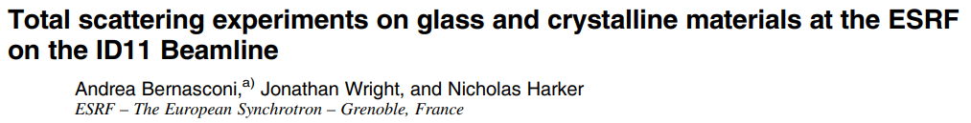
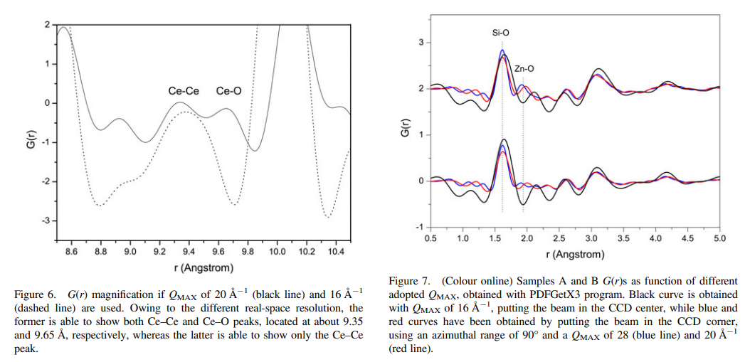
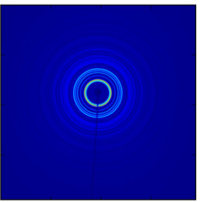
PDF Experiments – higher Qmax is better
Notes:
Another example for very high energy Xrays is to measure Pair Distribution Functions or PDFs.
This is something that was not obvious to us how to best do the experiments and so Andrea made some comparisons at ID11.
With our detector it was better to put the beam centre in the corner to get a bigger Q range and higher Q resolution.
Not sure this has caught on for everyone, but we think it can help.
The pictures show how the higher Qmax reduces the ripples and lets you see some extra features in the data.
Come to ESRF to get this data much faster (few seconds) and eventually with imaging combined.

Slide 9
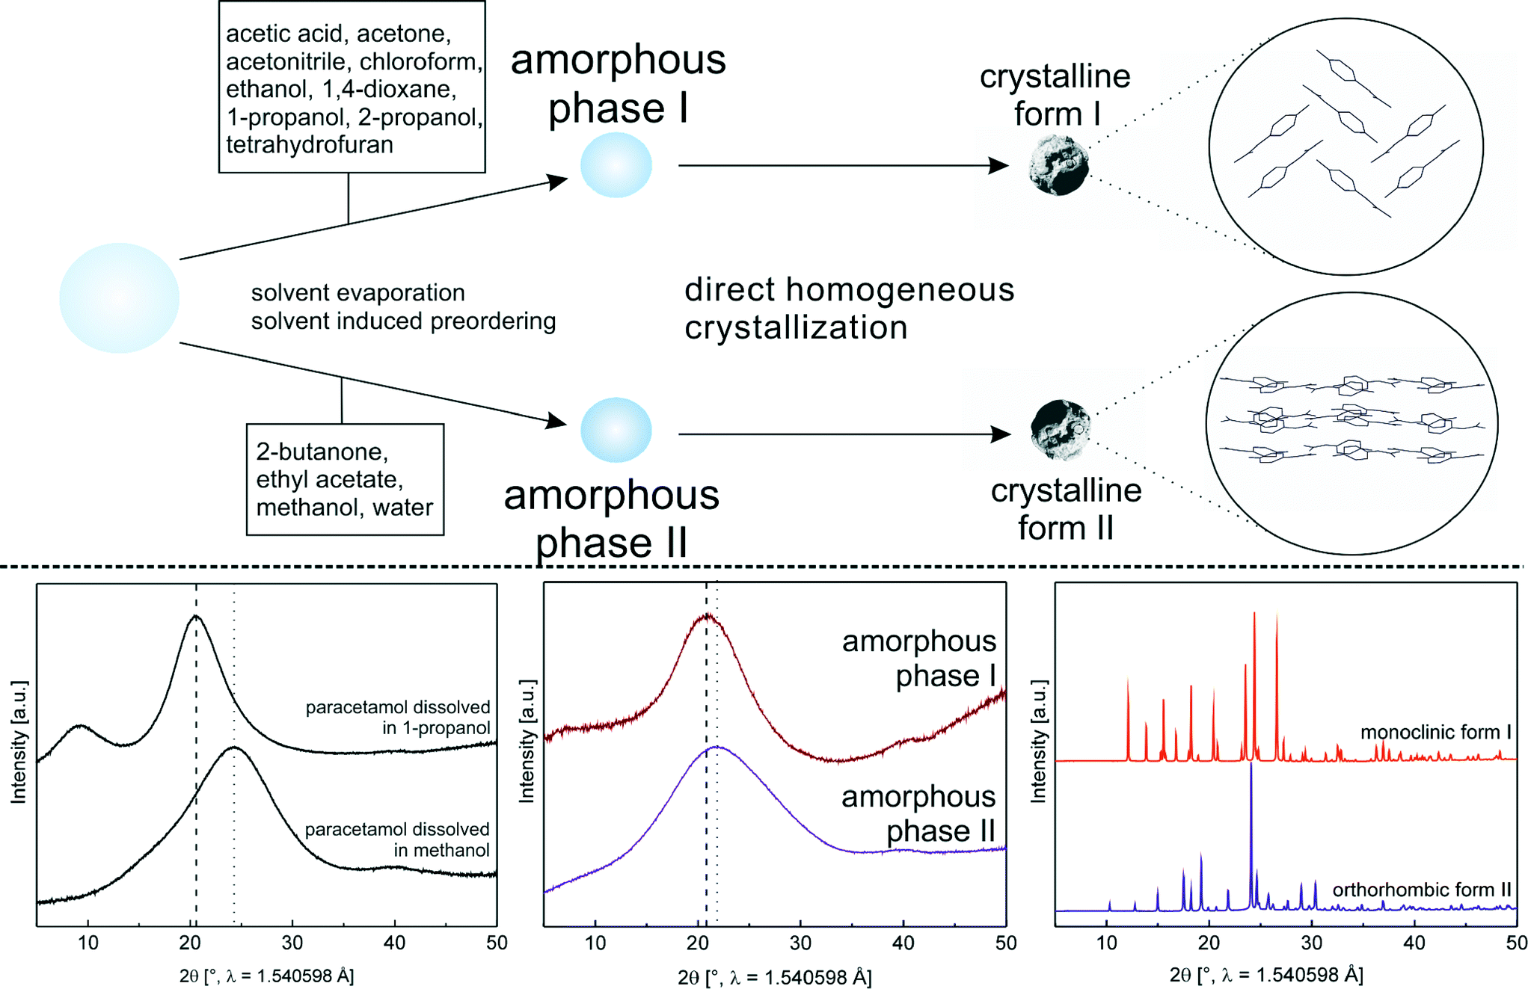
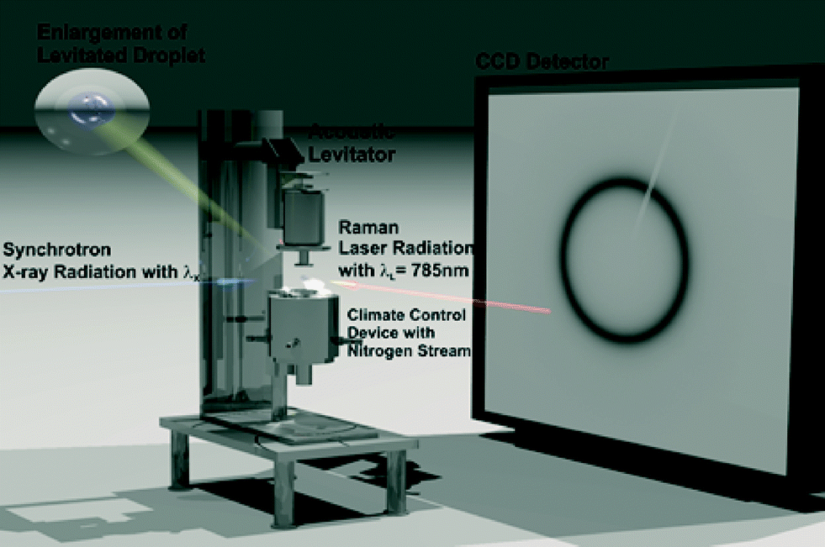
PDF method – ID11 / ID15a / ID22 / ID31
Direct evidence of polyamorphism in paracetamol
Yen Nguyen Thi,^{ab} Klaus Rademann^{b} and Franziska Emmerling*ª
DOI: 10.1039/C5CE01583A
CrystEngComm, 2015, 17, 9029-9036
Notes:
No I come to a couple of examples.
This one was following the crystallization of paracetamol to look at polymorphism,
Has been a big issue in pharma due to the way drug patents work (not for paracetamol, but other drugs)
Here they had a levitated sample and could show there are different amorphous precursors.

Slide 10
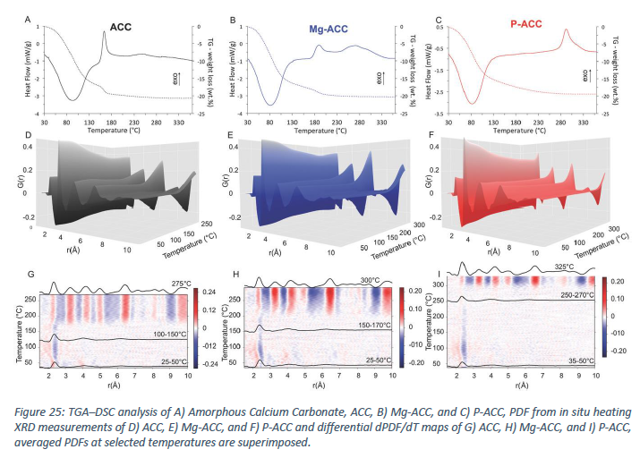
The Crystallization of Amorphous Calcium
Carbonate is Kinetically Governed by Ion
Impurities and Water
Marie Albéric, Luca Bertinetti, Zhaoyong Zou
Peter Fratzl, Wouter Habraken, Yael Politi
https://doi.org/10.1002/advs.201701000
Advanced Science 5(5) 2018 1701000
PDF gives a method to follow crystallization from the amorphous state in a continuous way.
Notes:
Another case for in-situ crystallization.
Key point is that you can follow a sample from reactants to products even if it goes via amorphous phases all using a single technique.
Here they can see differences for crystallization of calcium carbonate which ties into the CO2 storage a biominerals science.

Slide 11
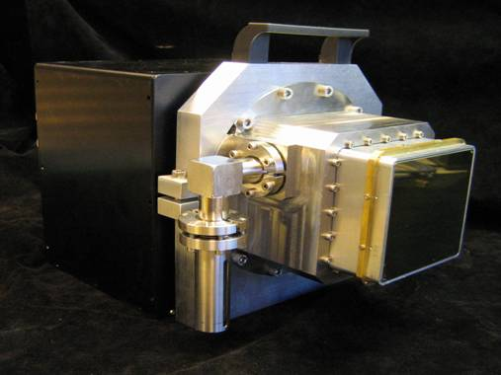
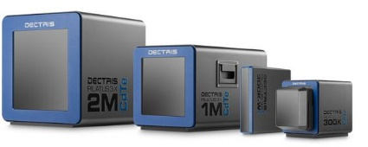
Ever faster 2D detectors
1 second per picture 1 hour = 3600 seconds = 60 x 60
10 pictures per second 1 hour = 36000 frames = 180 x 180
100 fps 1 hour = 360000 frames = 2D : 600 x 600
3D : 71 x 71 x 71
500 fps 1 hour = 1 800 000 frames = 2D : 1340 x 1340
3D : 121 x 121 x 121
ESRF Frelon CCD
Photon counting pixel detectors
Notes:
When I arrived at ID11 we were getting 8 seconds readout time for 1 frame
We still used scintillator detectors for many experiments.
Harald did not mention it, but he has managed to get most of the diffraction beamlines equipped with
High energy CdTe pixel detectors. Very exciting for us at the ESRF.

Slide 12
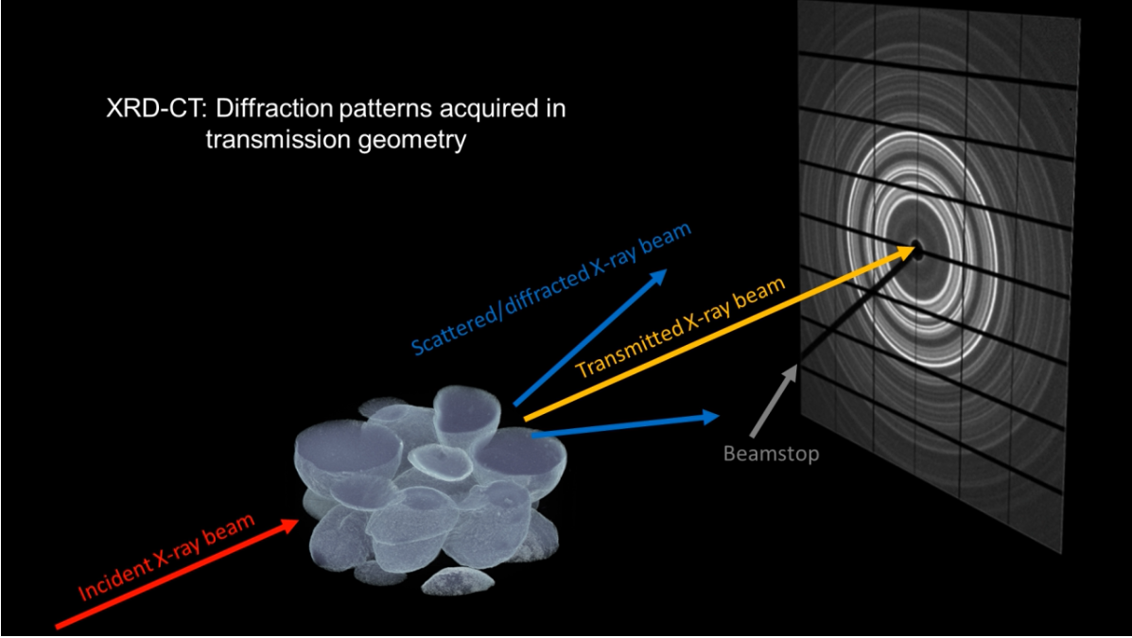
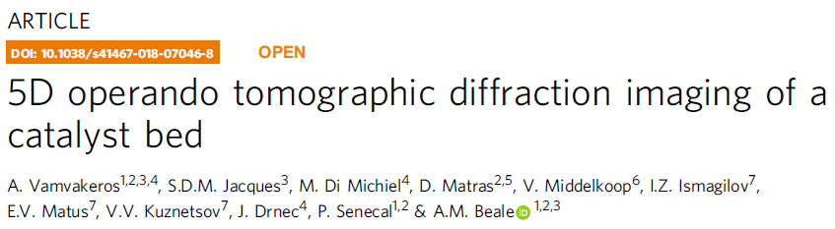

Notes:
Here is the picture from the XRD-CT experiments.
I will leave that for a moment and just try to give you the idea that this
2D detector might be running very very fast.
So how can you really measure 500 samples per second? This is the reason for the XRD-CT type experiments, we want to scan the beam across a sample because we cannot imagine getting a million samples per hour.
I would explain the XRD-CT methid as an the ultimate “fast sample changer” approach – you are looking at many samples inside a sample.

Slide 13
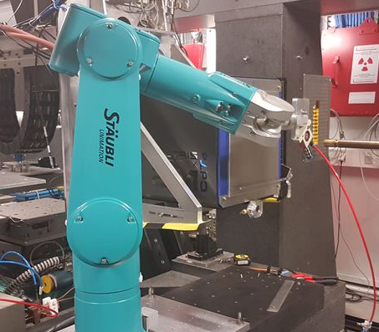
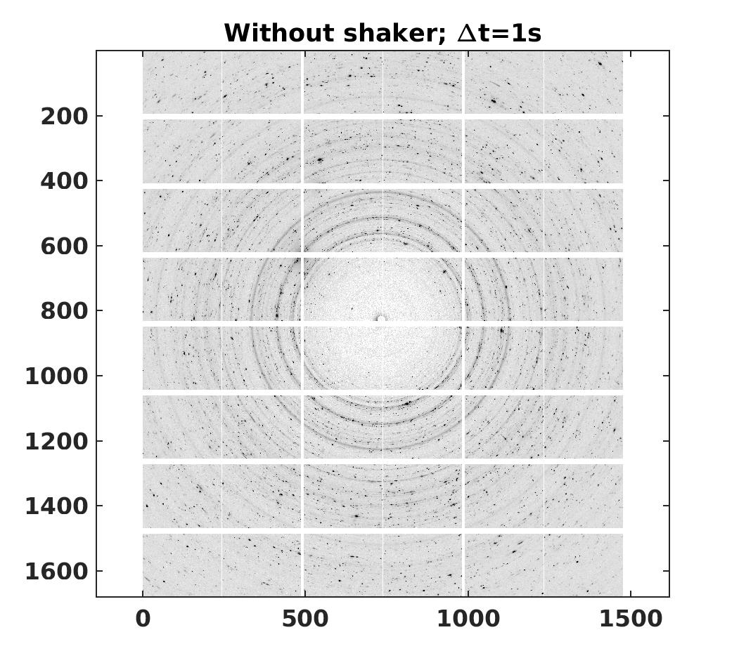
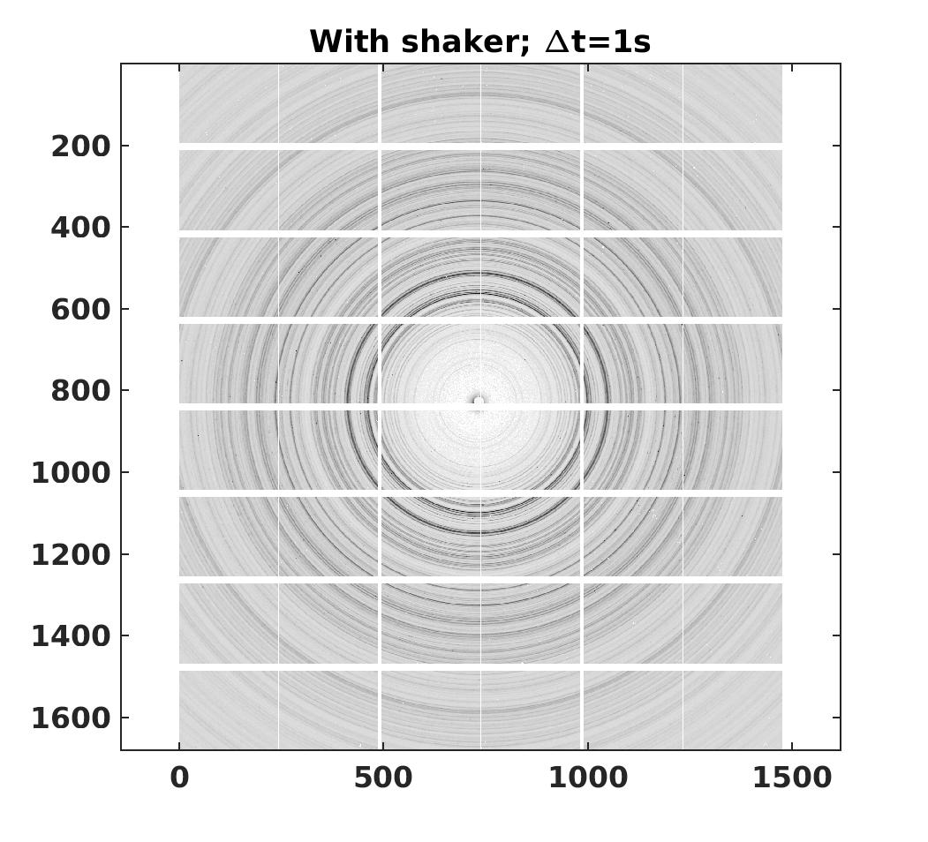
High Throughput powder diffraction – ID31 – Veijo Honkimaki
Robot enables rapid, precise and repeatable movement of the sample plate in all dimensions. This, together with the Pilatus3 CdTe detector, permits 240 diffraction measurements with excellent powder averaging within 5 minutes.
Notes:
More conventional sample changer based on a robot at ID31 beamline
Uses the idea from the Mars Rover and shakes samples to get a powder average.
No need to fill capillaries and no need to spin samples.
They are held in a well plate and the robot is shaking and scanning them in the beam.
This was 240 samples in 5 minutes – about 1 second counting per sample.
Could be very interesting for geological survey type work. Lots of work to prepare samples, label which is which and process the data (X-ray experiment might not be the most expensive part of the project).

Slide 14
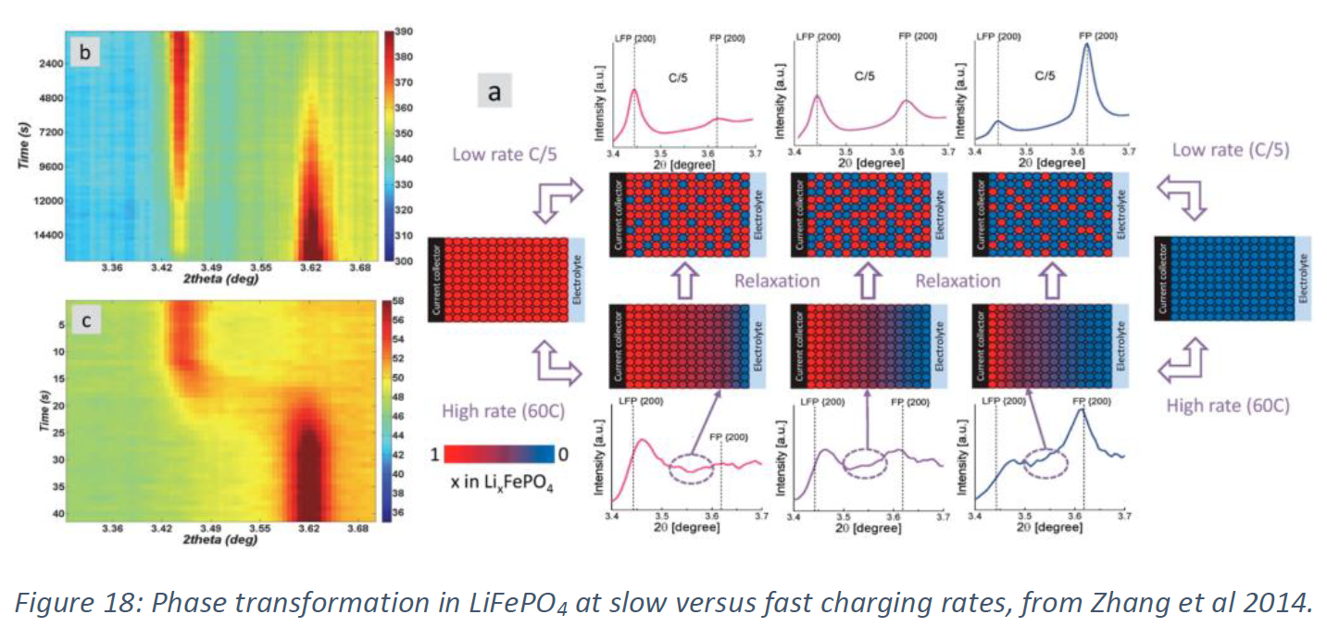
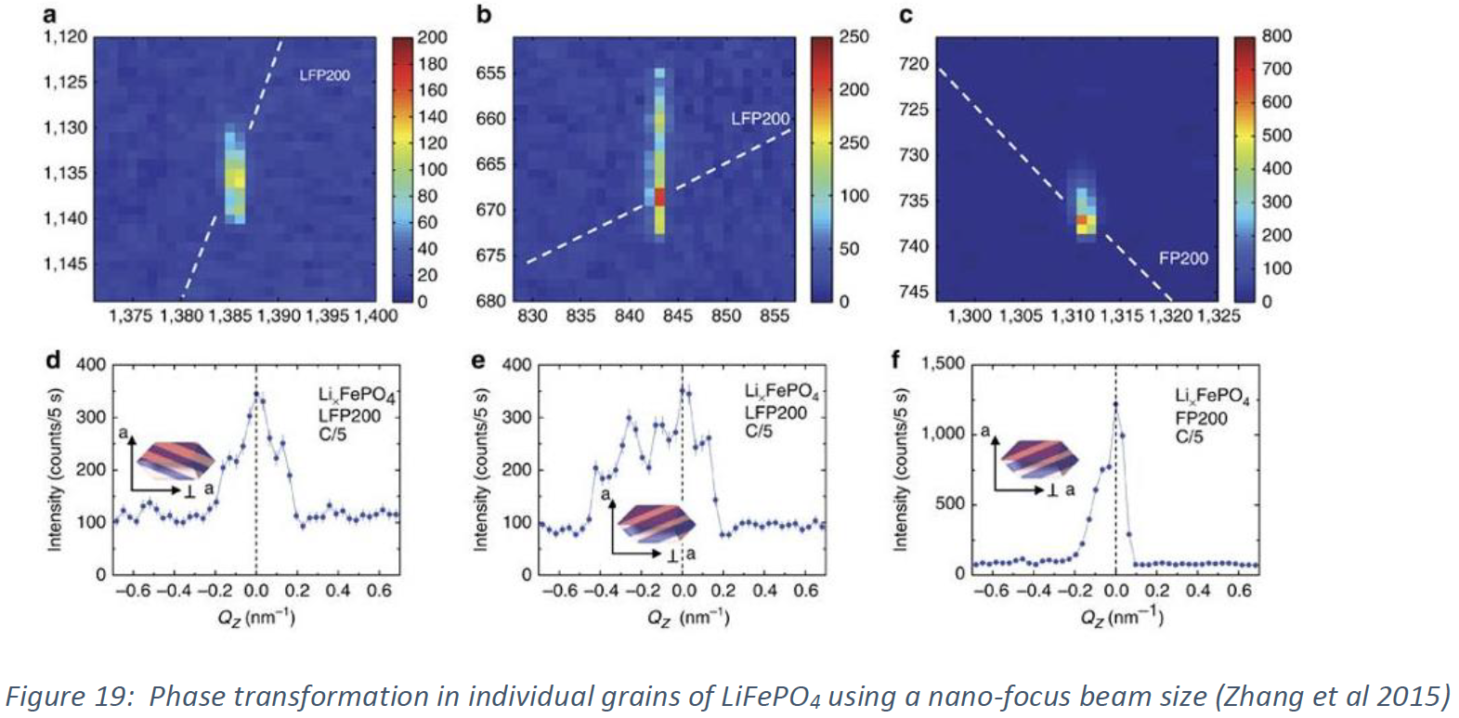
Rate dependent phase transition in LiFePO₄
Powder :
Zhang X., van Hulzen M., Singh D.P.,
Brownrigg A., Wright J.P., van Dijk N.H.,
Wagemaker M. “Rate-induced solubility and suppression of the first-order phase transition in olivine LiFePO4”
Nano Letters (2014)
Single crystal
Zhang X., van Hulzen M., Singh D.P., Brownrigg A., Wright J.P., van Dijk N.H., Wagemaker M. “Direct view on the phase evolution in individual LiFePO4 nanoparticles during Li-ion battery cycling”
Nature Communications (2015)
Notes:
Another way to use the fast detectors is time resolved experiments.
Story begins with a time resolved powder diffraction study of the phase transition in a Lithium Iron Phosphate battery material.
The material can tolerate very fast charge and discharge rates
The in-situ powder diffraction experiment shows a change to have an intermediate phase at very high rates
By using a nanofocus beam on the same sample they were able to get diffraction spots from individual grains inside the same samples.
These show streaking along specific directions which shows there is phase co-existence with a layer structure in the individual particles

Slide 15
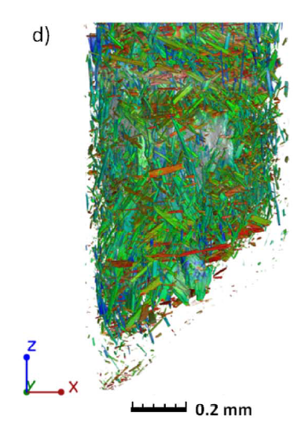
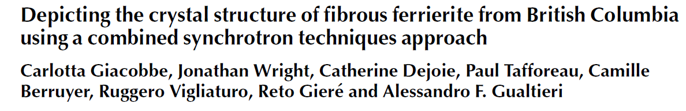
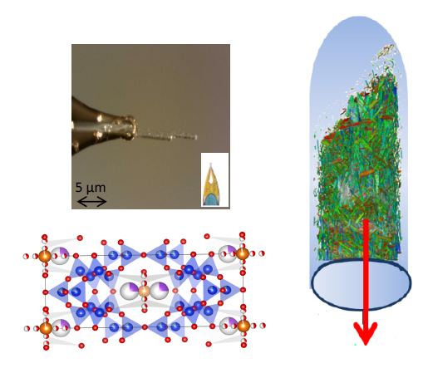
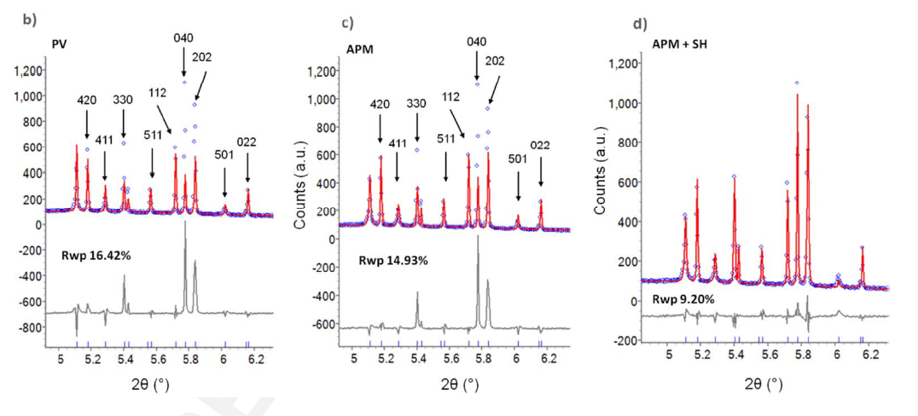
Combining diffraction with imaging
Is a single crystal representative for the bulk?
Combination of X-ray tomography and powder diffraction to get a true physical parameters for
Notes:
That is many times now that I have mentioned single crystals inside of powder samples so here is a recent example from Carlotta Giacobbe who is working with me as a scientist at beamline ID11.
She had this sample of a zeolite called ferrierite and there was a structural question about whether it is orthorhombic or monoclinc.
There is always this question for single crystals – is the crystal I measured really representative of the bulk of the sample?
She got the powder diffraction data and it was hard to get a nice fit because of peak shape issues and the intensities were not coming out right.
She did some tomography and with Paul and Camille they could segment out the crystals in the powder capillary and use that to check the particle size and preferred orientation.
She picked out a crystal and got the atomic structure and this all fitted together.

Slide 16
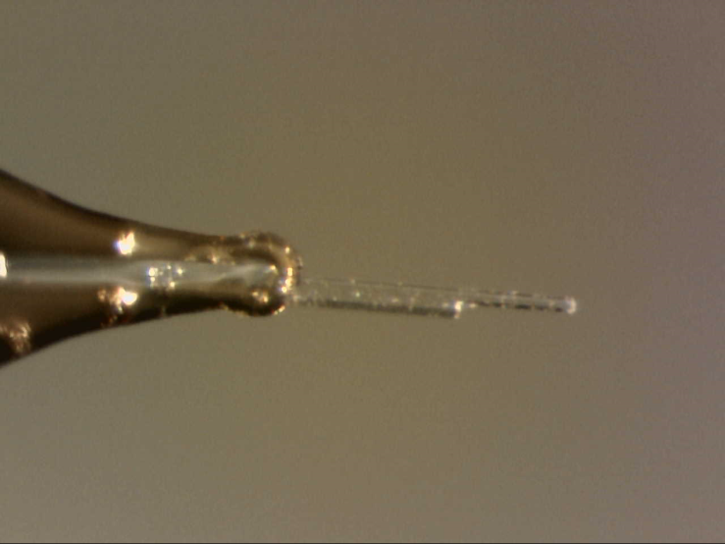
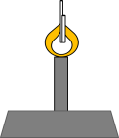
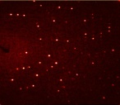
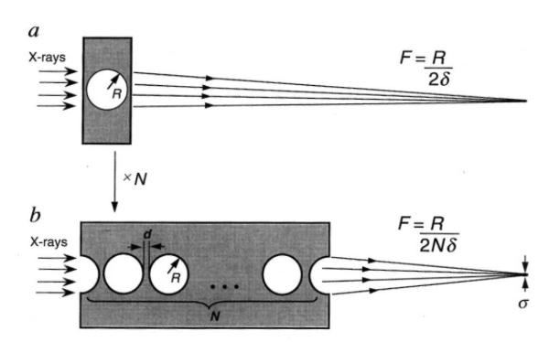
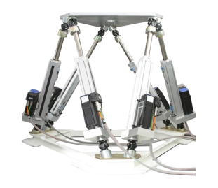

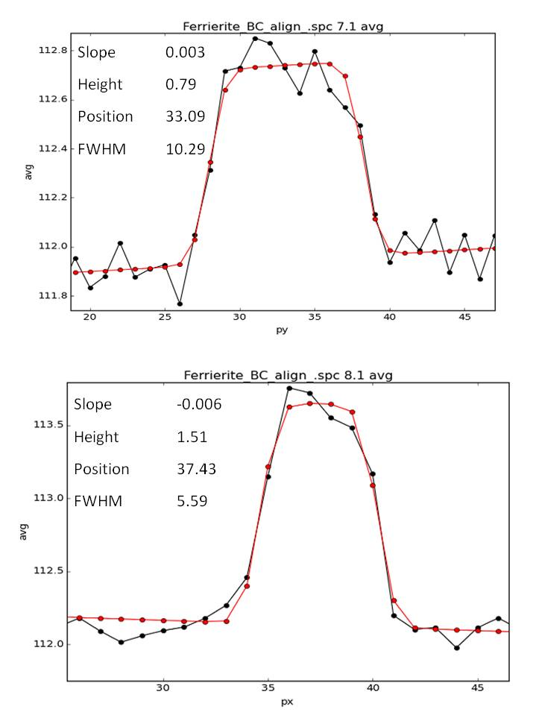

Nano-single crystal diffraction
ID11, ESRF
Nanoscope station
60 keV, 0.206 Å
beam size 500 nm× 500nm
X-ray beam
Diffracted beam
z
y
x
sample size 10 µm× 5 µm
Notes:
Turns out to be very very difficult to pick the crystal sometimes.
We have a new station which has beam sizes down to 100 nm
We can put a crystal in that tiny beamsize and rotate and the crystal stays in the beam.

Slide 17
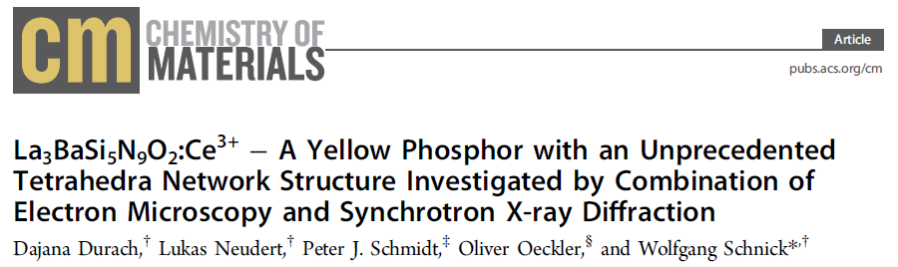
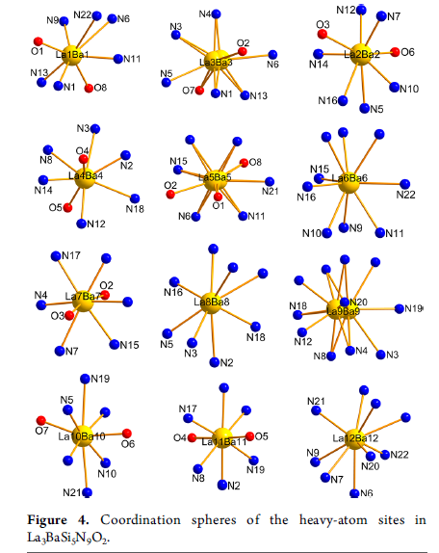
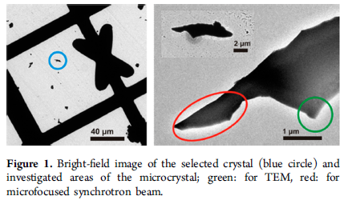
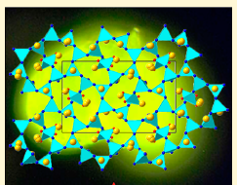
Notes:
The great problem for the micro-crystal diffraction experiments is to find and mount single crystals of a new and interesting sample.
Oliver Oecklers Leipzig group have been very productive solving structures by pre-selecting their samples inside a TEM before bringing them to ID11.
The find the crystal and check the composition and precharacterise in a TEM, so I am very happy to hear you have some TEM here in south Africa. My understanding is that these don’t need to be like the fantastic titan machines because you are going to go on and do the structures using Xrays to get really accurate bond lengths etc.
This example is…

Slide 18
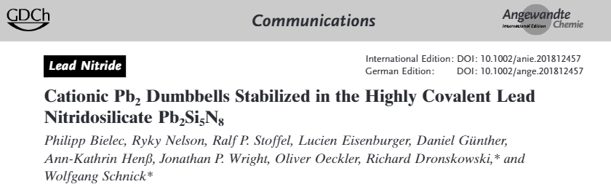
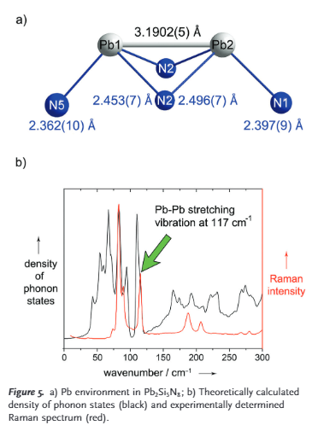

Single crystals on new endstation (since 2016)
Sample is mounted on TEM grid and selected in the TEM before coming to beamline
Accurate geometry around Pb to see N
Notes:
Nanofocusing endstation was commissioned in 2016
First publications are from single crystal X-ray diffraction with microcrystals
This example shows precise geometry of nitrogen next to lead, they have many other examples.

Slide 19

3 end stations : linking atomic to macroscopic
0.5 kg / 100 nm
5 kg / 1 μm
100 kg / 50 μm
Notes:
Beamline has 3 end stations
We are a user facility and we try to accommodate a wide range of scientific problems
Our strategy is to adapt the mechanical precision to the spatial resolution and sample size, so we have small, medium and large size instruments for
Single crystal – multicrystal – powders running on all three different stations
3DXRD station also has imaging detectors for micron scale and DCT

Slide 20



EH3 - 3DXRD NEAR- AND FAR-FIELD DETECTOR
Pixels << Grains
NEAR
FAR
Pixels >> Grains
NEAR-2
NEAR-1
FAR
Sample
Notes:
Actual experiment station.
What are “near” field and “far” field detectors?
In the data processing – can you figure out the diffraction angle (hkl family) from the spot position on the detector ?

Slide 21

Diffraction Contrast Tomography
Acquisition of both the diffraction and tomography data
Measurement of grain
distributions
orientations
strain state
W. Ludwig et al., Rev. Sci. Instrum. (2009)

Slide 22



Grain growth via DCT
Zhang J., Zhang Y., Ludwig W., Rowenhorst D., Voorhees P.W., Poulsen H.F.
“Three-dimensional grain growth in pure iron. Part I. Statistics on the grain level”
Acta Materialia (2018) 156 76-85.
Notes:
Now turning to the microstructure imaging and micron length scales on the 3DXRD station.
PhD thesis of Jin Zhang from DTU
15 time steps for the evolution of the microstructure with interrupted annealing
Results give the evolution of the grain boundaries for more than 1300 grains
Datasets are extremely rich – tracks the behavior of many thousands of different grain boundaries
Part 1 is the initial synchrotron result, part 2 will come in the future where they are trying to analyse and understand the behavior of many thousands of individual grain boundaries.

Slide 23
Focus X-ray beam to adapt to sample…
Nangles x Ny
… x Nslices
Sample
3D – Measure a full volume in one scan
2D – Measure a single slice,
need to stack many
1D – Must scan rotation and sample position
3D
2D
1D
Notes:
To try to summarise the different grain mapping techniques.
- DCT uses a large beamsize and sees the entire grains. Works great on undeformed samples
- 3DXRD(+HEDM) uses a line focus. Works for smaller grains (flux density) and with more deformation. Back projection is simpler as it is 2D. Stack slices (slow to collect).
- Future method (used very occasionally now for grains) scans a point focus beam.

Slide 24



XRD-CT : Dorota Matras et al
Evolution of 2D slices
or
3D volume data

Slide 25




XRDCT
(XDT, PDFCT, ...)

Slide 26

Claret et-al IUCrJ 2018
"Spotty" phases were removed by image processing. Ring-by-ring approach to preserve textured powder lines
Data were also scaled/corrected for ring current decay
(See also Vamvakeros et al, JAC 2015, etc)

Slide 27

Diffraction tomography: Impurities in UMo (data from ID22)
Data reduction is well established for powder rings
“Spotty” diffraction patterns are more challenging to reconstruct.
Indexing of single grains has been achieved, showing orientation relations of phases
Impurity precipitation in atomized particles evidenced by high resolution diffraction tomography
Anne Bonnin, Jonathan Wright, Rémi Tucoulou, and Hervé Palancher
APPLIED PHYSICS LETTERS 104, 121910 (2014)
Notes:
Example here is data which was collected on ID22. Collaboration with Anne Bonnin and Herve Palancher.
They had the data and we had the software for the grain-by-grain methods.
Rotate sample, scan sideways, fill in the sinograms.
Instead of continuous rings get isolated diffraction spots.
Pick these out of the images and index them on crystal lattices, then reconstruct as normal (ideally ART)

Slide 28

Index individual spots and reconstruct grain shapes
Impurity precipitation in atomized particles evidenced by high resolution diffraction tomography
Anne Bonnin, Jonathan Wright, Rémi Tucoulou, and Hervé Palancher, APL 2014
Notes:
Comparison of the different modes on the top left:
A absorption
B powder diffraction XRD-CT
C grain map using indexing from ImageD11/fable
Bottom shows pole figure and colors according to orientation.
Fine grained UO2 on surface gives rings versus spotty UMo (big spots) and U(C,O) small spots.
Note the strong gradient in grain size distribution across the inside of the grain – all the small ones are on one side.
Initial aim was to link surface porosity to grain structure. Absorption was not quite there to do that.

Slide 29
Trace impurity phase mapped out
1 wt% impurity phase
Clear orientation relationship between U(C,O) and UMo
Multiple U(C,O) domains in single UMo grain
Mainly found in larger UMo grains
Bonnin et al APL 2014
Notes:
Map out the trace impurity U(C,O) phase as well as the UMo.
Find the lattices are coherent with each other – shared axis, sqrt(2)xsqrt(2) for the other directions.
Within a single UMo grain we find all three directions for the smaller grains.
Tells that they form as a precipitate during solidification as opposed to acting as nucleation sites.
Present since you pour molten UMo onto a spinning graphite disk under vacuum.
Impurity is mainly associated to larger grains of UMo. Could be due to grain size and detection limit, or also cooling rate.
Mapped out the spatial location and role of a trace impurity phase. Detailed crystallographic information about orientation relationships.
Could not do this with EBSD as they do not succeed to cleave/polish the sample.

Slide 30






Slide 31





Tin Whisker : Hektor et al…

