Slide 1
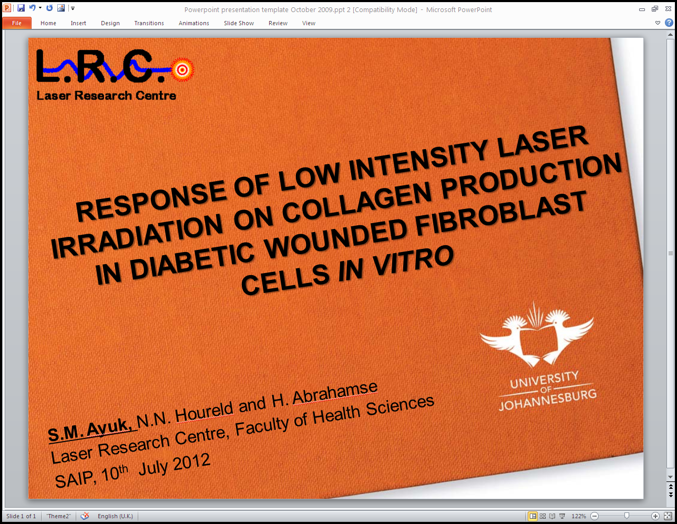

RESPONSE OF LOW INTENSITY LASER IRRADIATION ON COLLAGEN PRODUCTION IN DIABETIC WOUNDED FIBROBLAST CELLS IN VITRO
S.M. Ayuk, N.N. Houreld and H. Abrahamse
Laser Research Centre, Faculty of Health Sciences
SAIP, 10th July 2012

Slide 2
INTRODUCTION
Diabetes Mellitus
Keratinocyte and fibroblast malfunction
Hyperglycaemia
Increased MMPs
Impaired Wound Healing
ROS and AGES
Neuropathy
Hypoxia
Decreased host immunity
Impaired angiogenesis and neo vascularization
Adapted from Guo S and DiPietro L A 2010 J Dent Res 89(3):219-229
Notes:
Possible causes of impaired wound healing in DM. MMPs (matrix metalloproteases); ROS, reactive
oxygen species; AGEs, advanced glycation end-products.

Slide 3
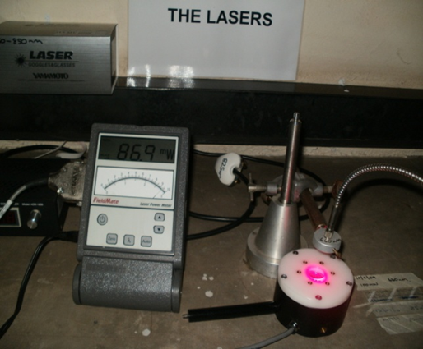
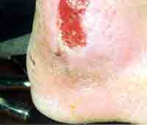
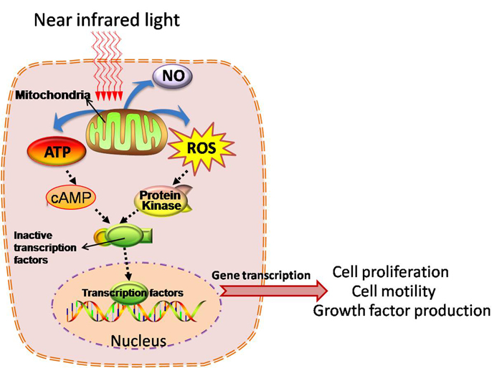
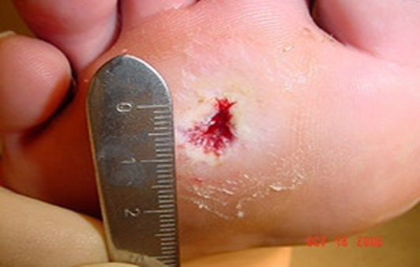
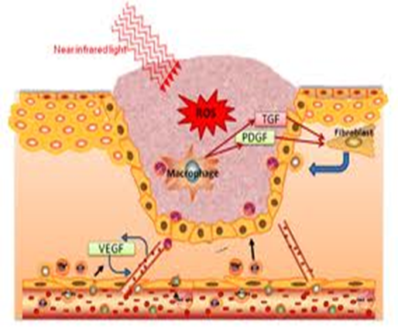
Response of Low Intensity Laser Irradiation (LILI) on Wound Healing (WH) & Collagen (Col-Ι) Production in Diabetic Ulcers (DU)
Houreld N and Abrahamse H 2007 Photomed Laser Surg 25
Lucas C, Criens-Poublon L J, Cockrell C T and de Haan R J. 2002 Lasers Med Sci 17

Slide 4
AIM
Determine if LILI at a wavelength of 660 nm at a fluence of 5 J/cm² enhances collagen production in an in vitro diabetic wounded model

Slide 5
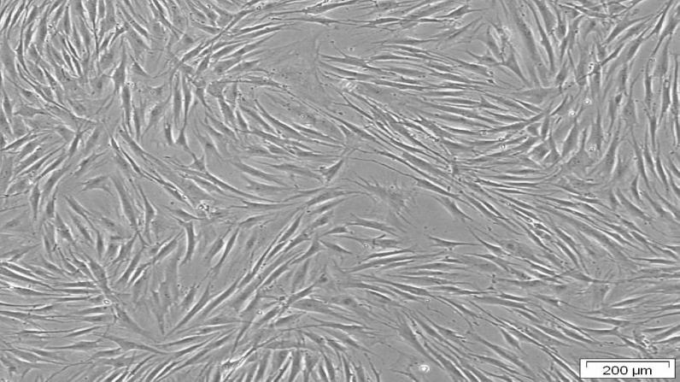
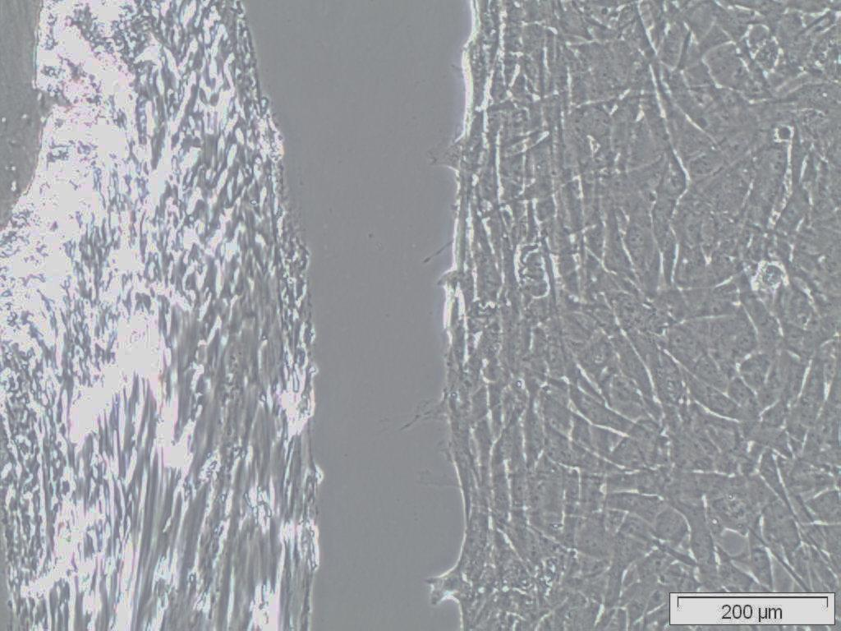
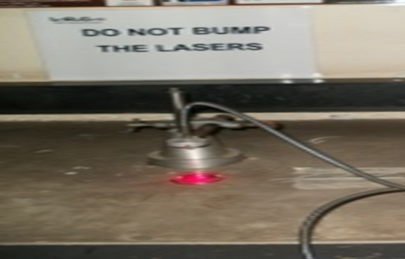
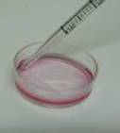
METHODOLOGY
Isolated Skin Fibroblast Culture
fibroblasts
Normal
Diabetic Wounded
CS
“wound”
Non-Irradiation
0 J/cm²
Irradiation
5 J/cm² , 660 nm
n=4
Incubation at 48 h, 72 h
Morphology
Microscopy
Viability
Trypan Blue
Proliferation
Vision Blue
MTT
Col-Ι
ELISA

Slide 6
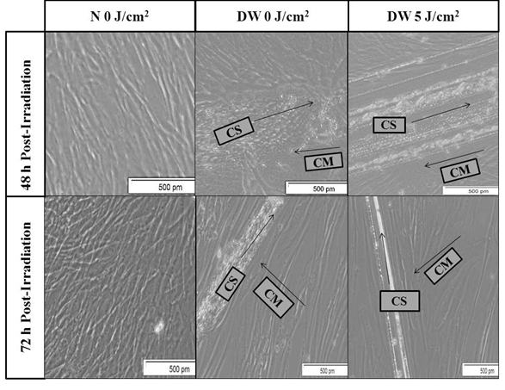
RESULTS-MORPHOLOGY

Slide 7
VIABILITY
*** = P < 0.001
* = P < 0.05

Slide 8
CELL PROLIFERATION
*** = P < 0.001

Slide 9
COLLAGEN PRODUCTION
***= P< 0.001

Slide 10
CONCLUSION
LILI influences collagen production in vitro and positively effects diabetic cells stimulating wound healing
LILI increases cell proliferation at fluence of 5 J/cm² and 660 nm
LILI does not distort the cell membrane

Slide 11



ACKNOWLEDGEMENTS
Thank you

